Slide 1

Potential impacts of climate change on precipitation
Kevin E. Trenberth
NCAR

Slide 2

Sayings that describe changes in precipitation with climate change
Sunshine is delicious, rain is refreshing, wind braces us up, snow is exhilarating; there is really no such thing as bad weather, only different kinds of good weather.
John Ruskin
The rich get richer and the poor get poorer!
More bang for the buck!
It never rains but it pours!

Slide 3

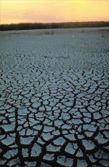
Global warming: Controlling Heat
The presence of moisture affects the disposition
of incoming solar radiation:
Evaporation (drying) versus temperature increase.
Human body: sweats
Homes: Evaporative coolers (swamp coolers)
Planet Earth: Evaporation (if moisture available)
e.g., When sun comes out after showers,
the first thing that happens is that the puddles dry up: before temperature increases.

Slide 4
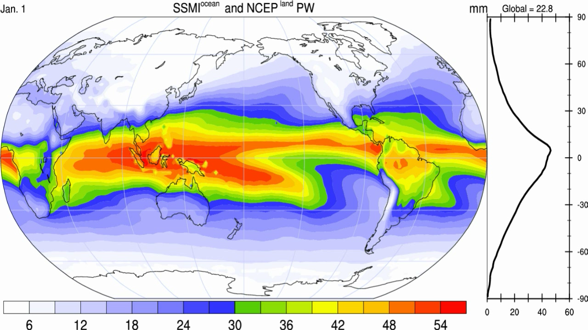
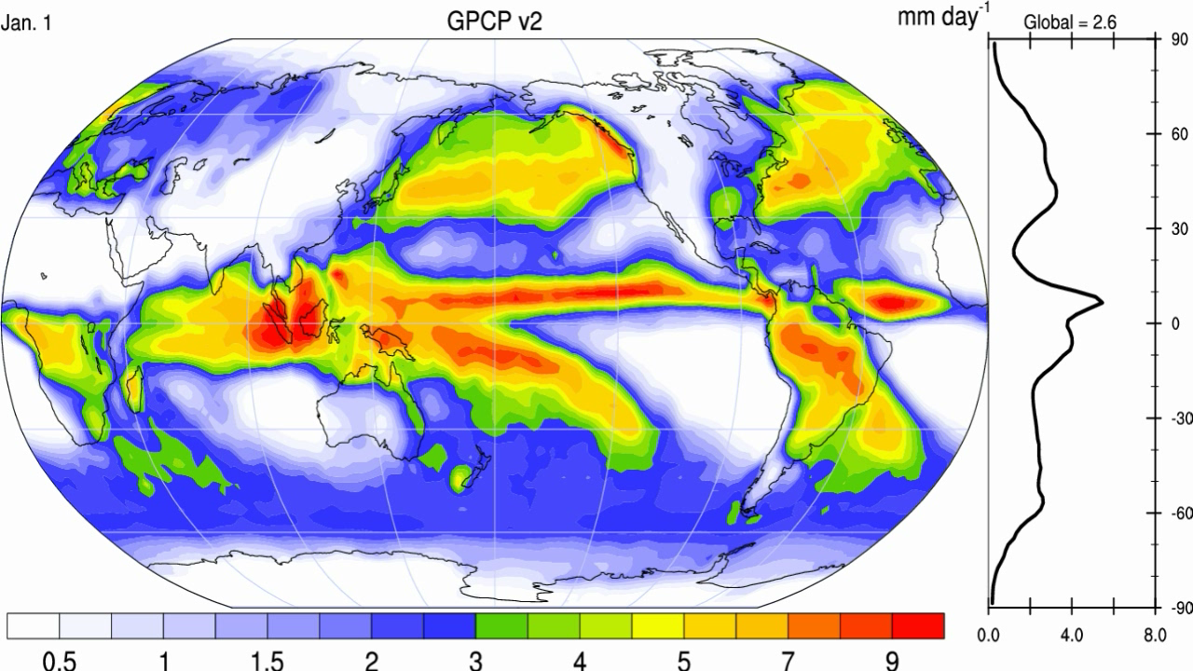
➢
Precipitable water
Precipitation

Slide 5
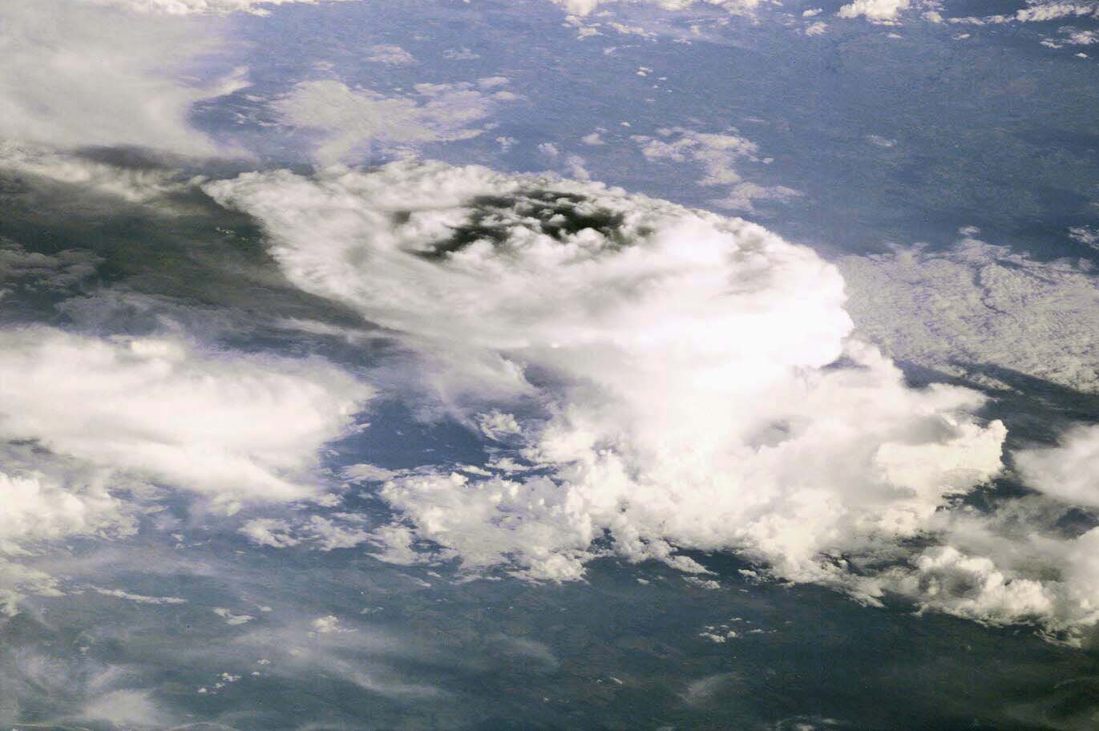
How should precipitation change as climate changes?
Usually only total amount is considered
But most of the time it does not rain
The frequency and duration (how often)
The intensity (the rate when it does rain)
The sequence
The phase: snow or rain
The intensity and phase affect how much runs off versus how much soaks into the soils.

Slide 6
Daily Precipitation at 2 stations
Monthly
Amount 75 mm
Amount 75 mm
A
B
Frequency 6.7%
Intensity 37.5 mm
Frequency 67%
Intensity 3.75 mm
drought wild fires local
wilting plants floods
soil moisture replenished
virtually no runoff

Slide 7
Frequency of precipitation: oceans
Estimated frequency of occurrence (%) of precipitation from Cloudsat observations find precipitation 10.9% of time over oceans (Ellis et al 2009 GRL)

Slide 8

Most precipitation comes from moisture convergence by weather systems
The intermittent nature of precipitation (average frequency over oceans is 11%) means that moderate or heavy precipitation
Can not come from local column.
Can not come from E.
Hence has to come from transport by storm-scale circulation into storm.
On average, rain producing systems
(e.g., extratropical cyclones; thunderstorms)
reach out and grab moisture from distance about
3 to 5 times radius of precipitating area.

Slide 9
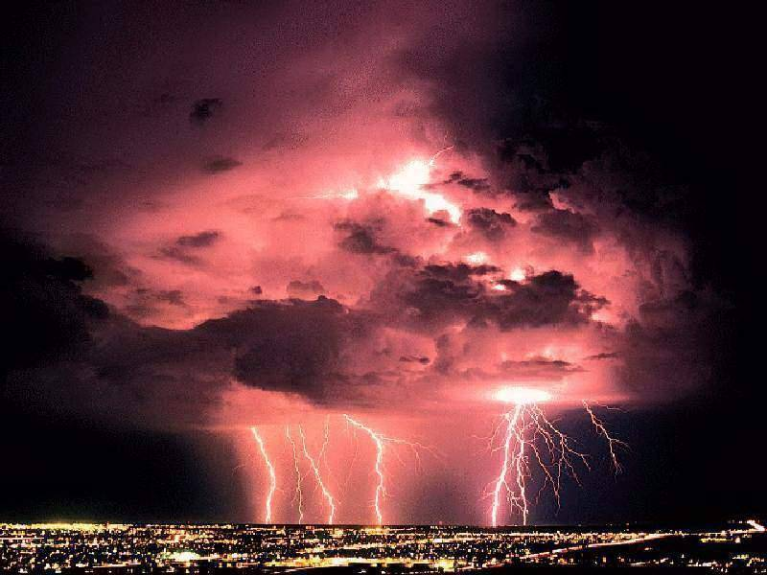
How is precipitation changing?

Slide 10
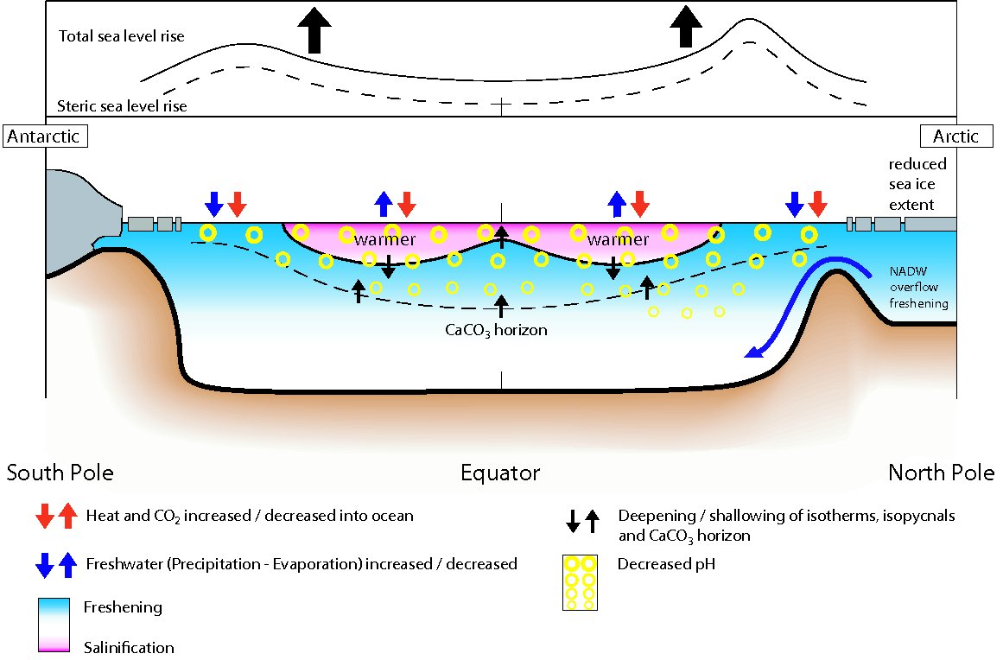
Changes in ocean state
from 1950-1960’s to 1990-2000’s (IPCC 2007 Figure 5.18)

Slide 11
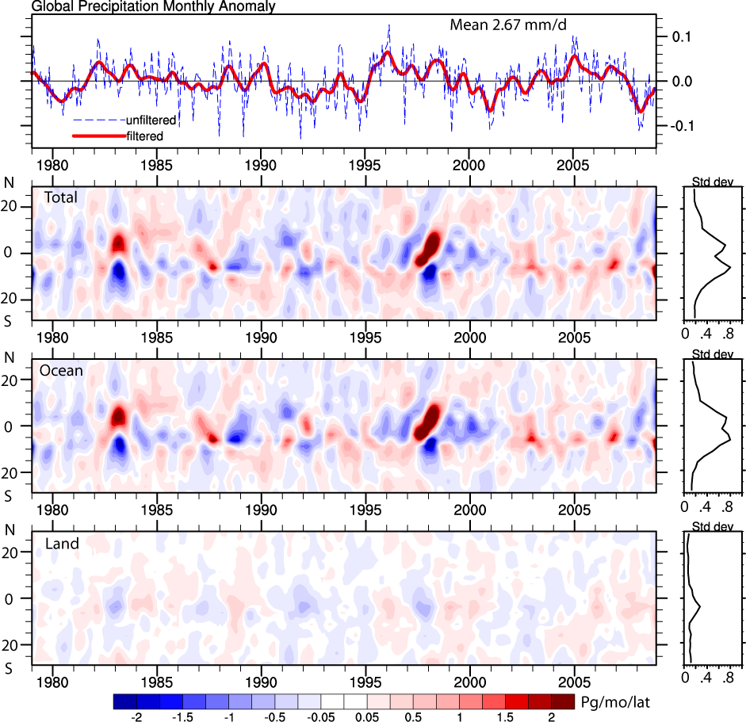
GPCP Global precipitation 1979-2008
Wentz 2007:
1987-2006

Slide 12
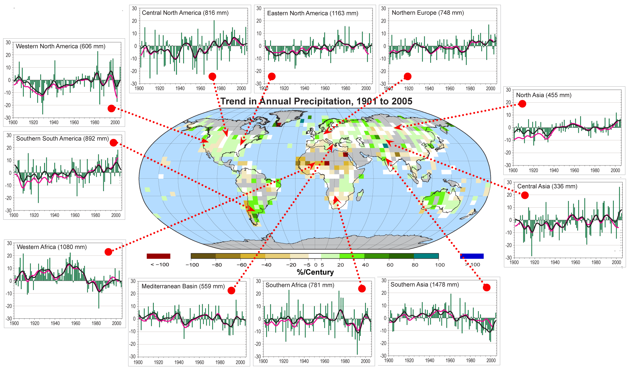
Land precipitation is changing significantly over broad areas
Increases
Decreases
Smoothed annual anomalies for precipitation (%) over land from 1900 to 2005; other regions are dominated by variability.
IPCC

Slide 13
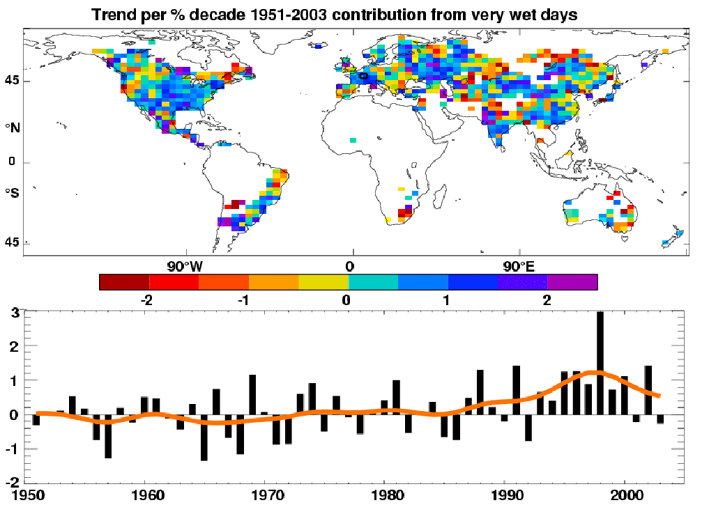
Precipitation
Observed trends (%) per decade for 1951–2003 contribution to total annual from very wet days > 95th %ile.
Alexander et al 2006
IPCC AR4
Heavy precipitation days are increasing even in places where precipitation is decreasing.

Slide 14
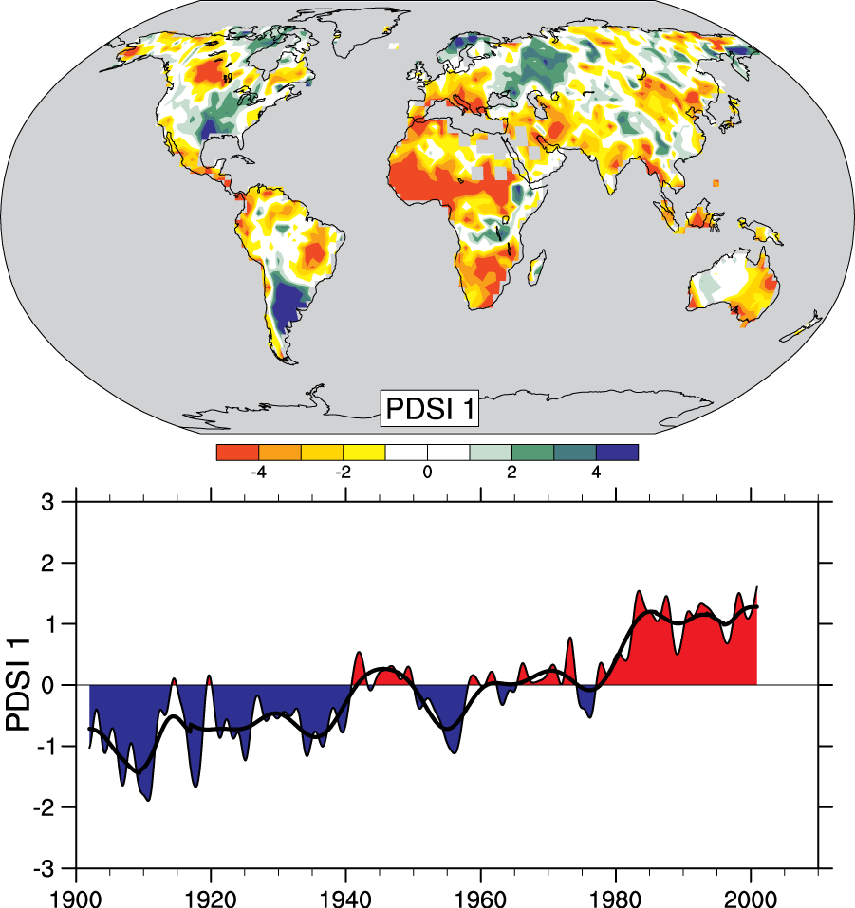
Drought is increasing most places
Mainly decrease in rain over land in tropics and subtropics, but enhanced by increased atmospheric demand with warming
The most important spatial pattern (top) of the monthly Palmer Drought Severity Index (PDSI) for 1900 to 2002.
The time series (below) accounts for most of the trend in PDSI.
Dai et al 2004
IPCC 2007

Slide 15
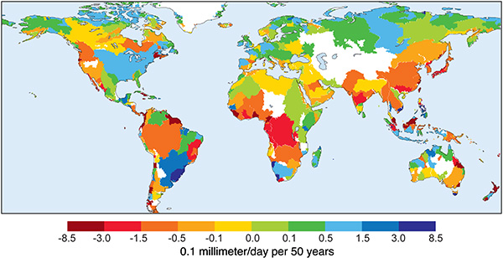
Trends 1948-2004 in runoff by river basin
Based on river discharge into ocean
Dai et al.2009

Slide 16
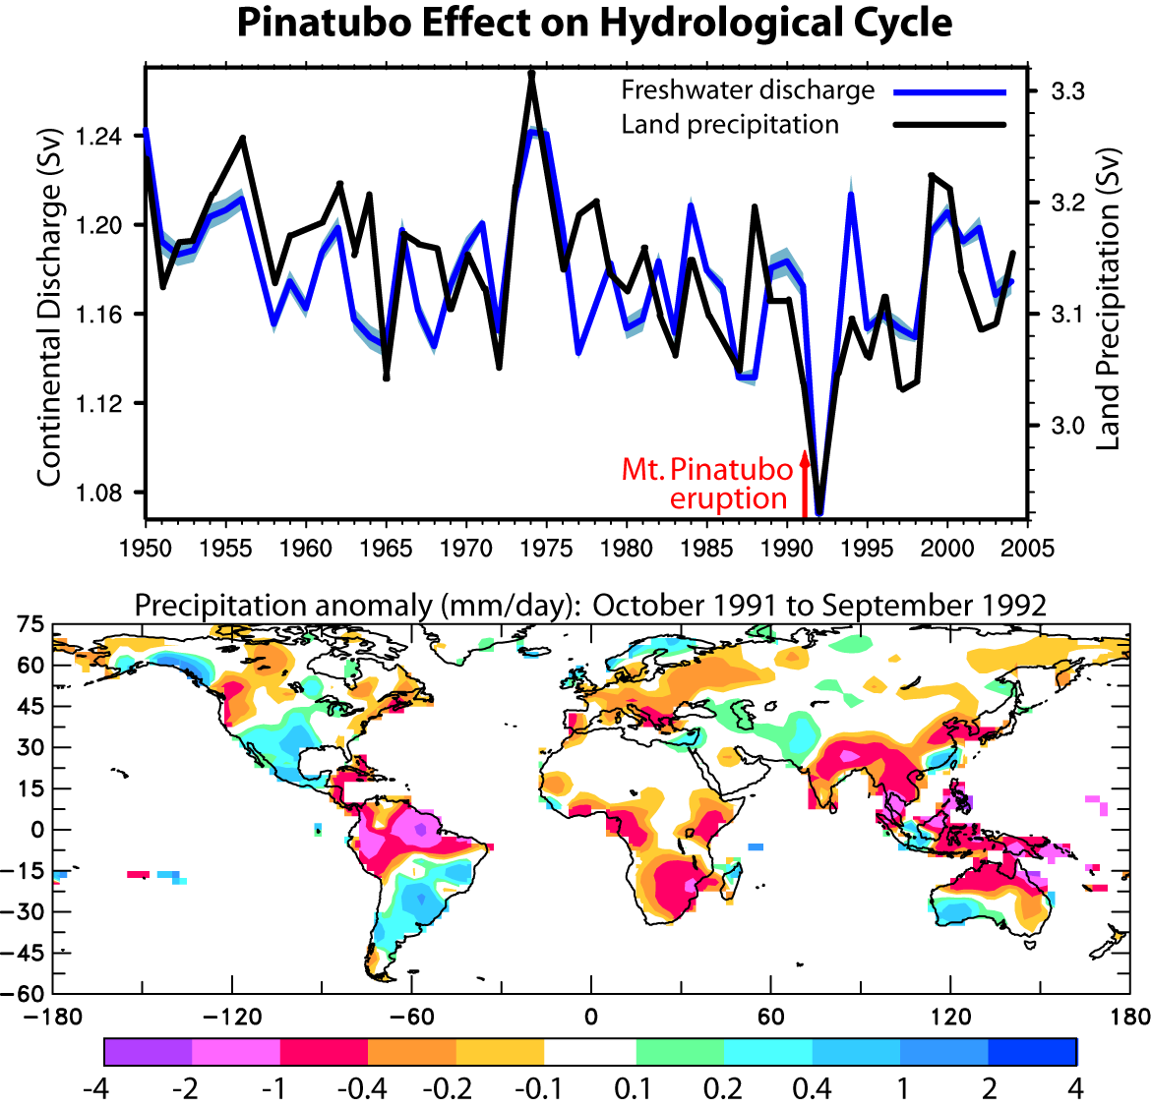
SSM/I era
GPCP satellite era
Estimated water year (1 Oct-30 Sep) land precipitation and river discharge into global oceans based on hindcast from output from CLM3 driven by observed forcings calibrated by observed discharge at 925 rivers.
Note: 1) effects of Pinatubo; 2) downward trend (contrast to Labat et al (2004) and Gedney et al (2006) owing to more data and improved missing data infilling)
Trenberth and Dai 2007; Dai et al. 2009

Slide 17
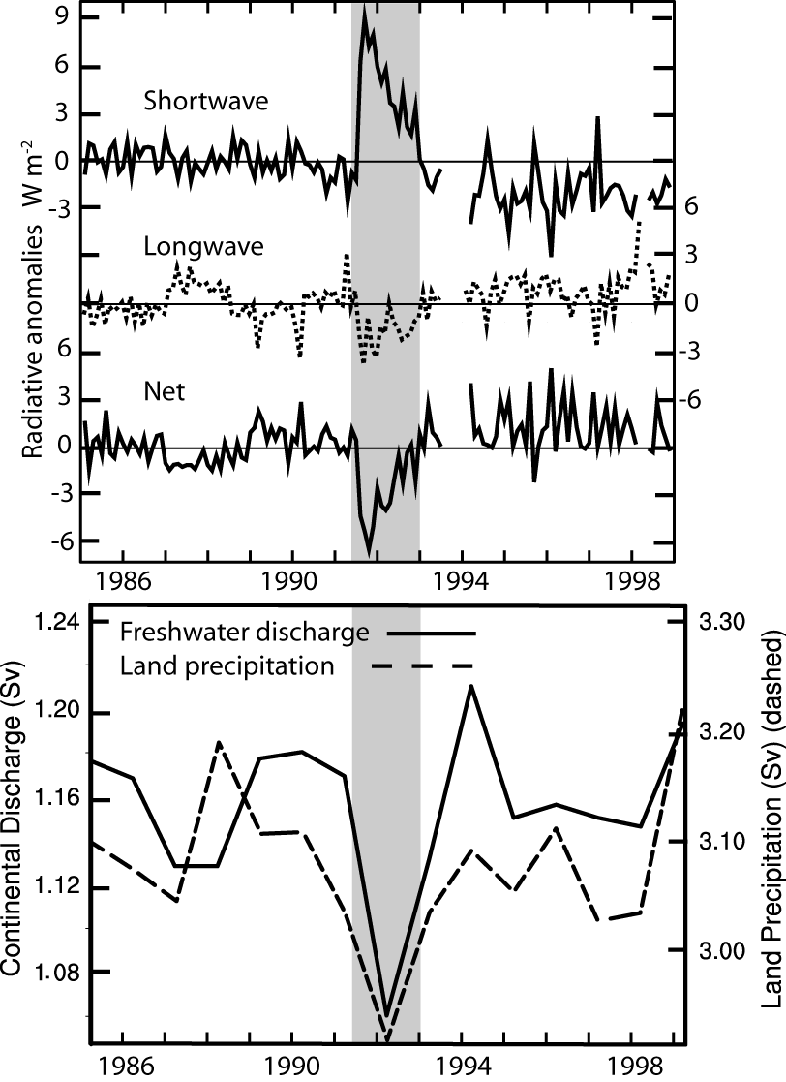
Mount Pinatubo in June 1991 had a pronounced effect on land precipitation and runoff (3.6σ).
Ocean precipitation was also slightly below normal, and the global values are lowest on record.
Trenberth and Dai 2007

Slide 18
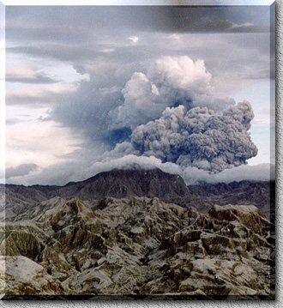
Geoengineering:
One proposed solution to global warming:
Emulate a volcano: Pinatubo
Cut down on incoming solar radiation
Is the cure worse than the disease?

Slide 19
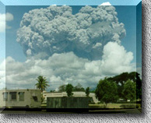
Geoengineering
Indications are that
climate models over-estimate the cooling with volcanoes (overestimate the benefits)
Climate models under-estimate the changes in precipitation and the hydrological cycle (underestimate the bad side effects)
Costs are high and go on forever
There is not an adequate observing system to tell if the effects are doing what they are supposed to, or saying just what is happening.
Holding out false hope of a magic pill solution works against taking seriously needed actions.
Who is to make decisions for all of humanity when there are potentially bad side effects that hurt some more than others? (Ethical issues)

Slide 20
Flood damages:
Local and national authorities work to prevent floods
(e.g., Corp of Engineers, Bureau of Reclamation, Councils)
Build ditches, culverts, drains, levees
Can backfire!
2. Deforestation in many countries:
Leads to faster runoff, exacerbates flooding
3. Increased vulnerability to flooding through
settling in flood plains and coastal regions
Increases losses.
Flooding statistics NOT useful for
determining weather part of flooding!

Slide 21

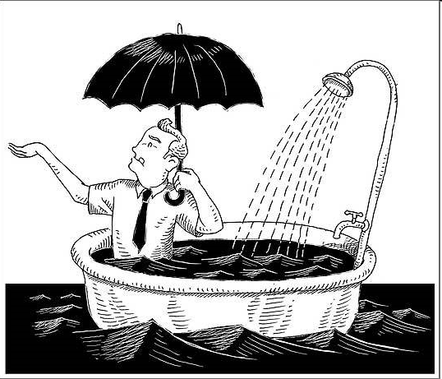
Factors in Changes in Precipitation
It never rains but it pours!

Slide 22

How should precipitation P change as the climate changes?
With increased GHGs: increased surface heating evaporation E⇑ and P⇑
Clausius Clapeyron: water holding capacity of atmosphere goes up about 7% per °C.
With increased aerosols, E⇓ and P⇓
Net global effect is small and complex
Models suggest E⇑ and P⇑ 2-3% per °C.

Slide 23
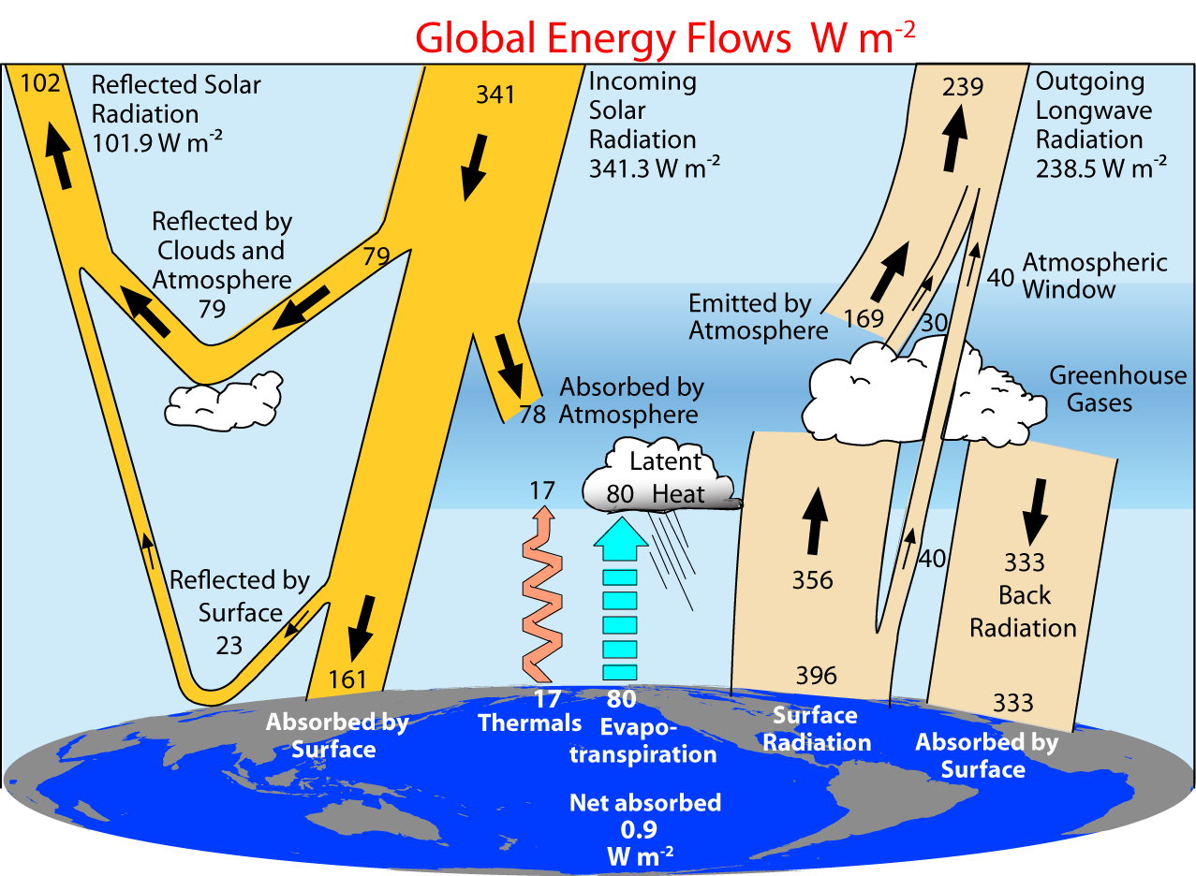
Controls on the changes in net precipitation
1. Changes in cloud
2. Changes in aerosol
3. Changes in atmospheric radiation
1.+2. Evaporation is limited by energy available
3. Latent heating has to be mostly balanced by net LW radiative losses (SH small)
4. Over land: Latent heating is partly balanced by sensible heat
2000-2005 Trenberth et al 2009

Slide 24
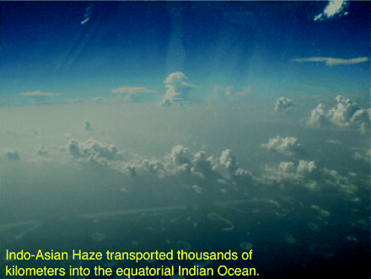
Aerosols have multiple effects:
Direct – cooling
from sulfate aerosol:
milky white haze, reflects
Direct – absorbing
e.g. black carbon
Indirect – changes cloud
Form cloud condensation nuclei, more droplets, brighter cloud;
Less rain, longer lasting cloud;
Absorption in cloud heats and burns off cloud
Less radiation at surface means less evaporation and less cloud
Lifetime only a week or so: Very regional in effects
Ramanathan et al 2001
Profound effects at surface:
Short-circuits hydrological cycle

Slide 25
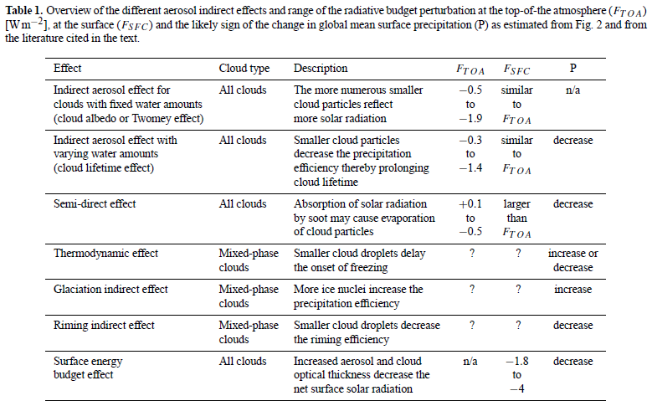
Aerosol indirect effects
Lohmann and Feichter 2005

Slide 26
TOA radiation does not change (much) in equilibrium
Controls on the changes in net precipitation
If the only change in climate is from increased GHGs:
then SW does not change (until ice melts and if clouds change), and so OLR must end up the same.
But downwelling and net LW↓ increases and so other terms must change: mainly evaporative cooling.
Transient response may differ from equilibrium (see Andrews et al. 09)
Land responds faster. Radiative properties partly control rate of increase of precipitation.: Stephens and Ellis 2008
2000-2005 Trenberth et al 2009

Slide 27
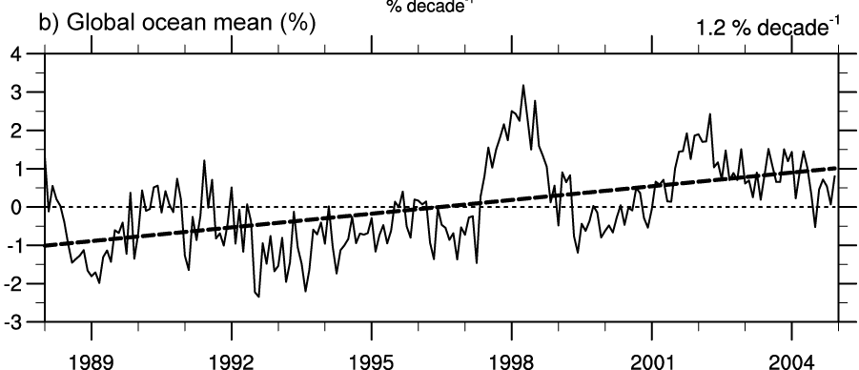
Air holds more water vapor at higher temperatures
A basic physical law tells us that the water holding capacity of the atmosphere goes up at about 7% per degree Celsius increase in temperature. (4% per °F)
Observations show that this is happening at the surface and in lower atmosphere: 0.55°C since 1970 over global oceans and 4% more water vapor.
This means more moisture available for storms and an enhanced greenhouse effect.
More intense rains (or snow) but
longer dry spells
Trenberth et al 2003
Total water vapor

Slide 28
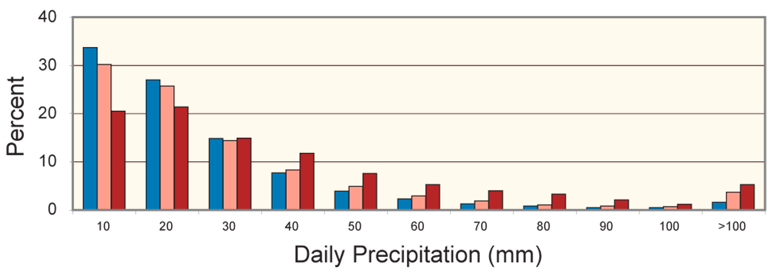
Higher temperatures: heavier precipitation
Percent of total seasonal precipitation for stations with 230mm±5mm falling into 10mm daily intervals based on seasonal mean temperature.
Blue bar -3˚C to 19˚C, pink bar 19˚C to 29˚C, dark red bar 29˚C to 35˚C, based on 51, 37 and 12 stations.
As temperatures and e_{s} increase, more precipitation falls in heavy (over 40mm/day) to extreme (over 100mm/day) daily amounts.
Karl and Trenberth 2003

Slide 29
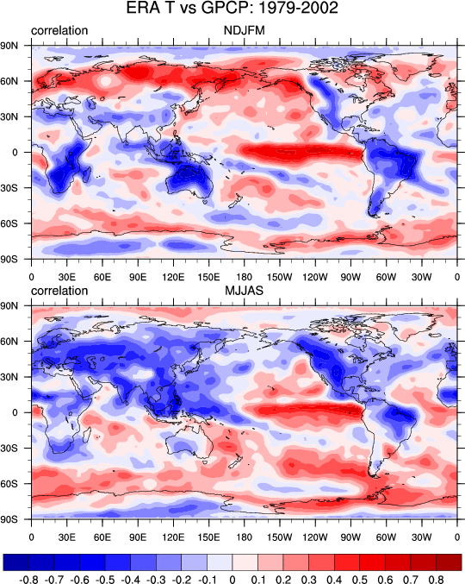
Precipitation vs Temperature
Winter high lats: air can’t hold moisture in cold; storms: warm and moist southerlies.
Clausius-Clapeyron effect
T⇒P
Nov-March
Correlations of monthly mean anomalies of surface temperature and precipitation.
May-September
Negative: means hot and dry or cool and wet.
Positive: hot and wet or cool and dry (as in El Nino region).
Trenberth and Shea 2005
Tropics/summer land: hot and dry or cool and wet
Rain and cloud cool and air condition the planet!
P⇒T
Oceans: El Nino high SSTs produce rain, ocean forces atmosphere
SST⇒P

Slide 30
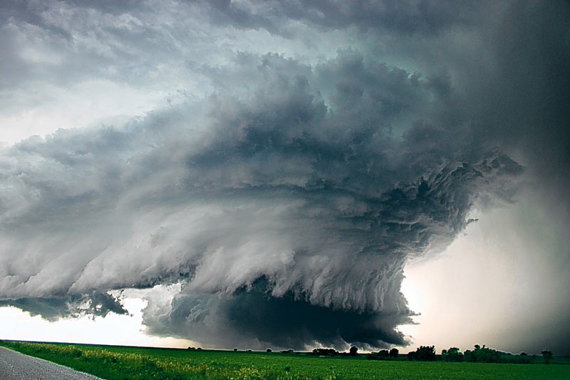

Temperature vs Precipitation
Cyclonic regime
Cloudy: Less sun
Rain: More soil moisture
Surface energy: LH ↑ SH↓
Rain ↑ Temperature ↓
Anticyclonic regime
Sunny
Dry: Less soil moisture
Surface energy: LH↓ SH↑
Rain ↓ Temperature ↑
Summer: Land
Strong negative correlations
Does not apply to oceans

Slide 31
Air holds more water vapor at higher temperatures
The C-C effect is important over oceans (abundant moisture) and over land at mid to high latitudes in winter.
“The rich get richer and the poor get poorer”. More moisture transports from divergence regions (subtropics) to convergence zones. Result: wet areas get wetter, dry areas drier (Neelin, Chou)
But increases in moist static energy and gross moist instability enables stronger convection and more intense rains. Hadley circulation becomes deeper.
Hence it changes winds and convergence: narrower zones.
“Upped ante” precip decreases on edges of convergence zones as it takes more instability to trigger convection. (Neelin, Chou)

Slide 32
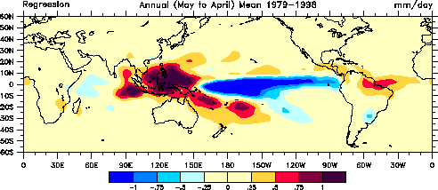
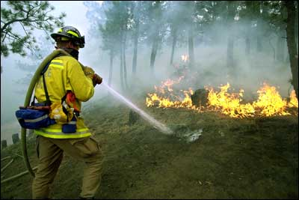
How else should precipitation P change as the climate changes?
“More bang for the buck”: With increased moisture, the winds can be less to achieve the same transport. Hence the divergent circulation weakens. (Soden & Held)
Changes in characteristics: more intense less frequent rains (Trenberth et al)
Changed winds change SSTs: ITCZ, storm tracks move: dipoles Example: ENSO
Type: snow to rain
Snow pack melts sooner, runoff earlier, summer soil moisture less, risk of summer drought, wildfires increases

Slide 33
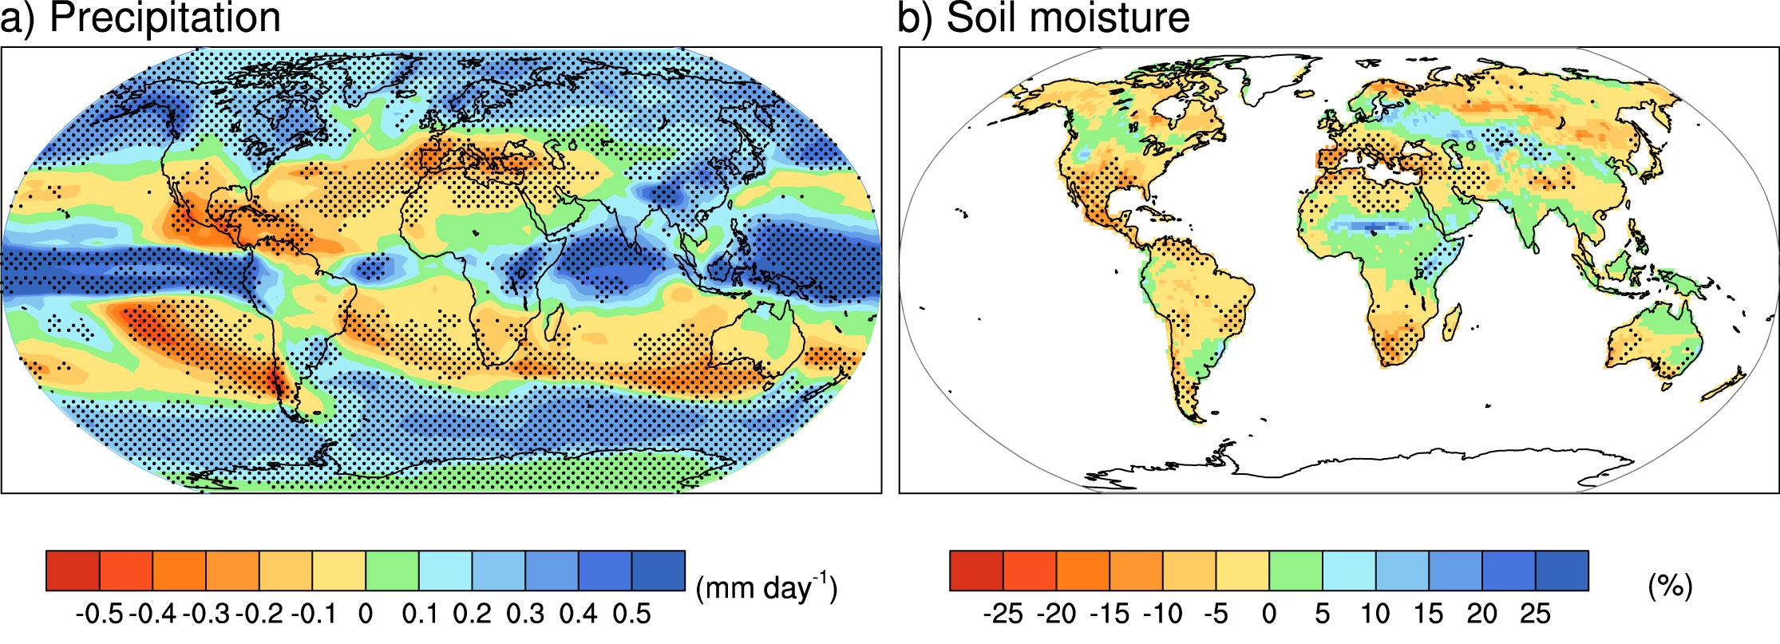
Model predictions
“Rich get richer, poor get poorer”
Projections: Combined effects of increased precipitation intensity and more dry days contribute to lower soil moisture
2090-2100 IPCC

Slide 34
IPCC AR4 Model Predicted Changes: 1980-99 vs. 2080-99
Precip. Amount
Precipitable Water
1.7% K⁻¹
9% K⁻¹
B1
A2
Global Percentage Change (%)
1 2 3 4 1 2 3 4
Precip. Intensity
2% K⁻¹
-0.8% K⁻¹
Precip. Frequency
1 2 3 4 1 2 3 4
Global Temp. Change (K)
Global Temp. Change (K)
(Sun et al.07)
Notes:
Each letter (a total of 17) represents a AR4 model, and blue for SERES B1 and red for SERES A2 scenarios.

Slide 35
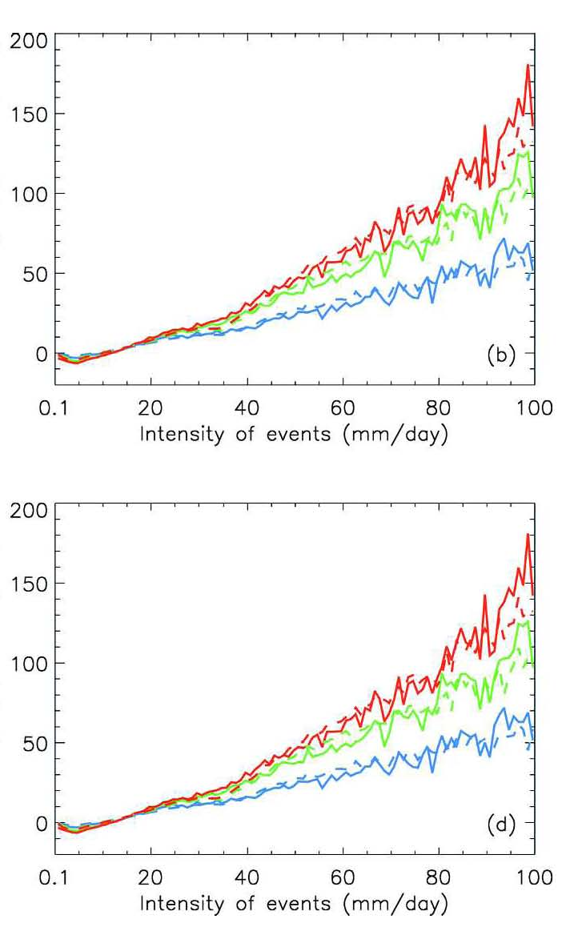
Precip. Frequency
A2
A1B
B1
Percentage Change (%)
(2080-2099 vs. 1980-1999)
There is higher frequency of more intense events contributing to the total amount.
The % change is over 100% for A1B and A2.
Precip. Amount
(Sun et al.’07)

Slide 36
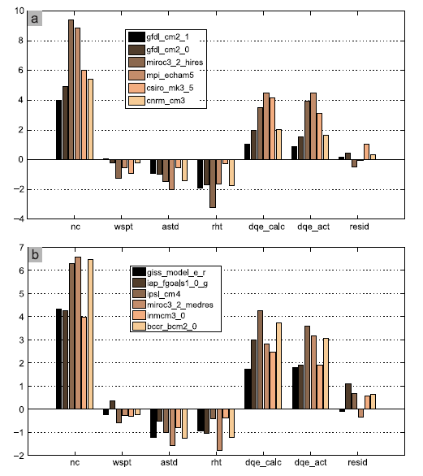
Model precipitation changes
R
Oceans
2-3% per K increase in E and P
C-C effect 4-6%
Sfc wind speed ↓ 0.01m/s
Sea-air T diff↓ 0.05K
Sfc RH ↑ 0.2%
AR4 models A1B
2046 to 2101
Richter and Xie 2008
Also: Trenberth 1998
Stephens and Ellis 2008
Allan and Ingram 2002

Slide 37
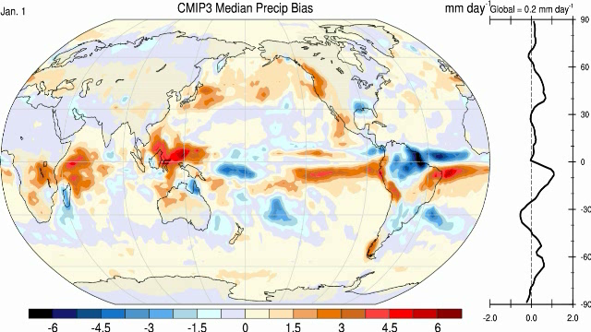
Precipitation in models: “all models are wrong, some are useful”
A challenge:
Amount: distribution: double ITCZ
Frequency: too often
Intensity: too low
Runoff: not correct
Recycling: too large
Diurnal cycle: poor
Lifetime: too short
(moisture)
Issues:
Tropical transients too weak
Hurricanes
MJOs
Easterly waves

Slide 38
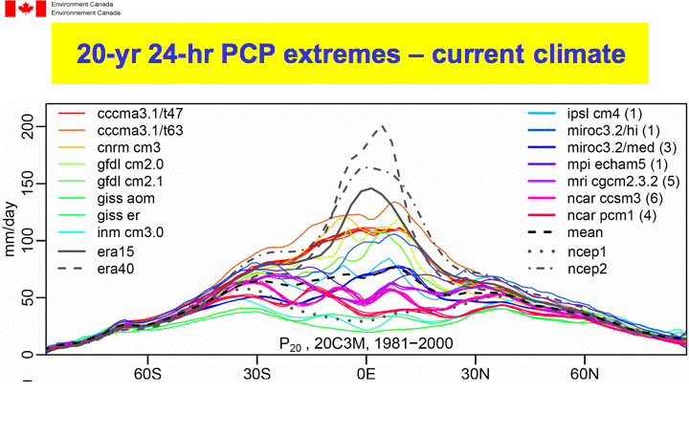
All models are wrong, some are useful!
There are many analyses of models, but models are demonstrably poor at many aspects of the hydrological cycle.
Courtesy Francis Zwiers

Slide 39
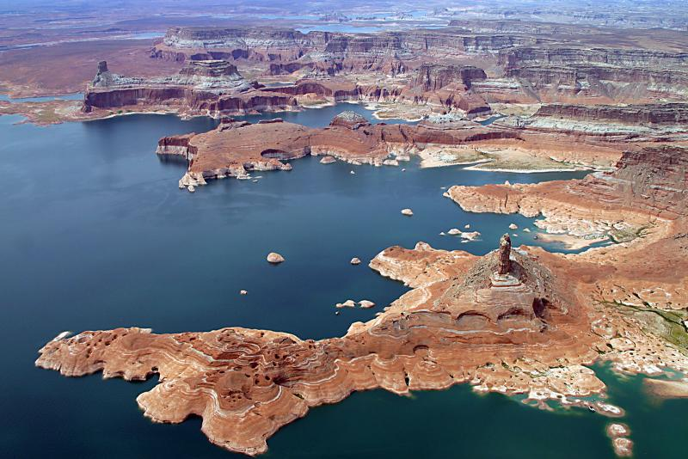
Water serves as the “air conditioner”
of the planet.
Rising greenhouse gases are causing climate change, semi-arid areas are becoming drier while wet areas are becoming wetter.
Increases in extremes (floods and droughts) are already here.
Water management:-
dealing with how to save in times of excess for times of drought –
will be a major challenge in the future.
Lake Powell

