Slide 1
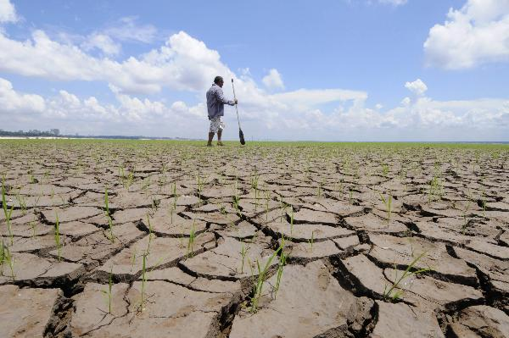
How does drought change with climate change?
Kevin E Trenberth
NCAR

Slide 2
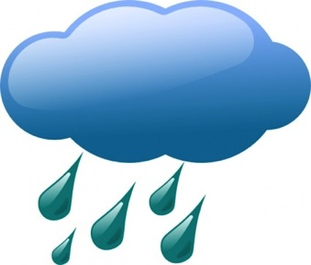
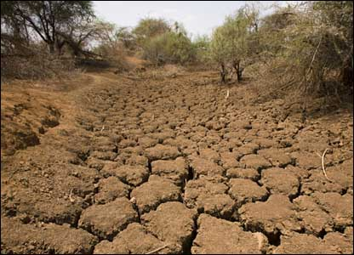
Warmer air holds more moisture
4% per °F
Global warming=
More heat
⇓
More drying
⇓
More evaporation
⇓
More moisture
More rain
More drought

Slide 3
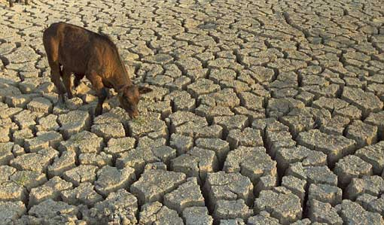
Drought
IPCC SREX and AR5 backed away from drought statements from AR4.
They cited conflicting studies, especially from
Dai 2011, 2013
Sheffield et al 2012
Van der Schrier et al 2013
“Confidence is low for a global-scale observed trend in drought or dryness (lack of rainfall) since the middle of the 20th century, owing to lack of direct observations, methodological uncertainties and geographical inconsistencies in the trends. Based on updated studies, AR4 conclusions regarding global increasing trends in drought since the 1970s were probably overstated.”

Slide 4
Drought
Nature: Sheffield et al. 2012 ‘Little change in global drought over the past 60 years’
Nature climate change: Dai 2012 ‘Increasing drought under global warming in observations and models’
JGR: Van der Schrier, G., Barichivich, J., Briffa, K. R. & Jones, P. D. 2013: ‘A scPDSI-based global dataset of dry and wet spells for 1901–2009’

Slide 5
Drought
A new assessment by Trenberth et al (2014):
Trenberth, K. E., A. Dai, G. van der Schrier, P. D. Jones, J. Barichivich, K. R. Briffa, and J. Sheffield, 2014: Global warming and changes in drought. Nature Climate Change, 4, 17-22
included Dai, Sheffield, van der Schrier et al.
clarified the issues:
PDSI and ET formulation
Thornthwaite vs Penman-Monteith
Self calibration
Datasets
PM requires cloud, radiation, wind, water vapor…
Precipitation
Natural variability (ENSO)
Trends affected
Global warming

Slide 6
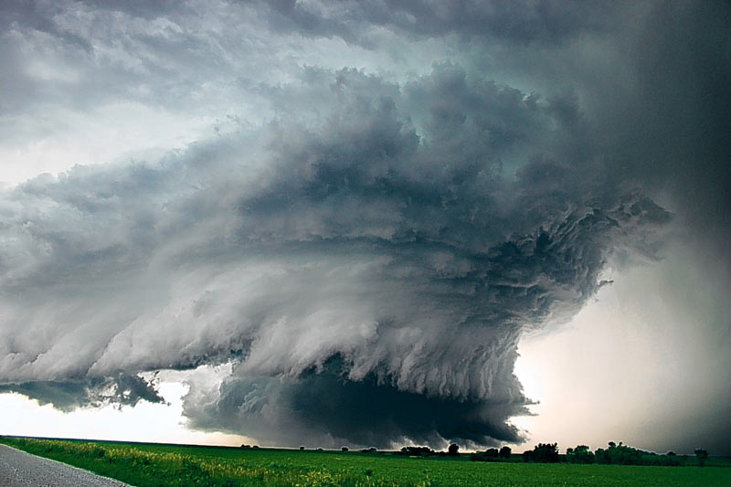
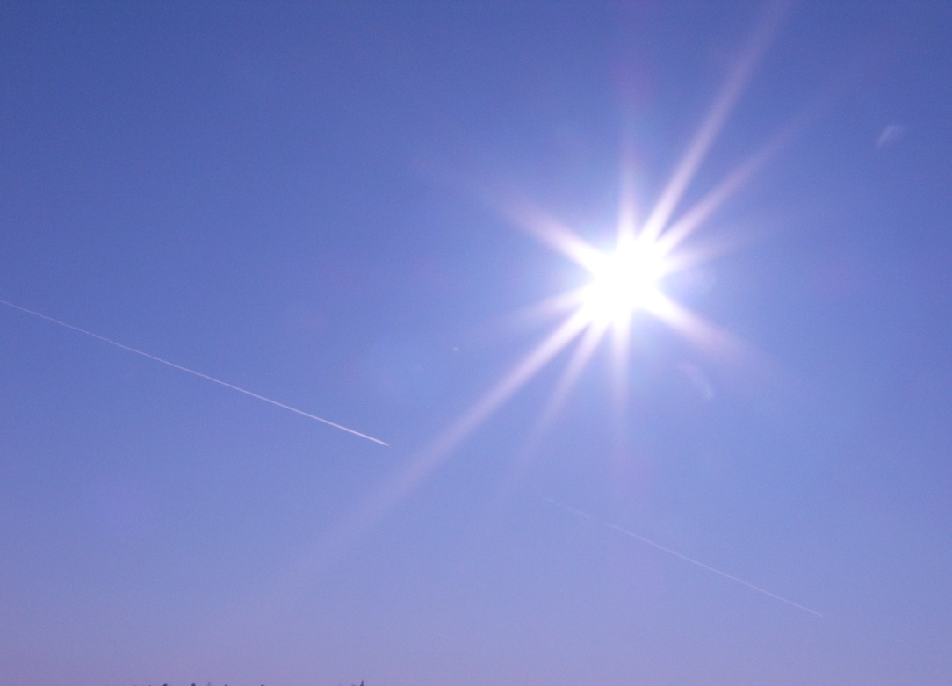

Temperature vs Precipitation
Cyclonic regime
Cloudy: Less sun
Rain: More soil moisture
Surface energy: LH ↑ SH↓
Rain ↑ Temperature ↓
Anticyclonic regime
Sunny
Dry: Less soil moisture
Surface energy: LH↓ SH↑
Rain ↓ Temperature ↑
Summer: Land
Strong negative correlations
Does not apply to oceans
On land results depend on availability of moisture

Slide 7
Drought
Whether and when a drought occurs is largely natural variability, dominated by ENSO.
But given a drought, global warming makes it more intense and longer lasting.
Extra heat builds up: has nowhere to go.
Increased drying
Increased heating and heat waves
Increased wildfire risk

Slide 8

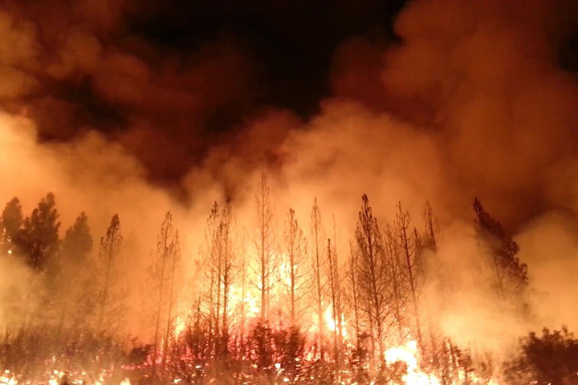
Currently the energy imbalance is order 1 W m⁻². In drought, water plays no role, and so over 1 month the extra accumulated energy is equivalent to running a microwave oven at full power (720W) over every square foot for 6 minutes.
No wonder things catch on fire!

Slide 9
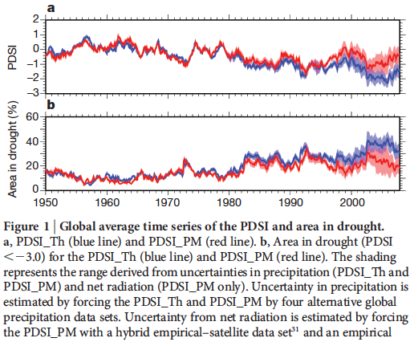
Sheffield et al 2012

Slide 10
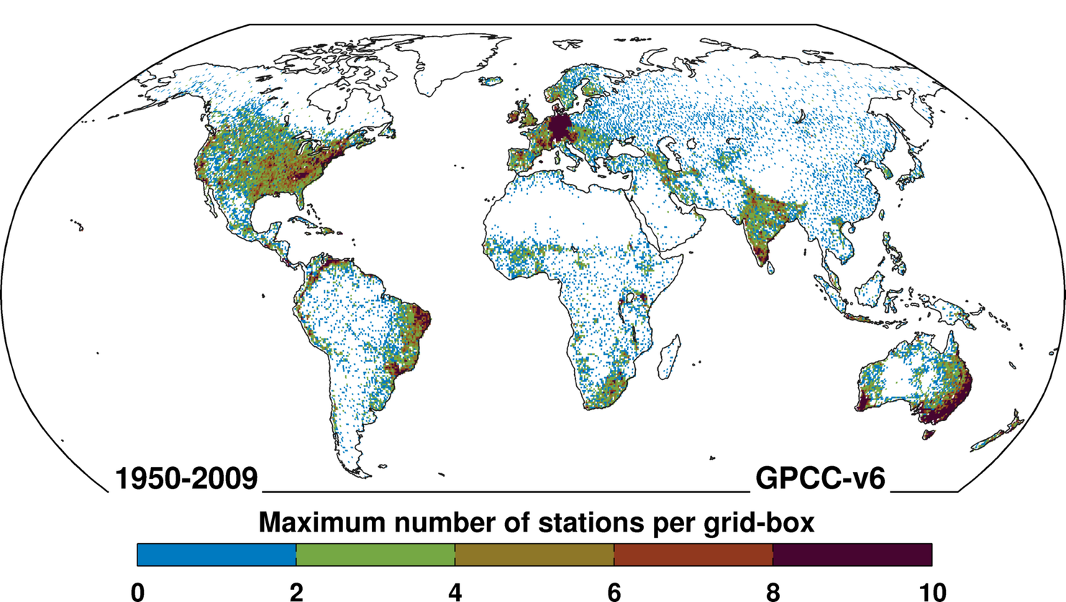
Precipitation matters

Slide 11
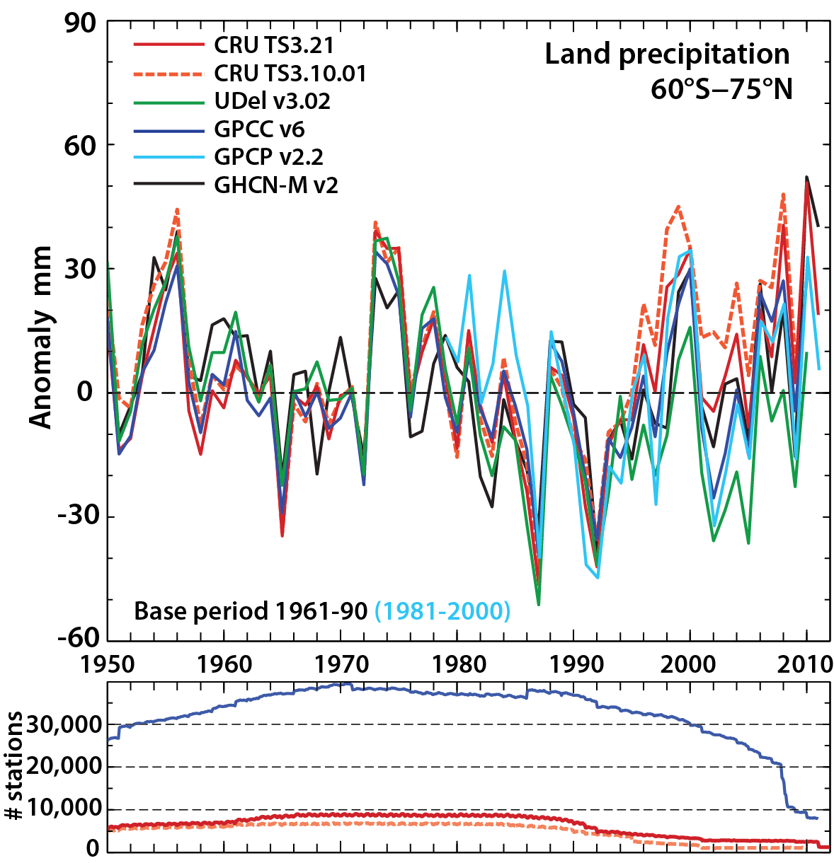
Global land precipitation
T et al. 2014 NCC

Slide 12
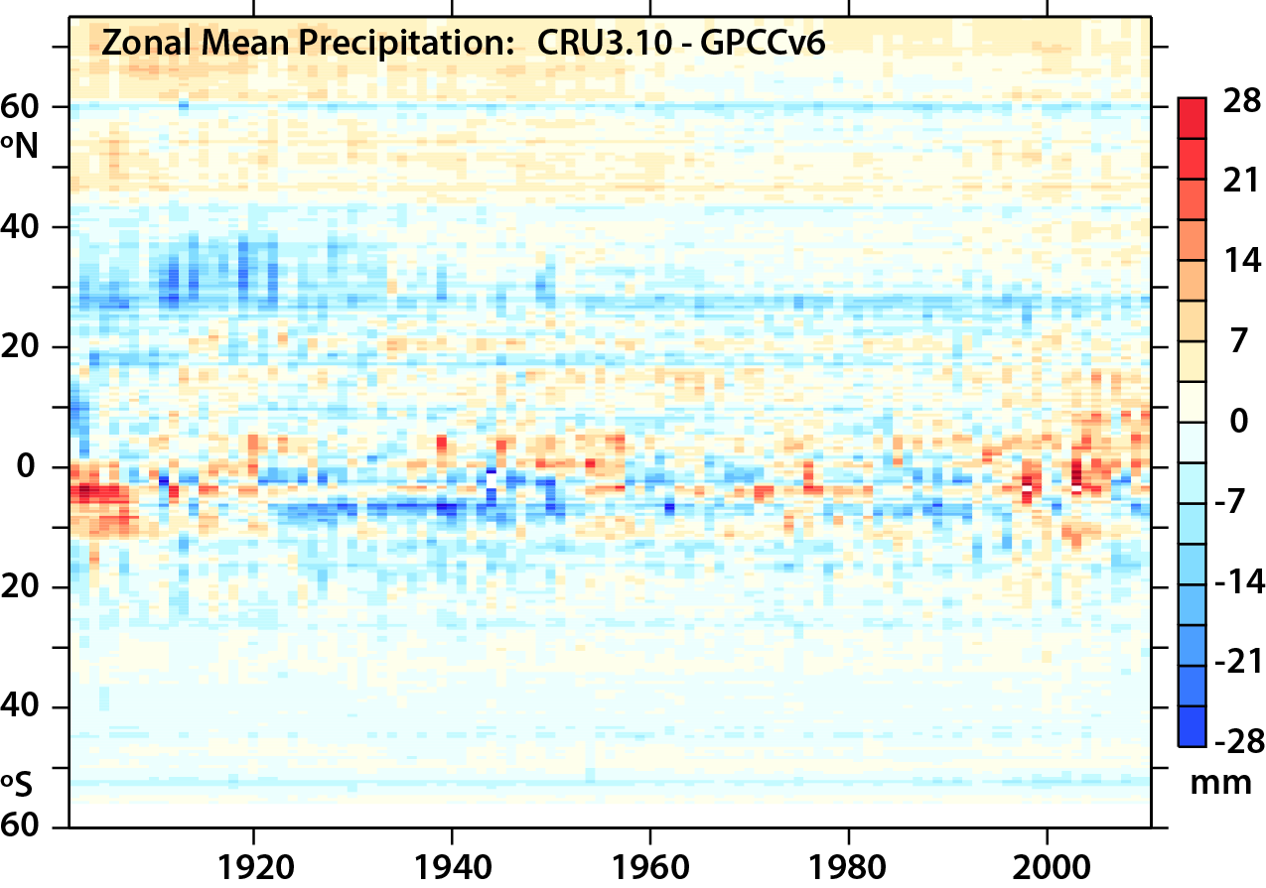
Differences

Slide 13
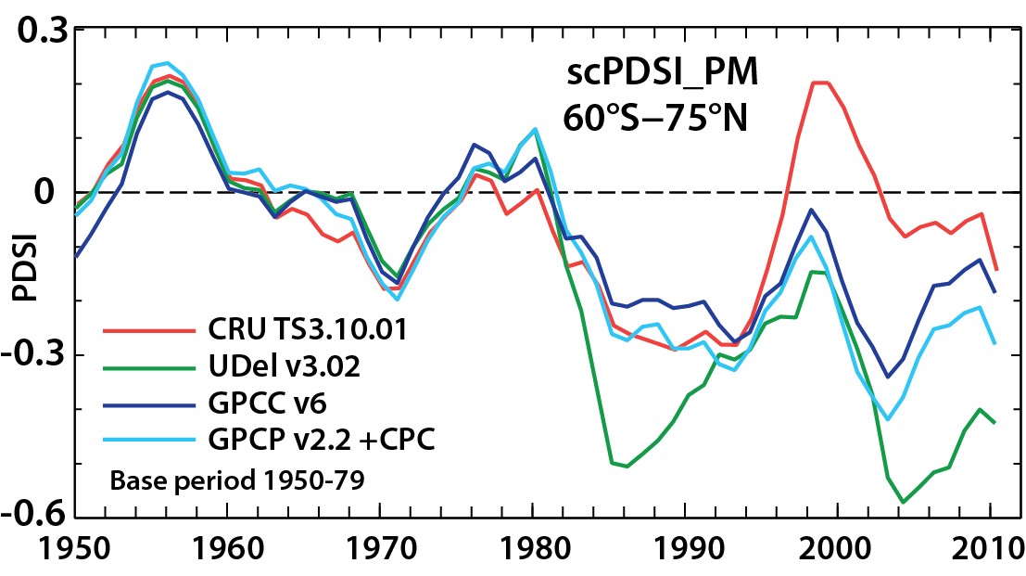
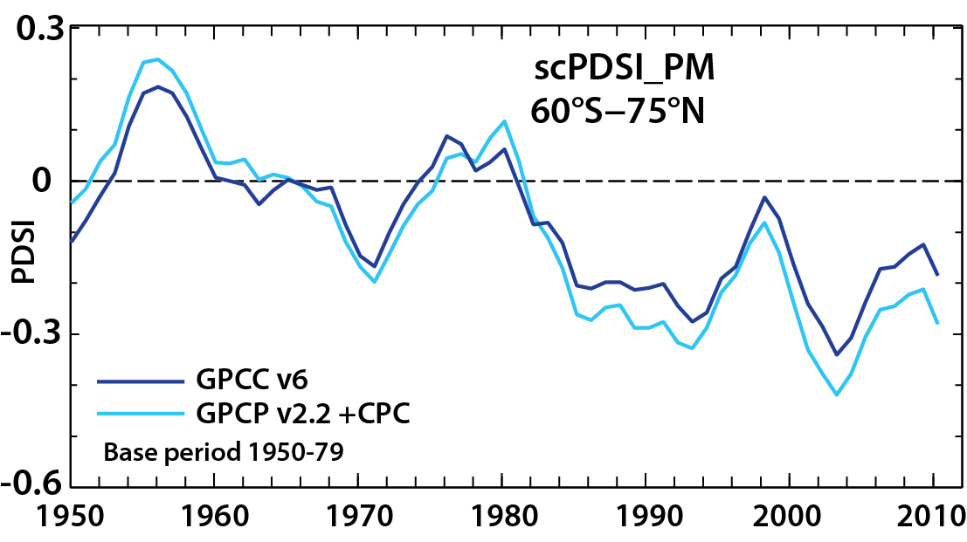
Consequences of different precipitation on PDSI
T et al. 2014 NCC

Slide 14
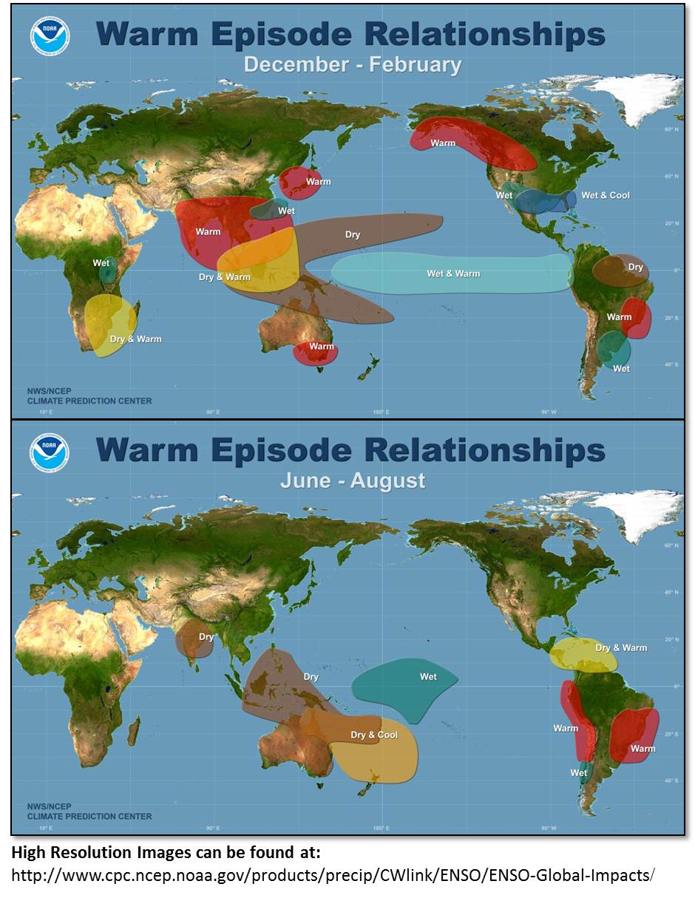
The biggest source of drought (and floods) around the world is ENSO
During El Niño, drought besets: Australia, Indonesia, India, the Philippines, Brazil, parts of east and south Africa, the western Pacific basin islands (incl. Hawaii), Central America, and parts of the U.S.

Slide 15
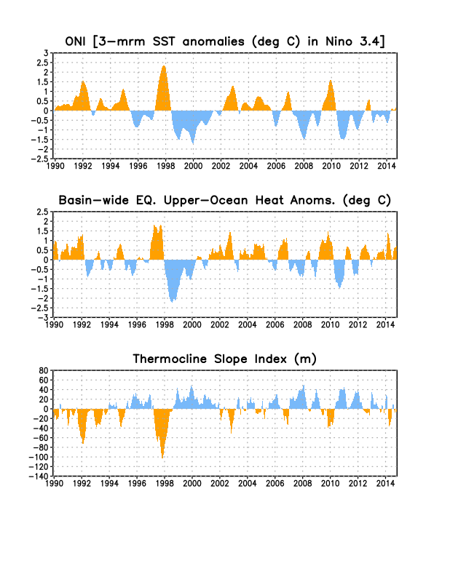
The biggest source of drought (and floods) around the world is ENSO
Fewer El Niño's in recent years means fewer droughts
During El Niño, drought besets: Australia, Indonesia, India, the Philippines, Brazil, parts of east and south Africa, the western Pacific basin islands (incl. Hawaii), Central America, and parts of the U.S.

Slide 16
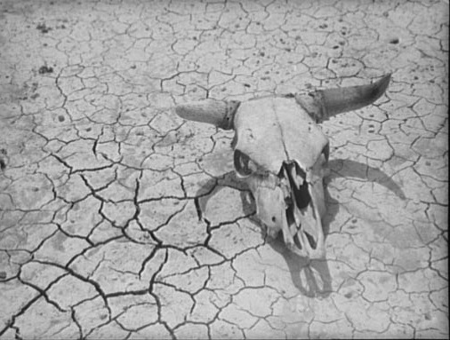
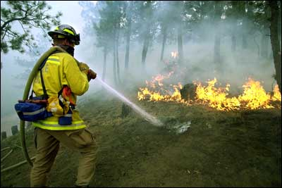
SNOW PACK: In many mountain areas, contributions of global warming include:
more precipitation falls as rain rather than snow, especially in the fall and spring
snow melt occurs faster and sooner in the spring
snow pack is therefore less as summer arrives
soil moisture is less, and recycling is less
global warming means more drying and heat stress
the risk of drought increases substantially in summer
along with heat waves and wildfires

Slide 17
Some 2013 climate extremes

Slide 18
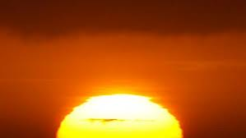
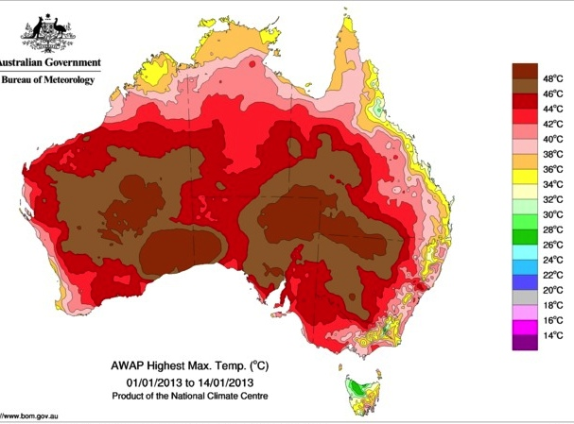
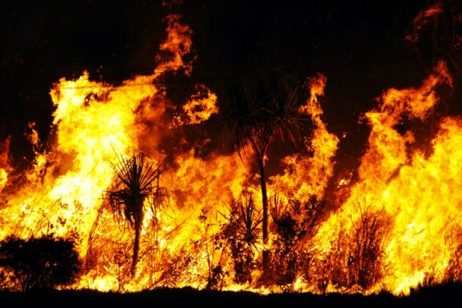
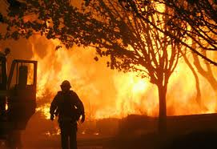
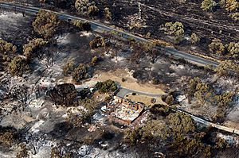
← 28: The Great Awakening: ten volcanoes awaken in one week
Portions of northern India blanketed with largest snowfall in 8 years →
Sydney scorches in record high temperatures of 46.5 degrees (115.7°F)
Posted on January 19, 2013 by The Extinction Protocol
Oz bushfires and heat: January 2013
Sydney record high 18 Jan 2013:
45.8°C (114.4°F) Observatory Hill
46.5 °C (115.7°F) Penrith
Hobart 8 Jan 2013: 41.8°C (107.2°F)
>80 structures lost Tasmania

Slide 19
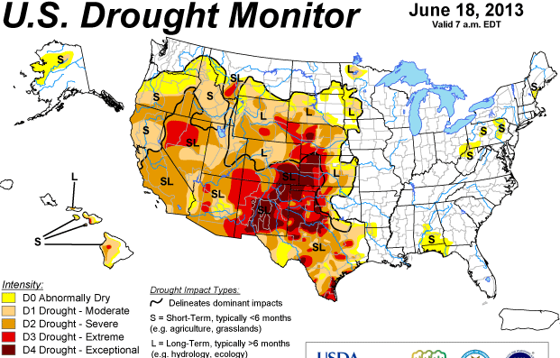
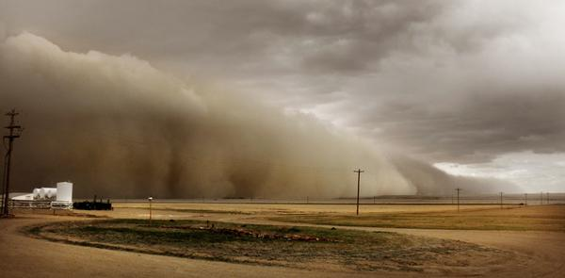
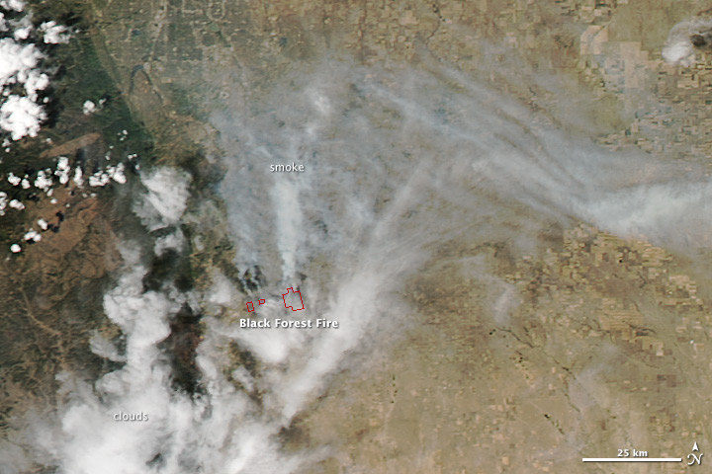
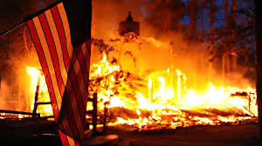
U.S. Drought and wildfires June 2013
Dust storm Lamar, CO
(June 15, Denver Post)
Black Forest wildfire CO:
>511 homes burned

Slide 20
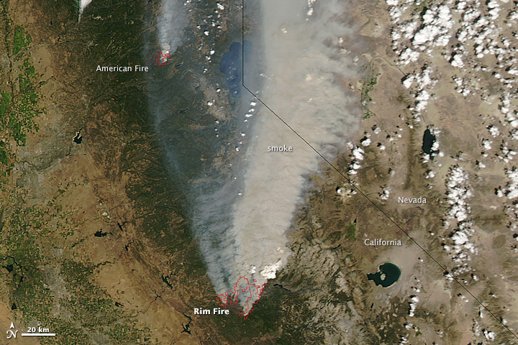
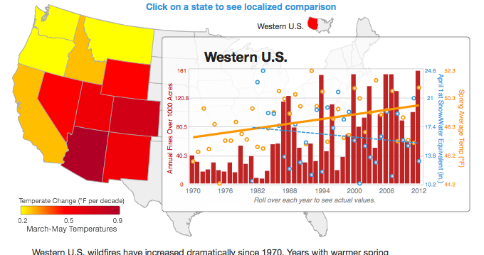
California Rim Fire late August 2013 One of biggest on record

Slide 21
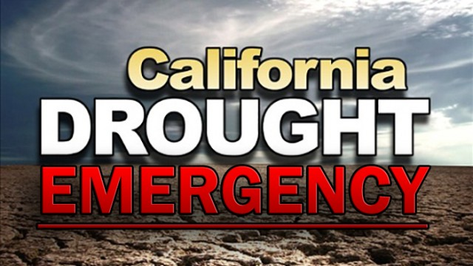
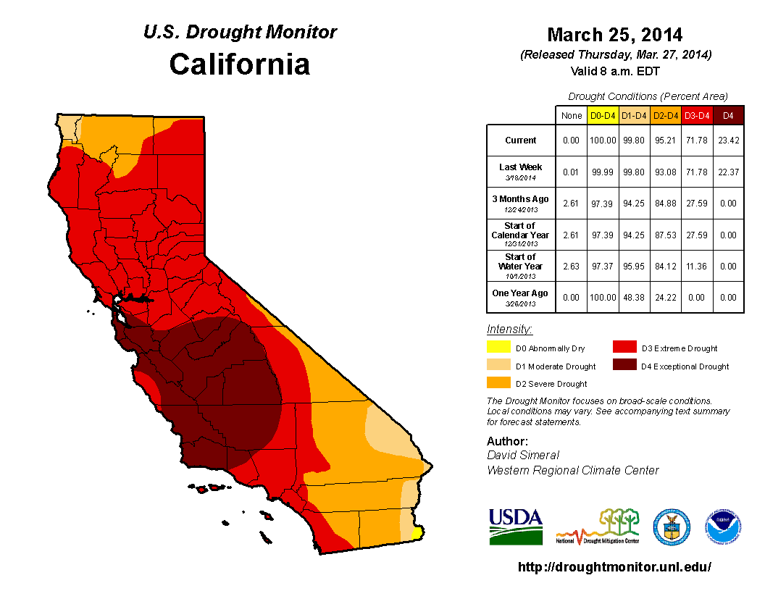
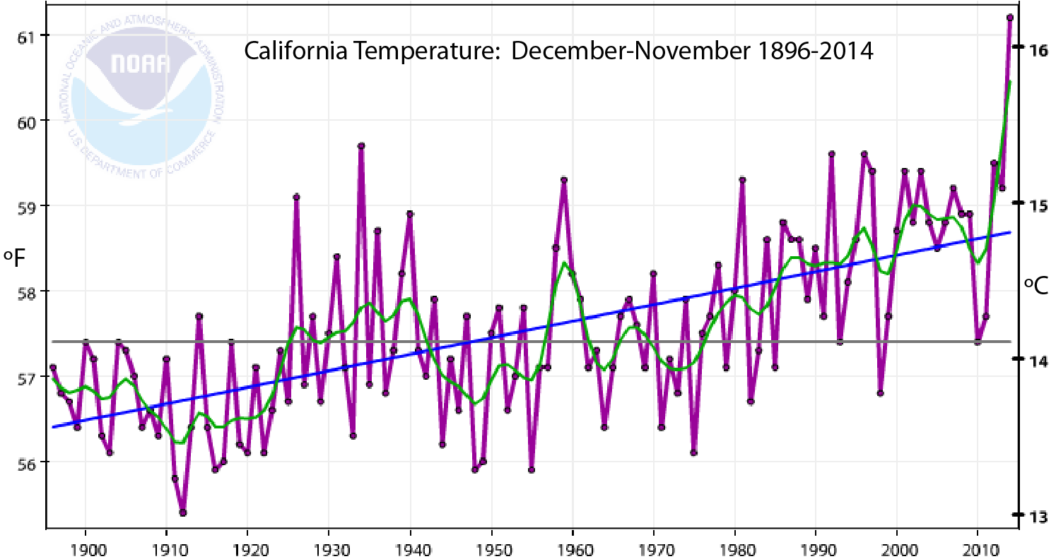
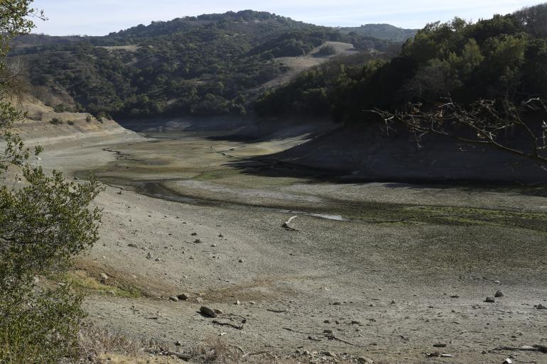
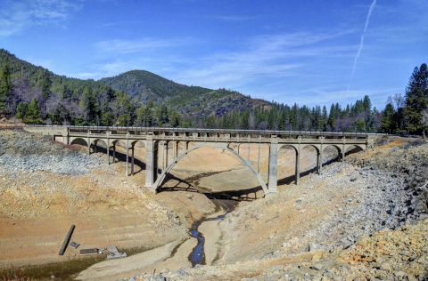
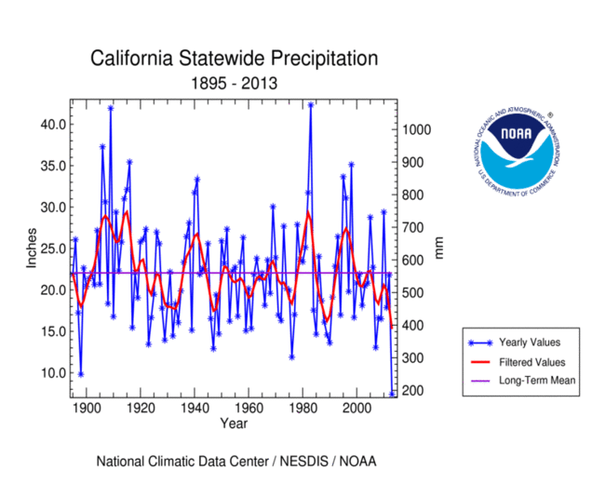
2013-14
Shasta Lake Feb 14, 2014
Mel Fechter
Near San Jose Jan 21 2014
California precipitation
mm

Slide 22
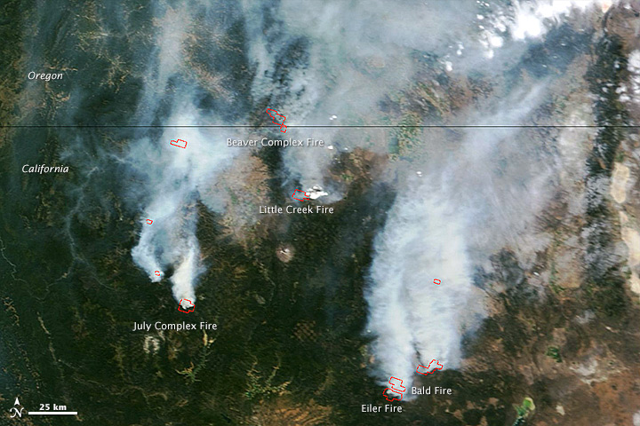
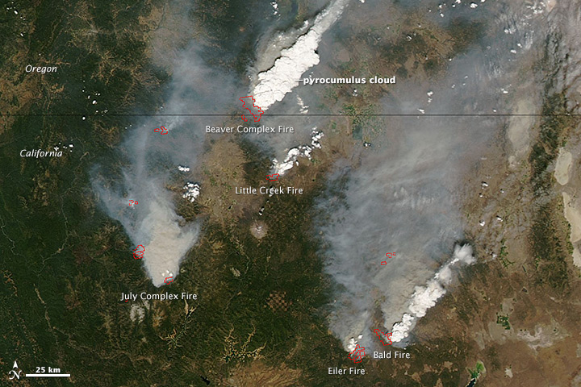
Wild fires in CA 2014
Aug 2, 2014
11 a.m.
1 p.m.
Natural color:
Development of pyro-cumulus
MODIS
NASA
July 31 2014: 82% of CA in extreme drought, 58% exceptional drought
Notes:
Terra in a.m. and Aqua in p.m.

Slide 23
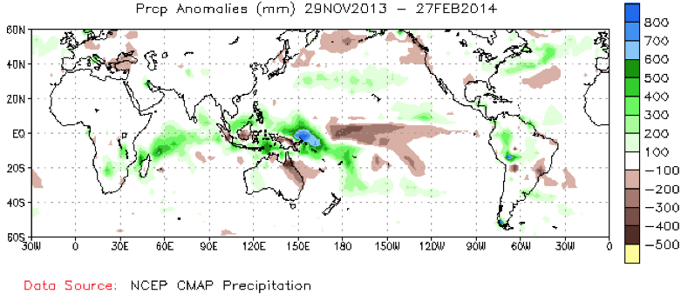
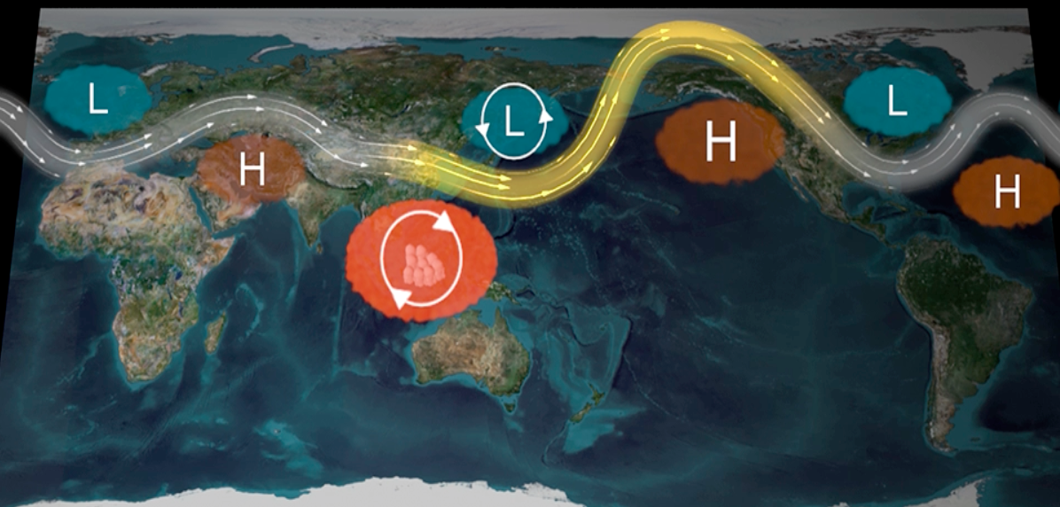
NOAA: Researchers offer new insights into predicting future droughts in California Natural cycles, sea surface temperatures found to be main drivers in ongoing event
NOAA Dec 8, news release
All droughts arise mainly in association with anticyclonic conditions (natural) - not new
Use of imperfect models
Few diagnostics of real world
No accounting for temperature and ET effects
At odds with other studies (GRL) on unprecedented nature of drought and record 2013 year!

Slide 24
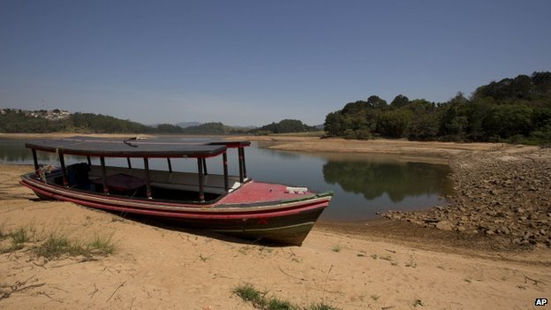
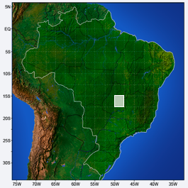
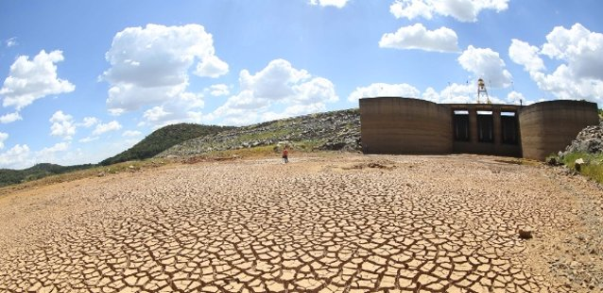
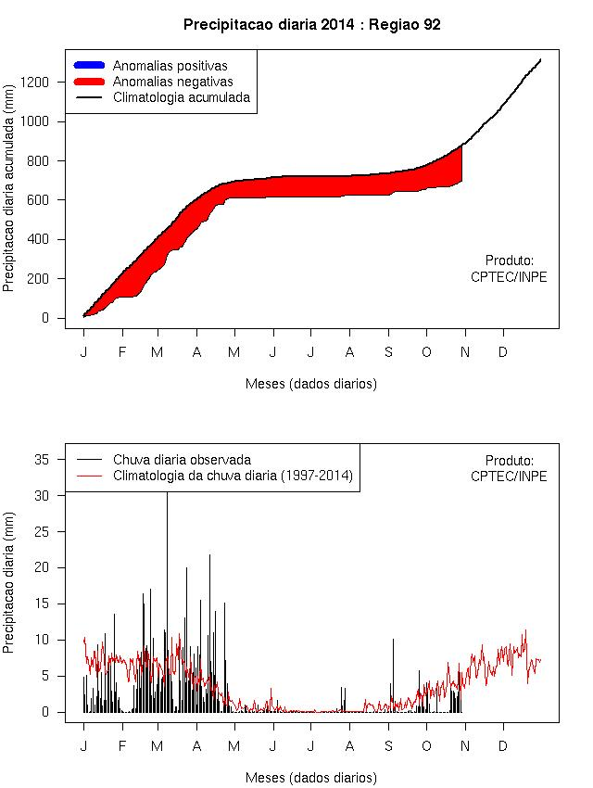
Brazil drought 2014
Sao Paulo running out of water
Worst on record
1/3 normal rain during last wet season DJF

Slide 25
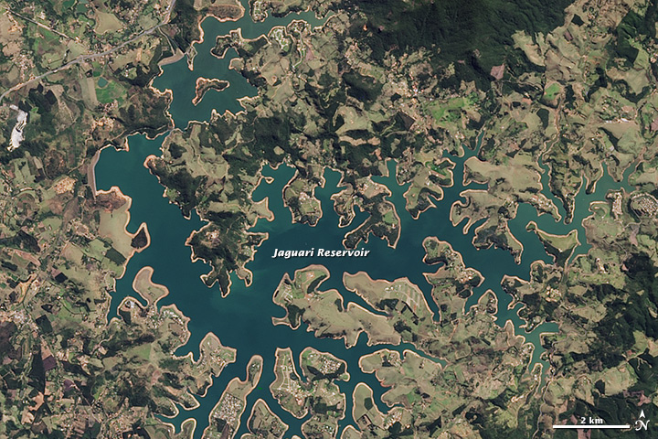
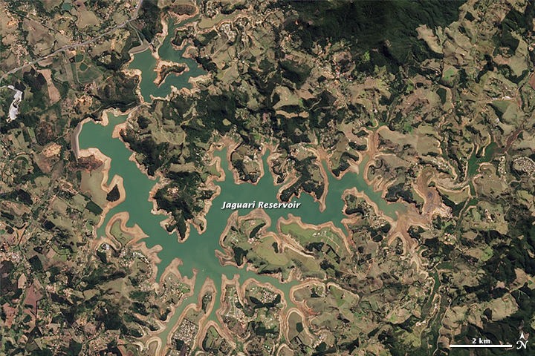
2014 Brazil drought
Aug 16 2013 vs Aug 3 2014 Landsat 8, natural color /NASA

Slide 26
Drought
Future projections from models clearly show increased risk of drought mostly from increased potential evapotranspiration associated with higher temperatures, and thus atmospheric demand.
Increased drought is especially prevalent where precipitation is reduced.

Slide 27
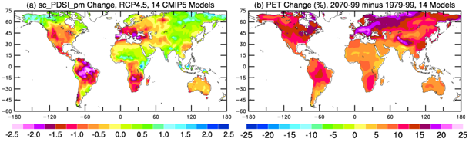
Future Drought
Projections of annual mean scPDSI_pm; PET
Ensemble of 14 models:
RCP4.5 scenario changes from 1970–99 to 2070–99
More extreme drought in summer
Dai 2014 submitted

Slide 28
Global warming does not cause drought:
But when droughts occur, they set in quicker and become more intense!
More intense precipitation, and
Longer dry spells
Increased risk of flooding and drought
Major challenges for a water manager

