Slide 1
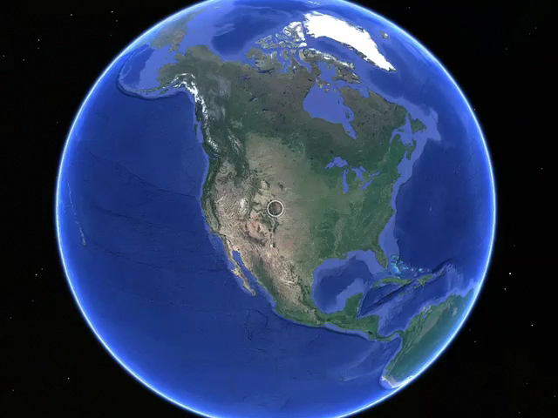
Climate change: It’s about the data not the politics
Kevin E Trenberth
NCAR
Conference on World Affairs, CU, 7-11 April 2014

Slide 2
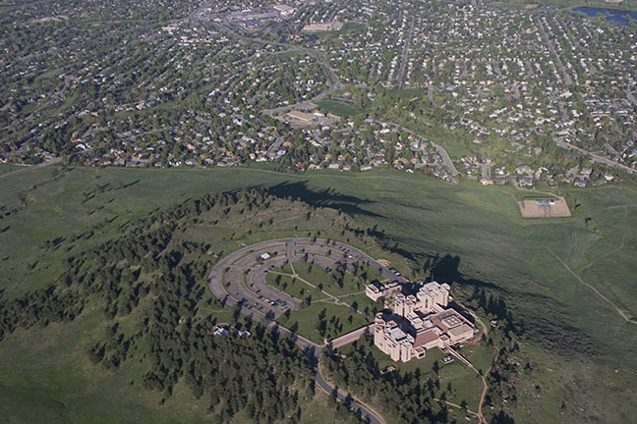
Climate change: It’s about the data not the politics
Kevin E Trenberth
NCAR
Conference on World Affairs, CU, 7-11 April 2014

Slide 3

First rule of management
“You can’t manage what you can’t measure”
“You are entitled to your own opinion but not your own facts.”
Patrick Daniel Moynahan

Slide 4
We have many facts and physical understanding.
The facts are not enough…
The role of scientists is to lay out the facts and the prospects and consequences,
but the decision on what to do is not ours:
that involves politics.

Slide 5
Climate change is happening:
It is due to humans
97% of scientists agree.
The data are of mixed quality and length, but together tell a compelling story leaving no doubt about the human role in climate change.
What we do about this problem involves value systems and politics!

Slide 6
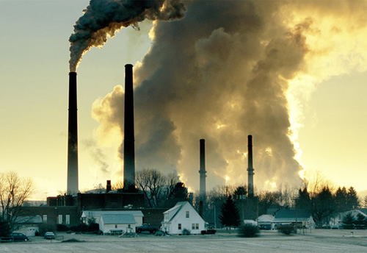
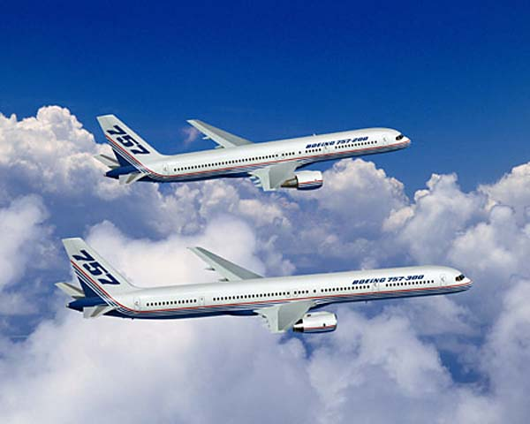
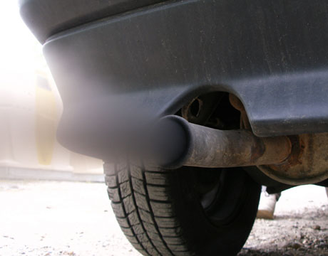
What Is Causing the Warming?
Emissions of carbon dioxide pollution

Slide 7
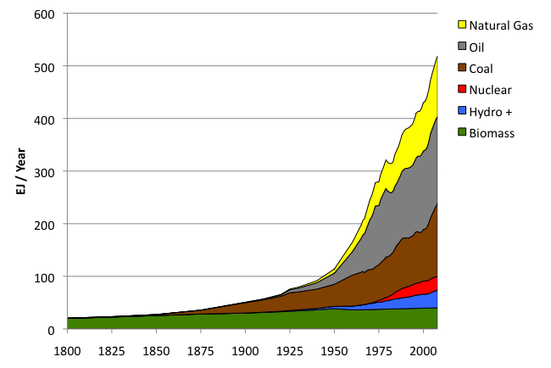
World Primary Energy Supply: 1800 – 2008
Fossil
fuels
Hydro + :means hydropower plus other renewables other than biomass.
Sources: Grubler (2008) - Energy Transitions, BP (2009) – Statistical Review of World Energy, EIA (2009) – International Energy Annual

Slide 8
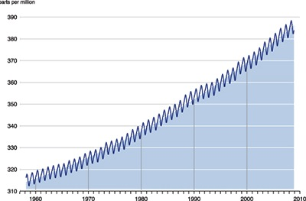
Changing atmospheric composition: CO₂
_{Mauna Loa, Hawaii}
ppm
390
380
370
360
350
340
330
320
310
Rate increasing
1960 1970 1980 1990 . 2000 2010
Data from Climate Monitoring and Diagnostics Lab., NOAA. Data prior to 1974 from C. Keeling, Scripps Inst. Oceanogr.

Slide 9
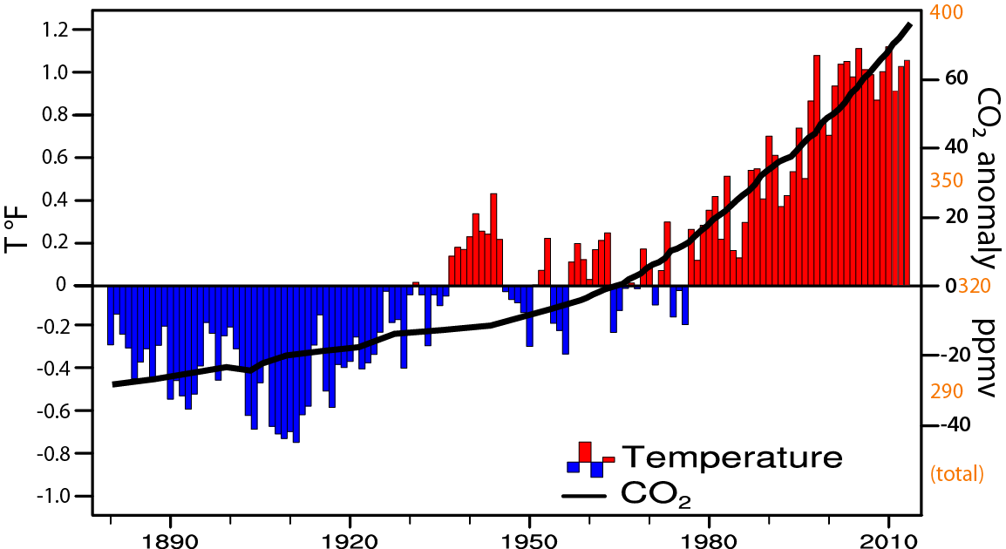
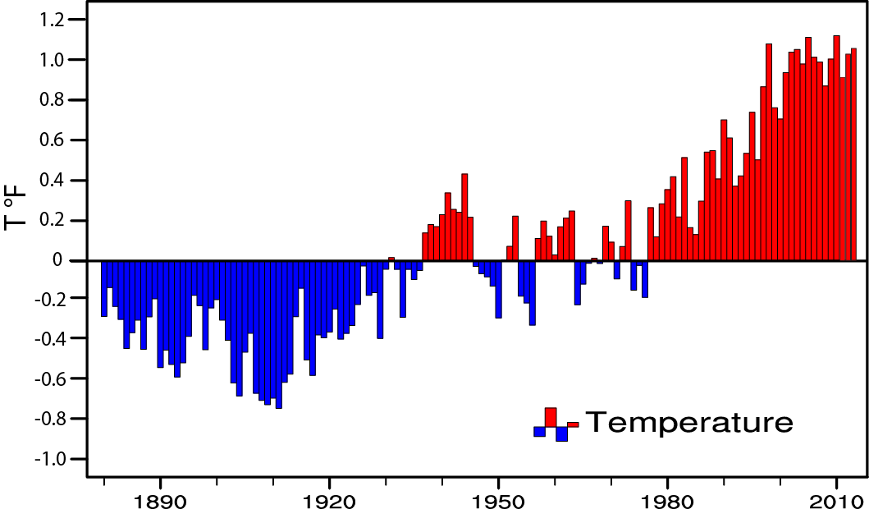
Global temperature and carbon dioxide: anomalies through 2013
Base period 1900-99; data from NOAA
Trenberth and Fasullo 2013 updated

Slide 10

Global Warming is Unequivocal
IPCC AR4: approved 113 govts
Since 1970, rise in: Decrease in:
Global surface temperatures NH Snow extent
Tropospheric temperatures Arctic sea ice
Global SSTs, ocean Ts Glaciers
Global sea level Cold temperatures
Water vapor
Rainfall intensity
Precipitation extratropics
Hurricane intensity
Drought
Extreme high temperatures
Heat waves
Ocean acidity

Slide 11
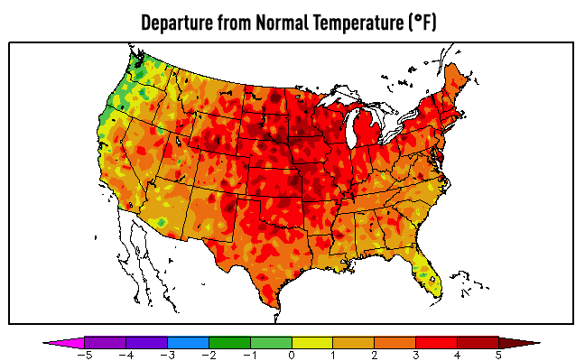
U.S. Temperatures: 2012 Hottest year on record
362 all time record Highs; 3,527 monthly weather records
0 record lows

Slide 12
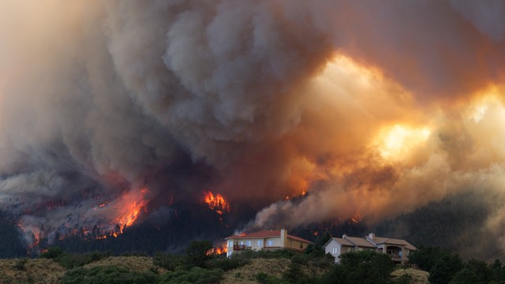
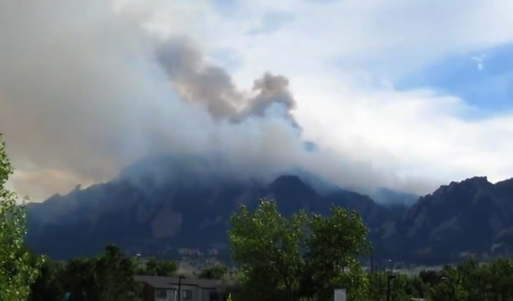
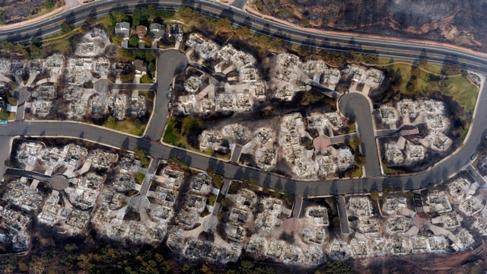
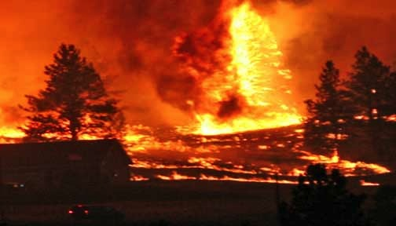
Colorado on Fire: June 2012
Flagstaff fire: above NCAR, circled.
High Park fire 259 houses, 1 death
Waldo Canyon fire
346 homes…

Slide 13
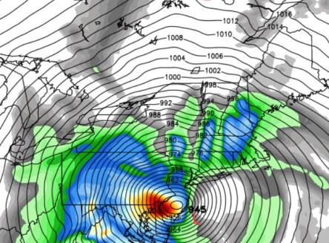
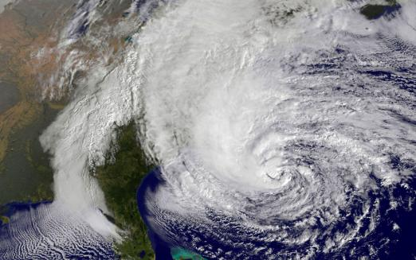
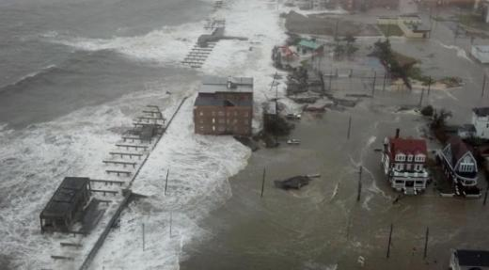
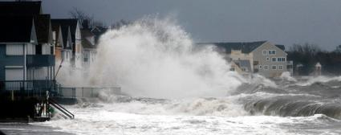
Super Storm Sandy: Oct 29-31, 2012.
It was more intense with stronger winds because of climate change
Sea level is higher => Much greater damage
Hybrid storm:
Over $70B damages
>110 lives lost

Slide 14
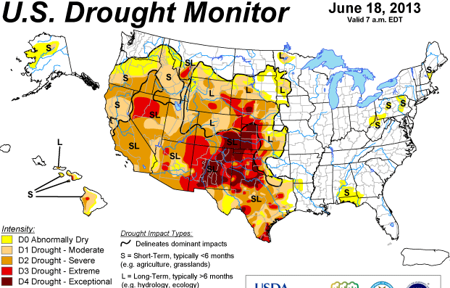
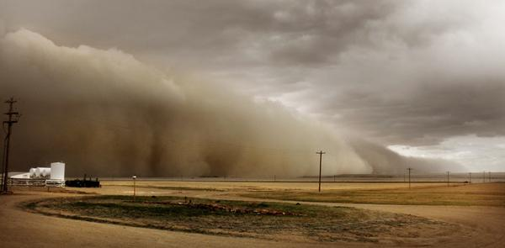
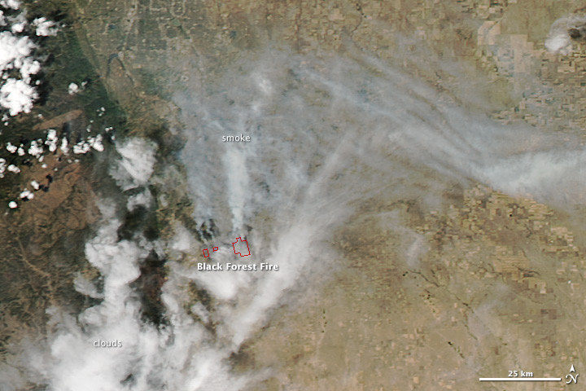
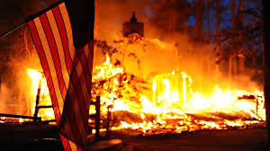
U.S. Drought and wildfires June 2013
Dust storm Lamar, CO
(June 15, Denver Post)
Black Forest wildfire CO:
>511 homes burned

Slide 15
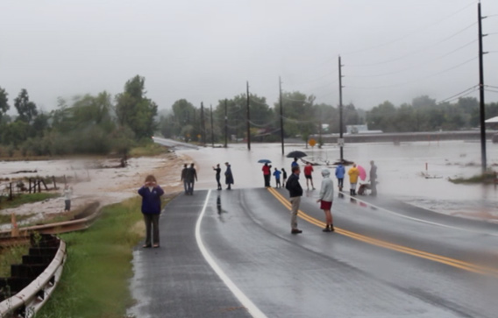
Boulder Flooding September 2013

Slide 16
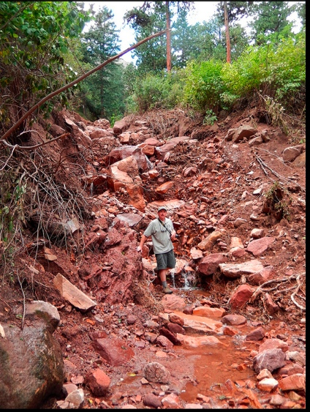
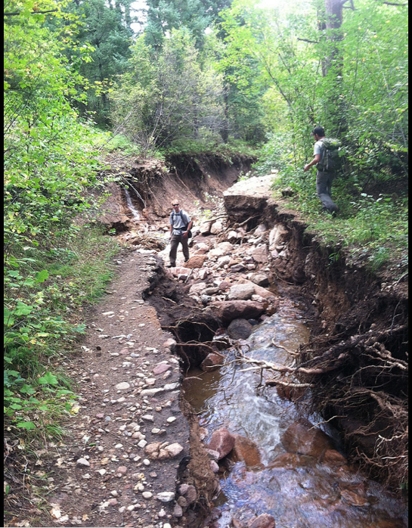
Former location of Mesa Trail over Bluebird creek. Green Mountain Rd (Flagstaff)
http://www.flickr.com/photos/bouldercolorado/sets/72157636661981633/

Slide 17
Science knowledge is going in one direction and politician views are going in another!
Many reports deal with the facts and the science of climate change. A new one by AAAS “scientists agree that humans are the primary cause of climate change”. There are many other reports, such as from the IPCC.
Of 10,855 climate studies published in peer-reviewed literature in 2013 only 2 rejected anthropogenic climate change. [James Lawrence Powell 2014]
56% (>130 members) of the current Republican caucus in the House of Representatives deny the basic tenets of climate science. 66% (30 members) of the Senate Republican caucus also deny the reality of climate change.
ThinkProgress.org
160 members of the 113th Congress have taken $58.8 million from fossil fuel industry
Notes:
http://thinkprogress.org/climate/2013/06/26/2202141/anti-science-climate-denier-caucus-113th-congress-edition/

Slide 18
Selective use of “facts” is done to reinforce one’s initial position
There is considerable psychological and social science research (e.g. Kahan et al. J Risk Res. 2011)
Polarization can increase
People with different values draw different conclusions from same information

Slide 19
Tragedy of the Commons
Everyone for themselves!
Solution requires people of the world to work together.
We are together on “spaceship Earth”.
To many people, that may suggest altruism:
Sharing the money, well-being and profits so carefully accrued to help other people.
Our society is founded on the premise of cheap and easily available fossil fuels that do not take into account the external costs of using those fossil fuels:
Need a principle of User Pays.

Slide 20

“Unless someone like you cares a whole awful lot
Nothing is going to get better. It’s not.”
The Lorax
Dr Suess 1972

