Slide 1
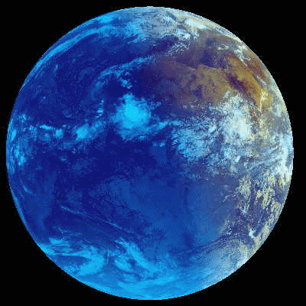

Challenges of a sustained climate observing system
Kevin E Trenberth
NCAR
with
Alan Belward, Otis Brown, Edward Haberman, Thomas R. Karl, Steve Running, Barbara Ryan, Michael Tanner, and Bruce Wielicki
Open Science
Conference

Slide 2
The challenge
“Understanding the complex, changing planet on which we live, how it supports life, and how human activities affect its ability to do so in the future, is one of the greatest intellectual challenges facing humanity.
It is also one of the most important challenges for society as it seeks to achieve prosperity, health and sustainability.”
National imperatives for the next decade and beyond (NRC 2007).

Slide 3

bservations of planet Earth and all climate system components and forcings
are increasingly needed for planning and decisions related to climate services in the broadest sense.
Climate change from human activities adds a whole new dimension and an imperative:
To acquire climate quality observations and analyze them into products for multiple purposes:
  diagnostics and empirical studies
  to inform decisions for mitigation, adaptation
  assess vulnerability and impacts,
  plan and monitor geo-engineering
  predict climate variability and change
  cope with consequences of variability and change

Slide 4
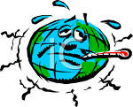
First rule of management
“You can’t manage what you can’t measure”

Slide 5
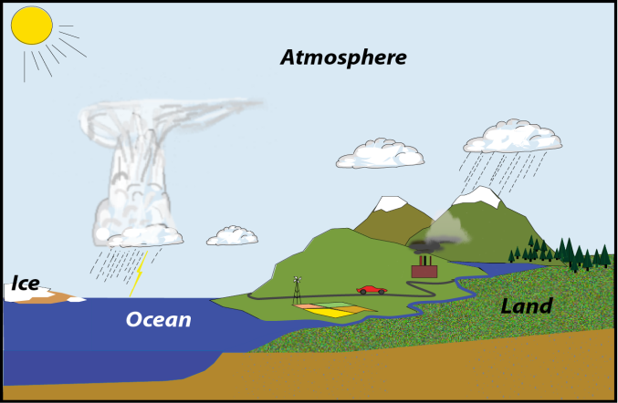
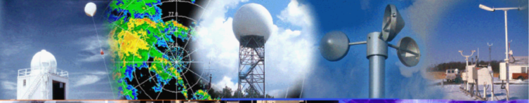
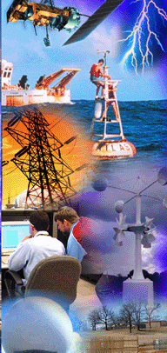
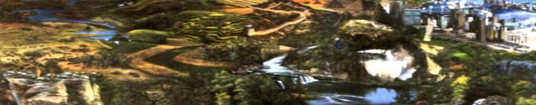
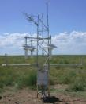
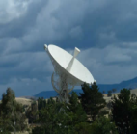



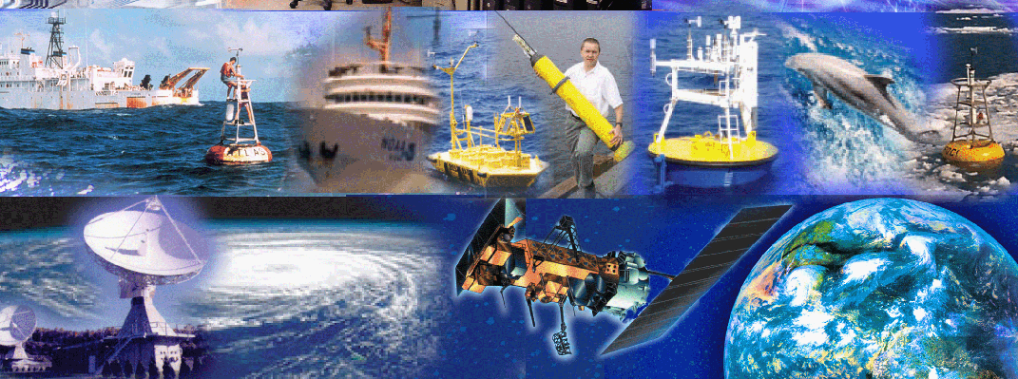
The climate system:
  Atmosphere
  Land
  Ocean
  Cryosphere
  Observations:
Atmosphere
Land
Oceans
Space
Courtesy:Tom Karl

Slide 6
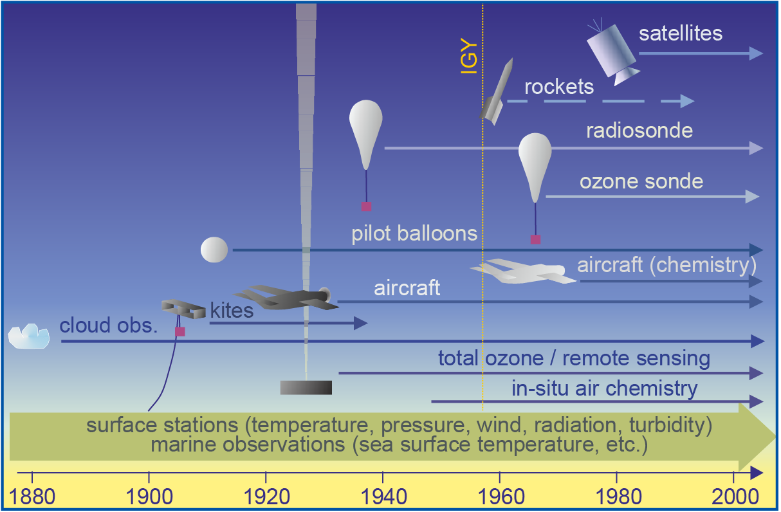
A challenge:
The changing observing system
The continuing changing observing system
Courtesy, S. Brönnimann

Slide 7
Satellite Data Streams
Dec
Feb
TIROS-N
TOVS
Jul
Apr
Nov
Oct
NOAA-6
Sep
Feb
NOAA-7
May
Jun
Jul Oct
NOAA-8
Jan
Nov
NOAA-9
NOAA-10
Dec
Sep
Nov
Jan
Sep
Sep
NOAA-11
Sep
Jun
NOAA-12
NOAA-14
Jan
Dec
ATOVS
NOAA-15
Sep
NOAA-16
Nov
NOAA-17
Jul
EOS Aqua
NOAA-18
Nov
EOS Aqua
Oct
GOES
Sounders
GOES-08
Apr
Jul
GOES-10
Apr
Jun
F08
GOES-12
Jul
Jul
F10
Dec
SSM/I
Dec
Nov
F11
Dec
Dec
F13
May
F14
May
F15
Dec
Aug
78 79 80 81 82 83 84 85 86 87 88 89 90 91 92 93 94 95 96 97 98 99 00 01 02 03 04 05 06 07 08
New satellites, instruments: continuity?

Slide 8
New technology
New observing systems and data processing systems are wonderful.
But can cause havoc for climate because they destroy continuity unless properly managed.
They aren’t properly managed!

Slide 9

Calibration, Accuracy, Benchmarks
Climate Data Records (CDRs)
  Calibration is essential
  In the absence of adequate accuracy, continuity (overlap) is essential
  One need is to develop and foster benchmark observations:
    In situ: GRUAN, GRN
    Space: GPS RO
    Space: CLARREO
  Cross calibration and reprocessing

Slide 10
Needed: CDRs for diagnostic studies
Data of known quality
The signal to noise is often adequate for interannual variability
  - but not for decades or trends
See our Poster T195A, session C23;
Schneider et al.
this morning
  Needed:
An ongoing assessment process
A physical framework that accounts, e.g. for mass, water and energy constraints
An informed guide for datasets: on their strengths and shortcomings
Reprocessing to produce CDRs
Reanalysis to synthesize

Slide 11
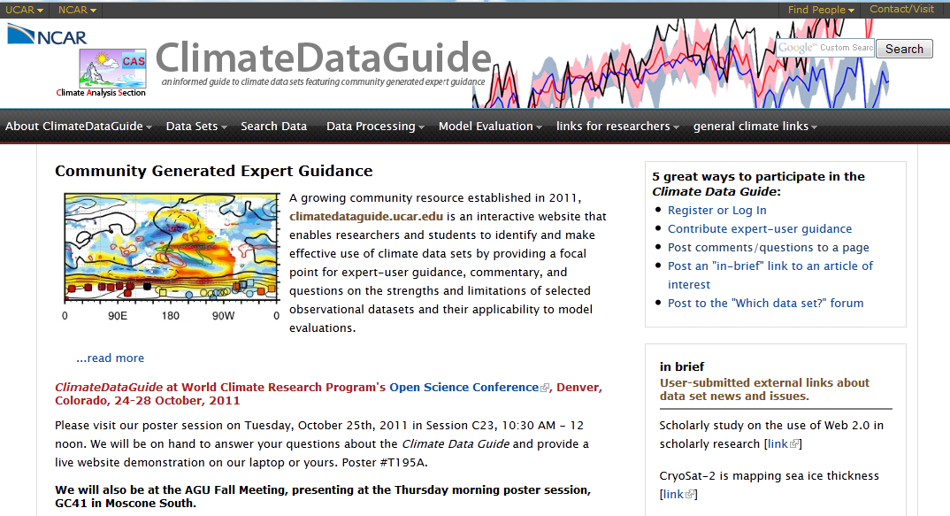
Informed Guide
http://climatedataguide.ucar.edu/
See our Poster T195A, session C23;
Schneider et al.
this morning

Slide 12
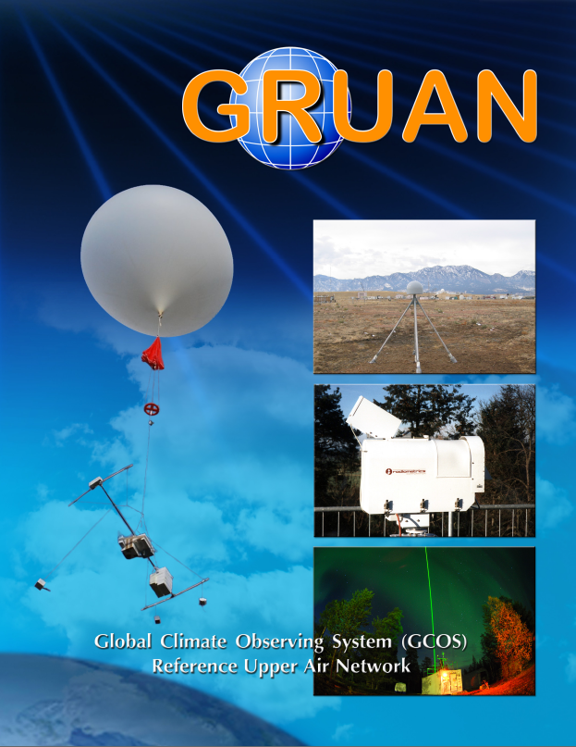

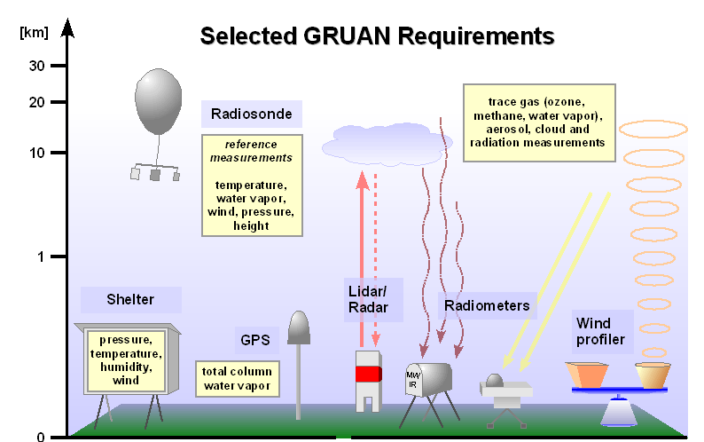
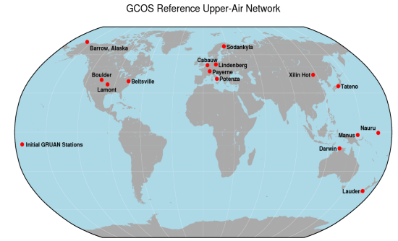

GCOS Reference
Upper Air Network
Priority 1: Water vapor, temperature, (pressure and wind)
Priority 2: Ozone, clouds, …
Provide long-term high-quality upper-air climate records
Constrain and calibrate data
Fully characterize the properties of the atmospheric column

Slide 13
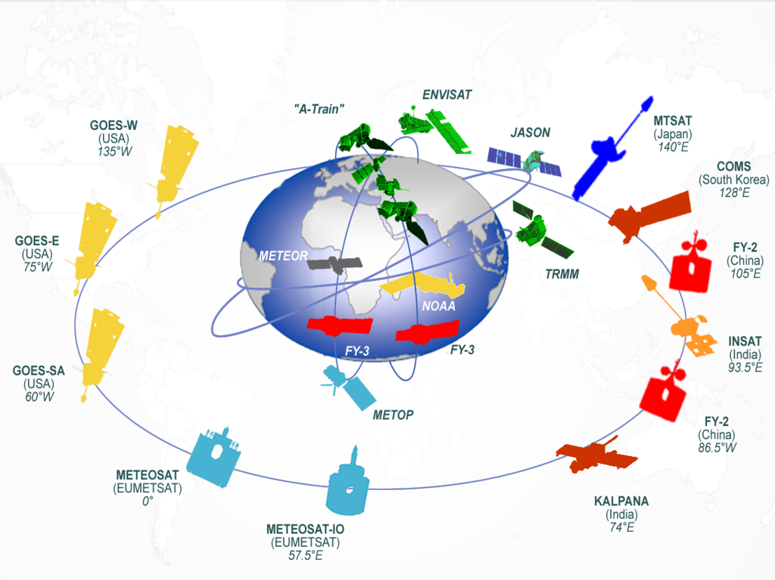
Space-based Global Observing System Schematic

Slide 14
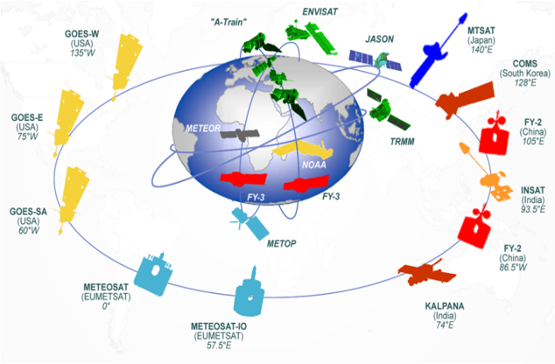








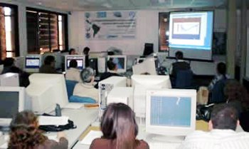
Information Value Chain
Satellites & sensors
Calibrated
data sets
Quality-controlled products
Dissemination & access
Awareness & training
Users
Internet
WMO IGDDS
Components
GSICS: Global Space-based Intercalibration System
IGDDS: WMO Integrated Global Data Dissemination Service
SCOPE-CM: Sustained Coordinated Processing of Environmental Satellite Data for Climate Monitoring
Vlab: Virtual Laboratory for Training in Satellite Meteorology

Slide 15
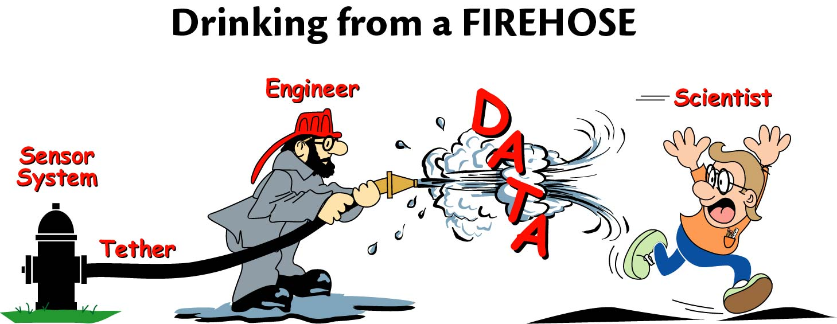
Given the observations:
Adequate analysis, processing, meta-data, archival, access, and management of the resulting data and the data products create further challenges in spite of the new computational tools.
Volumes of data continue to grow and the challenge is to distill information out of the increasing numbers.

Slide 16
Known issues
Nearly all satellite datasets contain large spurious variability associated with changing instruments/satellites, orbital decay and drift, calibration, and changing methods of analysis
Only 2 datasets (SSM/I water vapor; MSU T) were used in AR4 IPCC to examine trends
Once, the issue was getting a single time series. Now there is a proliferation and multiple datasets purporting to be the “one”. All differ, often substantially.

Slide 17
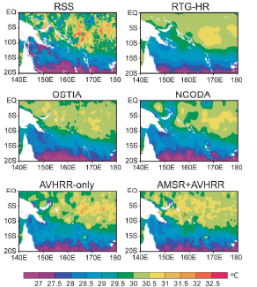
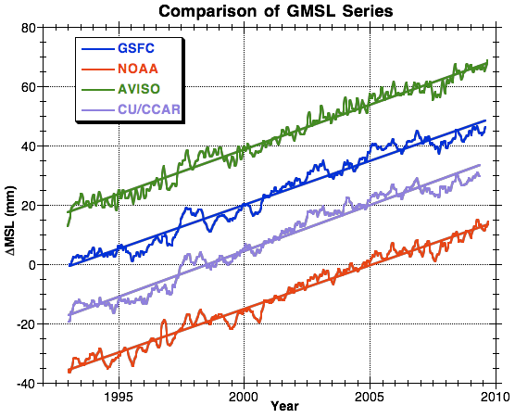
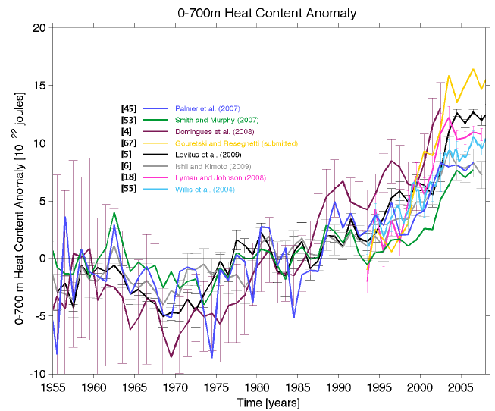
Large disparities among different analyses
Daily SST (1 Jan 2007)
Reynolds and Chelton 2010 JC
OHC
Palmer et al 2010
OceanObs’09
Sea Level
w. offsets

Slide 18
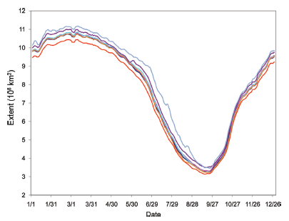
Total sea ice area: 2007
Arctic sea-ice extent for 2007 from seven algorithm products: Kattsov et al 2011 (Courtesy W. Meyer)
No single algorithm clearly superior.
Even bigger issues for ice thickness/
volume
The largest factor for ice concentration/extent consistency is intercalibration of the products through transitions through different generations of satellite-borne sensors.
Notes:
Passive microwave remote sensing instruments provide sea ice extent information day or night, clear or cloudy, and have a near-complete record since late-1978. However, there are many limitations of passive microwave imagery. First, the instantaneous field of view (sensor footprint) is large, ~25-50 km, limiting the precision of the ice edge location and concentration at the ice edge because of inherent subpixel ambiguity (Eppler et al., 1992; Hwang and Barber, 2006). In addition, passive microwave instruments are sensitive to the effects of snow cover, liquid water (Hwang et al., 2007a), brine volume change (Hwang et al., 2007b), melt ponds (Yackel and Barber, 2000), and ice temperature (Hwang et al., 2008). These effects can result in both overestimation and underestimation of sea ice amounts depending on seasonal and local conditions. Atmospheric emission can also affect the microwave signal (Oelke, 1997; Andersen et al., 2006). Finally, thin ice also tends to be underestimated by algorithms that convert brightness temperature estimates into ice concentration (Cavalieri, 1994; Hwang et al., 2007b; 2008). In general, biases in sea ice concentration are ~5% during winter (Steffen et al., 1992; Kwok, 2002), with higher errors in summer due to surface melt (Steffen et al., 1992). However, significantly higher errors have been found, depending on surface and atmospheric conditions (Comiso et al., 1997; Meier, 2005; Andersen et al., 2007). Different algorithms have different error magnitudes depending on conditions and no single algorithm has superior performance in all cases.

Slide 19
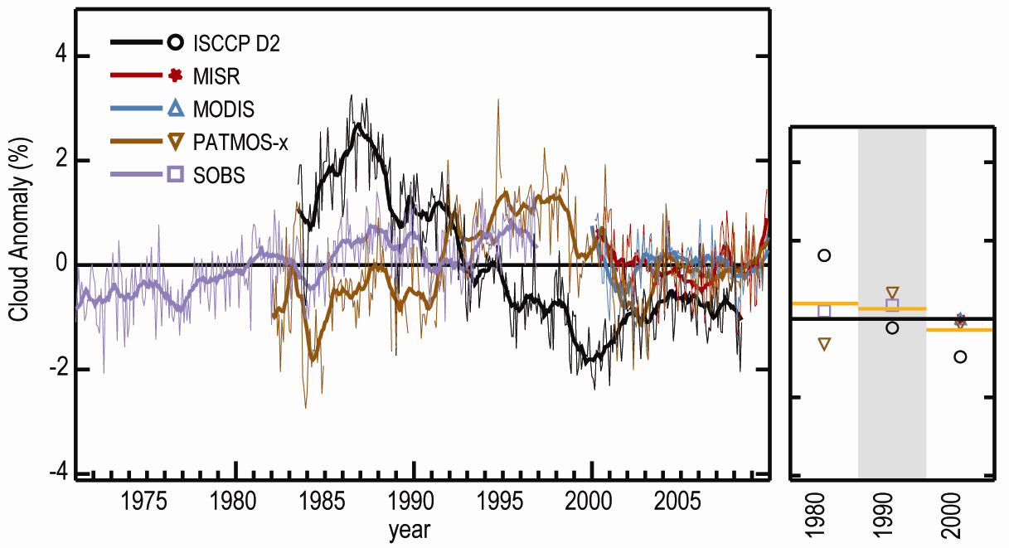
Cloud 1979 to 2009
A 1% increase in clouds is about -0.5 W m⁻²
State of Climate Report 2009: Foster et al.
SOB: sfc obs to 1996, MODIS, MISR, ISCCP, PATMOS-x
Issues: Sensor viewing angle, pixel footprint size, spectral channels,
diurnal satellite drift, and sensor calibration.

Slide 20
Clouds remain a major issue
Clouds are not well defined:
fn of sensitivity of instrument
compounded by aerosols
defn of clear sky includes aerosols??????
partitioning into clear sky and cloudy murky
The radiative properties of clouds matter most:
    Cloud amount
    Optical thickness, microphysical properties
    Cloud top temperature
    Cloud base temperature
    Water vapor: (invisible cloud) large radiative effects

Slide 21
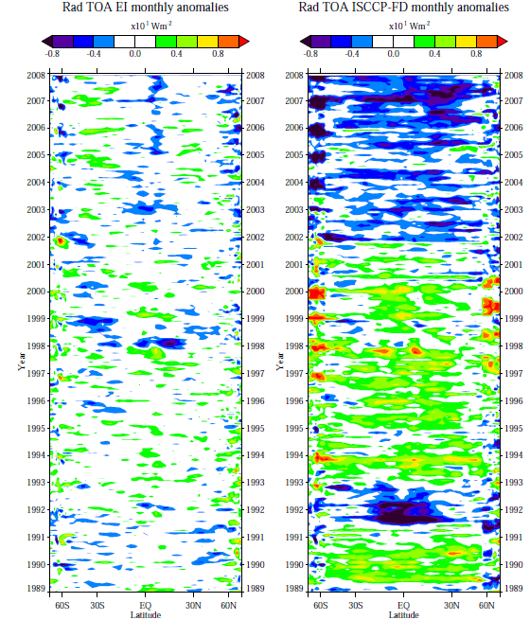
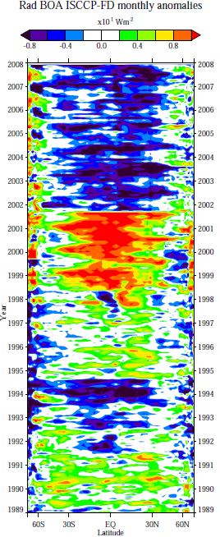
Radiation
TOA, Sfc
Major spurious changes in ISCCP-FD
NOAA 16
NOAA 15
NOAA 14
ATOVS↑
TOVS ↓
Pinatubo effects
Michael Mayer

Slide 22
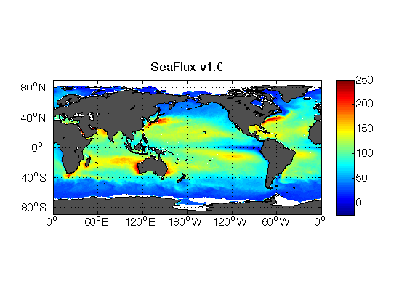
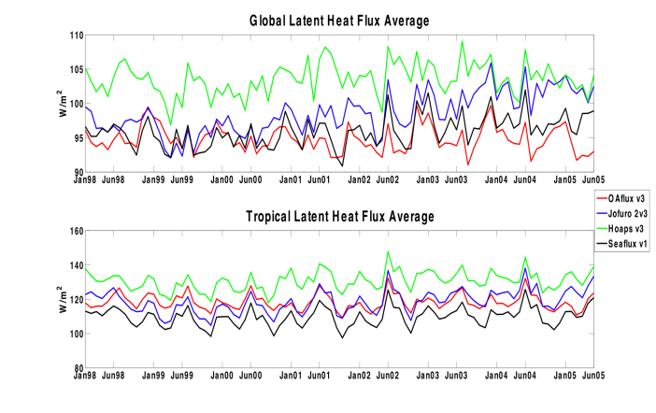
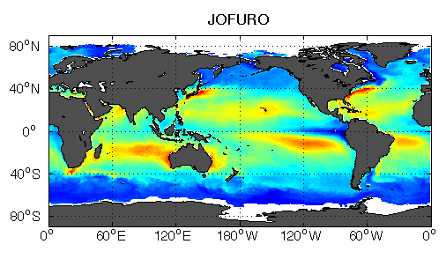
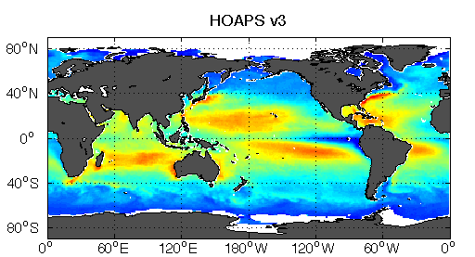
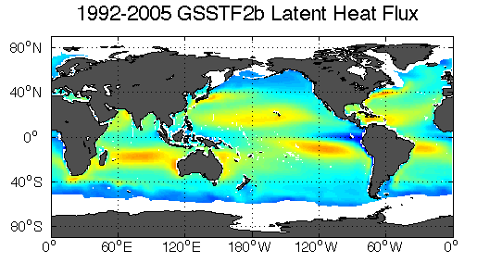
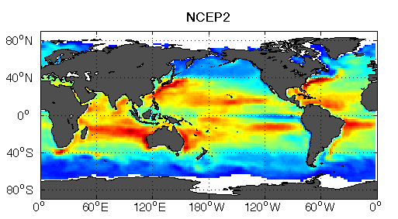
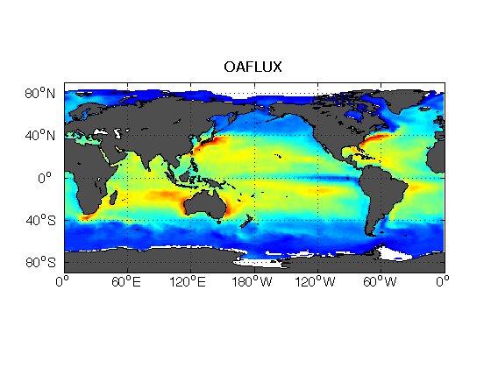
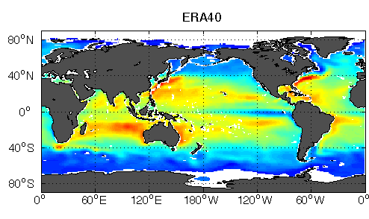
Latent Heat Flux: 1999-2005
W m⁻²
Courtesy:
Carol Ann Clayson

Slide 23
GEWEX Radiation Panel develops climate data records of water and energy variables, complete with metadata and error bars.
Clouds - ISCCP
Radiation - SRB
Surface ref. obs - BSRN
Aerosols - GACP
Precipitation - GPCP
Sfc gauge obs GPCC
Turbulent Fluxes
SeaFlux
LandFLux
- Soil Moisture
Water Vapor
Pentad
Global Datasets
Daily
TIME
1979
1985
1990
1995
2000
3 – 6 hrs
2005
2010
Parameter
Clouds
Water Vapor
50 km
Precipitation
250 km
100 km
TOA Radiation
100 km
SRF Radiation
100 km
Evaporation
50 km
Atmospheric Circulation
50 km
A GRP product is endorsed by GEWEX/GRP to conform to a high standard of production and documentation. It consists of a blend of available satellite and in-situ observations and is periodically compared and assessed against other products in an open and transparent fashion. It is openly available to everyone without restrictions.
GEWEX Data and Assessments Panel

Slide 24

GEWEX Reprocessing
The proliferation of datasets that are all different, with different strengths and weaknesses, demands assessment: Enormous need to evaluate and reprocess the data!
So the objectives are:
Reprocess all GRP products with common ancillary data and assumptions. Plan to reprocess approx. every 5 years.
Publish state of the “Observed” Water and Energy budgets
Expand accessibility to multi-variable products.
Facilitate research to interpret global and regional covariance among Water & Energy variables.
Assess all products of the same variable for strengths and weaknesses. Each agency wants to only reprocess their product.
Help move products to operations; share experience
(SCOPE-CM)

Slide 25
Atmospheric Reanalyses
Current atmospheric reanalyses, with the horizontal resolution (latitude; T159 is equivalent to about 0.8° ), the starting and ending dates, the approximate vintage of the model and analysis system, and current status.
Reanalysis | Horiz.Res | Dates | Vintage | Status
NCEP/NCAR R1 | T62 | 1948-present | 1995 | ongoing
NCEP-DOE R2 | T62 | 1979-present | 2001 | ongoing
CFSR (NCEP) | T382 | 1979-present | 2009 | thru 2010, ongoing
C20r (NOAA) | T62 | 1875-2008 | 2009 | Complete, in progress
ERA-40 | T159 | 1957-2002 | 2004 | done
ERA-Interim | T255 | 1989-present | 2009 | ongoing
JRA-25 | T106 | 1979-present | 2006 | ongoing
JRA-55 | T319 | 1958-2012 | 2009 | underway
MERRA (NASA) | 0.5° | 1979-present | 2009 | thru 2010, ongoing

Slide 26
Atmospheric Reanalyses
Reanalyze all observations with improved state-of-art system held constant.
Improves basic observations (QC)
Improves data processing, automation (monitoring system)
Improves understanding and models
Potential to improve further.
Very useful for examining anomalous atmospheric circulation
Getting better for decadal variations and trends, but further improvement needed:
Main spurious variations are from observing system changes
Many users, many citations
But many misuses!
Reanalysis in other domains: ocean, land, polar…

Slide 27
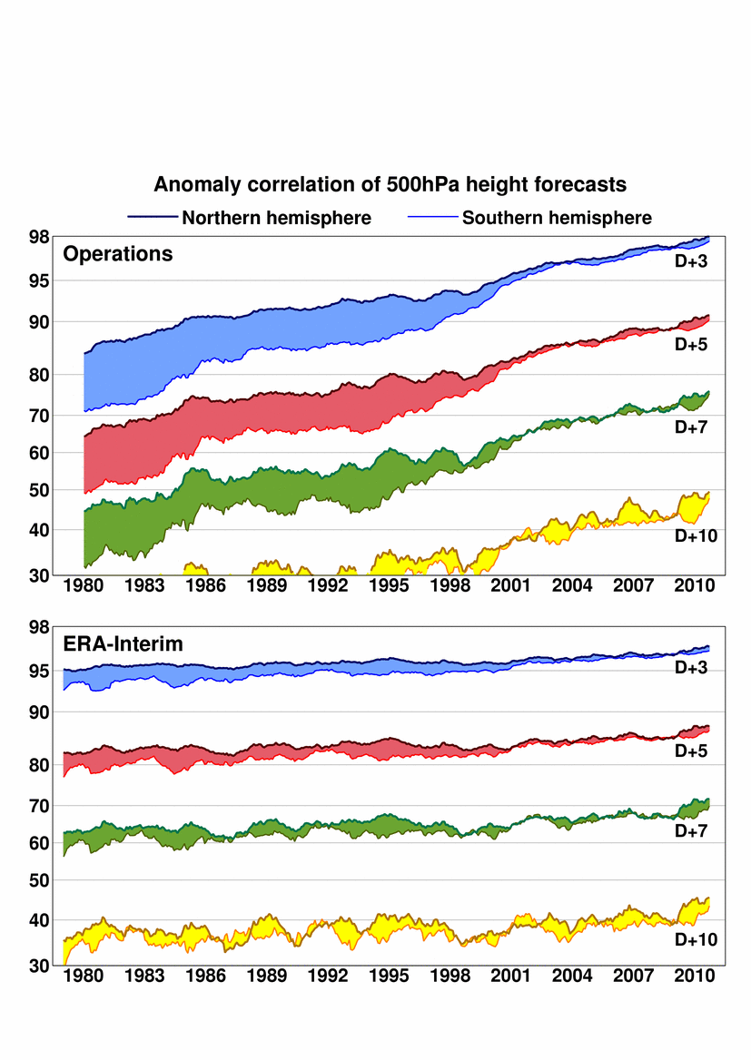
ECMWF
Improvement in forecasts:
From 1980 to 2000 comes
mostly from improvement
to forecasting system
Correlation (%) of actual and
predicted 500hPa height
anomalies
(12-month running means).
Reanalysis
Improvement since 2000 comes from both forecasting
system and observations
ERA-40 ERA-I
Courtesy Adrian Simmons

Slide 28
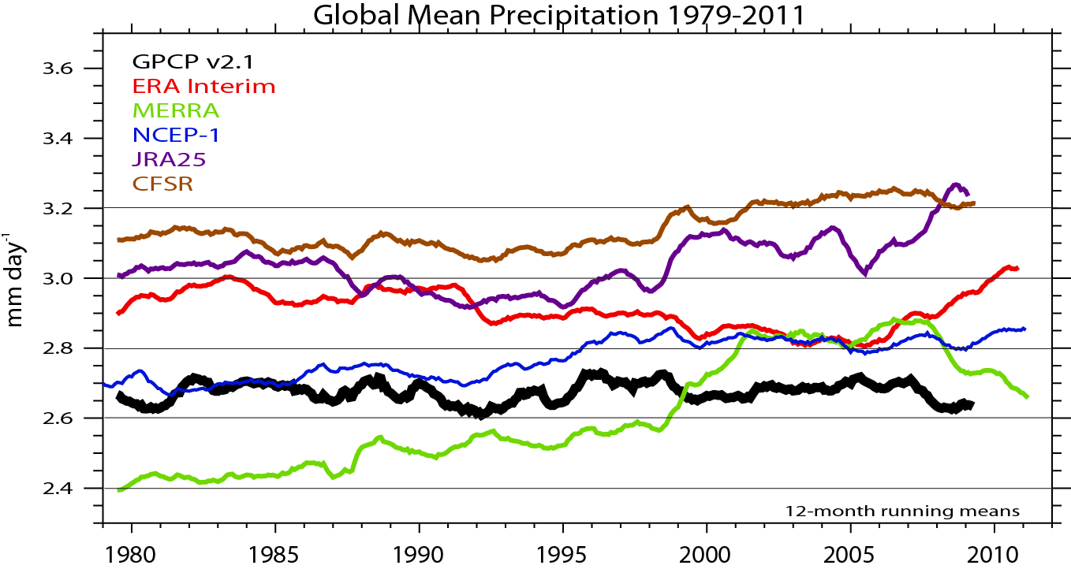
Global mean precipitation
12-mo running means
TOVS to ATOVs Nov 1998
Courtesy J Fasullo
Changes in SSM/I

Slide 29
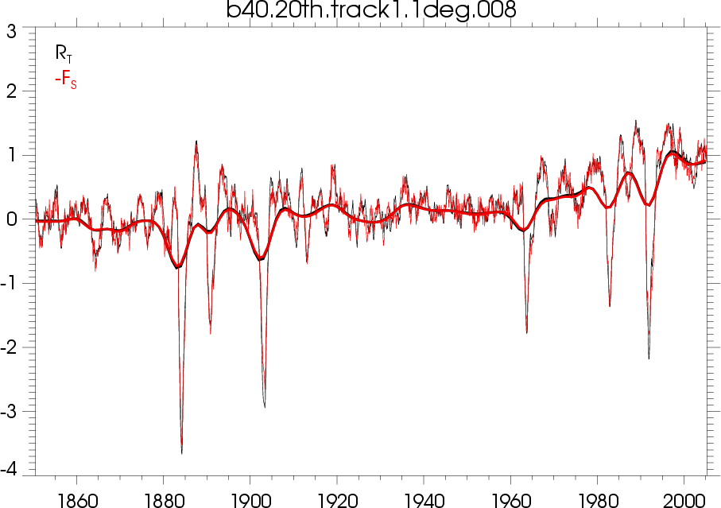
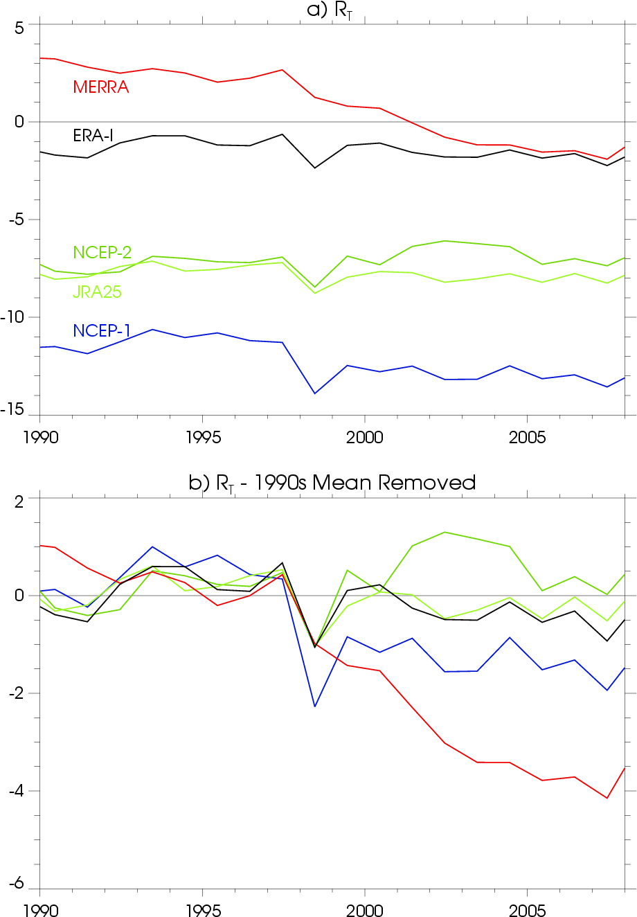
Reanalyses:
TOA 1990-2008
Net radiation
Trenberth et al 2009:
0.9 W m⁻² for 2000s
TOA Radiation
CCSM4
TOA radiation and surface flux over ocean;
Net 1990s 0.6 W m⁻² (Pinatubo knock down)
Net 2000s 0.9 W m⁻²
In a good model, the water and energy are conserved.
1990 1995 2000 2005

Slide 30
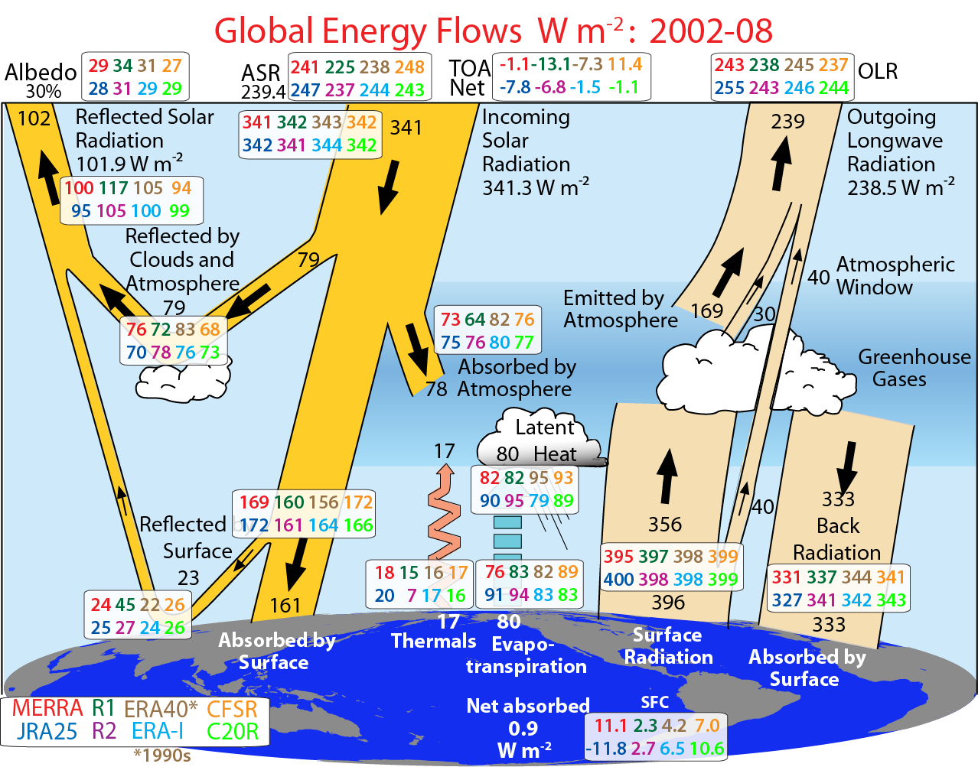
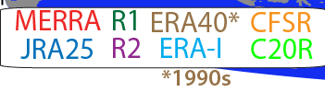
TOA Radiation
Trenberth et al 2011 J Climate

Slide 31

Major Concerns
Difficult to anticipate problems in satellite observing
  On-Orbit failures (ADEOS, Cryosat...)
  Inadequate funding and delays: NPP, JPSS
  Launch failures (OCO, Glory)

Slide 32
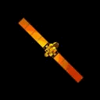
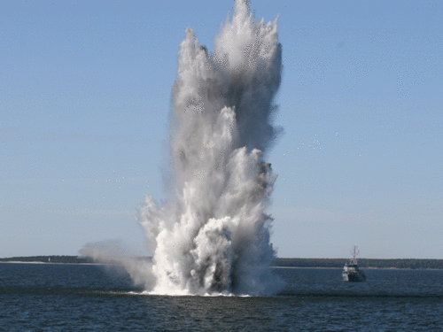
Orbiting (?)
Carbon Observatory

Slide 33
Major Concerns
Difficult to anticipate problems in satellite observing
  On-Orbit failures (ADEOS, Cryosat...)
  Inadequate funding and delays: NPP, JPSS
  Launch failures (OCO, Glory)
There is inadequate overlap and dual operation of observing systems
Need continued priority for key reference observing systems such as GRUAN and CLARREO
Major risk of gaps in the satellite records over the next 10-20 years
Observation continuity: key to climate record is in jeopardy;
  Planned redundancy is critical
  These have greatly increased the risk of us going blindly into the future wrt many aspects of climate

Slide 34
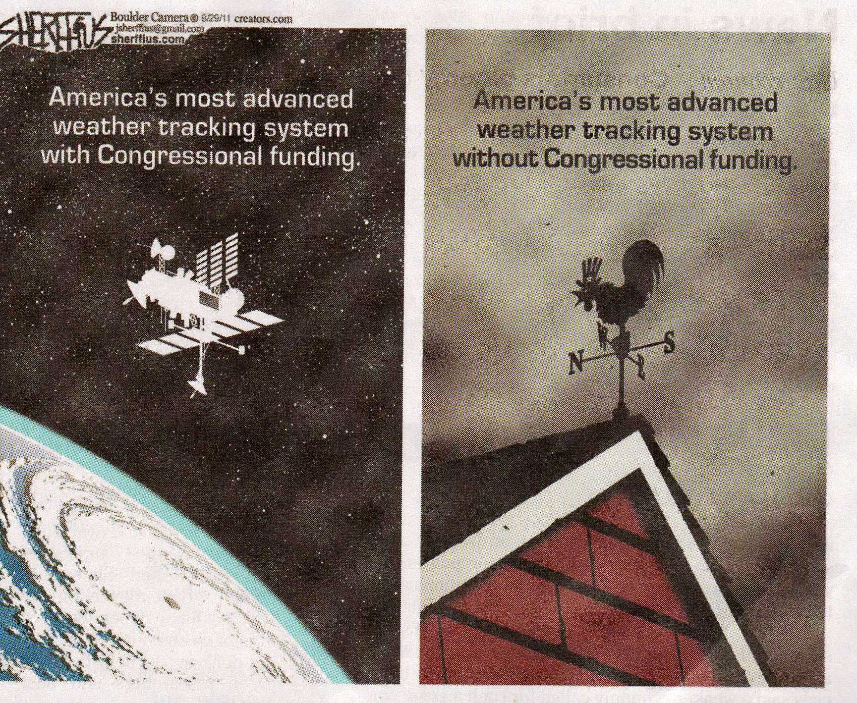

Slide 35
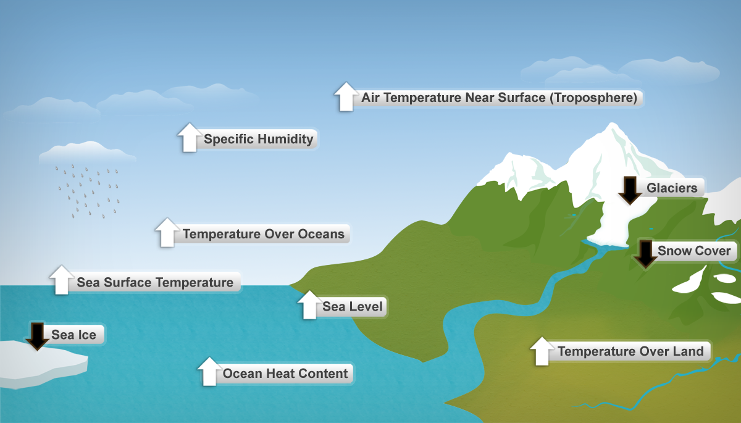
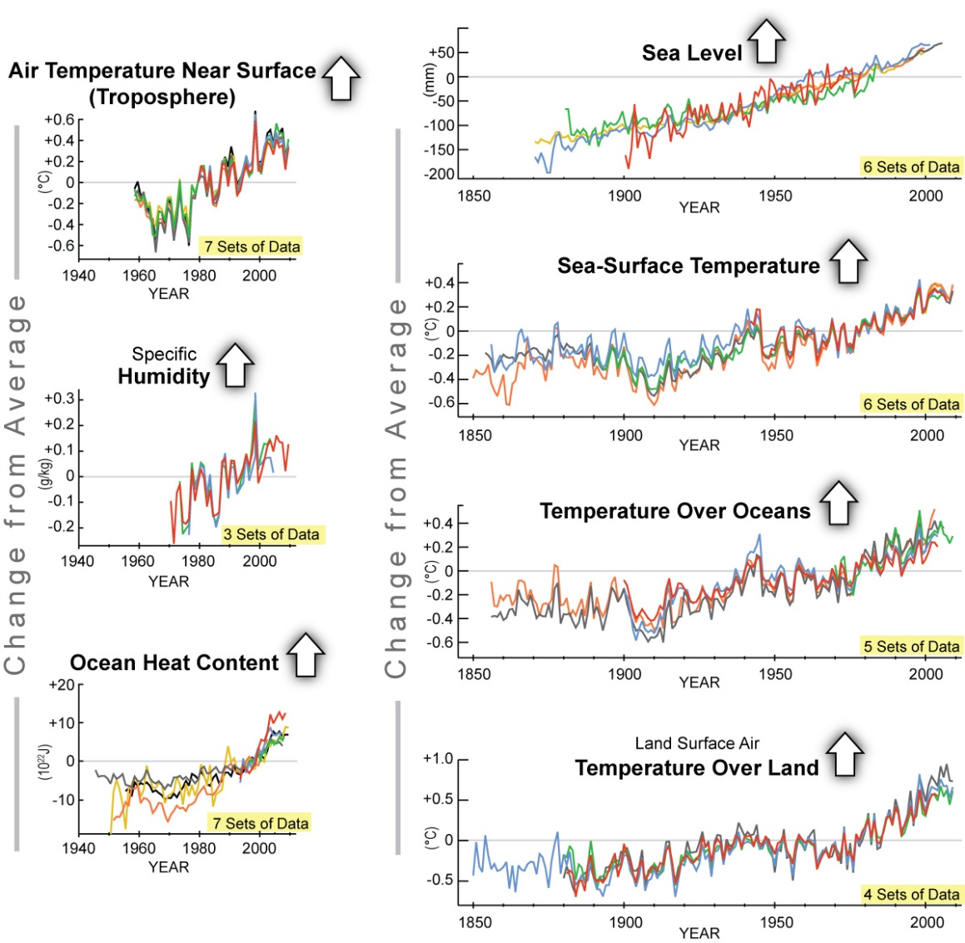
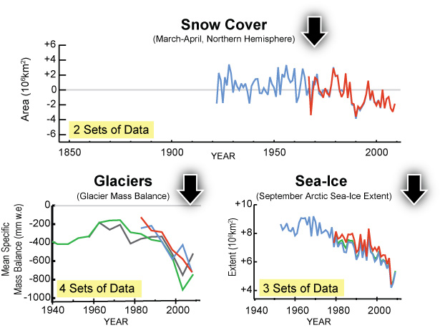
There is a LOT of potential:
10 Essential Climate Variable Indicators
2009 State of the Climate report

Slide 36
Where is this from?
Opportunity Lost?
Earth System Science Committee, 1985
Long-term needs
“To advance our understanding of the causes and effects of global change, we need new observations of the Earth. These measurements must be global and synoptic, they must be long-term, and different processes must be measured simultaneously.
* Long-term continuity is crucial. A 20-year time series of the crucial variables would provide a significant improvement in our understanding.
* Now we are on the verge of establishing a global system of remote sensing instruments and Earth-based calibration and validation programs. Together, these space- and Earth-based measurements can provide the necessary data”

Slide 37
Future challenges
The Earth is observed more completely today than at any other time but many of the observations are not "climate quality" and useful for monitoring long-term climate.
Because the climate is changing from human influences, there is an imperative to document what is happening, understand those changes and their causes, sort out the human contribution (because it has implications for the future), and make projections and predictions on various time horizons into the future.
"You can't manage what you can't measure" applies to Earth's climate system and affects adaptation to climate change and application of climate services.
The needs are compelling and enormous, but also feasible with international cooperation.

Slide 38
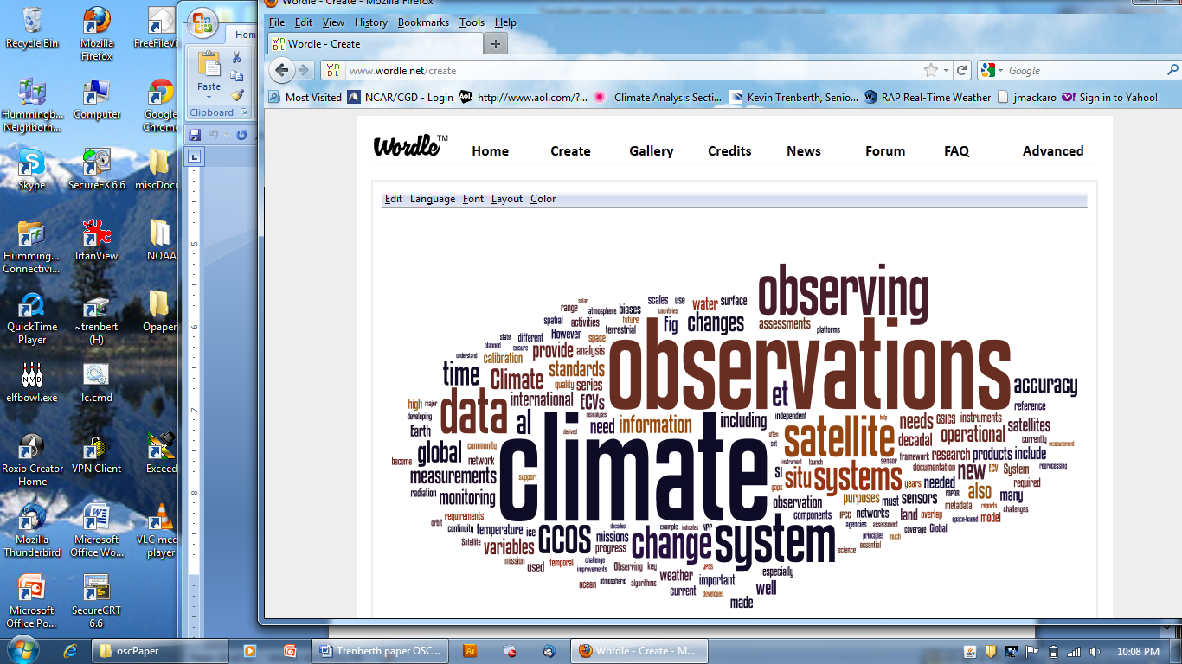
Summary

