Slide 1
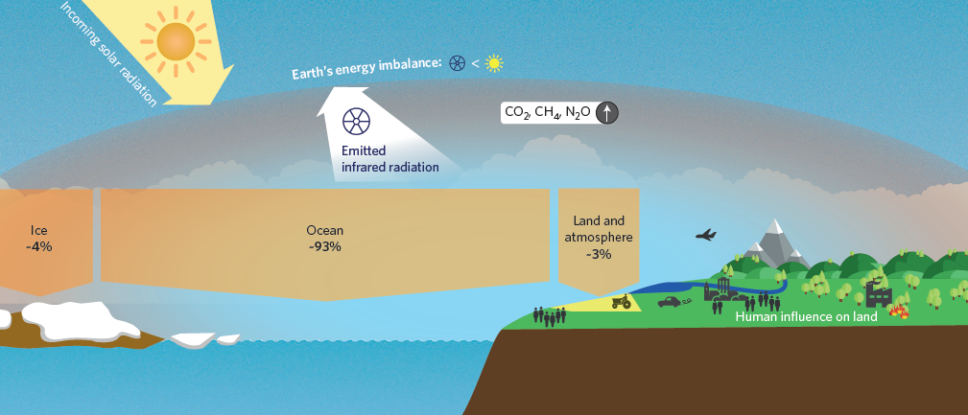
Insights into Earth’s energy imbalance from multiple sources
Kevin E Trenberth
NCAR
With help from
John Fasullo, Karina von Schuckmann and Lijing Cheng

Slide 2
Energy on Earth
The climate is changing from increased GHGs.
We expect an energy imbalance from heat-trapping GHG.
The planet warms until OLR increases to match the ASR.
But there are many feedbacks and complexities.
The most fundamental measure that the climate is changing is the energy imbalance.

Slide 3


http://www.clivar.org/research-foci/heat-budget
CLIVAR research focus
Consistency between planetary energy balance and ocean heat storage (CONCEPT-HEAT)
Co-chairs:
K. von Schuckmann, K. Trenberth
Scientific steering team members:
C.-A. Clayson; C. Domingues; S. Gulev; K. Haines; N. Loeb; M. Palmer; P.-P. Mathieu; R. Weller; M. Wild; Y. Xue
1st CONCEPT-HEAT workshop at Met Office, Exeter, UK: 29.09.-01.10.2015

Slide 4

Earth’s Energy Imbalance. Currently +0.5 to 1 Wm⁻²
The absolute measure of the Earth Energy Imbalance and its changes over time define the status of global climate change and expectations for continued global warming.
ISSI working group: “Consistency of Integrated Observing Systems monitoring the energy flows in the Earth System”
An imperative to monitor Earth’s energy imbalance
K. von Schuckmann, M. Palmer,
K. Trenberth, A. Cazenave,
D. Chambers, J. Hansen, S. Josey, Y. Kosaka, N. Loeb, P.P. Mathieu,
B. Meyssignac, M. Wild
Perspective paper NCC Jan 27, 2016
(von Schuckmann et al., 2016)
First meeting June 2014, Bern, Switzerland

Slide 5
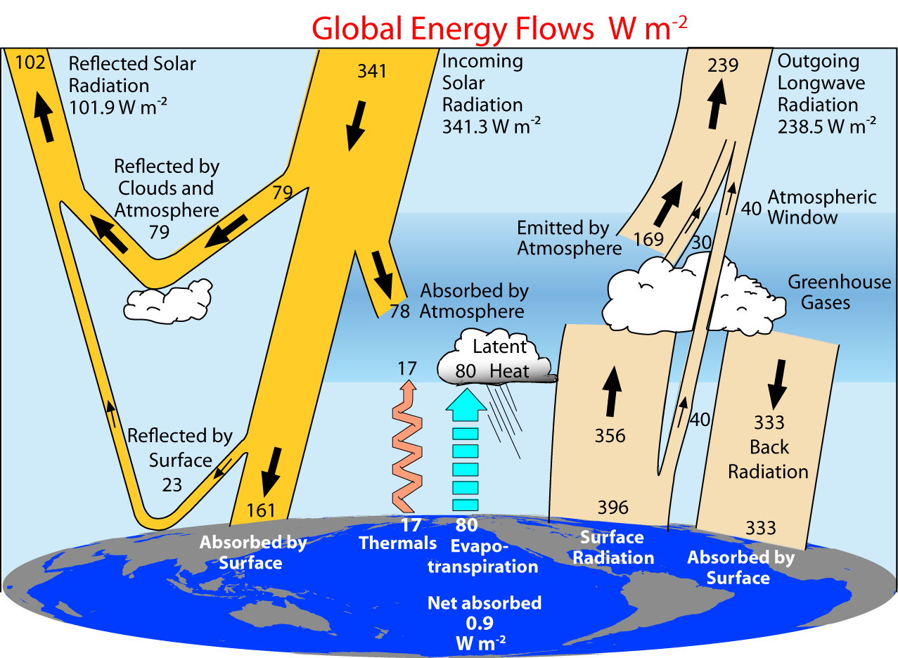
Trenberth et al (2009)

Slide 6
How do we measure it?
Earth’s Energy Imbalance
Direct measurements from space of ASR, OLR, Net
Take inventory of where all the energy has gone
Use climate models with specified forcings
Use atmospheric reanalyses
Use surface fluxes (assume no atmospheric heat capacity)
Not accurate enough; good for relative changes after 2000
Only viable option: requires derivative. Not consistent over time.
Depends on how good the model and the forcings are.
Do not conserve energy, do not have accurate forcings.
Large systematic errors.

Slide 7
Where does the heat go?
Global warming means more heat:
>92%
Warms land and atmosphere
Heat storage in the ocean (raises sea level)
Melts land ice (raises sea level)
Melts sea ice and warms melted water
Evaporates moisture ⇒ rain storms, cloud ⇒ possibly reflection to space

Slide 8
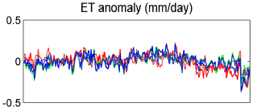
Constraining OHC
What is the non-ocean component?
Can be estimated in principle.
But how large can it be? Can we constrain the OHC?
Estimated to be about 0.07 W m⁻²
(Trenberth 2009, Hansen et al 2011)
Eric Wood et al. have relevant time series
Vinukollu et al 2011: ET

Slide 9
CESM results
Uses the Large Ensemble of 30 members of CESM1 (CAM5.2 1.25° resolution)
“Observed historical” forcing until 2005, then RCP8.5
We use 1990 to 2010 to examine the energy balance over land.

Slide 10
CESM mean surface fluxes
1990-2010
Net energy imbalance EEI = R_{T} (net radiation TOA)
This is close to the net global surface flux F_{s}
i.e. the atmospheric component is tiny.
Global 0.9 W m⁻²
Land 0.1 W m⁻²
Ocean 0.8 W m⁻²
Land includes inland seas and lakes
R_{T} = F_{s} (land) +F_{s} (ocean) (Positive down)

Slide 11
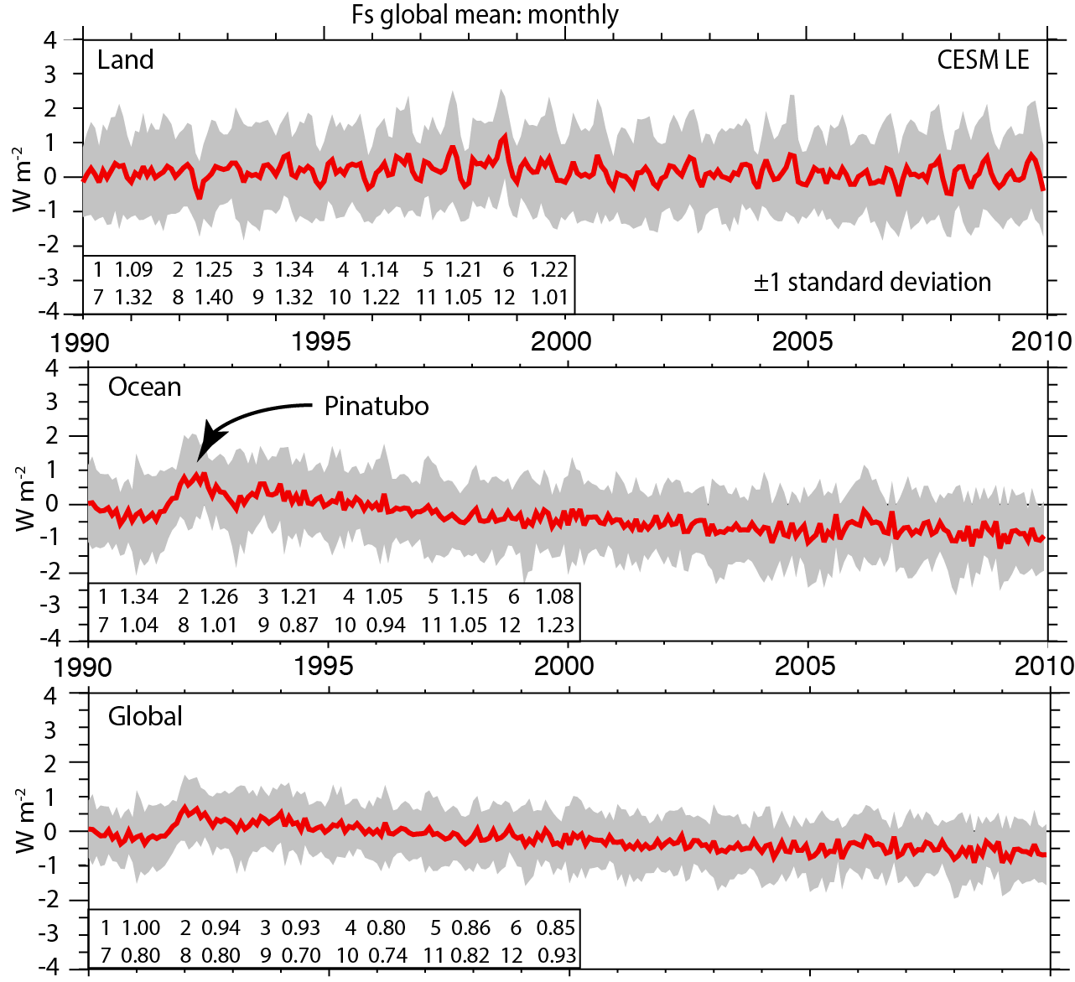
Weight
0.28
0.72
Max in August 0.4 W m⁻² globally (accounting for area of land)

Slide 12
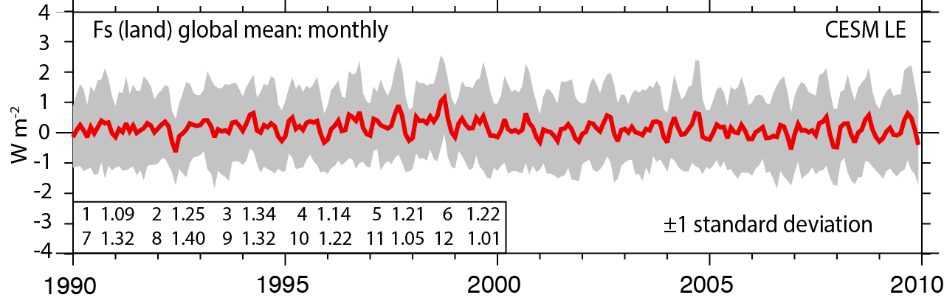
Non-ocean component of EEI in CESM large ensemble
Fs land; mean removed
Annual cycle has max in NH summer (E)
Max in August 0.4 W m⁻² globally (accounting for area of land)
F_{s} ocean and global R_{T} are aligned within 0.76 W m⁻² 95% of the time.

Slide 13
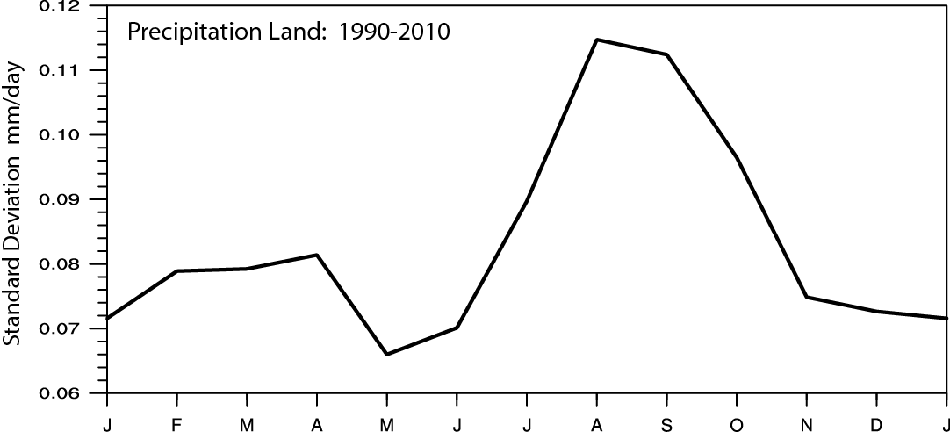
Precipitation over land
CESM ensemble standard deviation of global land precipitation. Overall 0.0835 mm/day = 0.68 W m⁻²
Highest: August 0.9 W m⁻² ; roughly double Fs
i.e. E cancels, so P-E variance much less.

Slide 14
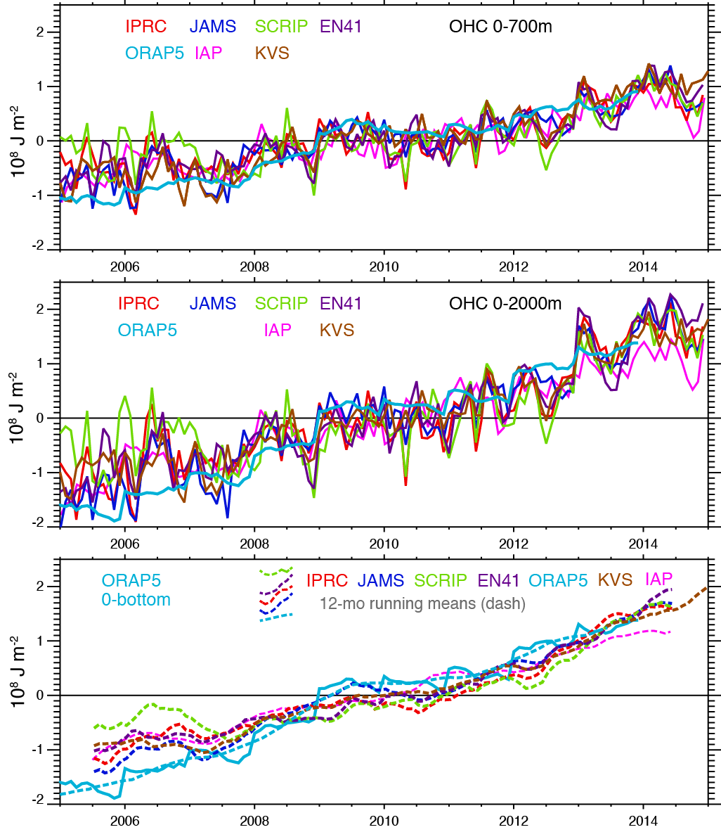
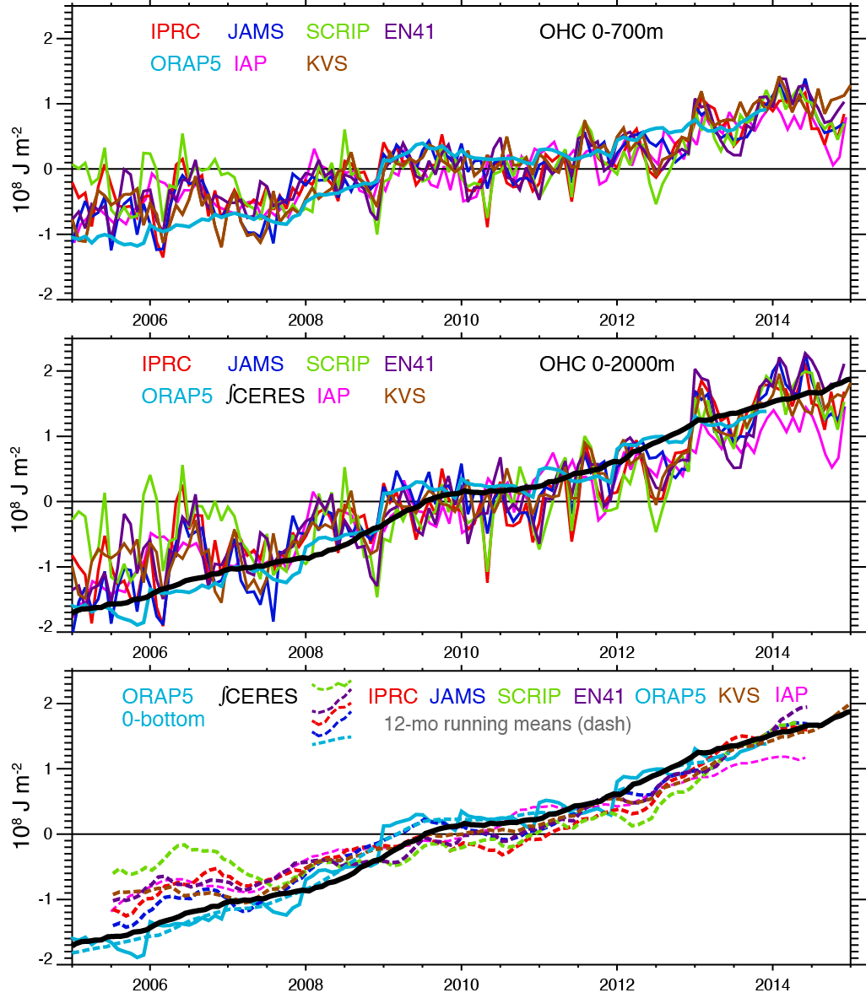
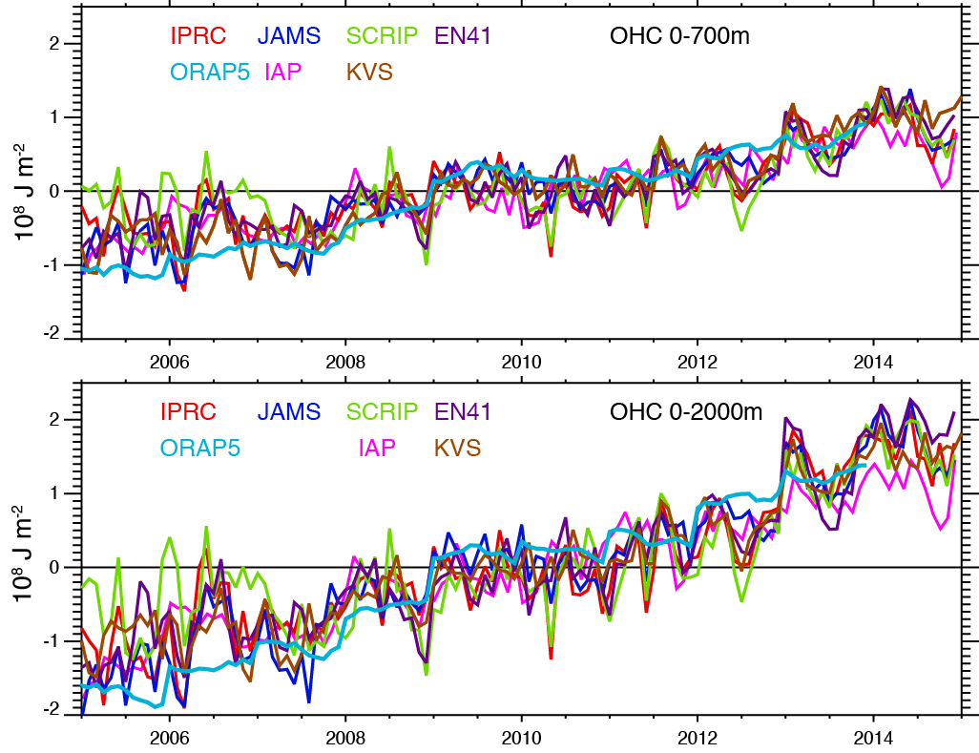
OHC
2005-14
56% of trend
0-700m
-1.8 to +1.8 is
0.8 W m⁻²
globally

Slide 15
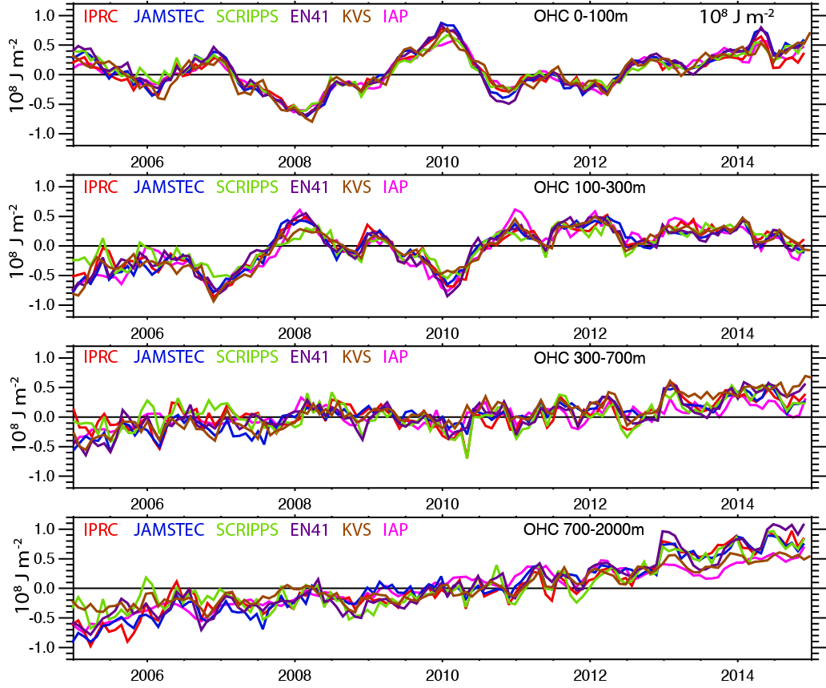
OHC
2005-14
By layer
56% of trend
0-700m

Slide 16
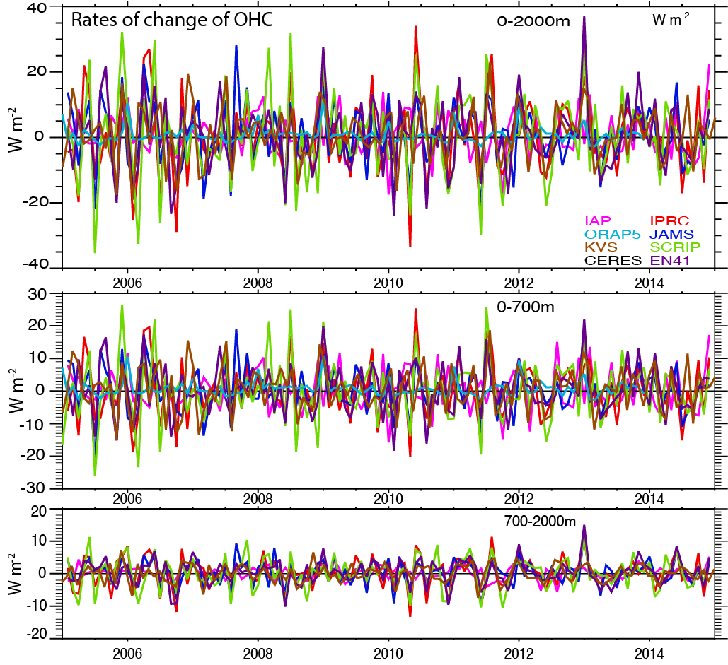
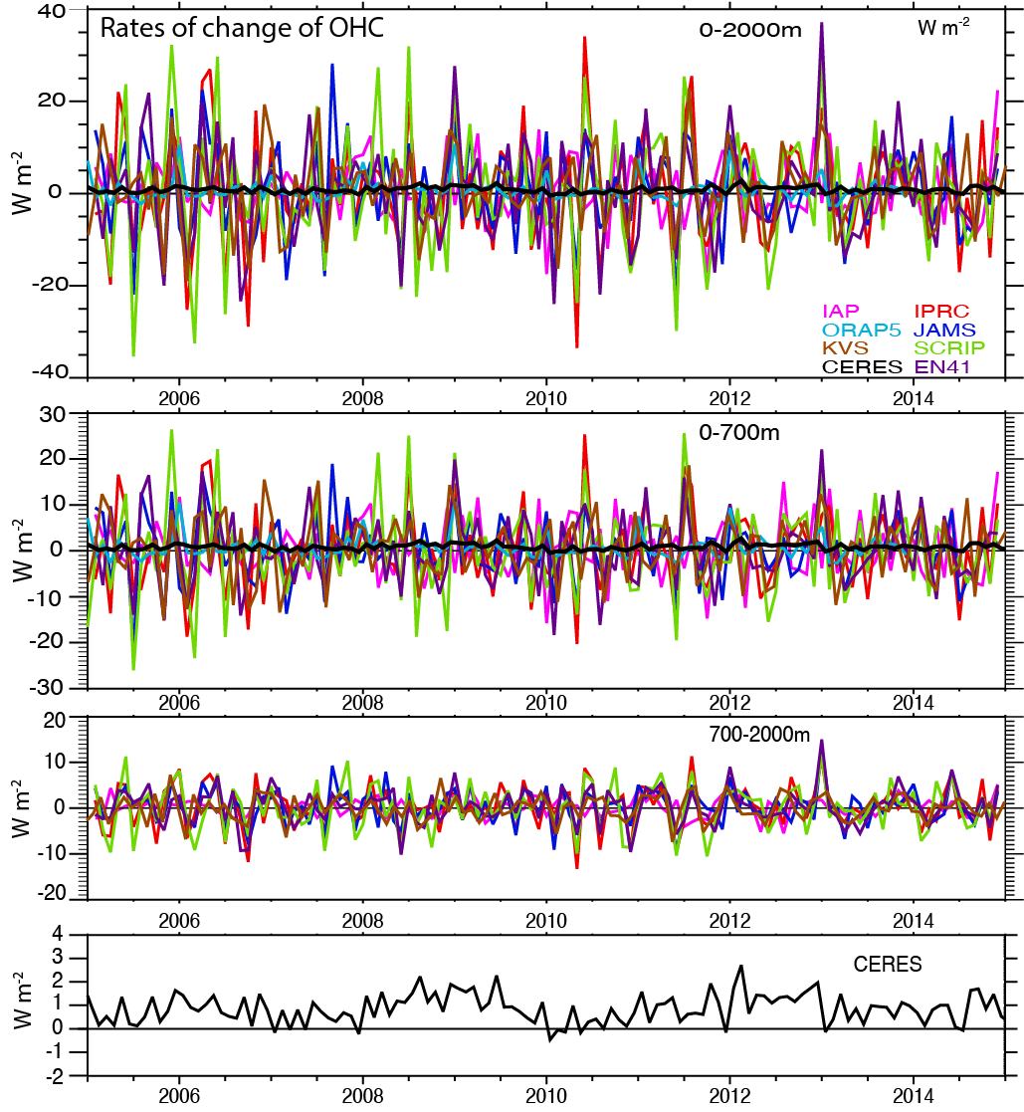
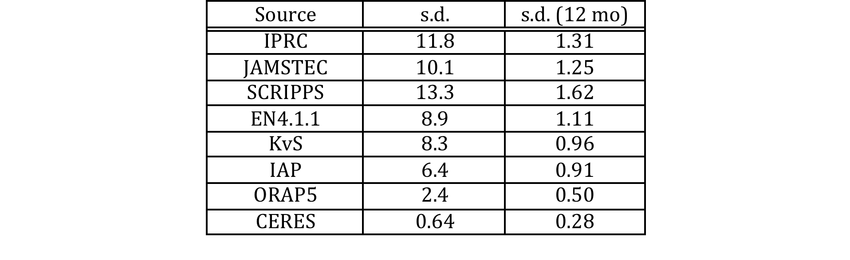
Rates of change of OHC

Slide 17
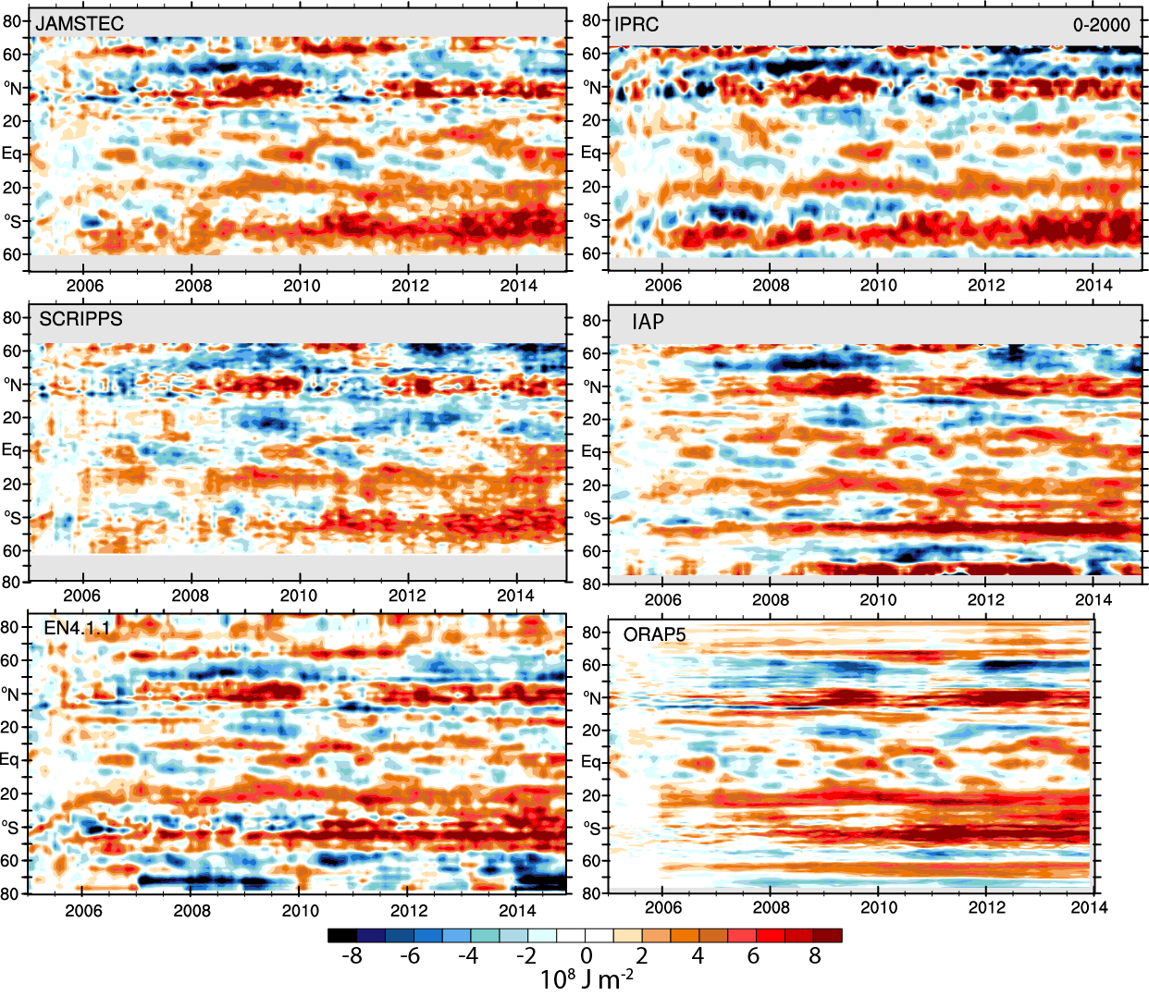
OHC relative to 2005 mean

Slide 18
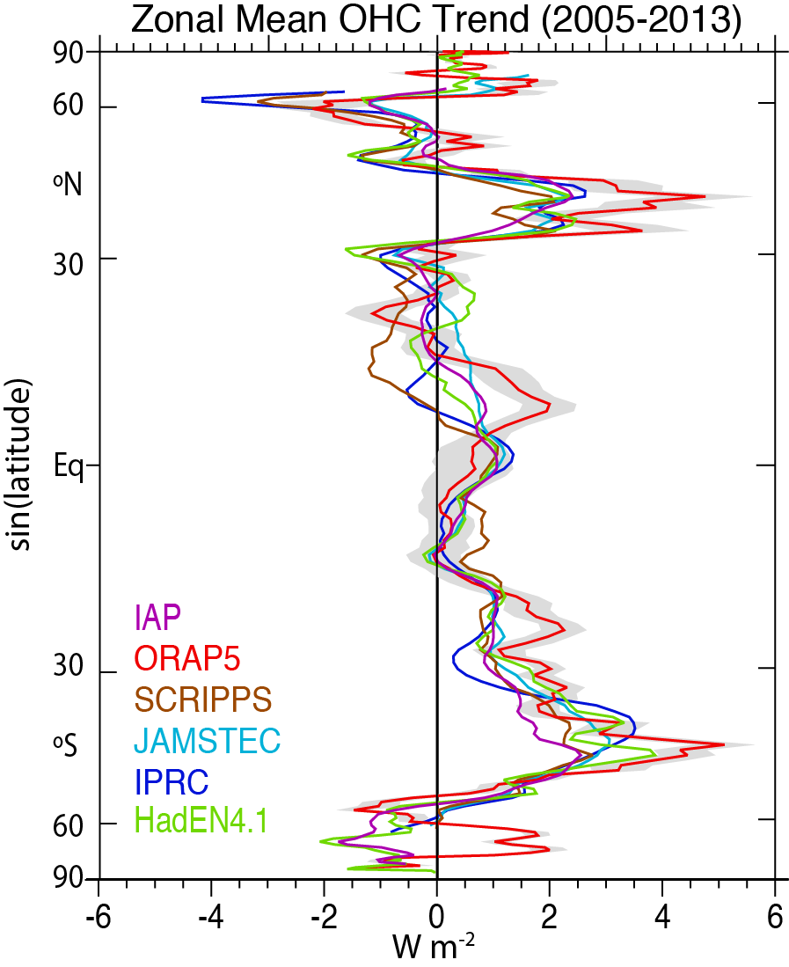

OHC zonal mean trends:
2005-13

Slide 19
Can we do this locally?

Slide 20
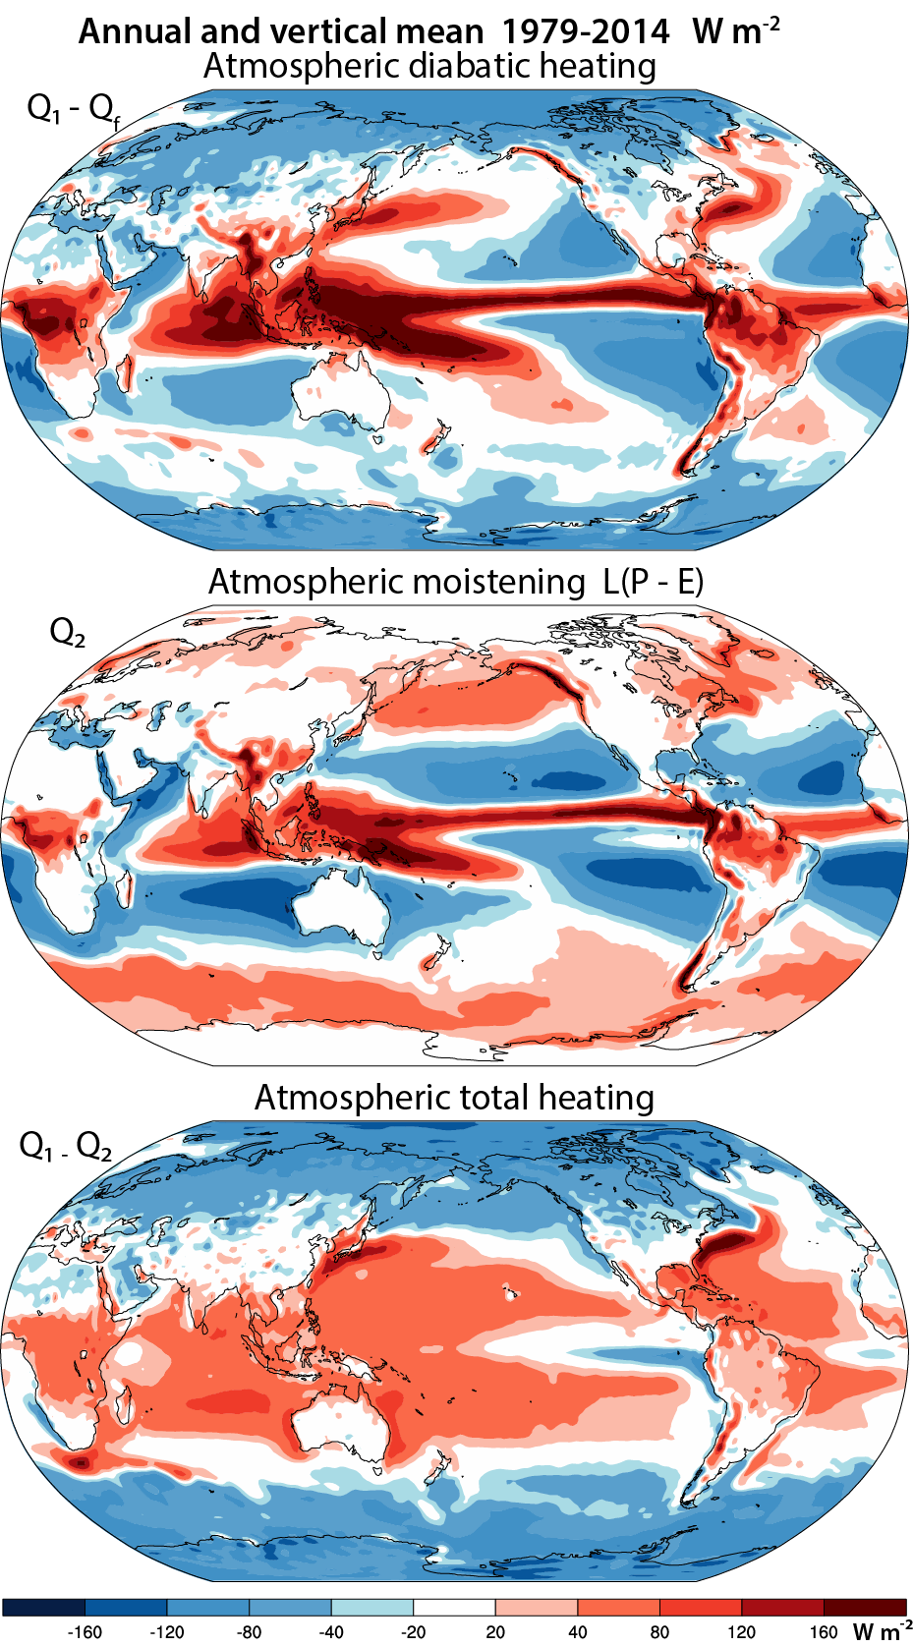
Diabatic heating
atmosphere
Q₁
Column
latent heating
Q₂
Total heating
Q₁-Q₂
Dominated by latent heating:
Precipitation
L(P-E)
Using ERA0-I reanalyses and the atmospheric vertically-integrated energy and moisture balances
to compute diabatic heating as a residual..
Includes moistening:
LE
Updated from
Trenberth & Stepaniak, 2003

Slide 21
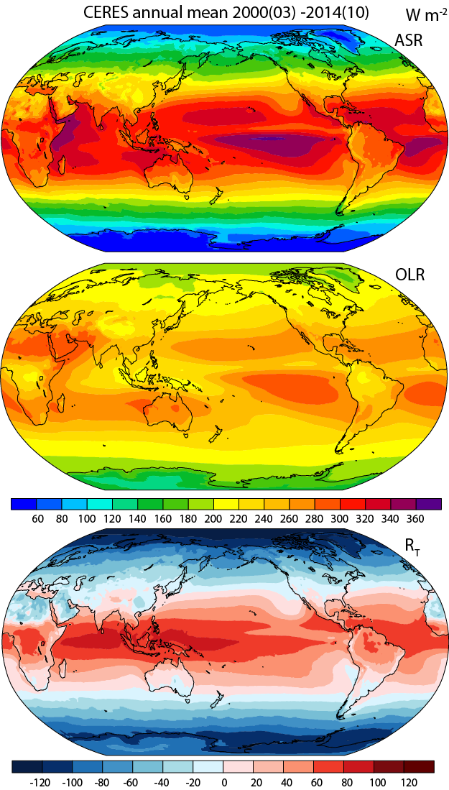
Net
Radiation
TOA
R_{T}
Difference due to ocean transports
(net surface flux)
Total
heating
Q₁-Q₂
= R_{T}+F_{s}
Updated from
Trenberth & Stepaniak, 2003

Slide 22
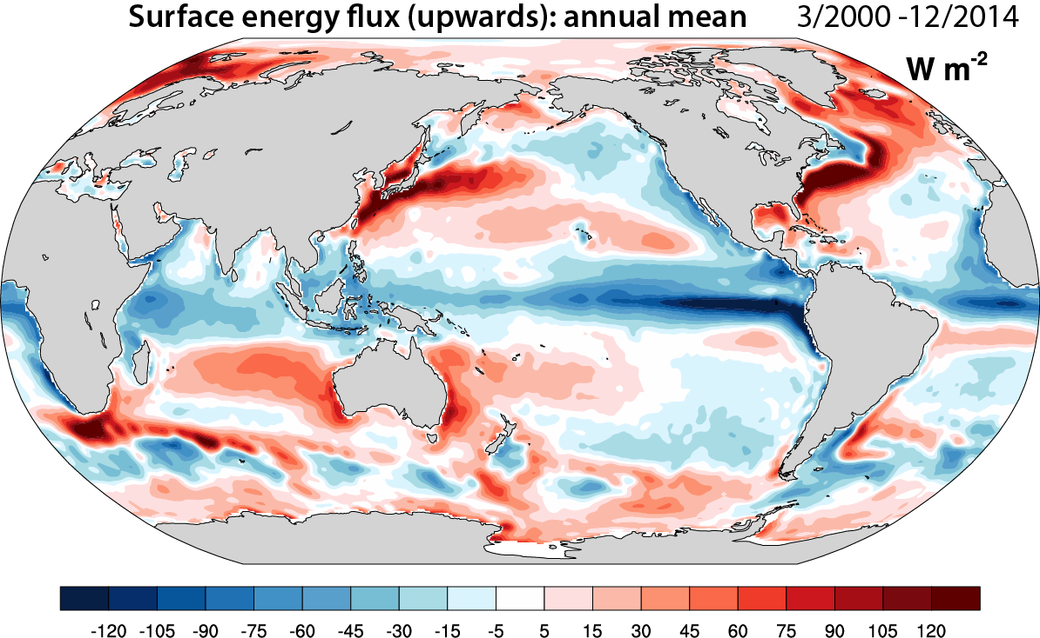
Annual mean surface flux
Updated from Trenberth and Fasullo (2008)

Slide 23
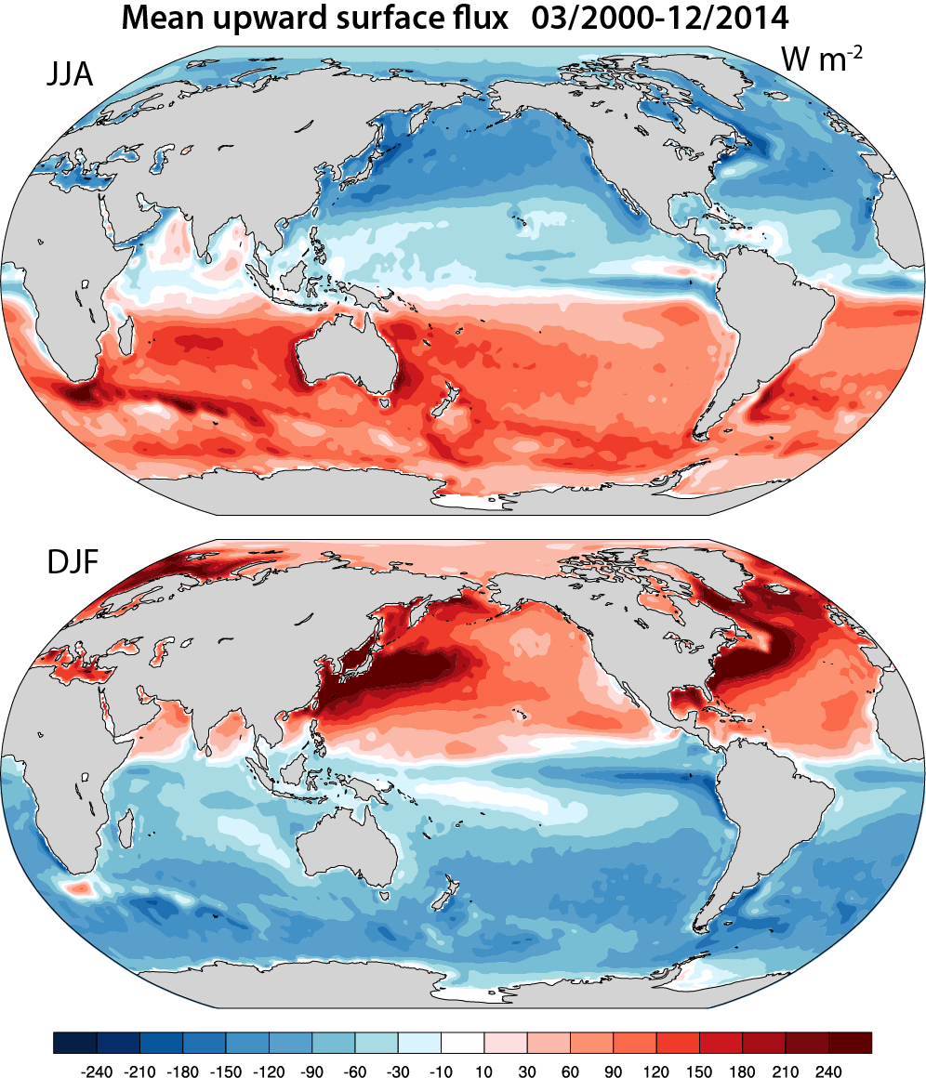
Seasonal mean surface flux
Upwards
JJA
DJF
Updated from Trenberth and Fasullo (2008)

Slide 24
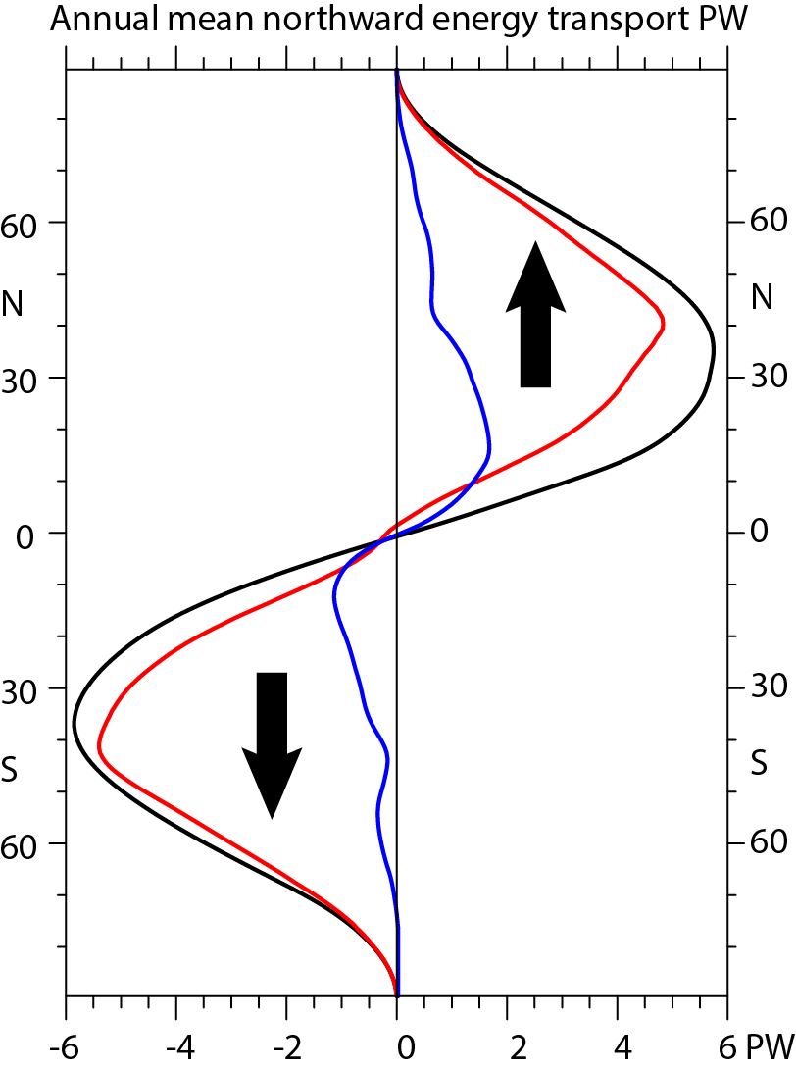
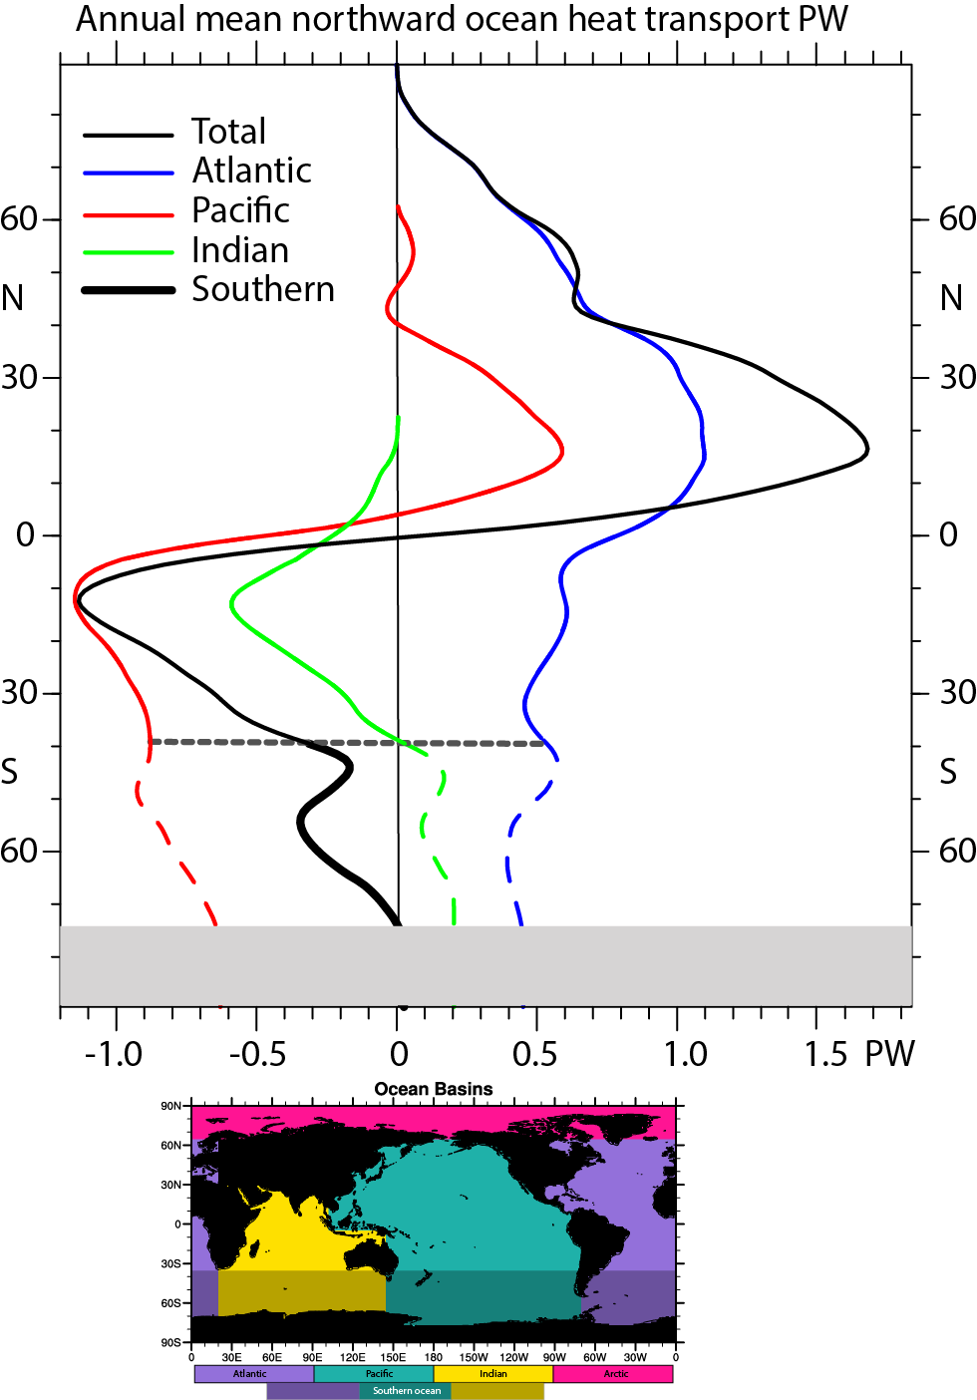
Energy transports
Total
Atmosphere
Ocean

Slide 25
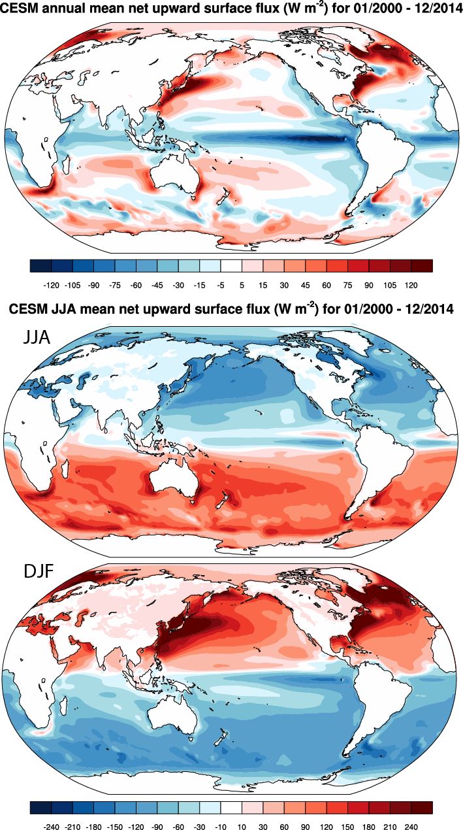
CESM model result

Slide 26
Synthesis: many communities
Observation products
TOA radiation
Atmospheric energy: total column
Surface Fluxes
OHC
Ocean heat transports
Sea ice
Sea level
Land heat/water
Models
Reanalysis: atmosphere, ocean
Climate modeling
Better:
Ocean states
OHC anals
EEI
Sfc fluxes
Coupling
Models
Decadal prediction

Slide 27
Workshop summary
Draft report available
Earth’s Energy Imbalance (EEI):
most fundamental measure for climate change
FINDINGS
Estimate EEI locally and as a function of time
The estimation of Ocean Heat Content (OHC) plays a key role for climate science
Studies of energy flows in climate modes
RECOMMENDATIONS
Concept of CAGEs:
Radiation flux and atmos. energy transport divergence;
ocean transport divergence & changes in OHC;
directly computing air-sea fluxes.
Improved ocean observation system
Improve OHC estimate capability
Vertical disposition of heat in the oceans
Spatial redistribution of heat in the oceans
Atmospheric teleconnections
Write letters concerning recommendations from the CONCEPT-HEAT community
Foster CONCEPT-HEAT (web pages, conference sessions, summer schools, and a brochure)

Slide 28
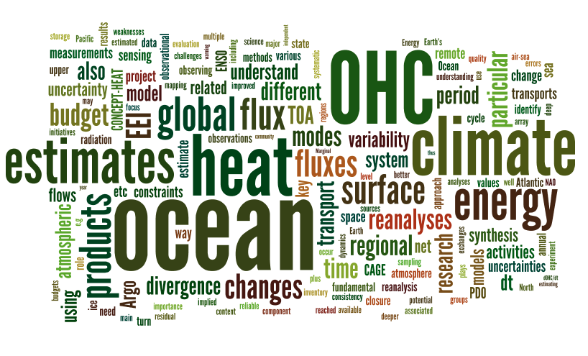

Slide 29
A new Institute?
Vision:
Accelerated scientific advances in the estimation of
Earth’s Energy Imbalance and global ocean heat content,
and their consequences for understanding, monitoring and predicting multi-year climate fluctuations within the coupled Earth System.
Goal:
To synthesize all observations to provide superior estimates of
ocean heat content and Earth’s Energy Imbalance using climate
and ocean models, confront the models with the observations and improve the ocean models for use in climate predictions on multiple time scales.
Contribute substantially to increase social, economic and ecosystem resiliency from prediction of multi-year climate fluctuations.

Slide 30
A new Institute?
Objectives:
Build a better more complete system of synthesizing observations related to energy flows through the climate system,
to produce global analyses of multiple fields that could be used for many purposes.
Provide guidance on the design of the near and long-term climate observing networks.
Build a better model that captures the energy flows with fidelity.
Improve climate predictions on multiple time scales, from seasons to decades, by capitalizing on the anomalous distribution of energy.

