Slide 1
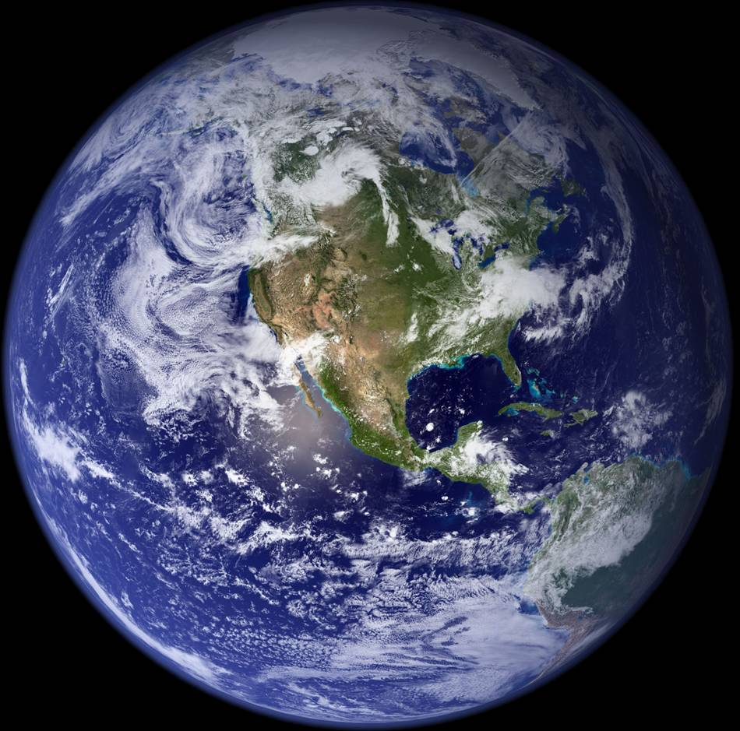
Building a Climate Information System
Kevin E Trenberth
NCAR

Slide 2
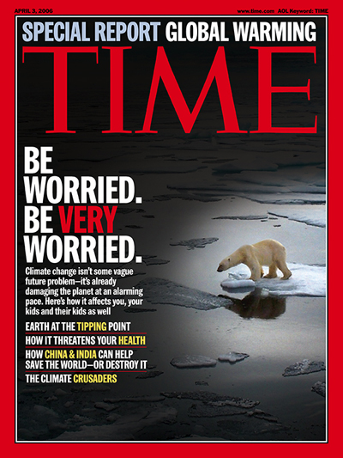
Global warming is “unequivocal”: Adaptation to climate change
Assess vulnerability
Determine impacts of possible changes
Devise coping strategies
Plan for future changes
Requires information

Slide 3
Imperative: A climate information system
Observations: forcings, atmosphere, ocean, land
Analysis: comprehensive, integrated, products
Assimilation: model based, initialization
Attribution: understanding, causes
Assessment: global, regions, impacts, planning
Predictions: multiple time scales
Decision Making: impacts, adaptation
An Integrated Earth System Information System

Slide 4
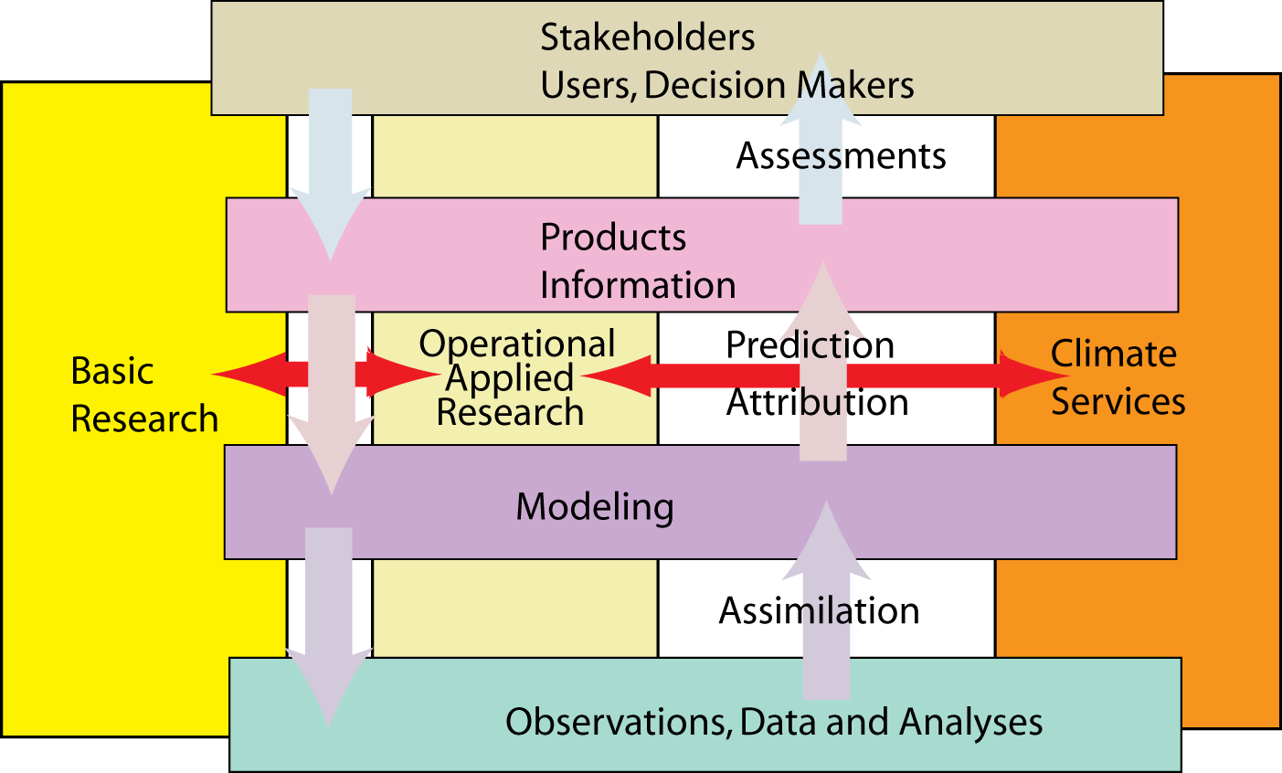

Climate Information System
WCRP
Trenberth, 2008 WMO Bull Nature 6 December 2007

Slide 5
WOAP:
WCRP Observations and Assimilation Panel
Last meeting late March 2010
http://wcrp.wmo.int/AP_WOAP4.html
Kevin Trenberth
Chair (2004-2010)
WCRP Observation and Assimilation Panel
WCRP/GCOS: WMO/IOC/ICSU

Slide 6
WOAP
WOAP is primarily sponsored by WCRP but is also co-sponsored by GCOS,
WOAP is a coordination Panel in WCRP
Preferred channel for interactions GCOS and WCRP
AOPC ,OOPC , TOPC are also co-sponsored by WCRP
WOAP helps to coordinate GCOS panels and issues
WOAP serves to help with GEOSS workplans.
Much material and background docs on WOAP website
Last mtg: March 2010, Hamburg, Germany

Slide 7
TOR for WOAP: paraphrased
Identify climate observational requirements
Help optimize observations
Act as a focal point for WCRP interactions with other groups
Promote and coordinate analysis, reprocessing, reanalysis and assimilation
Promote and coordinate information and data management activities, including web sites.
Observations include those from space platforms.

Slide 8
WOAP: Key climate issues
Climate data records
Continuity, continuity, continuity;
The need for reprocessing and reanalysis of past data and coordination of these activities among agencies and variables;
Includes evaluation and assessment or results
Importance of calibration, accuracy, benchmarks,
Space and in situ observations;
Reanalysis to produce global gridded fields
GRUAN, GPS RO,
CLARREO

Slide 9
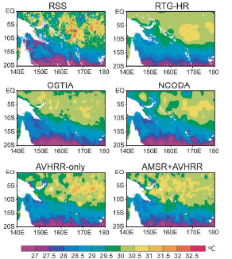
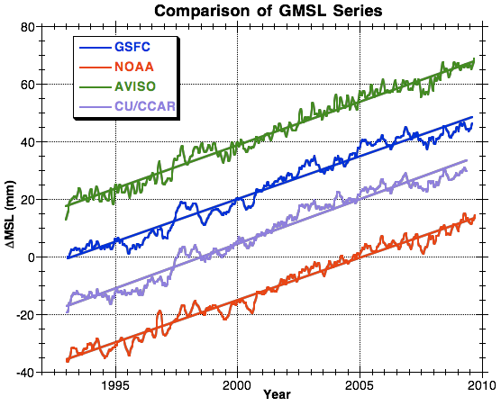
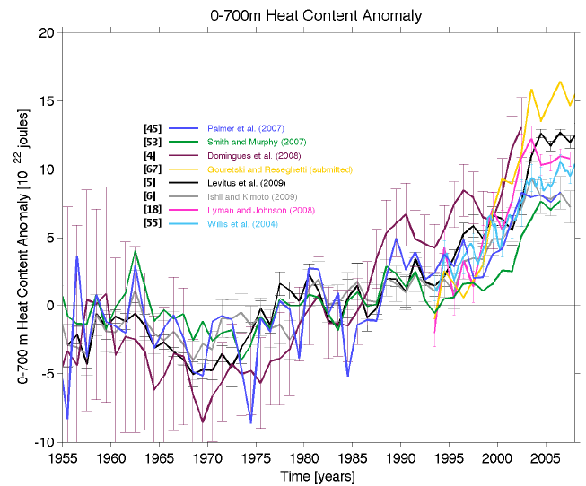
Large disparities among different analyses
Daily SST (1 Jan 2007)
Reynolds and Chelton 2010 JC
Sea Level OHC
Palmer et al 2010
OceanObs’09

Slide 10
Total sea ice area, 2007 and 2008
NASA Team
NASA Team 2
SSM/I Bootstrap
AMSR Bootstrap
ASI
Cal/Val (York)
Bristol
Norsex
Avg. of 8 algorithms
& ±1 st. dev. range
No single algorithm clearly superior
2007
2008
The largest factor for ice concentration/extent consistency is intercalibration of the products through transitions through different generations of satellite-borne sensors.
Notes:
Passive microwave remote sensing instruments provide sea ice extent information day or night, clear or cloudy, and have a near-complete record since late-1978. However, there are many limitations of passive microwave imagery. First, the instantaneous field of view (sensor footprint) is large, ~25-50 km, limiting the precision of the ice edge location and concentration at the ice edge because of inherent subpixel ambiguity (Eppler et al., 1992; Hwang and Barber, 2006). In addition, passive microwave instruments are sensitive to the effects of snow cover, liquid water (Hwang et al., 2007a), brine volume change (Hwang et al., 2007b), melt ponds (Yackel and Barber, 2000), and ice temperature (Hwang et al., 2008). These effects can result in both overestimation and underestimation of sea ice amounts depending on seasonal and local conditions. Atmospheric emission can also affect the microwave signal (Oelke, 1997; Andersen et al., 2006). Finally, thin ice also tends to be underestimated by algorithms that convert brightness temperature estimates into ice concentration (Cavalieri, 1994; Hwang et al., 2007b; 2008). In general, biases in sea ice concentration are ~5% during winter (Steffen et al., 1992; Kwok, 2002), with higher errors in summer due to surface melt (Steffen et al., 1992). However, significantly higher errors have been found, depending on surface and atmospheric conditions (Comiso et al., 1997; Meier, 2005; Andersen et al., 2007). Different algorithms have different error magnitudes depending on conditions and no single algorithm has superior performance in all cases.

Slide 11
Reanalysis
There is not a problem with lack of reanalyses, indeed there is a proliferation. The problems are:
Lack of an end to end program with adequate vetting and evaluation of products (and the funding for that), and
Reanalysis is all done in a research domain and not sustained, so that key personnel can be lost.
Lack of adequate vetting and diagnosis
Reanalysis is an essential part of climate services, especially in monitoring, attribution and prediction

Slide 12
Atmospheric Reanalyses
Current atmospheric reanalyses, with the horizontal resolution (latitude; T159 is equivalent to about 0.8° ), the starting and ending dates, the approximate vintage of the model and analysis system, and current status.
Reanalysis | Horiz.Res | Dates | Vintage | Status
NCEP/NCAR R1 | T62 | 1948-present | 1995 | ongoing
NCEP-DOE R2 | T62 | 1979-present | 2001 | ongoing
CFSR (NCEP) | T382 | 1979-present | 2009 | thru 2009, ongoing
C20r (NOAA) | T62 | 1875-2008 | 2009 | Complete, in progress
ERA-40 | T159 | 1957-2002 | 2004 | done
ERA-Interim | T255 | 1989-present | 2009 | ongoing
JRA-25 | T106 | 1979-present | 2006 | ongoing
JRA-55 | T319 | 1958-2012 | 2009 | underway
MERRA (NASA) | 0.5° | 1979-present | 2009 | thru 2010, ongoing

Slide 13
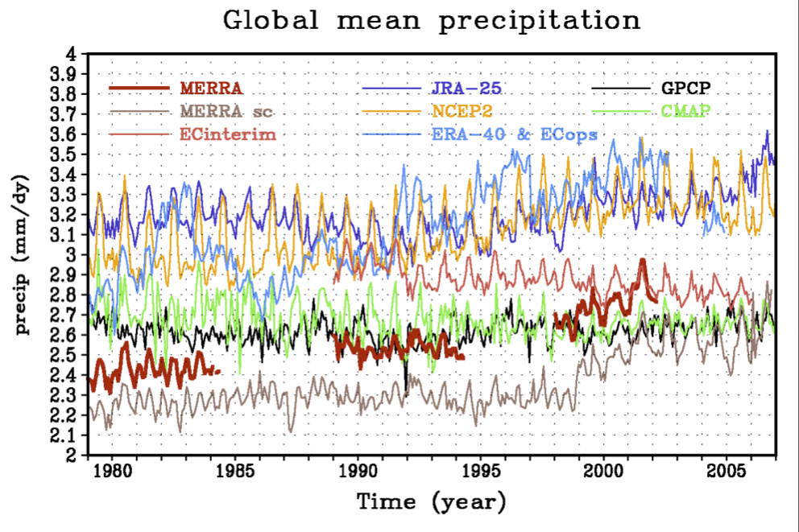
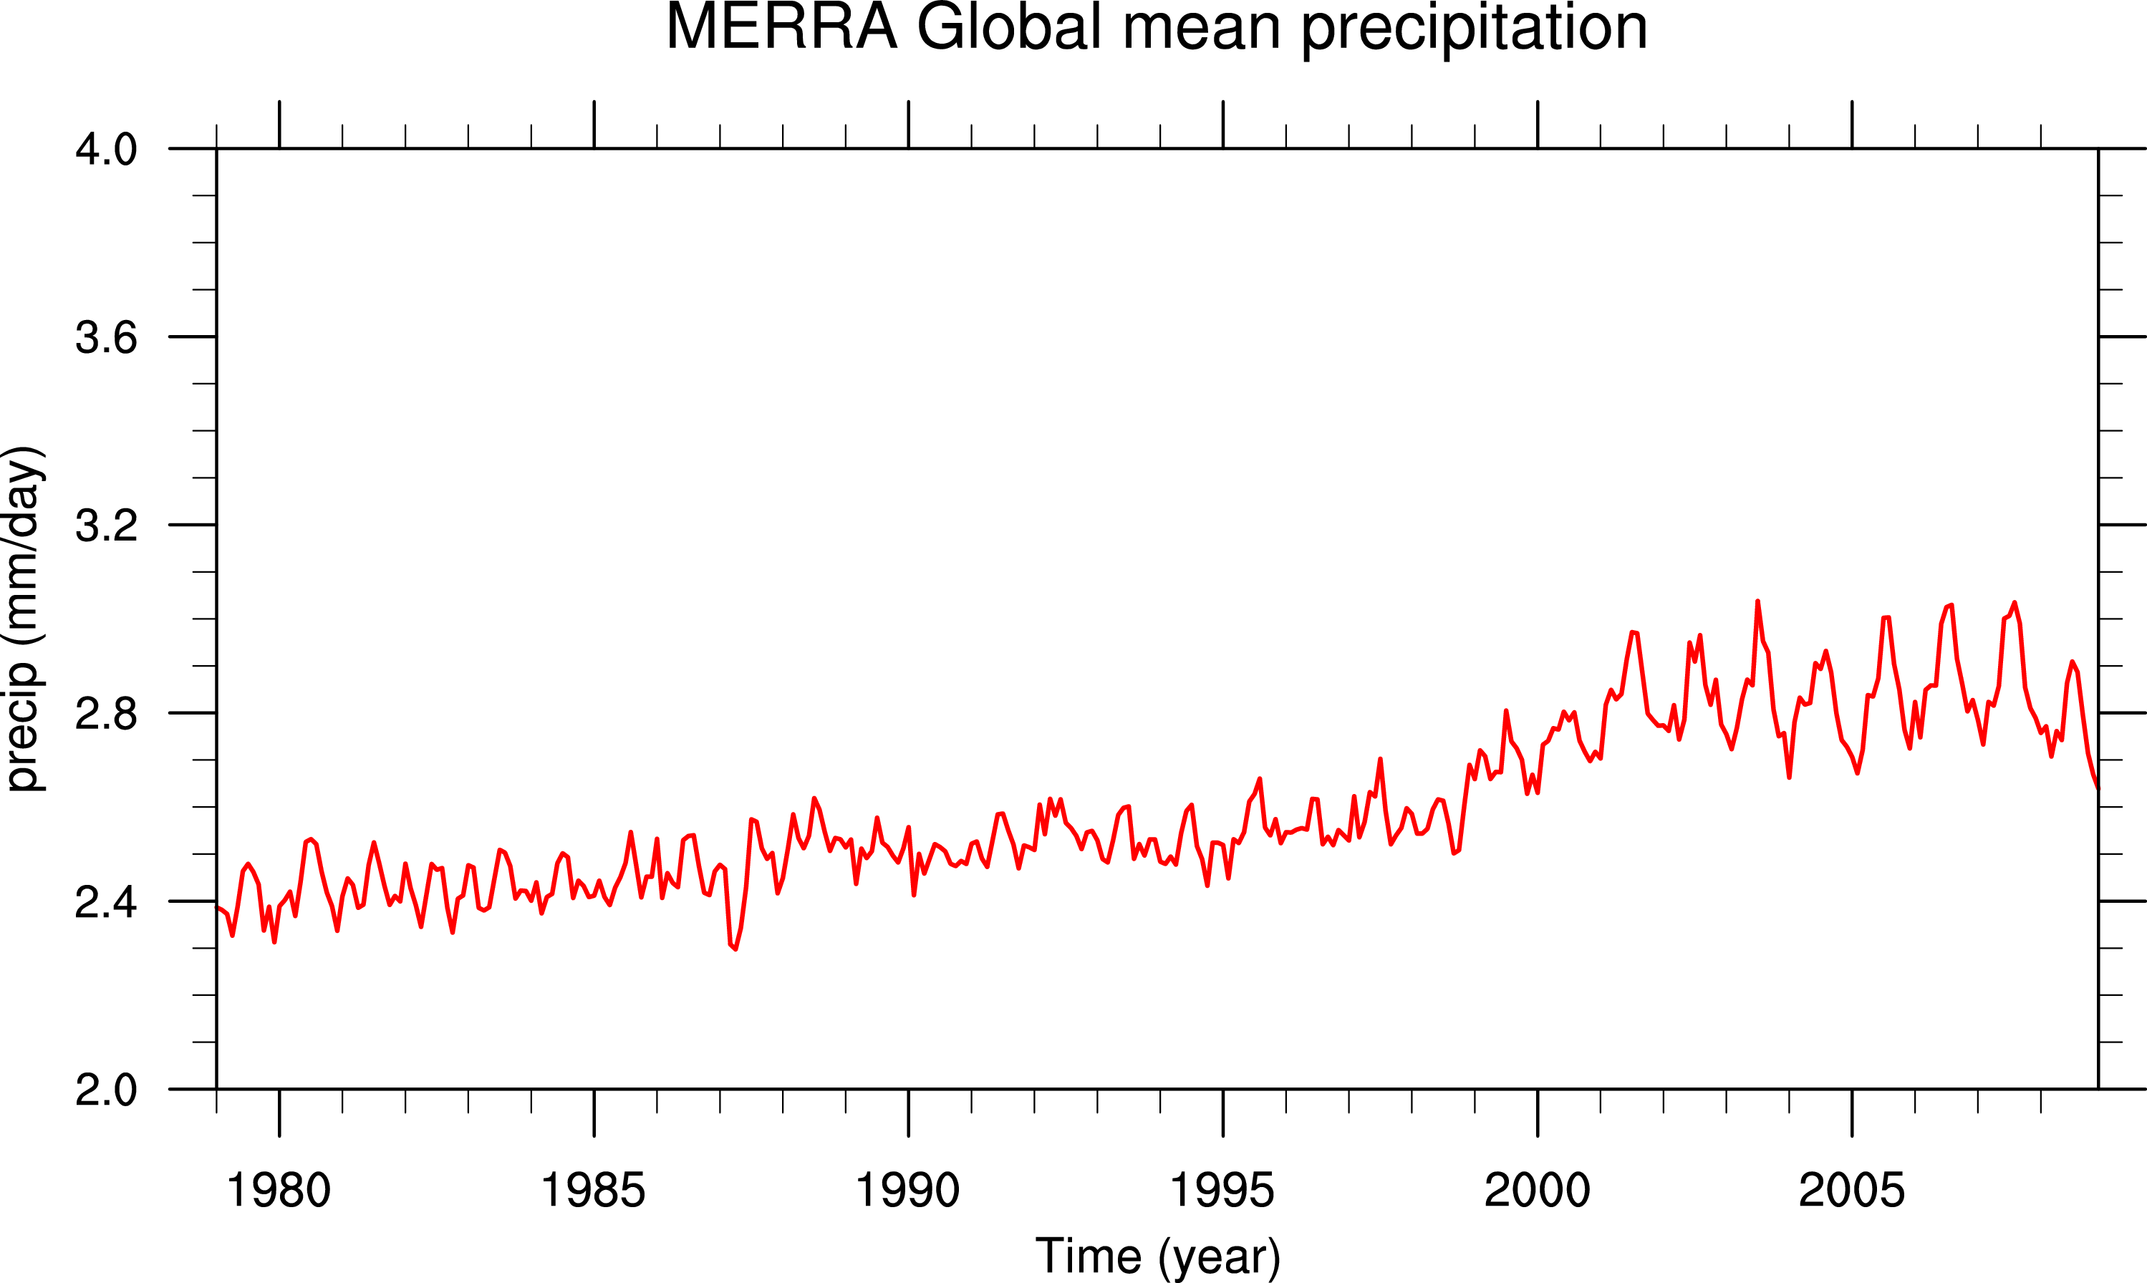
MERRA

Slide 14
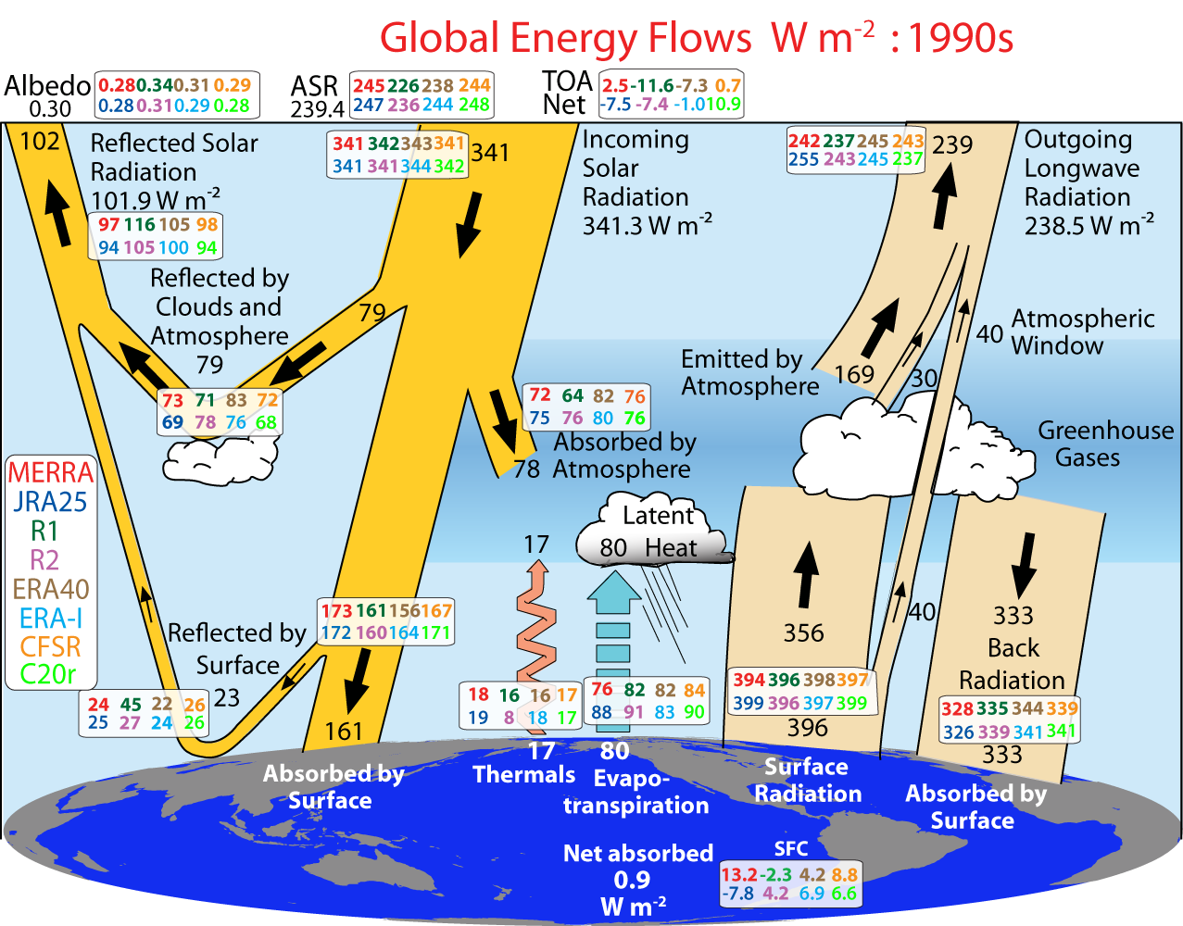
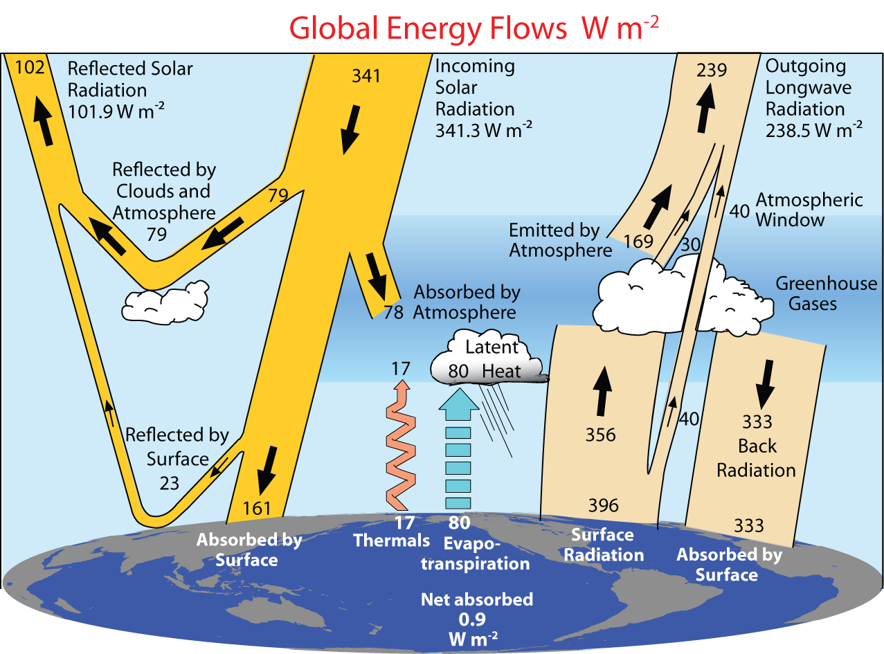
0.6

Slide 15
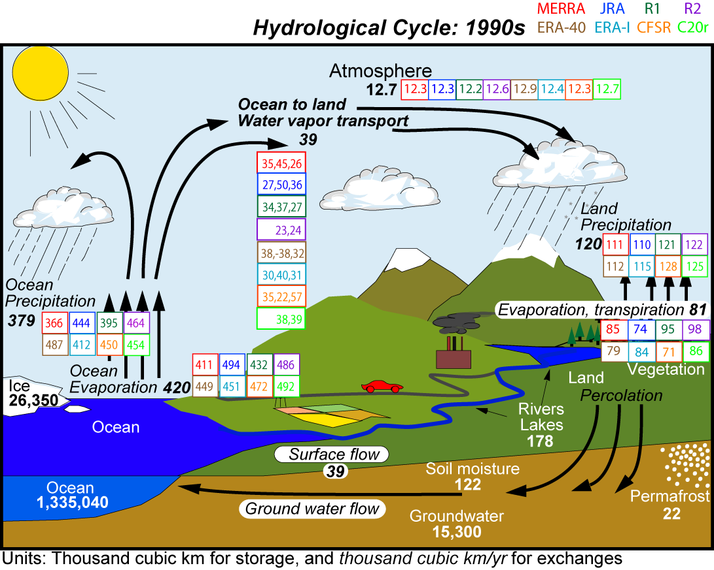
Transport
E-P_{ocean}
P-E_{land}

Slide 16
An Informed Guide to Climate Datasets with Relevance to Earth System Model Evaluation
Objectives:
Evaluate and assess selected climate datasets
Provide “expert-user” guidance addressing strengths & limitations
Fills and major community gap and an immediate need
Features:
Facilitate and enhance access to relevant datasets for diagnostic analyses and model evaluation (including CMIP5/AR5)
Web-based guide, including a means for enabling additional informed commentary and datasets outside of our own expertise
Atmosphere, Ocean, Land, Cryosphere, Biosphere
Expertise on datasets
NCAR proposal

Slide 17
IESA: US program
Integrated Earth System Analysis
Comprehensive reanalysis
Trenberth and Olson (1988)
Bengtsson and Shukla (1988)
Arkin et al. (1993)
Trenberth et al (2002; 2006; 2008)
BAMS; J Cl; Eos
CCSP/USGCRP SAP 1.3 (2008)
Randy Dole talk Tuesday

Slide 18
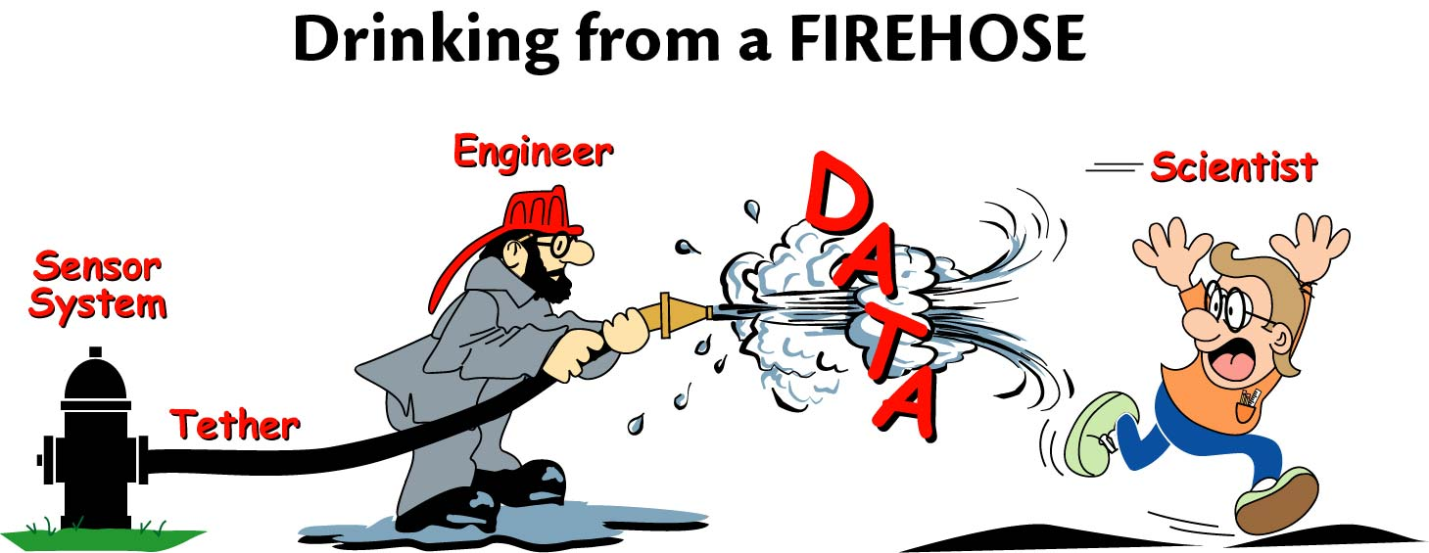
Future needs: Observations and Analysis
Observations: in situ and from space (that satisfy the climate observing principles);
A performance tracking system;
Climate Data Records (CDRs)
The ingest, archival, stewardship of data, data management;
Access to data
Data processing and analysis
The analysis and reanalysis of the observations and derivation of products,
Data assimilation and model initialization

Slide 19
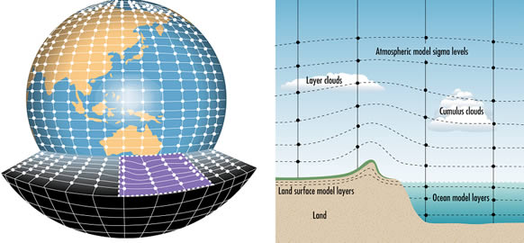
Future needs: Models
Data assimilation and model initialization
Better, more complete models
Assessment of what has happened and why (attribution) including likely impacts on human and eco-systems;
Prediction of near-term climate change over several decades: ensembles
Statistical models: applications
Downscaling, regional information
Responsiveness to decision makers and users.

Slide 20
Climate Observations
Process studies: atmosphere, ocean, land, cryosphere and their interactions
Sustained observations: the climate record
Enhanced monitoring
Analysis, assimilation and data products
Data stewardship, data access, QC
For JSC 2010:
Observations white paper

Slide 21
Role of WCRP
Advocate improved observations and analysis suitable for climate (satisfying the GCOS Climate Monitoring Principles to ensure continuity of record). This especially includes those from space.
Data set development: evaluating observations and promoting global reprocessing and reanalysis. Develop new products and datasets, analytical and diagnostic techniques, high level derived products: for use in understanding and analyzing climate variability and change, and for evaluating models.
Mechanisms and modes of variability in climate anomalies; operational attribution, numerical experimentation in near real time to allow reliable statements to be made not only about what the state of the climate is, but also why it is the way it is and the mechanisms involved.

Slide 22
Role of WCRP
Data assimilation and analysis: initializing of coupled models for prediction.
Provide advice on best datasets for various purposes (climatologies and time series) and their merits and limitations. (Error bars are greatly needed.)
High priority needs are to have assessments of datasets for use in evaluating climate models, and specifically those used in the AR5 IPCC report that will participate in the CMIP5 activity

Slide 23
Role of WCRP
Help improve and promote sound data stewardship, including data archiving, management, and access. This includes making sure that climate-related data variables are reaching data archives, and that standards are set for archiving new types of data.
Help make data accessible and available e.g., through the internet. Promote shared efforts for data quality control.

Slide 24
Climate Information System: WOAP role
Observations: advocating improved observations and analysis suitable for climate (satisfying the climate principles that are designed to ensure continuity of record). This especially includes those from space.
Data set development: evaluating observations and promoting their reprocessing and reanalysis into global fields. Developing new products and datasets.
Model datasets: promoting numerical experimentation
Making data available through the internet.
Diagnostics: developing analytical and diagnostic techniques to process observations and model data, and facilitate their comparison and evaluation. New products.

Slide 25
Climate Information System: WOAP role: continued
Attribution: develop capabilities that contribute to attribution capability via studies and numerical experimentation to allow reliable statements to be made not only about what the state of the climate is, but also why it is the way it is and the mechanisms involved.
Predictability and prediction: PDO, NAO, AMOC; improve initialization of models, improve observations for this purpose; regional models (downscaling).
High impact events and extremes: exploring drought, flooding, precipitation intensity and frequency, hurricanes, storms
Model evaluations: model vs observations; water and energy cycles, forcings

Slide 26
The challenge is to better determine:
how the climate system is changing
how the forcings are changing
how these relate to each other (incl. feedbacks)
attribution of anomalies to causes
what they mean for the immediate and more distant future (assessment)
Validate and improve models
seamless predictions on multiple time scales
how to use this information for informed planning and decision making
how to manage the data and reanalyze it routinely
how to disseminate products around the world
how to interact with users and stakeholders and add regional value
From Trenberth et al 2002
☺ ☺ ☹
😐
☹ 😐
☹ 😐
😐 ☹
☹
Information System

