Slide 1
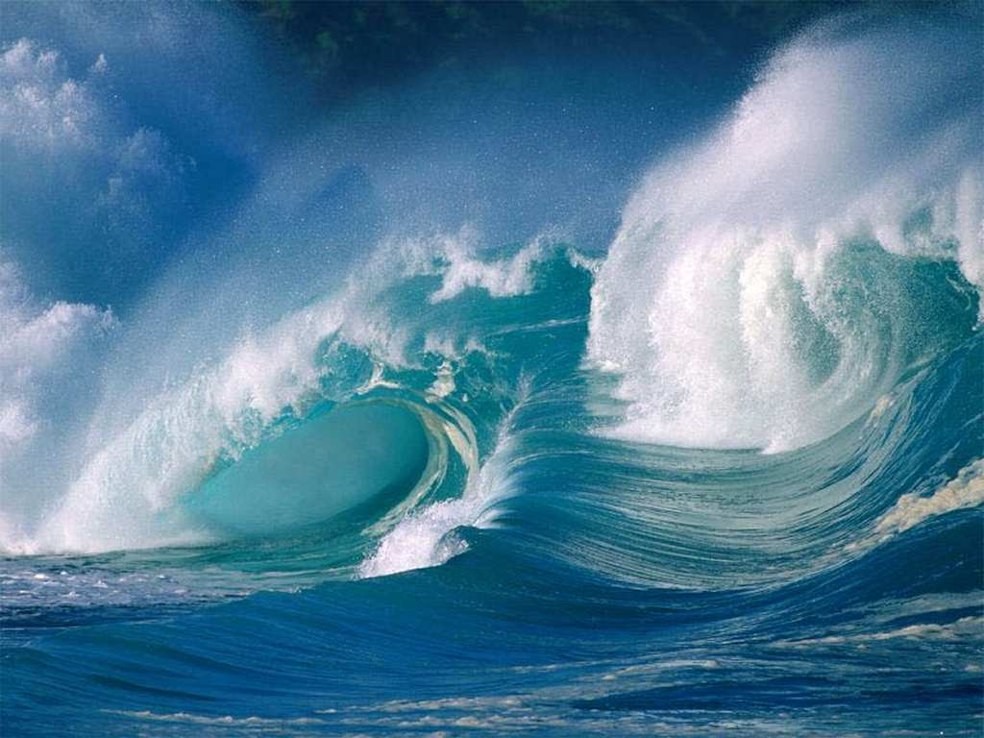
Role of the Ocean
in climate
Kevin E. Trenberth NCAR

Slide 2
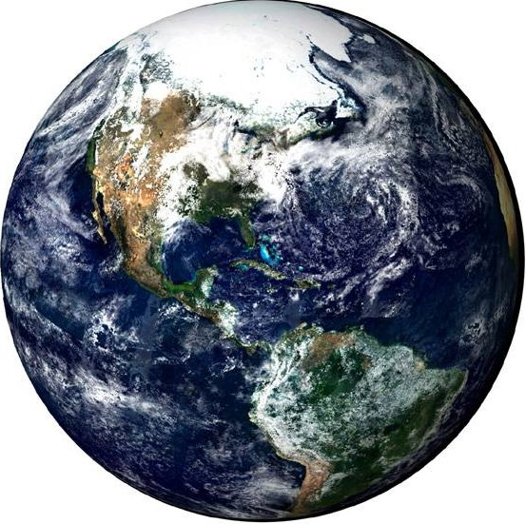
The role of the climate system
ICE
LAND
Atmosphere
Ocean

Slide 3

The role of the atmosphere
The atmosphere is the most volatile component of climate system
Winds in jet streams exceed 100 mph or even 200 mph; winds move energy around.
Thin envelope around planet 90% within 10 miles of surface 1/400th of the radius of Earth; clouds appear to hug the surface from space.
The atmosphere does not have much heat capacity
“Weather” occurs in troposphere (lowest part)
Weather systems: cyclones, anticyclones, cold and warm fronts tropical storms/hurricanes move heat around: mostly upwards and polewards

Slide 4
Role of Oceans
The oceans cover 70.8% of the Earth’s surface.
The oceans are wet: water vapor from the surface provides source for rainfall and thus latent heat energy to the atmosphere.
The heat capacity of the atmosphere is equivalent to that of 3.5 m of ocean. The oceans slowly adjust to climate changes and can sequester heat for years.
The ocean is well mixed to about 20 m depth in summer and over 100 m in winter. An overall average of 90 m would delay climate response by 6 years.
Total ocean: mean depth 3800 m.
Would add delay of 230 years if rapidly mixed. In reality, the response depends on rate of ventilation of water through the thermocline (vertical mixing).
Estimate of delay overall is 10 to 100 years.
The ocean currents redistribute heat, fresh water, and dissolved chemicals around the globe.

Slide 5
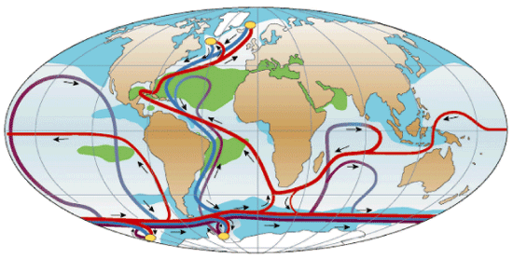
The great ocean conveyer:
of heat, freshwater and salts

Slide 6
Role of Land
Heat penetration into land with annual cycle is ~2 m.
Heat capacity of land is much less than water:
Specific heat of land 4½ less than sea water
For moist soil maybe factor of 2
Land plays lesser role than oceans in storing heat.
Consequently:
Surface air temperature changes over land are large and occur much faster than over the oceans.
Land has enormous variety of features: topography, soils, vegetation, slopes, water capacity.
Land systems are highly heterogeneous and on small spatial scales.
Changes in soil moisture affect disposition of heat: rise in temperature versus evaporation.
Changes in land and vegetation affect climate through albedo, roughness and evapotranspiration.

Slide 7
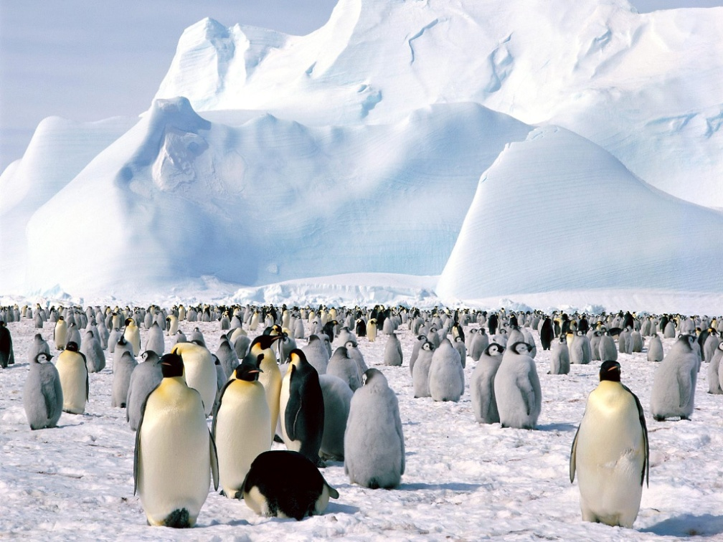
Role of Ice
Major ice sheets, e.g., Antarctica and Greenland. Penetration of heat occurs primarily through conduction.
⇒ The mass involved in changes from year to year is small but important on century time scales.
Unlike land, ice melts ⇒ changes in sea level on longer time-scales.
Ice volumes: 28,000,000 km³ water is in ice sheets, ice caps and glaciers.
Most is in the Antarctic ice sheet which, if melted, would increase sea level by ∼65 m, vs Greenland 7 m and the other glaciers and ice caps 0.35 m.
In Arctic: sea ice ~ 3-4 m thick
Around Antarctic: ~ 1-2 m thick
Ice is bright: reflects the solar radiation ⇒ ice-albedo feedback
Ice ↑ ⇒ radiation reflected ⇒ cooler ⇒ Ice ↑
The West Antarctic Ice Sheet (WAIS) partly grounded below sea level.
Warming could alter grounding of the ice sheet, making it float, and vulnerable to rapid (i.e. centuries) disintegration.
rise in sea level of 4-6 m.
May be irreversible if collapse begins.

Slide 8
Role of Coupling
El Niño-Southern Oscillation ENSO
Some phenomena would not otherwise occur:
ENSO is a natural mode of the coupled ocean-atmosphere system
ENSO: EN (ocean) and SO (atmosphere) together:
Refers to whole cycle of warming and cooling.
ENSO events have been going on for centuries (records in corals, and in glacial ice in S. America)
ENSO arises from air-sea interactions in the tropical Pacific
El Niño: warm phase, La Niña: cold phase
EN events occur about every 3-7 years

Slide 9
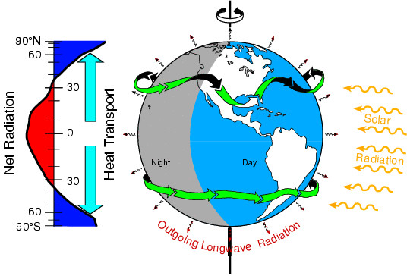
Energy on Earth
The main external influence on planet Earth is from radiation.
Incoming solar shortwave radiation is unevenly distributed owing to the geometry of the Earth-sun system, and the rotation of the Earth.
Outgoing longwave radiation is more uniform.

Slide 10


Energy on Earth
The incoming radiant energy is transformed into various forms (internal heat, potential energy, latent energy, and kinetic energy) moved around in various ways primarily by the atmosphere and oceans, stored and sequestered in the ocean, land, and ice components of the climate system, and ultimately radiated back to space as infrared radiation.
An equilibrium climate mandates a balance between the incoming and outgoing radiation and that the flows of energy are systematic. These drive the weather systems in the atmosphere, currents in the ocean, and fundamentally determine the climate. And they can be perturbed, with climate change.

Slide 11
F_{s} = H_{s}+LE-R_{s}
Q₁ = R_{T} + F_{s} + L(P-E)
Q₂ = L(P-E)
∇.F_{A} = Q₁-Q₂ = R_{T}+ F_{s}
= (R_{T} – R_{s}) + LE +H_{s}
R_{T}
∇.F_{A}
H_{s}
LE
R_{s}
LP
F_{s}
∇.F_{O}
∇.F_{O} = - F_{s}

Slide 12
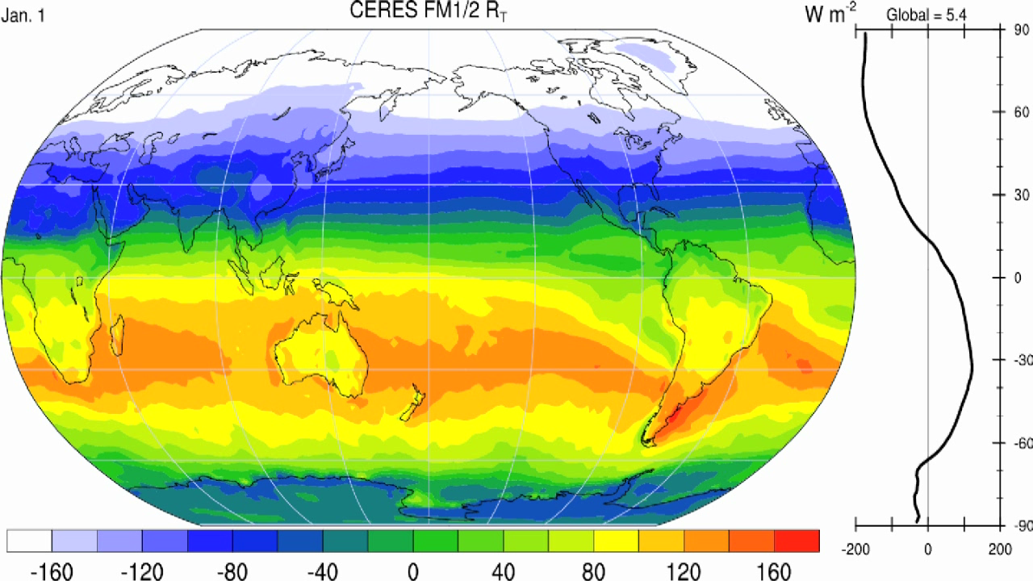
Top of atmosphere net radiation

Slide 13
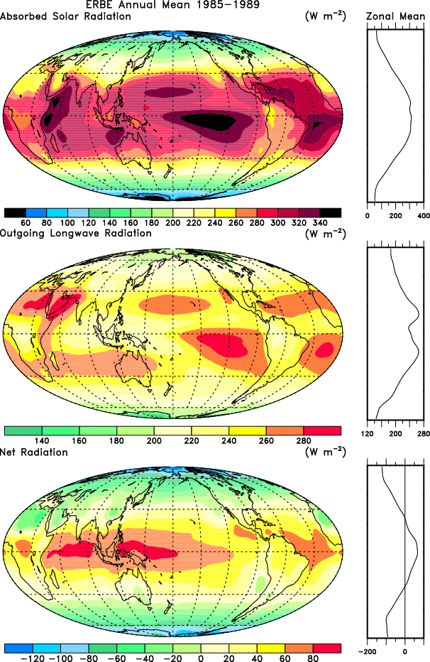
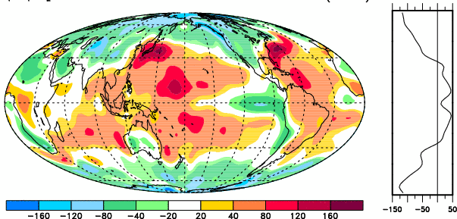
Net
Radiation
TOA
Difference due to ocean transports
Total atmos
“heating”
Q₁-Q₂
_{Includes} _{moistening}
Trenberth & Stepaniak, 2003

Slide 14
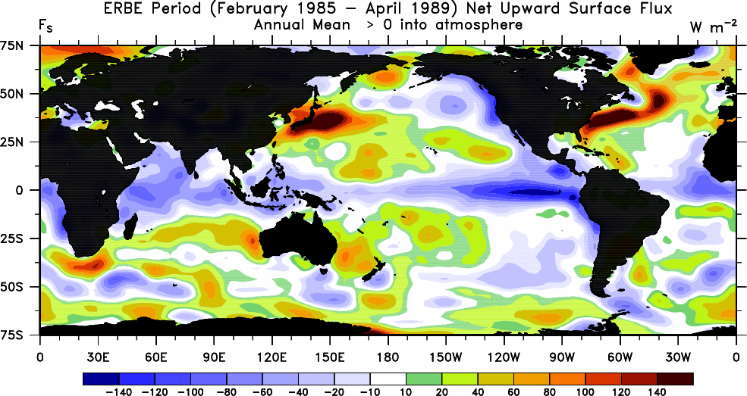
Annual mean net surface flux

Slide 15
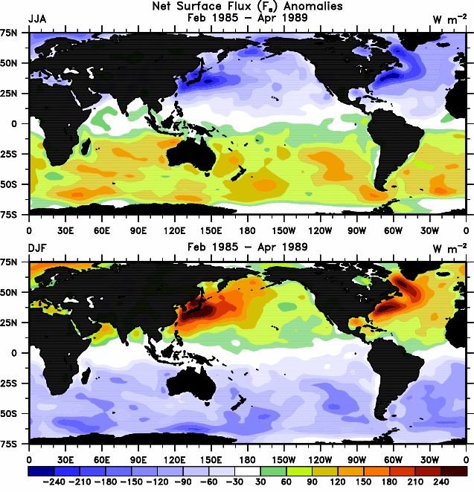
Departures from annual mean:
Equivalent ocean heat content
(Ignores annual cycle in ocean heat transports)

Slide 16
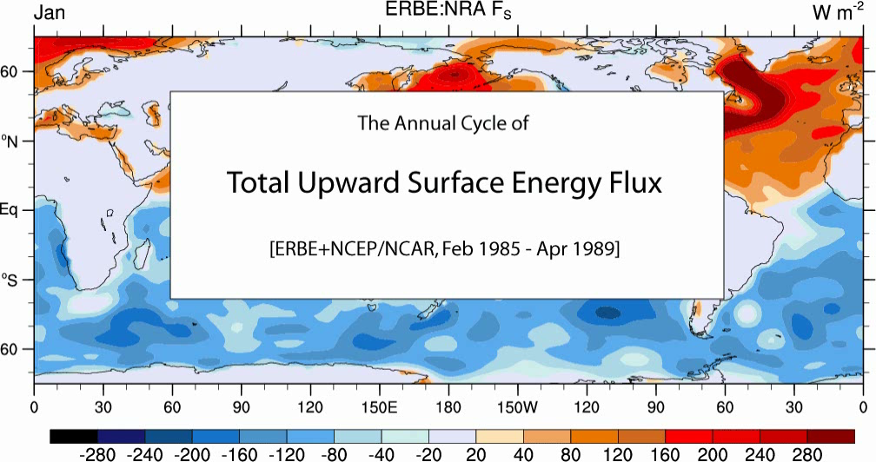

Slide 17
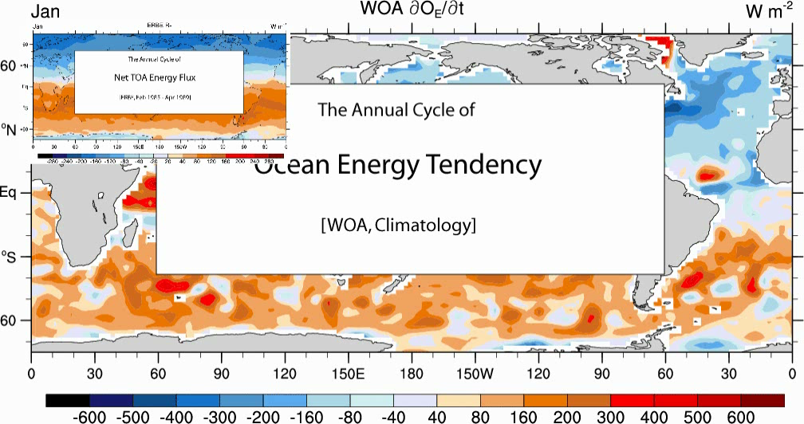

Slide 18
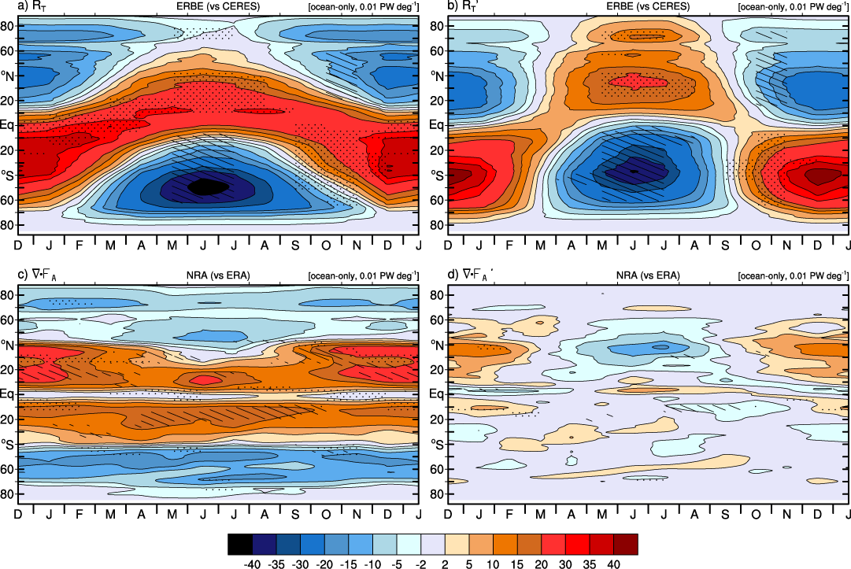
Ocean only

Slide 19
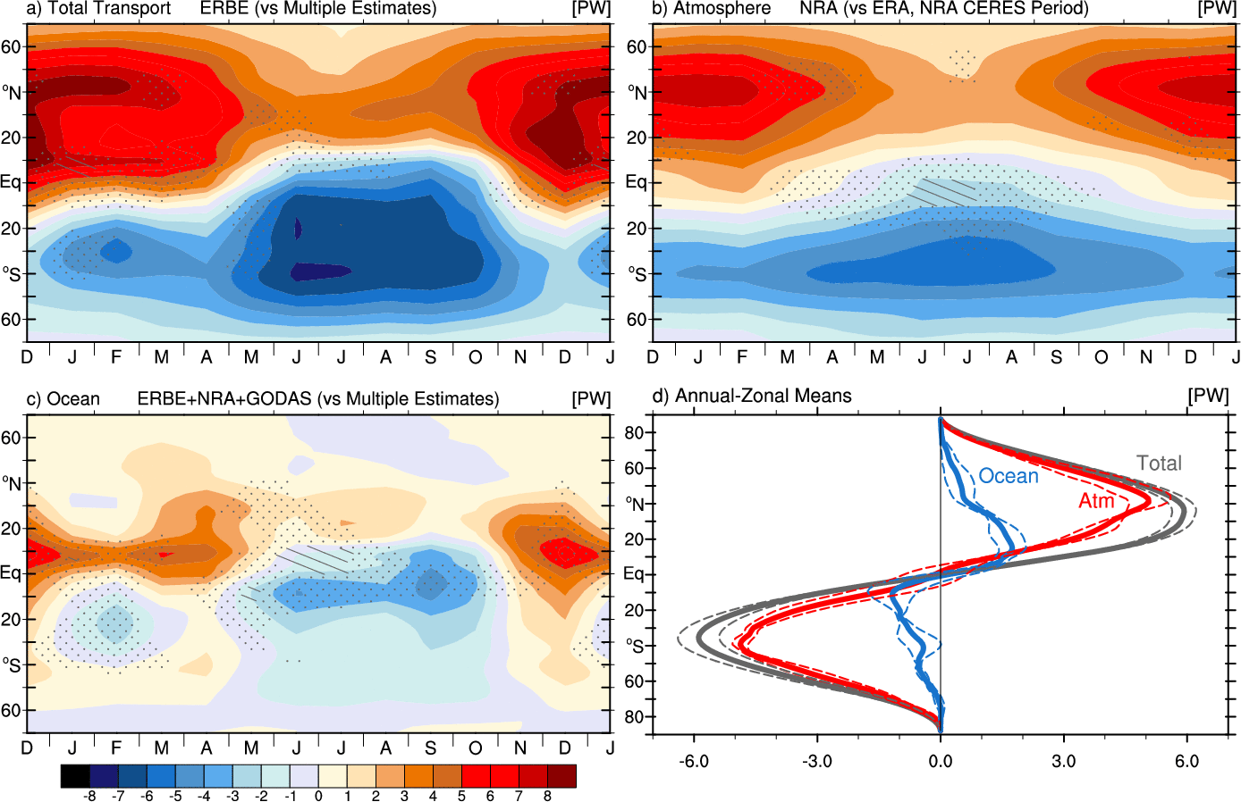
ERBE-period meridional energy transport

Slide 20

The changing climate

Slide 21
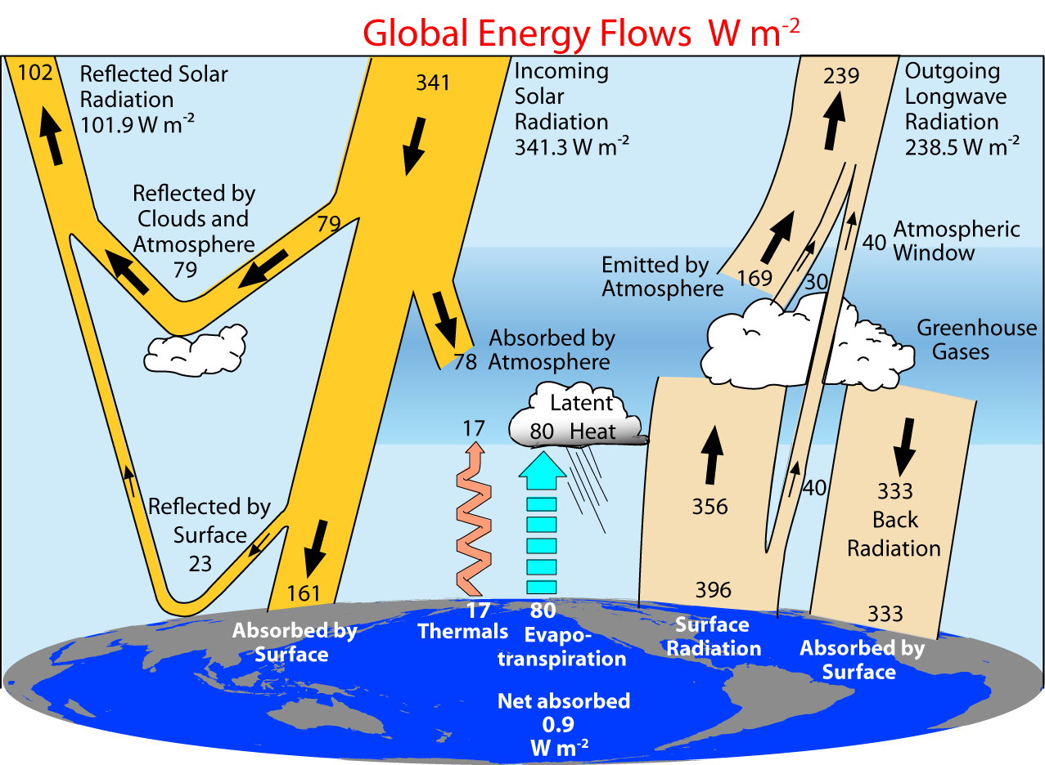
Trenberth et al 2009

Slide 22
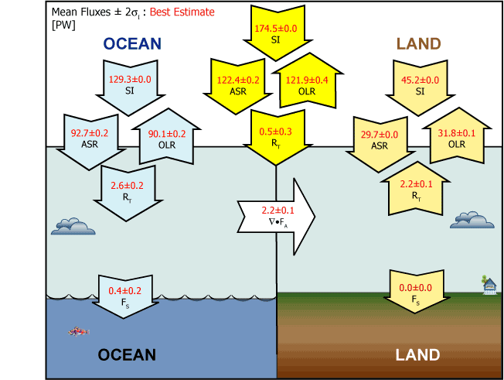
CERES period March 2000 to May 2004

Slide 23
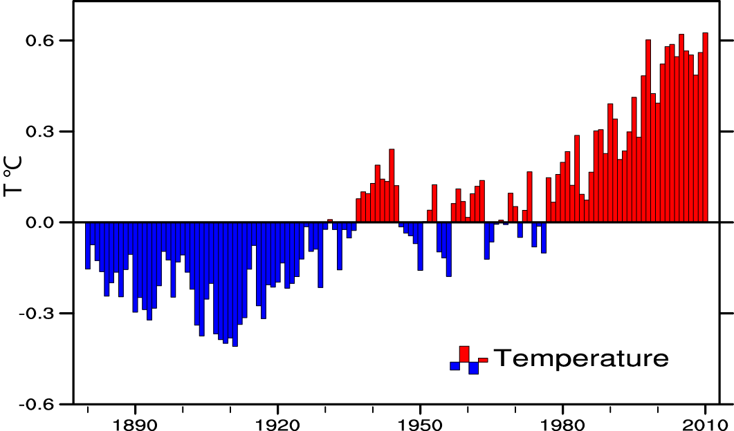
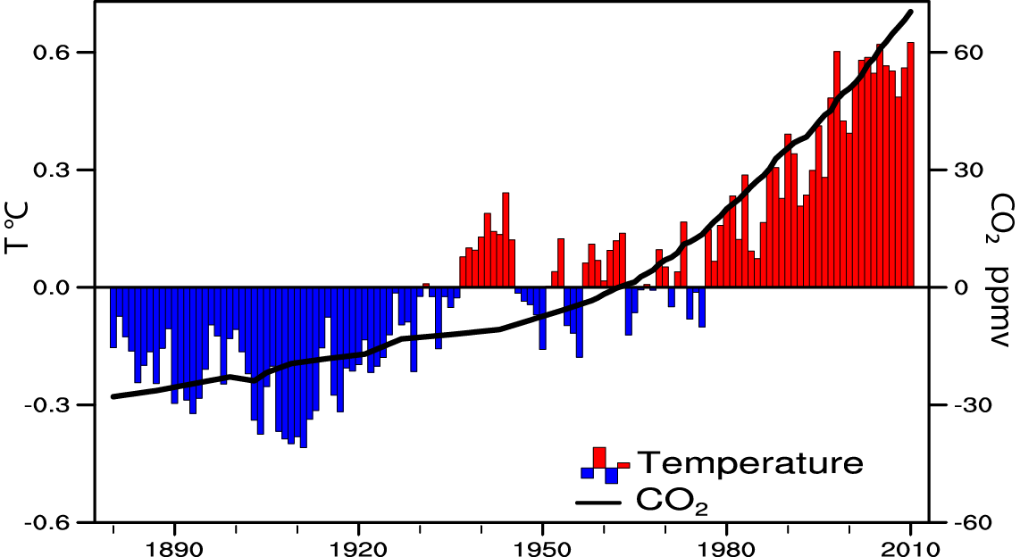
Global temperature and carbon dioxide: anomalies through 2010
Base period 1900-99; data from NOAA

Slide 24
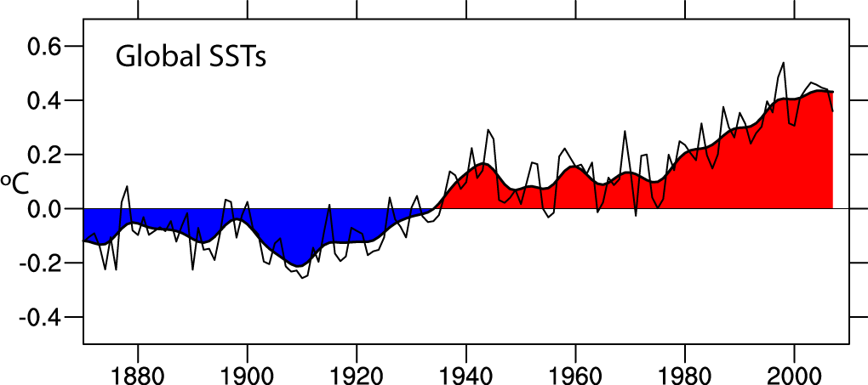
Global SSTs are increasing: base period 1901-70
Through 2009
Data: Hadley Centre, UK

Slide 25
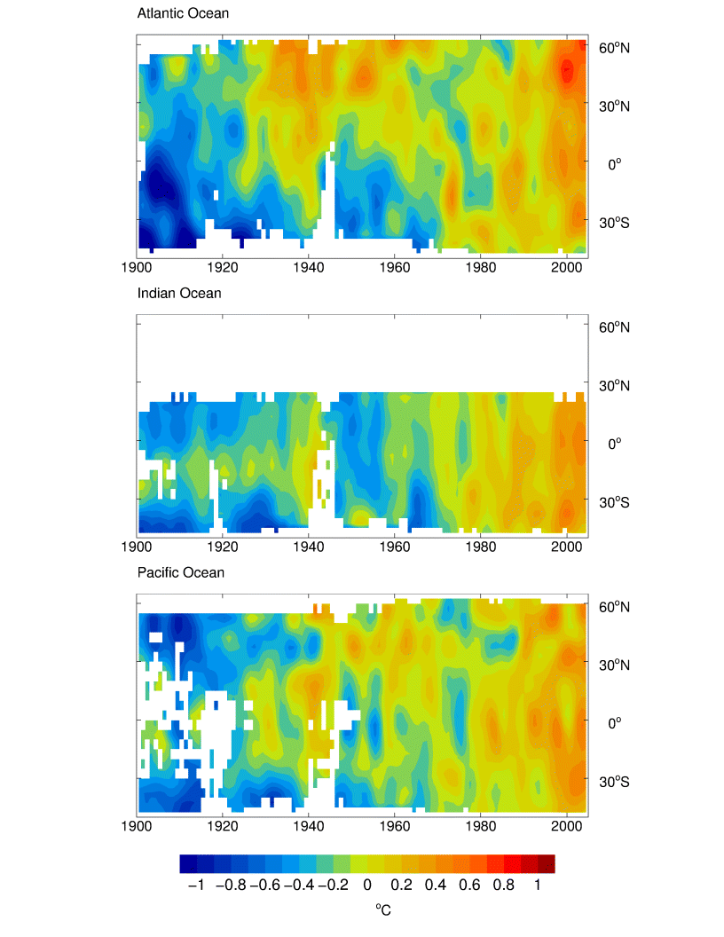
Changes in SSTs zonally averaged relative to 1961-90
Atlantic: N vs S
Indian: Steady warming
Pacific: tropics leads (ENSO, PDO)
Deg C

Slide 26
Global increases in SST are not uniform. Why?
Tropical Indian Ocean has warmed to be competitive as warmest part of global ocean.
Tropical Pacific gets relief from global warming owing to ENSO?
Atlantic has MOC/THC
The historical patterns of SST are NOT well simulated by coupled models!
Relates to ocean uptake of heat and ocean heat content.
The result is an imprint on global weather patterns:

Slide 27
Ocean heat content and sea level Global warming from increasing greenhouse gases creates an imbalance in radiation at the Top-Of-Atmosphere: now order 0.9 W m⁻². Where does this heat go?
Main sink is ocean: thermosteric sea level rise associated with increasing ocean heat content.
Some melts sea ice: no change in SL
Some melts land ice.
SL increases much more per unit of energy from land-ice melt: ratio about 30 to 90 to 1.
Sea-ice melt does not change sea level.

Slide 28
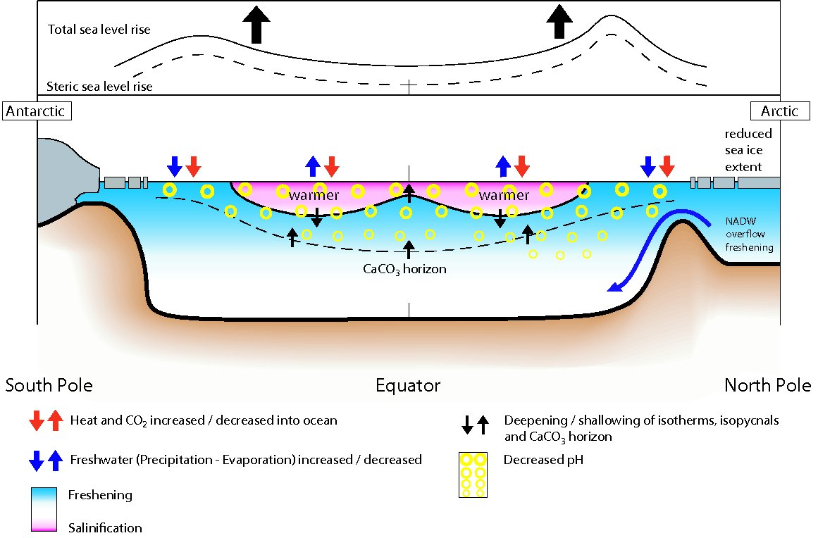
Changes in ocean state
from 1950-1960’s to 1990-2000’s (IPCC 2007 Figure 5.18)

Slide 29
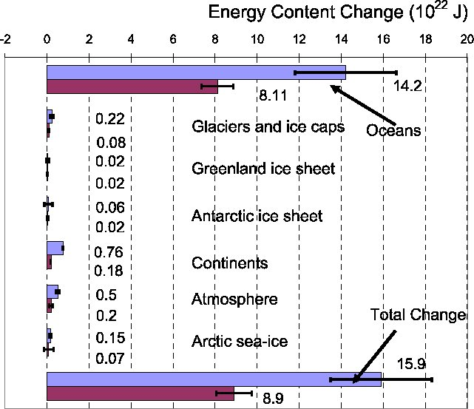
Energy content change 10²² J
1961-2003 (Blue bars)
Figure 5.4
IPCC AR4
1993-2003 (Burgundy bars)

Slide 30
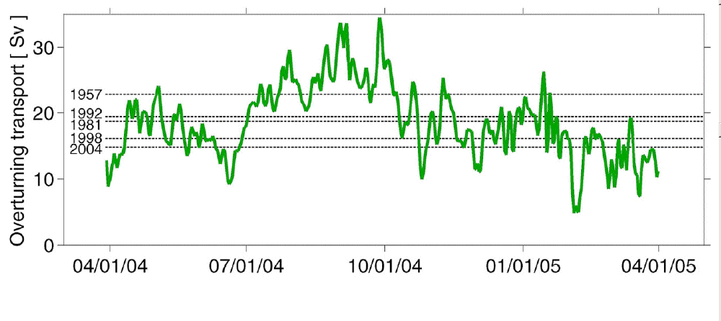
AMOC: Sampling Issues
The overturning transport 26.5N above 1000 m (green line), and the five snapshot estimates from hydrographic sections by Bryden et al., (2005).
All time series have been smoothed with a three-day low pass filter.
As modified from Baringer and Meinen (2008).

Slide 31
Is ocean warming accelerating?
IPCC: Causes of decadal variability not well understood
cooling due to volcanism?
artefact due to temporally changing observing system?
No statement on acceleration possible in AR4
Annual ocean heat content 0-700m relative to 1961-90 average
Since then:
Argo problems
XBT drop rate problems
identified
Ishii et al 2006
Willis et al 2004
Levitus WOA

Slide 32
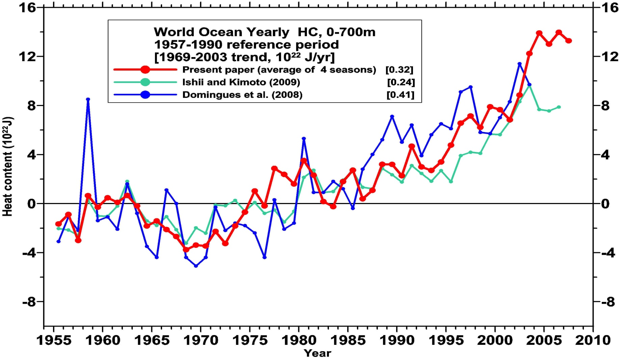
Revised ocean heat content
0.8 W m⁻²
0.3 W m⁻²
Levitus et al 2009
Yearly time series of ocean heat content (10²² J) for the 0-700 m layer from Levitus et al (2009), Domingues et al. (2008) and Ishii and Kimoto (2009) with a base period of 1957-1990. Linear trends for each series for 1969-2007 given in the upper portion of the figure.

Slide 33
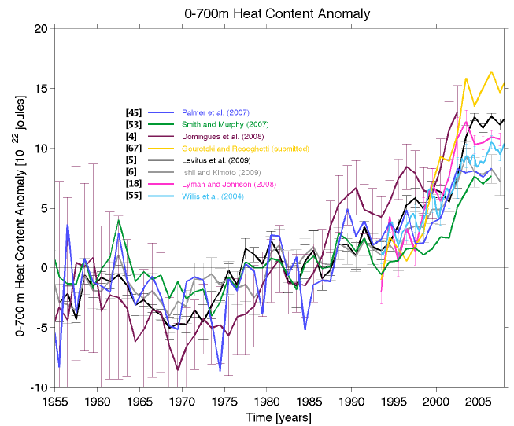
Ocean heat content to 700 m
Palmer et al OceanObs’09

Slide 34
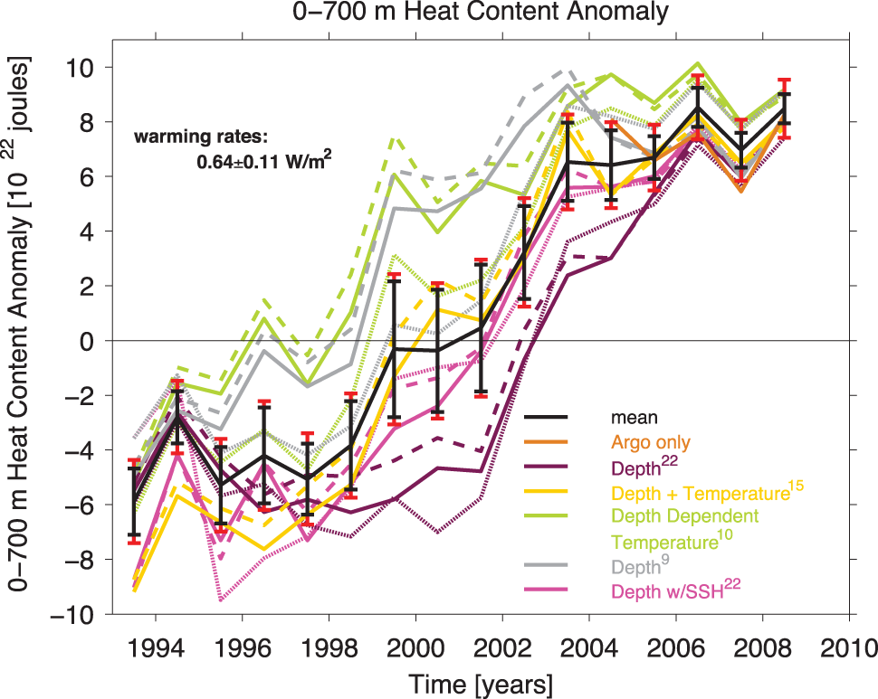
Lyman et al 2010 Nature

Slide 35
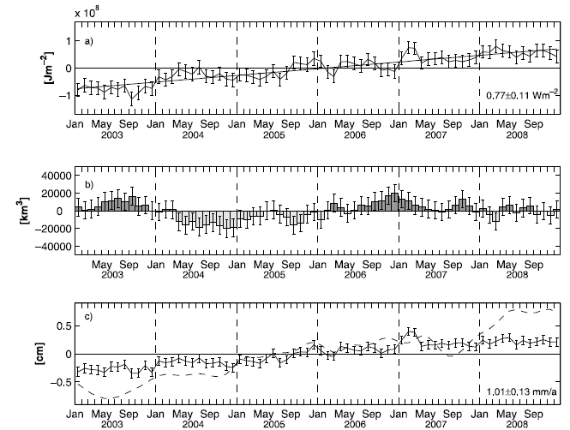
Ocean heat content 0-2000m
OHC
0.77 W m⁻²
gl ocean
0.54 W m⁻²
Global
Fresh water
Sea level and thermosteric
OHC
Von Schuckmann et al JGR 2009

Slide 36
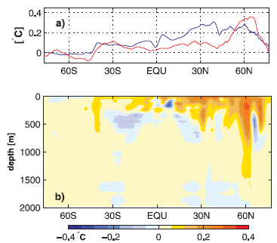
Ocean heat content 0-2000m
SST (red)
2003-2008 – 1990-2008
10 m depth
ARIVO –
WOA05
Temps
Difference for 2003-2008
From WOA05
Levitus et al
Von Schuckmann et al JGR 2009

Slide 37
Comments on Von Schuckman
VS did not provide 0-700 m OHC vs 0 to 2000m
Some floats are programmed to go only to 1000 m and do not go to 2000 m, so that coverage decreases with depth
How come all the error bars are the same even though coverage is increasing?
How good is the quality of the sensors over this time? Up to 30% report negative pressures at the surface.

Slide 38
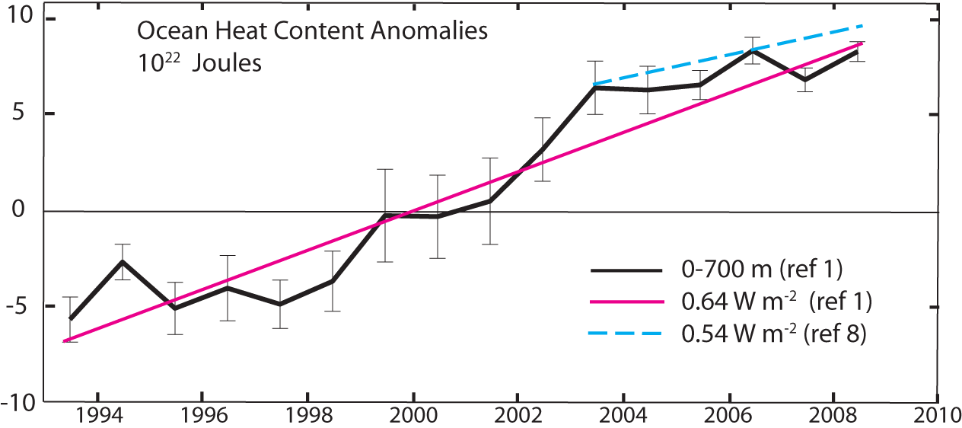
Ocean heat content is increasing
1. Lyman et al 2010 : to 700m
8. von Schuckmann et al 2009 :to 2000m From Trenberth 2010 Nature

Slide 39
Ocean fresh water
Or
The ocean salinity budget
The single most important role of the oceans in climate is that they are wet!

Slide 40
Melting ice
IPCC estimated melting ice contribution to SL rise was 1.2 mm/yr for 1992 to 2003.
How much is missed?
Is the Antarctic and Greenland melt a transient or not?
Many glaciers are not monitored
Ocean warming may change basal melting: poorly known
Ice sheets, buttressing by ice shelves poorly modeled
Concern future SL rise underestimated
Need process studies and improved models
Changes salinity: fresh water budget
affects ocean currents (MOC)

Slide 41
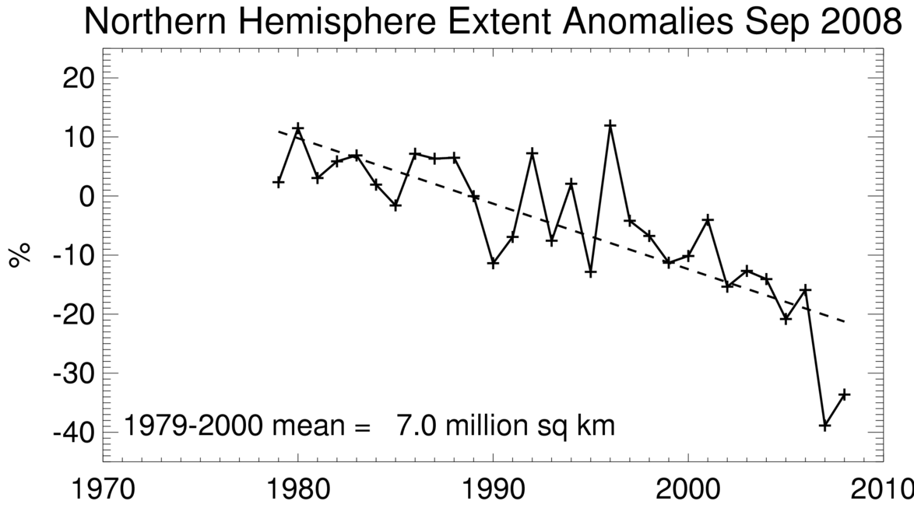
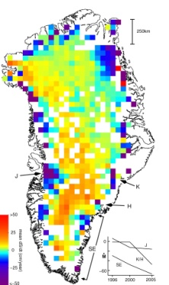
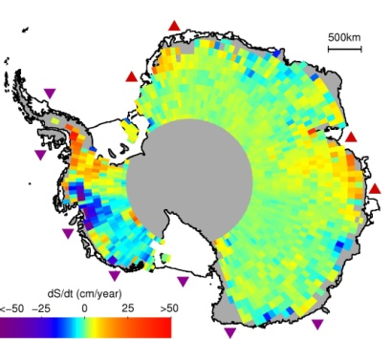
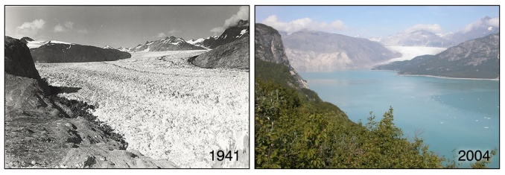
Snow cover and Arctic sea ice are decreasing
Arctic sea ice
area decreased by 2.7% per decade
(Summer: -7.4%/decade)
up to 2006:
2007: 22% (10⁶ km²) lower than 2005
2008: second lowest
2010: third lowest
Greenland and Antarctica ice sheets and glaciers are shrinking: Accelerated rate especially from 2002 to 2006?
To melt 10⁶ km² ice 1 m thick (2007) to 10°C = 3.4x10²⁰ J
Globally per year since 2004 this is 0.02 W m⁻²

Slide 42
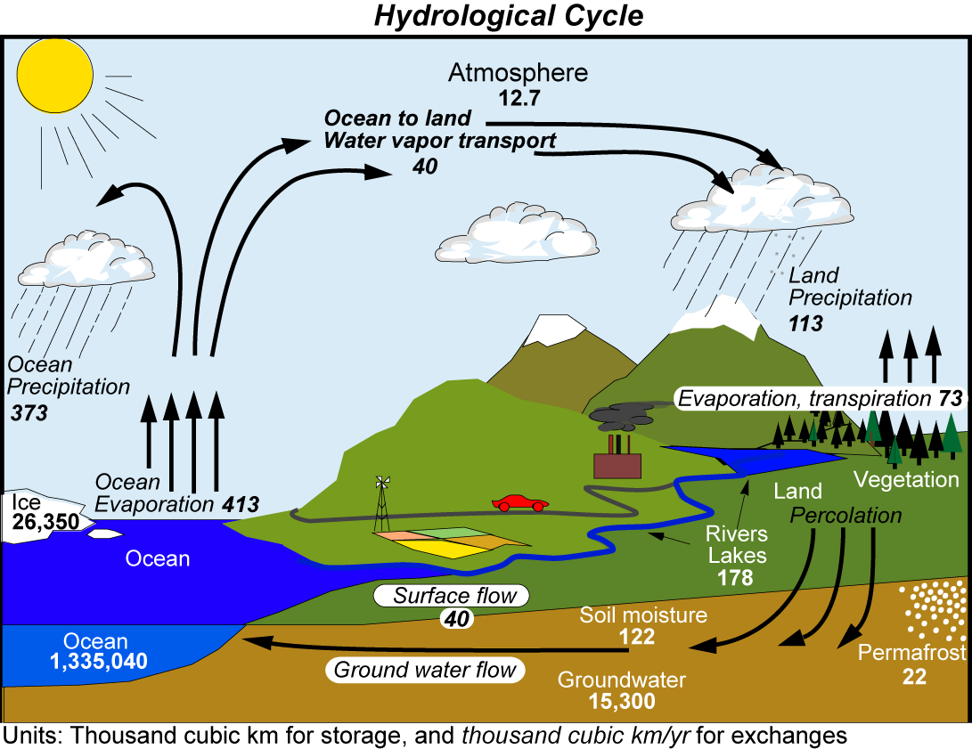
Trenberth et al 2007

Slide 43
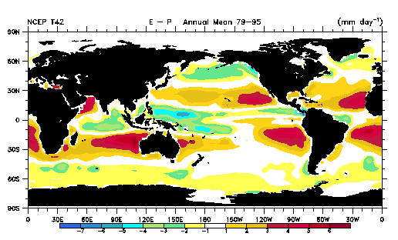
Divergences of water fluxes from E-P estimates over the oceans; values in Sv:
-0.2
-0.1
0.5
-0.1
0.1
0.4
0.5
-0.2
0.5
-0.0

Slide 44
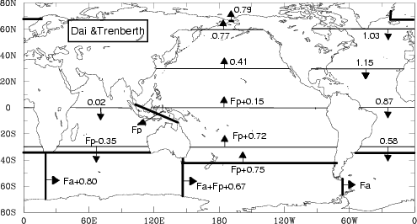
New estimate of fresh water transport in ocean from new values of E-P over ocean plus new river discharge estimates from Dai and Trenberth (2002)
Holfort and Siedler (2001) get –0.55 Sv at 30°S.

Slide 45
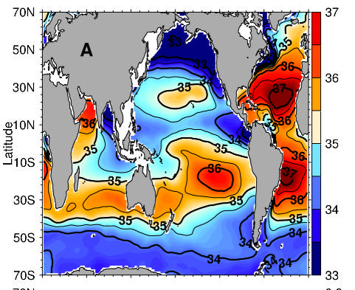
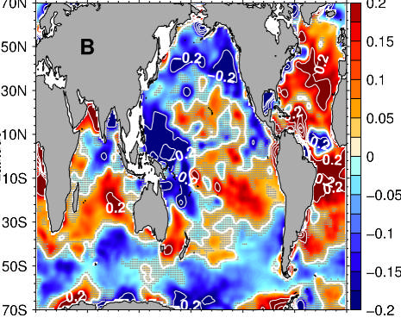
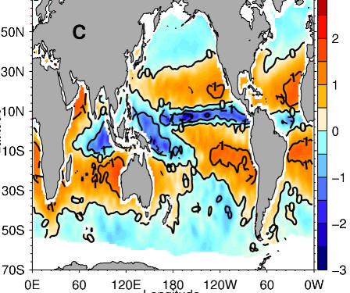
A. Mean salinity 1951-2000
C. Mean E-P 1980-1993 m³/yr
B. Linear trends pss/50yr (top)
Durack and Wijffels 2010 JC

Slide 46
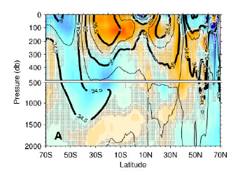
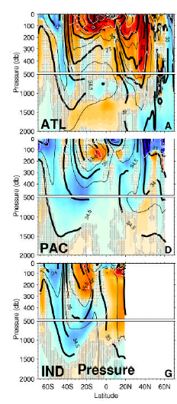
Linear trends pss/50yr
Durack and Wijffels 2010 JC
Subduction on isopycnals appears to account for much of the subsurface changes

Slide 47
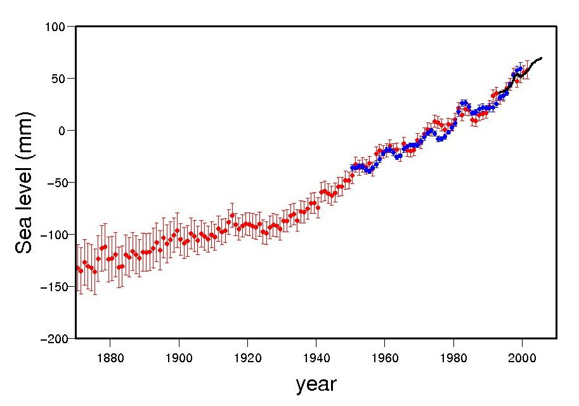
Sea level is rising in 20th century
Rates of sea level rise:
1.8 ± 0.5 mm yr⁻¹, 1961-2003
1.7 ± 0.5 mm yr⁻¹, 20th Century
3.1 ± 0.7 mm yr⁻¹, 1993-2003
Sea level rise:
0.17m ± 0.05 m 20th Century

Slide 48
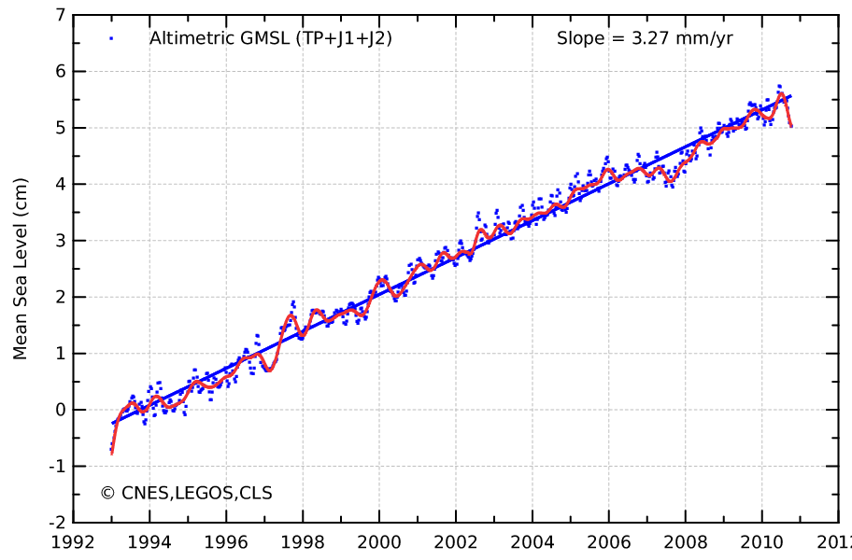
Sea level is rising:
from ocean expansion and melting glaciers
40
30
20
10
mm
0
-10
-20
-30
-40
Since 1992 Global sea level has risen 55 mm (2.2 inches)
To 2003: 60% from expansion as ocean temperatures rise, 40% from melting glaciers
AVISO: from TOPEX, Jason 1, Jason 2. Ann cy removed, IB, GIA applied

Slide 49
What about 2003 to 2008?
Global mean surface temperatures
1997 2003 2008

Slide 50
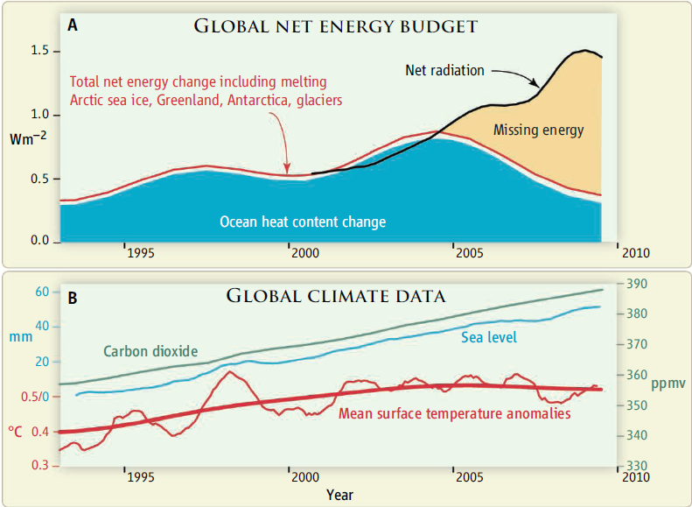
Can we track energy since 1993 when we have had good sea level measurements?
Trenberth and Fasullo Science 2010

Slide 51
Where does energy go?
10²⁰ Joules/yr
Trenberth 2009

Slide 52
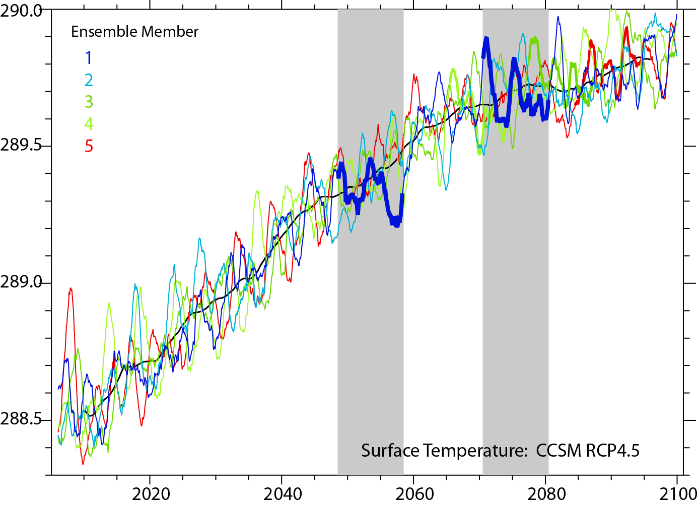
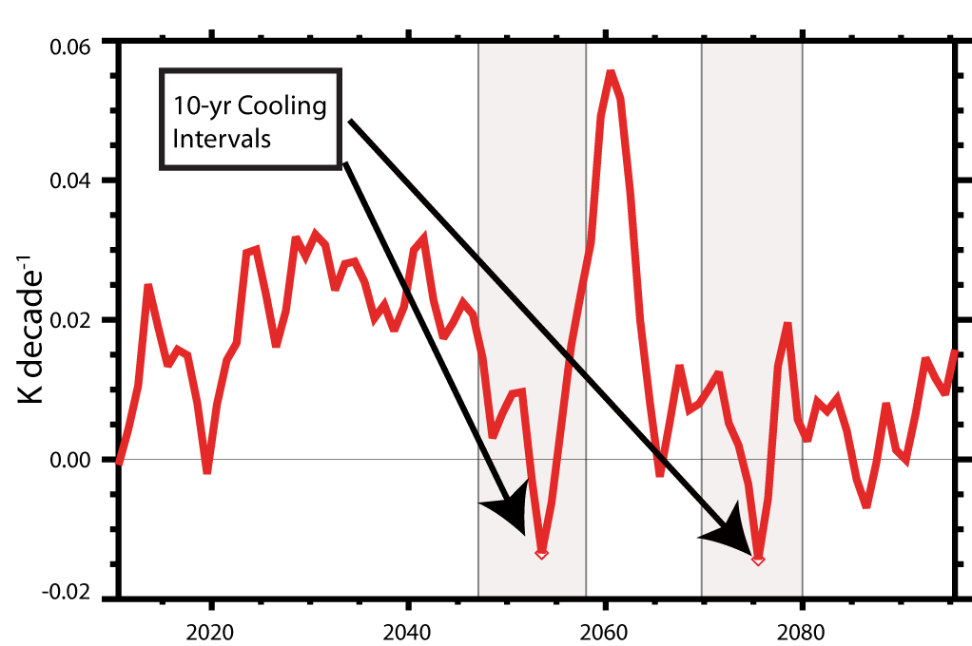
Missing energy in CCSM4?
In CCSM4, during periods with no sfc T rise, the energy imbalance at TOA remains about 1 W m⁻² warming. So where does the heat go?

Slide 53
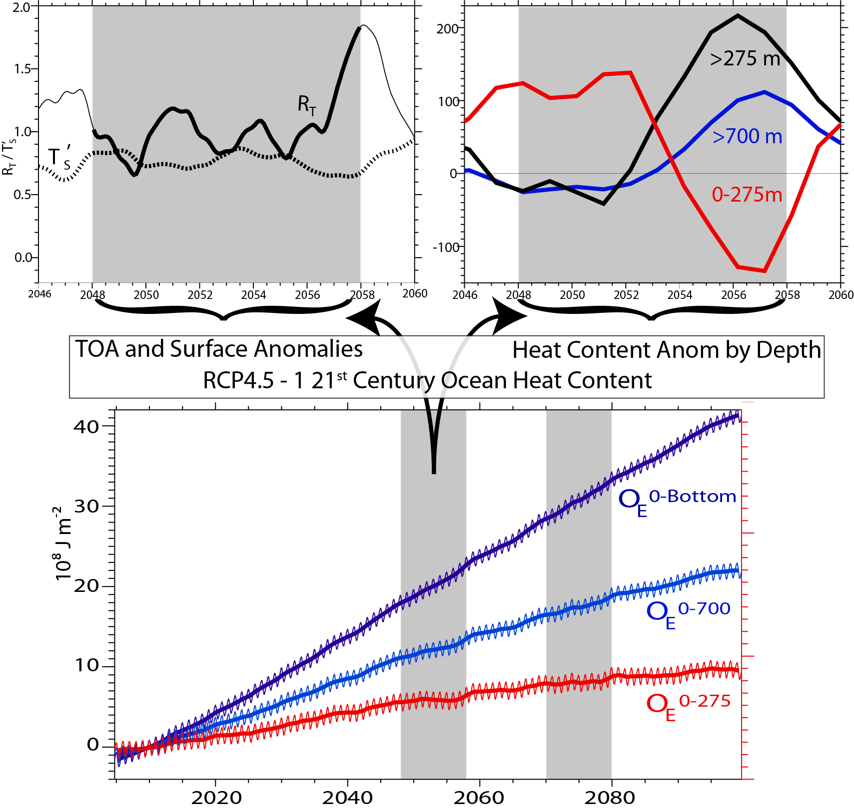
In CCSM4, during periods with no sfc T rise, the energy goes into the deep ocean, somehow.
Stasis also in upper OHC; but not for full depth ocean: heat below 700 m

Slide 54
Where does the heat go?
Questions regarding the mechanisms driving variability in deep ocean heat content remain. Both the CCSM4 and observations suggest that ENSO plays a necessary, if not sufficient, role. Strong recent ENSO events, including the El Niño of 1997/98 and the La Niña of 2007/08 exert a strong influence on trends in global temperature computed across this period.
Similarly, cooling decades from the CCSM4 are bounded by El Niño events at their initiation and La Niña events are their termination. Yet other intervals bounded by El Niño and La Niña are not accompanied by significant cooling. Our current work focuses on understanding this variable association between ENSO and global temperature trends.

Slide 55
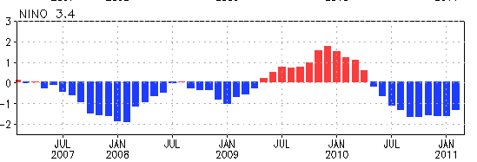
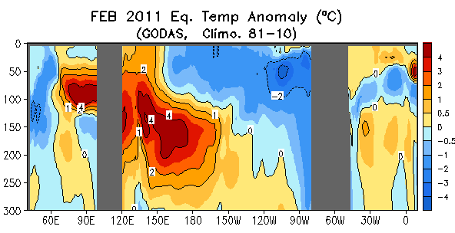
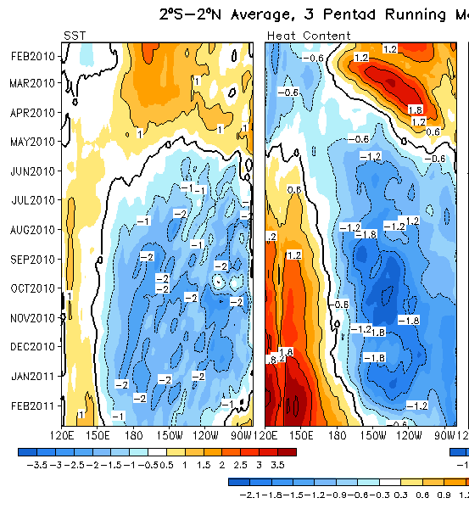


Evolution of recent ENSO Equatorial Pacific SST (ºC), 0-300m Heat Content (ºC)
Indian: 2S-2N
Pacific: 2S-2N
Notes:
Have a single plot?

Slide 56
Other issues
Ocean carbon
Acidification
Ocean color

Slide 57

Carbon Inventories of Reservoirs that Naturally Exchange Carbon on Time Scales of Decades to Centuries
Ocean Anth.
C=0.35%
Soil=2300 PgC
Preind.
Atm. C
=76%
Plants=650 PgC
Atm.=775 PgC
Anth.
C=24%
Ocean
38,136 PgC
Oceans contain ~90% of carbon in this 4 component system
anthropogenic component is difficult to detect

Slide 58









Annual mean air-sea CO₂ flux for 2000
Based on 3 million measurements since 1970
Global flux is 1.4 Pg C/yr
Takahashi et al., Deep Sea Res. II, 2009

Slide 59

Global CO₂ budget 1850-2006
Human Perturbation of the Global Carbon Budget
2000-2007
fossil fuel emissions
7.5 PgC/y
Source
deforestation
CO₂ flux (Pg C y⁻¹)
1.5
atmospheric CO₂
4.2
Sink
land
2.6
ocean
2.3
Time (y)
Canadell et al. (2007)
Global Carbon Project (2008)

Slide 60

The challenge is to better determine the heat budget at the surface of the Earth on a continuing basis:
Provides for changes in heat storage of oceans, glacier and ice sheet melt, changes in SSTs and associated changes in atmospheric circulation, some aspects of which should be predictable on decadal time scales.
Several models now can simulate major changes like the Sub-Sahara African drought beginning in the 1960s, the 1930’s “Dust Bowl” era in North America, given global SSTs.
Can coupled models predict these evolutions? (Not so far). But there is hope that they will improve.
In any case models should show some skill simply based on the current state, when it becomes well known and properly assimilated into models:
Need better observing system!

