Slide 1

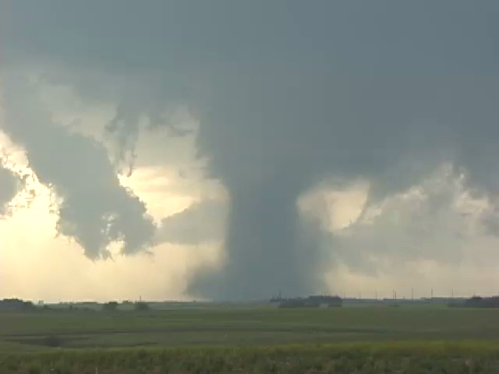
Physical understanding of changes in extremes
of precipitation
with climate change
Kevin E. Trenberth
NCAR

Slide 2
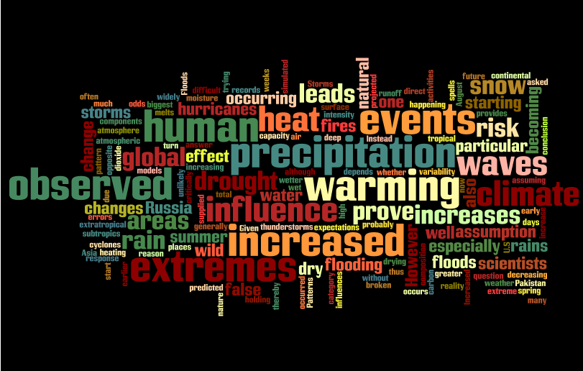
Summary

Slide 3

Sayings that describe changes in precipitation with climate change
Sunshine is delicious, rain is refreshing, wind braces us up, snow is exhilarating; there is really no such thing as bad weather, only different kinds of good weather.
John Ruskin
The rich get richer and the poor get poorer!
More bang for the buck!
It never rains but it pours!

Slide 4

“Everybody talks about the weather, but nobody does anything about it.”
— Attributed to Mark Twain, 1890s
“Now humans are doing something about the weather: global warming is contributing to an increased incidence of extreme weather because the environment in which all storms form has changed from human activities.”
Kevin Trenberth
USA Today 3 June.

Slide 5
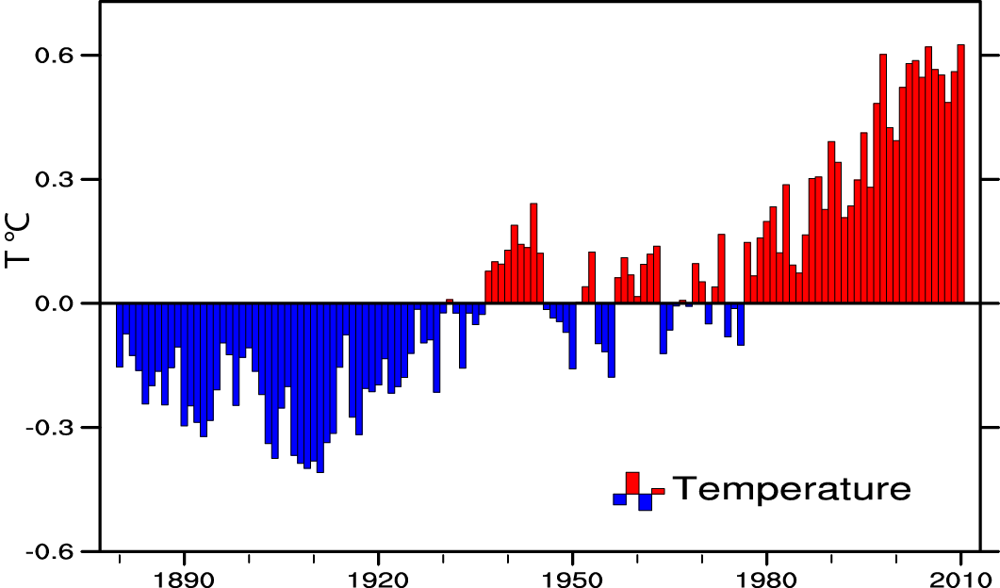
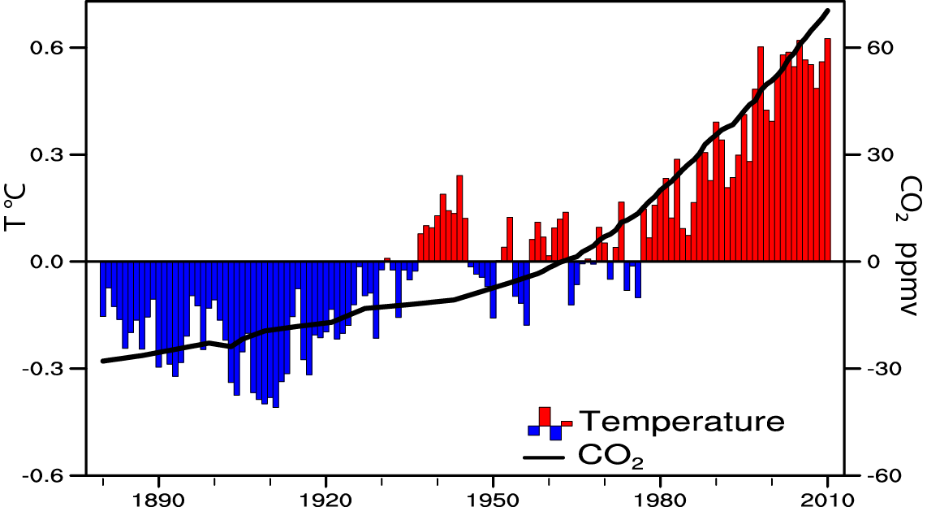
Global temperature and carbon dioxide: anomalies through 2010
Base period 1900-99; data from NOAA

Slide 6

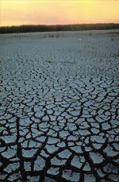
Global warming: Controlling Heat
The presence of moisture affects the disposition
of incoming solar radiation:
Evaporation (drying) versus temperature increase.
Human body: sweats
Homes: Evaporative coolers (swamp coolers)
Planet Earth: Evaporation (if moisture available)
e.g., When sun comes out after showers,
the first thing that happens is that the puddles dry up: before temperature increases.

Slide 7
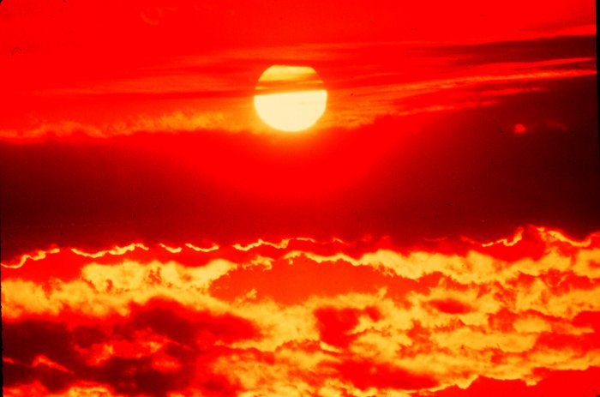
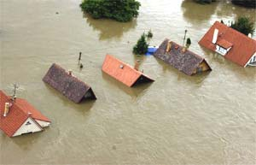
Climate change and extreme weather events
Changes in extremes matter most for society and human health
With a warming climate:
More high temperatures, heat waves
Wild fires and other consequences
Fewer cold extremes.
More extremes in hydrological cycle:
Drought
Heavy rains, floods
Intense storms, hurricanes, tornadoes

Slide 8
Attribution
Attribution is difficult as it requires good data and good models to take the signals apart.
Documentation of anomalies and how rare they are.
Ability to model the event
Models have difficulty with “blocking”
Models simulate monsoon rains poorly
At present all the uncertainties are lumped on the side of natural variability

Slide 9
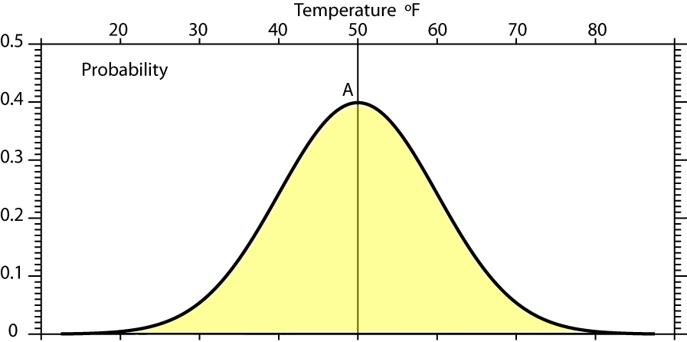
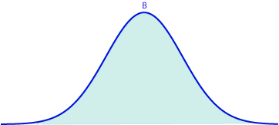
Reason for focus on extremes
Mean A: 50°F, s.d. 10°F

Slide 10
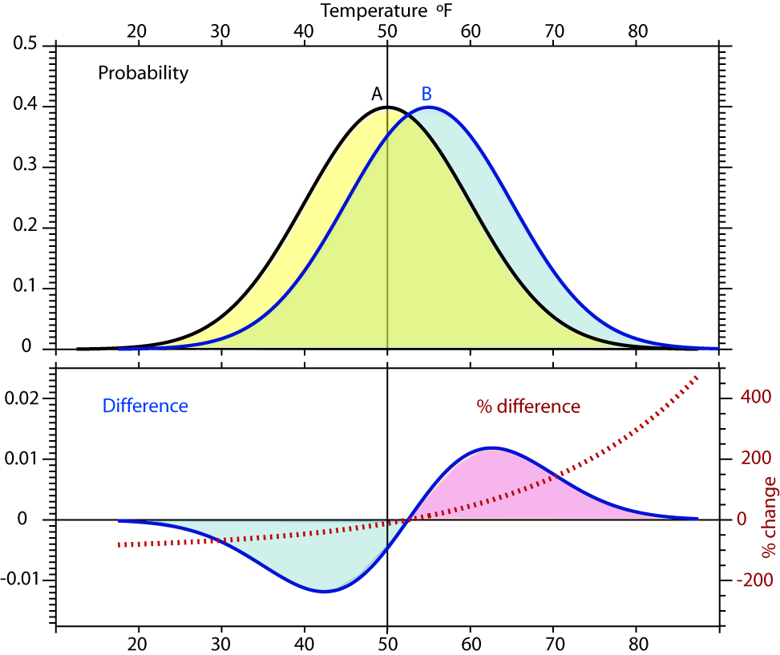
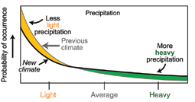
Reason for focus on extremes
Shift in climate: from A to B
Most of time the values are the same (green).
Biggest changes in extremes: >200%
Mean A: 50°F, s.d. 10°F
Mean B: 55°F, s.d. 10°F

Slide 11
Null hypothesis:
“There is no human influence on climate”
Burden of proof is high. Scientists typically require 95% confidence level (5% significance level)
Type I errors: False positive. Wrongly concluding there is a human influence when there isn’t.
Type II errors: False negative. Wrongly concluding there is no human influence, when there is. This kind of error is very common!

Slide 12
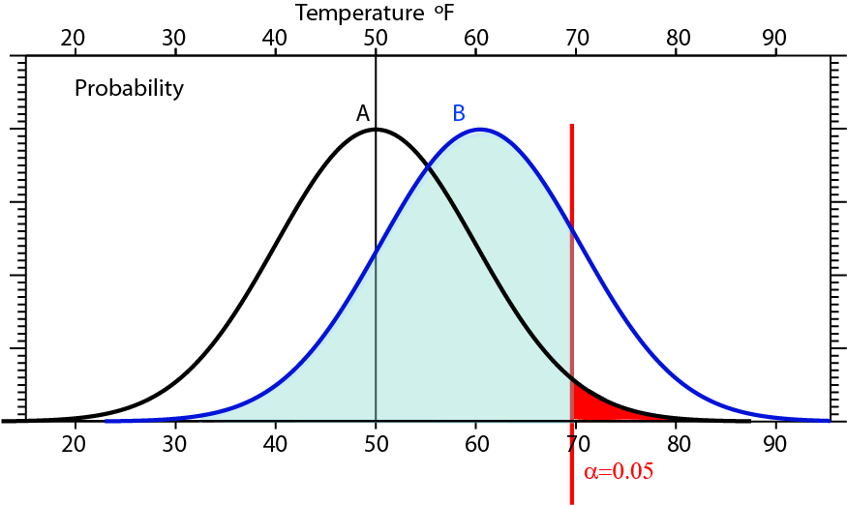
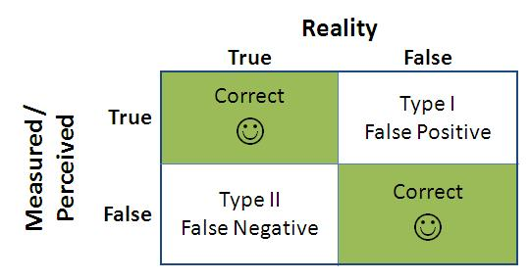
For a 1 standard deviation (10°F) shift in the distribution (due to climate change) from A to B, only values of B to the right of the two tailed 5% significance level (α=0.05 in red) would be considered significant under a null hypothesis of no change. All the values in the blue area of the B distribution would not.

Slide 13
Null hypothesis:
“There is no human influence on climate”
Was appropriate prior to 2007 (AR4) but IPCC found that global warming is “unequivocal” and “very likely” due to human activities.
So this null hypothesis no longer appropriate. If one reverses the null hypothesis “there is a human influence on climate” then it is very hard to prove otherwise at 95% level.
Key difference: the uncertainties fall on the other side!
So these are wrong questions:
“Is it due to global warming?”
“Is it due to natural variability?”
It is always both!
Moreover, natural variability is not a cause: where does the energy perturbation come from to cause the change?

Slide 14
Some extremes in 2010 of concern
The flooding in Pakistan (August) and related earlier flooding in China and India (July)
The Russian drought, heat wave and wild fires (which is an event physically related to the Asian flooding via a monsoon circulation and teleconnections)
The flooding events in the US, notably the nor-easters in February-March and the "Snowmageddon“ record breaking snows in Washington, Philadelphia and Baltimore.
Intense heavy rains in Nashville in May (over 20 inches in 2 days)
Wettest September ever in Australia, flooding since
Flooding in Columbia, drought in Brazil
The strong Atlantic hurricane season (19 named storms second after 2005 and tied with 1995 since 1944 when surveillance aircraft began monitoring, and 12 hurricanes). Only one storm made landfall in the US but 3 made landfall in Mexico and hurricane Karl caused extensive flooding in Mexico and Texas. Moisture from Hurricane Karl brought flooding rains to parts of southwest Wisconsin, southern Minnesota, and southeast South Dakota and contributed to Minnesota's wettest September in the 1895-2010 record.
Cold outbreaks in Europe and the U.S. (main population centers)

Slide 15
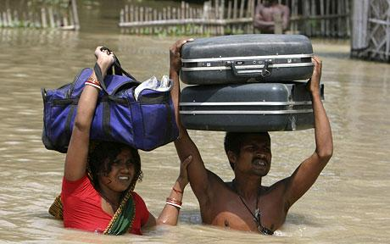
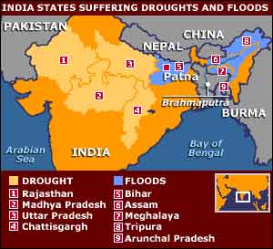

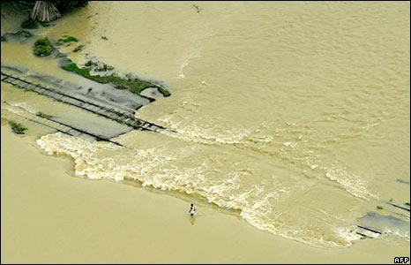
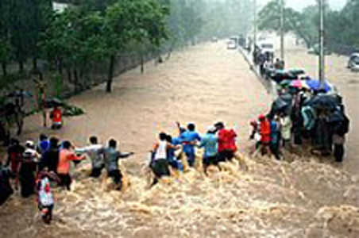
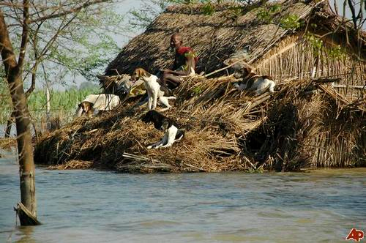
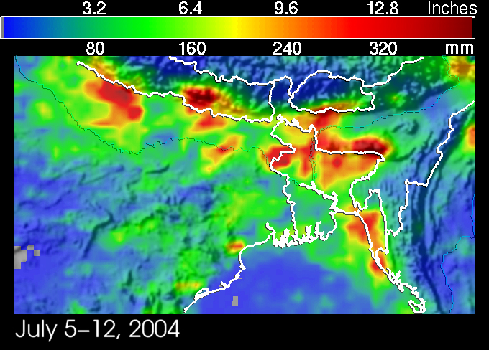
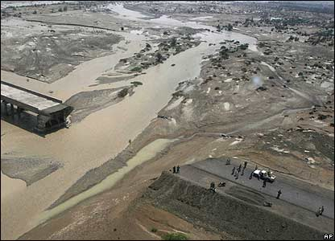
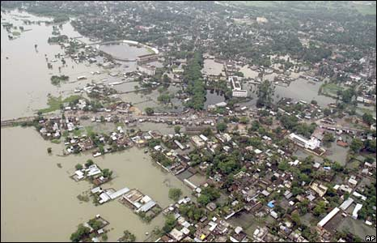
Jul-Aug 2010 India
From TRMM satellite

Slide 16
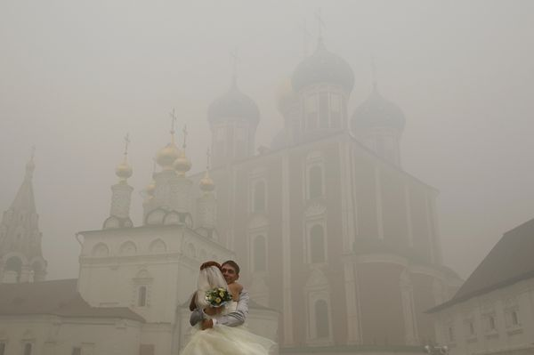
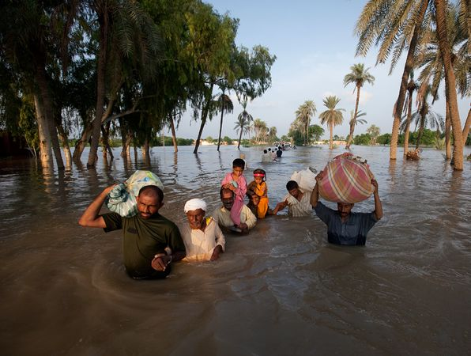
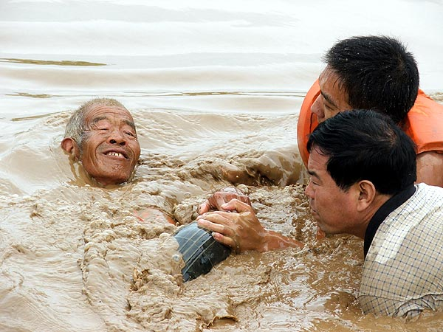
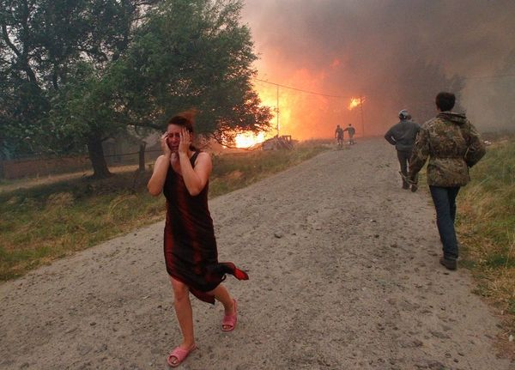
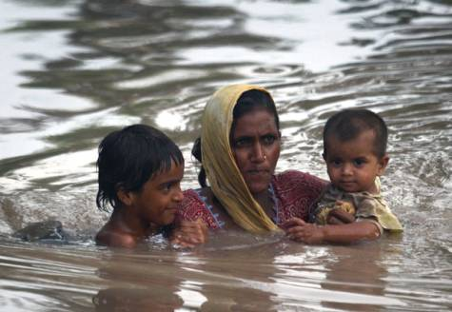
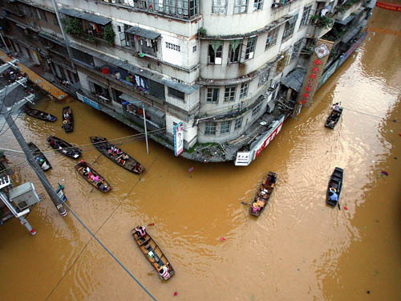
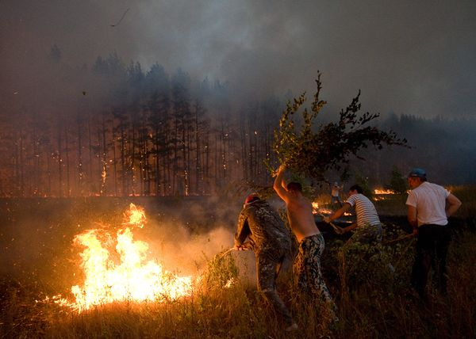
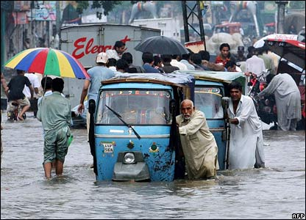
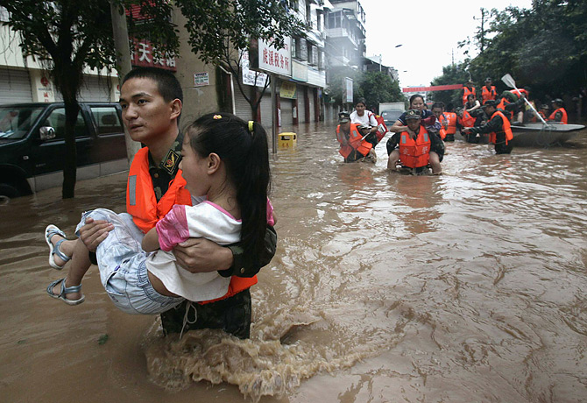
Aug 2010 Pakistan Russia China

Slide 17
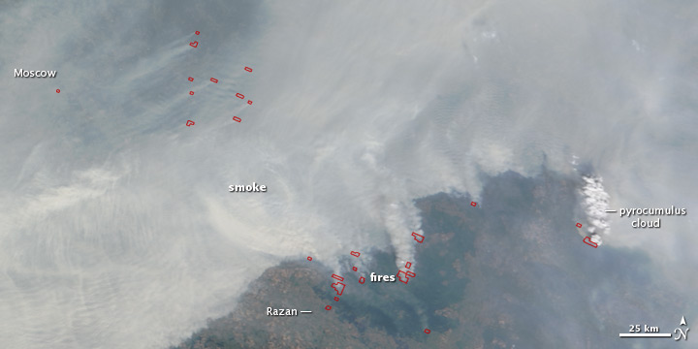
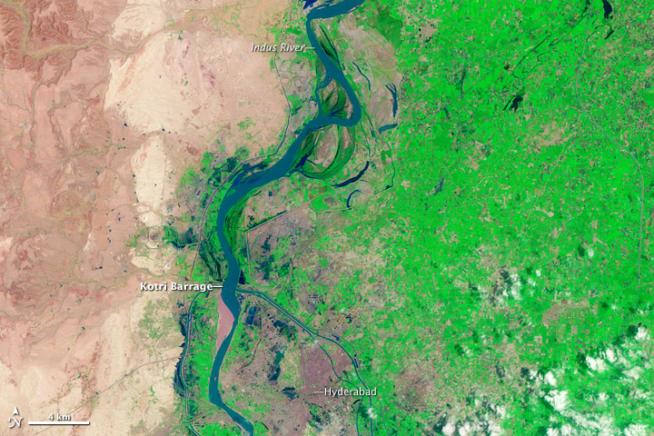
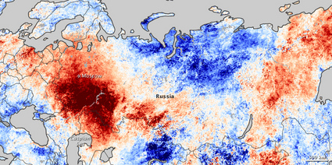
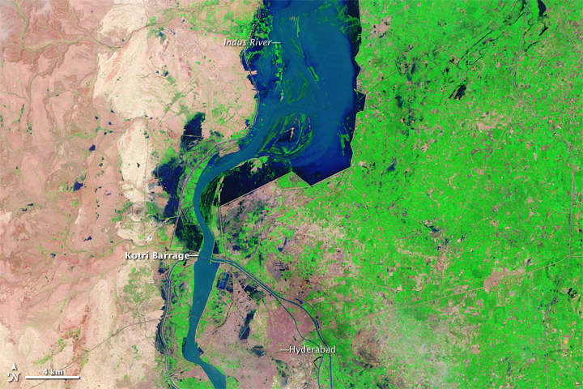
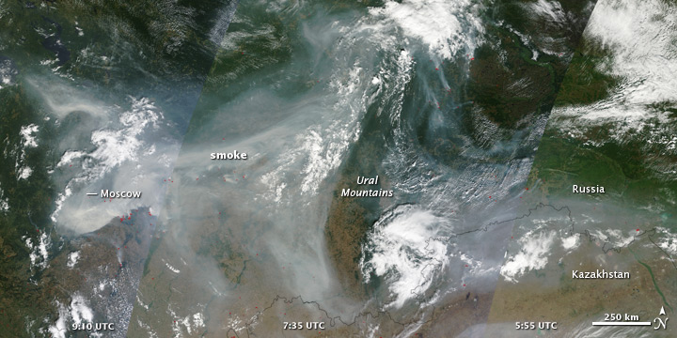
Russia Aug 2010
Pakistan
Jul 31, 2010
Indus
River
Aug 19, 2010
smoke
Courtesy NASA

Slide 18
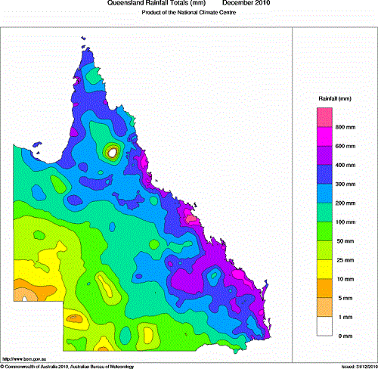
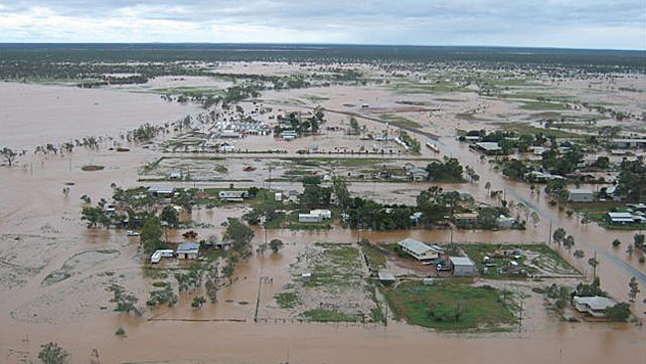
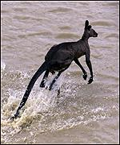

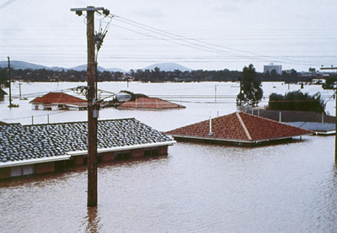
Flooding
Queensland Early Jan 2011

Slide 19
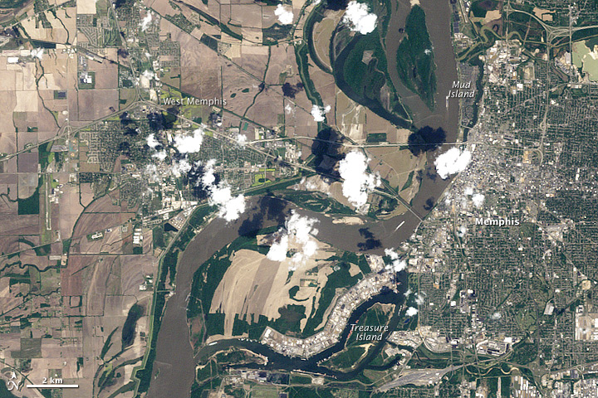
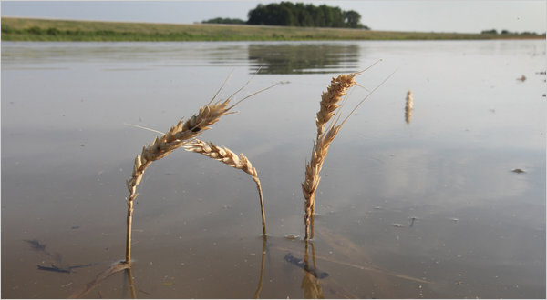
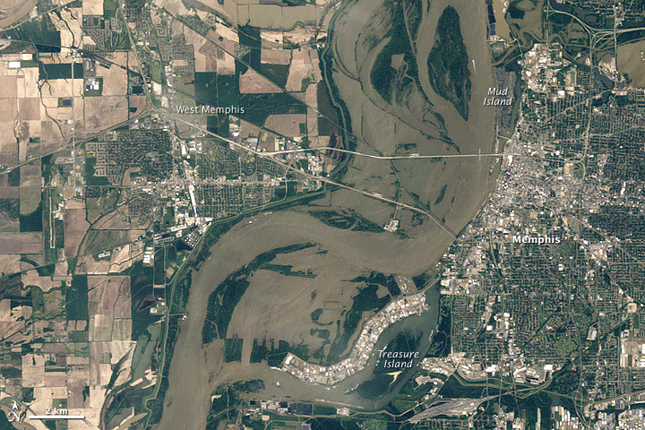
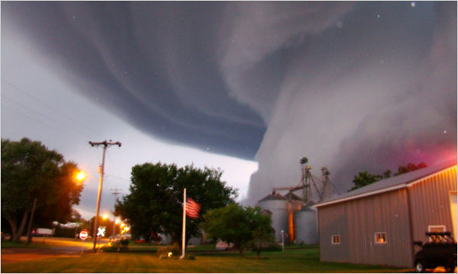
Mississippi River
May 11 (below) and at Memphis
Tornado
April 21, 2011
May 1, 2011

Slide 20

Precipitation

Slide 21
Key reference:
Trenberth, K. E., 2011: Changes in precipitation with climate change. Climate Research, 47, 123-138, doi:10.3354/cr00953.
http://www.cgd.ucar.edu/cas/Trenberth/trenberth.papers/SSD%20Trenberth%202nd%20proof.pdf
i.e. on my web site

Slide 22
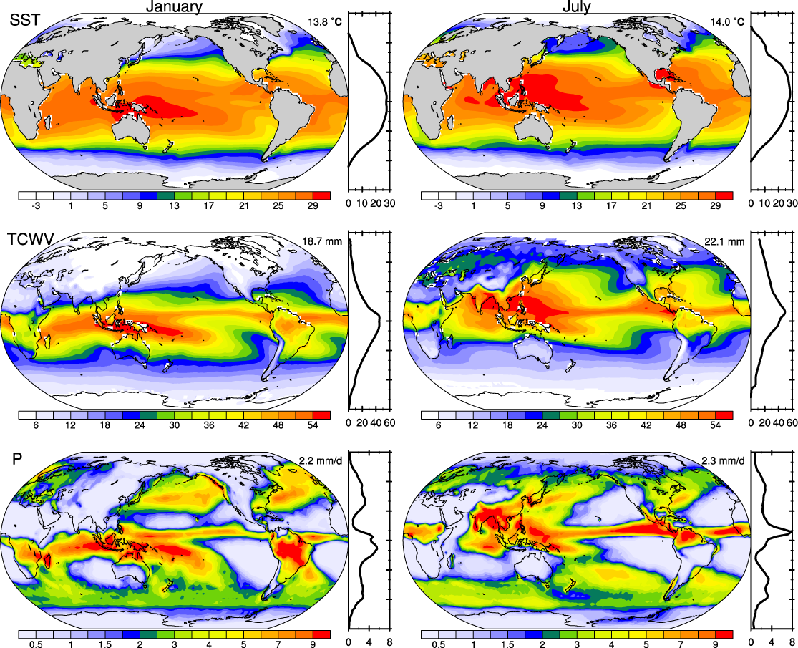
There is a strong relationship between SST and precipitable water, and also with mean precipitation in the tropics.

Slide 23
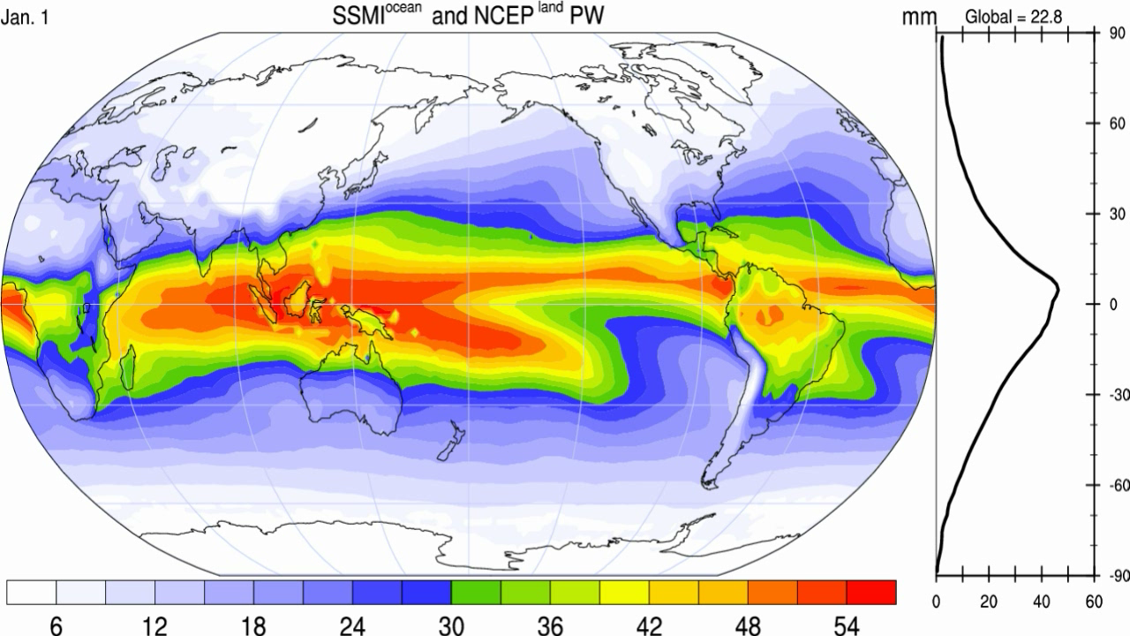
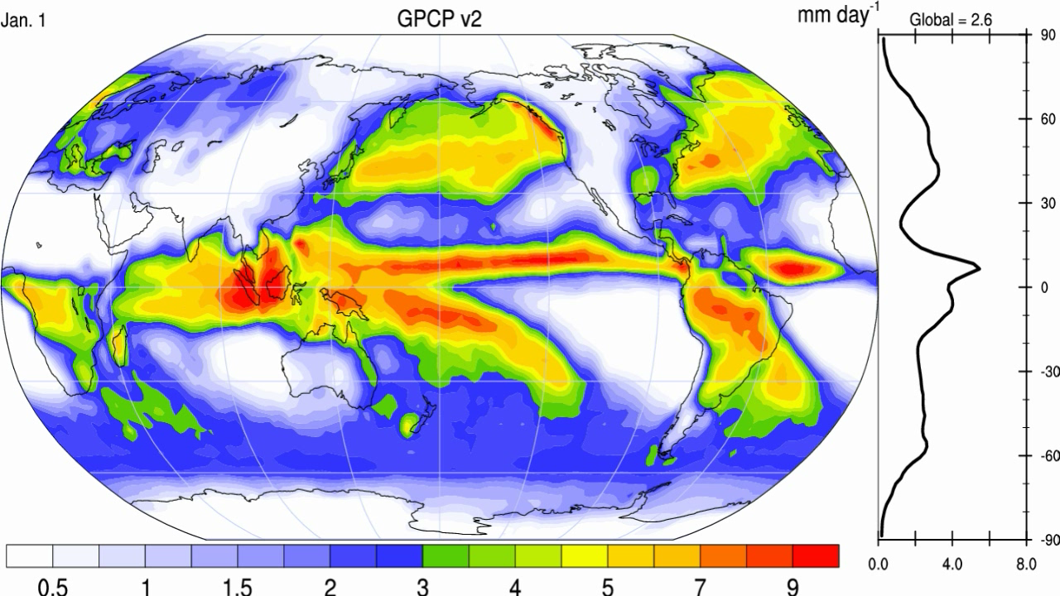
➢
Precipitable water
Precipitation

Slide 24
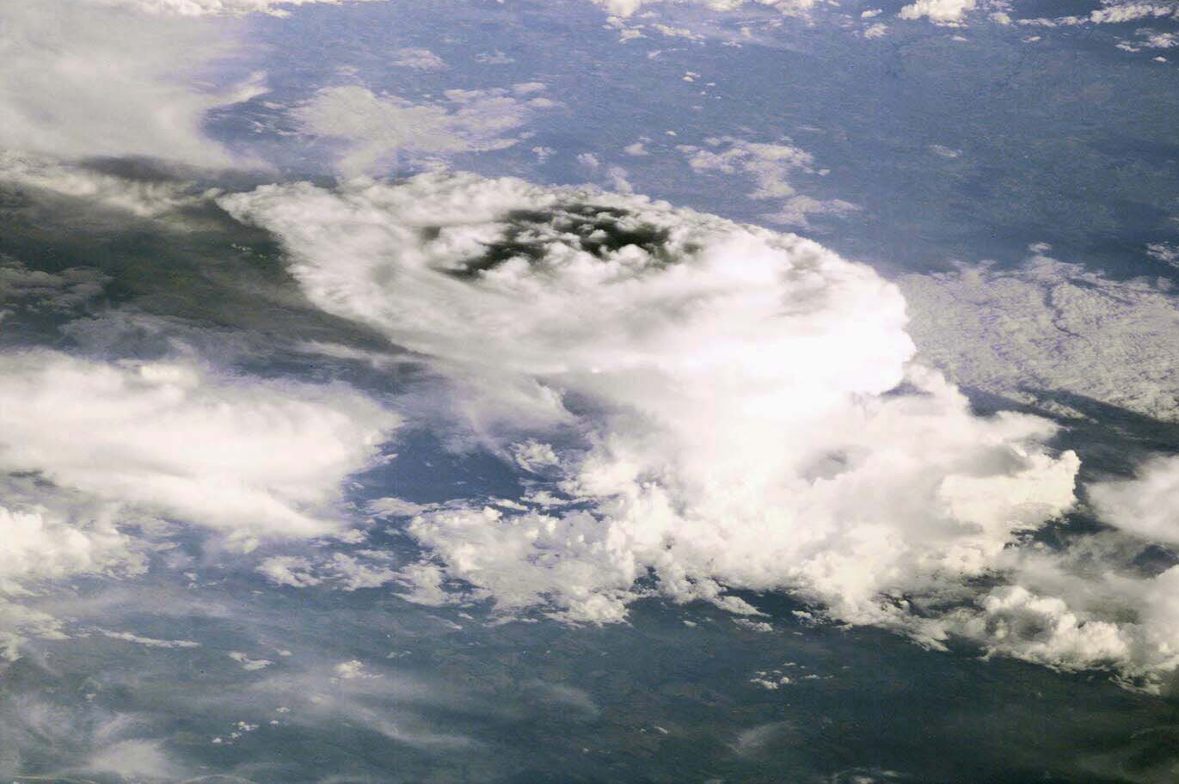
How should precipitation change as climate changes?
Usually only total amount is considered
But most of the time it does not rain
The frequency and duration (how often)
The intensity (the rate when it does rain)
The sequence
The phase: snow or rain
The intensity and phase affect how much runs off versus how much soaks into the soils.

Slide 25
Daily Precipitation at 2 stations
Monthly
Amount 75 mm
Amount 75 mm
A
B
Frequency 6.7%
Intensity 37.5 mm
Frequency 67%
Intensity 3.75 mm
drought wild fires local
wilting plants floods
soil moisture replenished
virtually no runoff

Slide 26

Most precipitation comes from moisture convergence by weather systems
The intermittent nature of precipitation (average frequency over oceans is 11%) means that moderate or heavy precipitation
Can not come from local column.
Can not come from E.
Hence has to come from transport by storm-scale circulation into storm.
On average, rain producing systems
(e.g., extratropical cyclones; thunderstorms)
reach out and grab moisture from distance about
3 to 5 times radius of precipitating area.

Slide 27
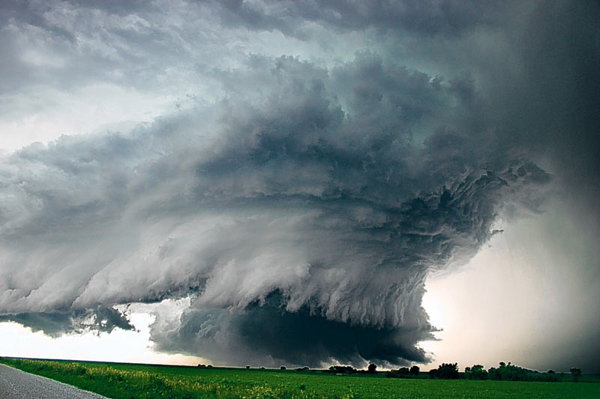
Most precipitation comes from moisture convergence by weather systems
Rain comes from moisture
convergence by low level winds:
More moisture means heavier rains

Slide 28
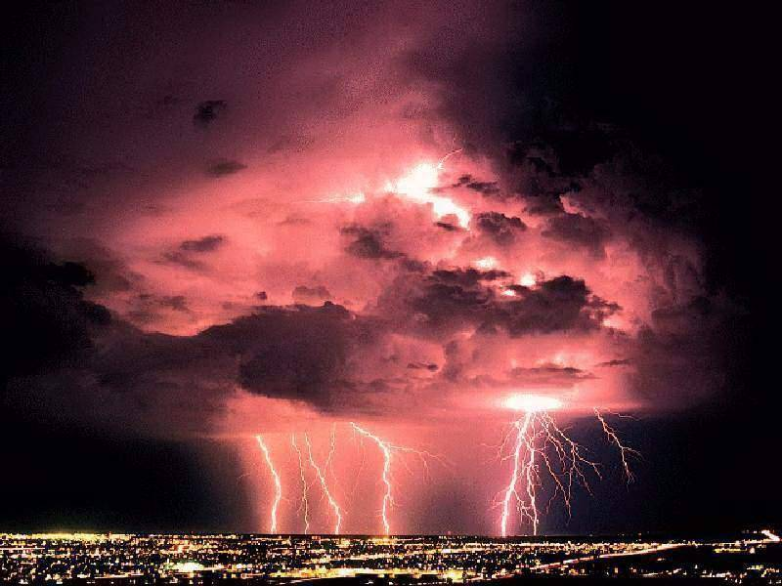
How is precipitation changing?

Slide 29
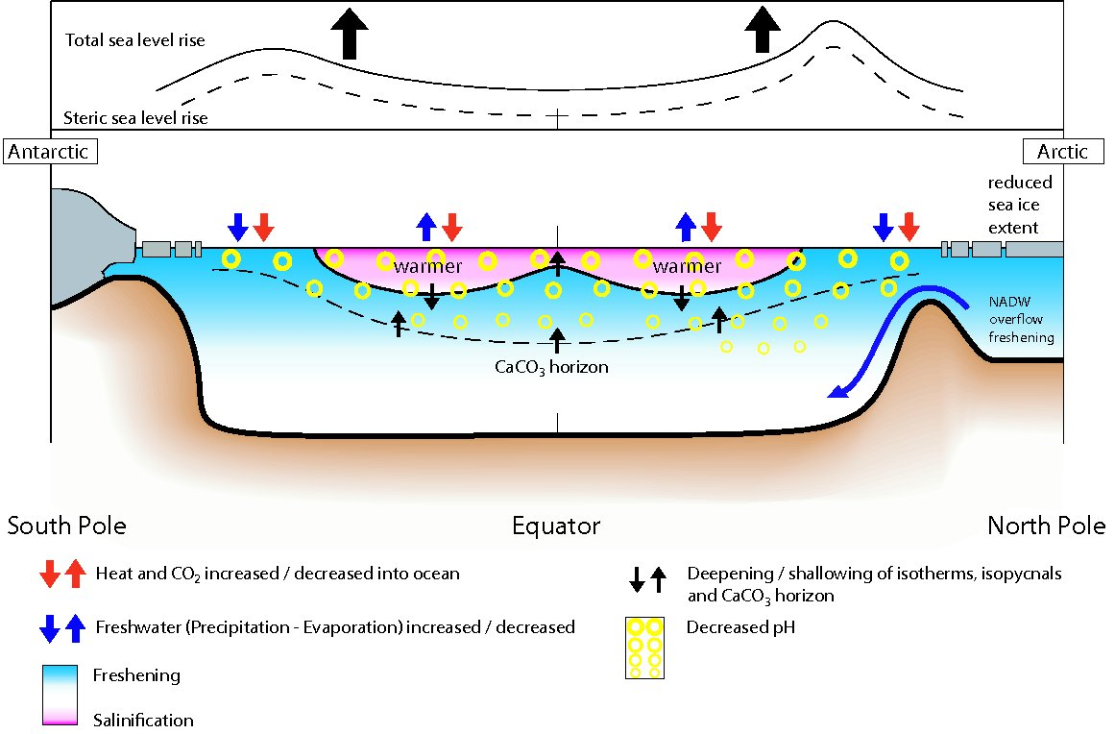
Changes in ocean state
from 1950-1960’s to 1990-2000’s (IPCC 2007 Figure 5.18)

Slide 30

GPCP Global precipitation 1979-2008
Wentz 2007:
1987-2006

Slide 31

2010 highest on record
Land: Annual mean precipitation anomalies

Slide 32

Land precipitation is changing significantly over broad areas
Increases
Decreases
Smoothed annual anomalies for precipitation (%) over land from 1900 to 2005; other regions are dominated by variability.
IPCC

Slide 33

Precipitation
Observed trends (%) per decade for 1951–2003 contribution to total annual from very wet days > 95th %ile.
Alexander et al 2006
IPCC AR4
Heavy precipitation days are increasing even in places where precipitation is decreasing.

Slide 34
Enhanced Drying over Land Under Global Warming
Increased longwave radiative heating provides additional energy for surface evaporation
Higher air temperatures increase atmospheric demand for water vapor
Reduced precipitation frequency can lead to longer dry spells and increased drought
Larger warming over land than over ocean leads to larger increases in potential evaporation over land than ocean, which can lead to increased water stress over land.

Slide 35

Drought is increasing most places
Mainly decrease in rain over land in tropics and subtropics, but enhanced by increased atmospheric demand with warming
The most important spatial pattern (top) of the monthly Palmer Drought Severity Index (PDSI) for 1900 to 2002.
The time series (below) accounts for most of the trend in PDSI.
Dai et al 2004
IPCC 2007

Slide 36

Trends 1948-2004 in runoff by river basin
Based on river discharge into ocean
Dai et al.2009

Slide 37

SSM/I era
GPCP satellite era
Estimated water year (1 Oct-30 Sep) land precipitation and river discharge into global oceans based on hindcast from output from CLM3 driven by observed forcings calibrated by observed discharge at 925 rivers.
Note: 1) effects of Pinatubo; 2) downward trend (contrast to Labat et al (2004) and Gedney et al (2006) owing to more data and improved missing data infilling)
Trenberth and Dai 2007; Dai et al. 2009

Slide 38

Geoengineering:
One proposed solution to global warming:
Emulate a volcano: Pinatubo
Cut down on incoming solar radiation
Is the cure worse than the disease?

Slide 39


Factors in Changes in Precipitation
It never rains but it pours!

Slide 40


Air holds more water vapor at higher temperatures
A basic physical law tells us that the water holding capacity of the atmosphere goes up at about 7% per degree Celsius increase in temperature. (4% per °F)
Observations show that this is happening at the surface and in lower atmosphere: 0.55°C since 1970 over global oceans and 4% more water vapor.
This means more moisture available for storms and an enhanced greenhouse effect.
More intense rains (or snow) but
longer dry spells
Trenberth et al 2003
Total water vapor

Slide 41

Higher temperatures: heavier precipitation
Percent of total seasonal precipitation for stations with 230mm±5mm falling into 10mm daily intervals based on seasonal mean temperature.
Blue bar -3˚C to 19˚C, pink bar 19˚C to 29˚C, dark red bar 29˚C to 35˚C, based on 51, 37 and 12 stations.
As temperatures and e_{s} increase, more precipitation falls in heavy (over 40mm/day) to extreme (over 100mm/day) daily amounts.
Karl and Trenberth 2003

Slide 42
How should precipitation P change as the climate changes?
With increased GHGs: increased surface heating evaporation E⇑ and P⇑
Clausius Clapeyron: water holding capacity of atmosphere goes up about 7% per °C. (4% per °F)
With increased aerosols, E⇓ and P⇓
Net global effect is small and complex
Models suggest E⇑ and P⇑ 2-3% per °C.

Slide 43



Bathtub analogy
Before warming
After warming
Evaporation
Atmosphere
Moisture
Precipitation
Inflow increases somewhat
Level increases a lot
Outflow is more episodic: larger
(because tub is fuller) but less frequent
Intermittent outflow:
Depends on bath plug

Slide 44

Controls on the changes in net precipitation
1. Changes in cloud
2. Changes in aerosol
3. Changes in atmospheric radiation
1.+2. Evaporation is limited by energy available
3. Latent heating has to be mostly balanced by net LW radiative losses (SH small)
4. Over land: Latent heating is partly balanced by sensible heat
2000-2005 Trenberth et al 2009

Slide 45
TOA radiation does not change (much) in equilibrium
Controls on the changes in net precipitation
If the only change in climate is from increased GHGs:
then SW does not change (until ice melts and if clouds change), and so OLR must end up the same.
But downwelling and net LW↓ increases and so other terms must change: mainly evaporative cooling.
Transient response may differ from equilibrium (see Andrews et al. 09)
Land responds faster. Radiative properties partly control rate of increase of precipitation.: Stephens and Ellis 2008
2000-2005 Trenberth et al 2009

Slide 46

Precipitation vs Temperature
Winter high lats: air can’t hold moisture in cold; storms: warm and moist southerlies.
Clausius-Clapeyron effect
T⇒P
Nov-March
Correlations of monthly mean anomalies of surface temperature and precipitation.
May-September
Negative: means hot and dry or cool and wet.
Positive: hot and wet or cool and dry (as in El Nino region).
Trenberth and Shea 2005
Tropics/summer land: hot and dry or cool and wet
Rain and cloud cool and air condition the planet!
P⇒T
Oceans: El Nino high SSTs produce rain, ocean forces atmosphere
SST⇒P

Slide 47

Temperature vs Precipitation
Cyclonic regime
Cloudy: Less sun
Rain: More soil moisture
Surface energy: LH ↑ SH↓
Rain ↑ Temperature ↓
Anticyclonic regime
Sunny
Dry: Less soil moisture
Surface energy: LH↓ SH↑
Rain ↓ Temperature ↑
Summer: Land
Strong negative correlations
Does not apply to oceans

Slide 48
Air holds more water vapor at higher temperatures
The C-C effect is important over oceans (abundant moisture) and over land at mid to high latitudes in winter.
“The rich get richer and the poor get poorer”. More moisture transports from divergence regions (subtropics) to convergence zones. Result: wet areas get wetter, dry areas drier (Neelin, Chou)
But increases in moist static energy and gross moist instability enables stronger convection and more intense rains. Hadley circulation becomes deeper.
Hence it changes winds and convergence: narrower zones.

Slide 49


How else should precipitation P change as the climate changes?
“More bang for the buck”: With increased moisture, the winds can be less to achieve the same transport. Hence the divergent circulation weakens. (Soden & Held)
Changes in characteristics: more intense less frequent rains (Trenberth et al)
Changed winds change SSTs: ITCZ, storm tracks move: dipoles Example: ENSO
Type: snow to rain
Snow pack melts sooner, runoff earlier, summer soil moisture less, risk of summer drought, wildfires increases

Slide 50

Precipitation in models: “all models are wrong, some are useful”
A challenge:
Amount: distribution: double ITCZ
Frequency: too often
Intensity: too low
Runoff: not correct
Recycling: too large
Diurnal cycle: poor
Lifetime: too short
(moisture)
Issues:
Tropical transients too weak
Hurricanes
MJOs
Easterly waves

Slide 51

All models are wrong, some are useful!
There are many analyses of models, but models are demonstrably poor at many aspects of the hydrological cycle.
Courtesy Francis Zwiers

Slide 52

Model predictions
“Rich get richer, poor get poorer”
Projections: Combined effects of increased precipitation intensity and more dry days contribute to lower soil moisture
2090-2100 IPCC

Slide 53
Russian heat wave attribution
Train of causation /evidence
There is a climate event, with observational evidence:
Record high temperatures in Russia, heat waves, wild fires, over a month
High SSTs in tropical Indian Ocean, western Pacific
Arctic sea ice loss: near record low
High precipitation, flooding in Pakistan, India, China: SE Asia
Distribution linked to La Nina

Slide 54


Temperatures
From Dole et al 2011

Slide 55

SSTs
Positive anomalies on top of normally high SSTs have extra impact owing to C-C

Slide 56

Northern Indian Ocean
Incl: Bay of Bengal and Arabian Sea
SSTs
May 2010 highest on record (30.4°C) and anomaly 0.9°C
(2.9 σ)
(base period 1960-89)

Slide 57

Precipitation
ERA-I

Slide 58

Record high SSTs in Caribbean and Gulf of Mexico Aug 2010
Record flooding in Columbia, 2nd highest activity in Atlantic tropical storms: 19 named, 12 hurricanes, 4 cat 4 or 5.
Drought in Brazil.

Slide 59





Flooding
Queensland
Early Jan 2011
La Niña

Slide 60

Flooding on the Mississippi:
There were multiple
“1-in-500 year” or “1-in-100 year flood events within a few years of each other in parts of the Basin…
1993
Then again in 2008.
And now: 2011
AP 2000; NYT 2011 Peter Gleick

Slide 61


SSTs in Gulf 0.5 to 1.5°C above 1981-2010 values:
~1.5°C above pre-1970 values

Slide 62


La Nina precipitation anomalies for JFM
anomalies (mm) frequency (%)
La Niña

Slide 63

19-25 April 2011
10 inches

Slide 64


Slide 65
The environment in which all storms form has changed owing to human activities.
Global warming has increased temperatures, and directly related to that, is an increase in the water holding of the atmosphere.
Over the ocean, where there are no water limitations, observations confirm that the amount of water vapor in the atmosphere has increased by about 4%, consistent with a 1°F warming of sea surface temperatures (SSTs) since about the 1970s.

Slide 66

More intense precipitation
Adapted from Peter Gleick
More intense and longer lasting drought

Slide 67







Prospects for increases in extreme weather events

