Slide 1
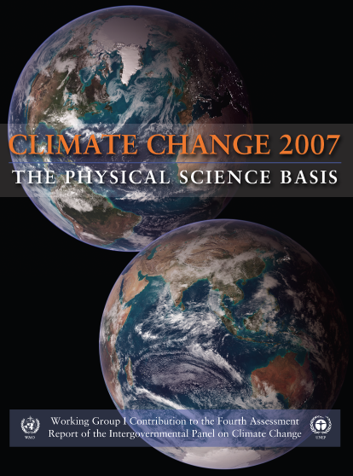
Climate change and the IPCC
Kevin Trenberth
NCAR
AR4: WG I
996 pp

Slide 2


IPCC
2007:
The Nobel Peace Prize goes to the Intergovernmental Panel on Climate Change (IPCC) and Albert Arnold (Al) Gore Jr. "for their efforts to build up and disseminate greater knowledge about man-made climate change, and to lay the foundations for the measures that are needed to counteract such change".

Slide 3
IPCC
1988 - The establishment of the IPCC
Role of the IPCC:
The role of the IPCC is to assess on a comprehensive, objective, open and transparent basis the scientific, technical and socio-economic information relevant to understanding the scientific basis of risk of human-induced climate change, its potential impacts and options for adaptation and mitigation.
Review by experts and governments is an essential part of the IPCC process.

Slide 4





1988 - The establishment of the IPCC
WMO, UNEP
1990 - First IPCC Assessment Report
1992 - IPCC Supplementary Reports
1994 - IPCC Special Report
1995 - Second IPCC Assessment Report
1996 - COP-2, 1997 - COP-3
2001 - Third IPCC Assessment Report
2002 - COP-8, 2003 - COP-9
2007 - Fourth IPCC Assessment Report
2009/12 - COP-15 Copenhagen
IPCC
1992- Adoption of the UNFCCC
1994- Entry into force of the UNFCCC
Ratified by 189 countries
1997- Adoption of Kyoto Protocol at COP-3
2005 Feb 16- Kyoto Protocol ratified by 164 countries
(But not by USA or Australia)

Slide 5
IPCC
Scenarios of future emissions
of greenhouse gases, aerosols
WGI
WGIII
Mitigation
Policy options
Scenarios of future concentrations
of greenhouse gases and aerosols
Feedbacks
Adaptation
Assessment of observations,
processes and models
WGII
Impacts
WGI
Projections of future climate:
The response, global, regional

Slide 6
IPCC Scientific Assessment 2007
AR4
WG I: 11 Chapters
996 pages (vs TAR 882)
140 lead authors
Hundreds contributors (66 Chapter 3)
2 or 3 Review editors for each chapter (26)
Over 700 reviewers.
Chapter 3: 2 CLAs, 10 LAs, 66 CAs
47 figures (126 panels), 8 Tables, 863 references,
102 pp. plus supplementary material
2231/ 1270 comments in scientific/governmental review
3501 total comments: all responded to in xls spread sheet (available publically)

Slide 7
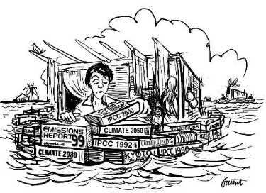

Slide 8
IPCC
The role of the IPCC
is to provide policy relevant but not policy prescriptive scientific advice to policy makers and the general public.
IPCC scientists with all kinds of value systems, ethnic backgrounds, and from different countries, gather together to produce the best consensus science possible, and with appropriate statements about confidence and uncertainty.
Scientists have become accustomed to this role and many find it hard to become advocates for particular courses of action, and have often been criticized as a result.

Slide 9
IPCC
A major strength of the IPCC process
has been the intergovernmental process, through reviews and then approval of the Summary for Policy Makers on a word-by-word basis. This provides ownership.
But it has also been subject to criticism as it is much more political. In principle, this process is designed to provide a report in which the content is determined by the science while how it is stated is determined jointly with the governments. Hence it aids communication between scientists and politicians.
NOTE: In terms of impact of the report, the process is as important as the report itself.

Slide 10
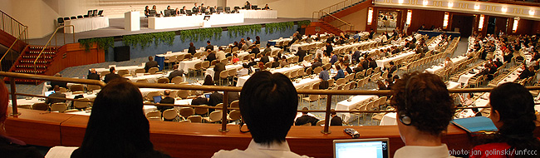
IPCC
Copenhagen December 2010
Representatives of 192 nations gathered in Copenhagen to seek a consensus on an international strategy for fighting global warming, in a series of meetings between Dec. 7 and Dec. 18, 2009.
Leaders concluded a climate change deal which fell short of even the modest expectations for the summit.
The accord drops what had been the expected goal of concluding a binding international treaty by the end of 2010, which leaves the implementation of its provisions uncertain. It is likely to undergo many months, perhaps years, of additional negotiation before it emerges in any internationally enforceable form.

Slide 11
IPCC
In late 2009:
Many emails were stolen from the University of East Anglia server involving Phil Jones.
Phil Jones and I were Coordinating Lead Authors on Chapter 3 of IPCC and so over 100 of the emails involved me.
Now known as “climategate” but really more like “swiftboating”, these emails have been used to damn the IPCC and many of us. There were several things in the emails that were obviously not for public consumption and violations of the freedom of information act were revealed.
None of mine were embarrassing to me at all, but one was highly misused and went viral.
Several enquiries have failed to reveal any issues with the science, and have exonerated Jones.

Slide 12
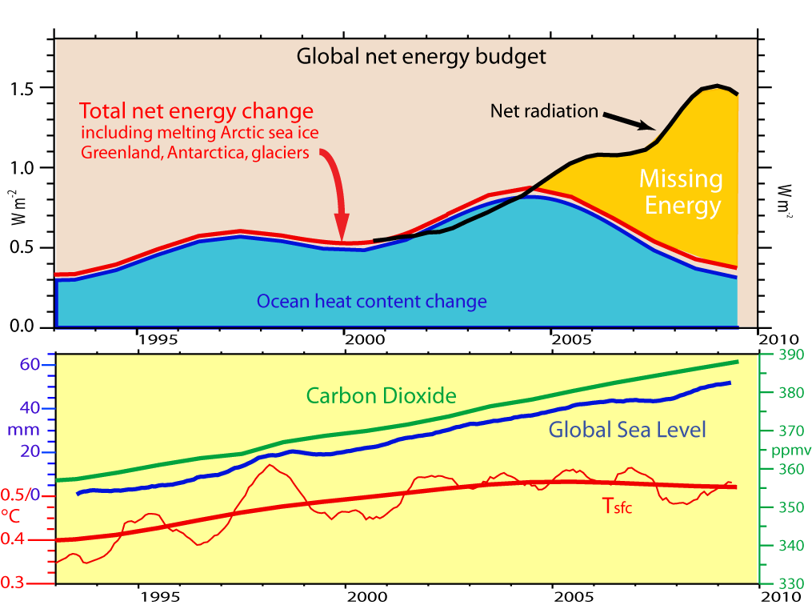
IPCC
One cherry-picked email quote of mine has gone viral: over 110,000 stories
"The fact is that we can't account for the lack of warming at the moment and it is a travesty that we can't."
Kevin Trenberth: "It is quite clear from the paper that I was not questioning the link between anthropogenic greenhouse gas emissions and warming, or even suggesting that recent temperatures are unusual in the context of short-term natural variability.“
This is now written up in
Science, 16 Apr 2010
pp 316-317.

Slide 13
IPCC
In late 2009 (coinciding with Copenhagen) to 2010, malicious attacks have occurred on many who participated in the IPCC report, and the IPCC did not handle them well by defending its processes.
The report itself has been scrutinized along with all of the comments and responses to the comments.
Two minor errors have been found: both in WG II, none in WG I.
Himalayan glaciers melt (correct in WG I)
Area of Netherlands below sea level
None of all the attacks have in any way changed the science or the conclusions with regard to the climate change threats.

Slide 14
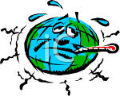
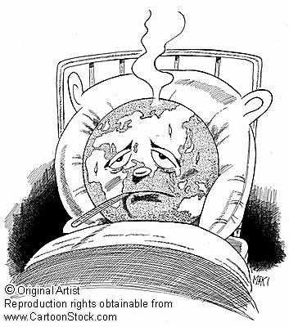
Running a fever:
Seeing the doctor
Symptoms: the planet’s temperature and carbon dioxide are increasing
Diagnosis: human activities are causal
Prognosis: the outlook is for more warming at rates that can be disruptive and will cause strife
Treatment: mitigation (reduce emissions) and adaptation
(plan for consequences)

Slide 15
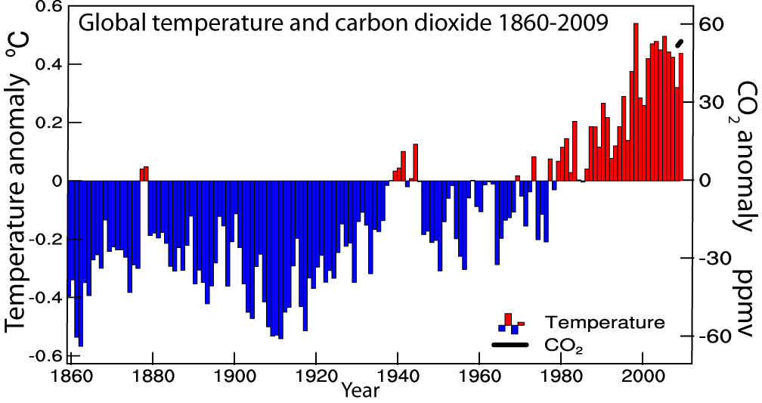
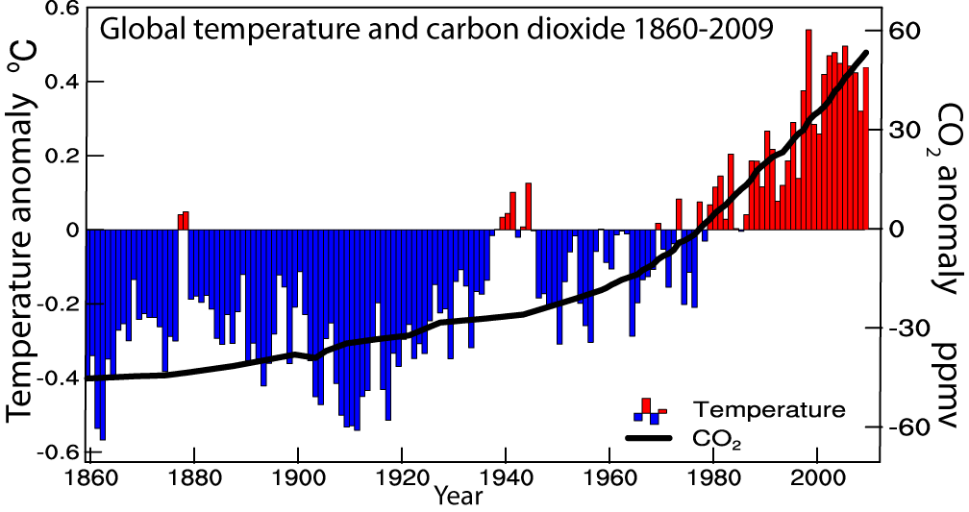
Global temperatures and carbon dioxide through 2009
Base period 1961-90

Slide 16
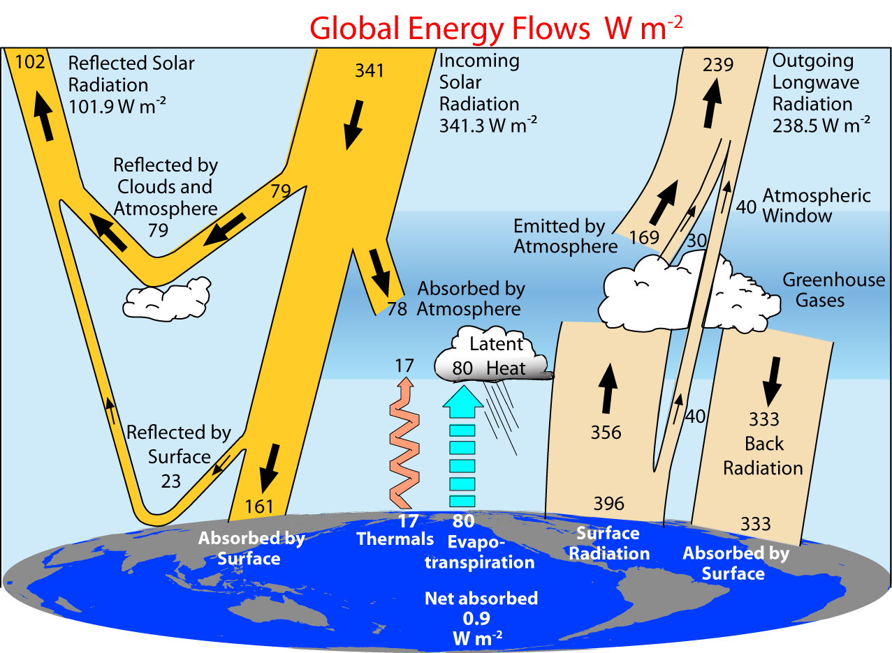
2000-2005 (CERES Period)
Trenberth et al 2009

Slide 17
Controls on the changes in net precipitation
1. Changes in cloud
2. Changes in aerosol
3. Changes in atmospheric radiation
1.+2. Evaporation is limited by energy available
3. Latent heating has to be mostly balanced by net LW radiative losses (SH small)
4. Over land: Latent heating is partly balanced by sensible heat
2000-2005 Trenberth et al 2009

Slide 18
TOA radiation does not change (much) in equilibrium
Controls on the changes in net precipitation
If the only change in climate is from increased GHGs:
then SW does not change (until ice melts and if clouds change), and so OLR must end up the same.
But downwelling and net LW↓ increases and so other terms must change: mainly evaporative cooling.
Transient response may differ from equilibrium (see Andrews et al. 09)
Land responds faster. Radiative properties partly control rate of increase of precipitation.: Stephens and Ellis 2008
2000-2005 Trenberth et al 2009

Slide 19
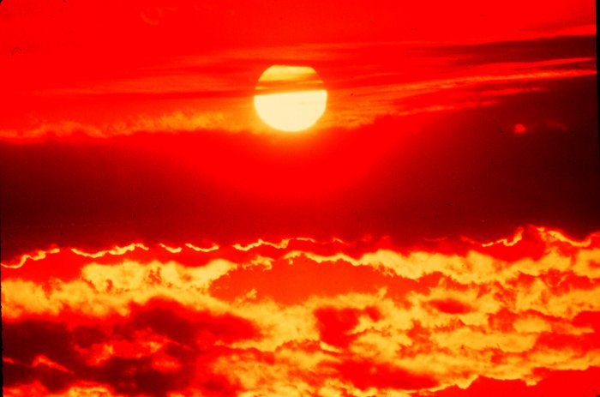
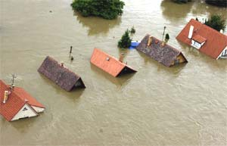
Climate change and extreme weather events
Changes in extremes matter most for society and human health
With a warming climate:
  More high temperatures, heat waves
  Wild fires and other consequences
  Fewer cold extremes.
More extremes in hydrological cycle:
  Drought
  Heavy rains, floods
  Intense storms, hurricanes, tornadoes

Slide 20
Daily Precipitation at 2 stations
Monthly
Amount 75 mm
Amount 75 mm
A
B
Frequency 6.7%
Intensity 37.5 mm
Frequency 67%
Intensity 3.75 mm
drought wild fires local
wilting plants floods
soil moisture replenished
virtually no runoff

Slide 21

Most precipitation comes from moisture convergence by weather systems
The intermittent nature of precipitation (average frequency over oceans is 11%) means that moderate or heavy precipitation
Can not come from local column.
Can not come from E.
Hence has to come from transport by storm-scale circulation into storm.
On average, rain producing systems
(e.g., extratropical cyclones; thunderstorms)
reach out and grab moisture from distance about
3 to 5 times radius of precipitating area.

Slide 22

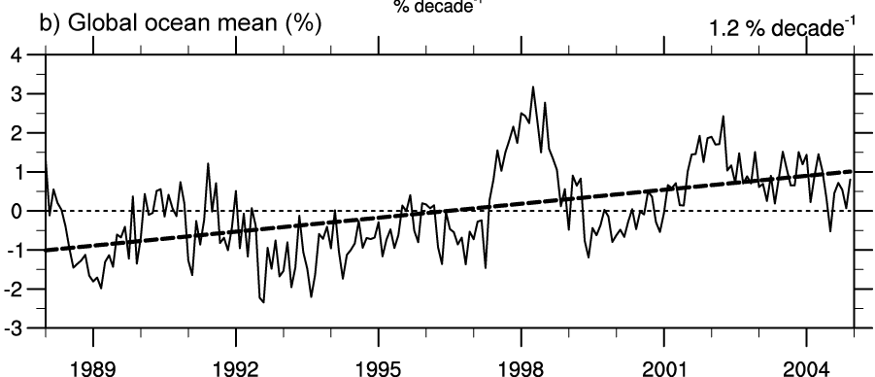
Air holds more water vapor at higher temperatures
A basic physical law tells us that the water holding capacity of the atmosphere goes up at about 7% per degree Celsius increase in temperature. (4% per °F)
Observations show that this is happening at the surface and in lower atmosphere: 0.55°C since 1970 over global oceans and 4% more water vapor.
This means more moisture available for storms and an enhanced greenhouse effect.
Total water vapor

Slide 23
How should precipitation P change as the climate changes?
With increased GHGs: increased surface heating evaporation E⇑ and P⇑
With increased aerosols, E⇓ and P⇓
Net global effect is small and complex
Warming and T⇑ means water vapor ⇑ as observed
Because precipitation comes from storms gathering up available moisture, rain and snow intensity ⇑ : widely observed
But this must reduce lifetime and frequency of storms
Longer dry spells
Trenberth et al 2003

Slide 24
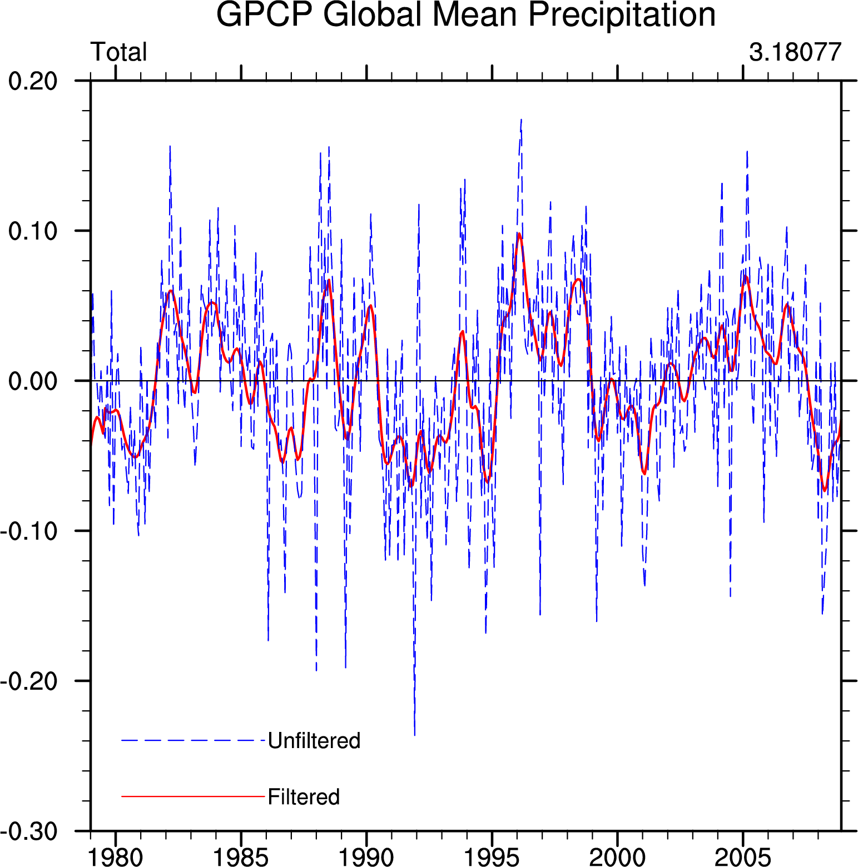
There is no trend in global precipitation amounts
GPCP Global precipitation 1979-2008
Wentz 2007:
1987-2006
Biggest changes in absolute terms are in the tropics, and there is a strong El Niño signal.

Slide 25
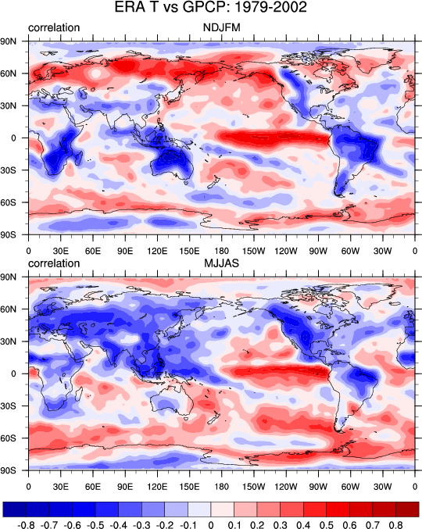
Precipitation vs Temperature
Winter high lats: air can’t hold moisture in cold; storms: warm and moist southerlies.
Clausius-Clapeyron effect
T⇒P
Nov-March
Correlations of monthly mean anomalies of surface temperature and precipitation.
May-September
Negative: means hot and dry or cool and wet.
Positive: hot and wet or cool and dry (as in El Nino region).
Trenberth and Shea 2005
Tropics/summer land: hot and dry or cool and wet
Rain and cloud cool and air condition the planet!
P⇒T
Oceans: El Nino high SSTs produce rain, ocean forces atmosphere
SST⇒P

Slide 26
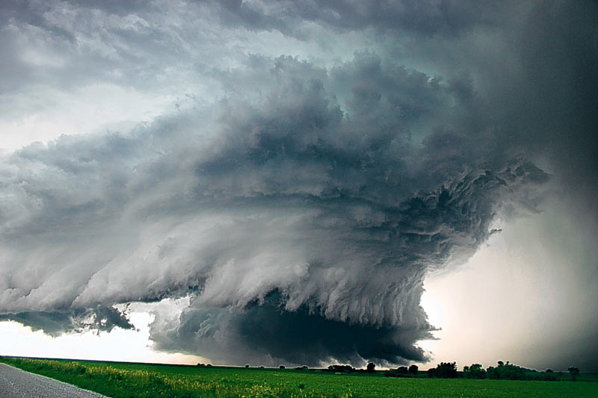
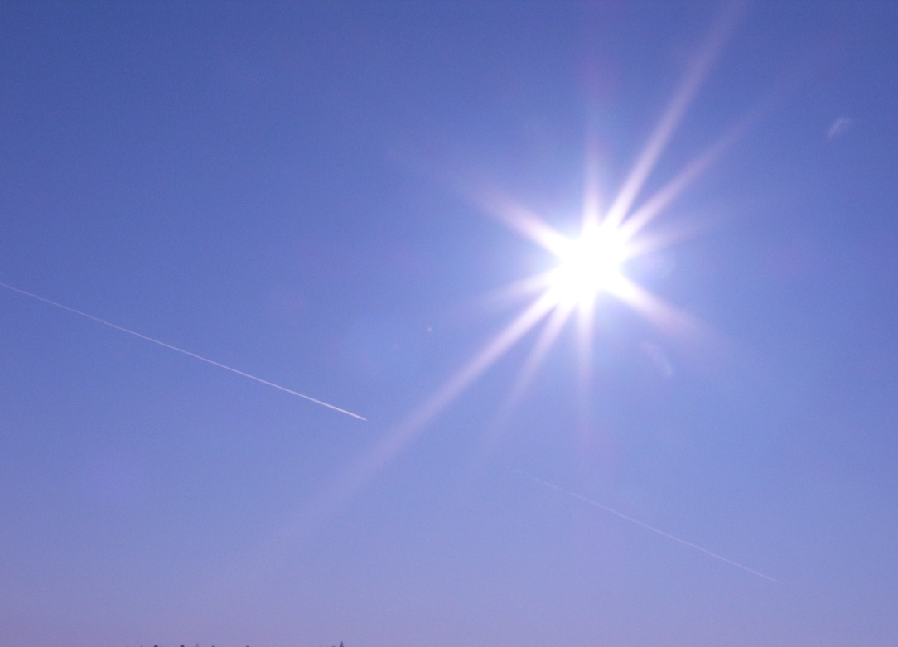
Temperature vs Precipitation
Cyclonic regime
Cloudy: Less sun
Rain: More soil moisture
Surface energy: LH ↑ SH↓
Rain ↑ Temperature ↓
Anticyclonic regime
Sunny
Dry: Less soil moisture
Surface energy: LH↓ SH↑
Rain ↓ Temperature ↑
Summer: Land
Strong negative correlations
Does not apply to oceans

Slide 27
Supply of moisture over land is critical
Over land in summer and over tropical continents, the strong negative correlations between temperature and precipitation suggest factors other than C-C are critical: the supply of moisture.
There is a strong diurnal cycle (that is not well simulated by most models).
In these regimes, convection plays a dominant role
Recycling is more important in summer and advection of moisture from afar is less likely to occur.
Monsoons play a key role where active.
Given the right synoptic situation and diurnal cycle, severe convection and intense rains can occur.

Slide 28
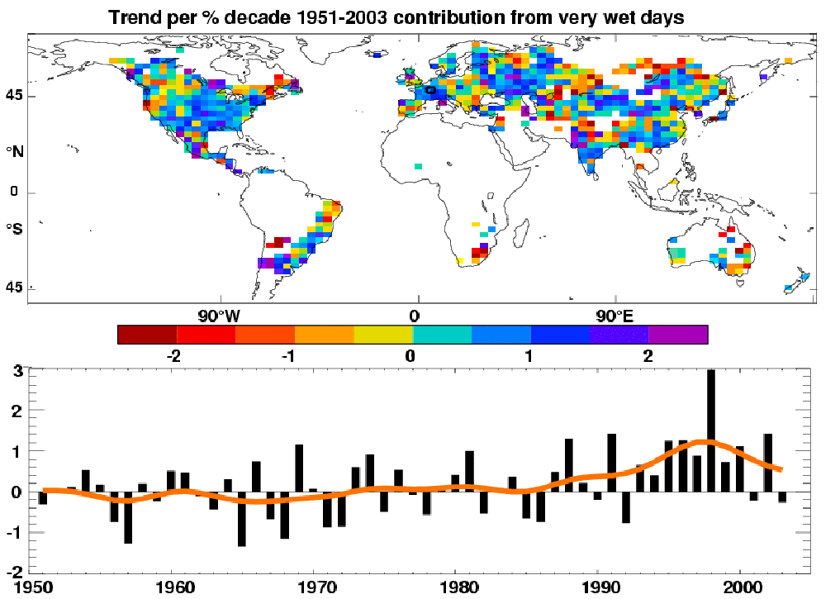
Precipitation
Observed trends (%) per decade for 1951–2003 contribution to total annual from very wet days > 95th %ile.
Alexander et al 2006
IPCC AR4
Heavy precipitation days are increasing even in places where precipitation is decreasing.

Slide 29
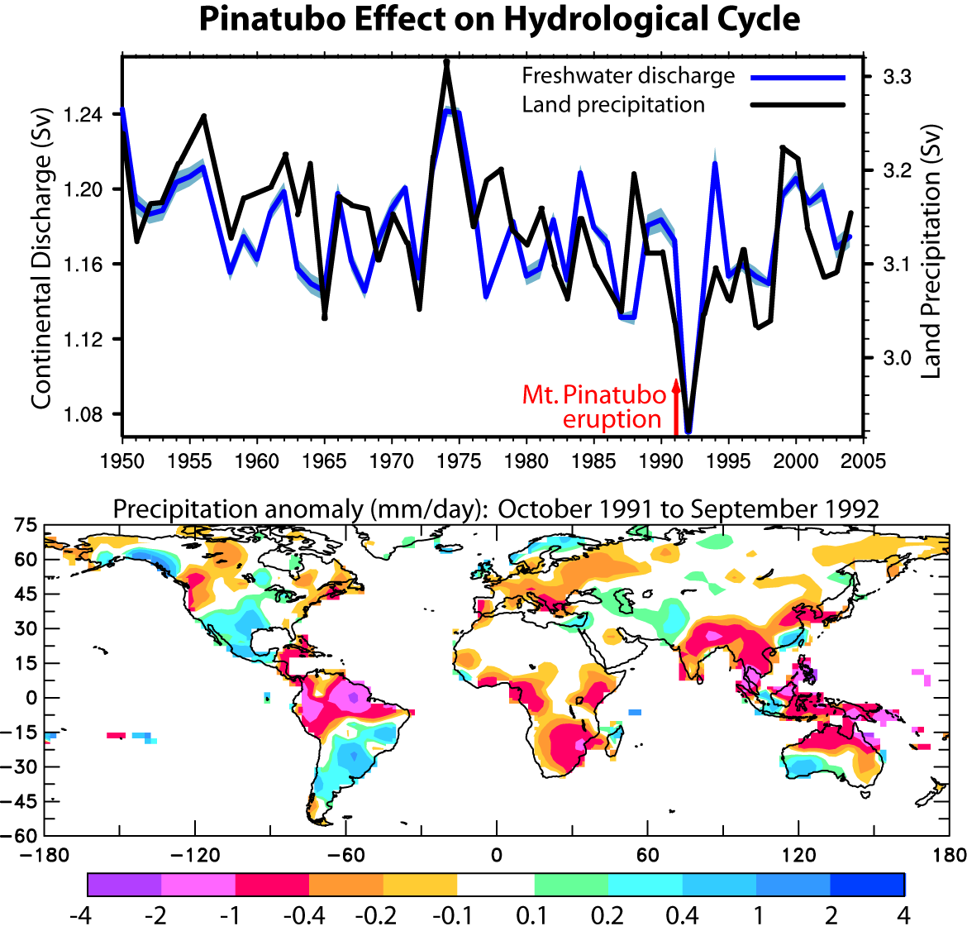
SSM/I era
GPCP satellite era
Estimated water year (1 Oct-30 Sep) land precipitation and river discharge into global oceans based on hindcast from output from CLM3 driven by observed forcings calibrated by observed discharge at 925 rivers.
Note: 1) effects of Pinatubo; 2) downward trend (contrast to Labat et al (2004) and Gedney et al (2006) owing to more data and improved missing data infilling)
Trenberth and Dai 2007; Dai et al. 2009

Slide 30
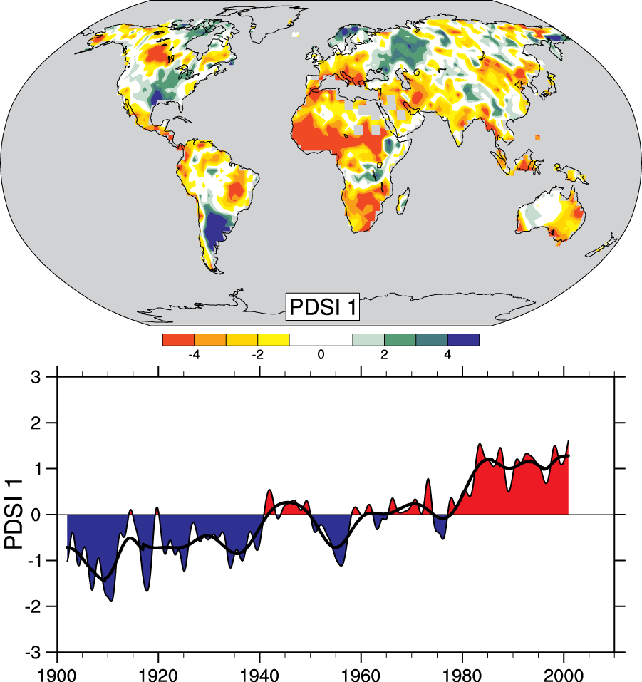
Drought is increasing most places
Mainly decrease in rain over land in tropics and subtropics, but enhanced by increased atmospheric demand with warming
The most important spatial pattern (top) of the monthly Palmer Drought Severity Index (PDSI) for 1900 to 2002.
The time series (below) accounts for most of the trend in PDSI.
AR4 IPCC

Slide 31
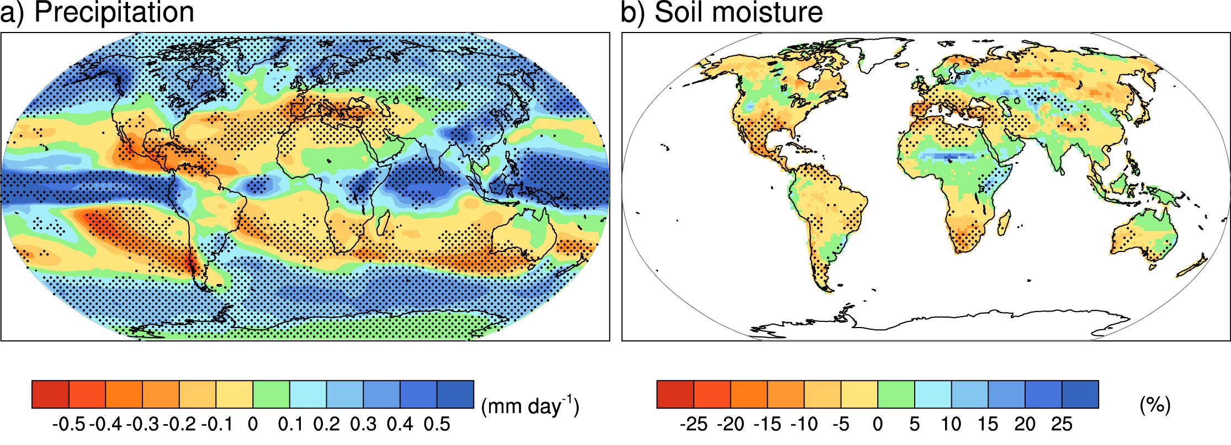
“Rich get richer, poor get poorer”
Projections: Combined effects of increased precipitation intensity and more dry days contribute to lower soil moisture
2090-2100 IPCC

Slide 32
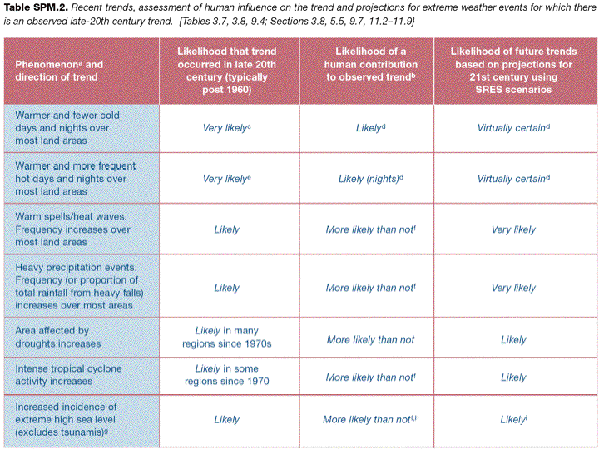
IPCC AR4

Slide 33
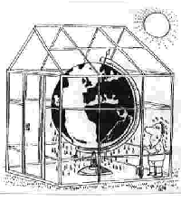
Global warming effects from humans are already identifiable
Rising sea level: coastal storm surges, salt water intrusions, flooding
Heavier rains, floods: water contamination, water quality
Drought: water shortages, agriculture, water quality
Heat-waves: wildfires
Stronger storms, hurricanes, tornadoes: damage, loss of life, loss of habitat
Changes in climate: crops, famine, discontent and strife, more insects (range, seasons), fungal and other disease; vector-borne disease.
Sea ice loss: habitat loss
Permafrost melting: infrastructure at risk

Slide 34
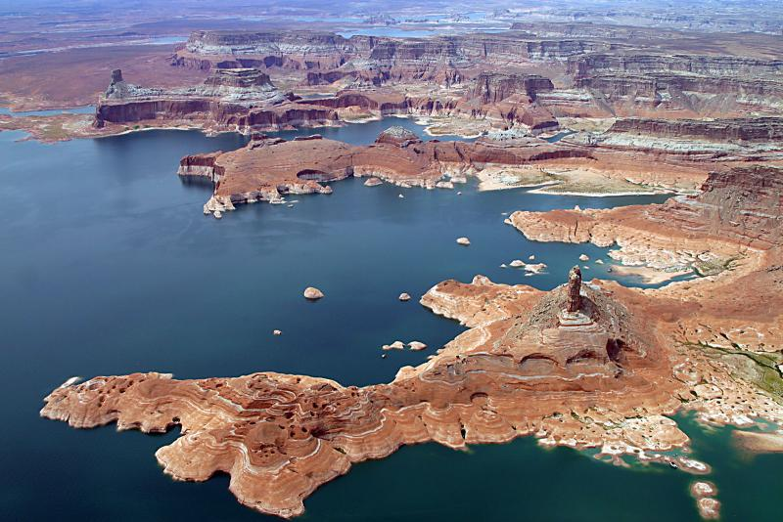
Water serves as the “air conditioner”
of the planet.
Rising greenhouse gases are causing climate change, semi-arid areas are becoming drier while wet areas are becoming wetter.
Increases in extremes (floods and droughts) are already here.
Water management:-
dealing with how to save in times of excess for times of drought –
will be a major challenge in the future.
Lake Powell

Slide 35
