Slide 1
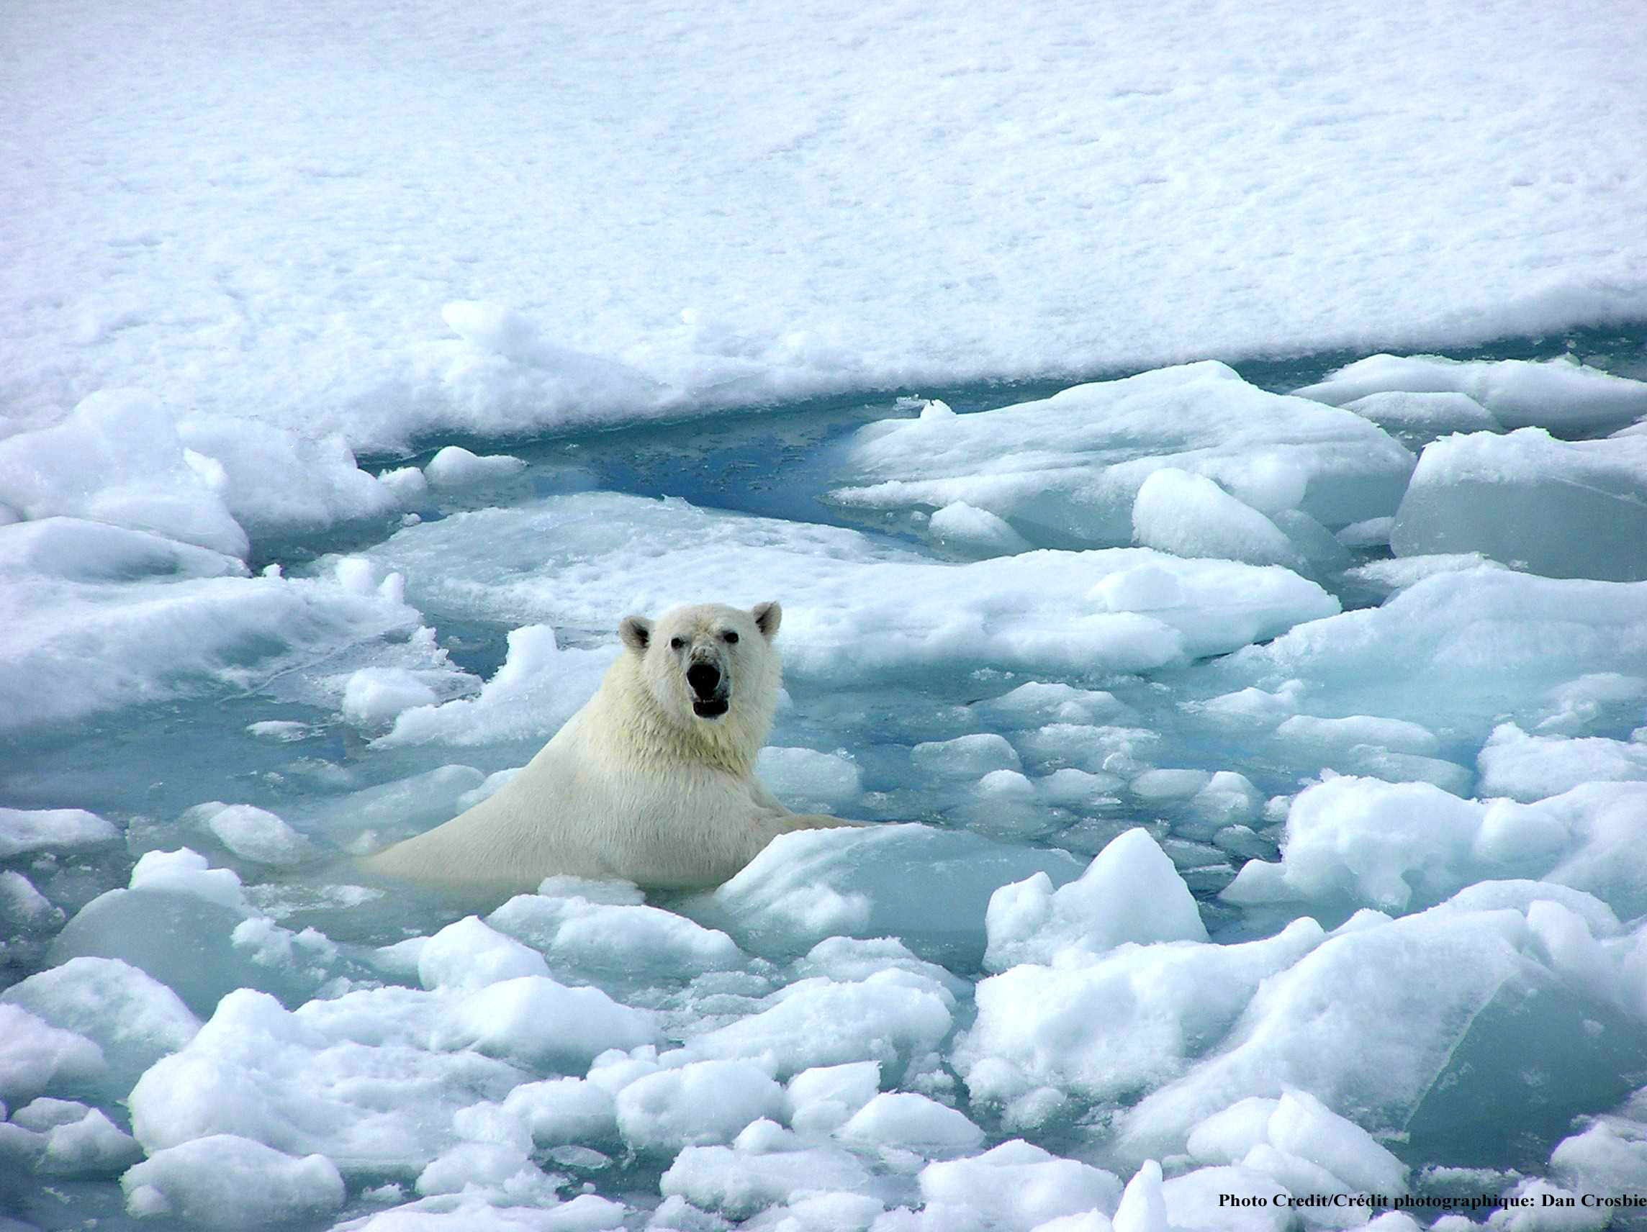


Global warming:
Coming ready or not!
Help!
Kevin E Trenberth
NCAR
NCAR Earth System Laboratory
NCAR is sponsored by NSF

Slide 2
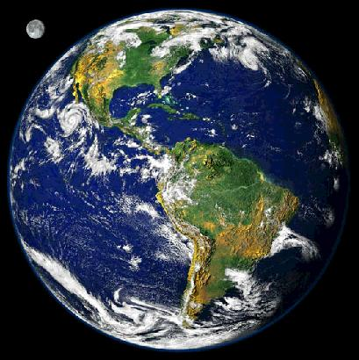

Climate
The atmosphere is a “global commons.”
Air over one place is typically half way round the world a week later, as shown by manned balloon flights.
The atmosphere is a dumping ground for all nations for pollution of all sorts. Some lasts a long time and is shared with all. One consequence is global warming!

Slide 3
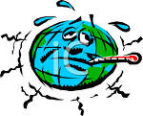
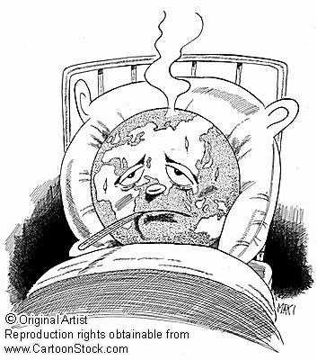
Running a fever:
Seeing the doctor
Symptoms: the planet’s temperature and carbon dioxide are increasing
Diagnosis: human activities are causal
Prognosis: the outlook is for more warming at rates that can be disruptive and will cause strife
Treatment: mitigation (reduce emissions) and adaptation (planning for consequences)

Slide 4
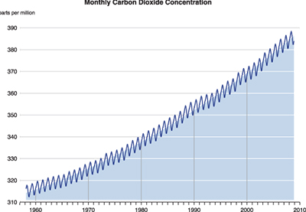
Changing atmospheric composition: CO₂
_{Mauna Loa, Hawaii}
ppm
390
380
370
360
350
340
330
320
310
Rate increasing
1960 1970 1980 1990 . 2000 2010
Data from Climate Monitoring and Diagnostics Lab., NOAA. Data prior to 1974 from C. Keeling, Scripps Inst. Oceanogr.

Slide 5
Fossil Fuel Emissions

Slide 6
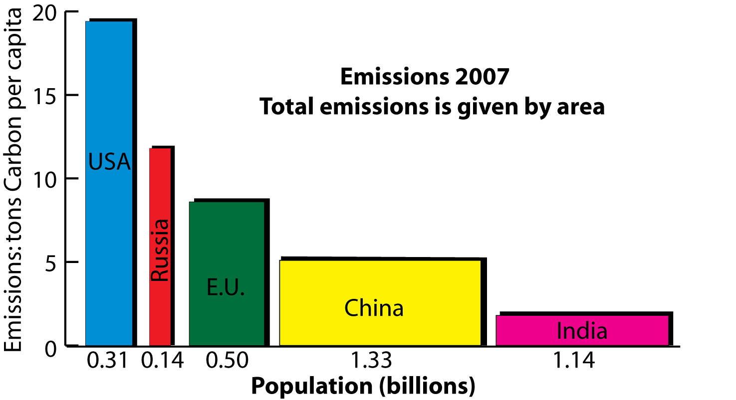
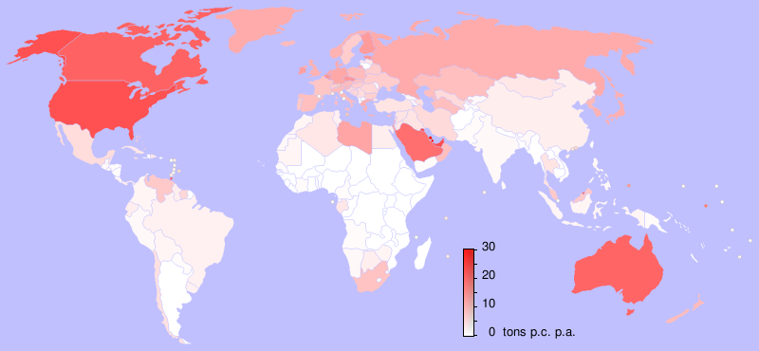
2007 emissions:
China biggest emitter (up 8% in 2007)
14% more than US
Per capita Pop.
  U.S.: 19.4 0.31
  Russia: 11.8 0.14
  E. U.: 8.6 0.50
  China: 5.1 1.33
  India: 1.8 1.14
  tons Billions
Netherlands Environmental
Assessment Agency 2008

Slide 7
LOWEST HIGHEST
D. Columbia Wyoming
Connecticut Alaska
Rhode Island North Dakota
Vermont West Virginia
California Louisiana
Idaho Montana
New York Indiana
Oregon, Kentucky
Massachusetts Alabama
Washington New Mexico
Tonnes CO₂ per capita
US Energy Inf. Agency

Slide 8
The Natural Greenhouse Effect: clear sky
CH₄
N₂0
6%
O₃
8%
Carbon
Dioxide
26%
Water
Vapor
60%
Clouds also have a greenhouse effect
Kiehl and Trenberth 1997

Slide 9
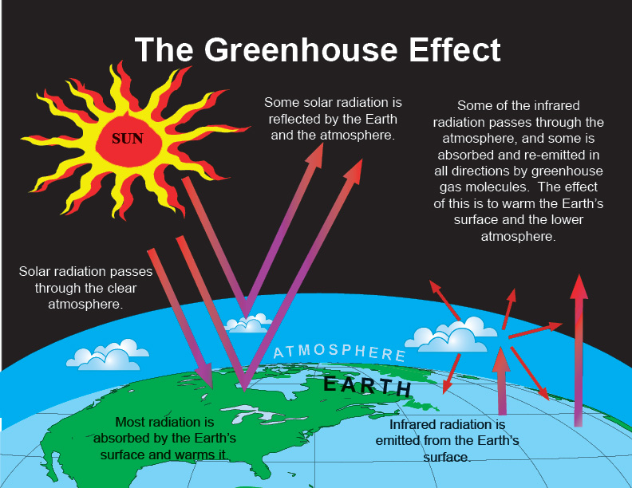

Slide 10
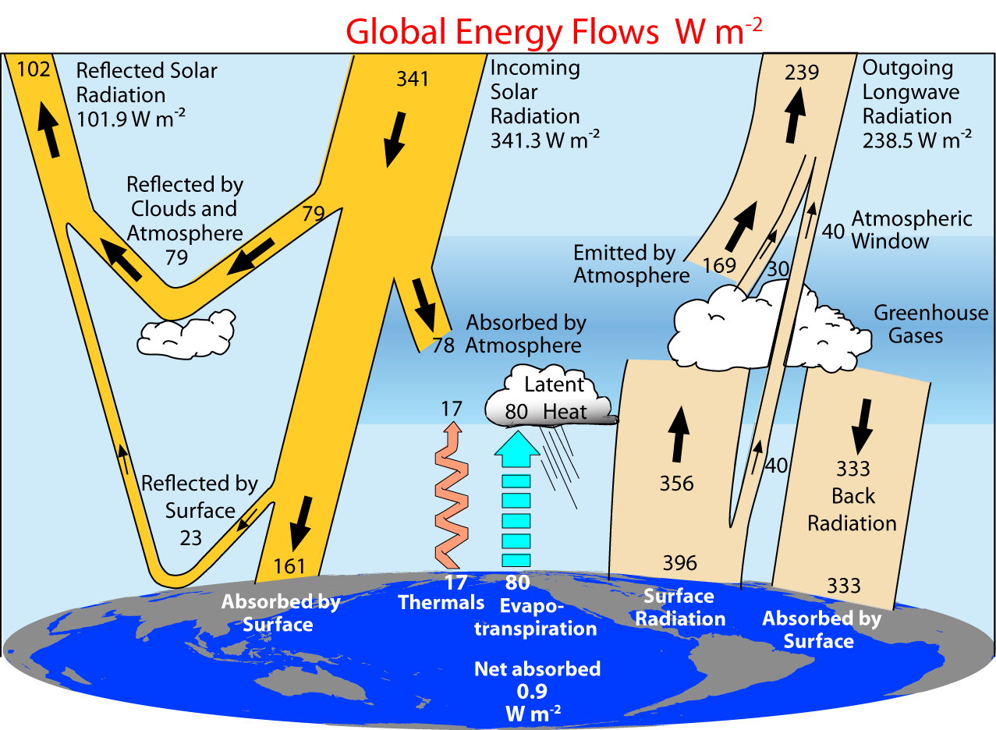
2000-2005 (CERES Period)
Trenberth et al 2009

Slide 11
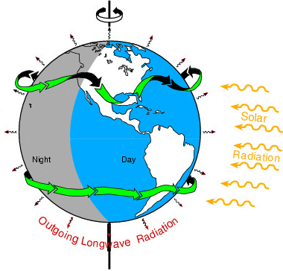
The incoming energy from the sun
is 341 W m⁻²: annual global mean:
It amounts to 175 PetaWatts
=175,000,000 billion Watts.
About 122 PW is absorbed.
The biggest power plants in existence
are 1000 MegaWatts and we normally think of units of
1 KiloWatt (= 1 bar heater), or a 100 W light bulb.
So the energy from the sun is 122 million of these power stations. It shows:
Direct human influences are tiny vs nature.
The main way human activities can affect climate is through interference with the natural flows of energy such as by changing the composition of the atmosphere

Slide 12
Changes in the sun
Solar irradiance from composite of several satellite-measured time series based on Frohlich & Lean (1998; http://www.pmodwrc.ch/pmod.php?topic=tsi/composite/SolarConstant)

Slide 13
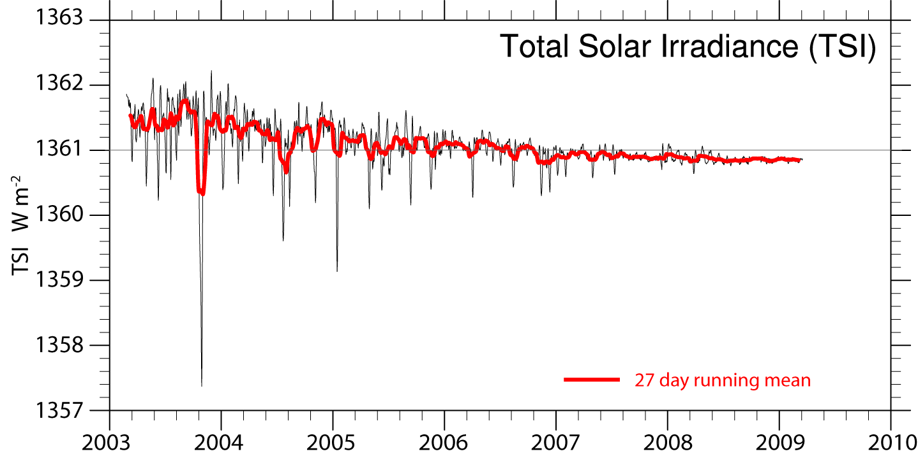
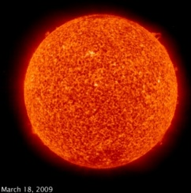
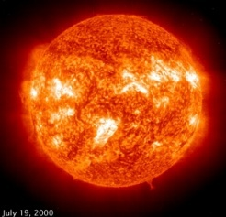
Solar irradiance
The drop of 0.5 W m⁻² since 2003 is equivalent to
-0.1 Wm⁻² in radiative forcing

Slide 14
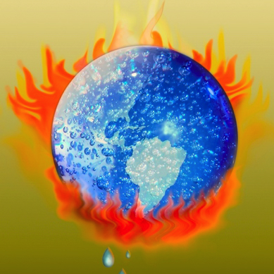
Global Warming is Unequivocal
IPCC: approved 113 govts
Since 1970, rise in: Decrease in:
Global surface temperatures NH Snow extent
Tropospheric temperatures Arctic sea ice
Global SSTs, ocean Ts Glaciers
Global sea level Cold temperatures
Water vapor
Rainfall intensity
Precipitation extratropics
Hurricane intensity
Drought
Extreme high temperatures
Heat waves
Ocean acidity

Slide 15
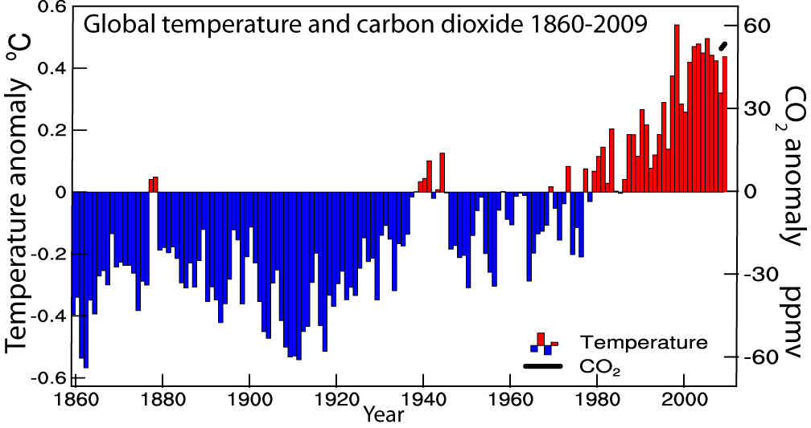
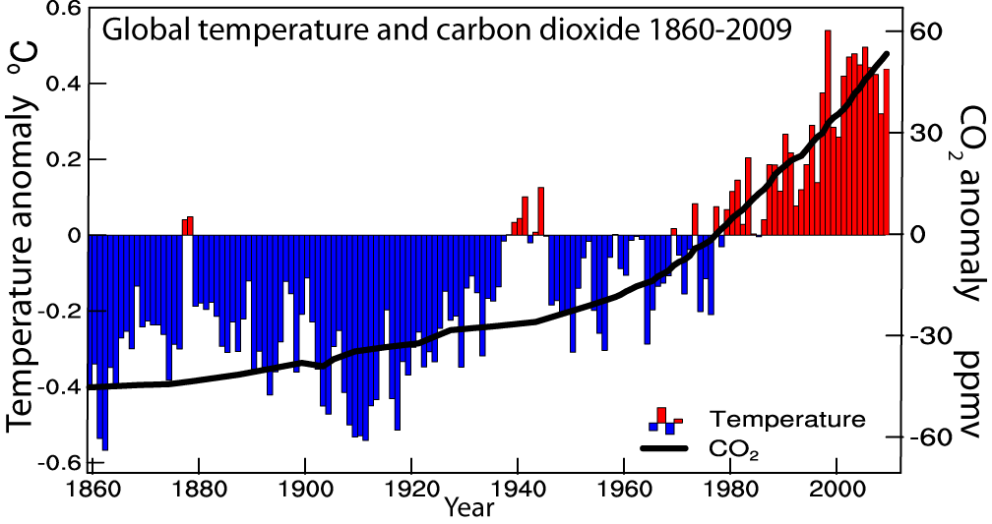
Global temperatures and carbon dioxide through 2009
Base period 1961-90

Slide 16
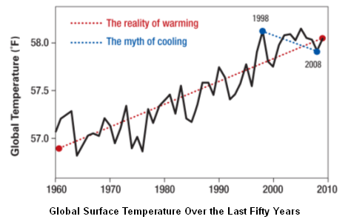
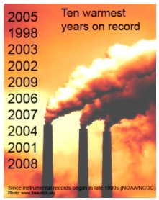
A few cooler years do not mean global warming is not happening!
1998 was especially warm from the major El Nino, but by cherry picking points one can infer the wrong trend (blue) vs the correct one (red).
From NOAA/NCDC

Slide 17
Context:
400,000 years of Antarctic ice core records (bubbles of trapped air) of Temperatures, Carbon dioxide and Methane.
CH₄ = 1774 ppb 2005
CO₂ = 379 ppm
Last ice age glacial:
20,000 years ago
Source: Hansen, Climatic Change 2005, based on Petit, Nature 1999
Notes:
The data comes from a 1999 article in Nature which discussed Antarctic ice cores.
Bottom scale shows 10,000 years per tick, with 1850 at the far right where it says 0. The far left is -420,000 years.
Bottom red line is temperature in celsuis, about 1 degree C = 2 degrees Farenheit. Note how in Antarctic temperature has varied cyclically from
About -10C to about +2 C. Also note the red temperature band at about 0-2 C, above 1850. This is the last 10,000 years, all of known civilization right here. This is the
Climate our society has known. It is a tiny range relative to the past. Also note how fast we come out of the depths of the ice ages. It happens very,
very quickly, and the cause of this is under active investigation. This is ‘abrupt climate change’. It appears that glaciers take tens of thousands of years
To generate, yet melt very quickly. This may have important ramifications for the ice on the planet now, and the potential for large sea level rise.
Green line in middle graph is methane, a very potent greenhouse gas (about 20x as powerful at Carbon Dioxide). Note how it varies from about 400 parts per
Billion to about 700 parts per billion (ppb) over the last 420,000 years.
Blue line in top graph is carbon dioxide. Note how it varies from about 180 parts per million to about 280 parts per million (ppm) over the last
420,000 years.
Here’s what the animated lines show: (you’ll need to start a slide show to see this)
Animation 1
The orange bars on the Temperature graph show the 100,000-year long slides into past ice ages. The ice ages are brought on
by subtle changes in the Earth’s orbital parameters – the roundness of our orbit around the sun (eccentricity), the tilt of the earth’s axis (inclination) and
Something called precession – how close the poles are to the sun during winter and summer. Believe it or not, these changes can bring on ice ages, and periods
Of warmth.
Animation 2 and 3
2) The solid black lines show how the methane and carbon dioxide concentrations are timed exquisitely with the temperature changes. This is because as the
Earth warms the oceans give off carbon dioxide (imagine heating a can of Coke on the stove), and because as it warms biological activity generates more methane.
As this happens both Co2 and CH4 provide additional warming (a “positive feedback loop”) and hence create more warming. As it cools the exact opposite
happens and cooling begets more cooling. These feedbacks are the crux of the science of global warming.
Animation 4
3) Now reveal the extensions of the graphs on the far right side. You can see just how out of whack carbon dioxide and methane are compared to historical norms. And everyone thinks carbon dioxide will go to AT LEAST 550 parts per million and may go as high as 1000 ppm. The system has never been ‘tweaked’ in this fashion in about 1m years, and this is why scientists are so concerned.

Slide 18

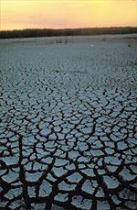
Controlling Heat
Human body: sweats
Homes: Evaporative coolers (swamp coolers)
Planet Earth: Evaporation (if moisture available)
e.g., When sun comes out after showers,
the first thing that happens is that the puddles dry up: before temperature increases.

Slide 19

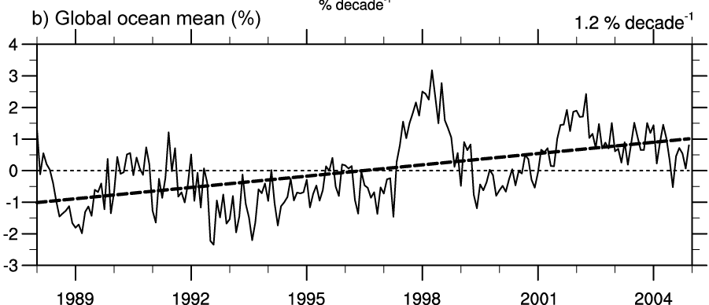
Air holds more water vapor at higher temperatures
A basic physical law tells us that the water holding capacity of the atmosphere goes up at about 7% per degree Celsius increase in temperature. (4% per °F)
Observations show that this is happening at the surface and in lower atmosphere: 0.55°C since 1970 over global oceans and 4% more water vapor.
This means more moisture available for storms and an enhanced greenhouse effect.
Total water vapor

Slide 20
How should precipitation P change as the climate changes?
With increased GHGs: increased surface heating evaporation E⇑ and P⇑
With increased aerosols, E⇓ and P⇓
Net global effect is small and complex
Warming and T⇑ means water vapor ⇑ as observed
Because precipitation comes from storms gathering up available moisture, rain and snow intensity ⇑ : widely observed
But this must reduce lifetime and frequency of storms
Longer dry spells
When it rains, it pours!
Trenberth et al 2003

Slide 21
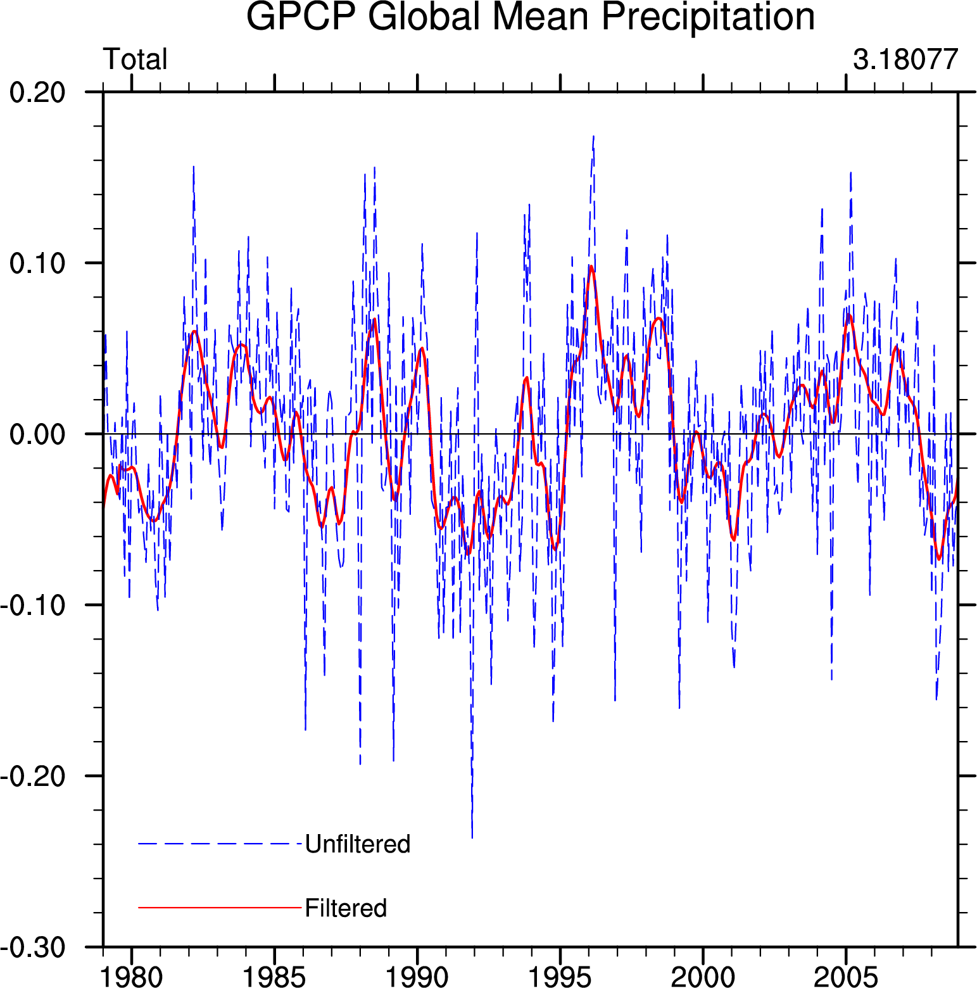
There is no trend in global precipitation amounts
GPCP Global precipitation 1979-2008
Biggest changes in absolute terms are in the tropics, and there is a strong El Niño signal.

Slide 22
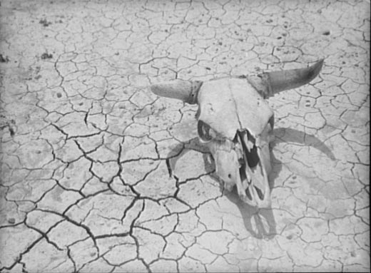
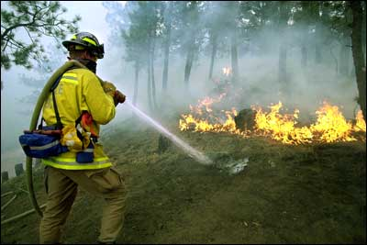
Declining Snow Pack in many mountain and continental areas contributes to drought
more precipitation falls as rain rather than snow, especially in the fall and spring.
snow melt occurs faster and sooner in the spring
snow pack is therefore less
soil moisture is less as summer arrives
the risk of drought increases substantially in summer
Along with wild fire

Slide 23
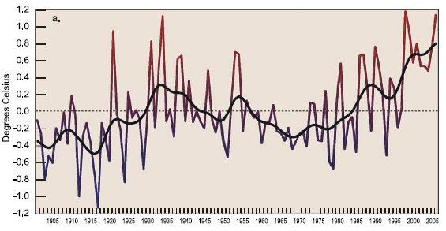
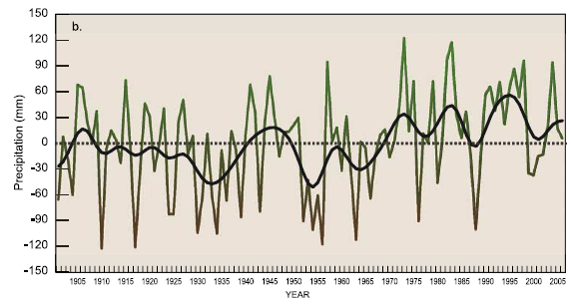
US changes
in
Temperature
Precipitation
Much wetter
1930s:
Hot and dry
Easterling et al 2007
GRL
1900 1950 2000

Slide 24
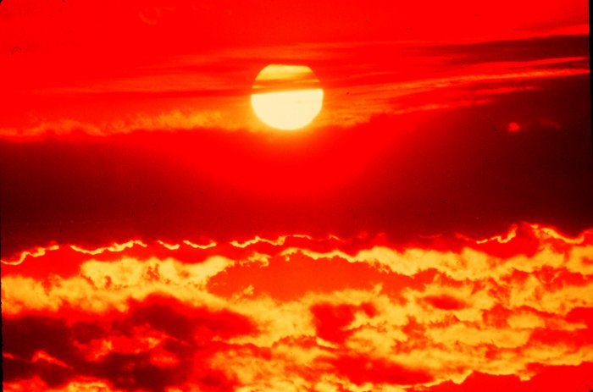
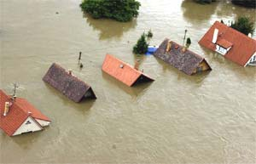
Climate change and extreme weather events
Changes in extremes matter most for society and human health
With a warming climate:
  More high temperatures, heat waves
  Wild fires and other consequences
  Fewer cold extremes.
More extremes in hydrological cycle:
  Drought
  Heavy rains, floods
  Intense storms, hurricanes, tornadoes

Slide 25
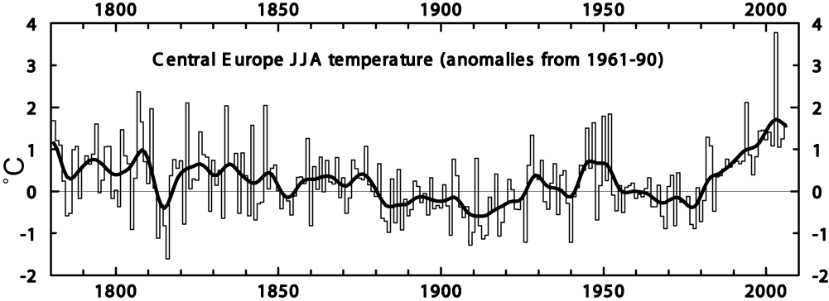
Heat waves are increasing: an example
Extreme Heat Wave
Summer 2003
Europe
>50,000 deaths
Trend plus variability?
IPCC

Slide 26
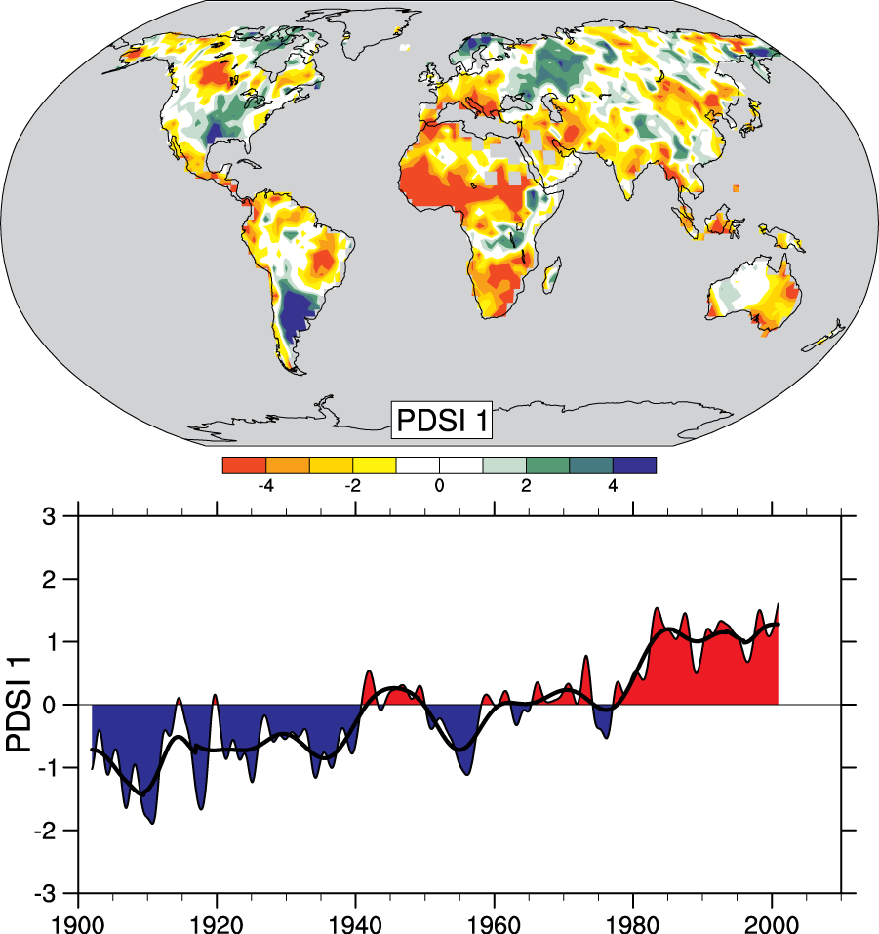
Drought is increasing most places
Mainly decrease in rain over land in tropics and subtropics, but enhanced by increased atmospheric demand with warming
The most important spatial pattern (top) of the monthly Palmer Drought Severity Index (PDSI) for 1900 to 2002.
The time series (below) accounts for most of the trend in PDSI.
IPCC

Slide 27
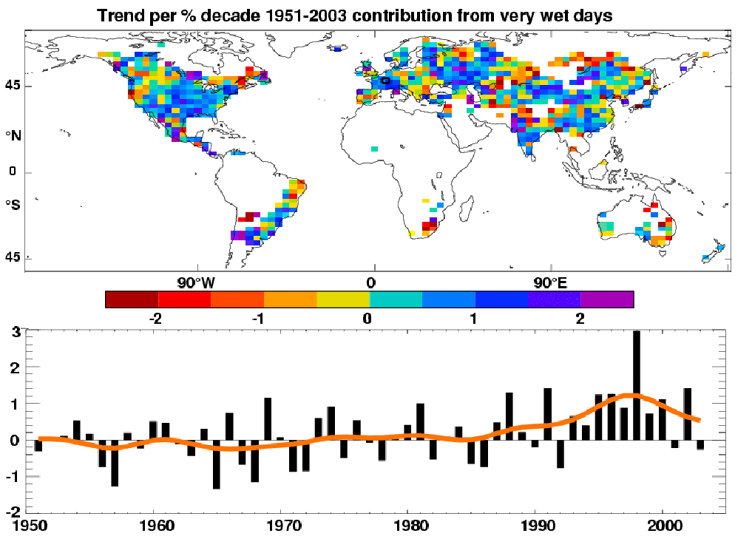
Heavy precipitation days are increasing even in places where precipitation is decreasing.
Precipitation
Observed trends (%) per decade for 1951–2003 contribution to total annual from very wet days > 95th %ile.
Alexander et al 2006
IPCC AR4

Slide 28
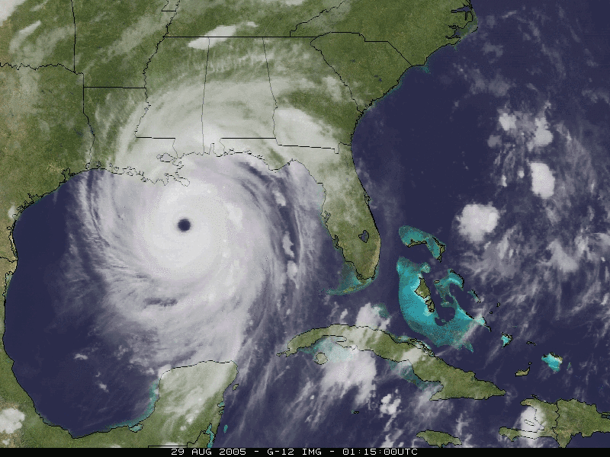
North Atlantic hurricanes have increased with SSTs
Katrina
August 2005
The 2005 season broke many records

Slide 29
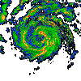
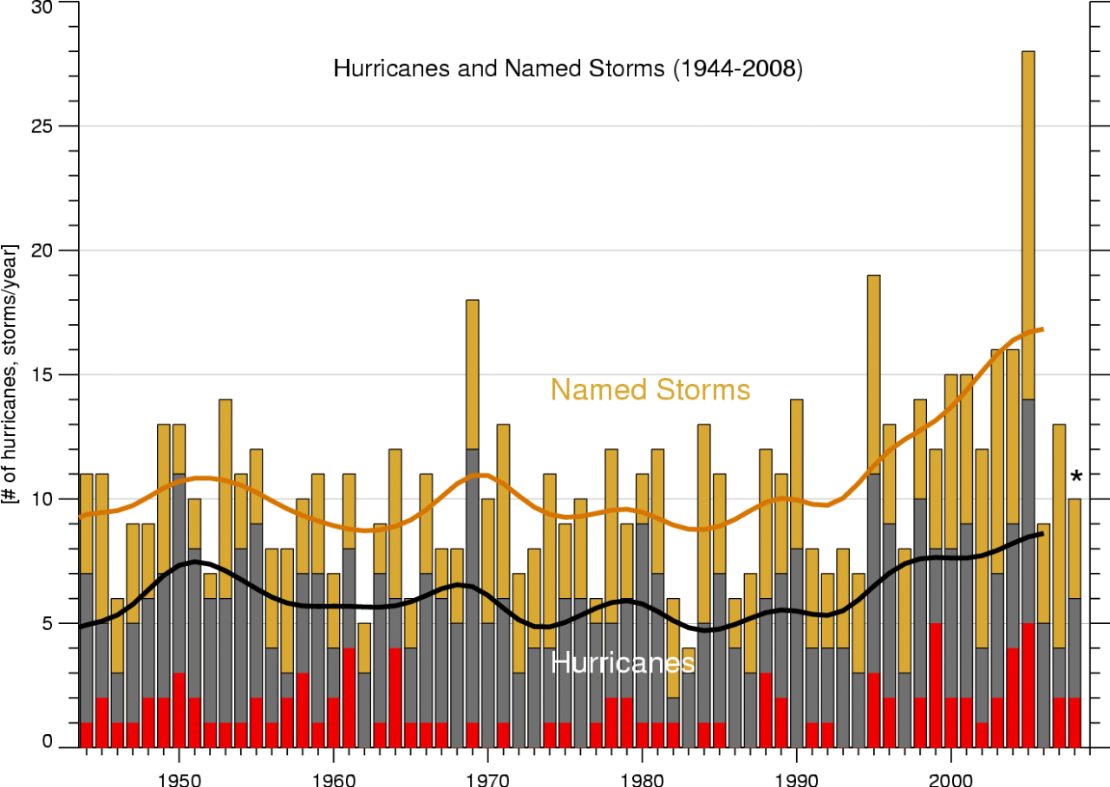
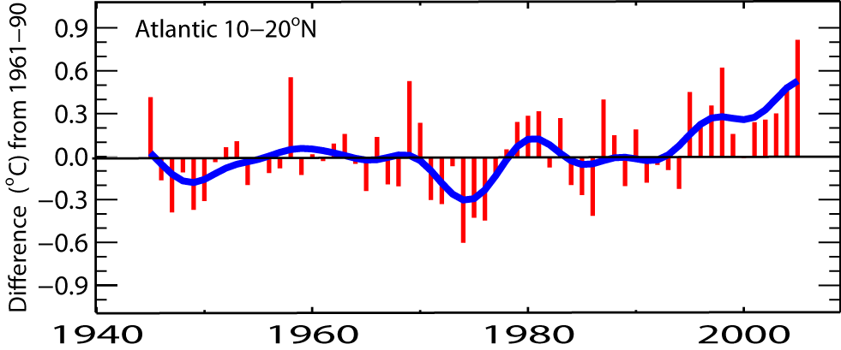
North Atlantic hurricanes have increased with SSTs
N. Atlantic hurricane record best after 1944 with aircraft surveillance.
Global number and percentage of intense hurricanes
is increasing
Thru 2009
Marked increase after 1994
(1944-2006)
SST
IPCC

Slide 30
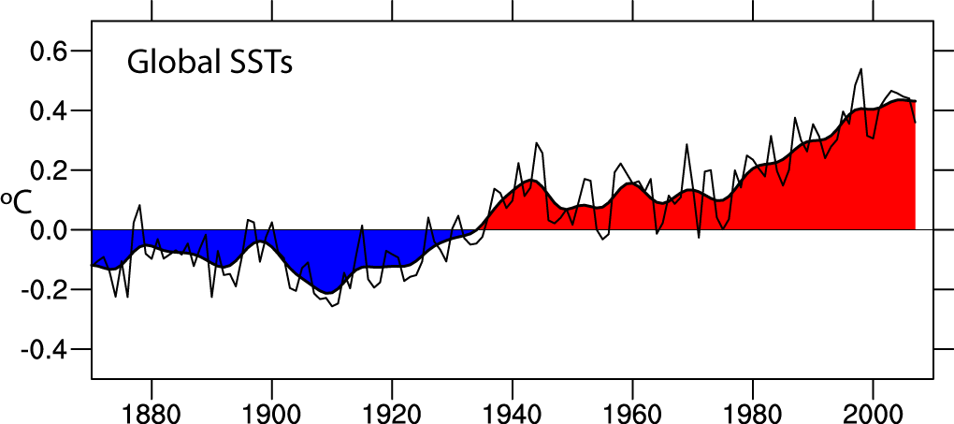
Global SSTs are increasing: base period 1901-70
Through 2007
Data: Hadley Centre, UK

Slide 31
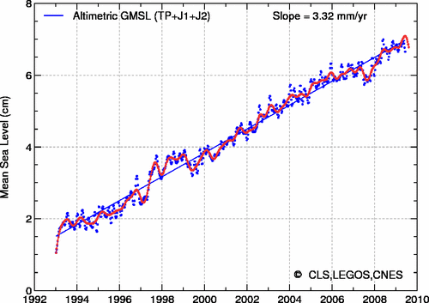
Sea level is rising:
from ocean expansion and melting glaciers
40
30
20
10
mm
0
-10
-20
-30
-40
Since 1992 Global sea level has risen 55 mm (2.2 inches)
To 2003: 60% from expansion as ocean temperatures rise, 40% from melting glaciers
AVISO: from TOPEX, Jason 1, Jason 2. Ann cy removed, IB, GIA applied

Slide 32
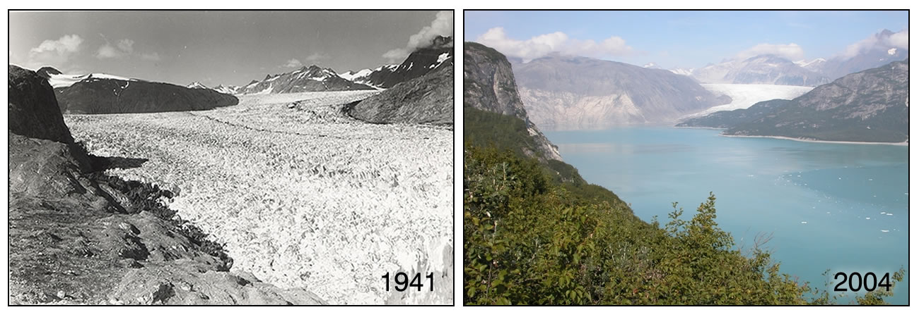
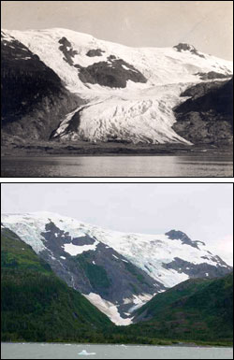
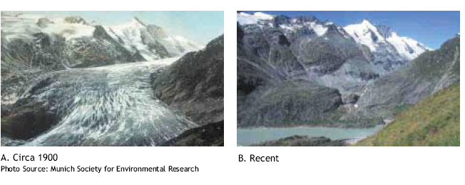
Evidence for reality of climate change
Glaciers melting
Muir Glacier, Alaska
1909
Toboggan
Glacier
Alaska
2000
1900 2003
Alpine glacier, Austria

Slide 33
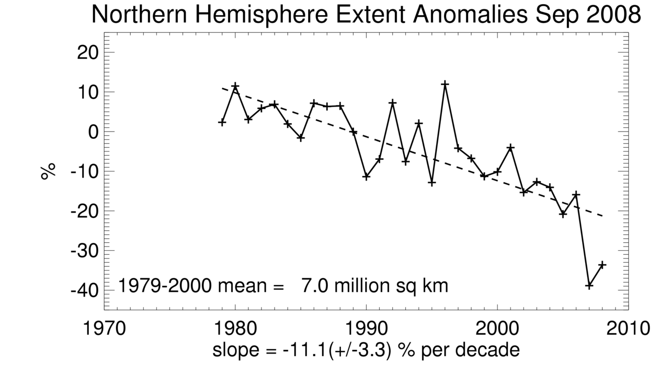
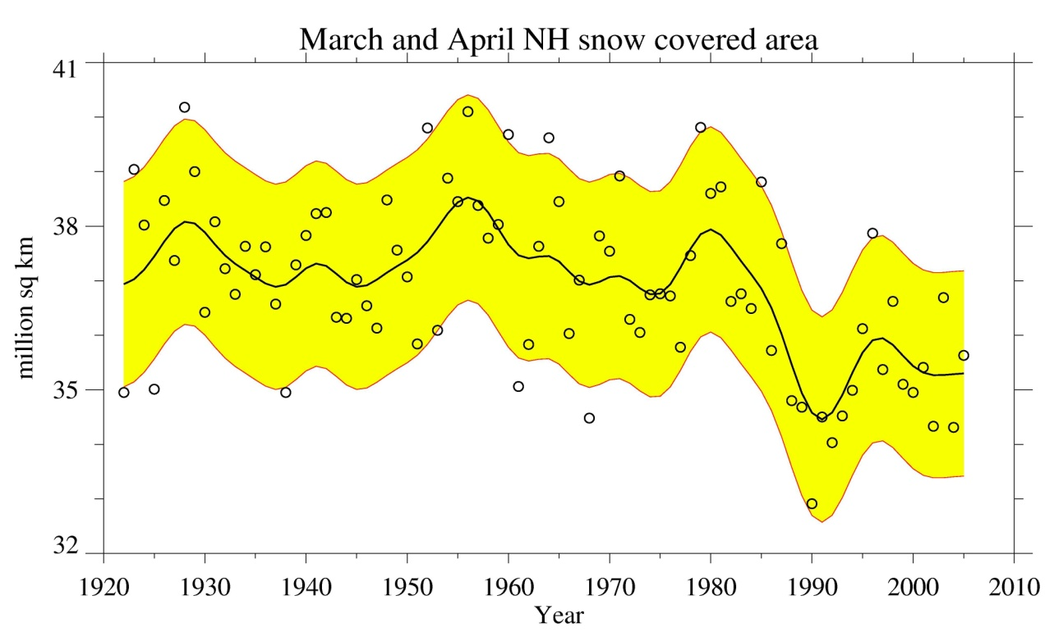
Snow cover and Arctic sea ice are decreasing
Arctic sea ice
area decreased by 2.7% per decade
(Summer: -7.4%/decade)
up to 2006:
2007: 22% (10⁶ km²) lower than 2005
2008: second lowest
2009: third lowest
Spring snow cover
shows 5% stepwise drop during 1980s
IPCC

Slide 34
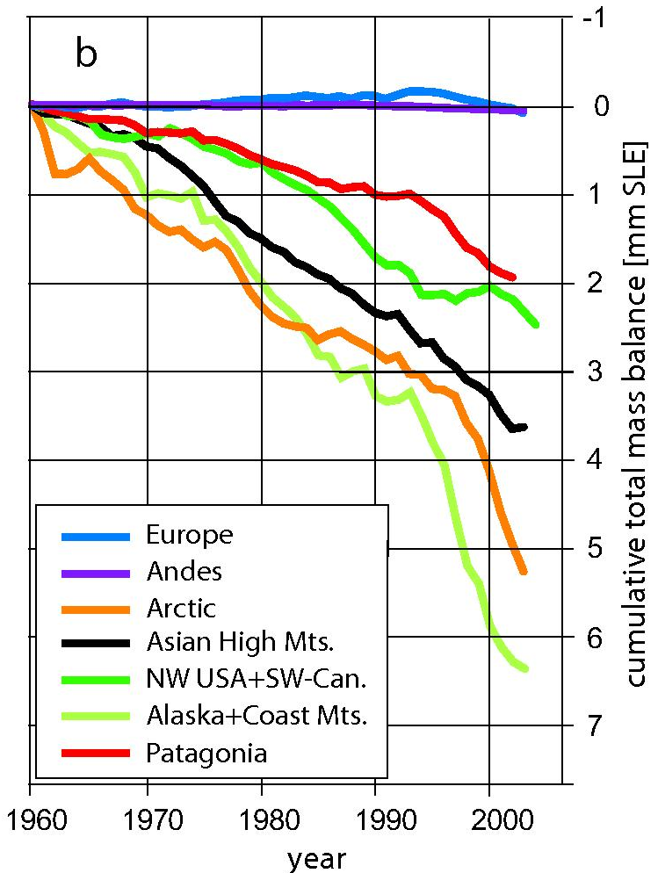
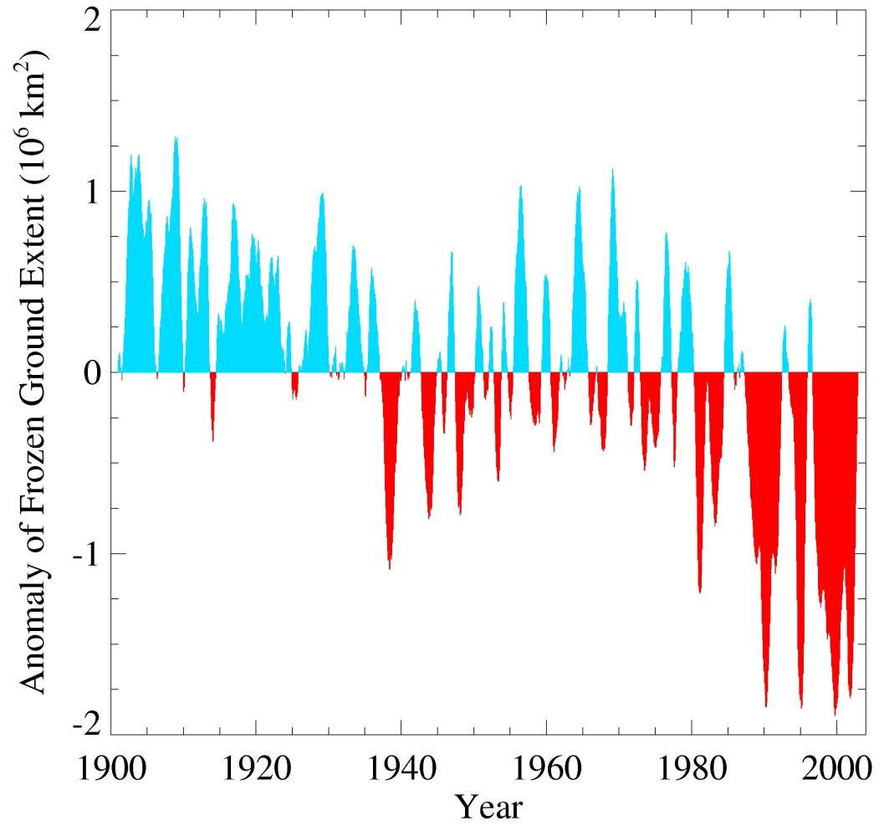
Glaciers and frozen ground are receding
Area of seasonally frozen ground in NH has decreased
by 7% from 1901 to 2002
Increased Glacier retreat since the early 1990s

Slide 35
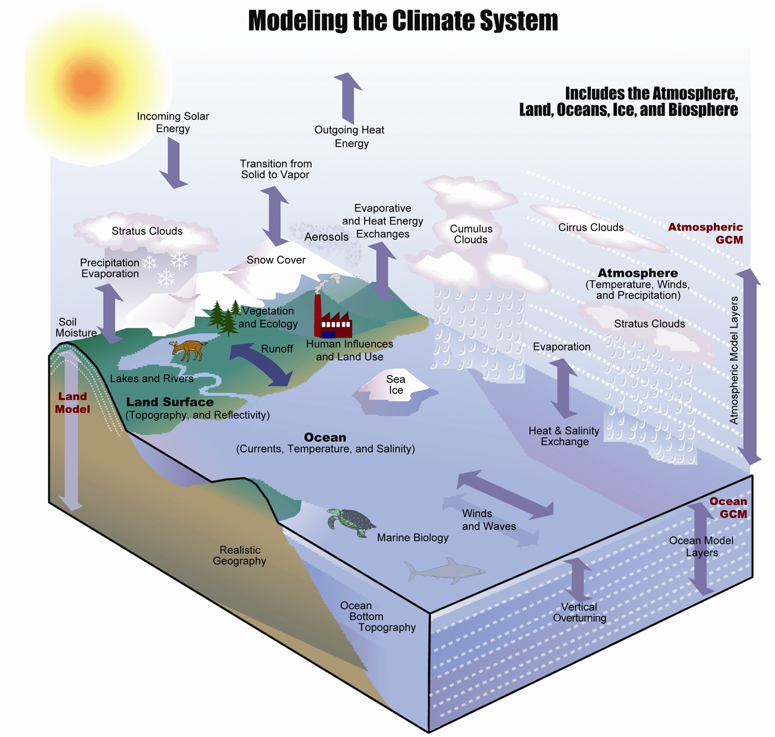
Karl and Trenberth 2003

Slide 36
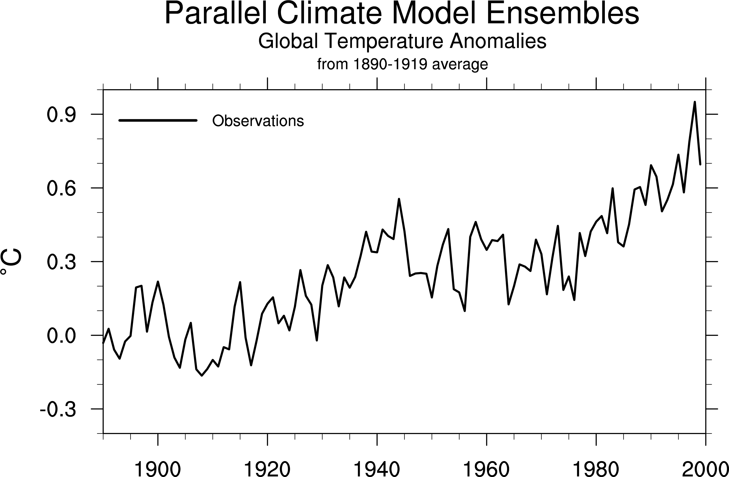
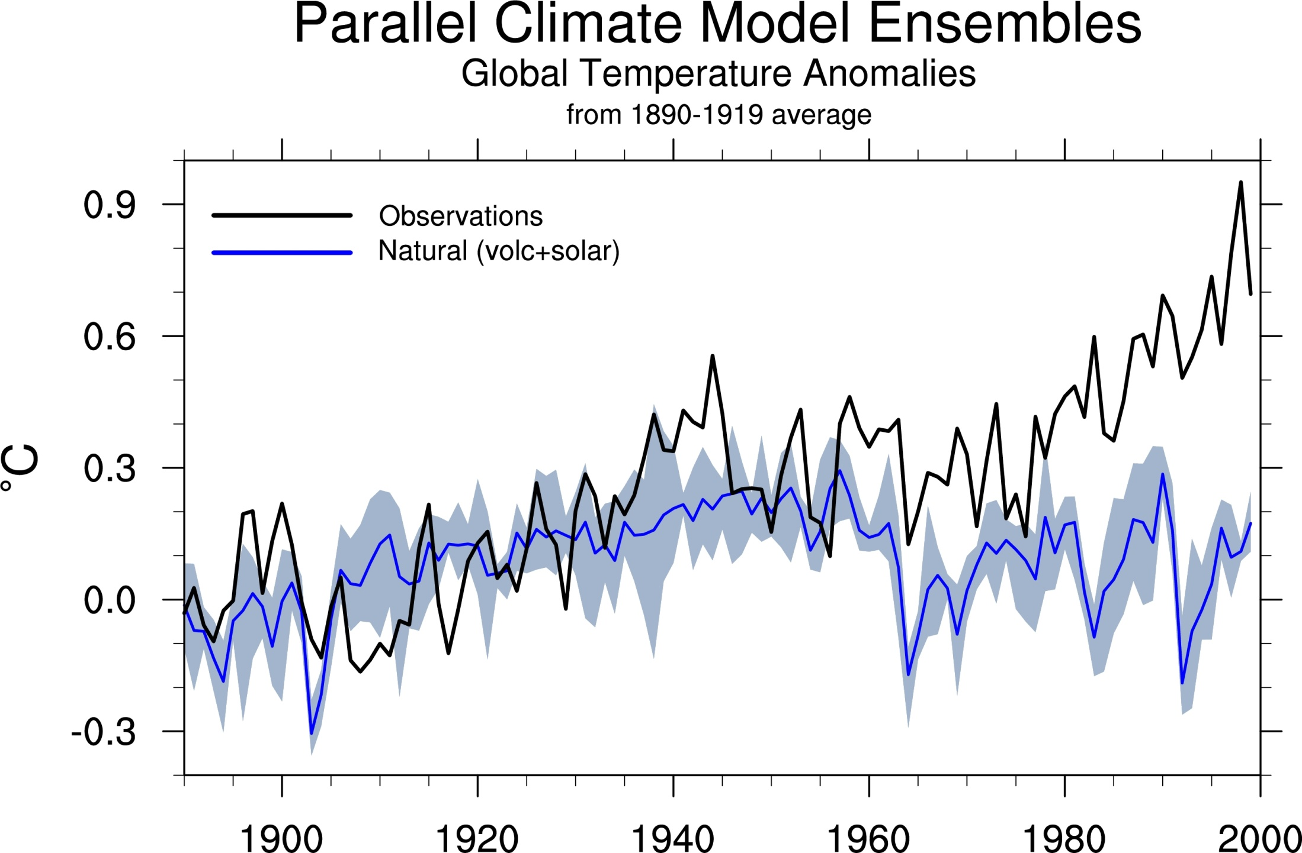
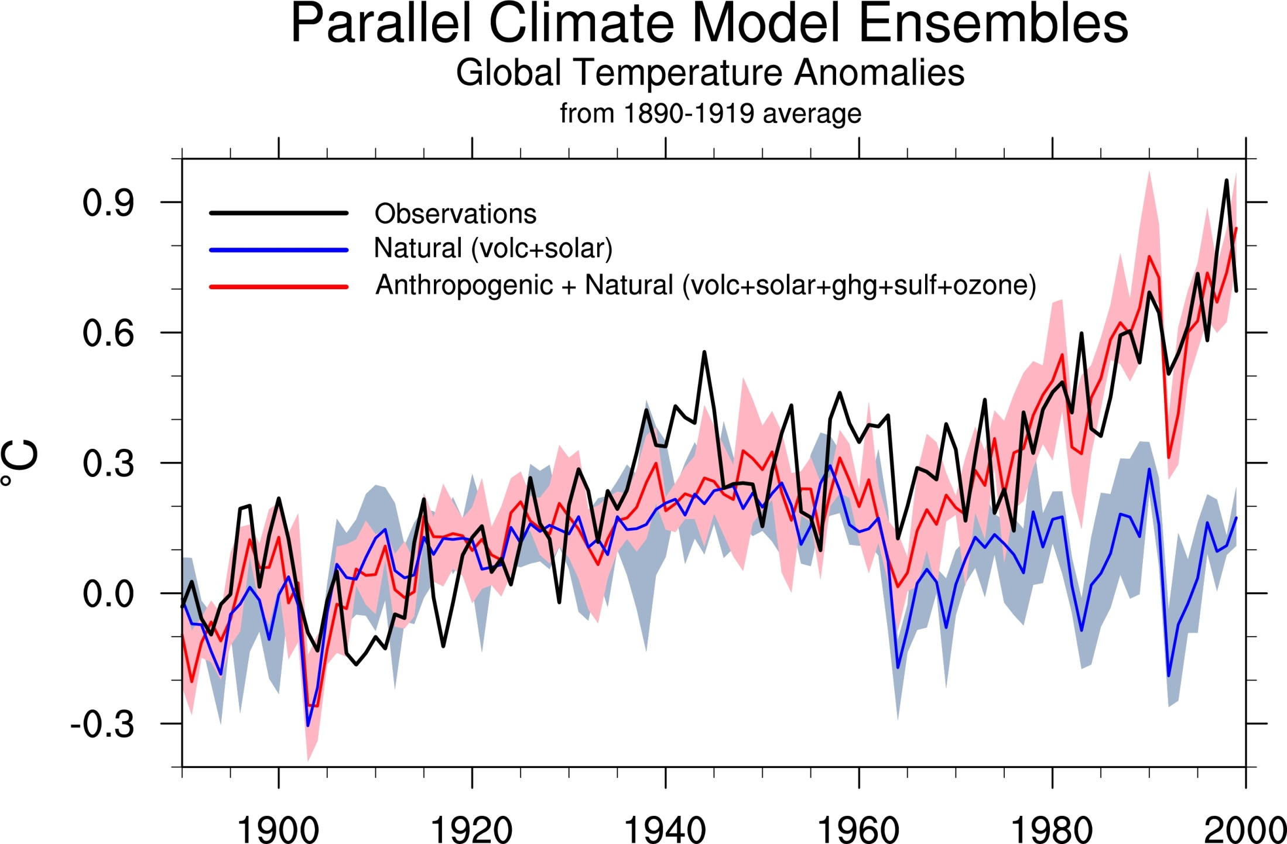
Natural forcings do not account for
observed 20th century warming after 1970
Meehl et al, 2004: J. Climate.

Slide 37
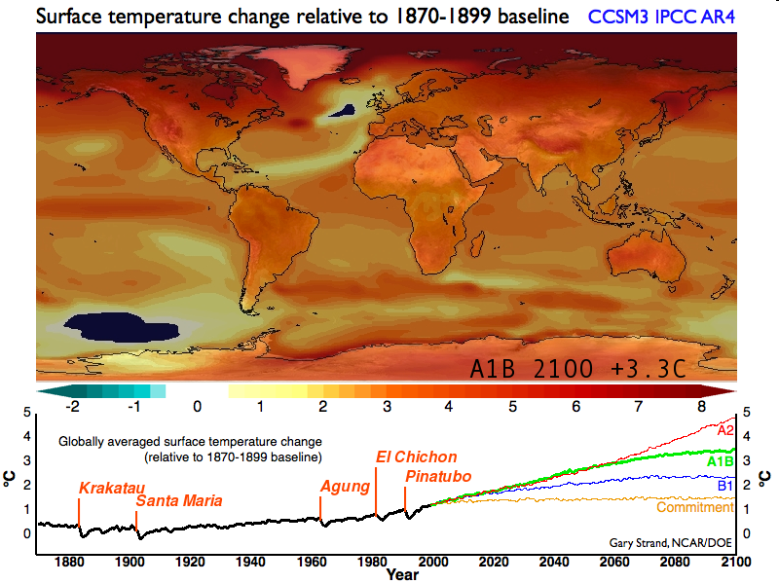
Projected temperature change
CCSM Movie

Slide 38
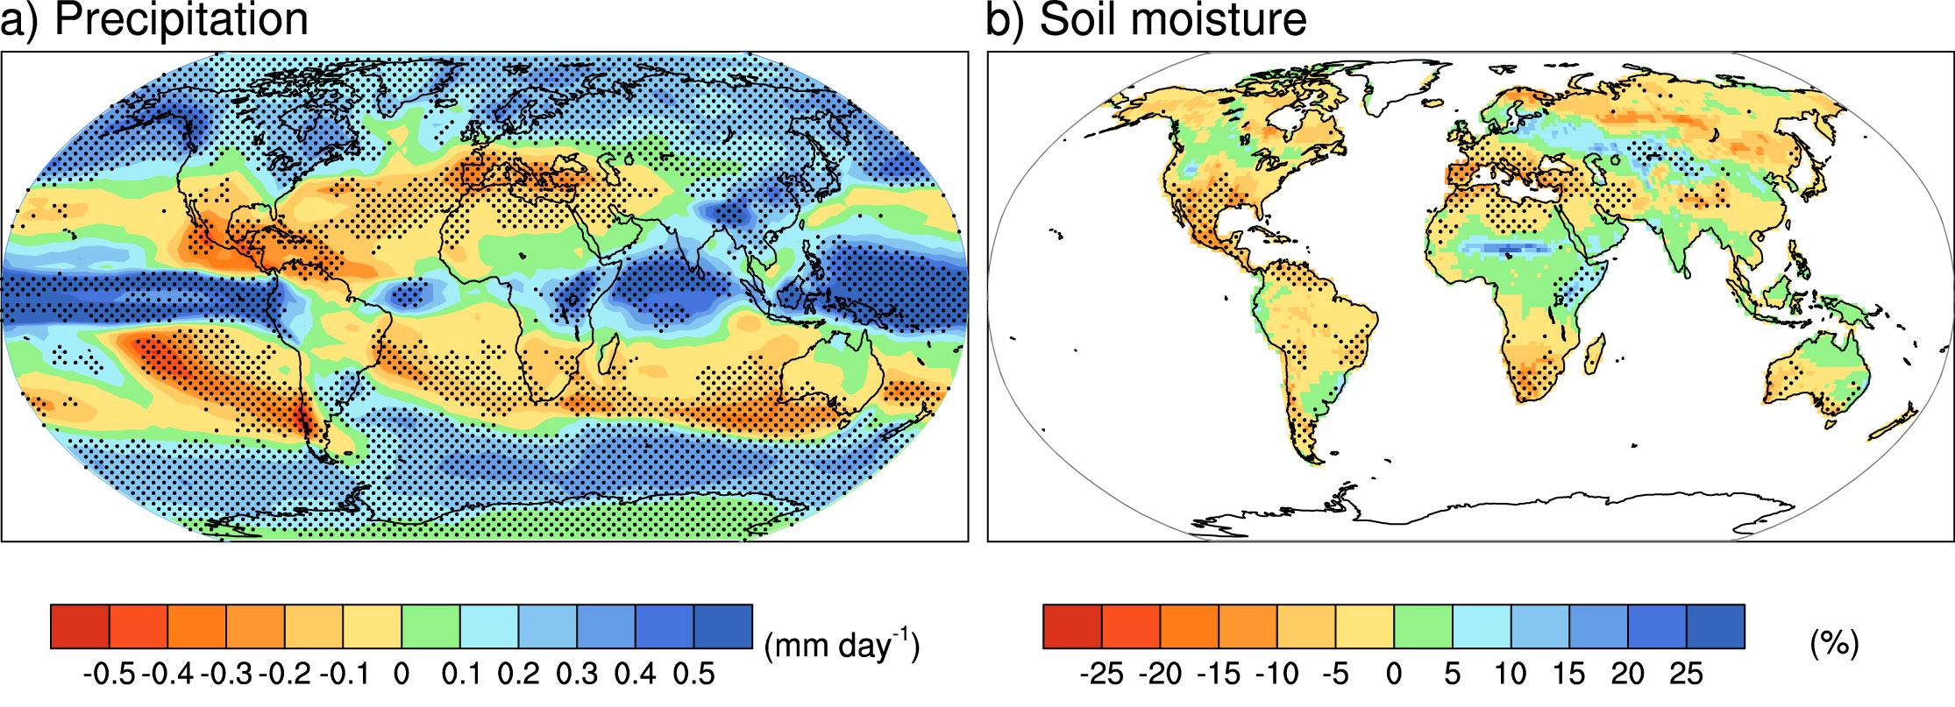
Projected Patterns of Precipitation Change
2090-2100
Combined effects of increased precipitation intensity and more dry days contribute to mean precipitation changes

Slide 39
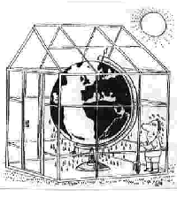
Global warming effects from humans are already identifiable
Rising sea level: coastal storm surges, salt water intrusions, flooding
Heavier rains, floods: water contamination, water quality
Drought: water shortages, agriculture, water quality
Heat-waves: wildfires
Stronger storms, hurricanes, tornadoes: damage, loss of life, loss of habitat
Changes in climate: crops, famine, discontent and strife, more insects (range, seasons), fungal and other disease; vector-borne disease.
Sea ice loss: habitat loss
Permafrost melting: infrastructure at risk

Slide 40
Multi-dimensional problem
Environmental
Economic
Human strife
Trade (tariffs)
Foreign policy
Security
Sustainability

Slide 41
Security and Climate Change
9 Aug 2009
"We will pay for this one way or another. We will pay to reduce greenhouse gas emissions today, and we’ll have to take an economic hit of some kind. Or we will pay the price later in military terms. And that will involve human lives."
GEN. ANTHONY C. ZINNI, former head of the Central Command, on climate change.

Slide 42
Global Warming Actions
Sustainable
Development
Prevent
Problem
Mitigate
Technological
Fix
Adapt
Tragedy of the Commons
Future generations
Values
Precautionary Principle
Vested Interests
No
Problem
Equity
Do Nothing

Slide 43


What is your carbon footprint?
You will be affected by climate change (you are already)
You will be affected by legislation designed to address climate change (whether good or bad)

Slide 44

Many things you can do:
Going
Green!

Slide 45
The Challenge:
Sustainable Management of an Ever-Changing Planet
NCAR Earth System Laboratory
NCAR is sponsored by NSF

