Slide 1

The Flow of Energy
through the
Earth’s Climate System
Kevin E. Trenberth
NCAR
with John Fasullo

Slide 2

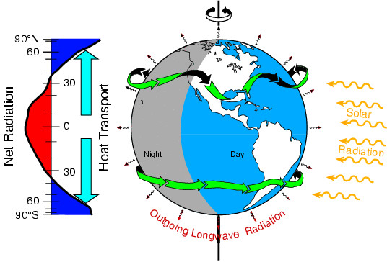
Energy on Earth
The main external influence on planet Earth is from radiation.
Incoming solar shortwave radiation is unevenly distributed owing to the geometry of the Earth-sun system, and the rotation of the Earth.
Outgoing longwave radiation is more uniform.

Slide 3

Energy on Earth
The incoming radiant energy is transformed into various forms (internal heat, potential energy, latent energy, and kinetic energy) moved around in various ways primarily by the atmosphere and oceans, stored and sequestered in the ocean, land, and ice components of the climate system, and ultimately radiated back to space as infrared radiation.
An equilibrium climate mandates a balance between the incoming and outgoing radiation and that the flows of energy are systematic. These drive the weather systems in the atmosphere, currents in the ocean, and fundamentally determine the climate. And they can be perturbed, with climate change.

Slide 4
Energy on Earth
Mean and annual cycle of radiation, energy storage and transport are analyzed holistically using datasets:
ERBE (Feb 1985 - Apr 1989)
3 satellite configuration; 2 polar orbiting satellites and 1 72-day precessing orbit covering 60°N-60°S Failure of NOAA-9 (afternoon crossing) in Feb 1987 left only 1 polar orbit (morning)
CERES (Mar 2000-present)
Terra: single polar orbiting satellite plus Aqua in Jul 2002
NCEP/NCAR Reanalyses
ERA-40 Reanalyses
JRA-25 Reanalyses
World Ocean Atlas ocean data
Japanese Meteorological Agency ocean data
Global Ocean Data Assimilation System (GODAS) NCEP
ECCO: MIT/SCRIPPS/JPL/UH ECCO-GODAE 1992-2004

Slide 5
F_{s} = ∇.F_{A} - R_{T}+ δA_{E}/δt
∇.F_{O} = – F_{s} – δO_{E}/δt
F_{s} = LE + H_{s} – R_{s}
From ERBE or CERES
R_{T}
From NRA, ERA-40 or JRA
∇.F_{A}
H_{s}
LE
Computed as residual
R_{s}
LP
F_{s}
Ocean heat storage from ocean analyses; transport is zero for global ocean
∇.F_{O}

Slide 6
ERBE was adjusted to have zero net radiation (consistent with ocean obs).
Original global adjustment (Trenberth 1997)
was modified separately for land and ocean to remove discontinuities exposed in this analysis
CERES was similarly adjusted:
in OLR to error limits, and albedo to reduce the imbalance of 6.4 W m⁻² to an acceptable ~0.9 W m⁻² consistent with models and ocean obs.

Slide 7
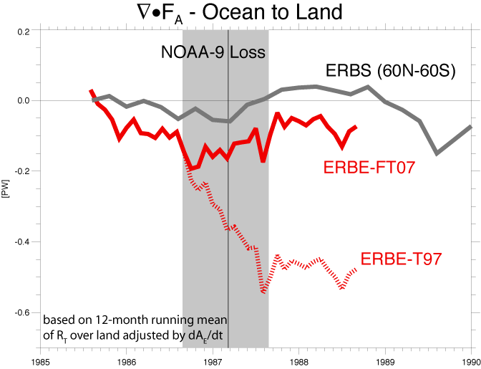
ERBE Tuning: Inferred Ocean to Land transport of energy
The spurious negative trend in implied ocean to land energy transport is addressed in revised tuning.
This also has the beneficial effect of yielding a continuous OLR record.
Land
ERBE revised
ERBE from Trenberth 1997
All 12-month running means

Slide 8
Global net flux balance error budget CERES error:
Wielicki et al. (2006) W m⁻².
Error Source | SW | LW | Net
Total Solar Irradiance (1361 vs 1365) | +1.0 | 0.0 | +1.0
Absolute Calibration | 1.0 | 1.0 | 2.0
Spectral Correction | 0.5 | 0.3 | 0.8
Spatial Sampling | <0.1 | <0.1 | <0.1
Angle Sampling | +0.2 | -0.1 | +0.1
Time Sampling (diurnal) | <0.2 | <0.2 | <0.2
Reference Altitude (20 km) | 0.1 | 0.2 | 0.3
Twilight SW Flux (-0.25 Wm⁻²) | <0.1 | 0.0 | <0.1
Near Terminator SW Flux | +0.7 | 0.0 | +0.7
3-D Cloud Optical Depth bias | +0.7 | 0.0 | +0.7
CERES SRBAVG Ed2D R_{T} |  |  | 6.4
1.5

Slide 9
CERES Tuning
Unadjusted, CERES fields depict a net TOA flux of ~6.4 W m⁻² which is unrealistic given the reported ocean heat tendency during CERES ~0.4 PW (e.g. Levitus et al. 2005) and model results.
Estimates of the error sources suggest that multiple small error sources combine constructively to yield a bias in the reported imbalance and that both longwave and shortwave budgets require adjustment (Wielicki et al. 2006).
We adjusted OLR +1.5 W m⁻² and albedo (+0.3% to 0.30) to give net 0.9 W m⁻² consistent with model estimates (e.g. Hansen et al. 2005) and ocean heat uptake (Willis et al. 2004)

Slide 10
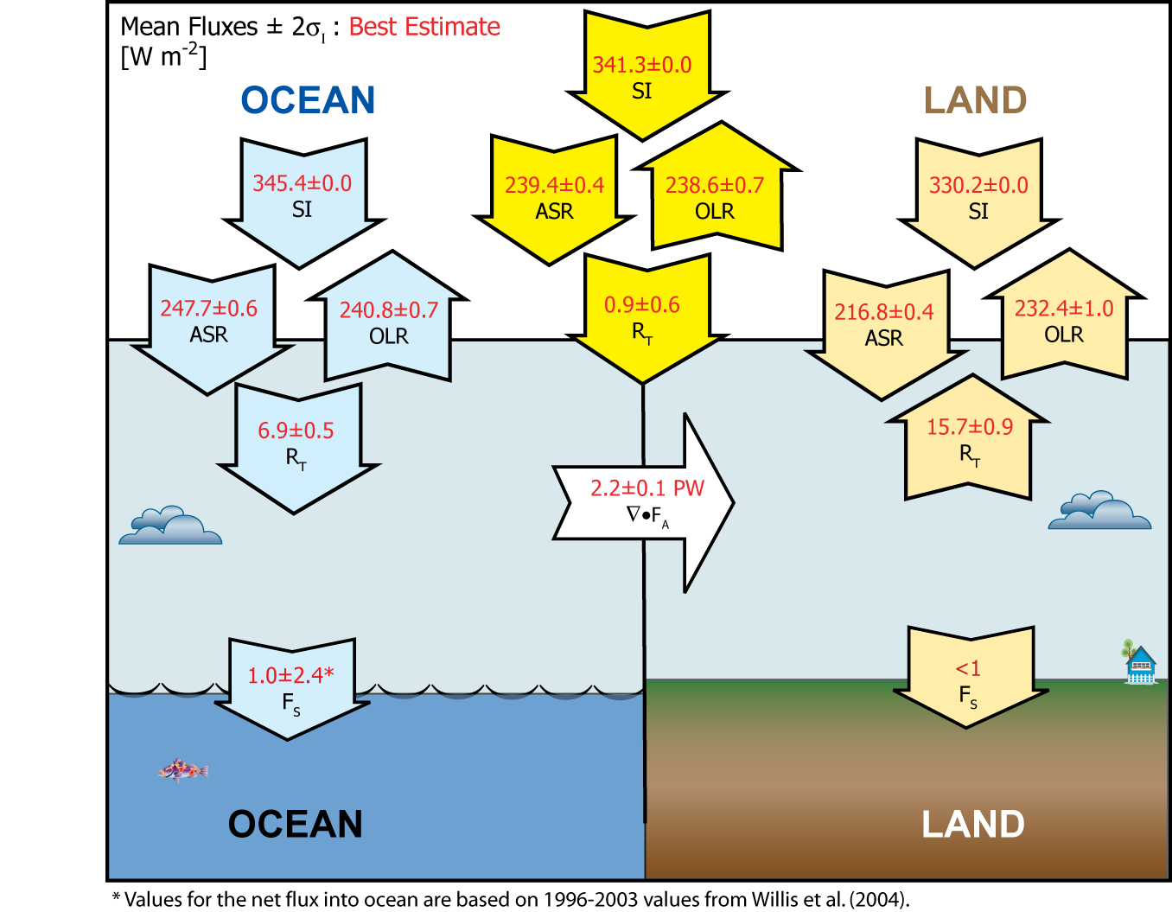
Global
CERES period March 2000 to May 2004

Slide 11
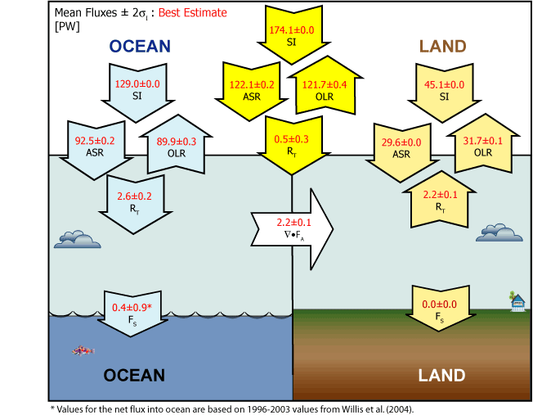
Net energy flow from ocean to land of 2.2 PW
Net imbalance into ocean 0.4 PW
CERES period March 2000 to May 2004

Slide 12
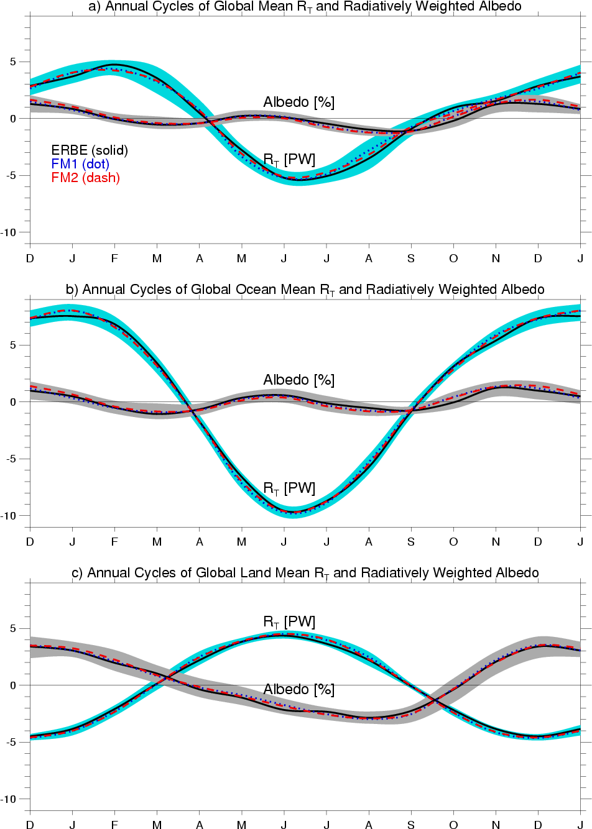
Mean annual cycles of
albedo and R_{T}
Global
Note albedo lower in February vs January over oceans (cloud)
Global-ocean
Global-land
shading is ±2σ
Perihelion
Jan 3
Shading represents ±2σ sampling of monthly means

Slide 13
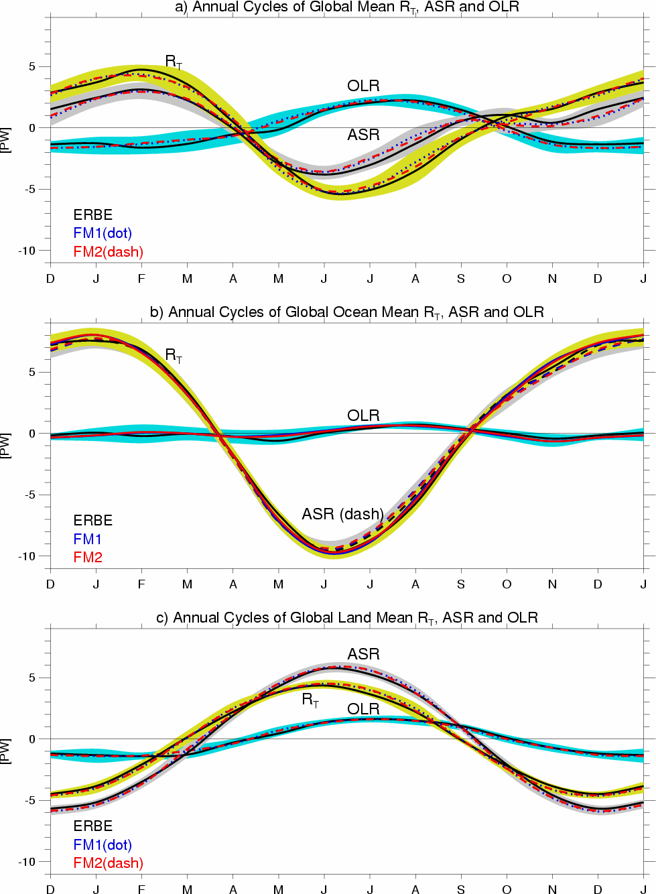
ASR, OLR, and RT
RT= ASR-OLR
Global
ASR peaks in February, 1 month after perihelion, owing to albedo decrease in February
Global-ocean
Global-land
Main OLR annual cycle from land (snow and temperature)
shading represents ±2σ

Slide 14
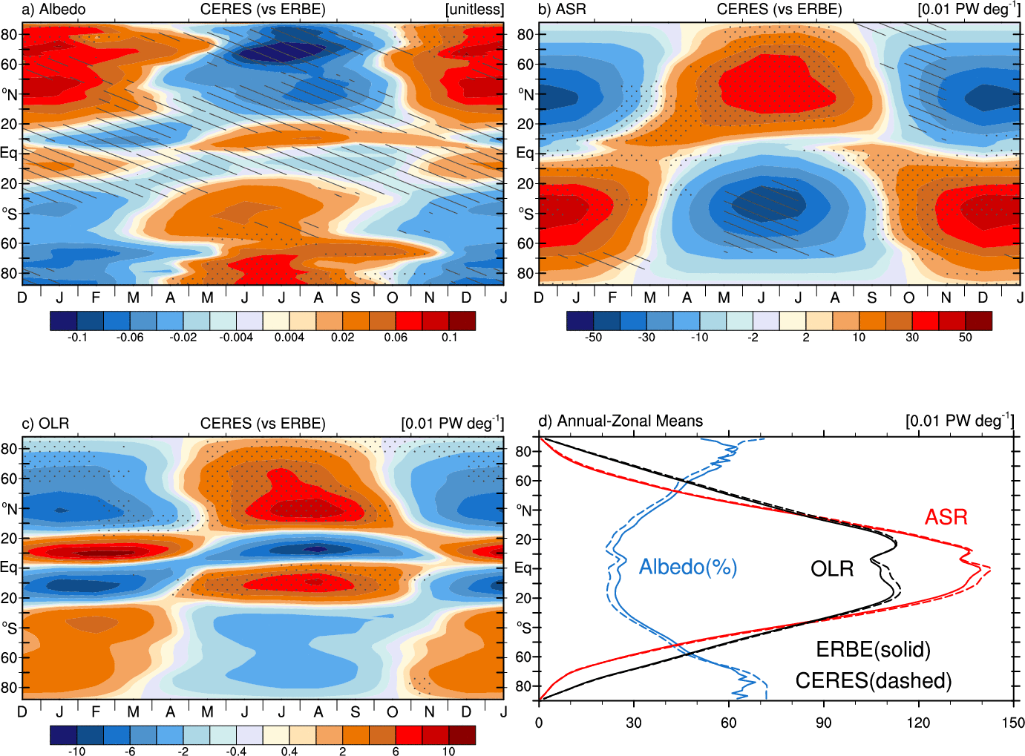
\\ CERES<ERBE ……CERES>ERBE

Slide 15
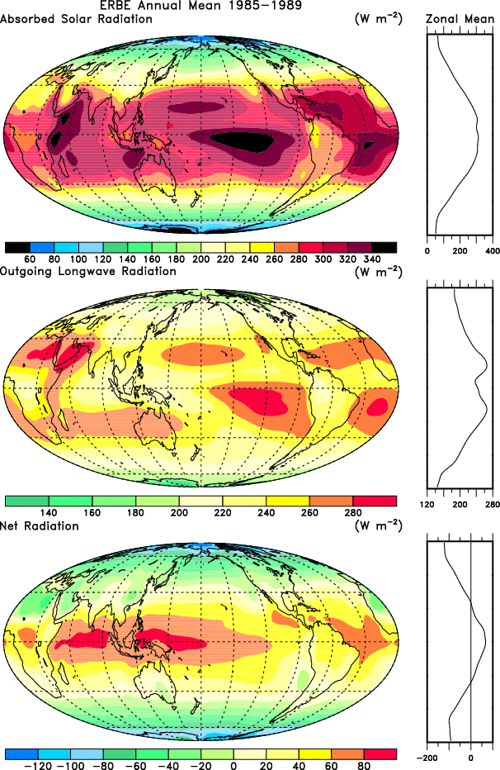
Annual Cycle of R_{T} (ERBE)
ASR
OLR
NET

Slide 16
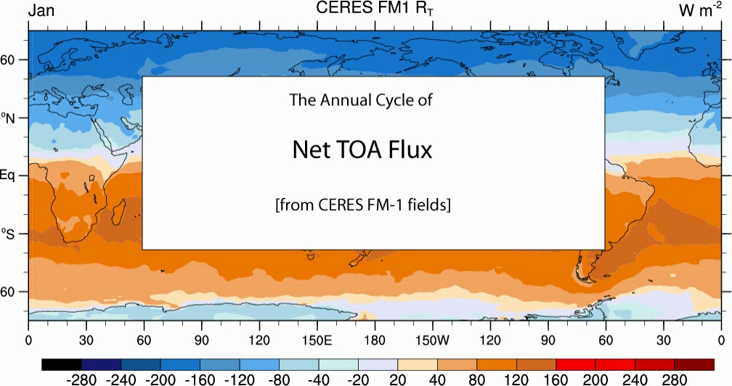

Slide 17
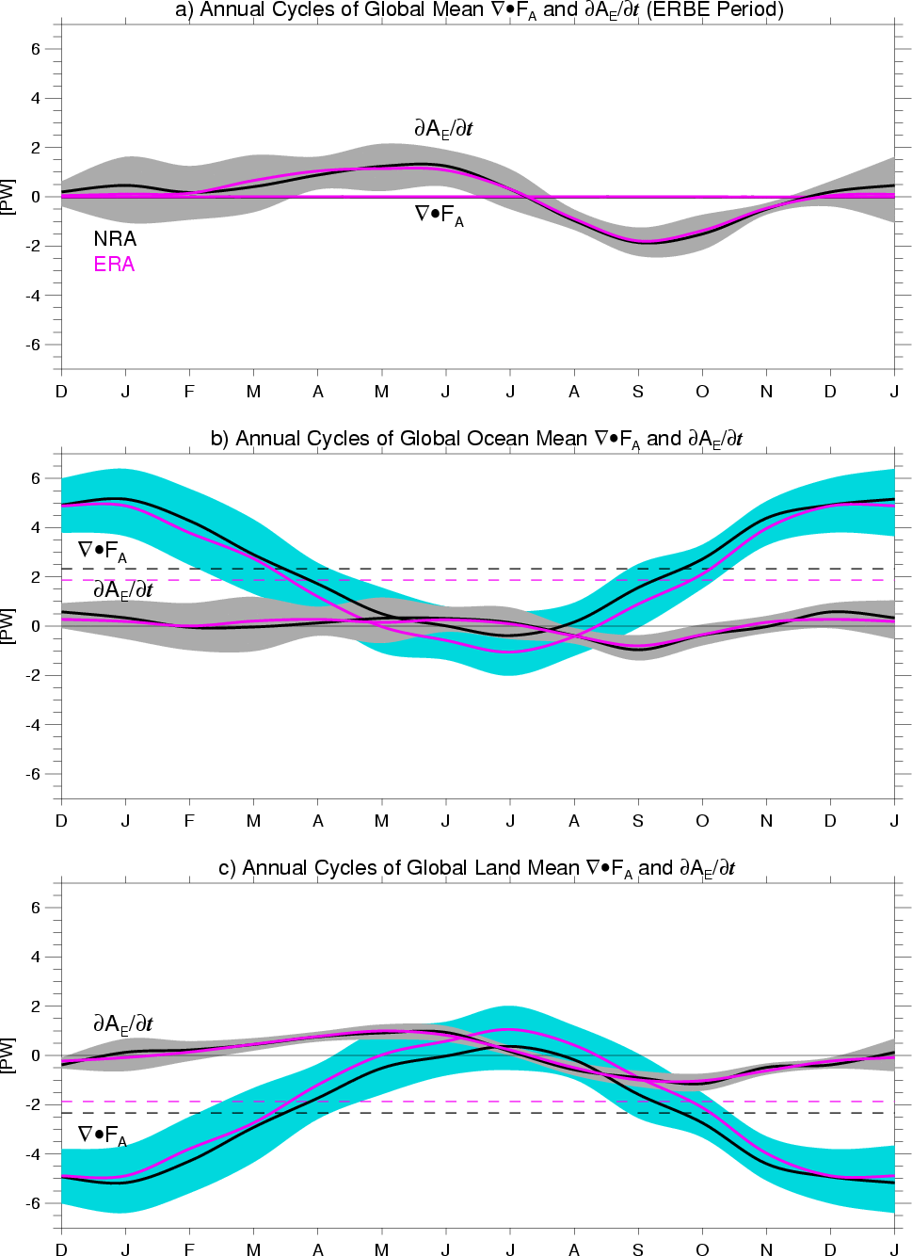
Atmospheric total energy divergence (∇•F_{A}) and tendency (δA_{E}/δt)
Global
global-ocean
global-land
Main ocean to land energy transport is in northern hemisphere in northern winter
Global =0

Slide 18
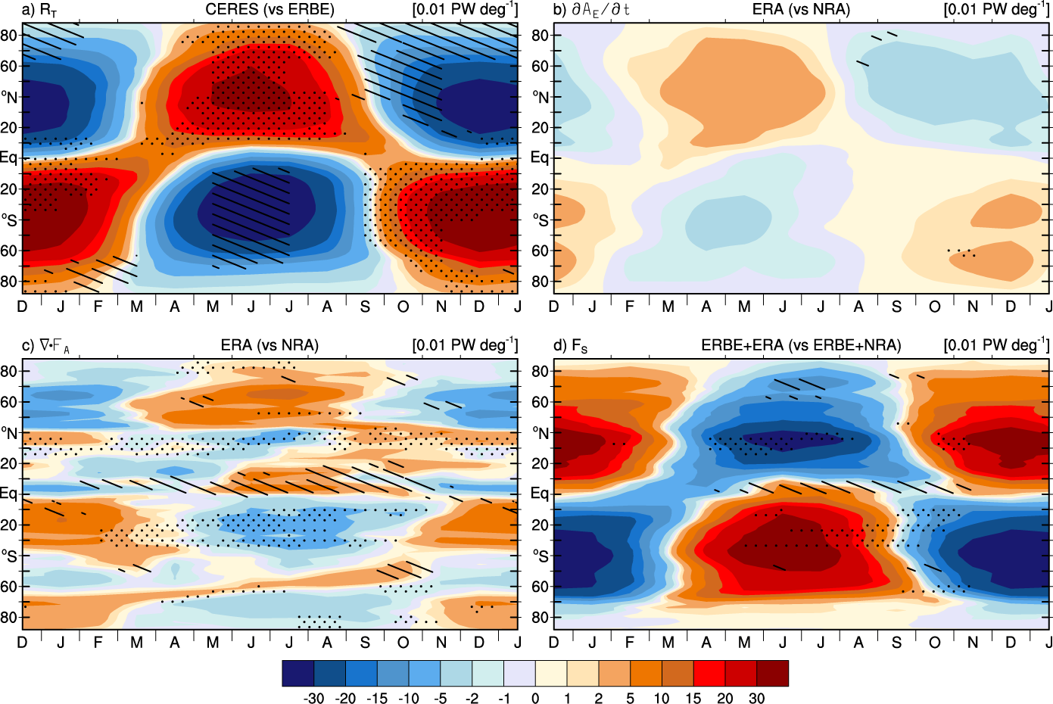
Land and ocean

Slide 19
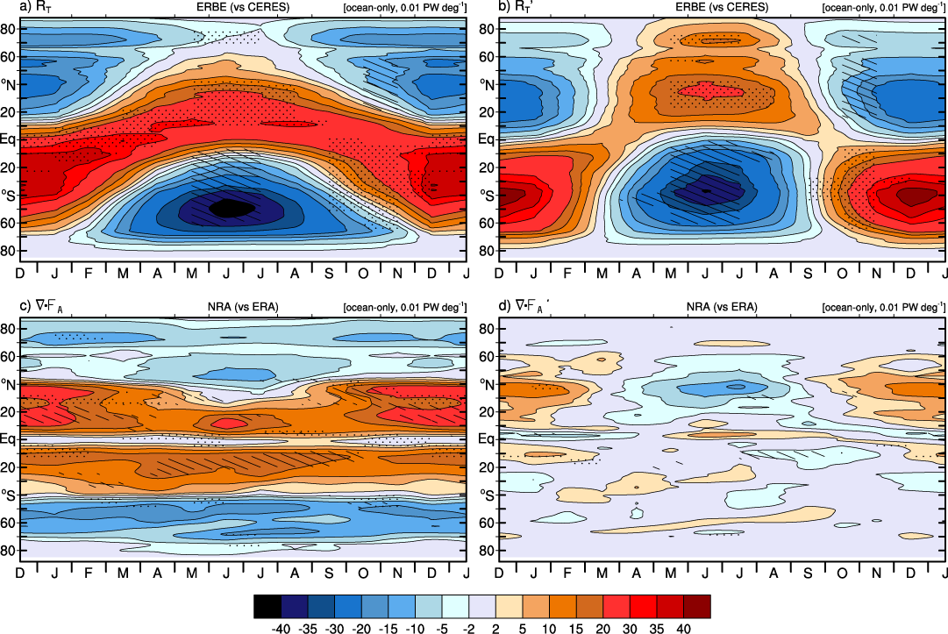
Ocean only

Slide 20
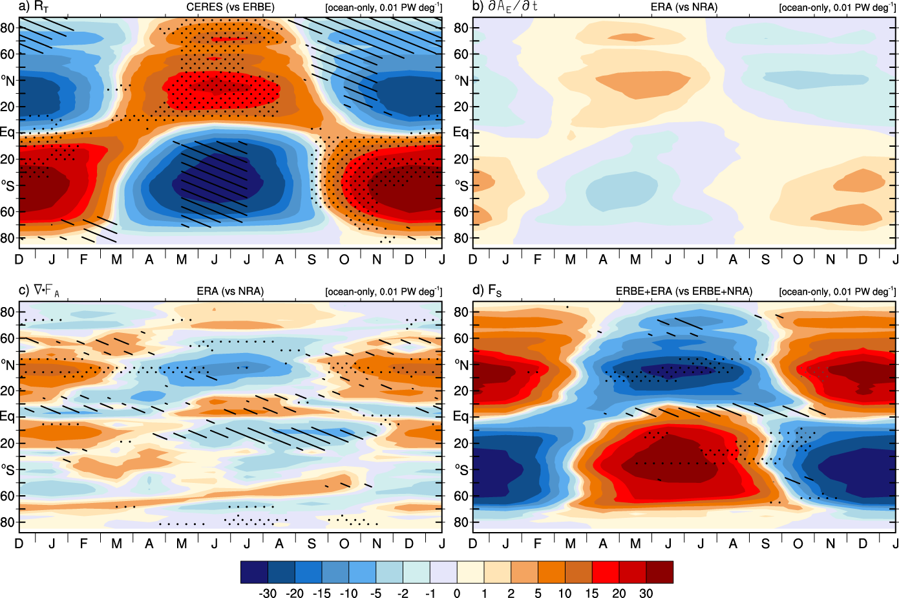
OCEAN

Slide 21
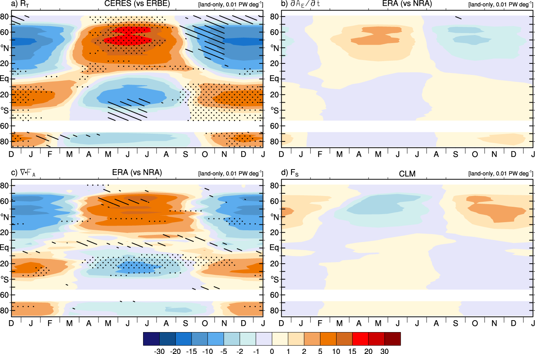
LAND

Slide 22
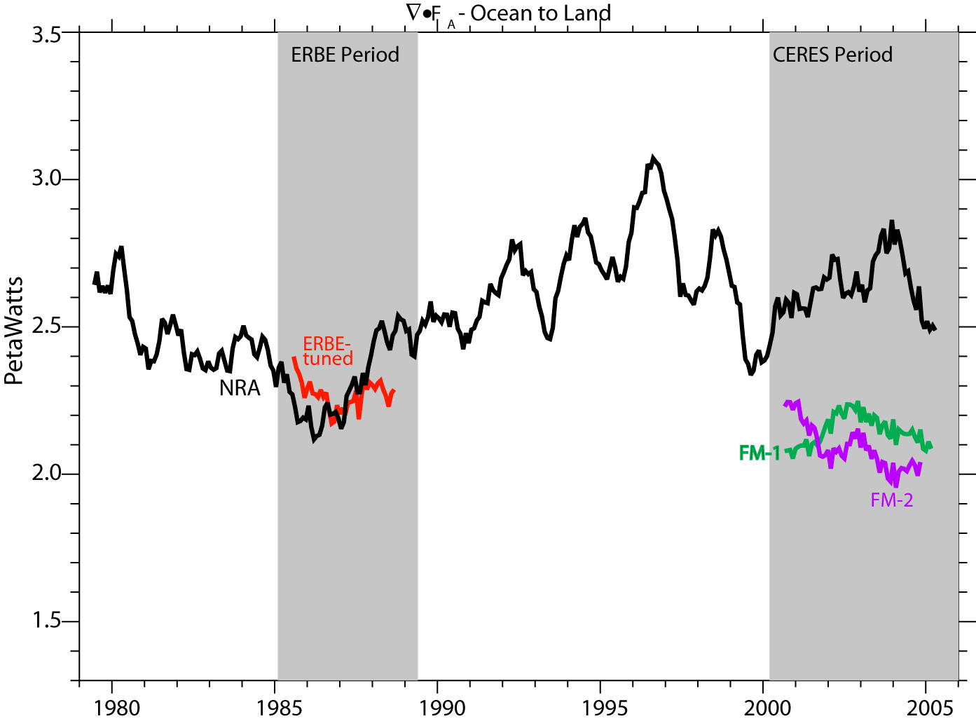
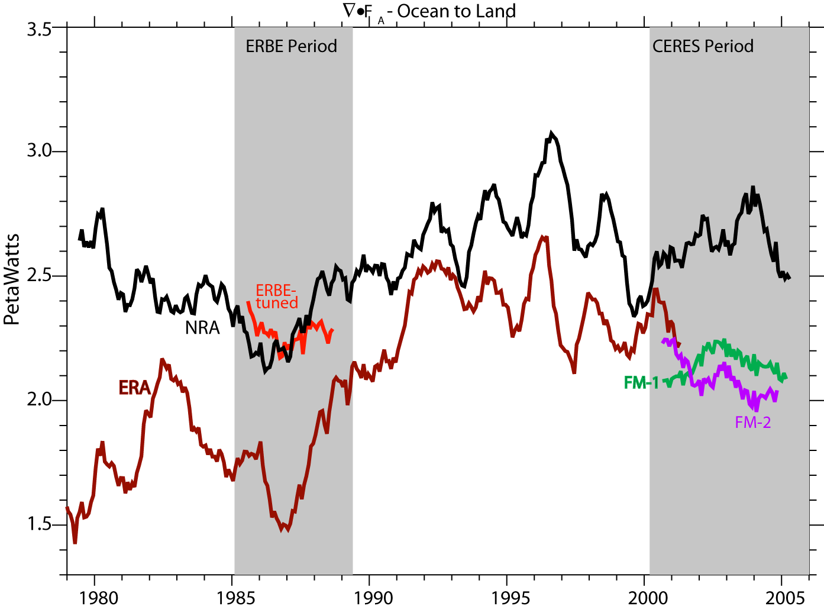
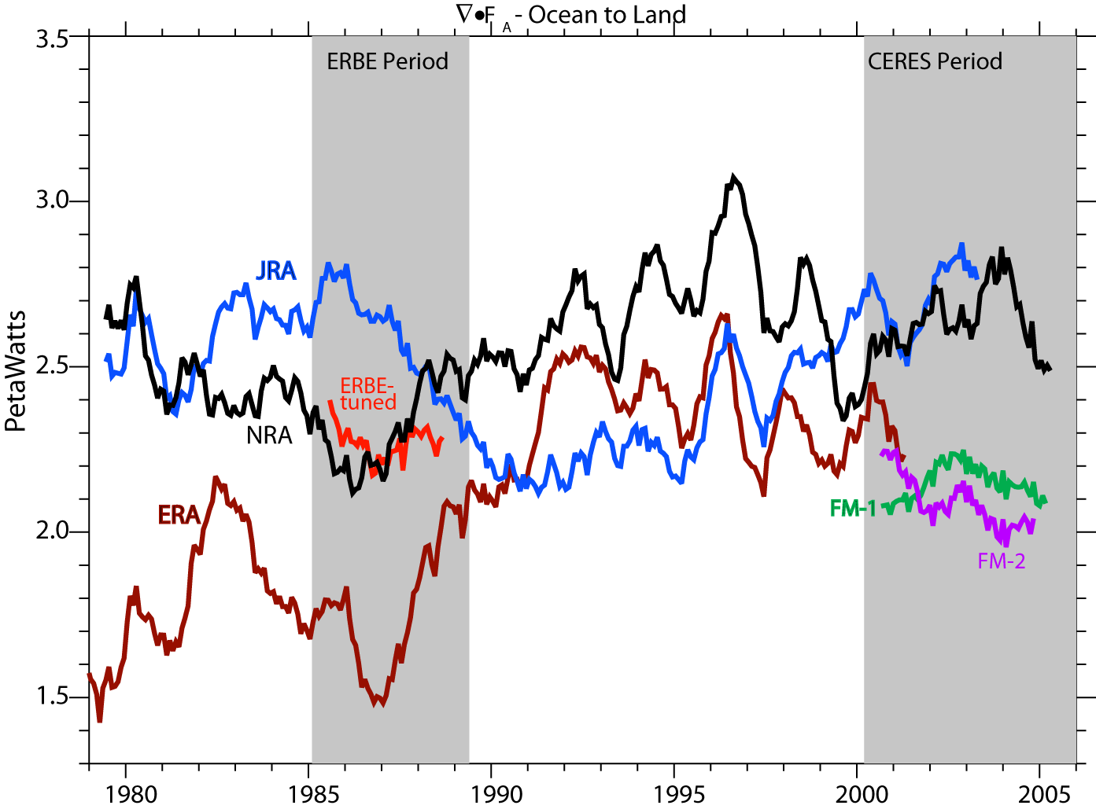
Pinatubo
SSMI
ATOVS
Net ocean to land energy transport 12-month running means for ERBE and CERES R_{T} over land and δA_{E}/δt.

Slide 23
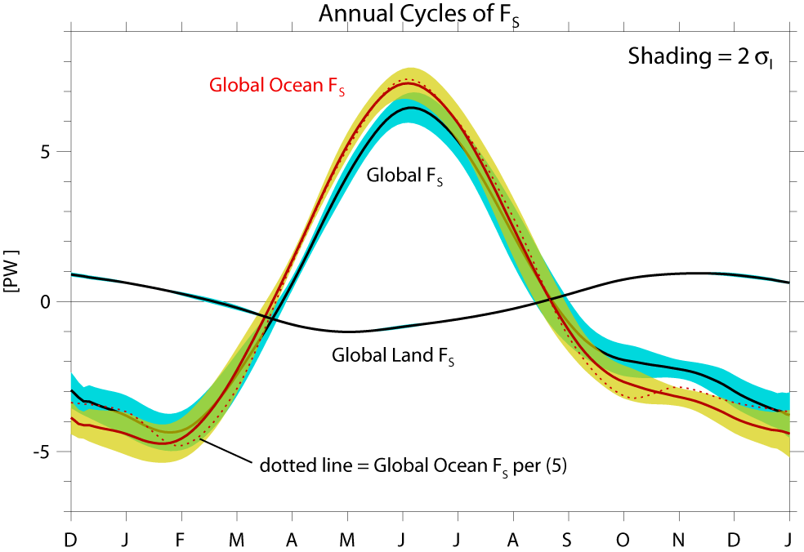
Global, global-ocean, and global-land (from CLM3) estimates of net upwards surface flux (F_{S}) using ocean (red) and land (dotted red).

Slide 24
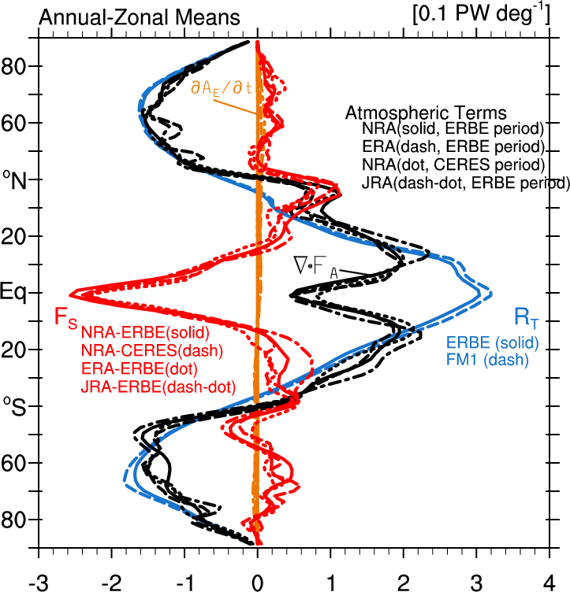

Slide 25
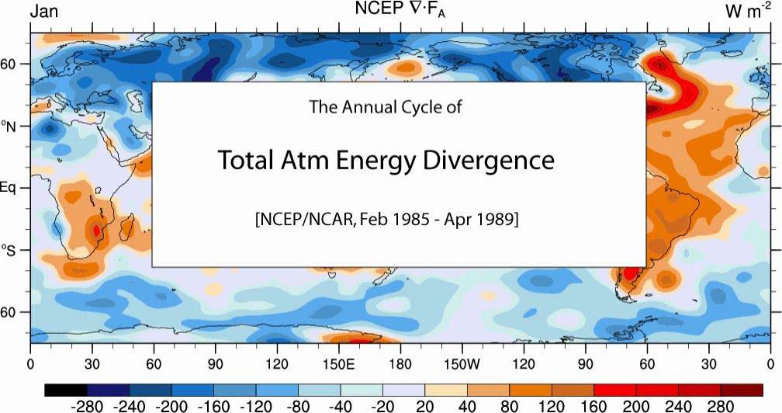
Annual cycle of ∇.F_{A}

Slide 26
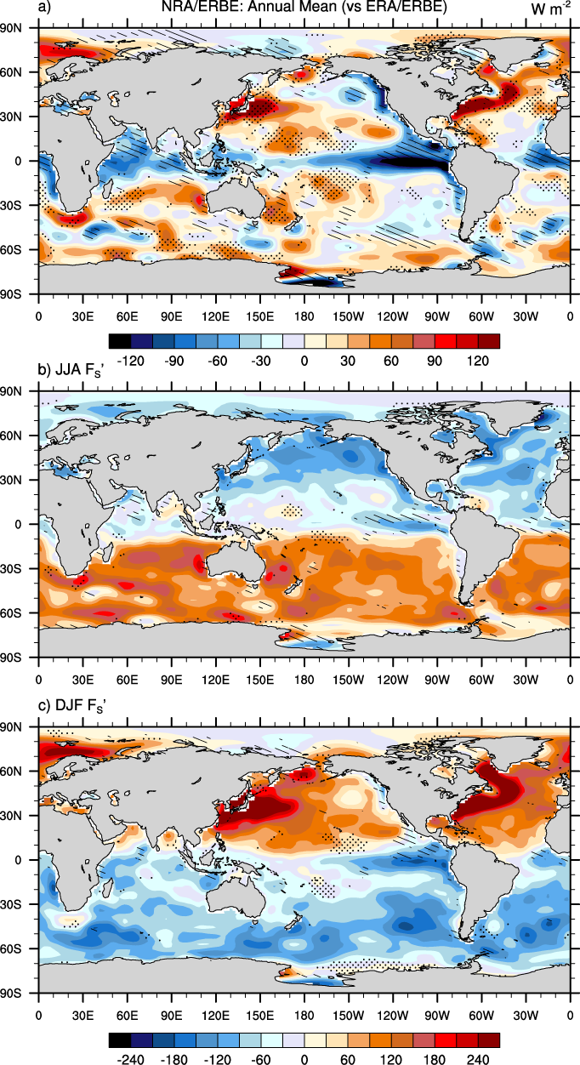
Annual cycle of Fs

Slide 27
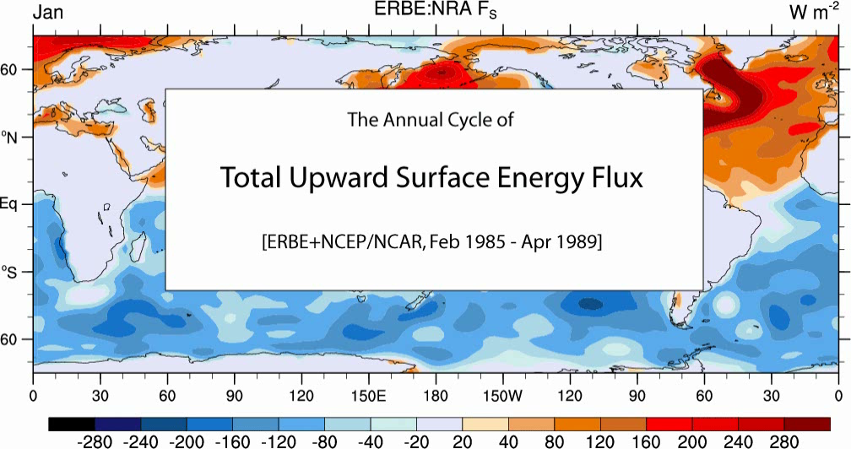

Slide 28
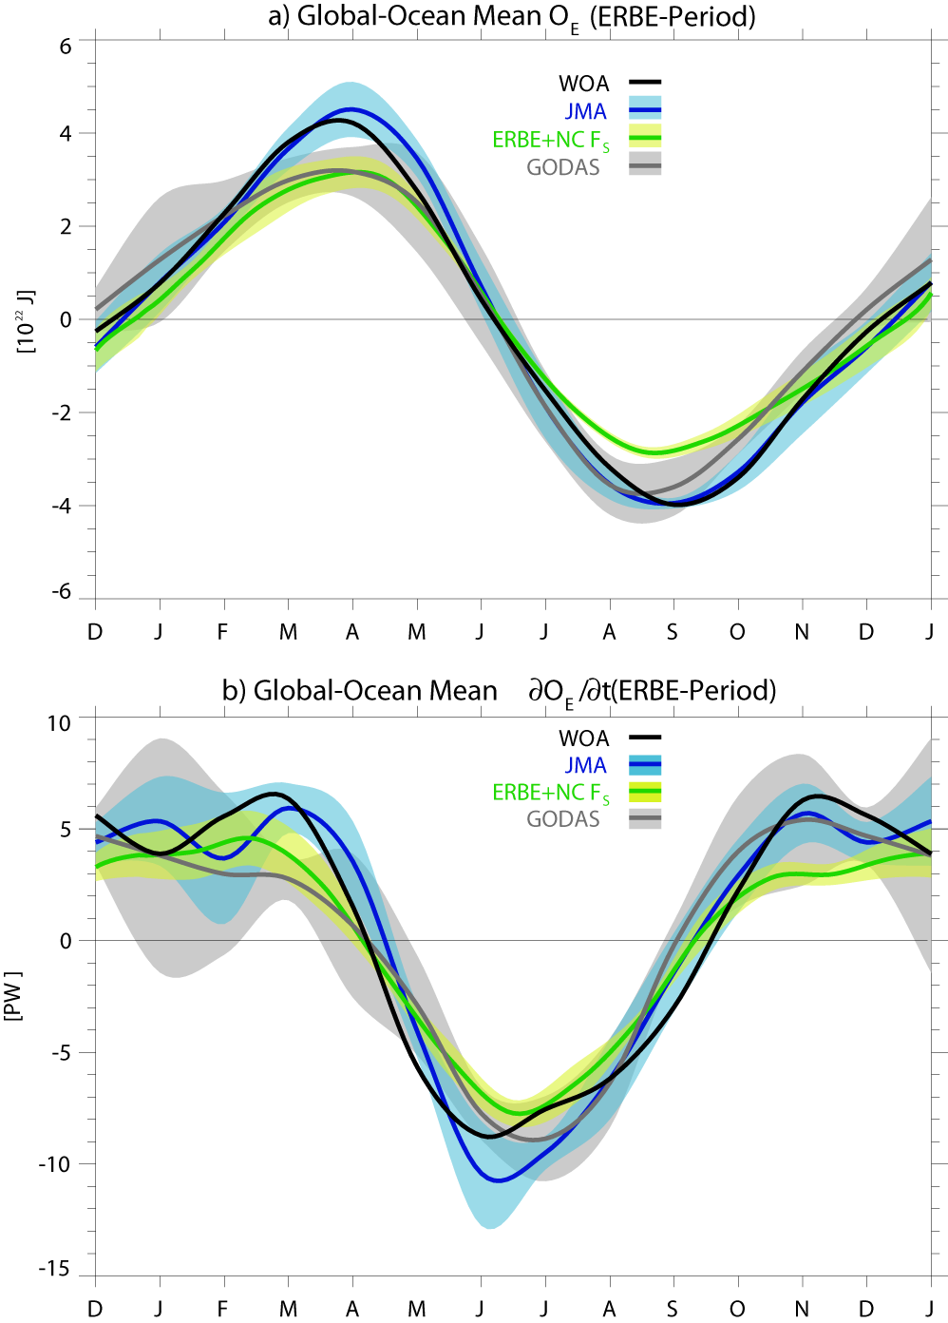
Amplitude of O_{E} much too large: we can show that the main discrepancies arise from south of 30°S where ocean sampling poor.
GODAS better than WOA.
O_{E} from WOA, GODAS and JMA (shading).
F_{S} has been integrated in time to provide O_{E} anomalies

Slide 29
O_{E} and δO_{E}/δt
from WOA
GODAS and JMA (shading).
O_{E} have been differenced to provide δO_{E}/δt
F_{S} has been integrated in time to provide O_{E} anomalies

Slide 30
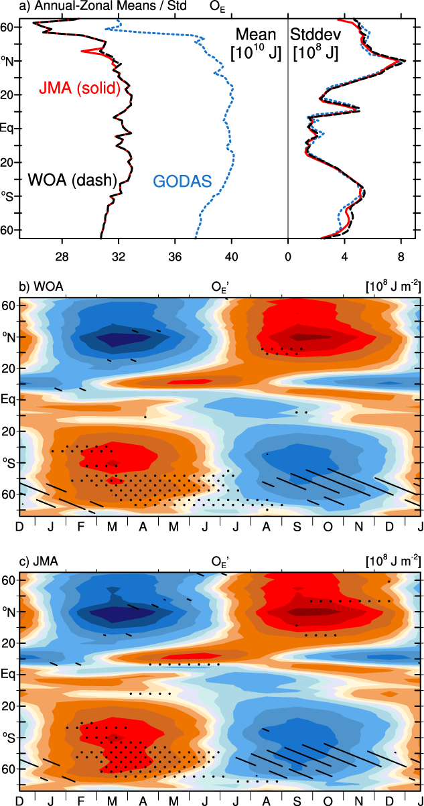
Annual zonal means
GODAS > JMA,WOA
Departures from annual mean
Differences from GODAS exceeding ±2σ over southern oceans
....WOA>GODAS
\\WOA<GODAS

Slide 31
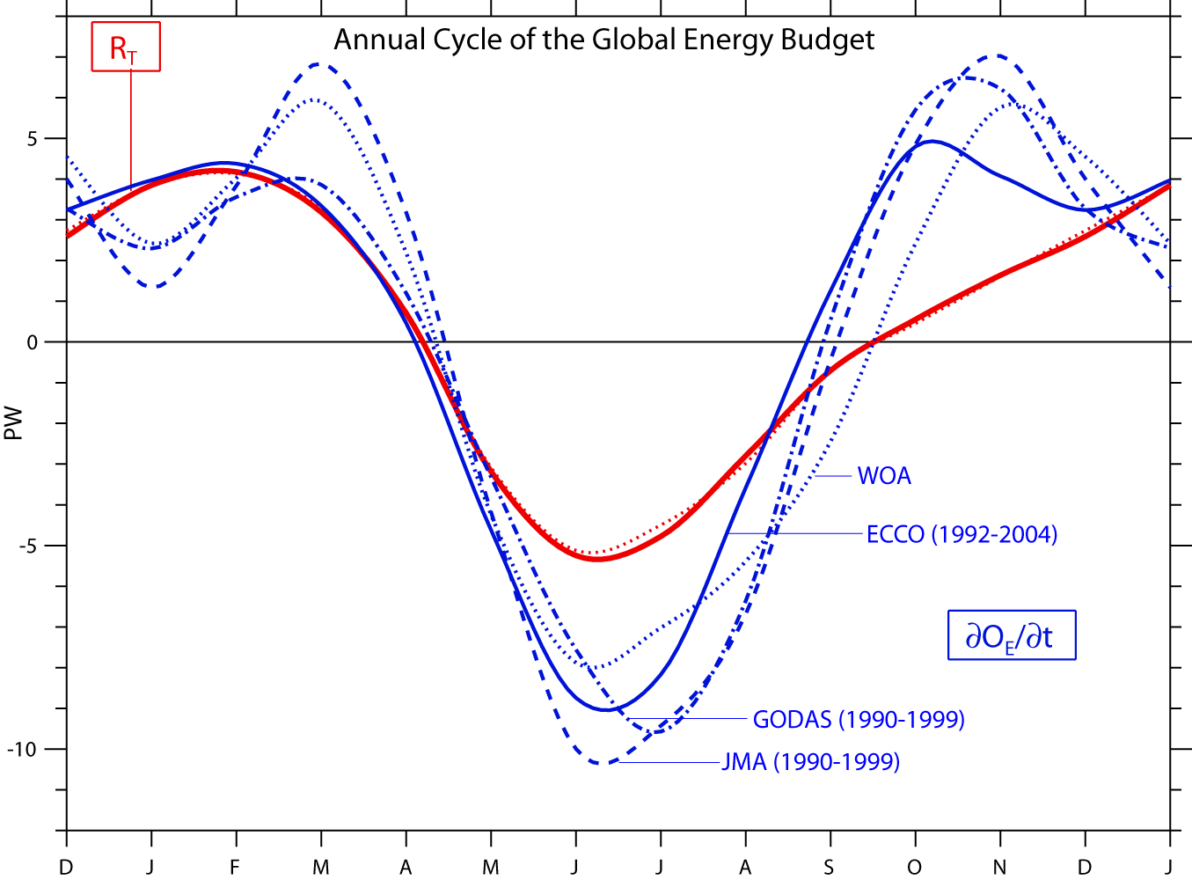
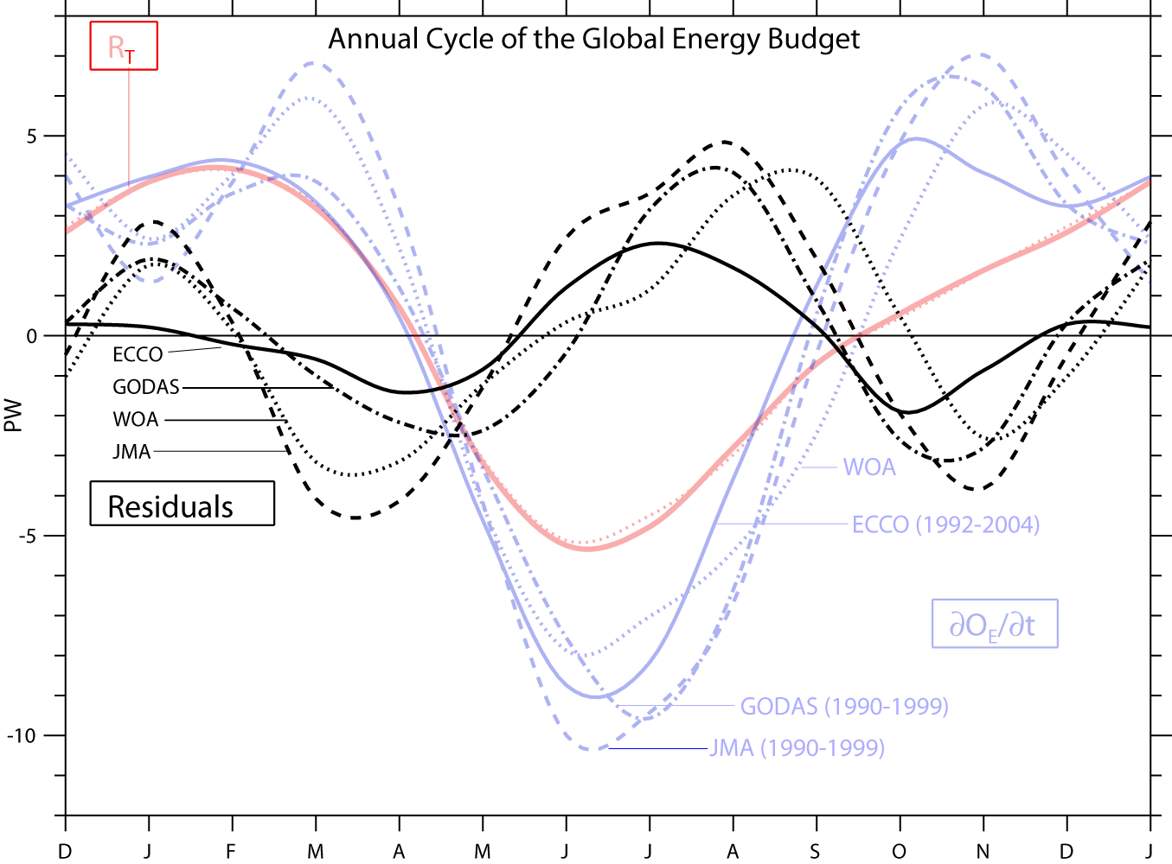

Slide 32
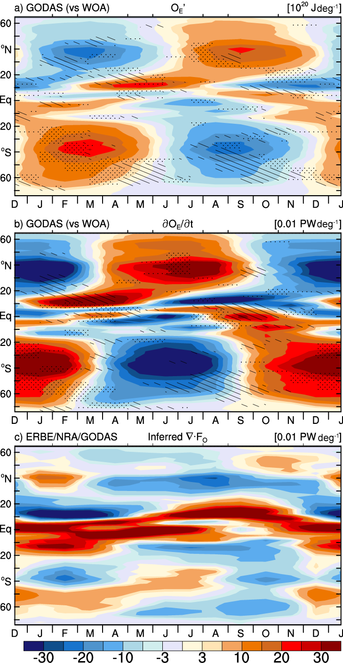
Zonal integral over the world oceans of
a) O_{E}’
b) δO_{E}/δt
c) ∇•F_{O}
in PW deg⁻¹.

Slide 33
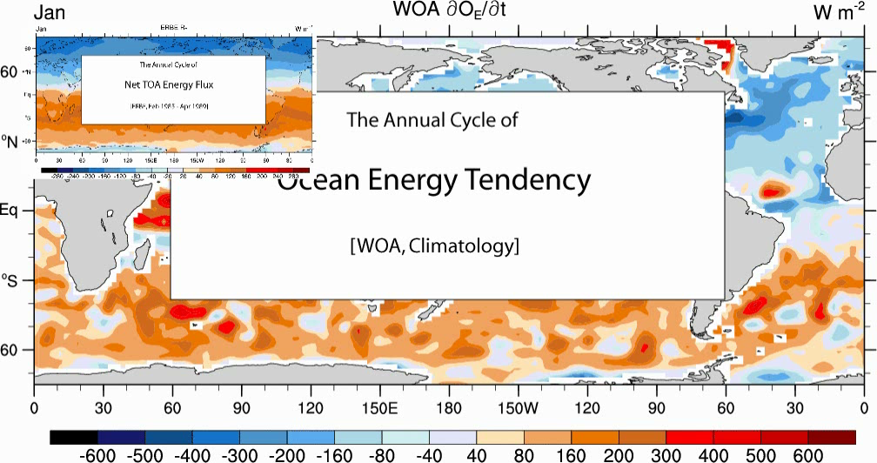

Slide 34
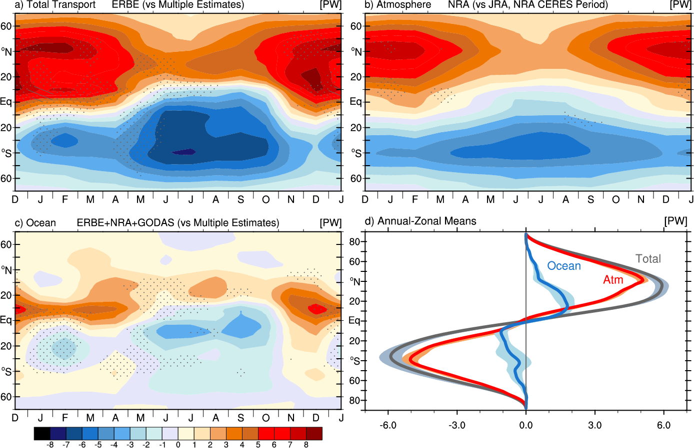
ERBE-period meridional energy transport

Slide 35
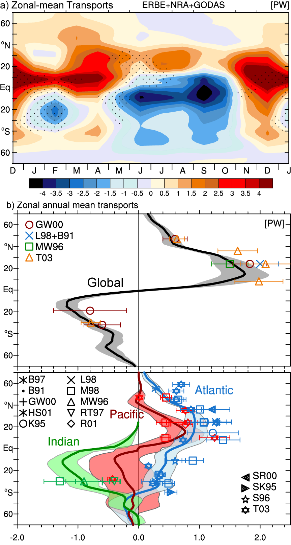
Ocean Transports
Comparisons of annual means with direct ocean transect estimates shows good results except slightly lower for Atlantic and global mean

Slide 36
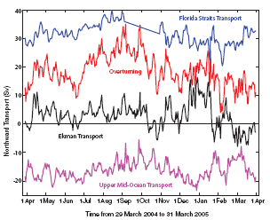
26.5°N Atlantic
Variability of MOC is large: average overturning is
18.7 ± 5.6 Sv (1 s.d)
(range: 4.0 to 34.9 Sv)
Cunningham et al 2007 Science

Slide 37
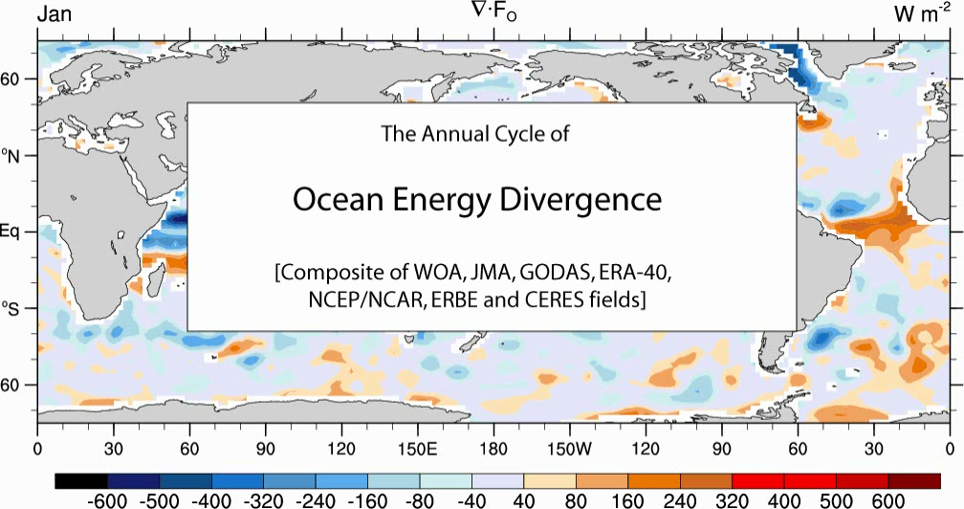

Slide 38
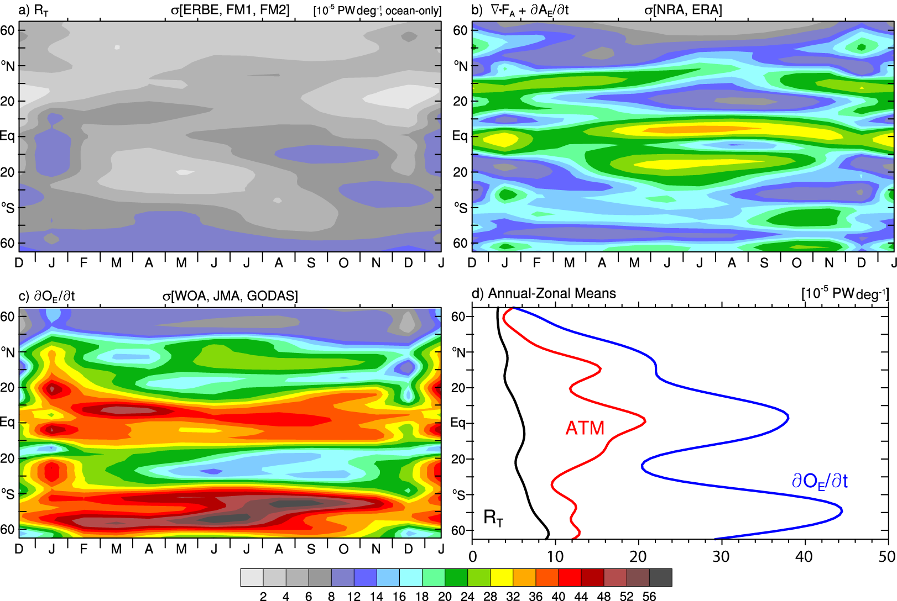

Slide 39
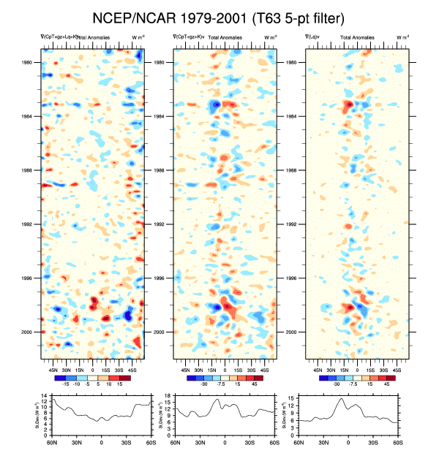
NRA divergence of energy
Total DSE LE
1980
1984
1988
1992
1996
2000
82-83 EN
97-98 EN

Slide 40
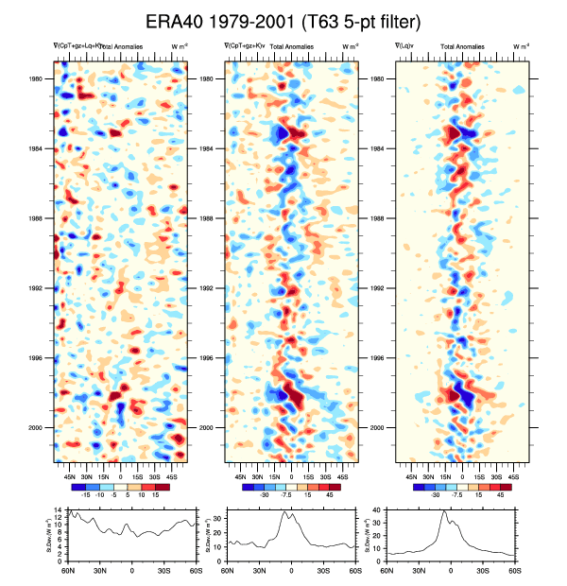
ERA-40 divergence of energy
Total DSE LE
1980
1984
1988
1992
1996
2000
82-83 EN
97-98 EN

Slide 41
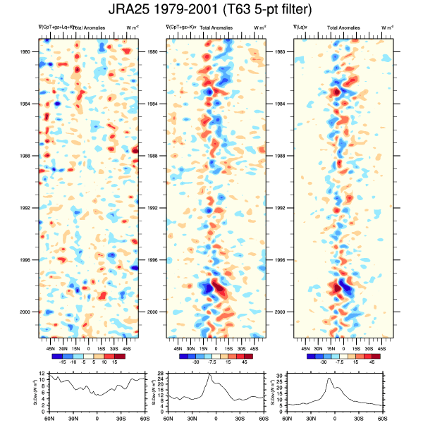
JRA divergence of energy
Total DSE LE
1980
1984
1988
1992
1996
2000
82-83 EN
97-98 EN

Slide 42
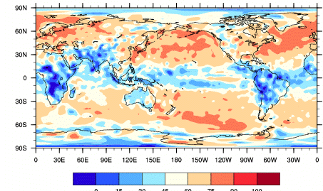
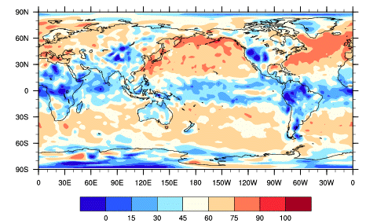
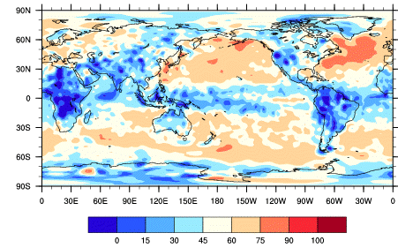
Correlations total energy divergence:
Monthly Anomalies
JRA vs ERA-40
JRA vs NRA
NRA vs ERA-40

Slide 43
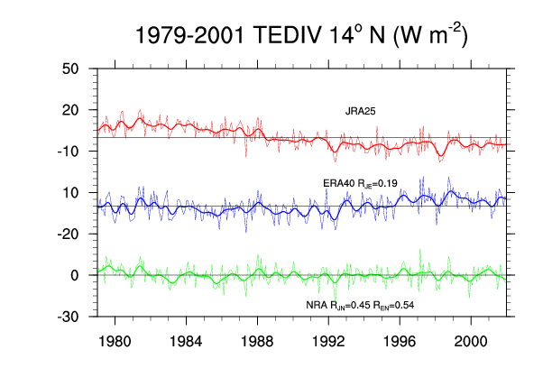
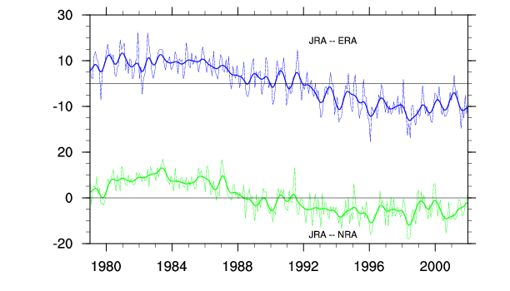
Spurious low frequency variability
Deficient low frequency variability on all time scales
SSM/I
Pinatubo
NOAA-9 to 11

Slide 44
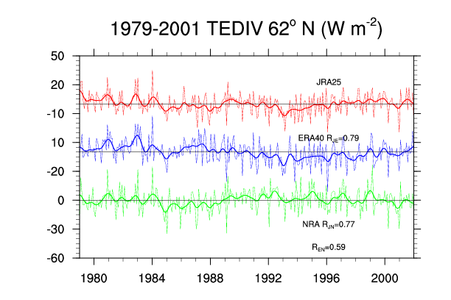
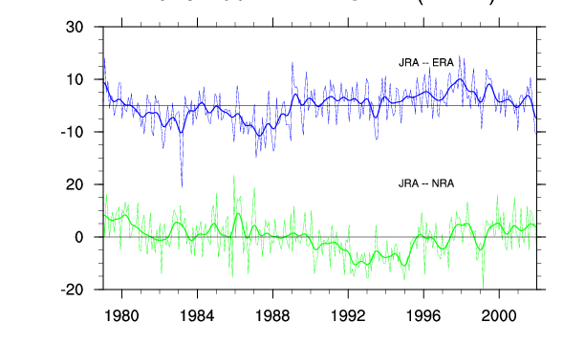

Slide 45
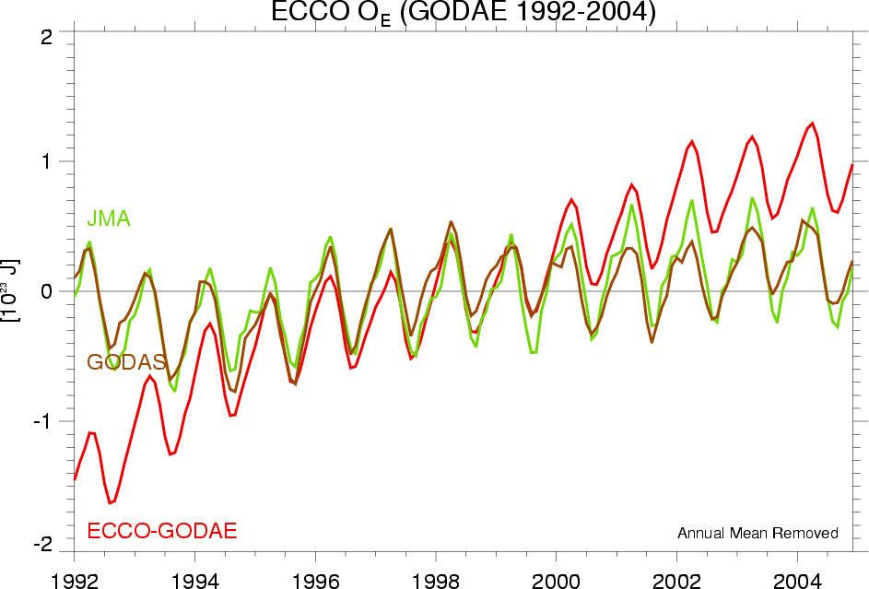
0.4 PW into ocean
implies 1.26x10²³ J/decade

Slide 46
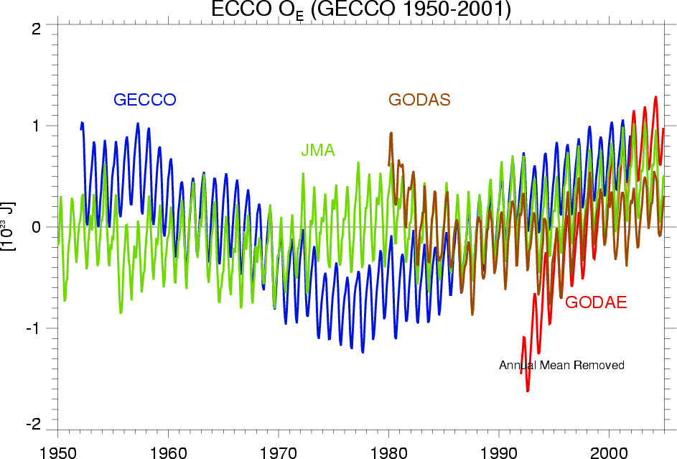
ECCO
GODAE

Slide 47
JRA Reanalyses
Large spurious variability associated with satellite transitions
TOVS to ATOVS in Nov 1998
NOAA-11 to 14 in 1995
NOAA-9 to 11, late 1988
SSM/I in July 1987
ERA-40 Reanalyses
Large spurious variability associated with Pinatubo and satellite transitions
NRA Reanalyses
Variability much too low

Slide 48
Ocean analyses
Large spurious variability associated with inadequate sampling (esp. southern hemisphere) and changing observations (esp. XBT to ARGO), and uncertainties in XBT drop rates
Satellite data
Lack of continuity and absolute calibration also gives spurious variability and unreliable trends

Slide 49
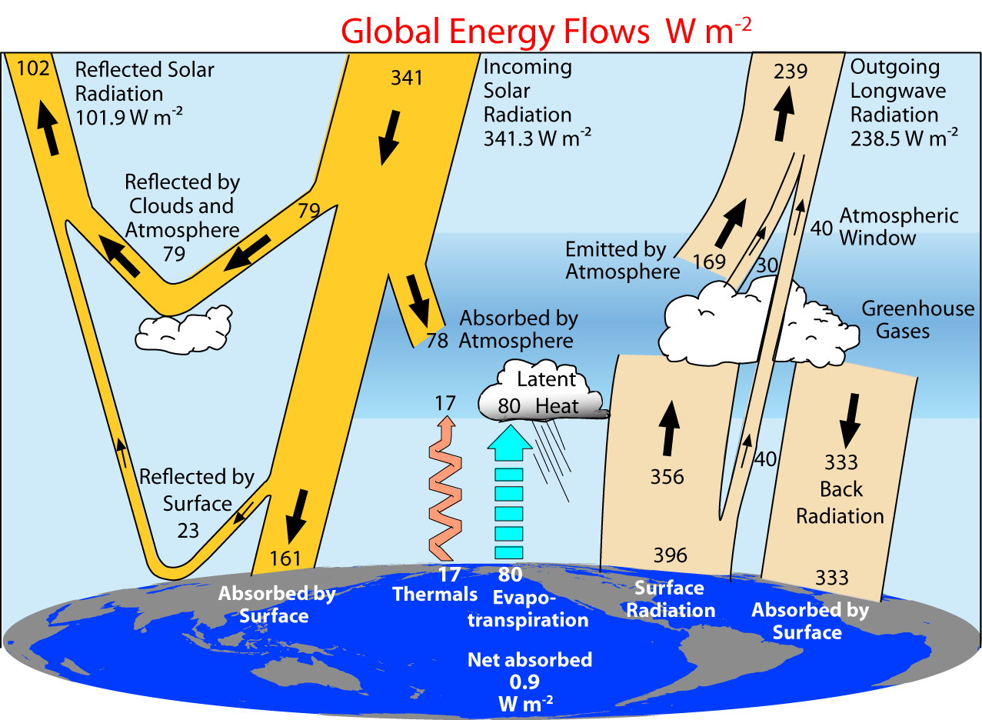
2000-2004 (CERES Period)

Slide 50
Conclusions
We have a new estimate of observed global energy budget and land vs ocean domains
A holistic view of the energy budget allows us to narrow estimates and highlight likely sources of errors.
Low frequency variability in atmosphere and ocean is highly uncertain based on analyses
We need to be able to do a full accounting of the energy storage and flows to determine what is happening to the planet and why the climate is changing.
We can and must do better: but observations from space are in jeopardy, and in situ observations also need improvement
We have used these to evaluate climate and weather models

Slide 51

That’s all folks!

