Slide 1
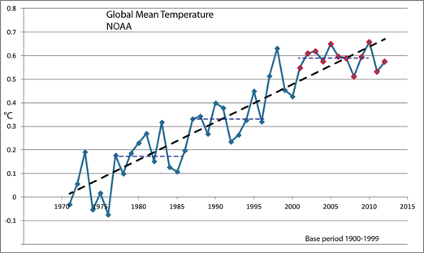


Climate change: It’s about the data, isn’t it?
Kevin E Trenberth
NCAR
NCAR Earth System Laboratory
NCAR is sponsored by NSF

Slide 2

First rule of management
“You can’t manage what you can’t measure”
“You are entitled to your own opinion but not your own facts.”
Patrick Daniel Moynahan

Slide 3
We have many facts and physical understanding.
The facts are not enough…
The role of scientists is to lay out the facts and the prospects and consequences,
but the decision on what to do is not ours:
that involves everyone and politics.

Slide 4
Climate change is happening: It is due to humans
97% of scientists agree.
The data are of mixed quality and length, but together tell a compelling story leaving no doubt about the human role in climate change.
What we do about this problem involves value systems and politics!

Slide 5
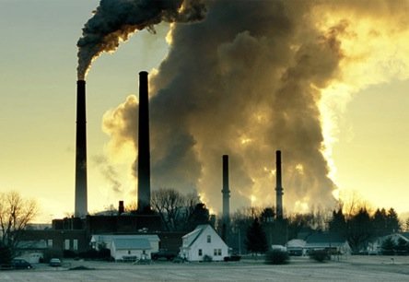

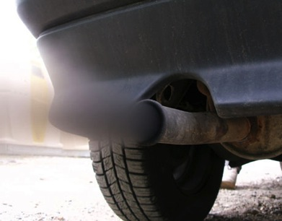
What Is Causing Warming?
Emissions of carbon dioxide pollution

Slide 6
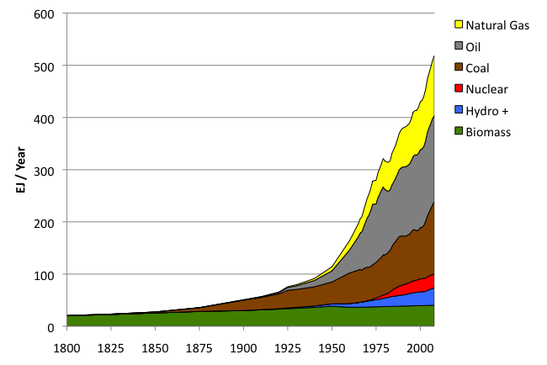
World Primary Energy Supply: 1800 – 2008
Fossil
fuels
Hydro + :means hydropower plus other renewables other than biomass.
Sources: Grubler (2008) - Energy Transitions, BP (2009) – Statistical Review of World Energy, EIA (2009) – International Energy Annual

Slide 7
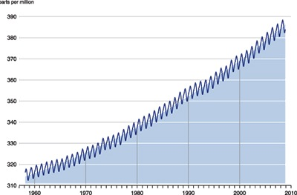
Changing atmospheric composition: CO₂
_{Mauna Loa, Hawaii}
ppm
390
380
370
360
350
340
330
320
310
Rate increasing
1960 1970 1980 1990 . 2000 2010
Data from Climate Monitoring and Diagnostics Lab., NOAA. Data prior to 1974 from C. Keeling, Scripps Inst. Oceanogr.

Slide 8
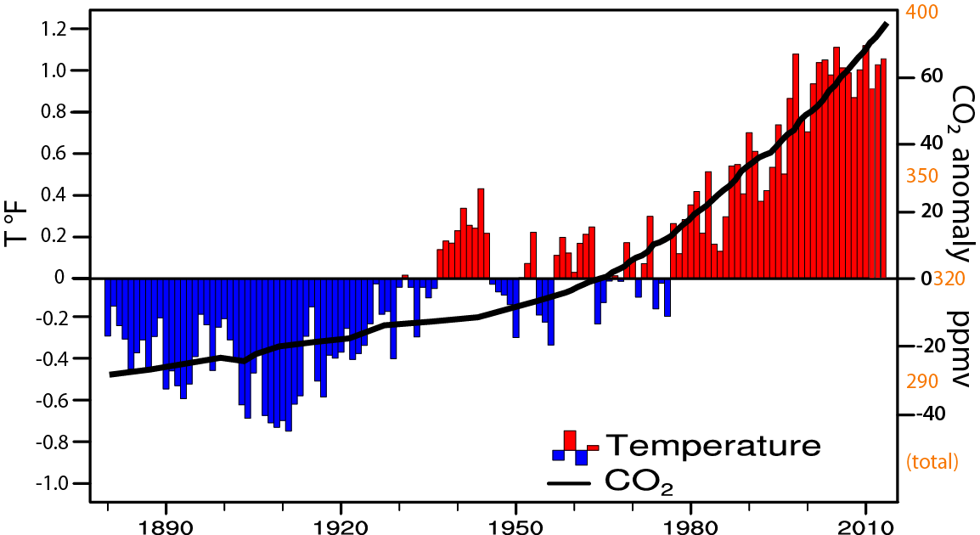
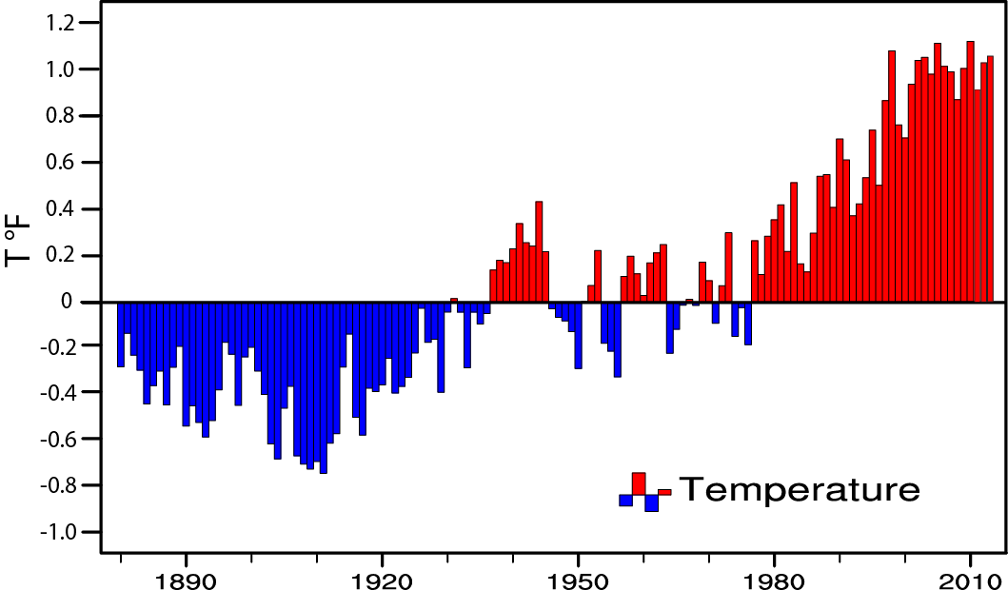
Global temperature and carbon dioxide: anomalies through 2013
Base period 1900-99; data from NOAA
Trenberth and Fasullo 2013 updated

Slide 9
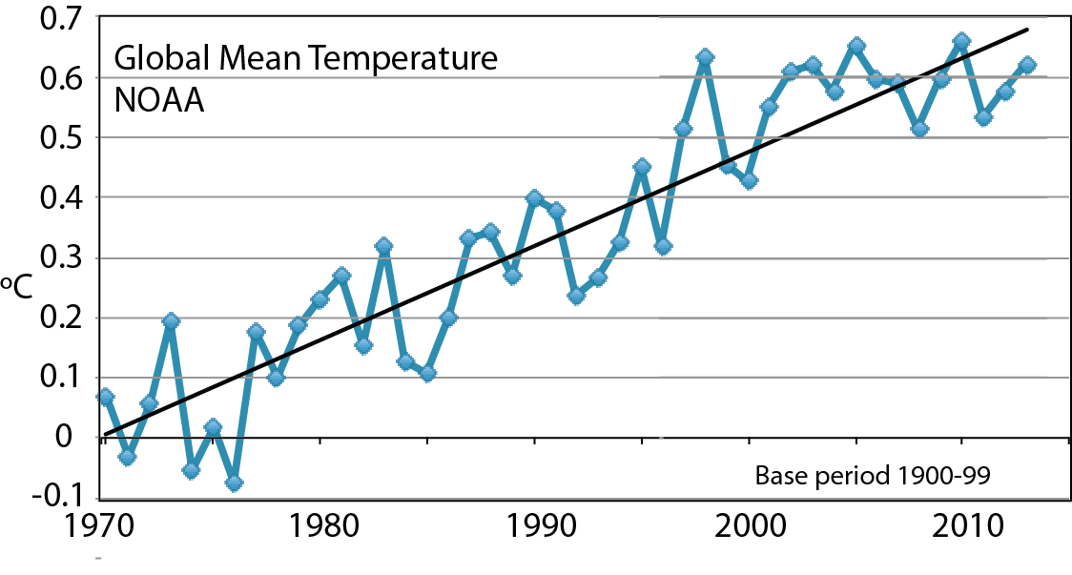
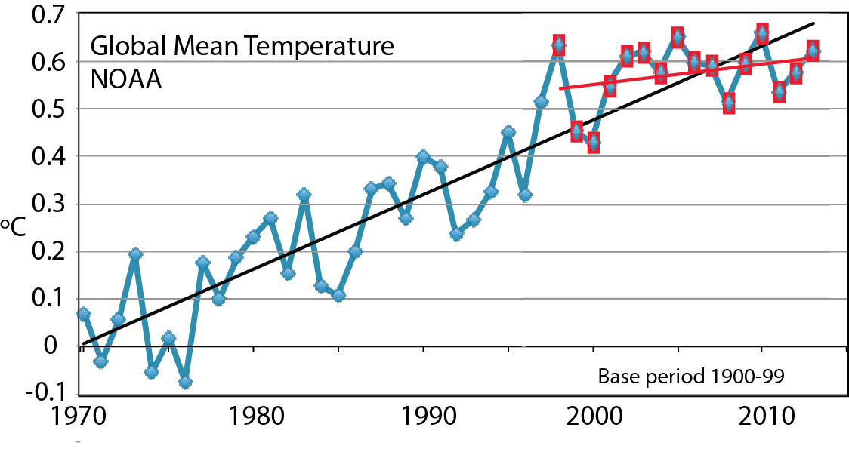
Global mean T

Slide 10
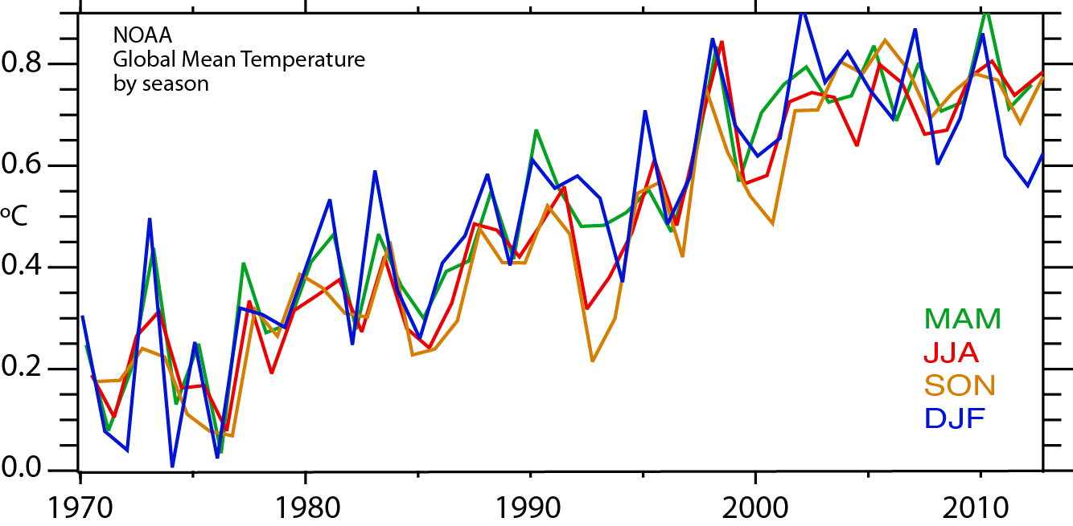
Seasonal global mean temperatures NOAA

Slide 11
Global warming means more heat: Where does the heat go?
>90%
Warms land and atmosphere
Heat storage in the ocean (raises sea level)
Melts land ice (raises sea level)
Melts sea ice and warms melted water
Evaporates moisture ⇒ rain storms, cloud ⇒ possibly reflection of sun’s rays to space

Slide 12
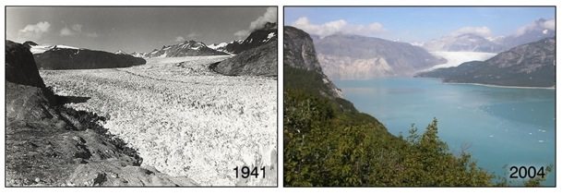
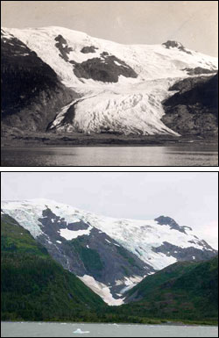
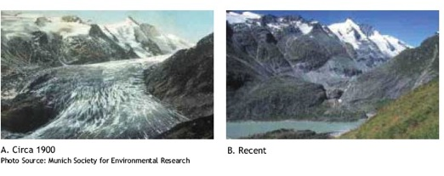
Evidence for reality of climate change
Glaciers melting
Muir Glacier, Alaska
1909
Toboggan
Glacier
Alaska
2000
1900 2003
Alpine glacier, Austria
Increased Glacier retreat since the early 1990s

Slide 13
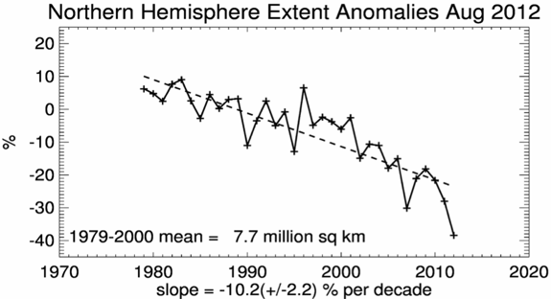
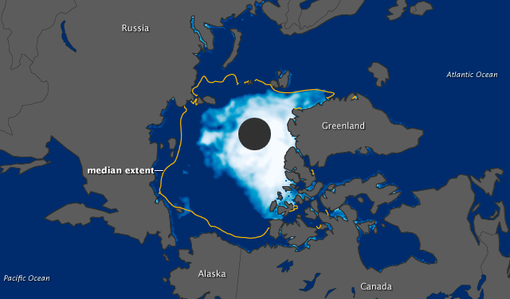
Snow cover and Arctic sea ice are decreasing
Arctic sea ice
area decreased by 40% in summer
2012 lowest on record
Late August 2012

Slide 14
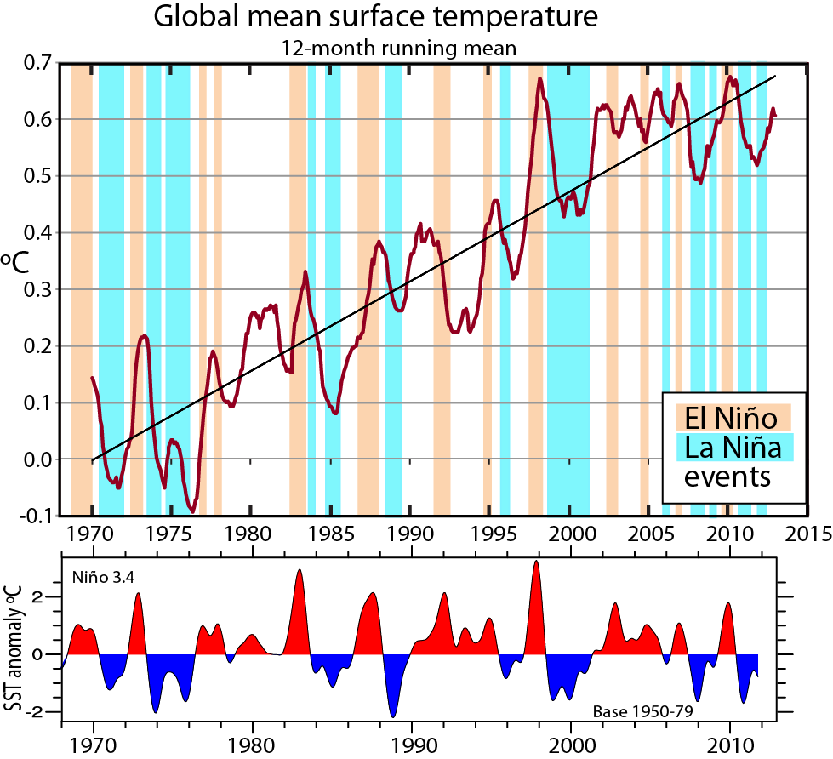
ENSO is the main source of interannual variability

Slide 15
Decadal variability
The hiatus is predominantly associated with natural variability and changes in Ocean Heat Storage:
more heat going deeper in association with the stronger and more frequent La Niña events since 1998
-Related to the Pacific Decadal Oscillation (PDO).
-Teleconnections are global and seasonally dependent.
-Largest hiatus, NH winter.

Slide 16
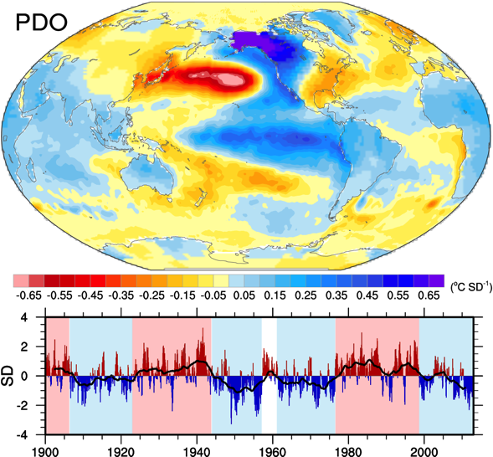
Decadal variability: PDO
EOF= Empirical Orthogonal Function
= Principal Component Analysis
= Eigenvector of covariance matrix
Based on SST EOF analysis north of 20N in Pacific with global mean removed.
Courtesy
Adam Phillips

Slide 17
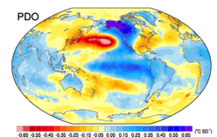
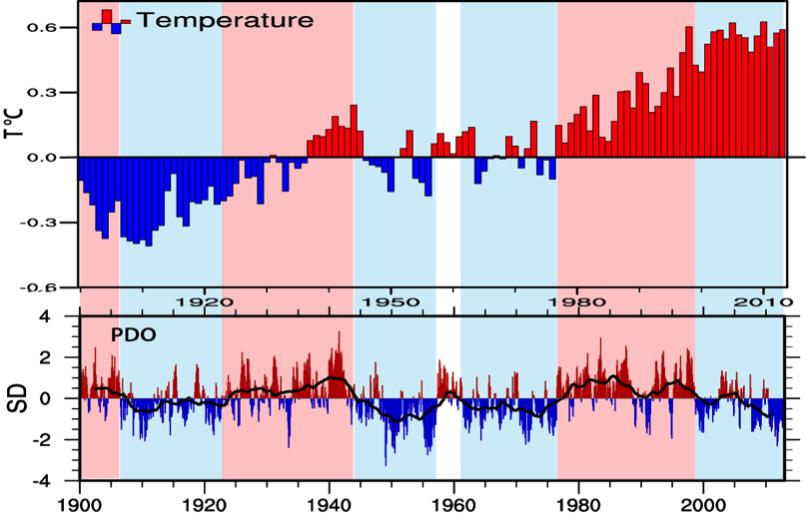
Global T and PDO

Slide 18
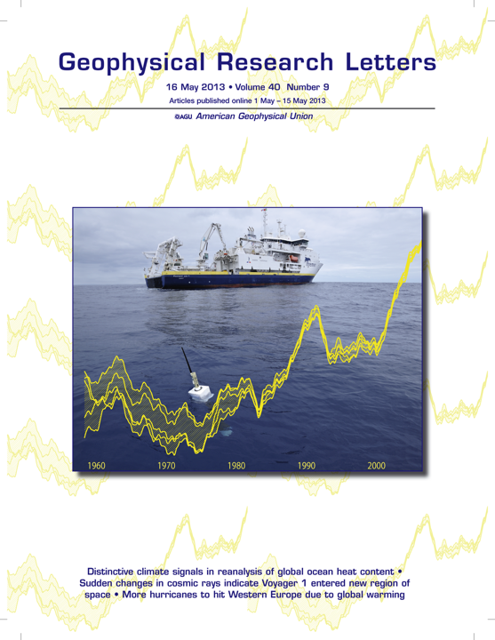
Ocean Heat Content ORAS4
5 member ensemble;
perturbed initial states
1958 through 2009
NEMO 1° 42 level 3Dvar
Bias corrected Argo era
Sfc fluxes from ERA,
Relaxed to obs SST (2-3 days)
Corrected XBTs, altimetry
10 day cycle
Balmaseda, Trenberth and Källén 2013 GRL

Slide 19
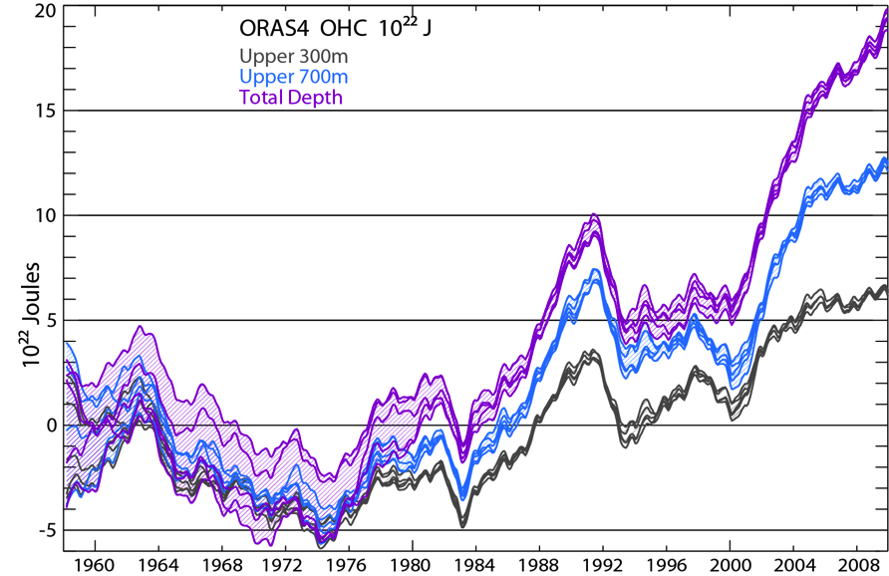
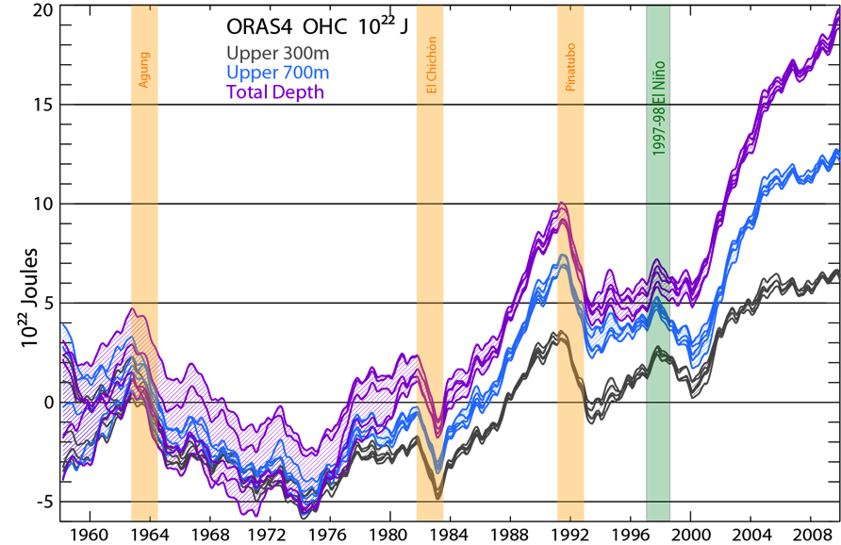
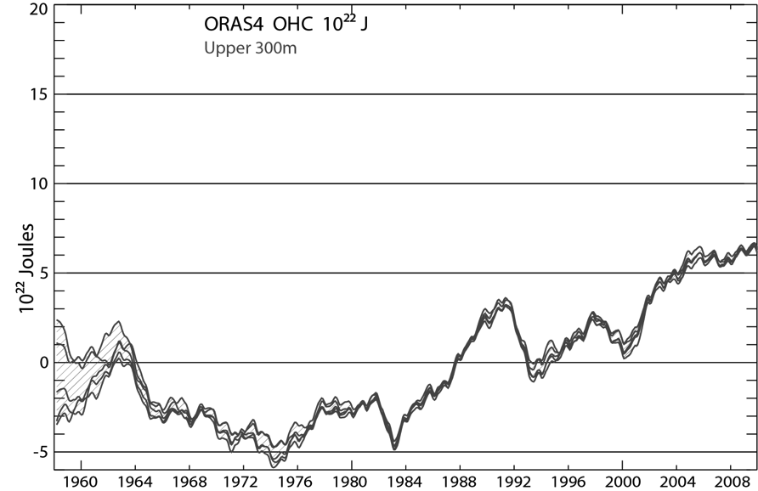
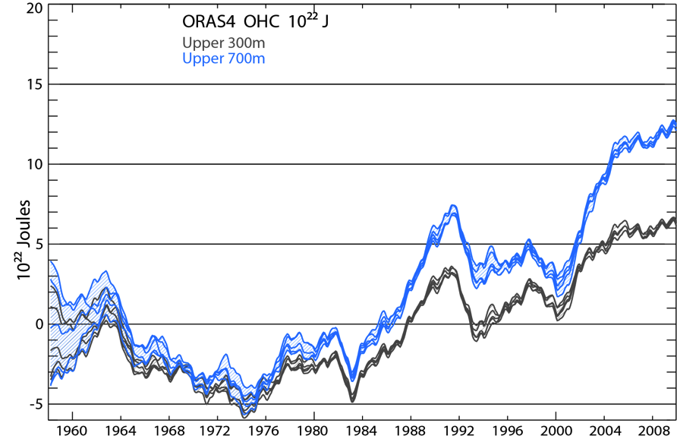
Global Ocean Heat Content
Amount of heat
Balmaseda, Trenberth and Källén 2013

Slide 20
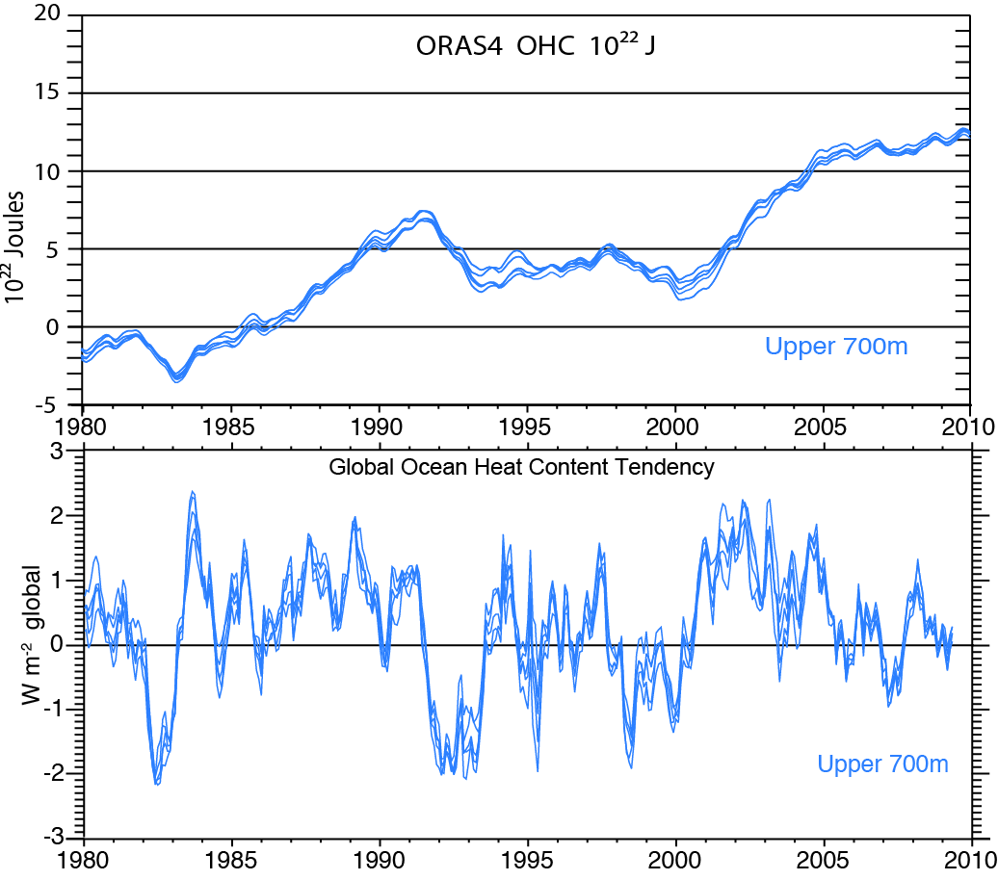
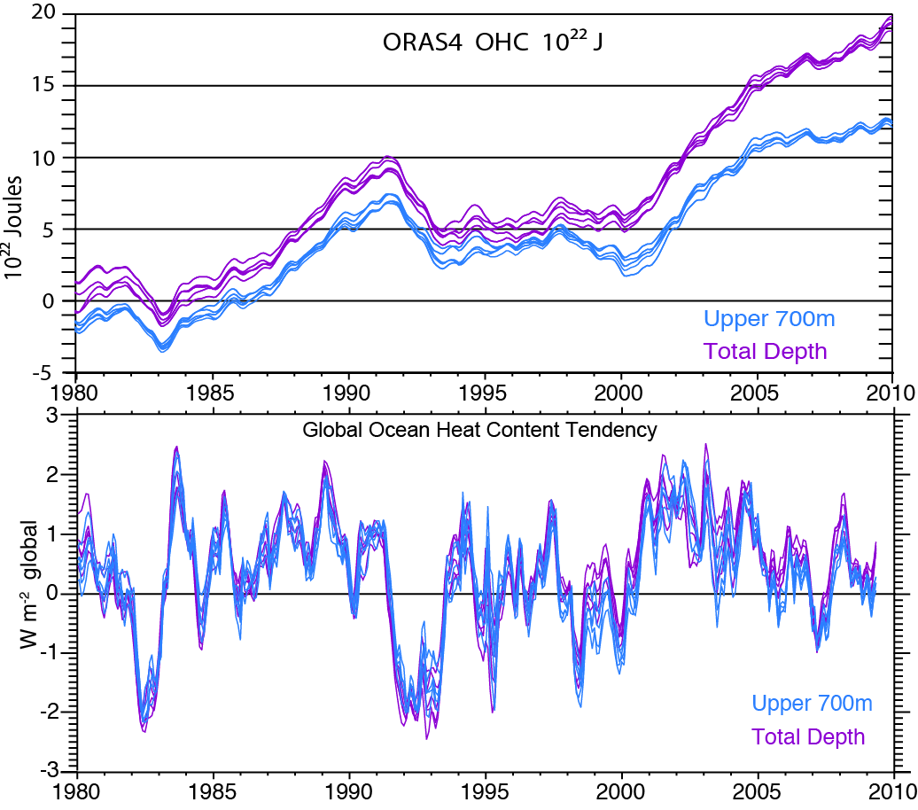
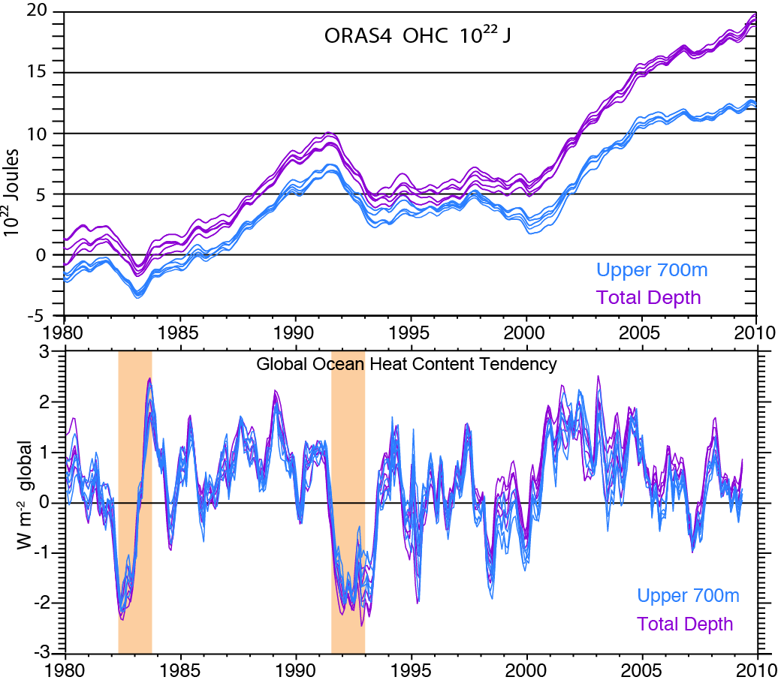
OHC from ORAS4 and rates of change
12-mo running means
Diff:
0.21
W m⁻² 2000s
Trenberth et al. 2014 J Cl

Slide 21
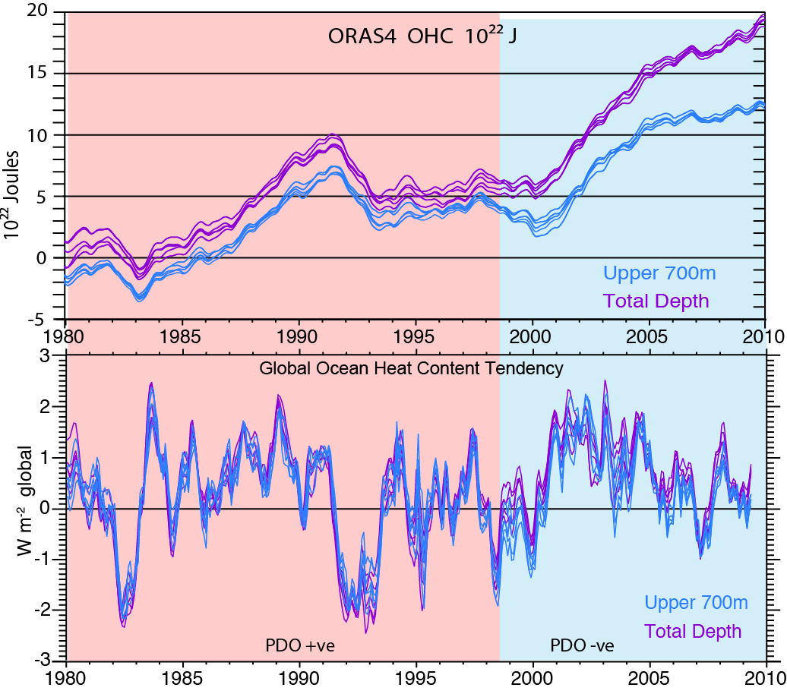
OHC from ORAS4 and rates of change
12-mo running means
Diff:
0.21
W m⁻² 2000s

Slide 22
Deep Doo Doo
There's a clearer analysis forming Of the increase in powerful storming; But it's not just hot air About which we should care, For the cold ocean depths have been warming.
Lynne Page
http://limericksbylin.com/

Slide 23
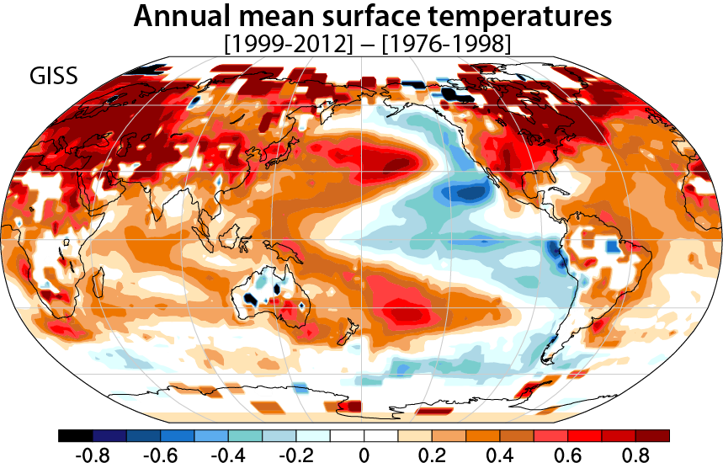
Sfc Temperatures: GISS
We have used epochs: 1999-2012 vs 1976-1998

Slide 24
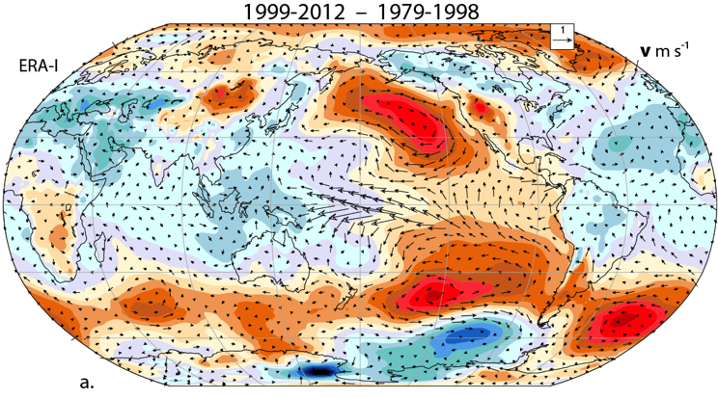
SLP and surface winds ERA-I

Slide 25
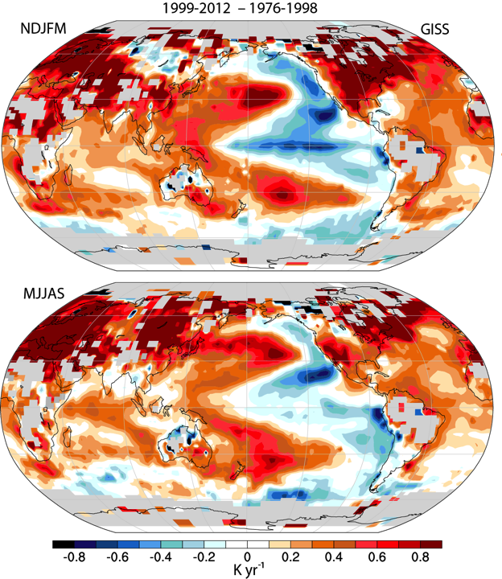
Sfc Temperatures: GISS
We have used epochs: 1999-2012 vs 1976-1998

Slide 26
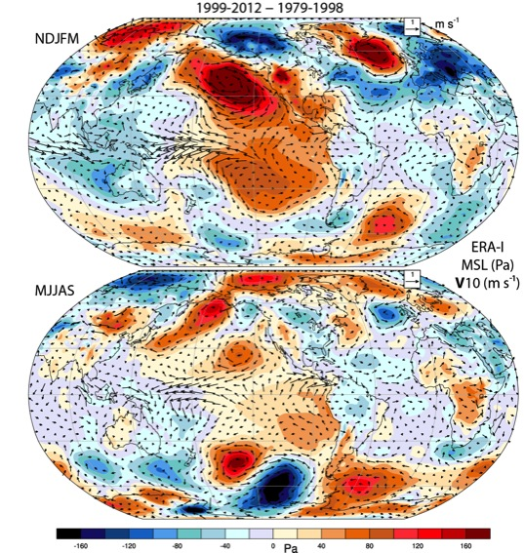
SLP and surface winds ERA-I
Over 2 m/s
Over 1 m/s

Slide 27
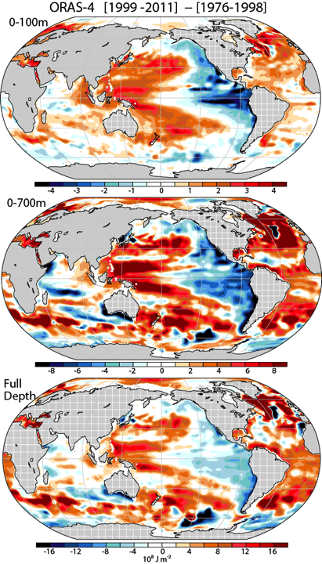
OHC 0-100m 0-700m Full depth
Note different color scales

Slide 28
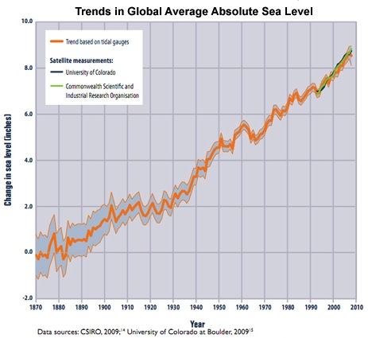
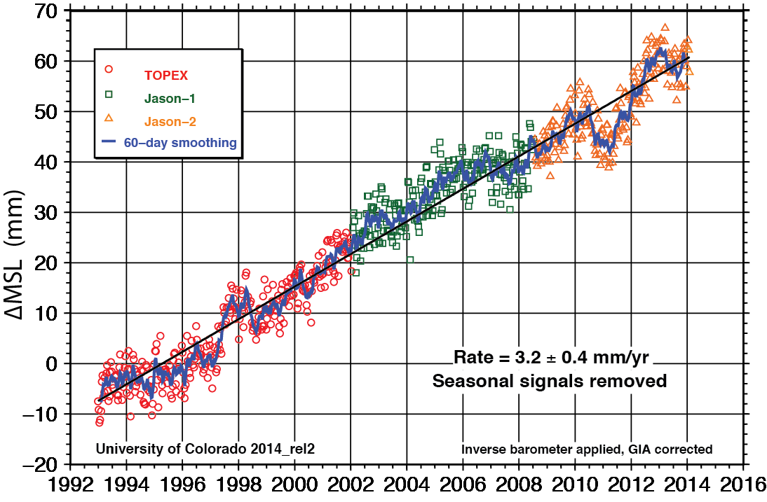
Sea Level Rise

Slide 29
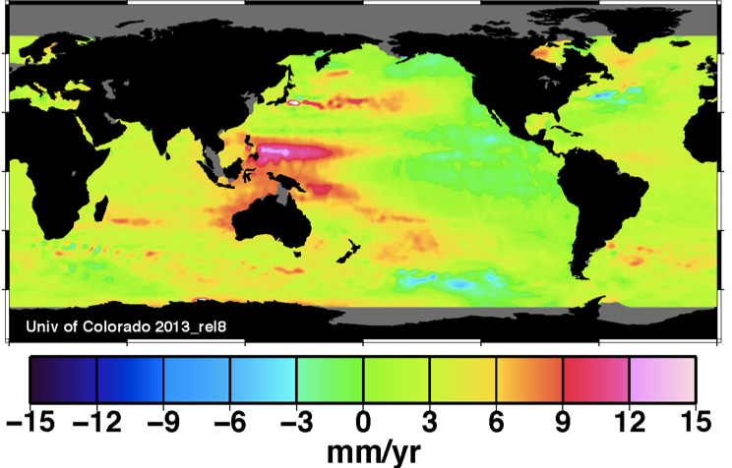
Sea level trend 1993-2012
U Colorado

Slide 30
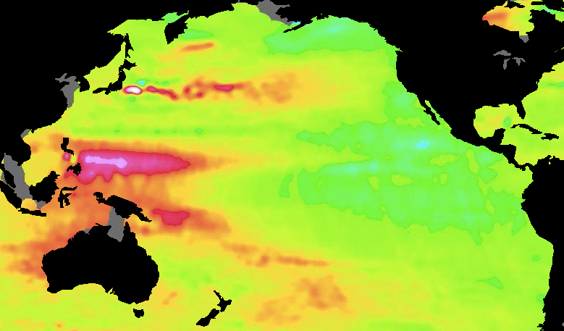
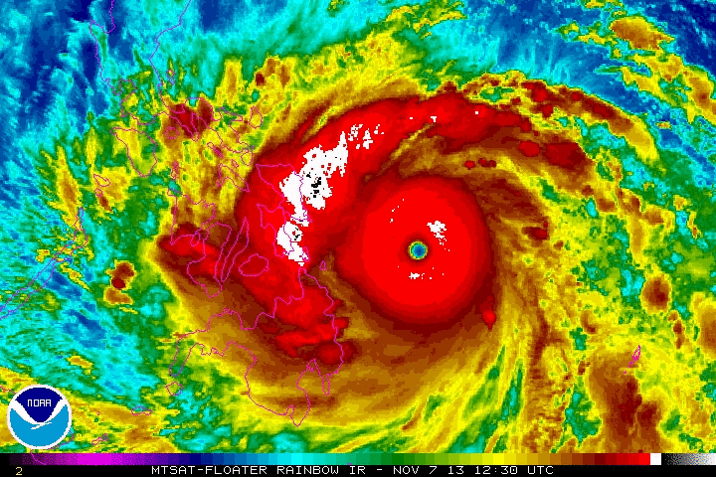
Haiyan 6-9 Nov 2013

Slide 31
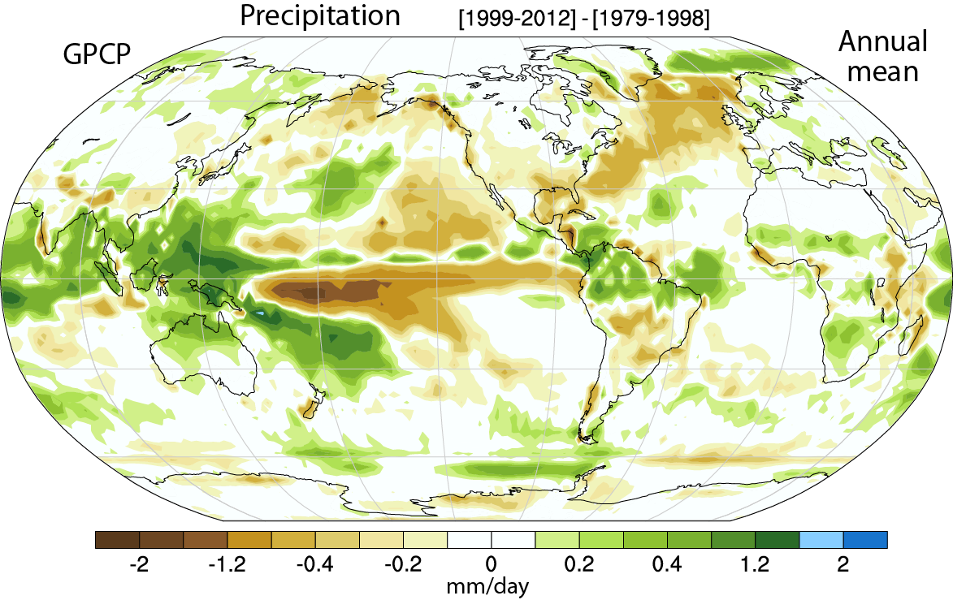
Precipitation GPCP

Slide 32
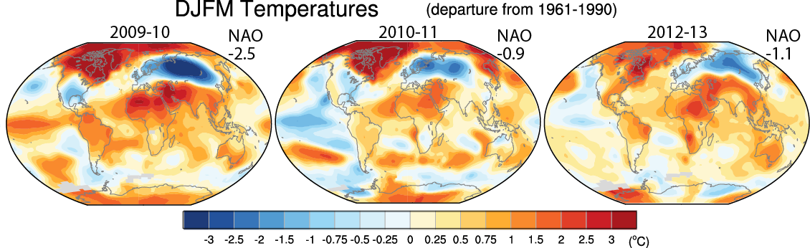
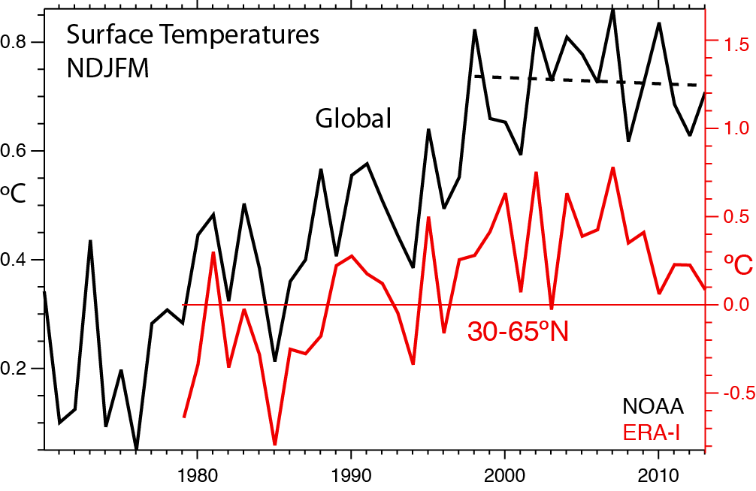
NAO -ve

Slide 33
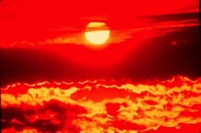
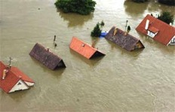
Changes in extremes
Matter most for society and human health
With a warming climate:
More high temperatures, heat waves
Wild fires and other consequences
Fewer cold extremes.
More extremes in hydrological cycle:
More intense precipitation
Longer dry spells
Increased risk of flooding and drought
More intense storms, hurricanes, tornadoes
Major challenges for a water manager

Slide 34
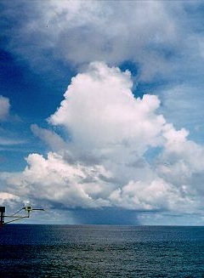
Why does it rain?

Slide 35

Warmer air holds more moisture
4% per °F
=7% per °C
- As long as moisture is available

Slide 36
Take a parcel of air:
When it rises
(for whatever reason),
it expands and cools,
and any moisture in it condenses
and forms a cloud,
and then it rains the moisture out.

Slide 37

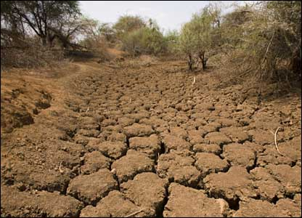
Warmer air holds more moisture
4% per °F
Global warming=
More heat
⇓
More drying
⇓
More evaporation
⇓
More moisture
More rain
More drought

Slide 38
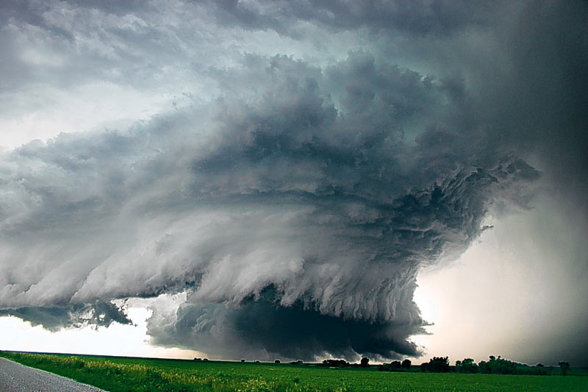
Most precipitation comes from moisture convergence by weather systems
Low level winds bring in moisture from afar
More moisture means heavier rains

Slide 39
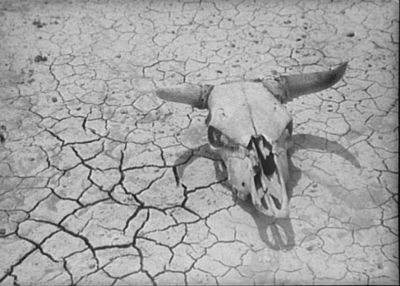
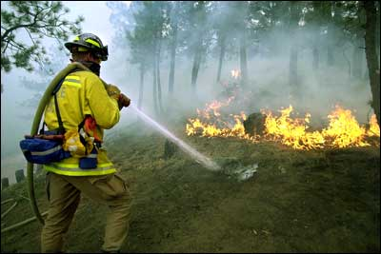
Declining Snow Pack in many mountain and continental areas contributes to drought
more precipitation falls as rain rather than snow, especially in the fall and spring.
snow melt occurs faster and sooner in the spring
snow pack is therefore less
soil moisture is less as summer arrives
the risk of drought increases substantially in summer
Along with wild fire

Slide 40
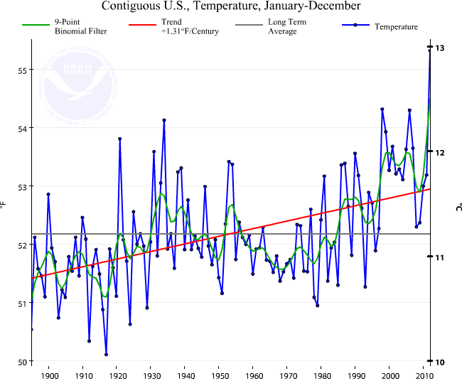
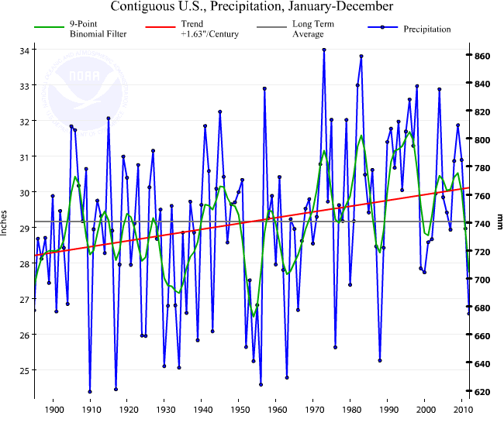
US 48 contiguous States
Temperature: annual
Precipitation:
Annual
Thru 2012
Temp
Precip
Much wetter
2012:
V hot and dry
1930s:
Hot and dry

Slide 41


Michigan
Temperature: annual
Precipitation:
Annual
Thru June 2014
Temp
Precip
Much wetter
1930s:
Hot and dry

Slide 42

U.S. Temperatures: 2012 Hottest year on record
362 all time record Highs; 3,527 monthly weather records
0 record lows

Slide 43




Super Storm Sandy: Oct 29-31, 2012.
It was more intense with stronger winds because of climate change
Sea level is higher => Much greater damage
Hybrid storm:
Over $70B damages
>110 lives lost

Slide 44
Some 2013-14 climate extremes

Slide 45




U.S. Drought and wildfires June 2013
Dust storm Lamar, CO
(June 15, Denver Post)
Black Forest wildfire CO:
>511 homes burned

Slide 46




Calgary, Alberta
Canada
Flooding
21-22 June 2013

Slide 47

Boulder Flooding September 2013
1000 yr storm:
Many records smashed
9 inches of rain in one day
17 inches in one week

Slide 48


Former location of Mesa Trail over Bluebird creek. Green Mountain Rd (Flagstaff)
http://www.flickr.com/photos/bouldercolorado/sets/72157636661981633/

Slide 49



UK floods Jan-Feb 2014

Slide 50


UK floods Jan-Feb 2014
Before and after

Slide 51







Balkans flooding 12-15 May 2014
3 months rain in 2 days
1 million affected

Slide 52




2013-14
Near San Jose Jan 21 2014
Shasta Lake Feb 14, 2014
Mel Fechter

Slide 53




CA drought 2014

Slide 54



California Rim Fire late August 2013 One of biggest on record

Slide 55


Wild fires in CA 2014
Aug 2, 2014
11 a.m.
1 p.m.
Natural color:
Development of pyro-cumulus
MODIS
NASA
July 31 2014: 82% of CA in extreme drought, 58% exceptional drought
Notes:
Terra in a.m. and Aqua in p.m.

Slide 56






Mid-West Flooding 2014
1895-2010
National Climate Assessment 2014

Slide 57




India-Pakistan floods September 2014
Temporary shelters
Srinagar-Kashmir
Lahore Pakistan

Slide 58


India-Pakistan floods early September 2014 vs 2012

Slide 59
Global warming continues
Over the past 15 years, a pause in the rise of global mean temperatures has small contributions from:
Small volcanoes
Quiet sun
There is no pause in the Arctic sea ice melt or global sea level rise
During the last decade, the ocean has warmed, but 30% of the warming occurs in depths below 700m. This involvement of the deep ocean in the heat uptake is unprecedented.
So what is to be done?

Slide 60
Science knowledge is going in one direction and politician views are going in another!
Many reports deal with the facts and the science of climate change. A new one by AAAS “scientists agree that humans are the primary cause of climate change”. There are many other reports, such as from the IPCC.
Of 10,855 climate studies published in peer-reviewed literature in 2013 only 2 rejected anthropogenic climate change. [James Lawrence Powell 2014]
ThinkProgress.org
Notes:
http://thinkprogress.org/climate/2013/06/26/2202141/anti-science-climate-denier-caucus-113th-congress-edition/

Slide 61
Science knowledge is going in one direction and politician views are going in another!
Many reports deal with the facts and the science of climate change. A new one by AAAS “scientists agree that humans are the primary cause of climate change”. There are many other reports, such as from the IPCC.
Of 10,855 climate studies published in peer-reviewed literature in 2013 only 2 rejected anthropogenic climate change. [James Lawrence Powell 2014]
56% (>130 members) of the current Republican caucus in the House of Representatives deny the basic tenets of climate science. 66% (30 members) of the Senate Republican caucus also deny the reality of climate change.
ThinkProgress.org
160 members of the 113th Congress have taken $58.8 million from fossil fuel industry
Notes:
http://thinkprogress.org/climate/2013/06/26/2202141/anti-science-climate-denier-caucus-113th-congress-edition/

Slide 62
Tragedy of the Commons
Everyone for themselves!
The atmosphere is a global commons (and dumping ground).
Solution requires people of the world to work together.
We are together on “spaceship Earth”.
To many people, that may suggest altruism:
Sharing the money, well-being and profits so carefully accrued to help other people.
Our society is founded on the premise of cheap and easily available fossil fuels that do not take into account the external costs of using those fossil fuels:
Need a principle of User Pays.

Slide 63

Risky Business!
A new report; “Risky Business: The Economic Risks of Climate Change in the United States”
co-chaired by Henry Paulson and Michael Bloomberg
July 2014 riskybusiness.org
“…taking a caution approach, waiting for more information, a business-as-usual approach, is actually radical risk taking.” (Paulson)
“…if we act now the U.S. can still avoid most of the worst impacts and significantly reduce the odds of costly climate outcomes – but only if we start changing our business and public policy practices today.”

Slide 64

Risky Business!
“The longer we wait to adapt to and mitigate climate change, the more devastating the economic impacts will be.” (Bloomberg)
e.g. between $66 and $106 billion of existing coastal property in the US will be below sea level by 2050.

Slide 65
We need a price on carbon emissions!
As we have seen this year, there are major costs: $billions, to climate change via droughts and wildfires, and floods. [Lives lost, crop loss, crop insurance, wild fire losses, costs of fighting fires, property damage, dislocation, disease, etc]
The costs are not borne by those who cause the problem.
Explicit and implicit subsidies for fossil fuels do not make the playing field level for renewable energy.
The U.S. is a major part of the problem.

Slide 66

“Unless someone like you cares a whole awful lot Nothing is going to get better. It’s not.” The Lorax Dr Seuss 1972

