Slide 1

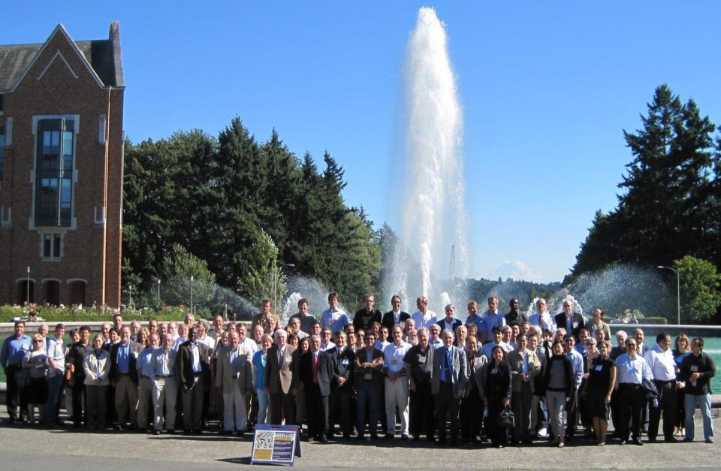
GEWEX Pan-GEWEX Meeting Seattle, Washington, 23-28 August 2010 Kevin Trenberth Chair SSG

Slide 2
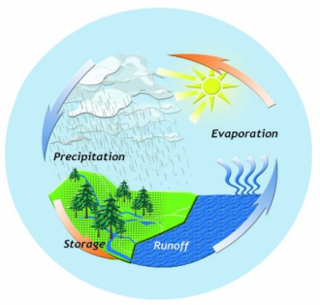
GEWEX: post 2013
Vision statement
Water and energy are fundamental for life on Earth. Fresh water is a major pressure point for society owing to increasing demand and vagaries of climate.
Extremes of droughts, heat waves and wild fires as well as floods, heavy rains and intense storms increasingly threaten to cause havoc as the climate changes. Other challenges exist on how clouds affect energy and climate. Better observations and analysis of these phenomena, and improving our ability to model and predict them, will contribute to increasing information needed by society and decision makers for future planning.

Slide 3
The Tools
Domains
Regional
Integrated / coupled
Global
Observational Data Sets
Models and Parameterizations
Application Products
GEWEX Radiation Panel
GEWEX Modeling:
GCSS/GABLS
GLASS
GEWEX Hydroclimatology
Panel
Theory
Modelling
Observations
GEWEX achieves its goals through data set development and
analysis, process studies and model improvement
Notes:
Basic structure of GEWEX from a classical point of view, transgressed into the current set –up and linked to results/activities
Global Data sets (precip, radiation, cloud cover etc.), Land surface parameterization, cloud parameterization etc., Forecasts e.g. droughts, floods,

Slide 4
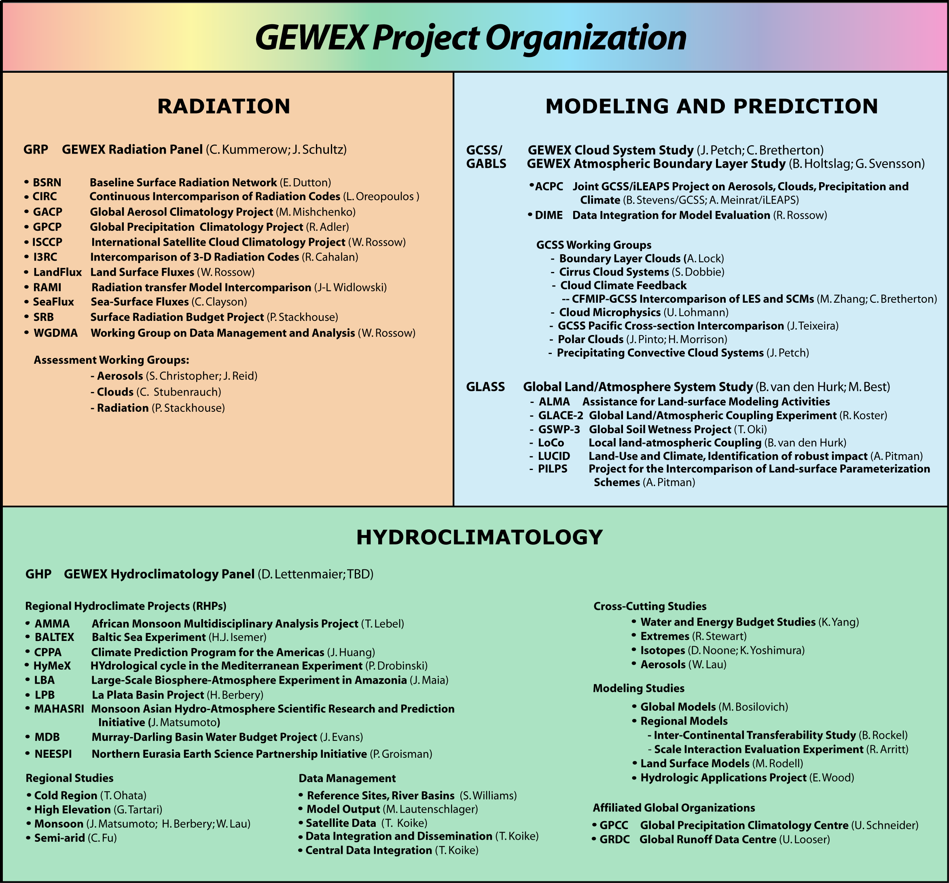
J. Polcher

Slide 5
GRP
Radiative processes and understanding
Global Data sets on radiative and turbulent fluxes
Global In-situ observational networks, development and standardization (radiation, soil moisture)
Development and improvement of radiative transfer codes
Intercomparison studies and assessment
http://www.gewex.org/projects-GRP.htm
CEOP ⇒ GHP
Globally distributed extensive regional data sets covering water and energy cycle observations (in situ and space borne and modeling data)
Data management system / GEO Prototype for Water Cycle Observations
Regional Climate Modeling and Process Descriptions (Monsoons, Extremes, etc)
Hydrological Applications and Forecasting (Drought monitoring, Hydrological Ensemble Predictions…)
Coupling with Global Modeling and Global Data sets
http://www.gewex.org/projects-CEOP.htm
GMPP ⇒ GCSS/GABLS, GLASS
Model Parameterization and development from land surface process to atmospheric processes
Cloud process descriptions, parameterizations and model, data sets and tools, intercomparison studies
Atmospheric Boundary layer studies, descriptions and intercomparison studies (diurnal cycle)
Strong cooperation with Numerical Prediction Centers and weather forecasting “through” WGNE
Land surface feed back/coupling studies
http://www.gewex.org/projects-GMPP.htm

Slide 6
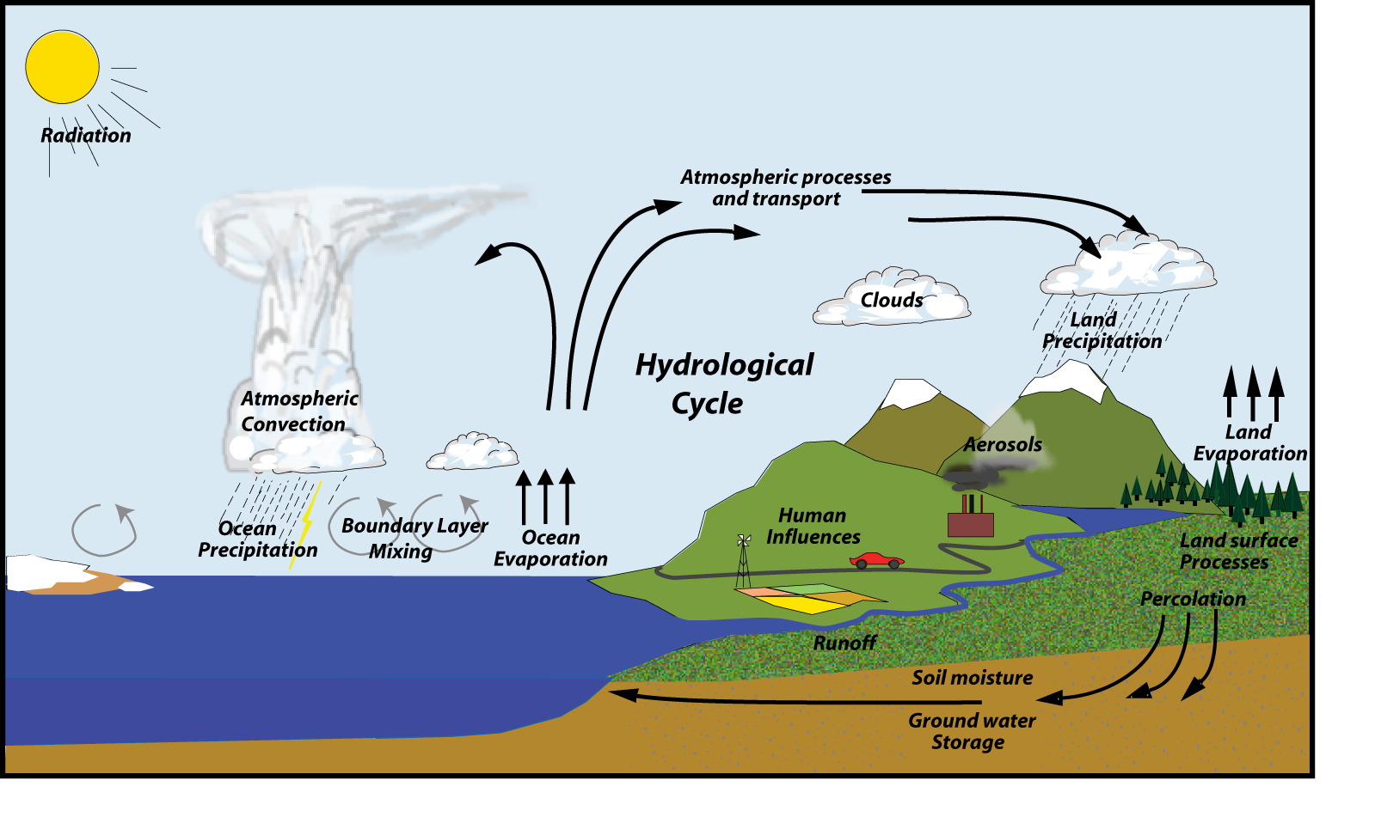
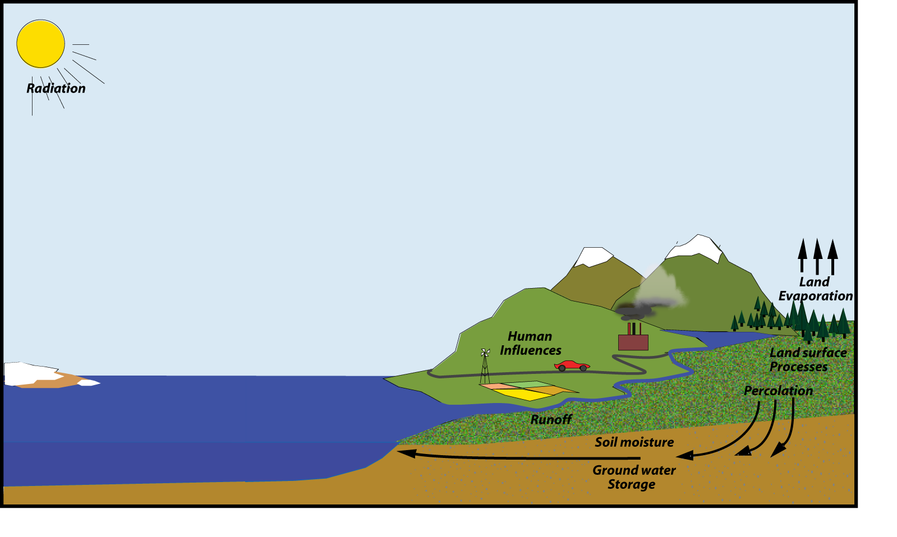


GEWEX
GEWEX Cloud System Study
Atmospheric Processes
GEWEX Atmospheric Boundary Layer Panel
GEWEX Radiation Panel
Global Land-Atmospheric System Study
Land Surface Processes
GEWEX Hydroclimatology Panel

Slide 7
There is a new WCRP structure post 2013: how does GEWEX fit ?
Where is the atmosphere?
Everywhere, yet nowhere!
What are the implications for GEWEX?
Main proposals from JSC-31
Core projects retained but with revised responsibilities to facilitate climate system research at the interface of the physical Earth system components:
Ocean-atmosphere (think CLIVAR)
Land-atmosphere (think GEWEX)
Cryosphere (think CliC)
Stratosphere-troposphere (think SPARC)
Within each core project there is a common set of basic “themes”:
Observations and analysis
Model development, evaluation and experiments
Processes and understanding
Applications and services
Capacity building

Slide 8
Some Key Issues for GEWEX
The new GEWEX has adopted the mission of “land-atmosphere”
However GEWEX has also decided to be much more:
GEWEX will continue to embrace the global energy and water cycles
GEWEX also embraces activities spanning Earth system domains and other integrating themes
monsoons
extremes …

Slide 9
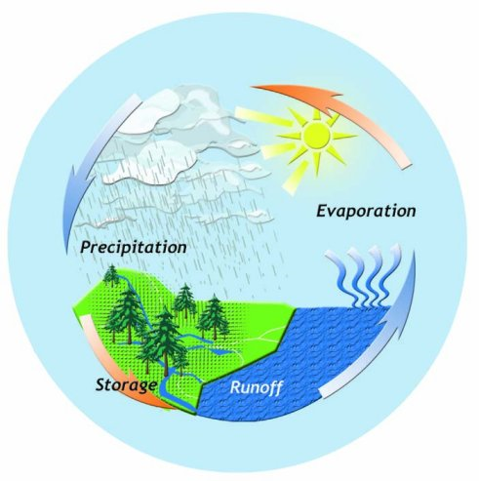
GEWEX : post 2013
Possible new name mooted:
Global and Regional Energy
and Water project (GREW)
[GEWEX grew]
or
Global and regional Energy and Water Existentialism: GEWEX
Exchanges: GEWEX
Notes:
Climate, Energy and Water: CLEW

Slide 10
GEWEX: post 2013
Mission statement
To measure and predict global and regional energy and water variations, trends, and extremes (such as heat waves, floods and droughts), through improved observations and modeling of land, atmosphere and their interactions; thereby providing the scientific underpinnings of climate services.
To measure and predict global and regional energy and water variations, trends, and extremes (such as heat waves, floods and droughts), through improved observations and modeling of land, atmosphere and their interactions; thereby providing the scientific underpinnings of climate services.

Slide 11
Imperatives: Headlines
Datasets: Foster development of climate data records of atmosphere, water, land, and energy-related quantities, including metadata and uncertainty estimates.
Analysis: Describe and analyze observed variations, trends and extremes (such as heat waves, floods and droughts) in water and energy-related quantities.
Processes: Develop approaches to improve process-level understanding of energy and water cycles in support of improved land and atmosphere models.
Modeling: Improve global and regional simulations and predictions of precipitation, clouds, and land hydrology, and thus the entire climate system, through accelerated development of models of the land and atmosphere.
Applications: Attribute causes of variability, trends and extremes, and determine the predictability of energy and water cycles on global and regional bases in collaboration with the wider WCRP community.
Technology transfer: Develop diagnostic tools and methods, new observations, models, data management, and other research products for multiple uses and transition to operational applications in partnership with climate and hydro-meteorological service providers.
Capacity building: Promote and foster capacity building through training of scientists and outreach to the user community.

Slide 12
Imperatives: Headlines
Datasets: Foster development of climate data records of atmosphere, water, land, and energy-related quantities, including metadata and uncertainty estimates.
Analysis: Describe and analyze observed variations, trends and extremes (such as heat waves, floods and droughts) in water and energy-related quantities.
Processes: Develop approaches to improve process-level understanding of energy and water cycles in support of improved land and atmosphere models.
Modeling: Improve global and regional simulations and predictions of precipitation, clouds, and land hydrology, and thus the entire climate system, through accelerated development of models of the land and atmosphere.
Applications: Attribute causes of variability, trends and extremes, and determine the predictability of energy and water cycles on global and regional bases in collaboration with the wider WCRP community.
Technology transfer: Develop diagnostic tools and methods, new observations, models, data management, and other research products for multiple uses and transition to operational applications in partnership with climate and hydro-meteorological service providers.
Capacity building: Promote and foster capacity building through training of scientists and outreach to the user community.

Slide 13
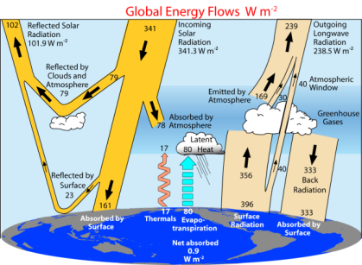
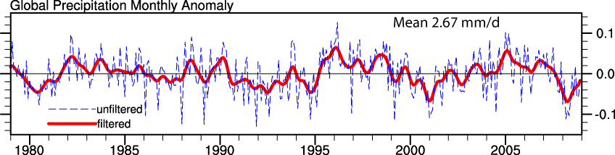
Example: Imperatives: 1
DATASETS: Foster development of climate data records of atmosphere, water, land, and energy-related quantities, including metadata and uncertainty estimates.
Lead: GRP, CEOP; Partners: SCOPE-CM, CEOS, WOAP
Actions:
Reprocess GEWEX datasets, provide advice on other efforts and lead evaluations.
Continue evaluation and refinement of sensor algorithms, influencing next generation space-born platforms and reprocessing.
Development of appropriate calibration/validation/evaluation datasets to confront models.
Devise robust ways of dealing with the more diverse, complex, higher spatial and temporal resolution, and much greater volumes of data.
Build on CEOP experience in data management, archival and access.
Trenberth et al 2009; 2010

Slide 14
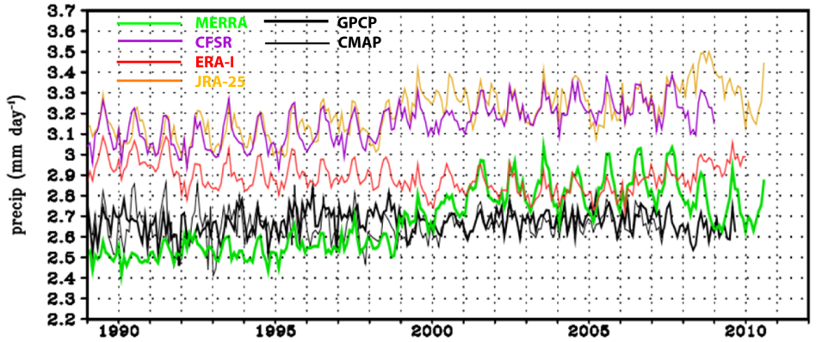
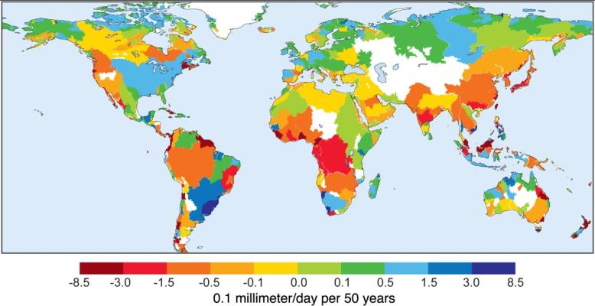
2. Analysis: Describe and analyze observed variations, trends and extremes (such as heat waves, floods and droughts) in water and energy-related quantities.
Precipitation from observations and reanalyses
(courtesy D. Dee)
Runoff trends 1948 to 2004
(Dai et al 2009)

Slide 15
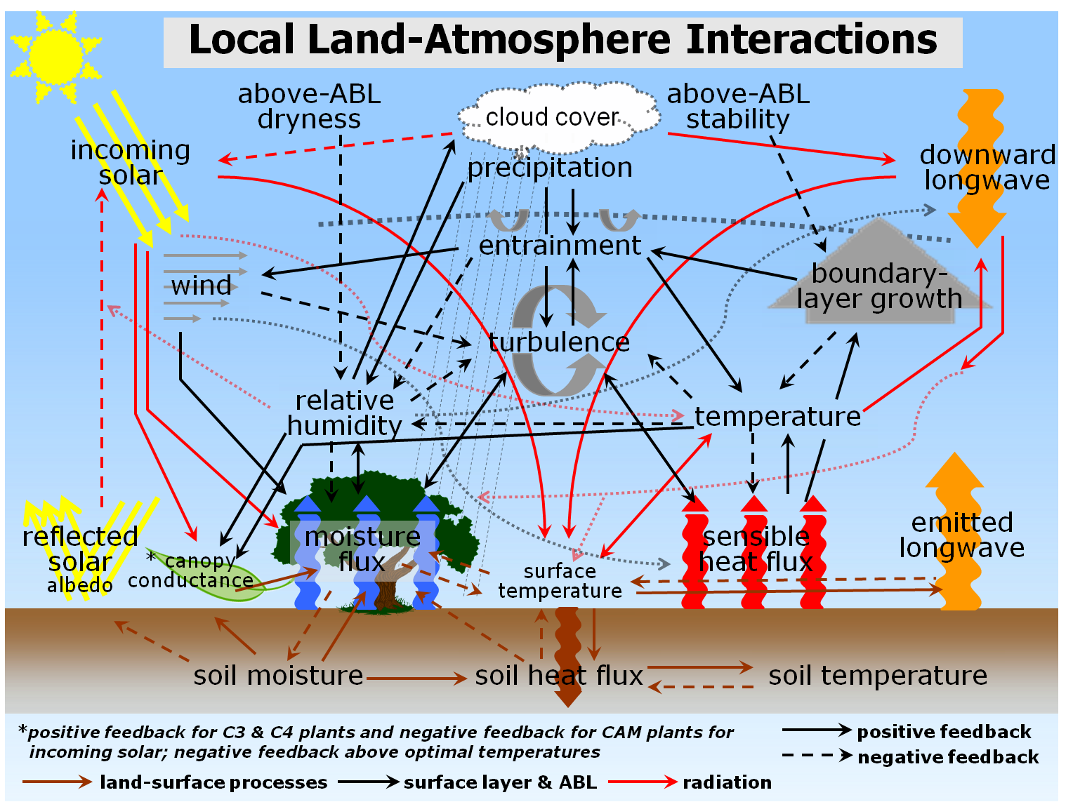
3. Processes: Develop diagnostic approaches to improve process-level understanding of energy and water cycles in support of improved land and atmosphere models.
Courtesy Mike Ek, K Trenberth
Stevens and Feingold 2009

Slide 16
CEOP GHP
Continental Scale Experiment (CSE) concept developed (1990s)
development, diagnosis, and testing of coupled land-atmosphere models
focus on water and energy budget closure at near-continental scale.
E.g. Mississippi basin well instrumented and analyzed GAPP
Regional Hydrometeorological Projects extend this concept to other regions: MAGS, BALTEX, GAME, LBA, AMMA
GEWEX Hydrometeorological Panel (GHP) coordinated these
Coordinated Enhanced Observing Period: second phase of GEWEX 2001-2006
Combined with GHP and evolved to Coordinated Energy and Water Cycle Observations Project (CEOP) in 2007-2008
GEWEX Hydroclimatology Panel (GHP) in 2010

Slide 17
CEOP GHP
Regional water cycles

Slide 18
CEOP GHP
There has been considerable modeling within CEOP of 2 kinds:
Regional Hydrological Project modeling, which can range from detailed hydrologic models over catchments or river basins, to regional climate modeling such as now given by CORDEX
Global and intercontinental transferability
The MAC: Multi-model Analysis for CEOP (Bosilovich et al 2009)
Global models in GCSS/GABLS and GLASS should enable interactions with RHPs which provide local expertise and datasets for validation etc, in context of global processes.
How to do this remains a challenge?

Slide 19
Revitalizing GHP
CEOP reference sites vs flux towers
10 year data set; mission creep
Archive for regional projects
New Phase
Need to reinvigorate RHPs
Type I (core; criteria) and type II (affiliated)
Stronger hydrological activities: foster the next generation of hydrologically realistic land surface schemes (cf home for PILPS)

Slide 20
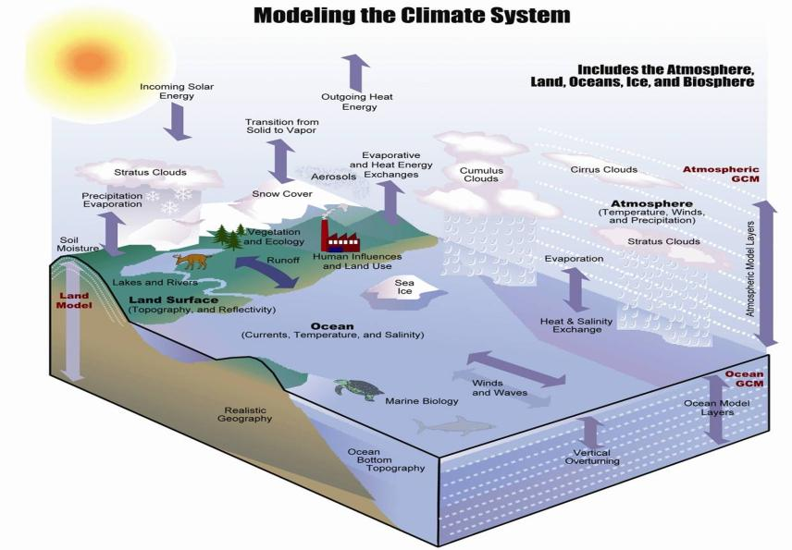
4. Modeling: Improve global and regional simulations and predictions of precipitation, clouds, and land hydrology, and thus the entire climate system, through accelerated development of models of the land and atmosphere.
Proposal from the last JSC meeting for a “Modeling Council”: “… the Modeling Council concept would allow the Projects to be better connected to the WCRP modeling efforts. “

Slide 21

Framework for Atmospheric Model Enhancement (FAME)
Mission: Improving the representation of physical and dynamical processes in the troposphere in models for all purposes and especially weather and climate services
Ingredients
PBL (GABLS)
Clouds and Convection (GCSS)
Radiation (shared with GRP and SPARC)
Coupling to dynamical processes
Coupling to numerics

Slide 22
FAME
Should reside within GEWEX
GEWEX would not be anything like the same without it
already there
maintains links to GLASS
potentially good links to LAMs and RHPs
natural focus on energy and water cycle
deals with “fast processes”
Will raise visibility of atmospheric model development

Slide 23
FAME: post 2013
How this develops as a working group or panel within GEWEX but interacting with all of WCRP: CLIVAR, CliC, SPARC and feeding into other modeling WGs is not yet clear.
WG on Atmospheric Processes and model development for climate (WGAP)?
Needs to integrate with regional modeling (such as CORDEX)

Slide 24
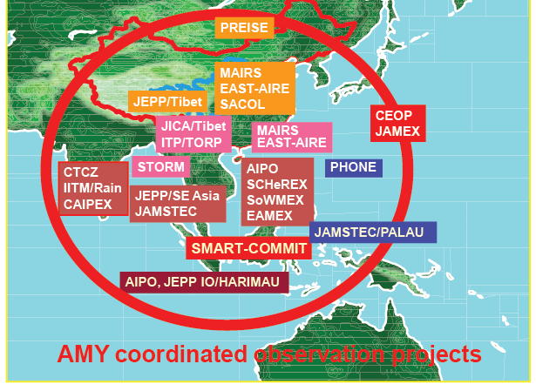
5. Applications: Attribute causes of variability, trends and extremes, and determine the predictability of energy and water cycles on global and regional bases in collaboration with the wider WCRP community.
Pan-WCRP & WMO Cross-cutting studies: Monsoons Extremes

Slide 25
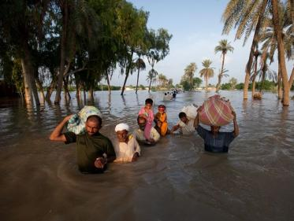
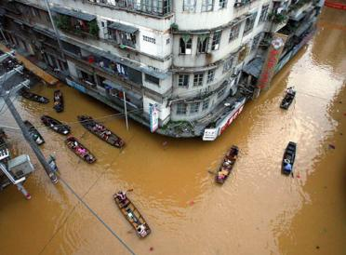
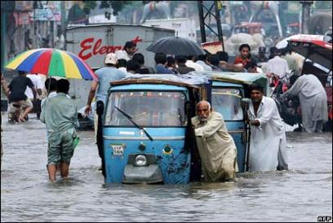
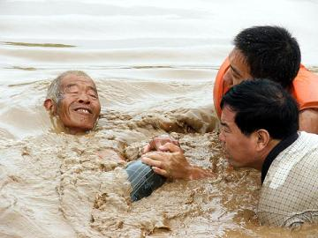
Monsoon crosscuts
Concern that, once again, because monsoons cut across land and ocean domains, they may not be adequately addressed in new WCRP structure
Models do not simulate monsoons well
How much is resolution (e.g. of topography, land-sea divide)?
Can models simulate the floods in Pakistan, China, India in summer 2010, and in Australia in their summer 2010-11?

Slide 26
WCRP extremes workshop
Workshop on metrics and methodologies of estimation of extreme climate events: WCRP-UNESCO (GEWEX/CLIVAR/IHP)
UNESCO, Paris: 27-30 Sept 2010
Chair: Olga Zolina
132 from 32 countries
Oral, poster, discussion sessions; 3 Breakout Groups
Community white paper, Eos* and BAMS(?) article
http://www.extremeworkshop.org/
Goal: To provide much improved observational datasets and model capabilities on variability and extremes, especially those that have high impacts on society and the environment; and develop a climate information system that include predictions and assessments of future changes in risk from extremes.
*21 Dec 2010 issue

Slide 27
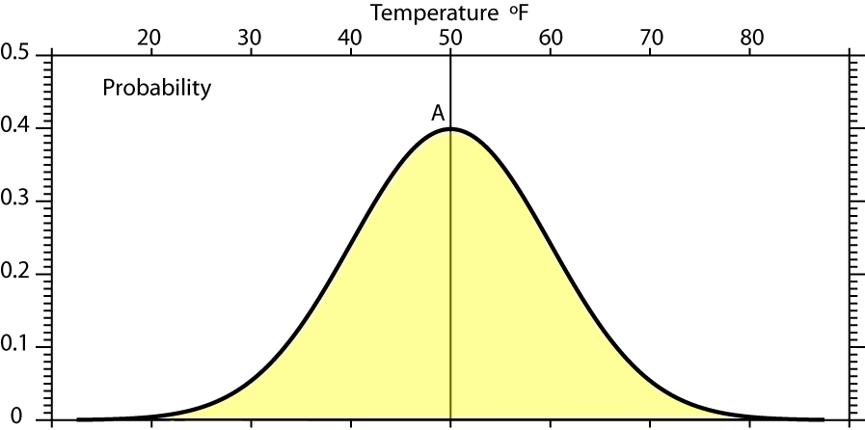
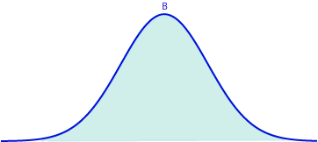
Reason for focus on extremes
Mean A: 50°F, s.d. 10°F

Slide 28
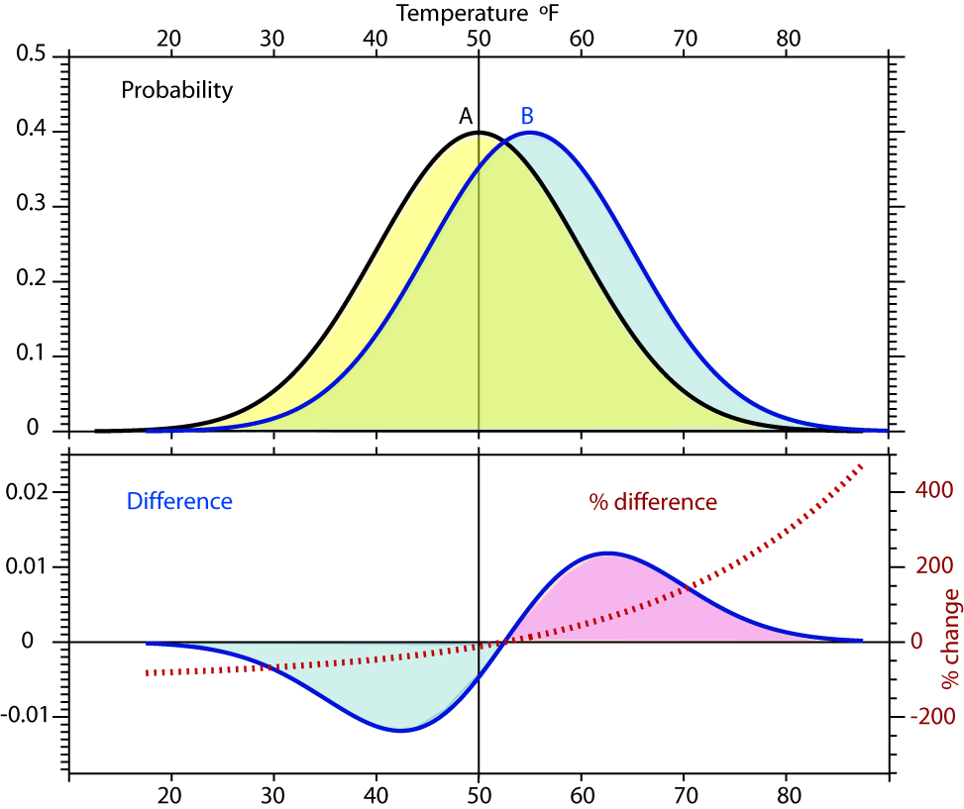
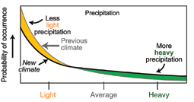
Reason for focus on extremes
Shift in climate: from A to B
Most of time the values are the same (green).
Biggest changes in extremes: >200%
Mean A: 50°F, s.d. 10°F
Mean B: 55°F, s.d. 10°F

Slide 29
Issues for extremes in models
Model definitions are often different from obs:
Model grid box value may not be comparable to mean of grid box from observations
Model results typically not available or archived.
Need appropriate output from models (high frequency, stats, ability to generate pdfs)
Ability and utility of models
Model extremes are not well simulated.
Is there confidence in the physics?
Improvements of models (intensity, frequency of precip etc)
Improvements in resolution

Slide 30
Moral for extremes in models
Provide a focus for evaluating and development of models wrt how well they replicate extremes:
Developing better methods for comparing model grid point values with observations. Compare apples with apples: gridded data
Establish extreme-related measures for evaluation of models.
Ensure that archives of model runs include sufficient high frequency data to assess pdfs and extremes.
Improve model archives with hourly data
Assess ability and utility of models wrt extremes
As fn of resolution
As fn of parameterizations (e.g. convection)
Set up specific CMIP5 analysis projects focused on extremes
Derive certain mandatory statistics
What do these mean for impacts: downscaling?

Slide 31
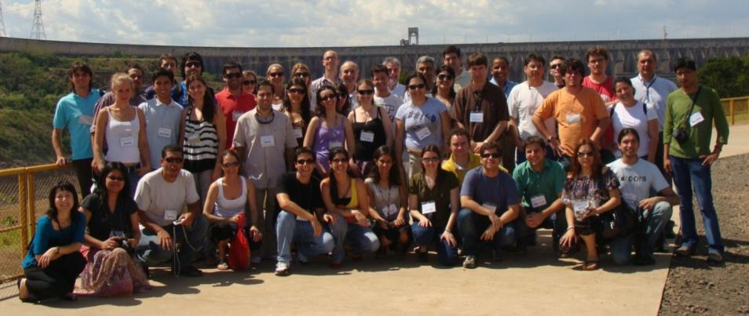
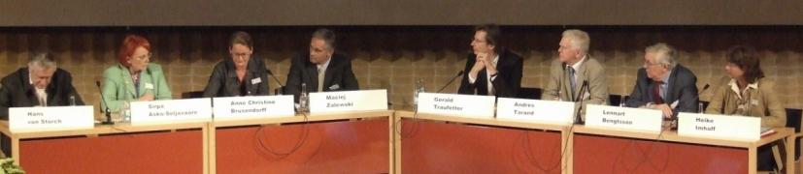
7. Capacity Building: Promote and foster the development of capacity through training of scientists and outreach to the user community.
Education: workshops, training, summer schools; observations, data; technology use; interactions with users; outreach.
Participants at a recent La Plata Basin Workshop held in Itaipú Technological Park, Foz do Iguaçu, Paraná State, Brazil.
A panel discussion at the International BACC Conference, May 2006 in Gothenburg, Sweden, providing for science – stakeholder interaction and GEWEX/BALTEX outreach.

Slide 32
GEWEX
Please join us!

