Slide 1
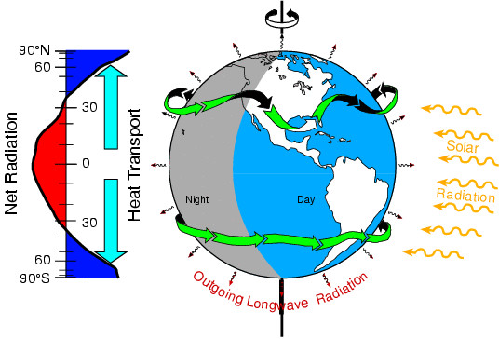
Tracking Earth’s Energy:
From El Niño to global warming
Kevin E Trenberth and John Fasullo
NCAR
Where has global warming from increased GHGs gone?

Slide 2
Stolen emails “climategate”
"The fact is that we can't account for the lack of warming at the moment and it is a travesty that we can't." Kevin Trenberth
"It is quite clear from the paper that I was not questioning the link between anthropogenic greenhouse gas emissions and warming, or even suggesting that recent temperatures are unusual in the context of short-term natural variability.“
Kevin Trenberth

Slide 3
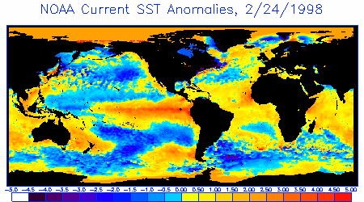
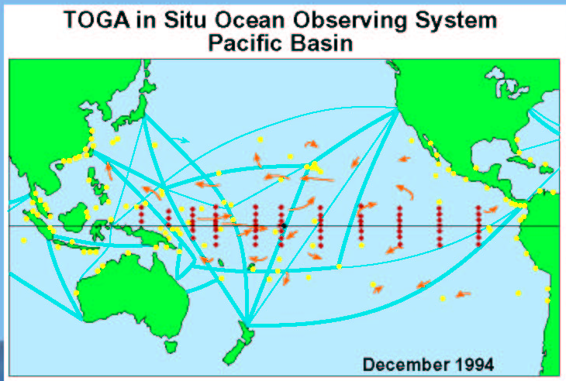
ENSO
In 1997-98, successful warning of a massive El Niño were issued several months in advance.
These were made possible by the TAO moored buoys tracking the buildup of energy in the oceans and its redeployment during El Niño.

Slide 4
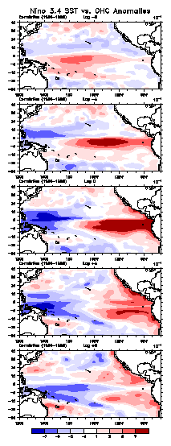
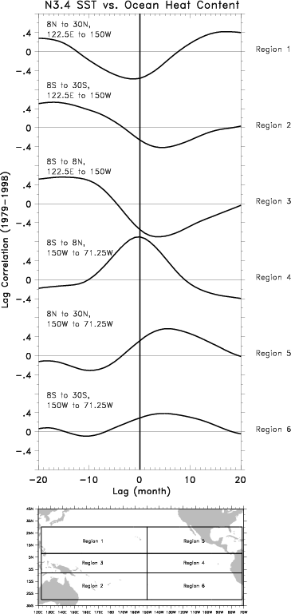
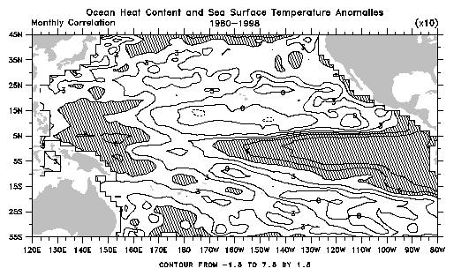
1
2
3
4
5
6
Evolution of ENSO
Ocean heat content
1980-1998
Trenberth et al. 2002
lag
-8
-4
0
4
8
1 5
3 4
2 6

Slide 5
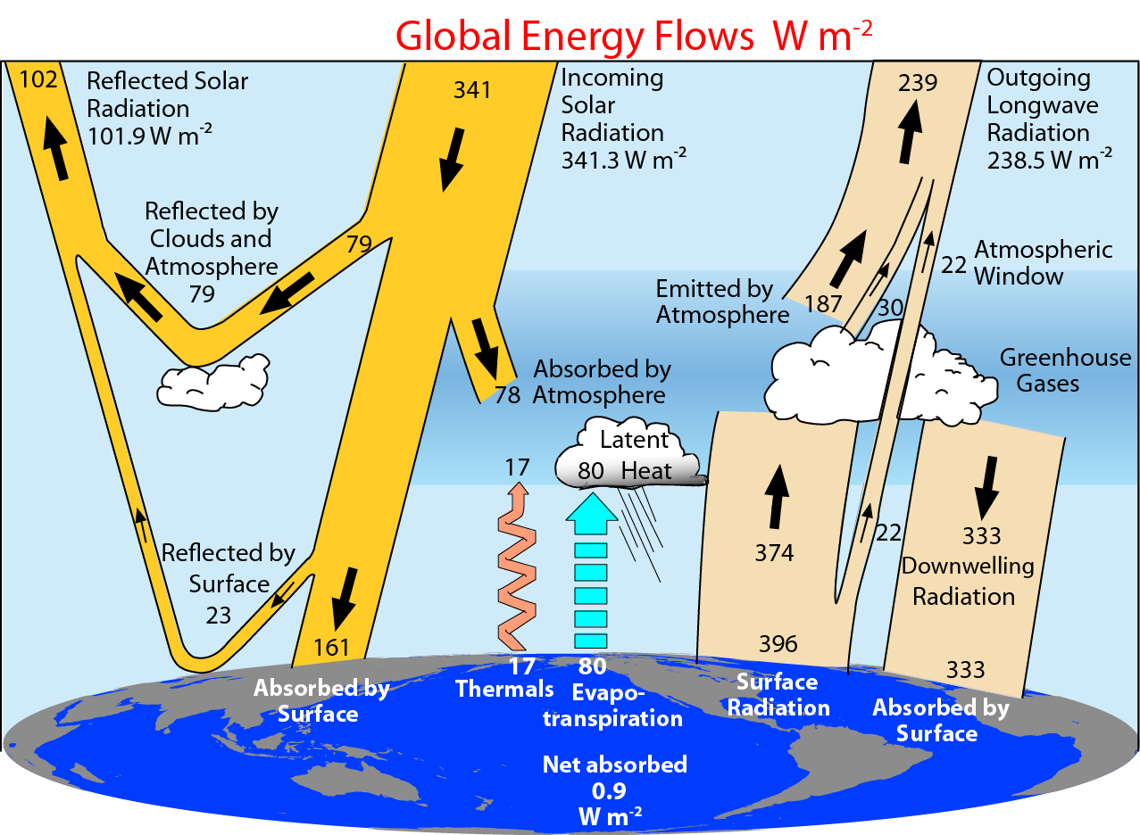
2000-2005 Adapted from Trenberth et al 2009

Slide 6
Ocean heat content and sea level
Global warming from increasing greenhouse gases creates an imbalance in radiation at the Top-Of-Atmosphere: now order 0.9±0.5 W m⁻².
Where does this heat go?
Main sink is ocean: thermosteric sea level rise associated with increasing ocean heat content.
Some melts sea ice: no change in SL
Some melts land ice.
SL increases much more per unit of energy from land-ice melt: ratio about 30 to 90 to 1.
Sea-ice melt does not change sea level.

Slide 7
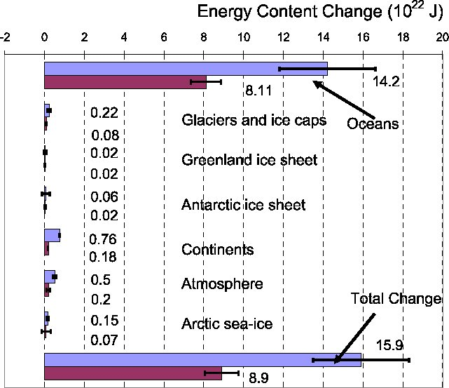
Energy content change 10²² J
>90%
oceans
1961-2003 (Blue bars)
Figure 5.4
IPCC AR4
1993-2003 (Burgundy bars)

Slide 8
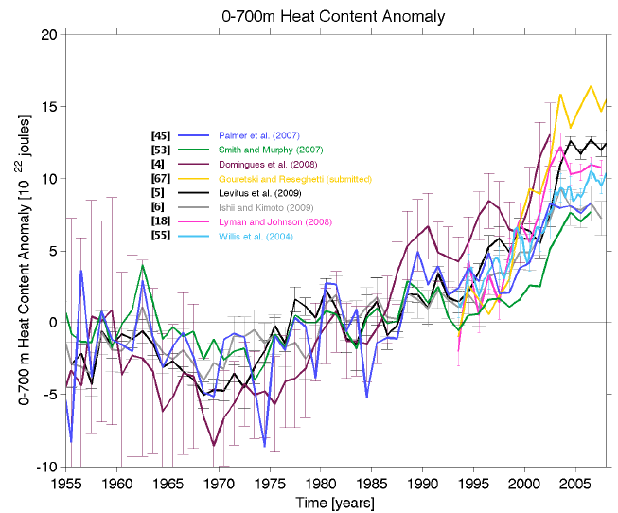
Ocean heat content to 700 m
Palmer et al OceanObs’09

Slide 9
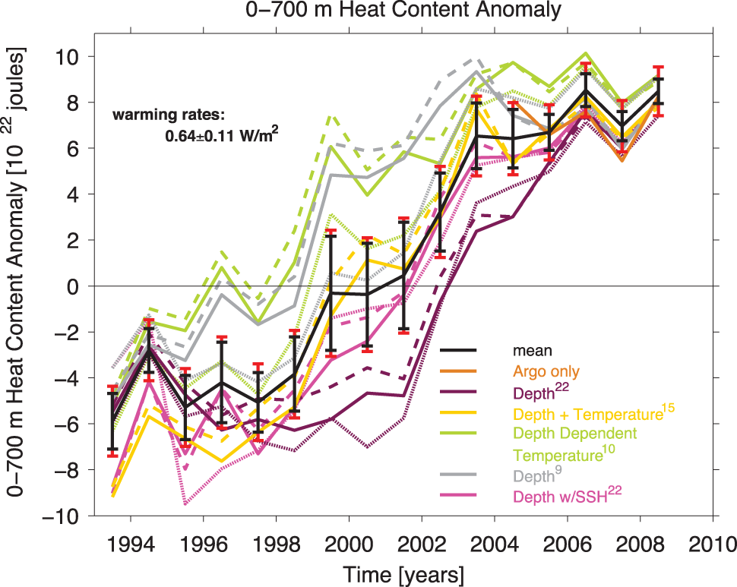
Lyman et al 2010 Nature

Slide 10
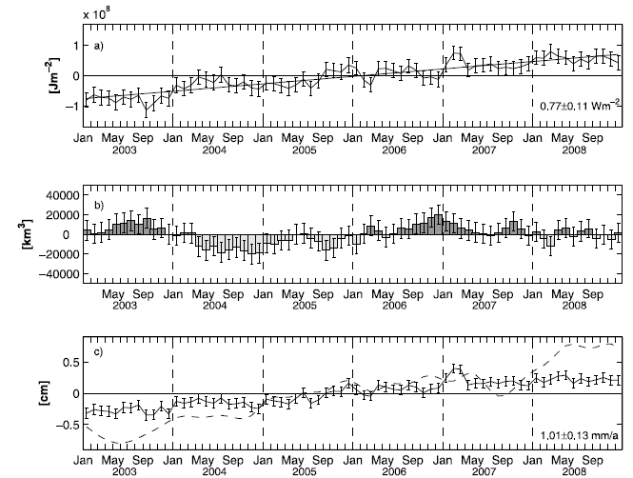
Ocean heat content 0-2000m
OHC
0.77 W m⁻²
gl ocean
0.54 W m⁻²
Global
Fresh water
Sea level and thermosteric
OHC
Von Schuckmann et al JGR 2009

Slide 11
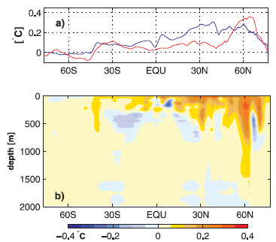
Ocean heat content 0-2000m
SST (red)
2003-2008 – 1990-2008
10 m depth
ARIVO –
WOA05
Temps
Difference for 2003-2008
From WOA05
Levitus et al
Von Schuckmann et al JGR 2009

Slide 12
Comments on Von Schuckmann
VS did not provide 0-700 m OHC vs 0 to 2000m
Some floats are programmed to go only to 1000 m and do not go to 2000 m, so that coverage decreases with depth
How come all the error bars are the same even though coverage is increasing?
How good is the quality of the sensors over this time? Up to 30% report negative pressures at the surface.

Slide 13
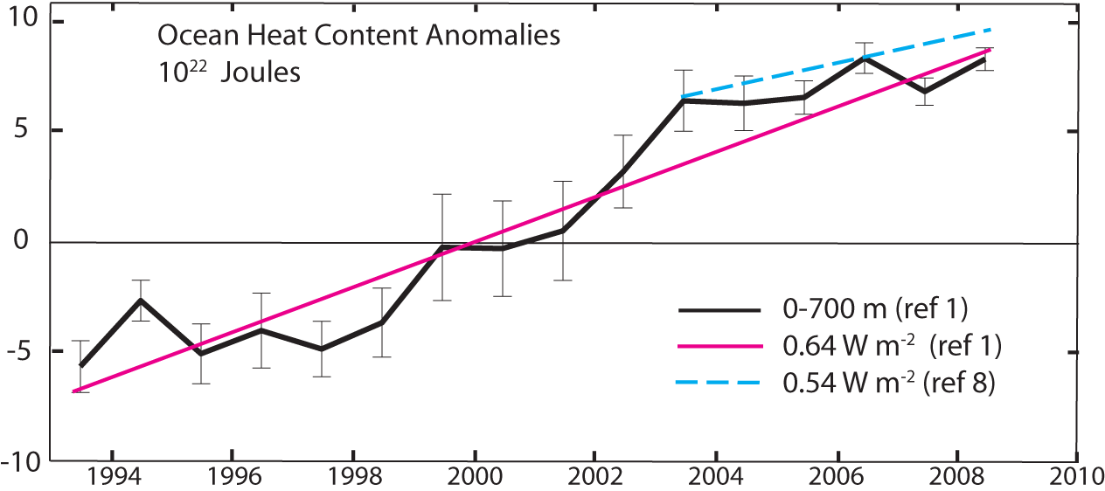
Ocean heat content is increasing
1. Lyman et al 2010 : to 700m
8. von Schuckmann et al 2009 :to 2000m From Trenberth 2010 Nature

Slide 14
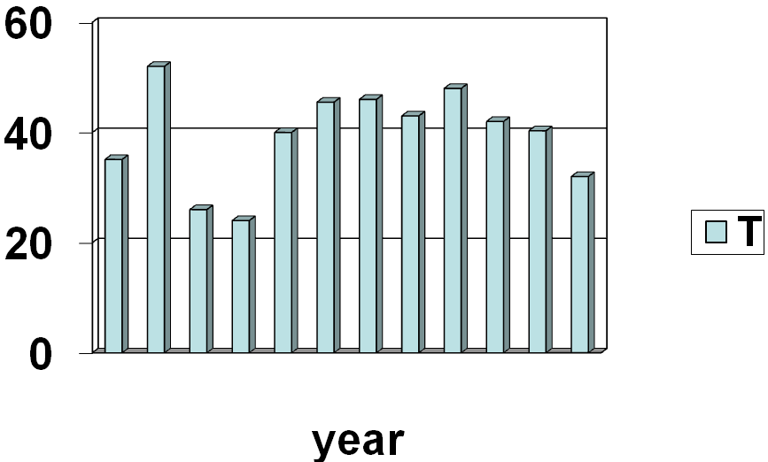
Where did the heat go?
2008 is the coolest year since 2000
Carbon dioxide continues to rise
Radiative forcing continues apace
Where did global warming go?
1997 2003 2008

Slide 15
Where does energy go?
Warms land and atmosphere
Heat storage in the ocean (sea level)
Melts land ice (sea level)
Melts sea ice and warms melted water
Evaporates moisture ⇒ cloud ⇒ reflection = lost to space
Can we track it?

Slide 16
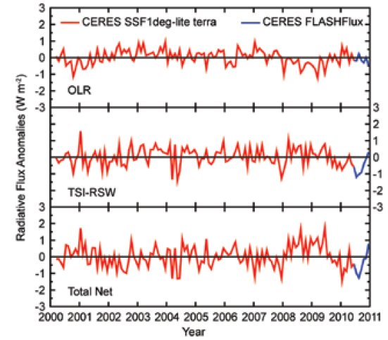
CERES SSF 1Deg Lite Ed2.5 Anomalies
Kratz et al 2011 BAMS

Slide 17
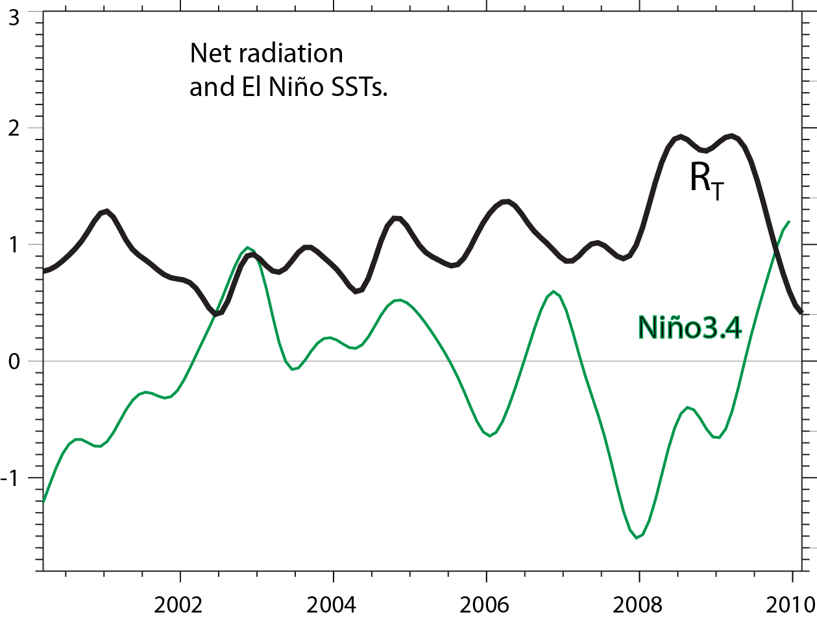
CERES EBAF adjusted product
R_{T}
Nino
3.4

Slide 18
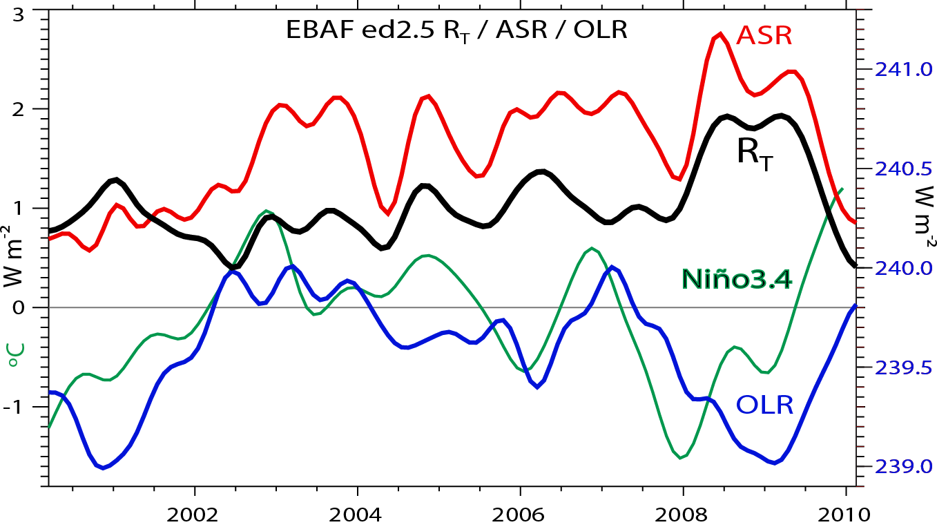
R_{T}
Nino
3.4
R_{T}=ASR-OLR

Slide 19
Where does energy go?
10²⁰ Joules/yr
Trenberth 2009

Slide 20
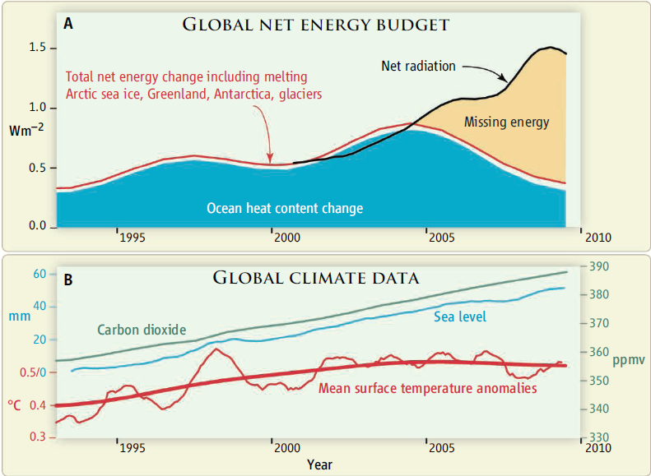
Can we track energy since 1993 when we have had good sea level measurements?
Trenberth and Fasullo Science 2010

Slide 21
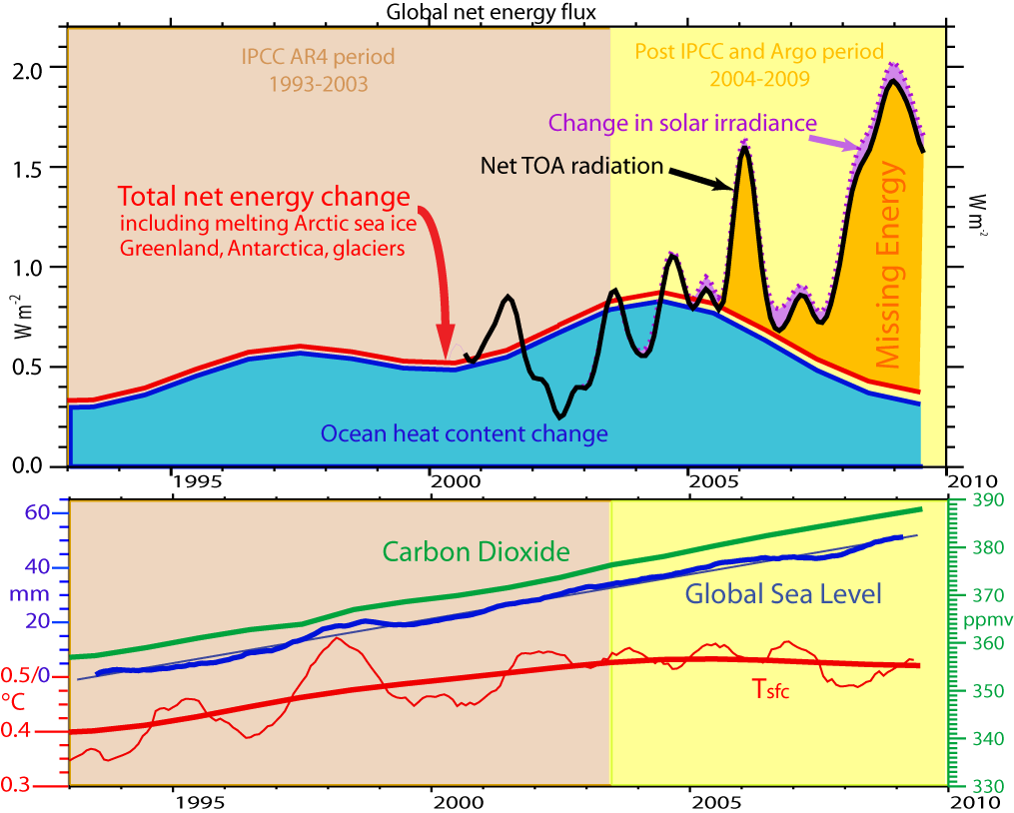

Slide 22
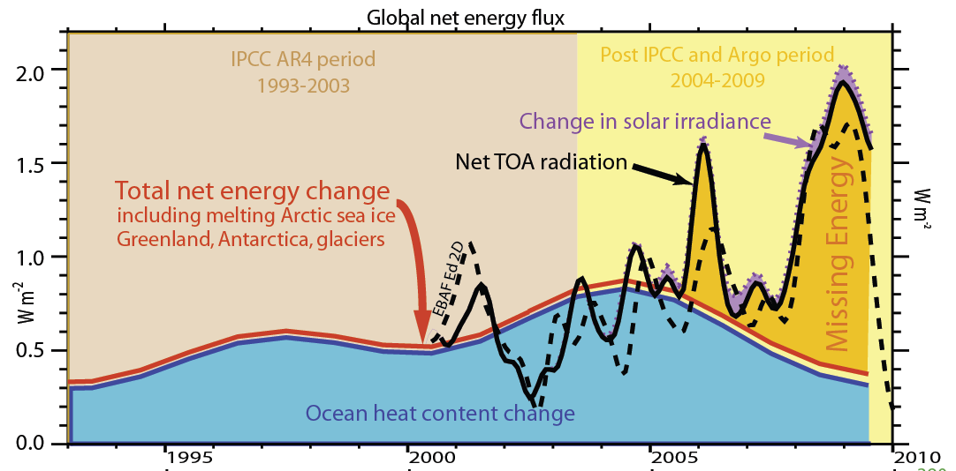

Slide 23
Where does the heat go?
At present this is difficult to do from observations/ocean reanalyses,
so what about models?

Slide 24
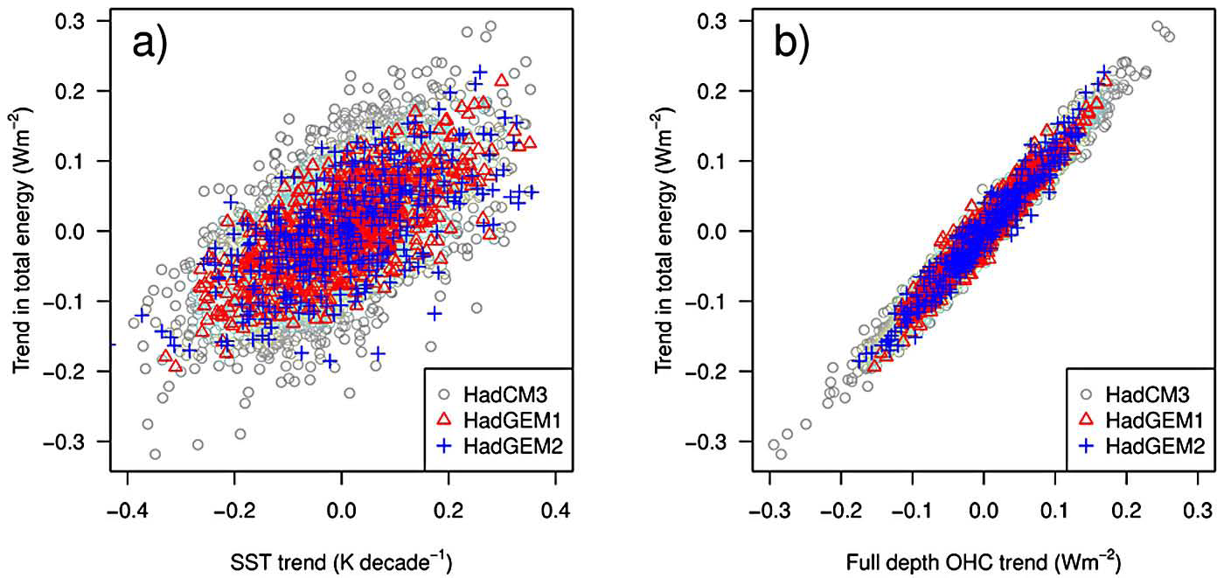
SST vs OHC vs TOA
Linear decadal trends in total energy (W m⁻²) regressed against decadal trends in : a) globally SST (K dec⁻¹); b) full-depth OHC (W m⁻²). The trend in total energy is equivalent to the average TOA radiation balance.
Palmer et al. GRL 2011

Slide 25
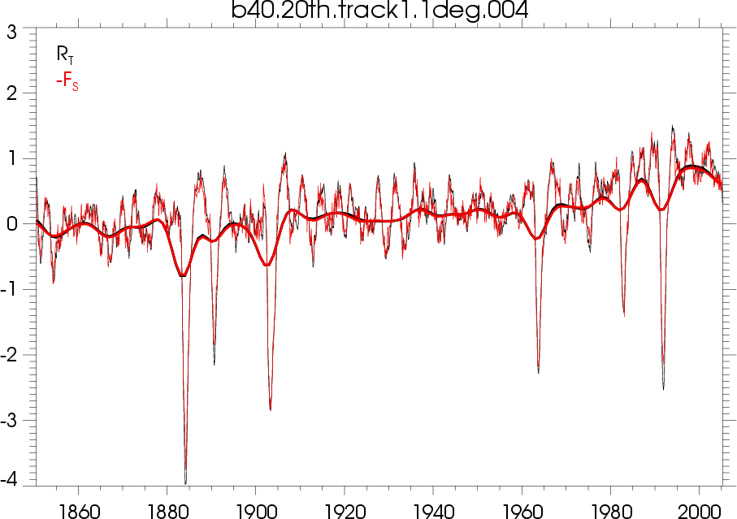
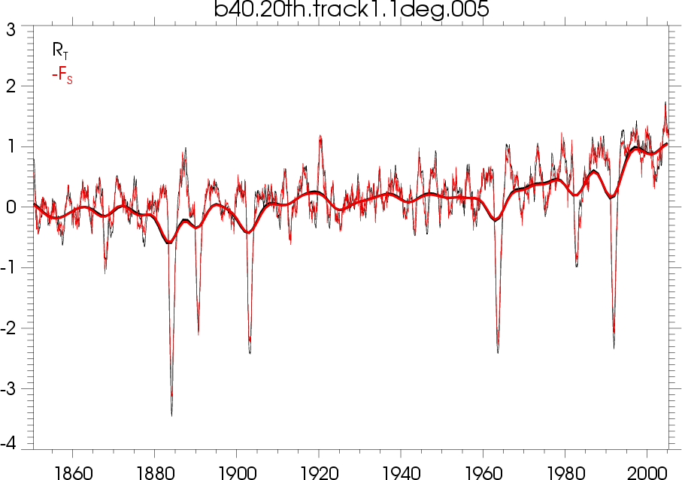
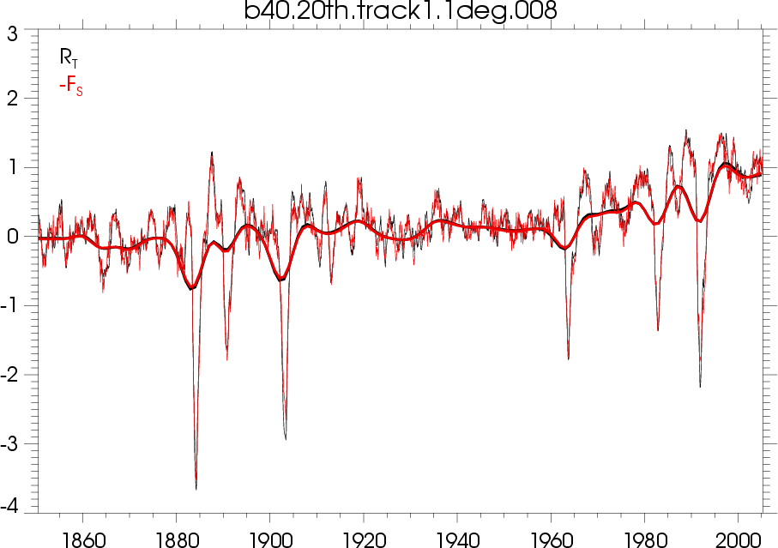
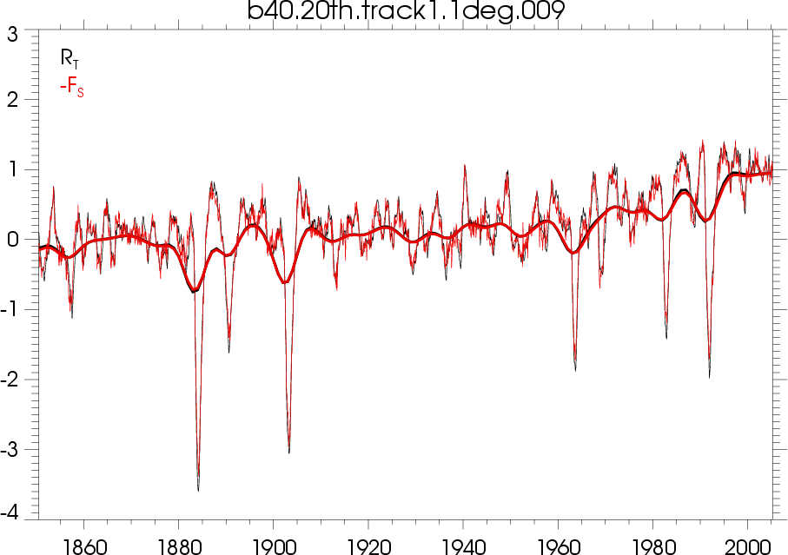
TOA Radiation and Fs from CCSM4
0.9

Slide 26
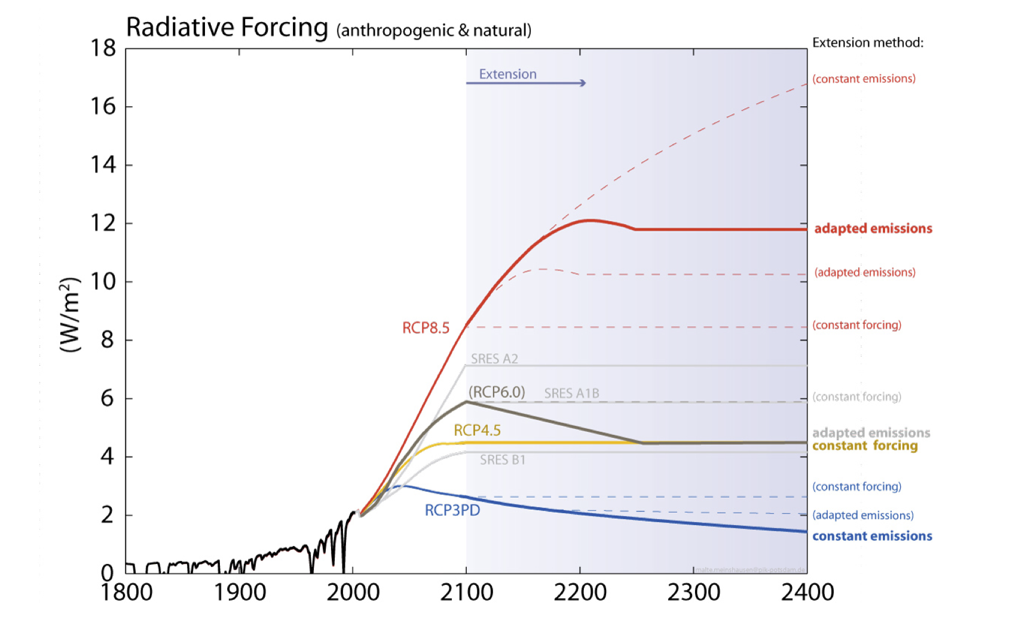
RCP 4.5
Representative Concentration Pathways (RCPs) for use in AR5

Slide 27
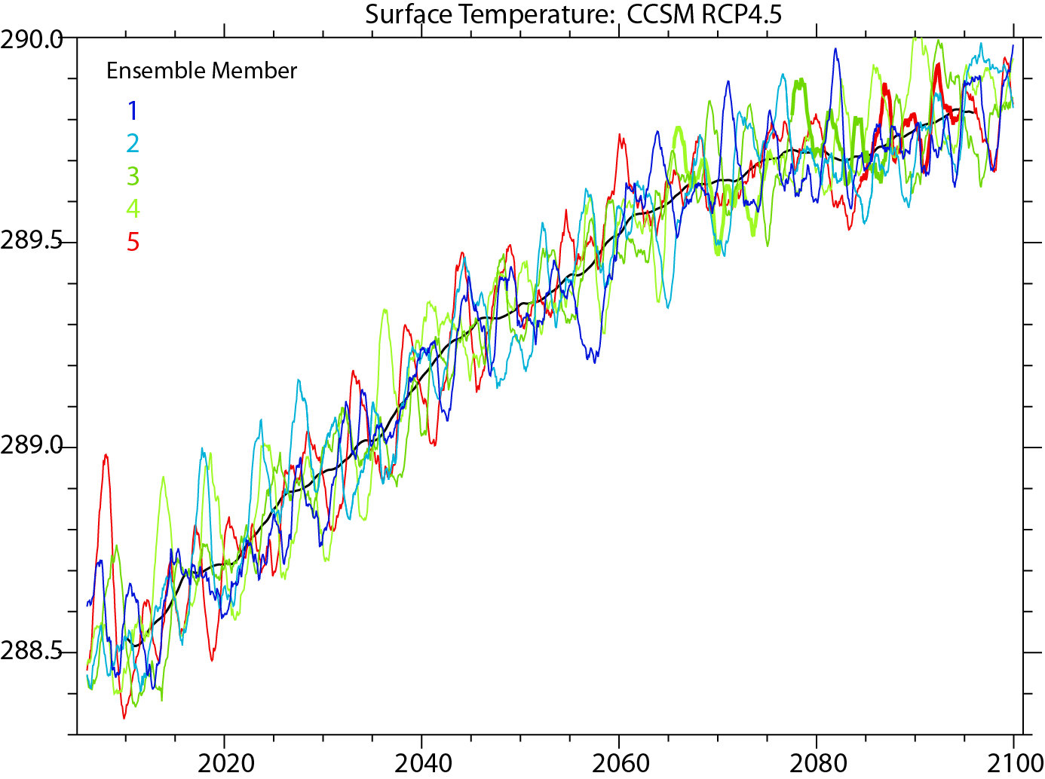
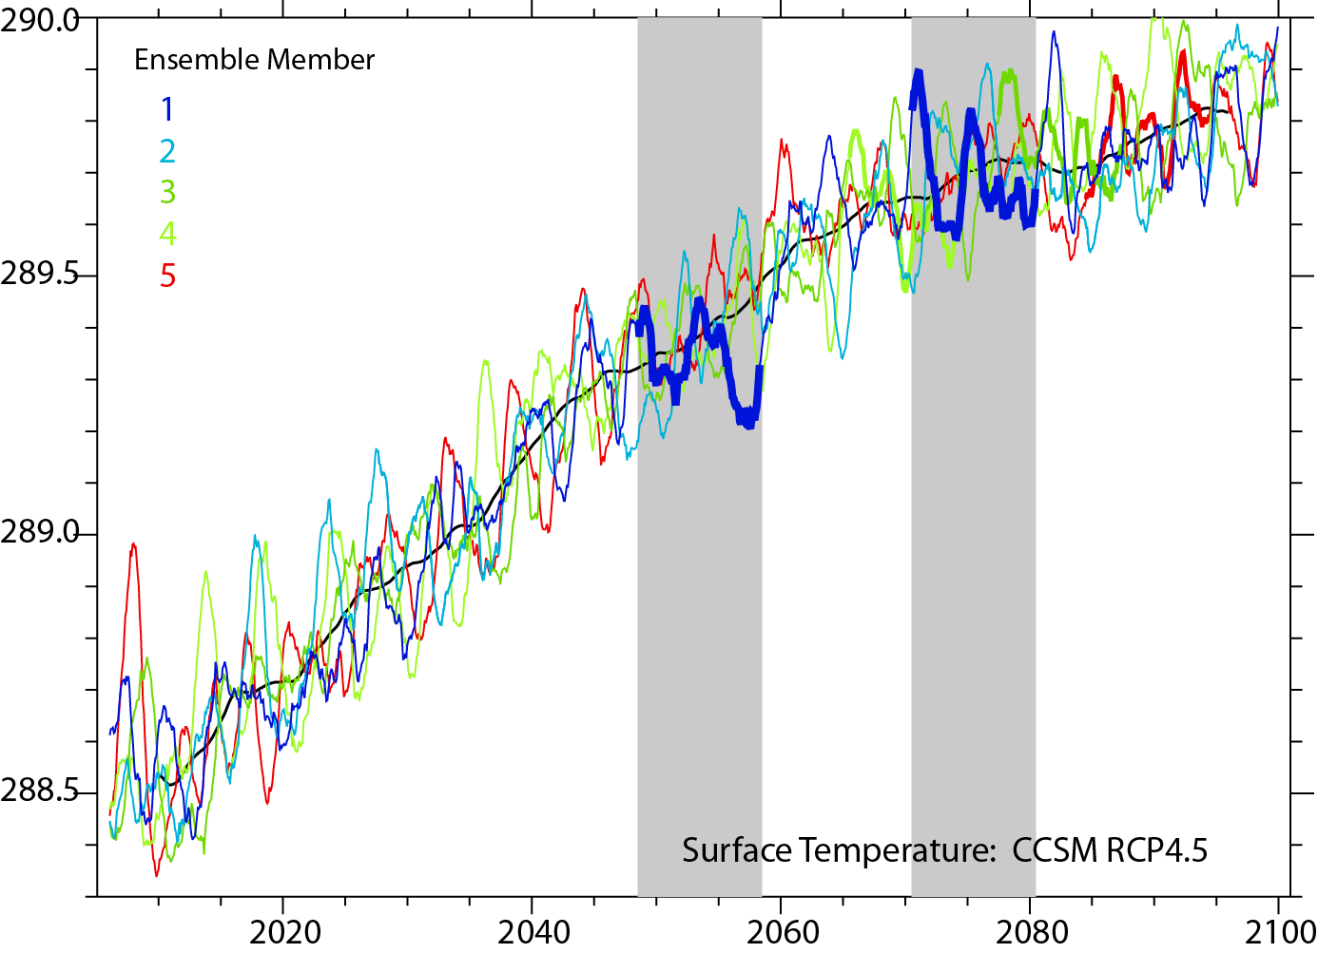
Missing energy in CCSM4?
In CCSM4, sfc T rises in 5 ensemble members.

Slide 28
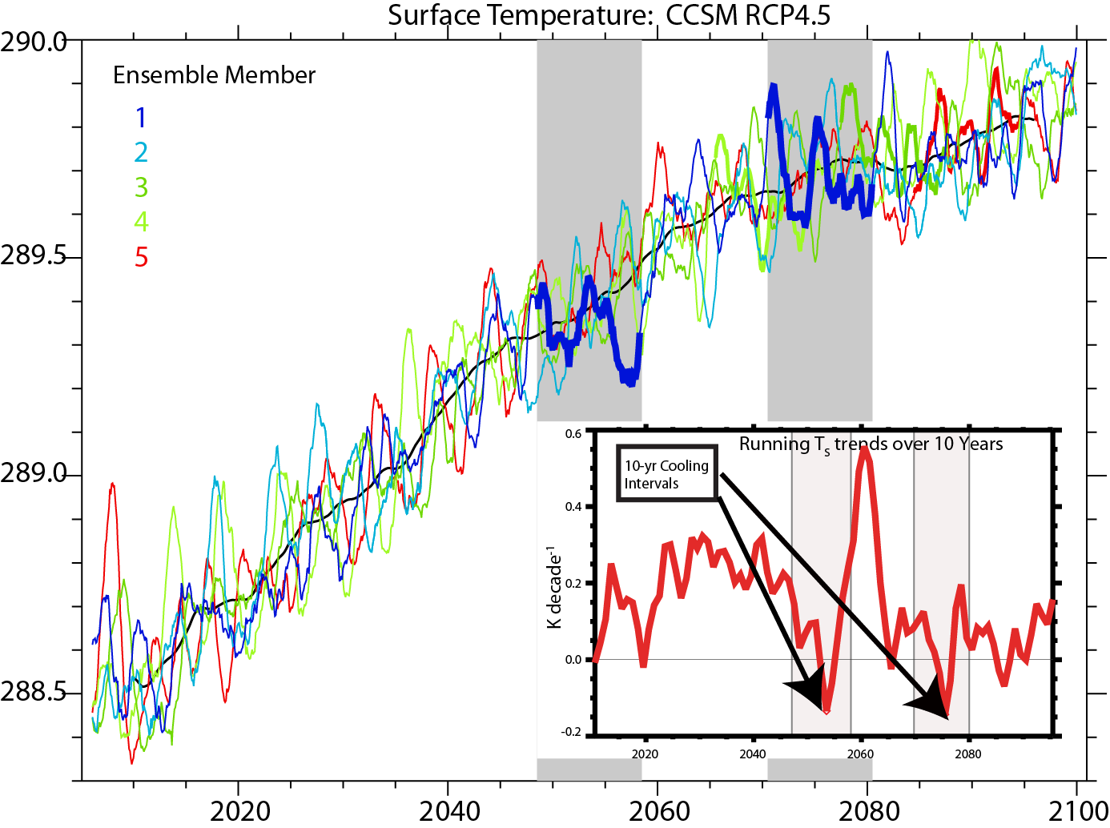
Missing energy in CCSM4?
In CCSM4, during periods with no sfc T rise, the energy imbalance at TOA remains about 1 W m⁻² warming. So where does the heat go?

Slide 29
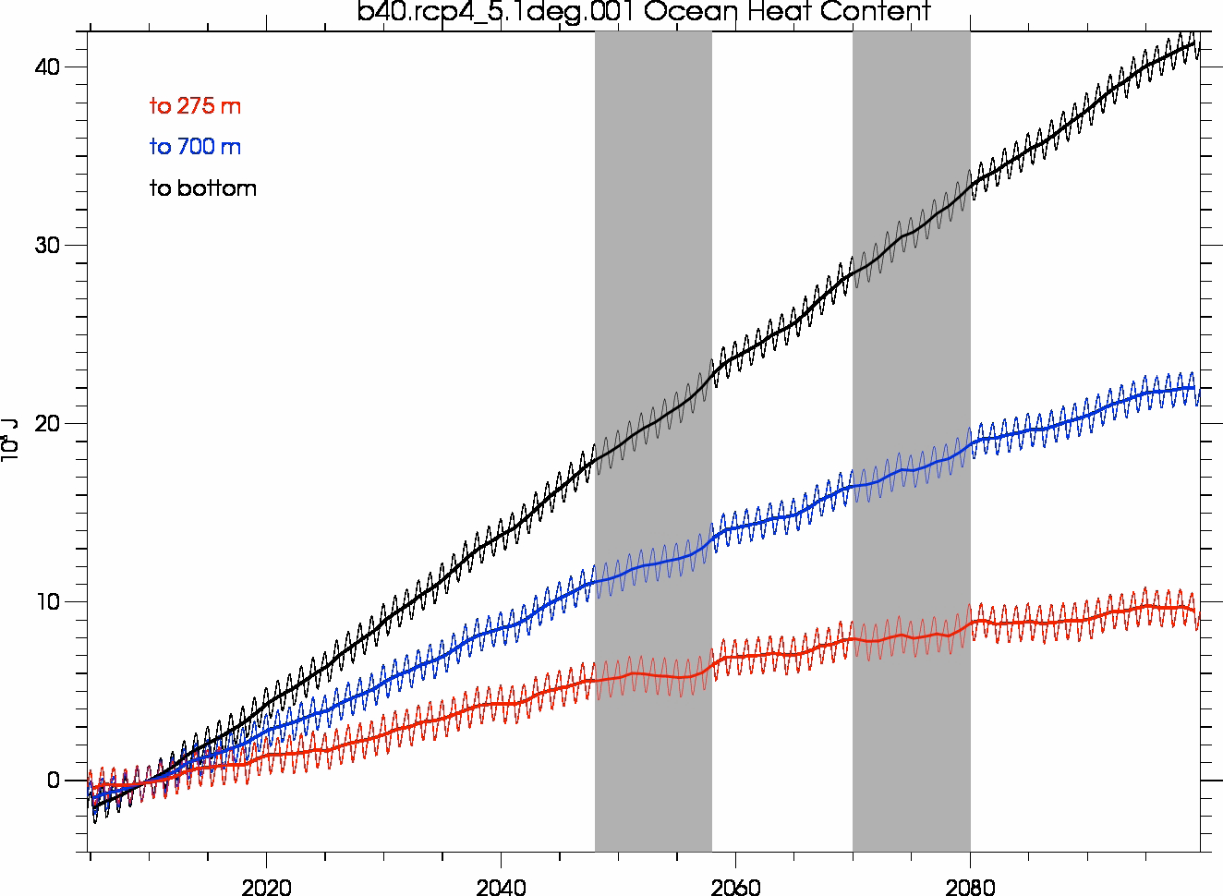
Missing energy in CCSM4?
Ocean heat content for those two periods shows no warming trend in the upper 275 meters, little trend down to 700 meters, but an ongoing warming trend in the deep ocean; the heat is going into the deep ocean, but where and how?
In CCSM4, during periods with no sfc T rise, the energy goes into the deep ocean, somehow.

Slide 30
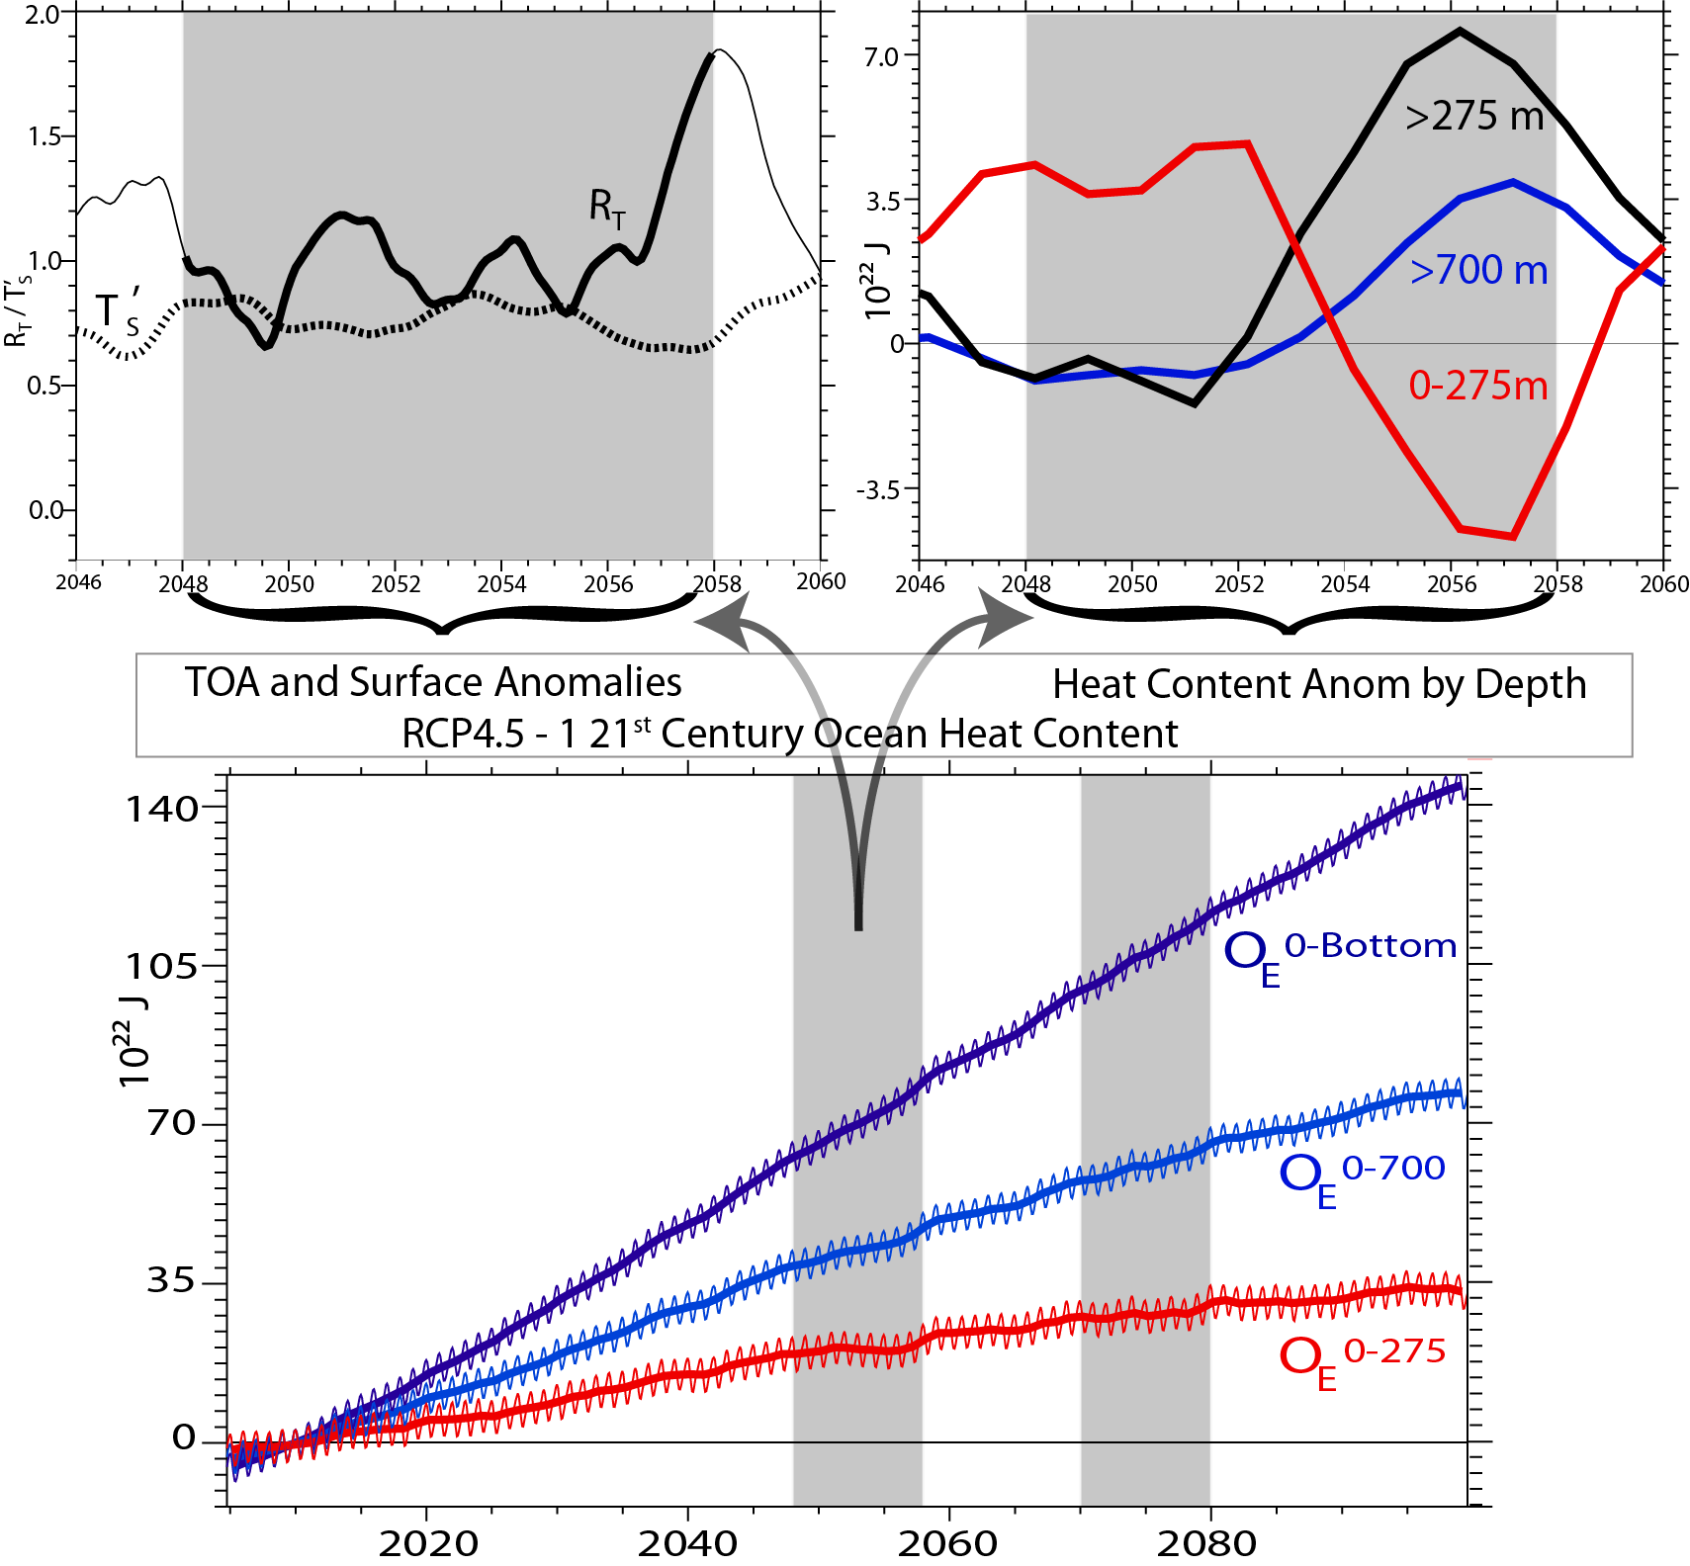
Dep. From 20 yr running mean

Slide 31
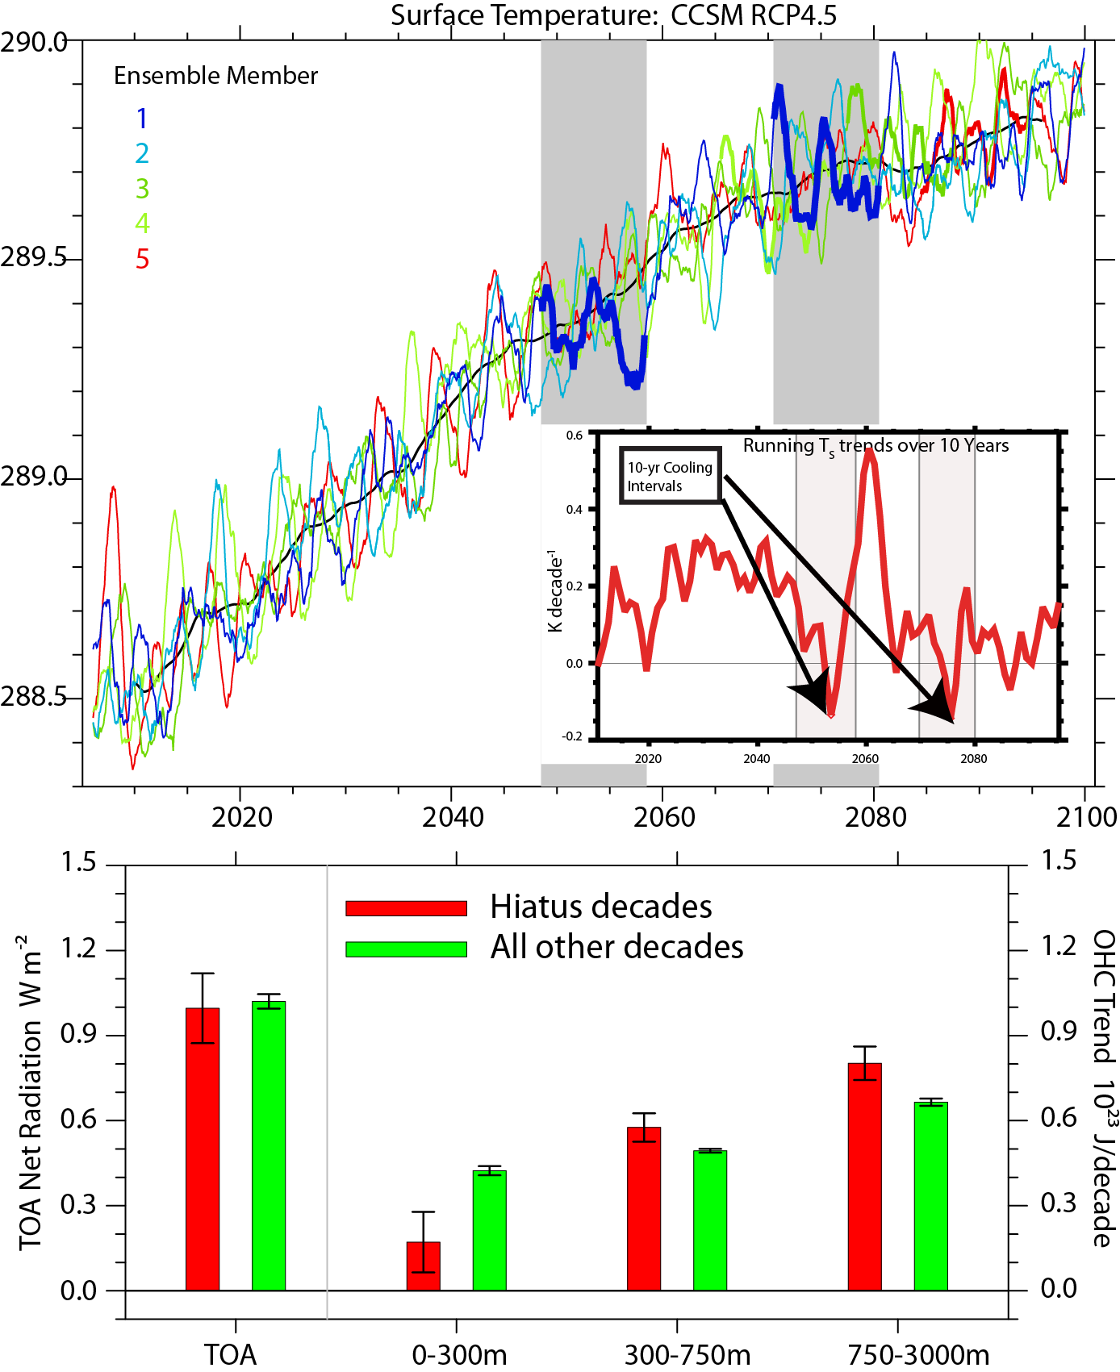
RCP4.5
Composites from 5 ensemble members 10 distinct 10-year periods with either zero or slightly negative globally averaged temperature trend.

Slide 32
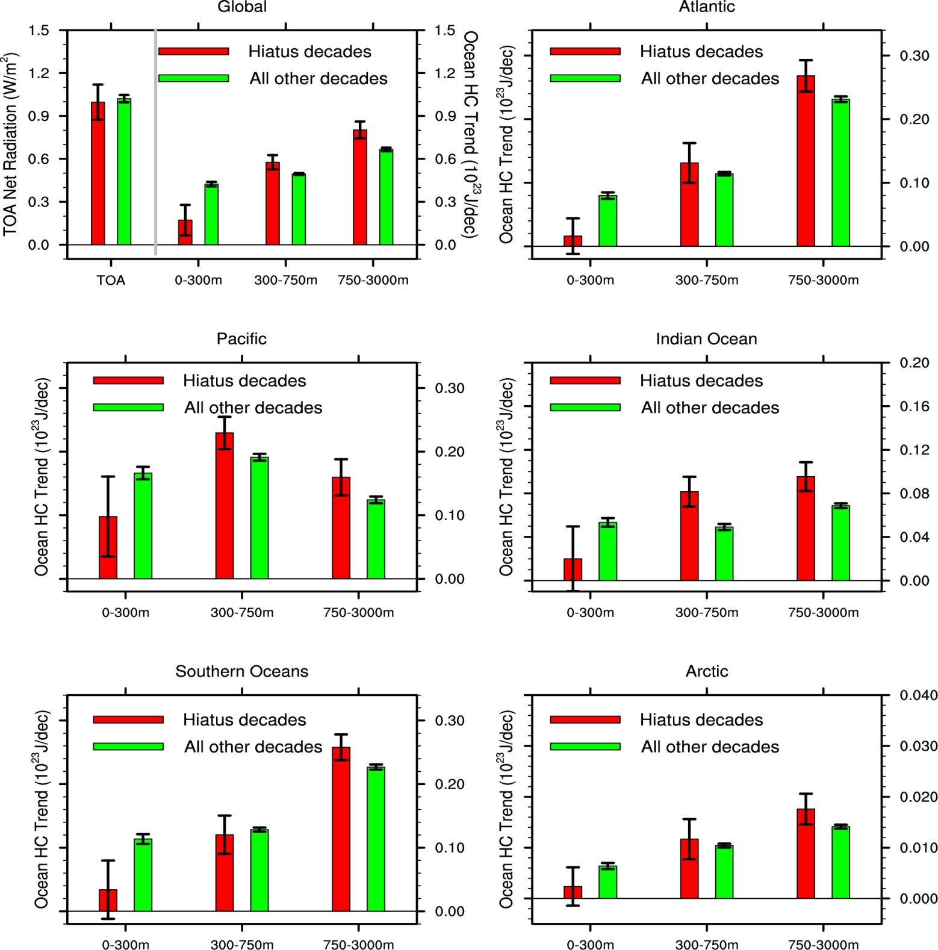
750 to 3000m
Is the same as for 750 to bottom.

Slide 33
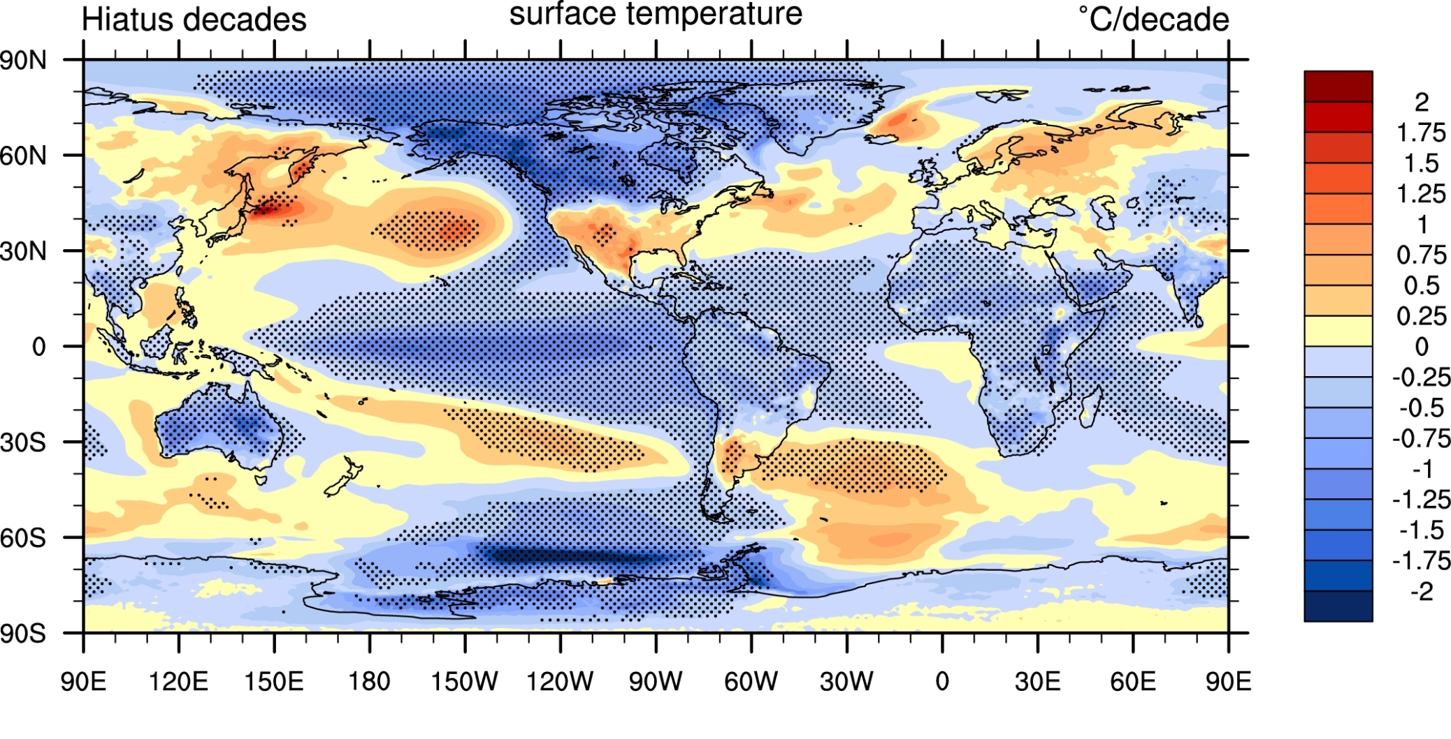
Missing energy in CCSM4?
Taking five ensemble members of RCP4.5 and compositing 10 distinct 10-year periods with either zero or slightly negative globally averaged temperature trend shows these time periods are characterized by a negative phase of the Interdecadal Pacific Oscillation (IPO) or La Niña.
(the t-test was based on the variance across the 5 year differences in these 7 periods compared to the 5 year differences from the entire run.)

Slide 34
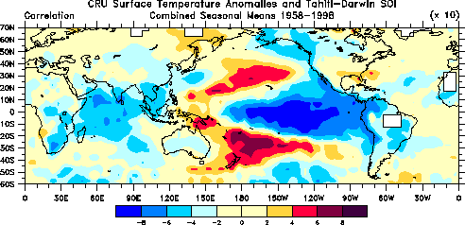
La Nina temperatures
(correlation with SOI)
Trenberth and Caron 2000

Slide 35

Changes in the depth of the 20°C isotherm for the hiatus decades relate to OHC changes. Positive (the 20°C isotherm is deeper) suggest regions where heat is taken down into the subsurface ocean. Relates especially to subtropical overturning cells.

Slide 36
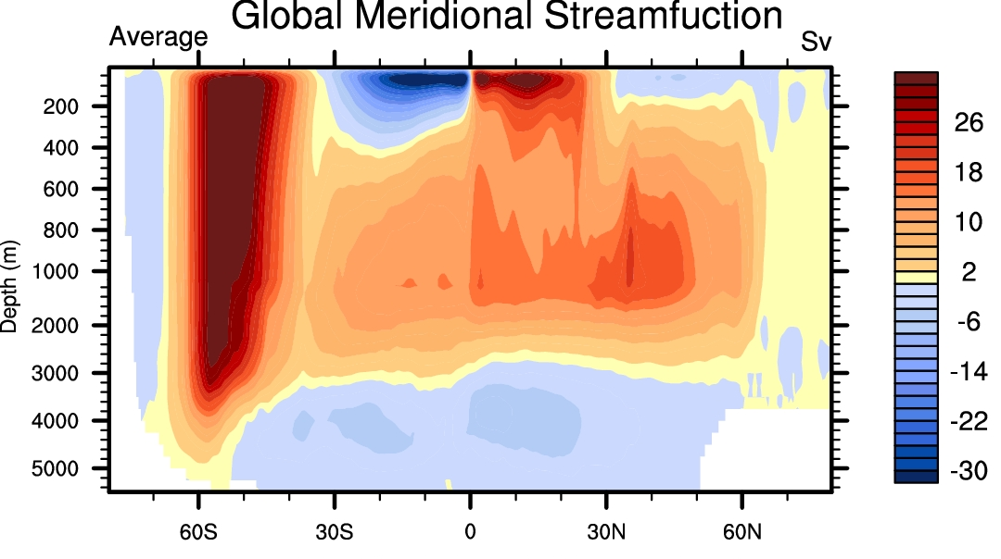

+ve=clockwise

Slide 37
Conclusions
.
In the model, it is easy to get a decade of no surface temperature rise: relates to La Nina/ -ve PDO.
Recent experience indicate the same behavior in observations of the real world.
The energy imbalance at TOA remains the same: about 1 W m⁻².
The heat imbalance does not go into top 300 m of the ocean; in fact that region loses heat.
Instead heat penetrates below there and some below 700m.
The mechanism appears to relate to subtropical meridional overturning cells.

Slide 38
Where does the heat go?
Questions remain. Both the CCSM4 and observations suggest that ENSO plays a necessary, if not sufficient, role. Strong recent ENSO events, including the El Niño of 1997/98 and the La Niña of 2007/08 exert a strong influence on trends in global temperature computed across this period.
Similarly, cooling decades from the CCSM4 are bounded by El Niño events at their initiation and La Niña events are their termination. Yet other intervals bounded by El Niño and La Niña are not accompanied by significant cooling.
Our current work focuses on understanding this variable association between ENSO and global temperature trends.

