Slide 1
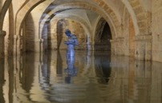
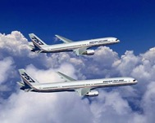
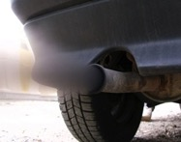
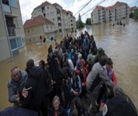
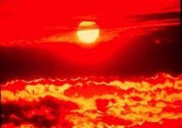
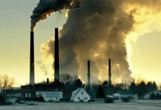
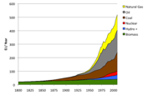
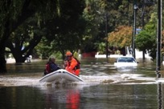
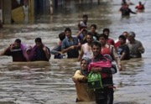
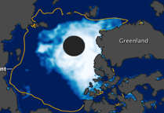
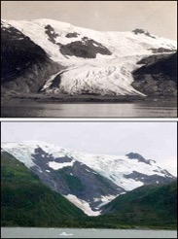
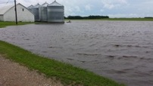
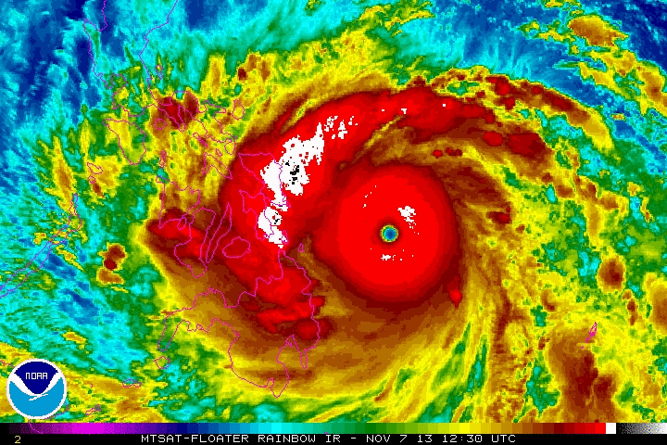
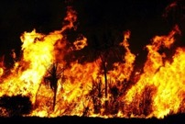
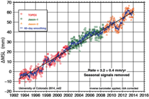
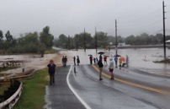
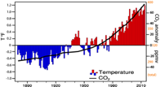
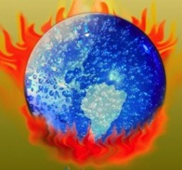
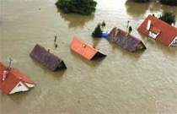
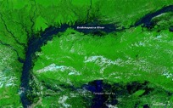
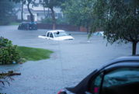
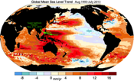
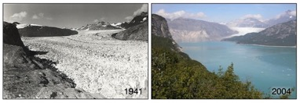
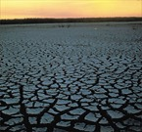
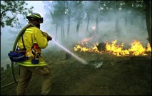
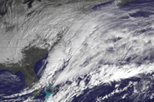
Fifty shades of climate change
Fifty shades of
Kevin E. Trenberth
NCAR

Slide 2
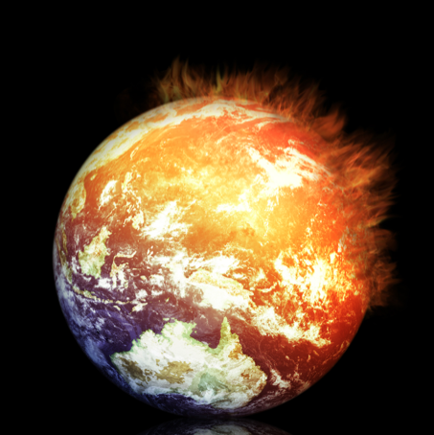
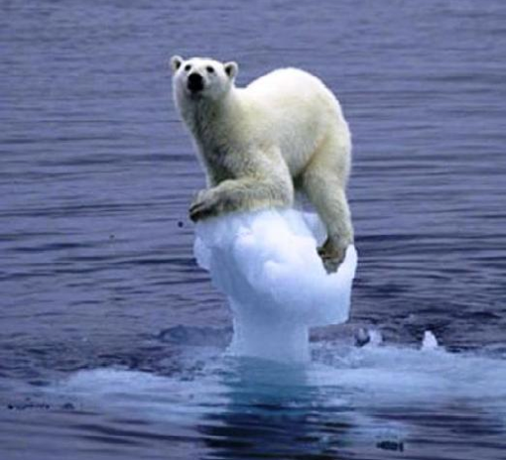
Global warming is alive and well Not that this is a good thing! Kevin E Trenberth NCAR

Slide 3
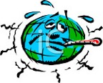
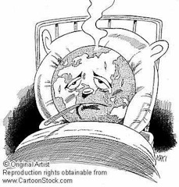
Running a fever: Seeing the doctor
Symptoms: the planet’s temperature and carbon dioxide are increasing
Diagnosis: human activities are causal
Prognosis: the outlook is for more warming at rates that can be disruptive and will cause strife
Treatment: mitigation (reduce emissions) and adaptation (plan for consequences)

Slide 4
Climate change is happening: It is due to humans
97% of scientists agree.
The data are of mixed quality and length, but together they tell a compelling story leaving no doubt about the human role in climate change.
What we do about this problem involves value systems and politics!

Slide 5
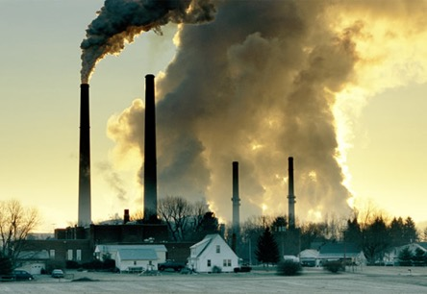
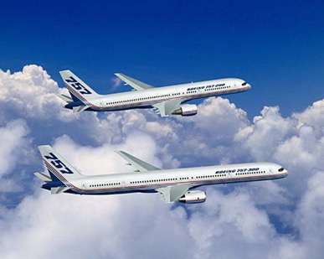
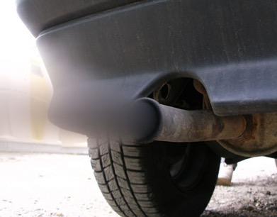
What Is Causing Warming?
Emissions of carbon dioxide pollution

Slide 6
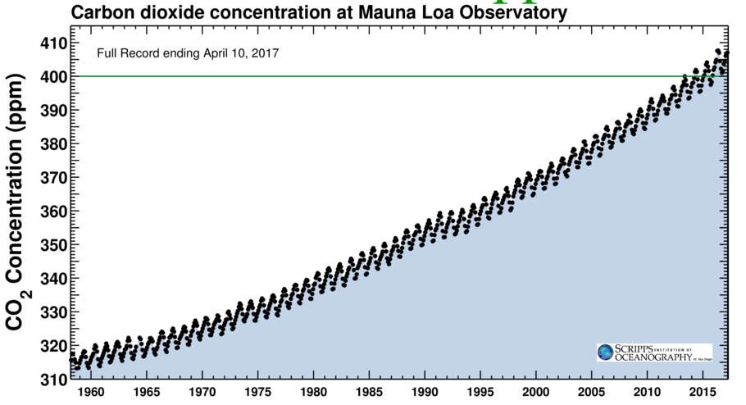
Changing atmospheric composition: CO₂
_{Mauna Loa, Hawaii}
Rate increasing
Data from Climate Monitoring and Diagnostics Lab., NOAA. Data prior to 1974 from C. Keeling, Scripps Inst. Oceanogr.

Slide 7
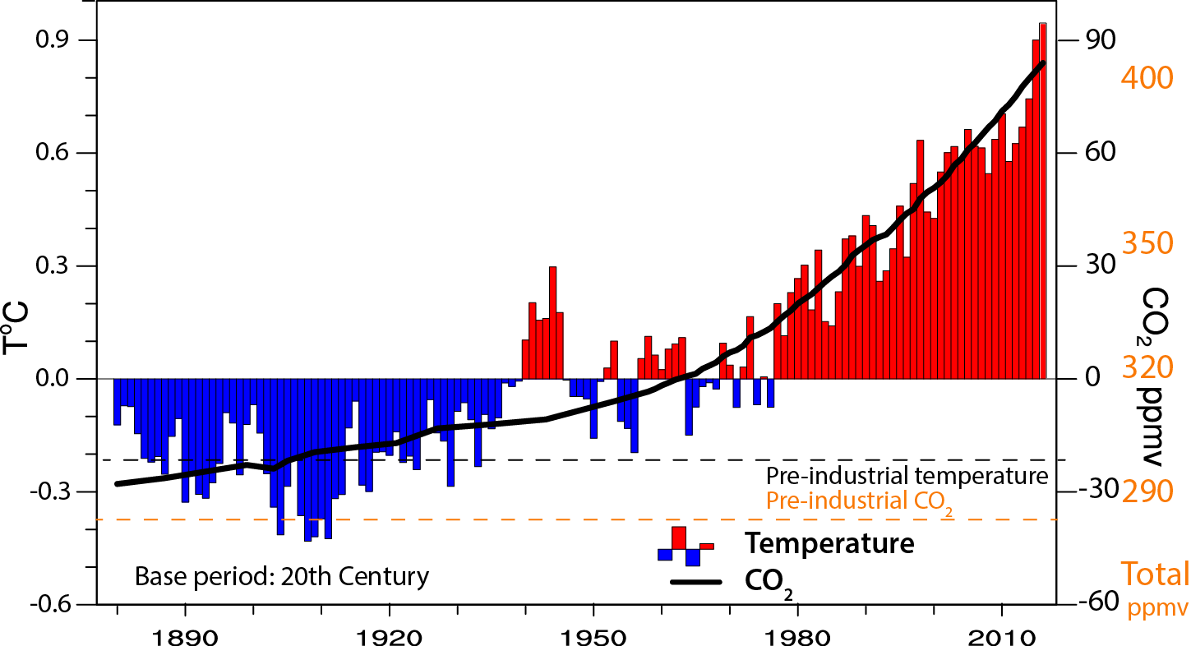
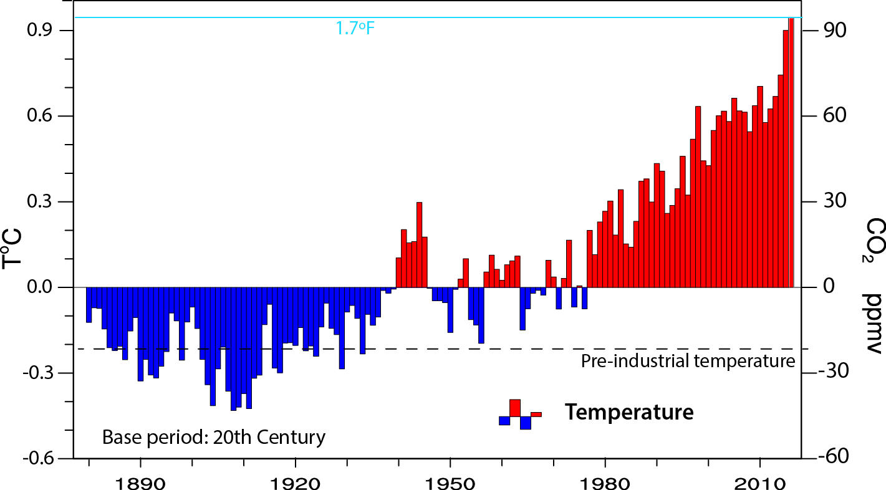

Global temperature and carbon dioxide: anomalies through 2016
Sept 2015-Aug 2016: warmest
12 months on record
1°F-
-1°F-
Base period 1900-99; data from NOAA

Slide 8
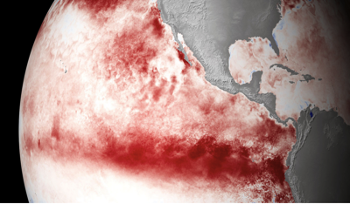
The 2015-16 El Niño event

Slide 9
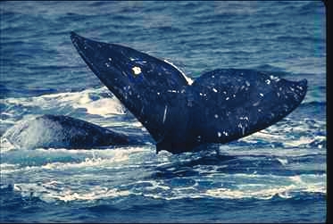
Peak El Niño occurs about Christmas season ...
“Christ Child”
“The Boy”
“The Little One”
Cf: La Niña
“The Girl”

Slide 10
What is El Niño?
El Niño: Warming of sea surface waters in the central and eastern tropical Pacific Ocean.
El Niño: the ocean part:
La Niña: is the cold ocean phase:
Cool sea temperatures in tropical Pacific
EN events occur about every 3-7 years
Arise from ocean-atmosphere interactions in tropical Pacific

Slide 11
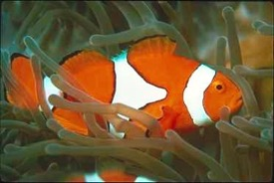
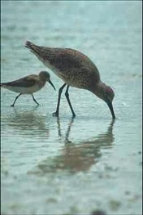

Changes affect the whole Food Chain

Slide 12
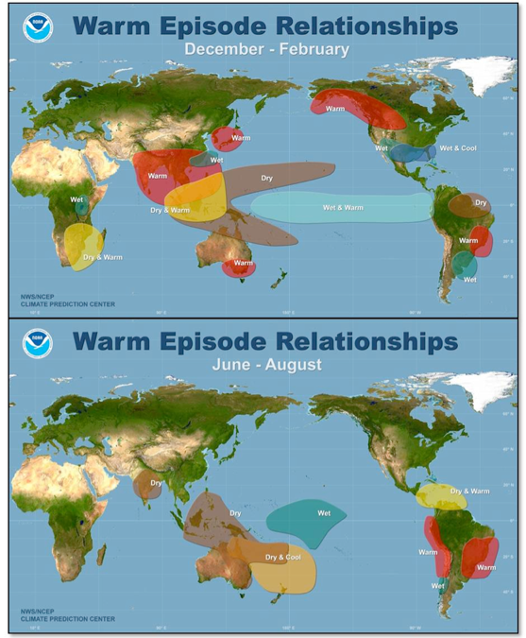
The biggest source of drought and floods around the world is El Niño
During El Nino, drought besets: Australia, Indonesia, India, the Philippines, Brazil, parts of east and south Africa, the western Pacific basin islands (incl. Hawaii), Central America, and parts of the U.S.

Slide 13
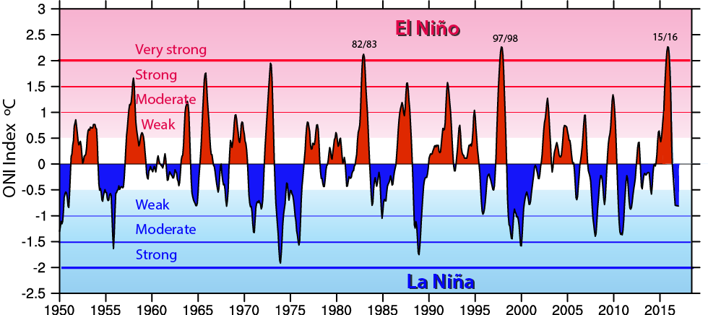
El Niño events since 1950
El Niños are red
La Niñas are blue
They follow in sequence
Every year or two

Slide 14
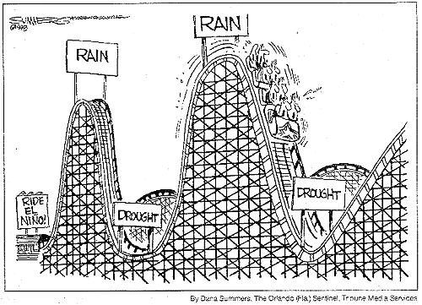
ENSO Cycles

Slide 15
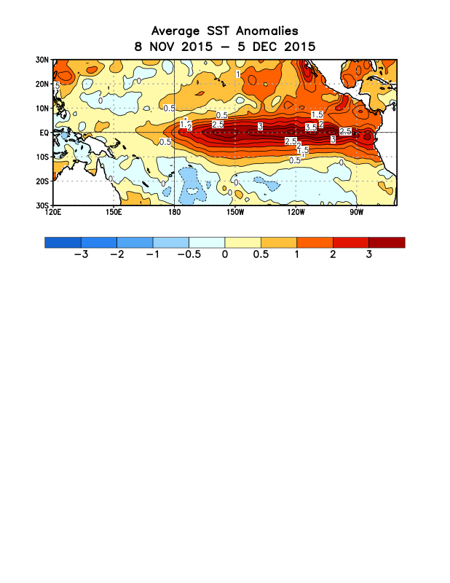
ᴼC
NOAA
3.5 ºC = 6.3ºF

Slide 16
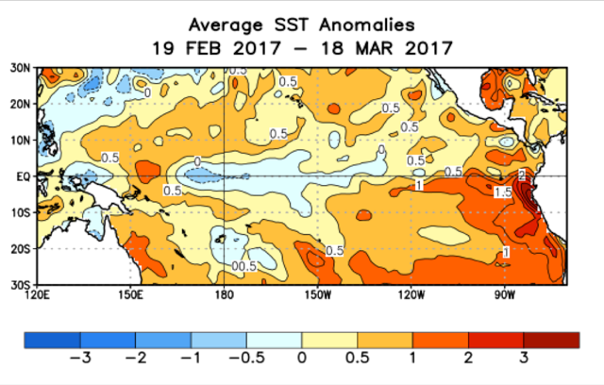
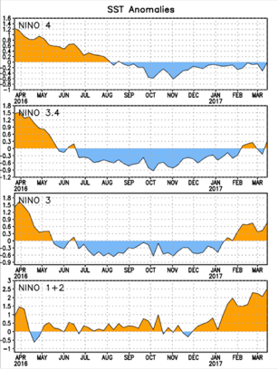
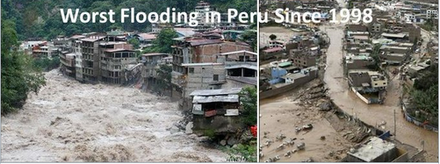
2017 El Niño?
Flooding in Chile and Peru in March 2017

Slide 17
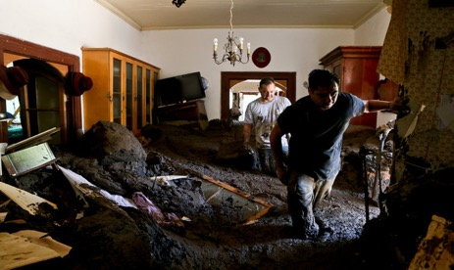
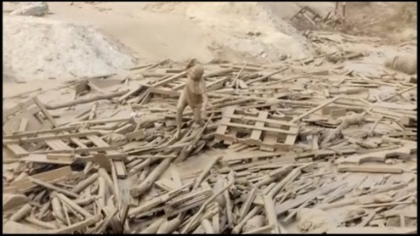
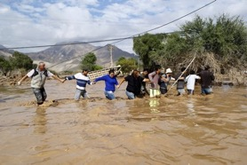







Chile: 27 Feb 2017 Peru: 19 March 2017
Colombia, 1-2 April, 2017
Notes:
https://youtu.be/7P00xhSYYpA

Slide 18

El Niño made me do it!

Slide 19
Global warming means more heat: Where does the heat go?
>90%
Warms land and atmosphere
Heat storage in the ocean (raises sea level)
Melts land ice (raises sea level)
Melts sea ice and warms melted water
Evaporates moisture ⇒ rain storms, cloud ⇒ possibly reflection of sun’s rays to space

Slide 20


Controlling Heat
Human body: sweats
Homes: Evaporative coolers (swamp coolers)
Planet Earth: Evaporation (if moisture available)
e.g., When sun comes out after showers,
the first thing that happens is that the puddles dry up:
before the temperature increases.

Slide 21



Evidence for reality of climate change
Glaciers melting
Muir Glacier, Alaska
1909
Toboggan
Glacier
Alaska
2000
1900 2003
Alpine glacier, Austria
Increased Glacier retreat since the early 1990s

Slide 22


Snow cover and Arctic sea ice are decreasing
5
Arctic sea ice
area decreased by 40% in summer
2012 lowest on record
Late August 2012

Slide 23

Ocean Heat Content

Slide 24


Sea Level Rise
3 inches

Slide 25


Warmer air holds more moisture
4% per °F
Global warming=
More heat
⇓
More drying
⇓
More evaporation
⇓
More moisture
More rain
More drought

Slide 26

Take a parcel of air:
When it rises
(for whatever reason),
it expands and cools,
and any moisture in it condenses
and forms a cloud,
and then it rains the moisture out.

Slide 27


Slide 28

Most precipitation comes from moisture convergence by weather systems
Low level winds bring in moisture from afar
More moisture means heavier rains

Slide 29

Mountains and climate change
Continental climate: strong seasons continue
Snow falls if temperature below about 35°F
Greatest amounts 28-32°F
“Too cold to snow”: freeze dried air
So more snow is a result of a warming climate
unless it is so warm it turns to rain.
Glaciers retreat: amplifies changes (snow feedback)
More snow in mid-winter
Snow melt sooner, runoff earlier: Less snowpack
Prospects for less water in summer
Greater risk of drought, heat waves, wild fires
Expansion of pests (Like bark beetle)
Imgpot.com

Slide 30

Senator James Inhofe stunt on snow and climate change in Senate
What about all the snow?
26 Feb 2015

Slide 31






Jonas: East coast snow storm Jan 22-23 2016

Slide 32

Northern Hemisphere snow cover extent
27 Jan 2015 NOAA

Slide 33


US 48 contiguous States
Temperature: annual
Precipitation:
Annual
Thru 2016
Temp
Precip
Much wetter
2012:
V hot and dry
1930s:
Hot and dry
“Dust Bowl”

Slide 34


1981-2015 vs 1901-60
Or 1925-1960 Alaska
% diff in top 20% of daily precipitation

Slide 35


Attribution of climate change
With climate models, scientists can play “God”.
We can run models with and without human influences and see what the difference is.
Global surface temperature
IPCC 2013

Slide 36


Changes in extremes
Matter most for society and human health
With a warming climate:
More high temperatures, heat waves
Wild fires and other consequences
Fewer cold extremes.
More extremes in hydrological cycle:
More intense precipitation
Longer dry spells
Increased risk of flooding and drought
More intense storms, hurricanes, tornadoes
Major challenges for a water manager

Slide 37


Extremes matter
Extremes may or may not be rare
They often break records: values outside of previous experience
Things break (thresholds crossed)
High impact events, high costs, loss of life and limb.
The straw that breaks the camel’s back

Slide 38
Some recent extremes

Slide 39

U.S. Temperatures: 2012 Hottest year on record
362 all time record Highs; 3,527 monthly weather records
0 record lows

Slide 40




Colorado on Fire: June 2012
Flagstaff fire: above NCAR, circled.
High Park fire 259 houses, 1 death
Waldo Canyon fire
346 homes…

Slide 41

Boulder Flooding September 2013

Slide 42





Slide 43

Composite satellite imagery

Slide 44

15 Sept 2013
Very high SSTs, 30°C
123 lives lost, >4.2B$

Slide 45
2015-16 events
What have we seen from the combination of El Niño and climate change?

Slide 46






Fort McMurray, Alberta CA May 2016 Following 8 month long drought Drought in South Africa Jan 2016 worst on record
Wildfires galore: summer 2015 Western US Alaska, Canada, Washington, Oregon, California Widespread drought in Indonesia wildfires in Borneo, Oct 2015
California, April
Borneo
Fort McMurray
NSW
S Africa
Africa
Record heat with wildfires 10-12 February 2017 New South Wales, Australia 87 wild fires Whole State 44.0°C (111.2°F) White Cliffs: Minimum T 34.2°C (93.6°F)
Notes:
http://www.washingtonpost.com/blogs/capital-weather-gang/wp/2015/08/10/central-and-eastern-europe-simmering-in-historic-heat-wave/
http://thinkprogress.org/climate/2015/08/10/3689813/heat-wave-middle-east/
The Rocky Fire burning about 200 miles northeast of San Francisco grew on Tuesday to 69,600 acres, and was 20% contained as of Wednesday morning.

Slide 47








Floods all around the world South Carolina, Oct 2015 Chennai, India, Nov-Dec 2015 Missouri, Nov-Dec 2015 Ascunción, Paraguay Dec 2015 Houston, April 2016 Louisiana, Aug. 2016 California, J-F 2017 ENSO related as to where. Global warming to amounts
S Carolina
Chennai
Missouri
Paraguay
Houston
Louisiana
Notes:
http://www.washingtonpost.com/blogs/capital-weather-gang/wp/2015/08/10/central-and-eastern-europe-simmering-in-historic-heat-wave/
http://thinkprogress.org/climate/2015/08/10/3689813/heat-wave-middle-east/
The Rocky Fire burning about 200 miles northeast of San Francisco grew on Tuesday to 69,600 acres, and was 20% contained as of Wednesday morning.

Slide 48









Summer 2015: Hurricanes galore: El Niño + global warming
and
2016
Philippines, China,
Taiwan,
Japan, …
Cyclone Winston: Fiji
21-22 February 2016
Haiti
Hurricane Matthew
Haiti, Carolinas October 2016
Goni, Atsani 25 Aug
N Carolina
Widespread flooding in Japan
(Sept 10): TS Etau, Joso,
Notes:
http://mashable.com/2015/10/22/hurricanes-typhoons-2015-photos/#73Tz3EqPFmqM

Slide 49



Louisiana flooding: mid August 2016
More than 100,000 ask for Federal aid. 60K houses damaged.
>31 inches rain in some spots.
Worst since Sandy.

Slide 50

Hurricane Matthew, October 2016

Slide 51

Haiti, Before and after

Slide 52

SSTs
Also 1981-2010 is 1° F above pre-1970 normal

Slide 53

Record high total column water vapor
Charleston SC Oct 8: 74 mm (2.93”)
Jacksonville FL Oct 7: 72 mm (2.82”)
Oct 2016
Notes:
Oct 9 2016:
At least two sites had record amounts of precipitable water (the total amount of liquid water that would cover the ground over a given location if all the moisture in a column of air above was condensed). These readings are taken with radiosonde soundings (balloon-borne instrument packages) that have been conducted regularly since 1948. Jacksonville, FL: 2.85” at 8 pm EDT Friday Previous record: 2.82” on July 20, 1983 72 mm Charleston, SC: 2.93” at 2 am EDT Saturday (special sounding) 74.4 mm Previous record: 2.70” on August 15, 2010 October record (and 3rd highest in any month]: Newport/Cape Hatteras, NC: 2.85” at 8 pm EDT Saturday

Slide 54




Hurricane Matthew, October 2016
Florida, North/South Carolina
Nichols, S Carolina
Flagler Beach, FL
Kinston, N Carolina
Lumberton, NC

Slide 55


Rainfall from Matthew
Oct 6-8 2016
Kinston, N Carolina
Lumberton, NC

Slide 56

U.S. billion $ disasters: last 20 years
$42B per year
Notes:
http://finance.yahoo.com/news/louisianas-flooding-cost-lot-000000791.html

Slide 57
El Niño’s occur naturally:
With better understanding of El Niño we can predict the risks and facilitate planning, and turn it to our advantage.
Global climate change is human made:
We need to act to slow the rates of change
and plan for the consequences.

Slide 58
We have many facts and physical understanding.
The facts are not enough…
The role of scientists is to lay out the facts and the prospects and consequences,
but the decision on what to do is not ours:
that involves everyone and politics.

Slide 59

Risky Business!
A report; “Risky Business: The Economic Risks of Climate Change in the United States”
co-chaired by Henry Paulson and Michael Bloomberg
July 2014 riskybusiness.org
“…taking a caution approach, waiting for more information, a business-as-usual approach, is actually radical risk taking.” (Paulson)
“…if we act now the U.S. can still avoid most of the worst impacts and significantly reduce the odds of costly climate outcomes – but only if we start changing our business and public policy practices today.”

Slide 60

Risky Business!
“The longer we wait to adapt to and mitigate climate change, the more devastating the economic impacts will be.” (Bloomberg)
e.g. between $66 and $106 billion of existing coastal property in the US will be below sea level by 2050.

Slide 61

Pope’s encyclical on climate change: Laudato Si’,” or “Praise Be to You”
“Climate change is a global problem with grave implications: environmental, social, economic, political and for the distribution of goods. It represents one of the principal challenges facing humanity in our day.”
Critique of consumerism; irresponsible development
Plea for swift and unified global action
Most vulnerable are the poorest peoples
Critical of those who deny climate change
To love God, you have to love and care for the rest of creation
Call to action
All is not lost
Jun 18, 2015
Notes:
“…to love God, you have to love your fellow human beings, and you have to love and care for the rest of creation,” Vincent Miller, who holds a chair in Catholic theology and culture at the University of Dayton, a Catholic college in Ohio. NY Times Jun 18 2015

Slide 62
We need a price on carbon emissions!
As we have seen, there are major costs: $billions, to climate change via droughts and wildfires, and floods. [Lives lost, crop loss, crop insurance, wild fire losses, costs of fighting fires, property damage, dislocation, disease, etc]
The costs are not borne by those who cause the problem.
Explicit and implicit subsidies for fossil fuels do not make the playing field level for renewable energy.
The U.S. is a major part of the problem.

Slide 63

Centers of Action?
UN efforts toward agreement in Paris (Dec 2015)
UNFCCC Conference of the Parties
Kyoto Protocol 1997-2012
December binding agreements?
Developing countries
Obligations
Financial aid
Enforcement
Global targets

Slide 64


Centers of Action?
Congress
Rejected Kyoto
Keystone pipeline
Carbon tax -no
Gas tax -no
Energy efficiency and infrastructure?
Wind tax credit renewal?
Solar tax credit extension?
EPA and the Federal Courts
The States and Regions

Slide 65




Centers of Action?
EPA and the Federal Courts
Clean Power Plan: by 2030 clean power
32% lower emissions relative to 2005
Endangerment finding upheld
Plan released Aug 3, 2015
Proposal June 2014
3.8 million comments
Court review
Implemented by the States
Carbon targets for each
Building blocks, flexibility
More efficient coal plants
Effective use of gas plants
Renewables, nuclear
Efficiency
Leadership in some States
And some cities
In Jeopardy!
Notes:
The Clean Energy Incentive Program (CEIP) will reward states that make early investments in renewable energy and energy efficiency measures to comply with the rule in 2020 and 2021.
This is a big deal: the CEIP will encourage the widespread development and use of wind, solar, and other zero-carbon sources of power, which are essential to long-term clean energy and climate strategies.
Think of the CEIP as a matching-fund program that states can voluntarily use to incentivize early investment in renewables as well as energy efficiency projects in low-income communities.
The plan is flexible – reflecting the different needs of different states.
• The plan will put Americans to work making the US electricity system less dirty and our homes and businesses more efficient. In fact, the Clean Power Plan is projected to reduce individuals’ electric bills by about $7 per month by 2030.
• It will keep the US – and our businesses – at the forefront of a global movement to produce and consume energy in a better, more sustainable way.

Slide 66


Dec 12, 2016
Ratified Oct 2016
Went into effect Nov 4, 2016
Will everyone follow through?

Slide 67










Many things you can do:
Use energy efficient light bulbs
Walk, bicycle
Drive less, and drive fuel efficient vehicles
Do not over-heat or over-cool:
Set thermostat to 76°F in summer
Set to 66°F in winter
Wear a sweater
Insulate your house etc:
Use biofuels (?)
Use a clothesline
Vote!

Slide 68




Many things you can do:
My house:
Solar panels
Use renewable energy
Reduce coal fired power (unless carbon capture and storage employed)

Slide 69







20 September 2014: New York City. Some 400,000 marched for climate justice.
March for science
April 22, 2017
March for climate
April 29, 2017
Photos: Gary Braasch

Slide 70

April 22, 2017
Denver

Slide 71


Slide 72

Contact information
The hottest year on record signals that global warming is alive and well, The Conversation, January 20, 2016.
https://theconversation.com/the-hottest-year-on-record-signals-that-global-warming-is-alive-and-well-53480
Yes, we can do 'sound' climate science even though it's projecting the future, The Conversation. US Edition, 5 April 2017 http://theconversation.com/yes-we-can-do-sound-climate-science-even-though-its-projecting-the-future-75763
Kevin Trenberth
Distinguished Senior Scientist
Phone: 303.497.1318
Email: trenbert@ucar.edu
http://www.cgd.ucar.edu/staff/trenbert/

