Slide 1
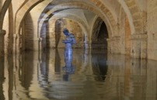
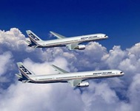
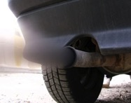
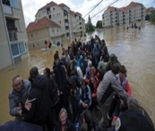
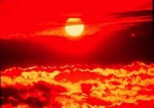
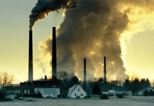
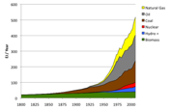
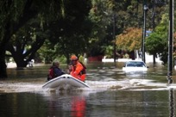
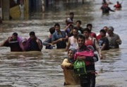
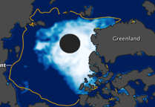
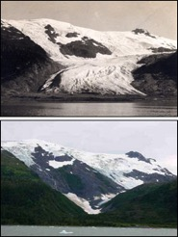
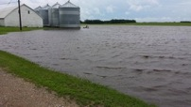
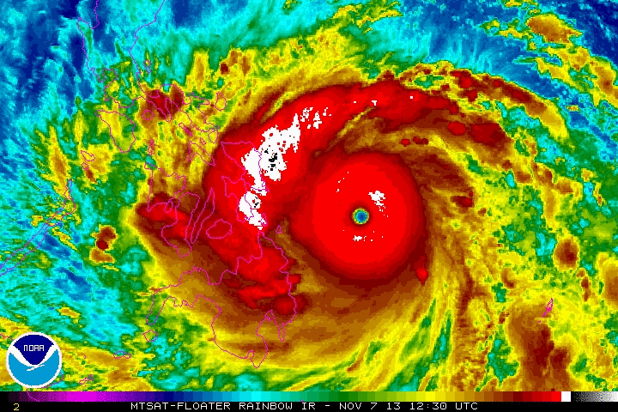
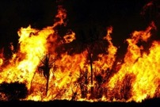
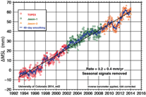
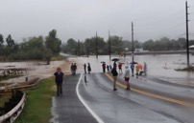
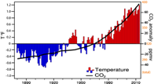
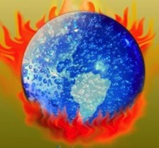
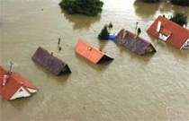
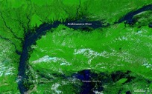
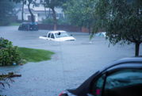
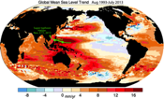
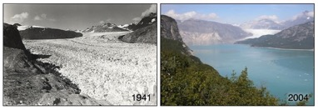
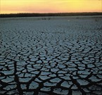
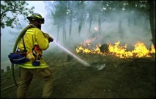
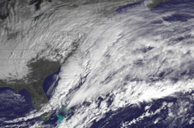
Fifty shades of climate change
Climate disruption in the U.S.?
Kevin E. Trenberth
NCAR
Fifty shades of

Slide 2
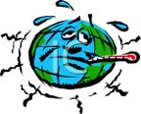
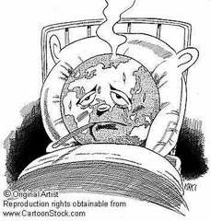
Running a fever:
Seeing the doctor
Symptoms: the planet’s temperature and carbon dioxide are increasing
Diagnosis: human activities are causal
Prognosis: the outlook is for more warming at rates that can be disruptive and will cause strife
Treatment: mitigation (reduce emissions) and adaptation (planning for consequences)

Slide 3
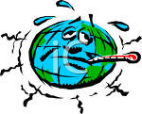
First rule of management
“You can’t manage what you can’t measure”
“You are entitled to your own opinion but not your own facts.”
Patrick Daniel Moynahan

Slide 4
We have many facts and physical understanding.
The facts are not enough…
The role of scientists is to lay out the facts and the prospects and consequences,
but the decision on what to do is not ours:
that involves everyone and politics.

Slide 5
Climate change is happening:
It is due to humans
97% of scientists agree.
The data are of mixed quality and length, but together tell a compelling story leaving no doubt about the human role in climate change.
What we do about this problem involves value systems and politics!

Slide 6



What Is Causing Warming?
Emissions of carbon dioxide pollution

Slide 7

World Primary Energy Supply: 1800 – 2008
Fossil
fuels
Hydro + :means hydropower plus other renewables other than biomass.
Sources: Grubler (2008) - Energy Transitions, BP (2009) – Statistical Review of World Energy, EIA (2009) – International Energy Annual

Slide 8
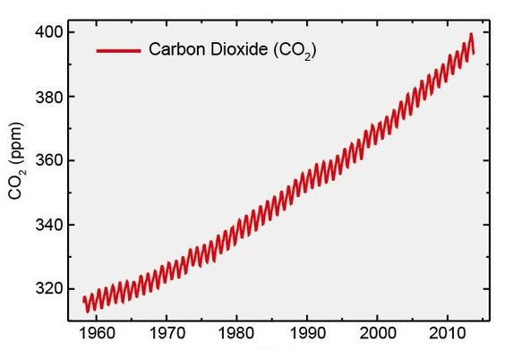
Changing atmospheric composition: CO₂
_{Mauna Loa, Hawaii}
Rate increasing
Data from Climate Monitoring and Diagnostics Lab., NOAA. Data prior to 1974 from C. Keeling, Scripps Inst. Oceanogr.

Slide 9
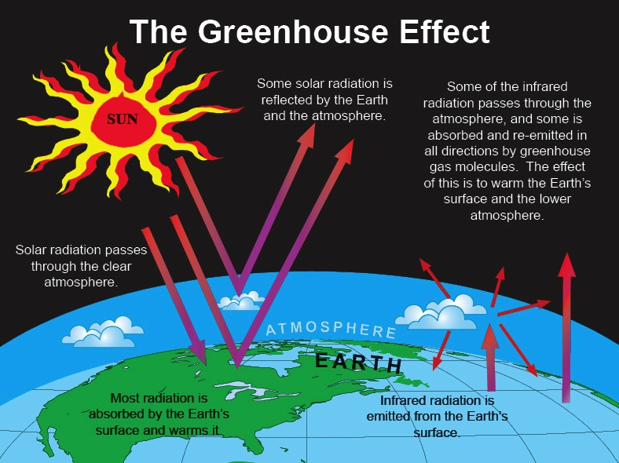

Slide 10
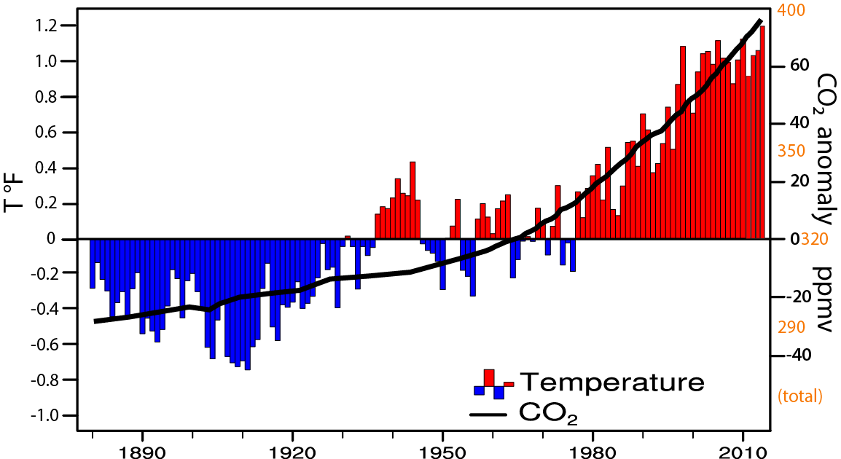
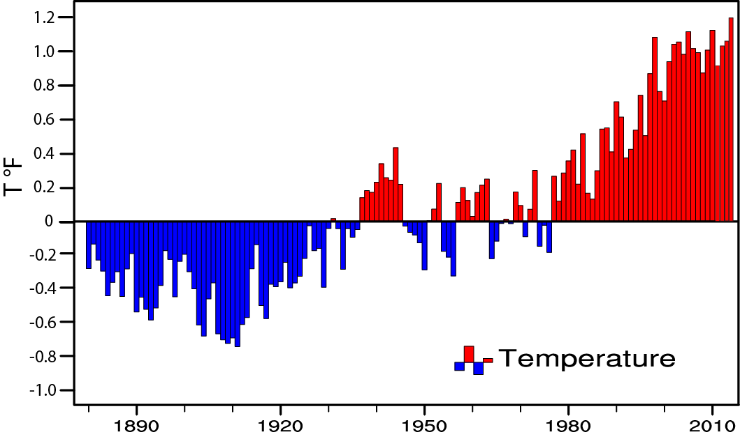
Global temperature and carbon dioxide: anomalies through 2014
Base period 1900-99; data from NOAA

Slide 11
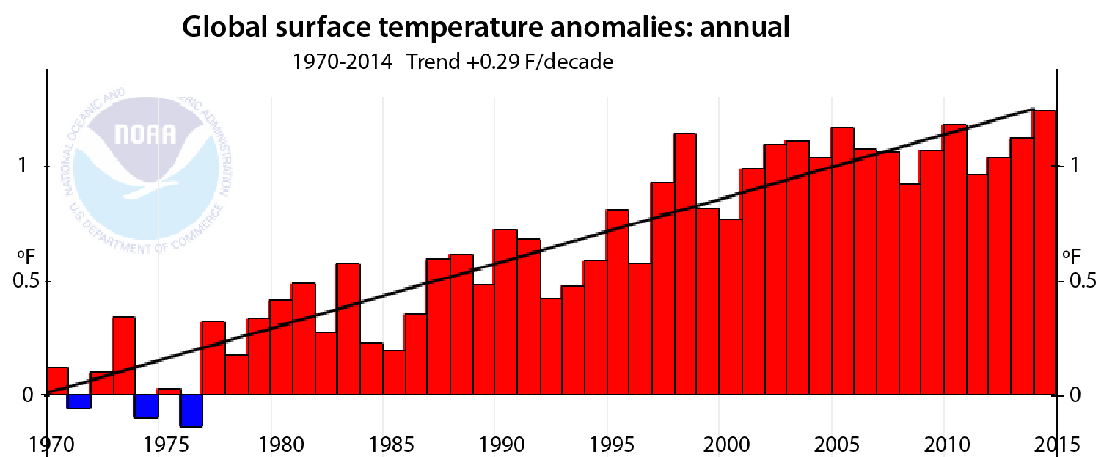
Global temperature and carbon dioxide: anomalies through 2014
Base period 1900-99; data from NOAA

Slide 12
Global warming means more heat:
Where does the heat go?
>90%
Warms land and atmosphere
Heat storage in the ocean (raises sea level)
Melts land ice (raises sea level)
Melts sea ice and warms melted water
Evaporates moisture ⇒ rain storms, cloud ⇒ possibly reflection of sun’s rays to space

Slide 13

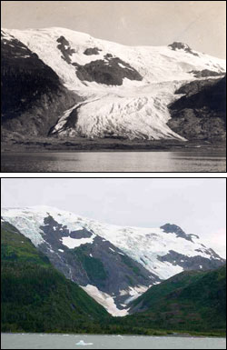
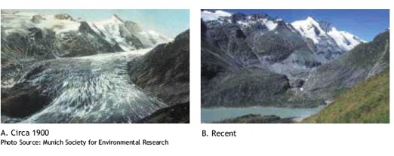
Evidence for reality of climate change
Glaciers melting
Muir Glacier, Alaska
1909
Toboggan
Glacier
Alaska
2000
1900 2003
Alpine glacier, Austria
Increased Glacier retreat since the early 1990s

Slide 14
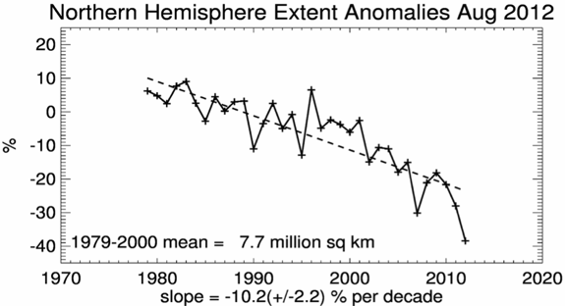
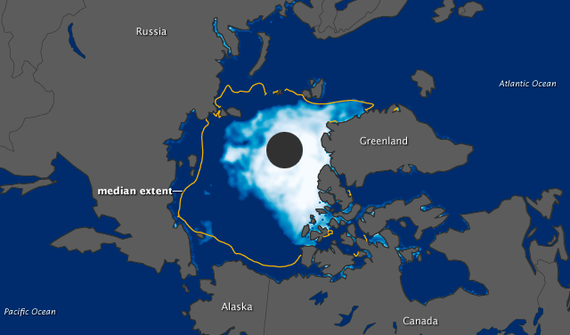
Snow cover and Arctic sea ice are decreasing
4
Arctic sea ice
area decreased by 40% in summer
2012 lowest on record
Late August 2012

Slide 15
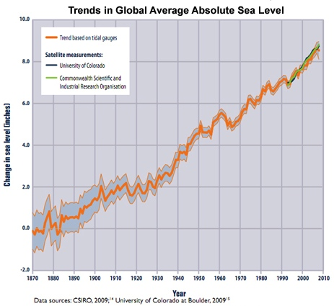
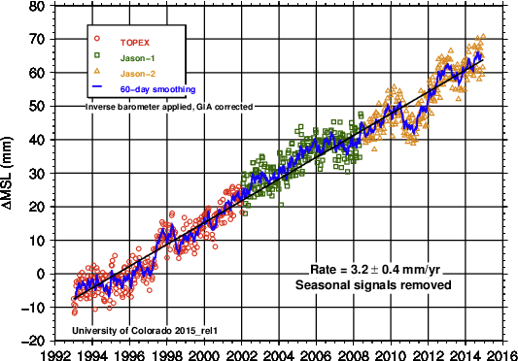
Sea Level Rise

Slide 16
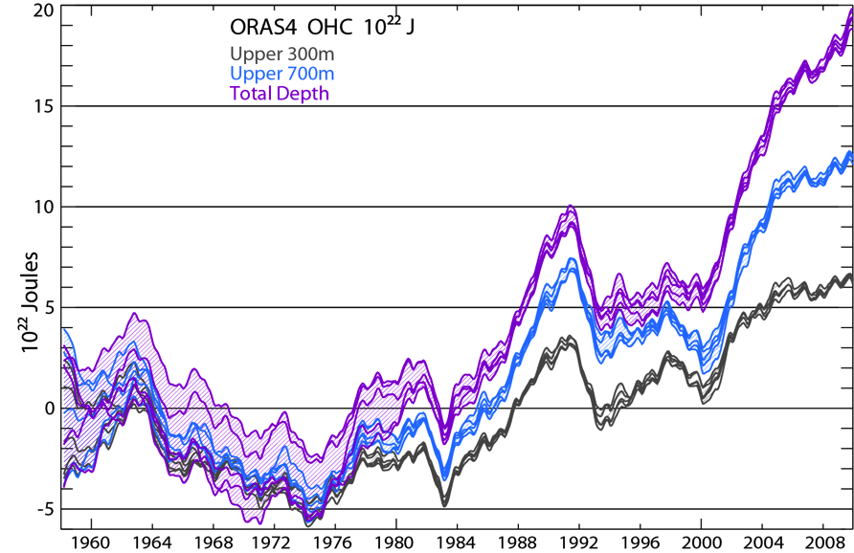
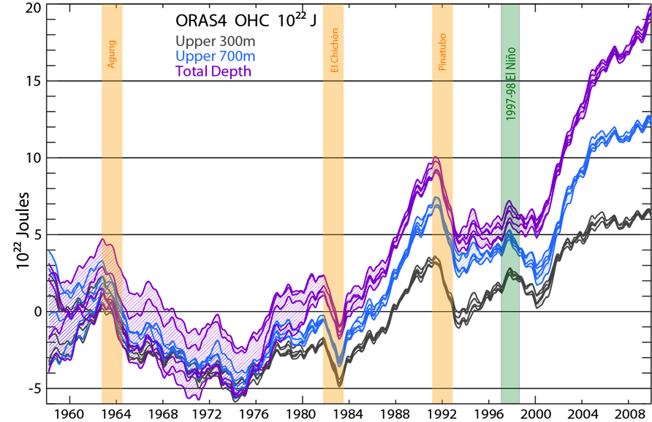
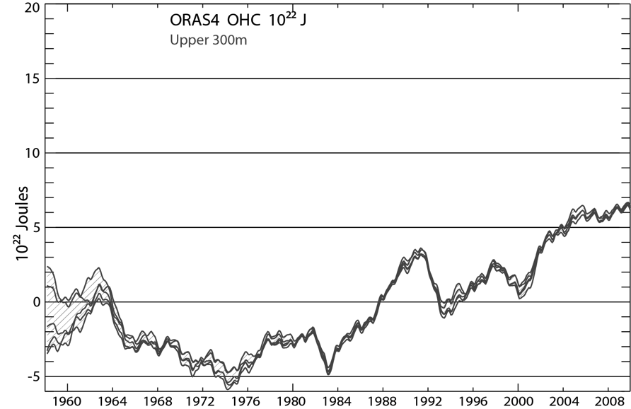
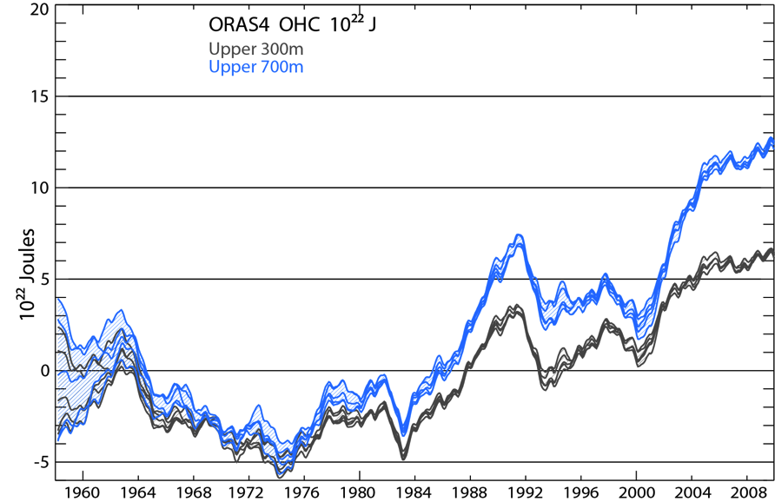
Global Ocean Heat Content
Amount of heat
Balmaseda, Trenberth and Källén 2013

Slide 17

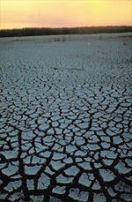
Controlling Heat
Human body: sweats
Homes: Evaporative coolers (swamp coolers)
Planet Earth: Evaporation (if moisture available)
e.g., When sun comes out after showers,
the first thing that happens is that the puddles dry up: before temperature increases.

Slide 18
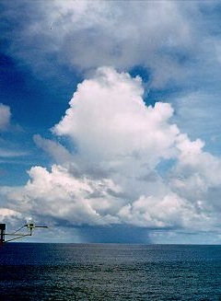
Why does it rain?

Slide 19

Warmer air holds more moisture
4% per °F
=7% per °C
- As long as moisture is available

Slide 20
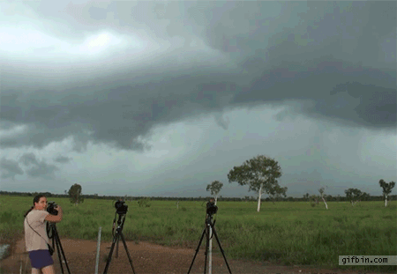
Take a parcel of air:
When it rises
(for whatever reason),
it expands and cools,
and any moisture in it condenses
and forms a cloud,
and then it rains the moisture out.

Slide 21
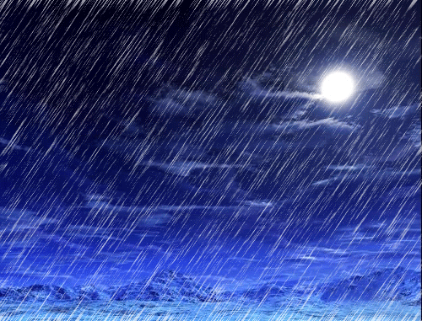

Slide 22

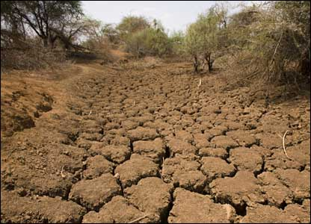
Warmer air holds more moisture
4% per °F
Global warming=
More heat
⇓
More drying
⇓
More evaporation
⇓
More moisture
More rain
More drought

Slide 23
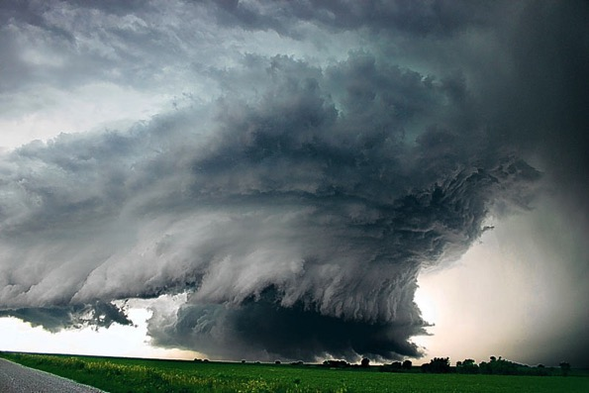
Most precipitation comes from moisture convergence by weather systems
Low level winds bring in moisture from afar
More moisture means heavier rains

Slide 24

Senator James Inhofe stunt on snow and climate change in Senate
What about all this snow?
26 Feb 2015

Slide 25

Winter storms and climate change
Snow falls if temperature below about 35°F
Greatest amounts 28-32°F
“Too cold to snow”: freeze dried air
So more snow is a result of a warming climate unless it is so warm it turns to rain.
More snow in mid-winter
Shorter snow season (each end more rain)
Snow melt sooner, runoff earlier
Less snowpack by late spring
27 Jan 2015 NOAA

Slide 26

Northern Hemisphere snow cover extent
27 Jan 2015 NOAA

Slide 27


US 48 contiguous States
Temperature: annual
Precipitation:
Annual
Thru 2014
Temp
Precip
Much wetter
2012:
V hot and dry
1930s:
Hot and dry

Slide 28


Attribution of climate change
With climate models, scientists can play “God”.
We can run models with and without human influences and see what the difference is.
Global surface temperatures
IPCC 2013

Slide 29


Changes in extremes
Matter most for society and human health
With a warming climate:
  More high temperatures, heat waves
  Wild fires and other consequences
  Fewer cold extremes.
More extremes in hydrological cycle:
  More intense precipitation
  Longer dry spells
  Increased risk of flooding and drought
  More intense storms, hurricanes, tornadoes
Major challenges for a water manager

Slide 30
Some recent extremes

Slide 31

U.S. Temperatures: 2012 Hottest year on record
362 all time record Highs; 3,527 monthly weather records
0 record lows

Slide 32




Colorado on Fire: June 2012
Flagstaff fire: above NCAR, circled.
High Park fire 259 houses, 1 death
Waldo Canyon fire
346 homes…

Slide 33




Super Storm Sandy: Oct 29-31, 2012.
Well predicted a week in advance (by ECMWF)
Hybrid storm:
Over $70B damages
>110 lives lost

Slide 34






2013: heat
Oz bushfires and heat: January
CO drought, wildfires and heat: June
CA wildfires and heat: Aug
CA drought: 2013 driest on record
⬇
2014
CA wildfires
WA wildfires

Slide 35






2013: Flooding
Buenos Aires, Argentina: April
Elbe: Germany June
Haiyan:
Philippines, Nov
Calgary, Alberta, Canada; June
India, June
Boulder CO: September

Slide 36









2014: Flooding
Southern England Jan-Feb
Christchurch, New Zealand March-April
India-Pakistan
September
Midwest: April
Balkans, May
East Coast: Islip NY, August

Slide 37




2015: Flooding
Cyclone Pam
Vanuatu March 2015

Slide 38
Science knowledge is going in one direction and politician views are going in another!
Many reports deal with the facts and the science of climate change. A new one by AAAS “scientists agree that humans are the primary cause of climate change”. There are many other reports, such as from the IPCC.
Of 10,855 climate studies published in peer-reviewed literature in 2013 only 2 rejected anthropogenic climate change. [James Lawrence Powell 2014]
ThinkProgress.org
160 members of the 113th Congress have taken $58.8 million from fossil fuel industry
56% (>130 members) of the previous Republican caucus in the House of Representatives deny the basic tenets of climate science. 66% (30 members) of the Senate Republican caucus also deny the reality of climate change.
Notes:
http://thinkprogress.org/climate/2013/06/26/2202141/anti-science-climate-denier-caucus-113th-congress-edition/

Slide 39
Tragedy of the Commons
Everyone for themselves!
The atmosphere is a global commons (and dumping ground).
Solution requires people of the world to work together.
We are together on “spaceship Earth”.
To many people, that may suggest altruism:
Sharing the money, well-being and profits so carefully accrued to help other people.
Our society is founded on the premise of cheap and easily available fossil fuels that do not take into account the external costs of using those fossil fuels:
Need a principle of User Pays.

Slide 40

“It is profitable to let the world go to hell”
Jørgen Randers
Professor of climate strategy at the Norwegian Business School
Jan 2015

Slide 41

Risky Business!
A recent report; “Risky Business: The Economic Risks of Climate Change in the United States”
co-chaired by Henry Paulson and Michael Bloomberg
July 2014 riskybusiness.org
“…taking a caution approach, waiting for more information, a business-as-usual approach, is actually radical risk taking.” (Paulson)
“…if we act now the U.S. can still avoid most of the worst impacts and significantly reduce the odds of costly climate outcomes – but only if we start changing our business and public policy practices today.”

Slide 42

Risky Business!
“The longer we wait to adapt to and mitigate climate change, the more devastating the economic impacts will be.” (Bloomberg)
e.g. between $66 and $106 billion of existing coastal property in the US will be below sea level by 2050.

Slide 43

Pope on Climate Change:
“Man Has Slapped Nature in the Face”
"I think we have exploited nature too much,"
Francis said, citing deforestation and monoculture.
"Thanks be to God that today there are voices, so many people who are speaking out about it."
Jan 15, 2015; A.P.

Slide 44

Obama mocks Republican stance on climate science
State of Union Address, 20 Jan 2015
Rep. Joe Barton (R-Texas), a former chairman of the House Energy and Commerce Committee, said “man-made climate change runs counter to Judeo-Christian theology.”
"An inconvenient truth, so to speak, is the simple fact that for the last 17 years, there has been no recorded increase in temperatures," Sen. Ted Cruz (R-Texas) said.

Slide 45
We need a price on carbon emissions!
As we have seen, there are major costs: $billions, to climate change via droughts and wildfires, and floods. [Lives lost, crop loss, crop insurance, wild fire losses, costs of fighting fires, property damage, dislocation, disease, etc]
The costs are not borne by those who cause the problem.
Explicit and implicit subsidies for fossil fuels do not make the playing field level for renewable energy.
The U.S. is a major part of the problem.

Slide 46
Social cost of carbon emissions
Drew Shindell has developed a metric called the "Social Cost of Atmospheric Release.” [Clim. Ch 2015]
The author calculated "climate damages" based on the relevant greenhouse gas emissions and their effect on climate change and regional health.
Accounting for all hidden environmental costs:
a gallon of gas would cost $6.25 (+$3.80),
a kilowatt hour of coal-fired energy increases 300% (from 10 to 40 cents),
gas-fired power would rise from 7 cents to 17 cents.
Overall, the total annual price tag of transportation, electricity, and industrial combustion is estimated at $330-970 billion.

Slide 47

Centers of Action?
UN efforts toward agreement in Paris
  UNFCCC Conference of the Parties
  Kyoto Protocol 1997-2012
  December binding agreements?
Developing countries
  Obligations
  Financial aid
  Enforcement
  Global targets

Slide 48


Centers of Action?
Congress
  Rejected Kyoto
  Keystone pipeline
  Carbon tax -no
  Gas tax -no
  Energy efficiency and infrastructure?
  Wind tax credit renewal? Unlikely
  Solar tax credit extension? Unlikely
  Hopes to derail EPA rules
EPA and the Federal Courts
The States and Regions

Slide 49


Centers of Action?
EPA and the Federal Courts
  Clean power plan: by 2030 clean power
  Endangerment finding upheld
  Proposal released June 2, 2014
  3.8 million comments
  Court review
Implemented by the States
  Carbon targets for each
  Building blocks, flexibility
  More efficient coal plants
  Effective use of gas plants
  Renewables, nuclear
  Efficiency
Leadership in some States
  And some cities

Slide 50









Many things you can do:
Use energy efficient light bulbs
Walk, bicycle
Drive less, and drive fuel efficient vehicles
Do not over-heat or over-cool:
Set thermostat to 76°F in summer
Set to 66°F in winter
Wear a sweater
Insulate your house etc:
Use biofuels (?)
Use a clothesline

Slide 51

Going Green

Slide 52


Many things you can do:
Use renewable energy
Reduce coal fired power (unless carbon capture and storage employed)

Slide 53



Many things you can do:
VOTE!
Vote for responsible candidates
Most important!

Slide 54







20 September 2014: New York City. Some 400,000 marched for climate justice.
Gary Braasch

