Slide 1
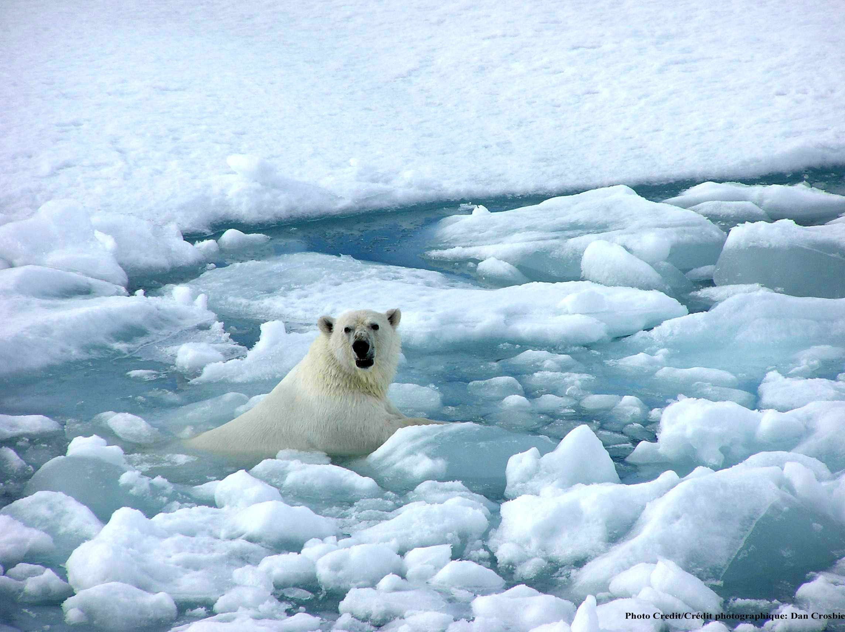
Climate Change:
Updated scientific assessment
Help!
Kevin E Trenberth
NCAR

Slide 2
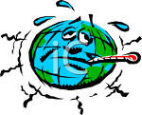
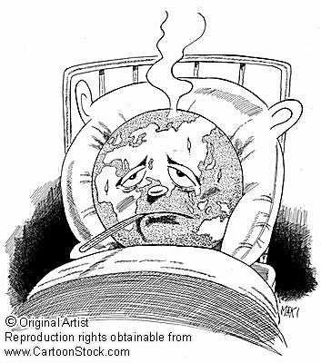
Running a fever:
Seeing the doctor
Symptoms: the planet’s temperature and carbon dioxide are increasing
Diagnosis: human activities are causal
Prognosis: the outlook is for more warming at rates that can be disruptive and will cause strife
Treatment: mitigation (reduce emissions) and adaptation (planning for consequences)

Slide 3
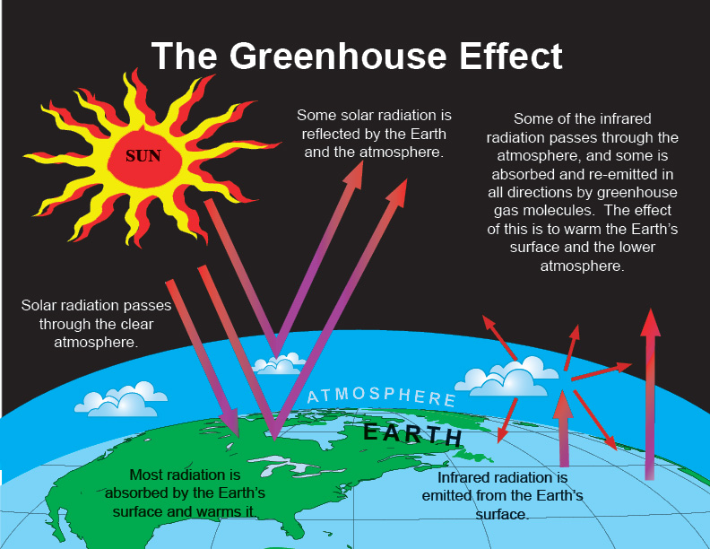

Slide 4
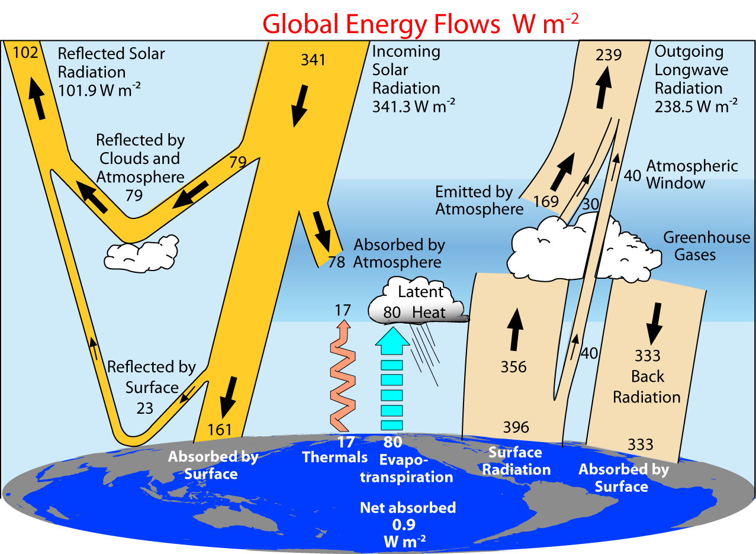
2000-2005 Trenberth et al 2009

Slide 5
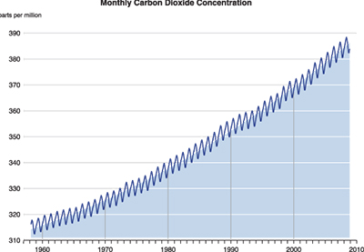
Changing atmospheric composition: CO₂
_{Mauna Loa, Hawaii}
ppm
390
380
370
360
350
340
330
320
310
Rate increasing
1960 1970 1980 1990 . 2000 2010
Data from Climate Monitoring and Diagnostics Lab., NOAA. Data prior to 1974 from C. Keeling, Scripps Inst. Oceanogr.

Slide 6
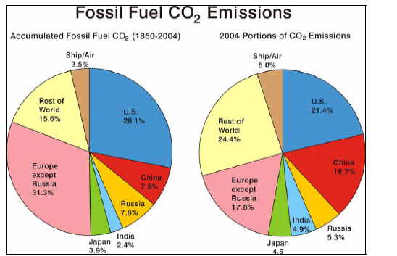

Slide 7
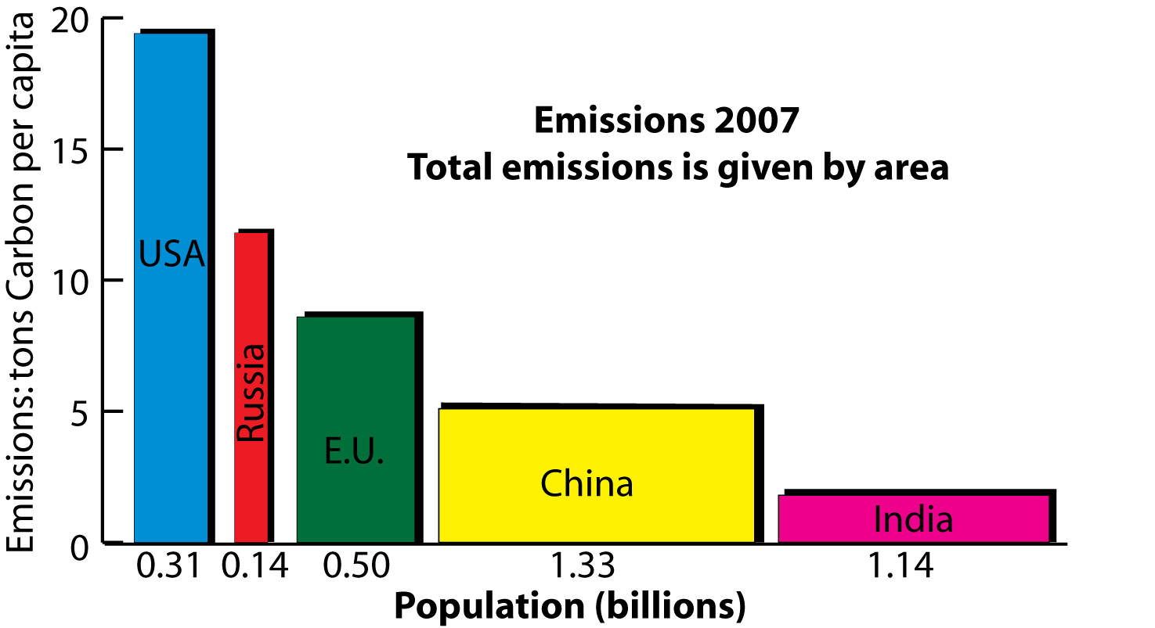
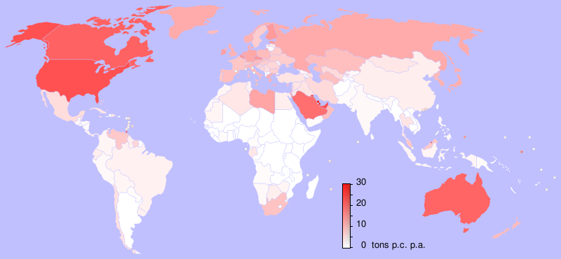
2007 emissions:
China biggest emitter (up 8% in 2007)
14% more than US
Per capita Pop.
  U.S.: 19.4 0.31
  Russia: 11.8 0.14
  E. U.: 8.6 0.50
  China: 5.1 1.33
  India: 1.8 1.14
  tons Billions
Netherlands Environmental
Assessment Agency 2008

Slide 8
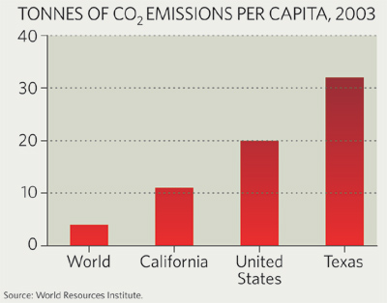

Slide 9
The Natural Greenhouse Effect: clear sky
CH₄
N₂0
6%
O₃
8%
Carbon
Dioxide
26%
Water
Vapor
60%
Clouds also have a greenhouse effect
Kiehl and Trenberth 1997

Slide 10
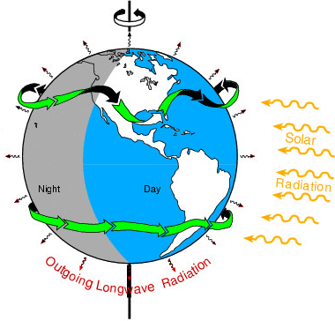
The incoming energy from the sun
is 341 W m⁻²: annual global mean:
It amounts to 175 PetaWatts
=175,000,000 billion Watts.
About 122 PW is absorbed.
The biggest power plants in existence
are 1000 MegaWatts and we normally think of units of
1 KiloWatt (= 1 bar heater), or a 100 W light bulb.
So the energy from the sun is 122 million of these power stations. It shows:
Direct human influences are tiny vs nature.
The main way human activities can affect climate is through interference with the natural flows of energy such as by changing the composition of the atmosphere

Slide 11
Changes in the sun
Solar irradiance from composite of several satellite-measured time series based on Frohlich & Lean (1998; http://www.pmodwrc.ch/pmod.php?topic=tsi/composite/SolarConstant)

Slide 12
The climate is changing
Global warming is “unequivocal”
to quote IPCC in 2007
Approved unanimously by 113 governments in Paris

Slide 13
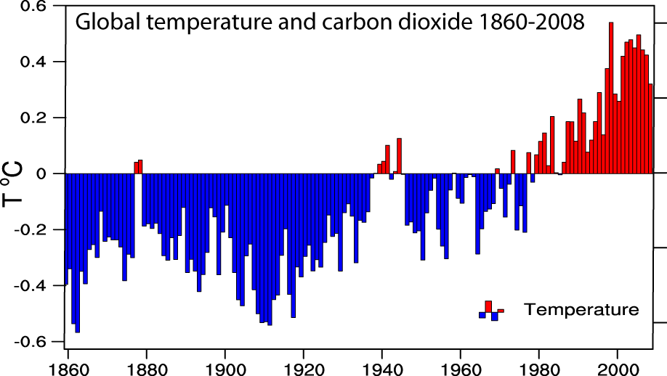
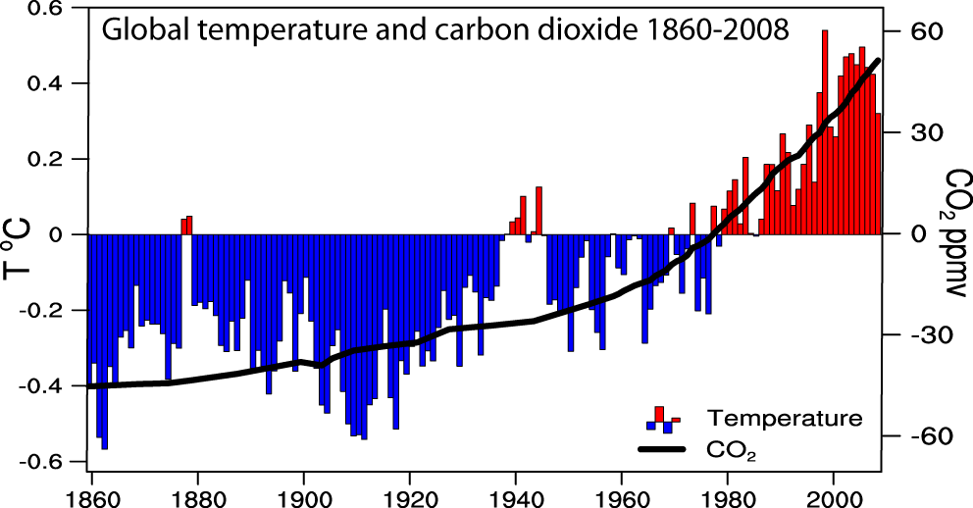
Global temperatures and carbon dioxide through 2008
Base period 1961-90

Slide 14

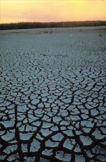
Controlling Heat
Human body: sweats
Homes: Evaporative coolers (swamp coolers)
Planet Earth: Evaporation (if moisture available)
e.g., When sun comes out after showers,
the first thing that happens is that the puddles dry up: before temperature increases.

Slide 15
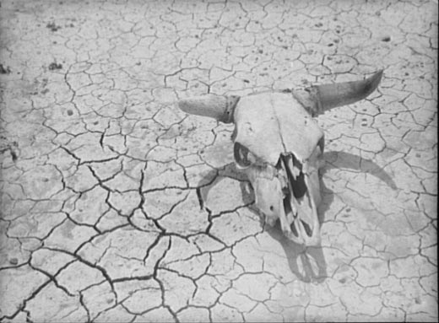
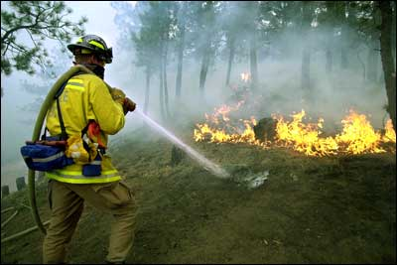
Declining Snow Pack in many mountain and continental areas contributes to drought
more precipitation falls as rain rather than snow, especially in the fall and spring.
snow melt occurs faster and sooner in the spring
snow pack is therefore less
soil moisture is less as summer arrives
the risk of drought increases substantially in summer
Along with wild fire

Slide 16
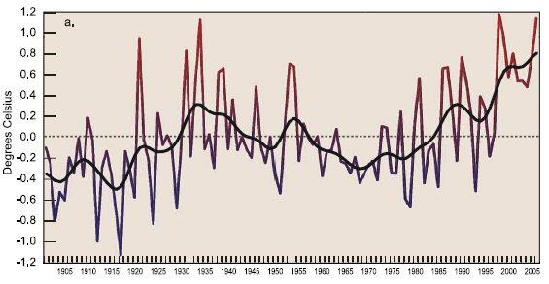
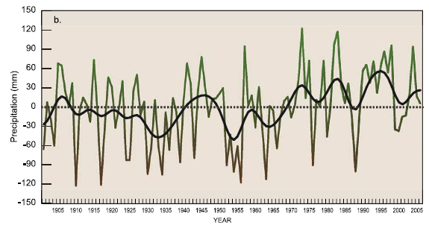
US changes
in
Temperature
Precipitation
Much wetter
1930s:
Hot and dry
Easterling et al 2007
GRL
1900 1950 2000

Slide 17
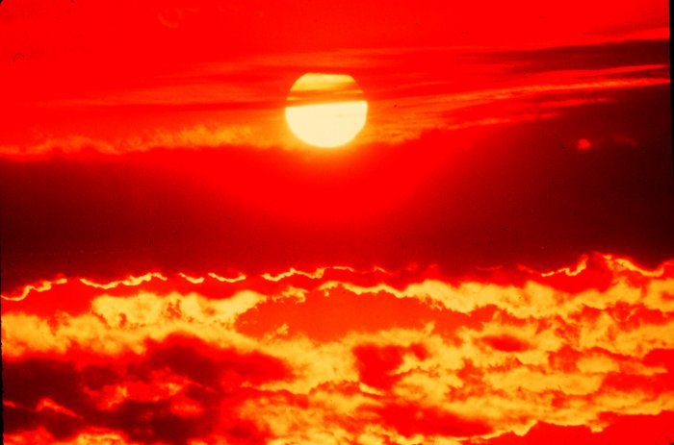
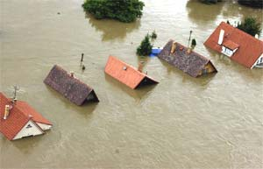
Climate change and extreme weather events
Changes in extremes matter most for society and human health
With a warming climate:
  More high temperatures, heat waves
  Wild fires and other consequences
  Fewer cold extremes.
More extremes in hydrological cycle:
  Drought
  Heavy rains, floods
  Intense storms, hurricanes, tornadoes

Slide 18
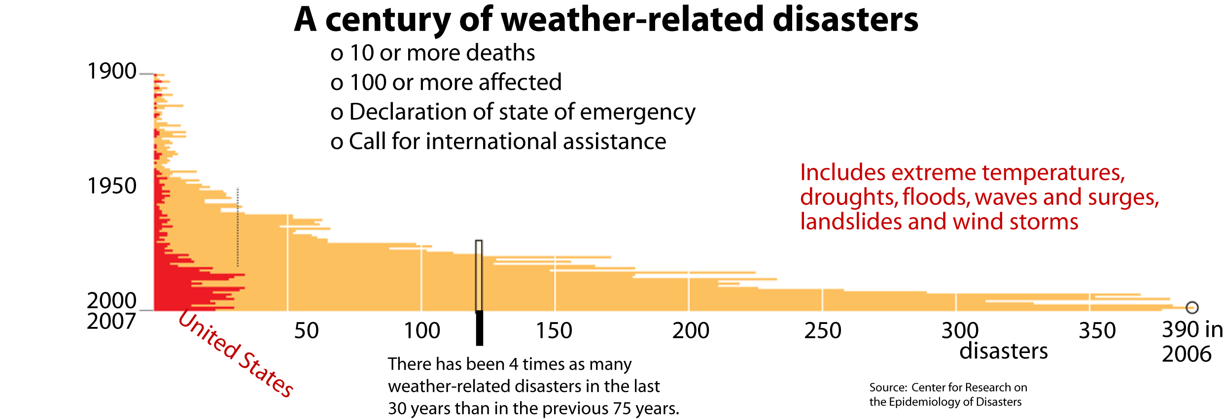
A century of weather-related disasters:
Disasters are increasing, especially in U.S.
2008:
Wildfires, heatwaves, California
Tornadoes, deaths
Mississippi flooding
Hurricanes Ike and Gustav
More in US than any where else
Rest of World

Slide 19
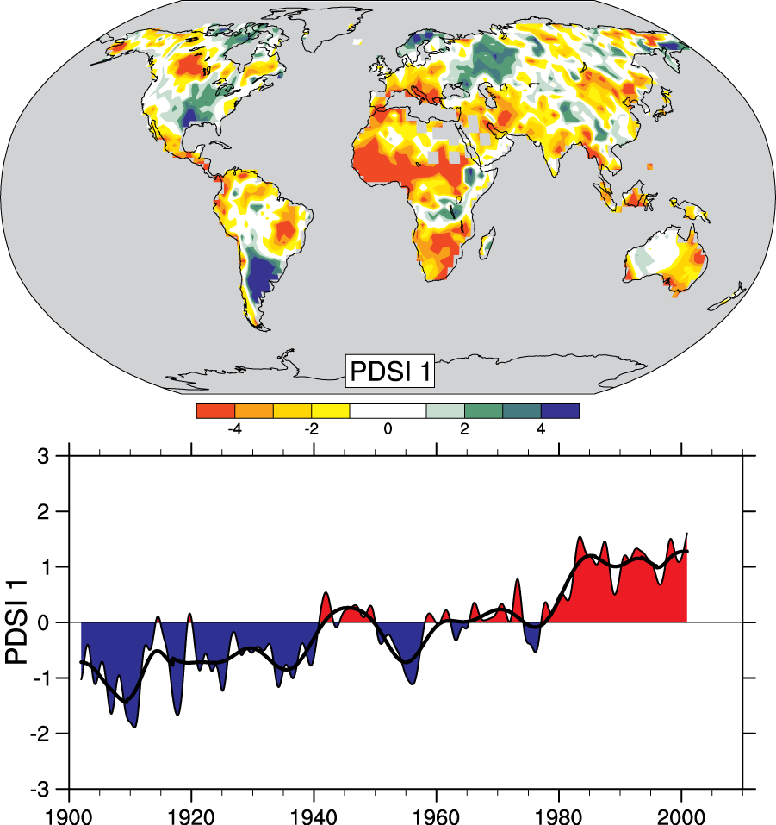
Drought is increasing most places
Mainly decrease in rain over land in tropics and subtropics, but enhanced by increased atmospheric demand with warming
The most important spatial pattern (top) of the monthly Palmer Drought Severity Index (PDSI) for 1900 to 2002.
The time series (below) accounts for most of the trend in PDSI.
IPCC

Slide 20
Impacts of hazardous weather
a: Brush fire in Macedonia, Greece during the SE European summer 2007 drought.
b: Upton-upon-Severn in Worcestershire, England during the flooding of July 2007.
c: Father and son in flood ravaged Bangladesh, 2007.
d: An Ethiopian shepherd leads livestock through the dust in the desert where severe drought in East Africa has forced overgrazing.

Slide 21
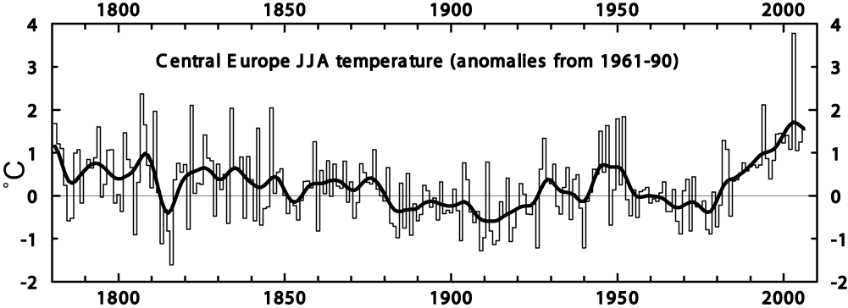
Heat waves are increasing: an example
Extreme Heat Wave
Summer 2003
Europe
>50,000 deaths
Trend plus variability?
IPCC

Slide 22
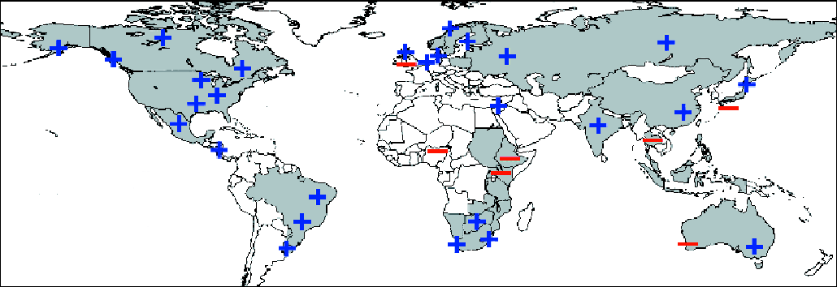
Proportion of heavy rainfalls: increasing in most land areas
Regions of disproportionate changes in heavy (95th) and very heavy (99th) precipitation
IPCC

Slide 23
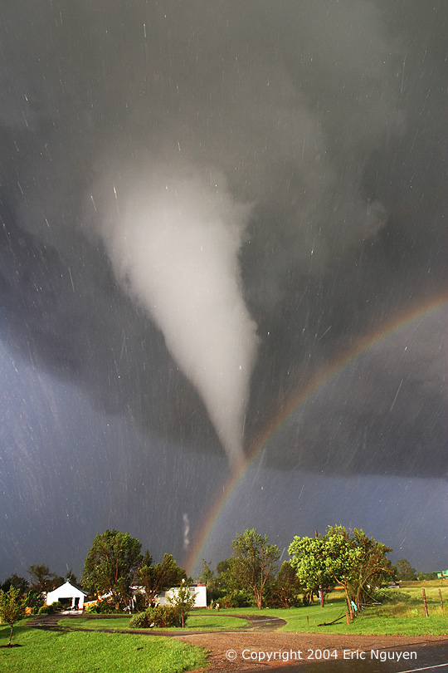
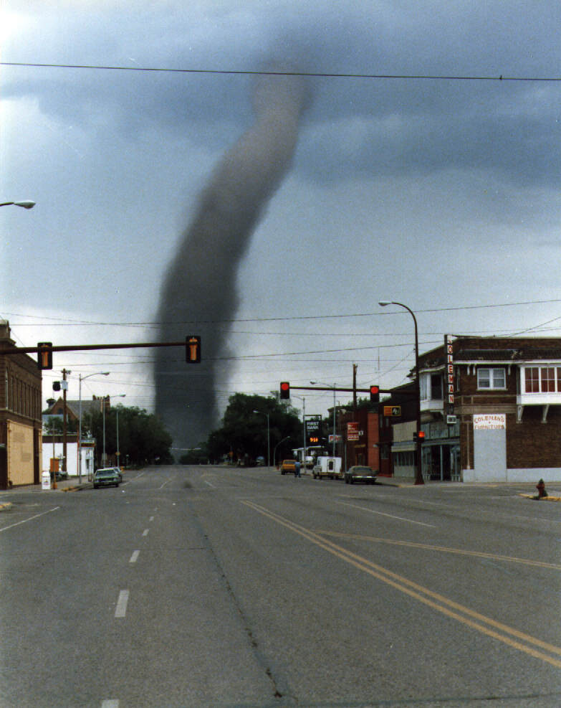

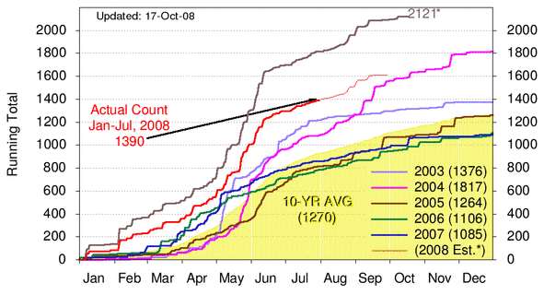
U.S. Annual Tornadoes
*2008: preliminary count, may include duplicates; Corrected through July
Total 2008
120 deaths (thru July)
1380 tornadoes (thru July)
447 tornadoes in May

Slide 24
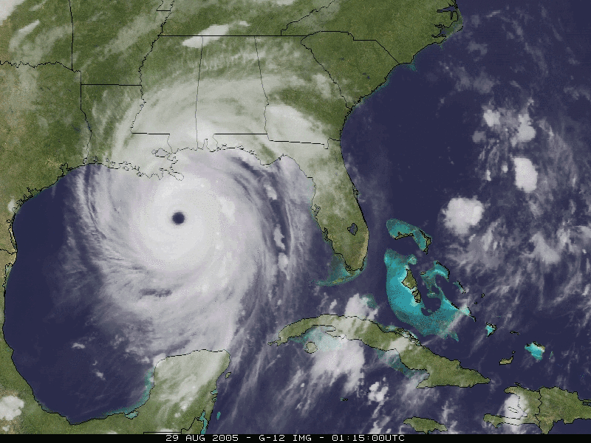
North Atlantic hurricanes have increased with SSTs
Katrina
August 2005
The 2005 season broke many records

Slide 25
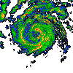
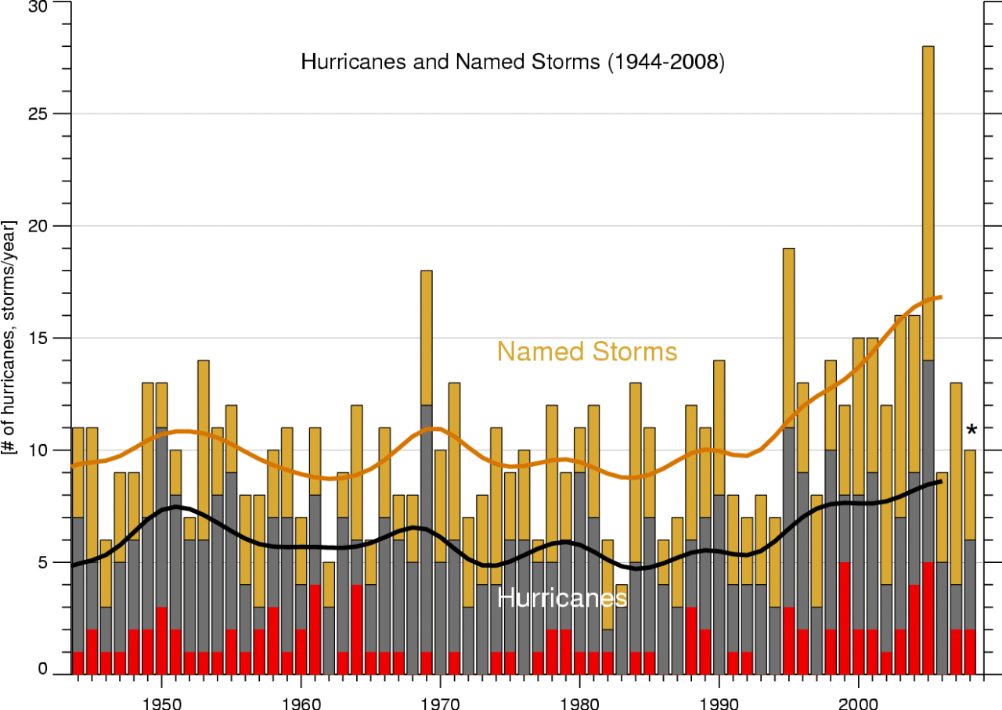
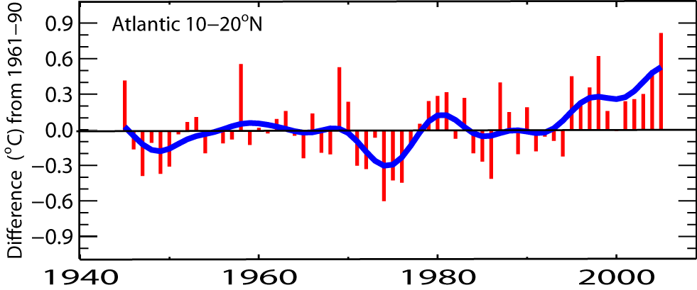
North Atlantic hurricanes have increased with SSTs
N. Atlantic hurricane record best after 1944 with aircraft surveillance.
Global number and percentage of intense hurricanes
is increasing
Thru 2008
Marked increase after 1994
(1944-2006)
SST
IPCC

Slide 26
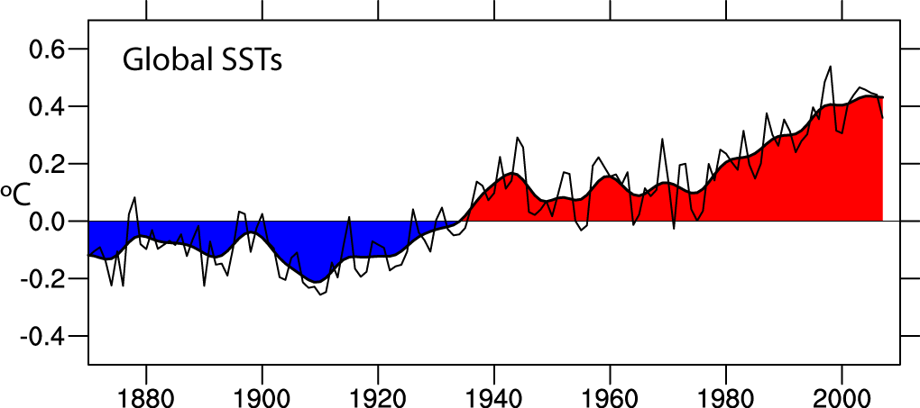
Global SSTs are increasing: base period 1901-70
Through 2007
Data: Hadley Centre, UK

Slide 27
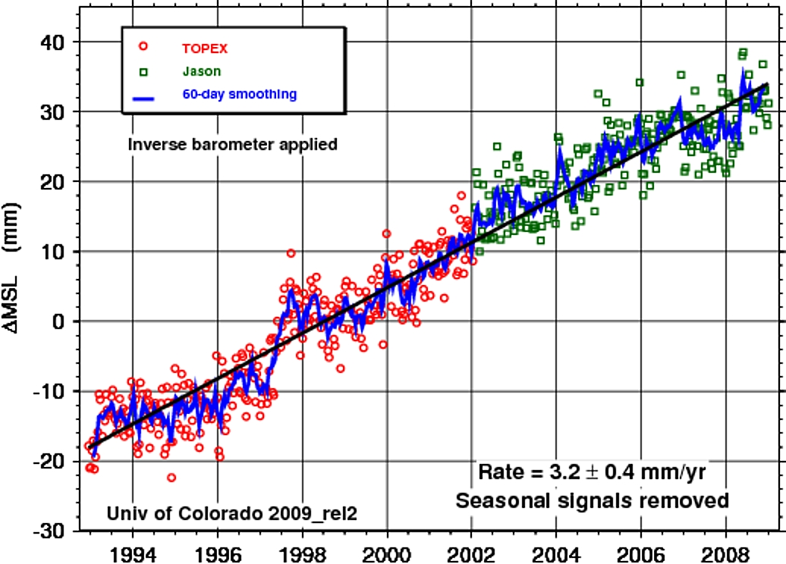
Sea level is rising:
from ocean expansion and melting glaciers
Since 1992
Global sea level
has risen 48 mm
(1.9 inches)
60% from
expansion as ocean temperatures rise,
40% from melting glaciers
Courtesy Steve Nerem
U Colo

Slide 28
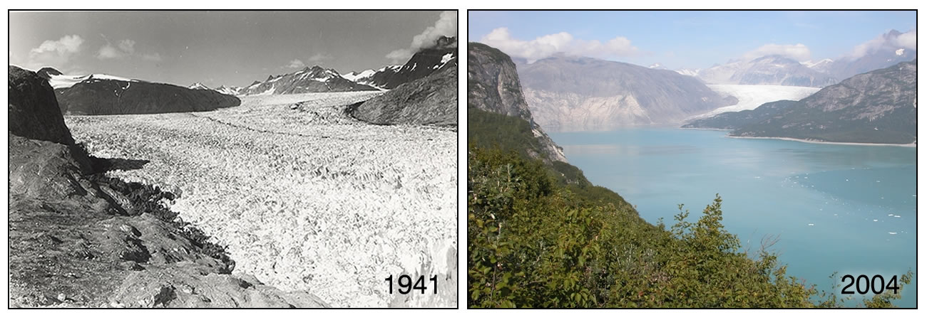
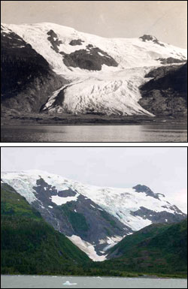
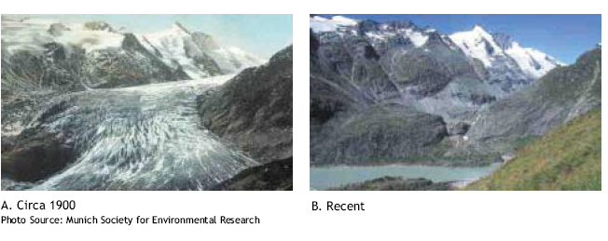
Evidence for reality of climate change
Glaciers melting
Muir Glacier, Alaska
1909
Toboggan
Glacier
Alaska
2000
1900 2003
Alpine glacier, Austria

Slide 29
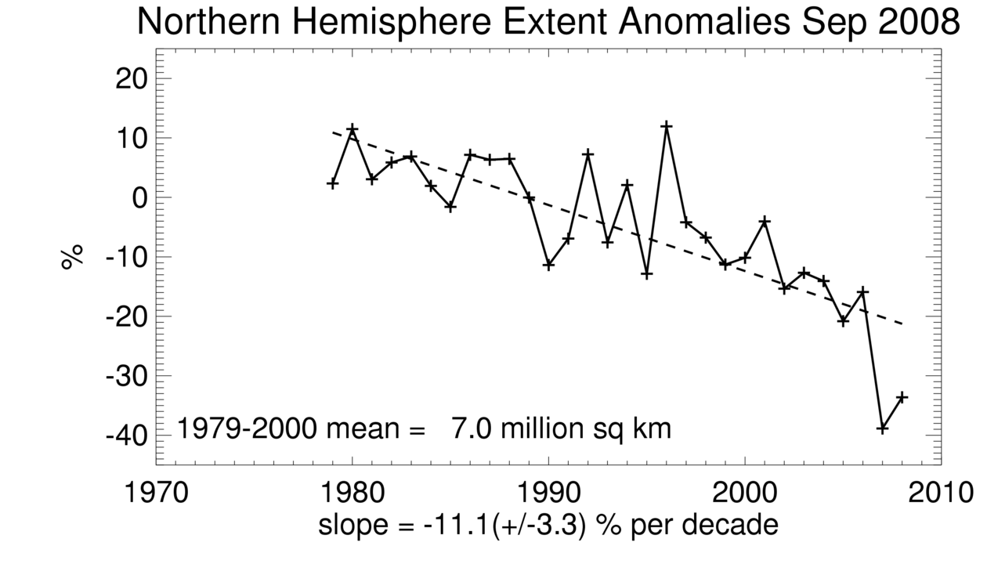
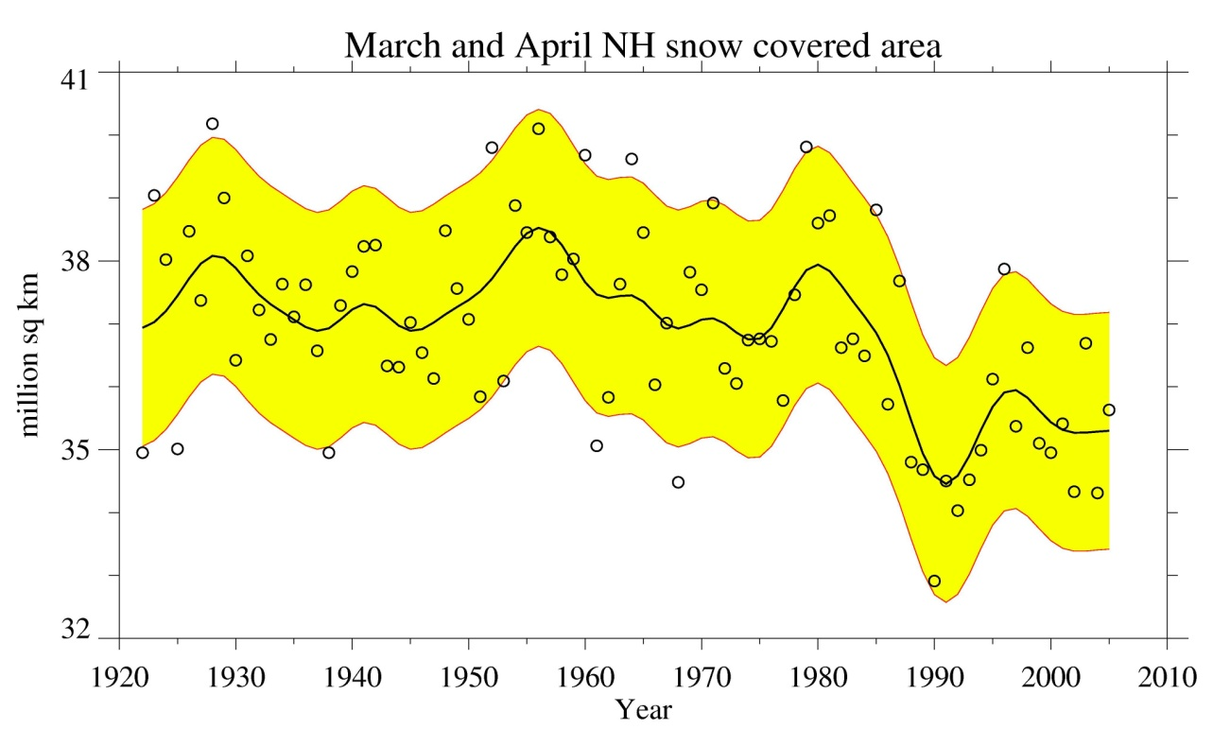
Snow cover and Arctic sea ice are decreasing
Arctic sea ice
area decreased by 2.7% per decade
(Summer: -7.4%/decade)
up to:
2007: 22% (10⁶ km²) lower than 2005
2008, second lowest
Spring snow cover
shows 5% stepwise drop during 1980s
IPCC

Slide 30
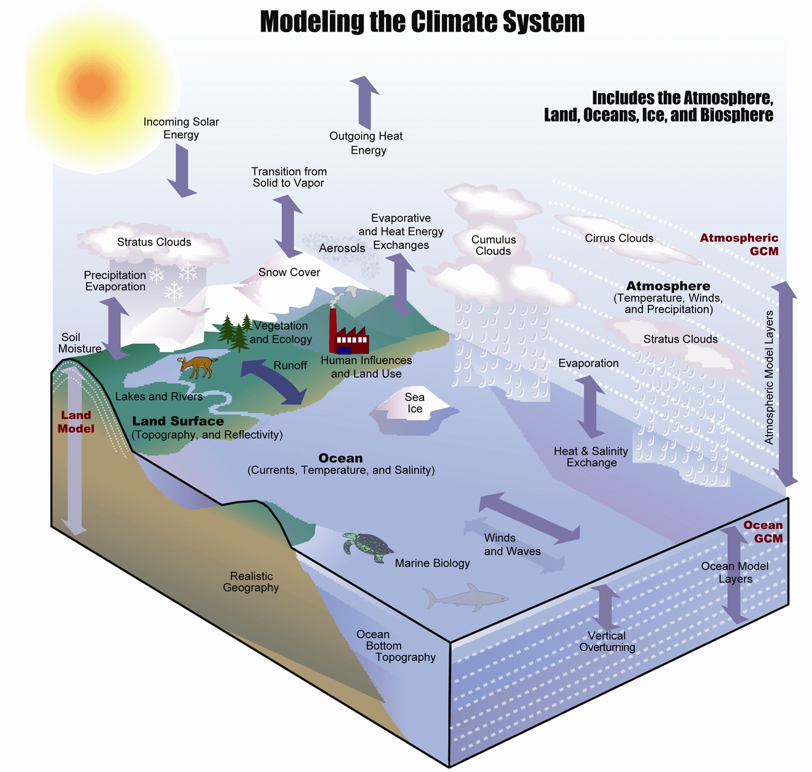
Karl and Trenberth 2003

Slide 31
Effects of resolution in models
Global cloud distribution
320 km resolution 20 km resolution

Slide 32
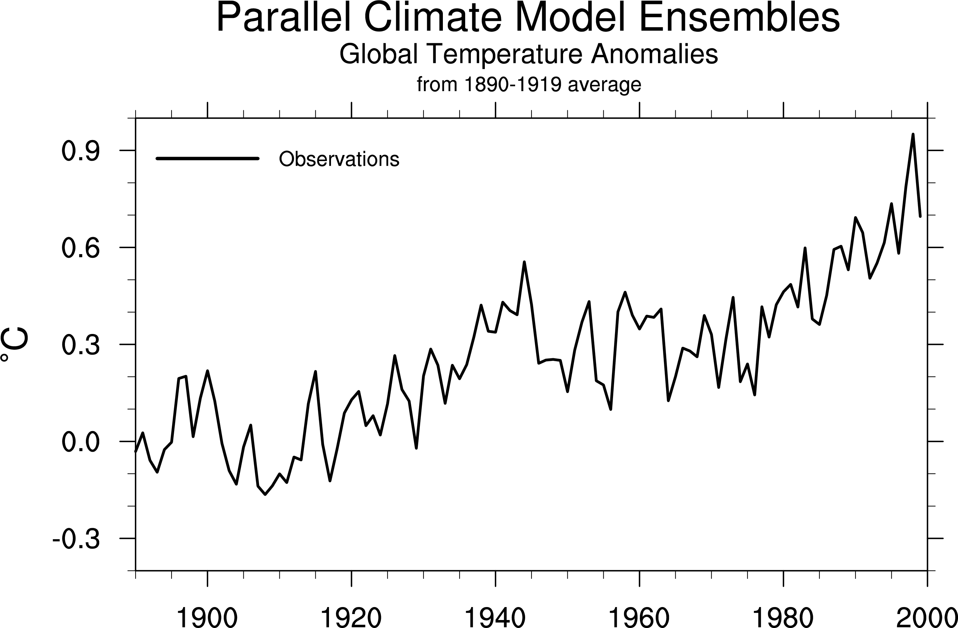
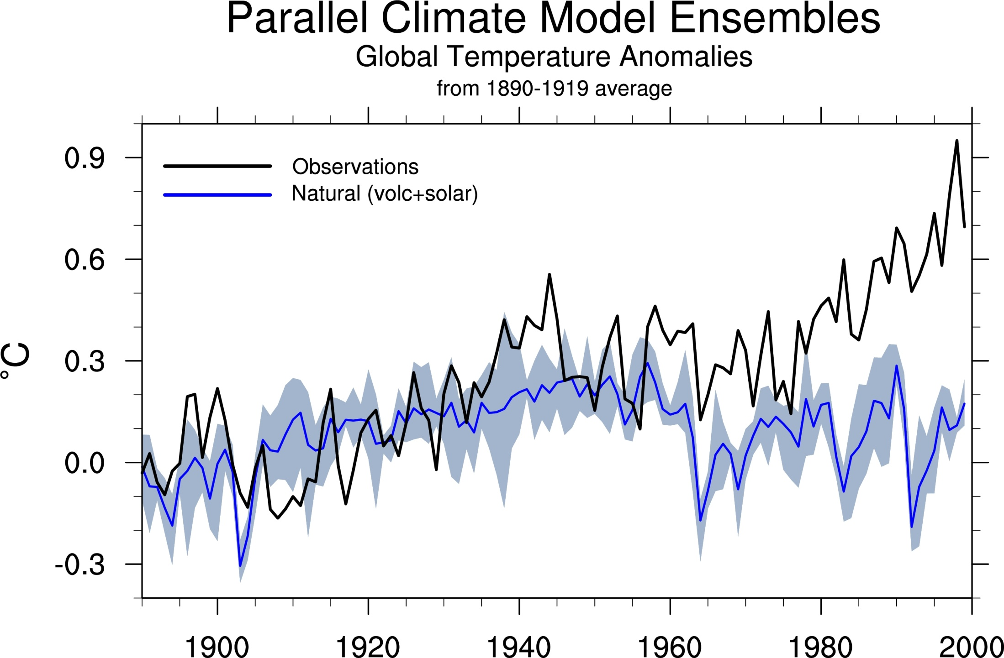
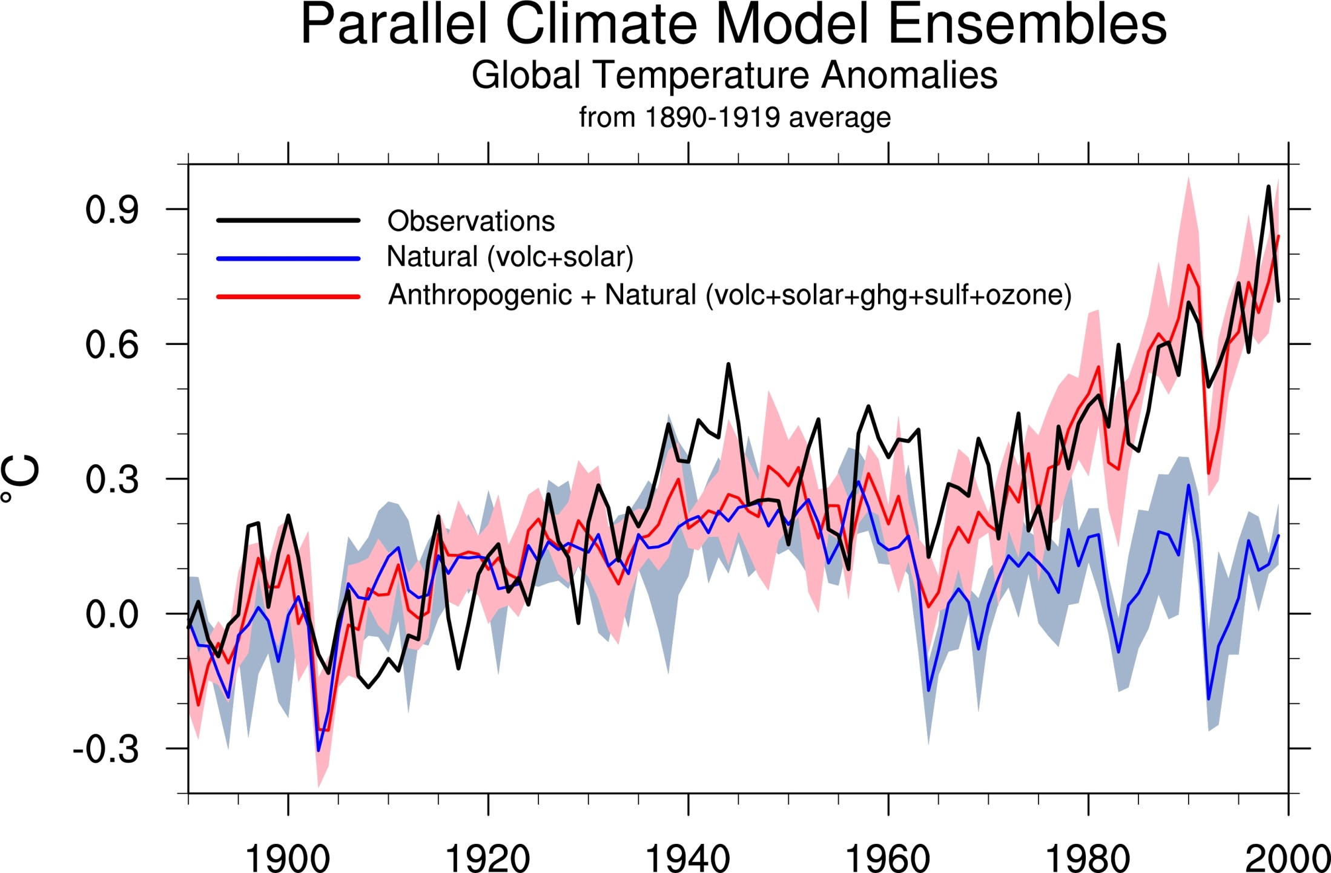
Natural forcings do not account for
observed 20th century warming after 1970
Meehl et al, 2004: J. Climate.

Slide 33
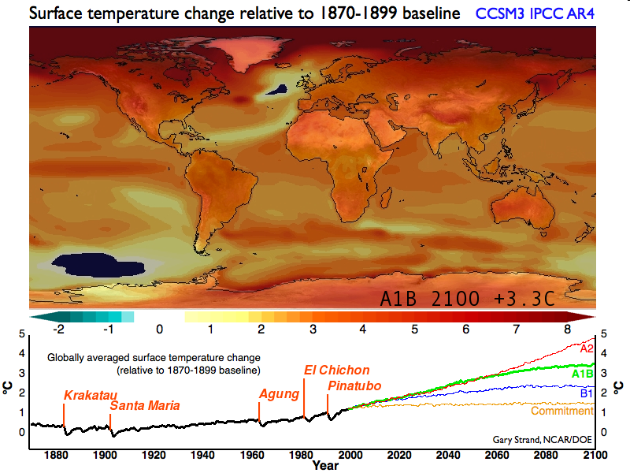
Projected temperature change

Slide 34
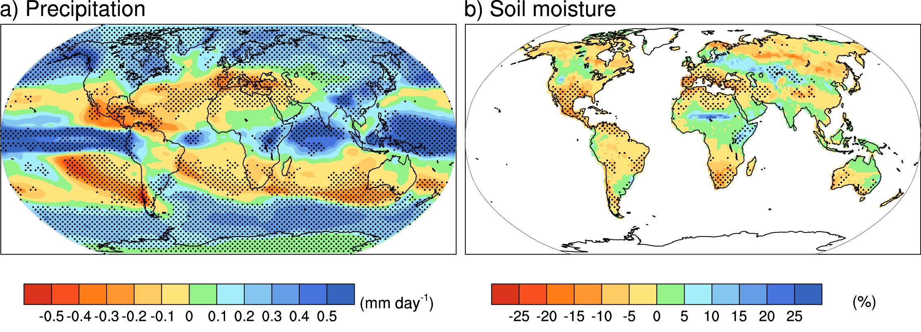
Projected Patterns of Precipitation Change
2090-2100
Combined effects of increased precipitation intensity and more dry days contribute to mean precipitation changes

Slide 35
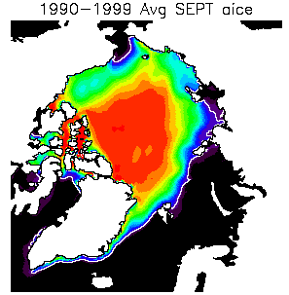
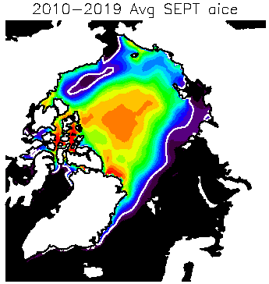
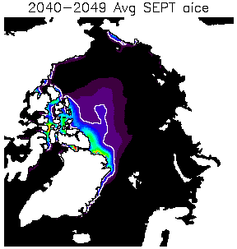

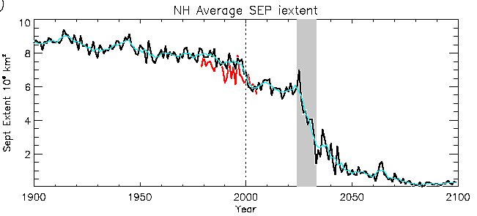
Arctic sea ice disappears in summer by 2050
Already 2007 lowest on record by 22%
Abrupt Transitions in Summer Sea Ice
Gradual forcing results in abrupt Sept ice decrease
Extent decreases from 80 to 20% coverage in 10 years.
Relevant factors:
  Ice thinning
  Arctic heat transport
  Albedo feedback
2007 x
Holland et al., GRL, 2006

Slide 36

Global warming effects from humans are already identifiable
They are apt to become worse and more common
They affect health and well-being
  Direct loss of life
  Loss of habitat, farming commodities, etc
  Water shortages, or excesses
  Increases in range and times of bugs
  Heat waves, wildfires

Slide 37
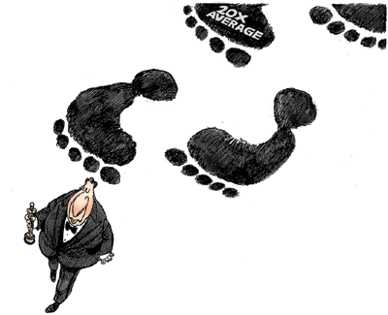
What is your carbon footprint?
You will be affected by climate change (you are already)
You will be affected by legislation designed to address climate change (whether good or bad)

Slide 38
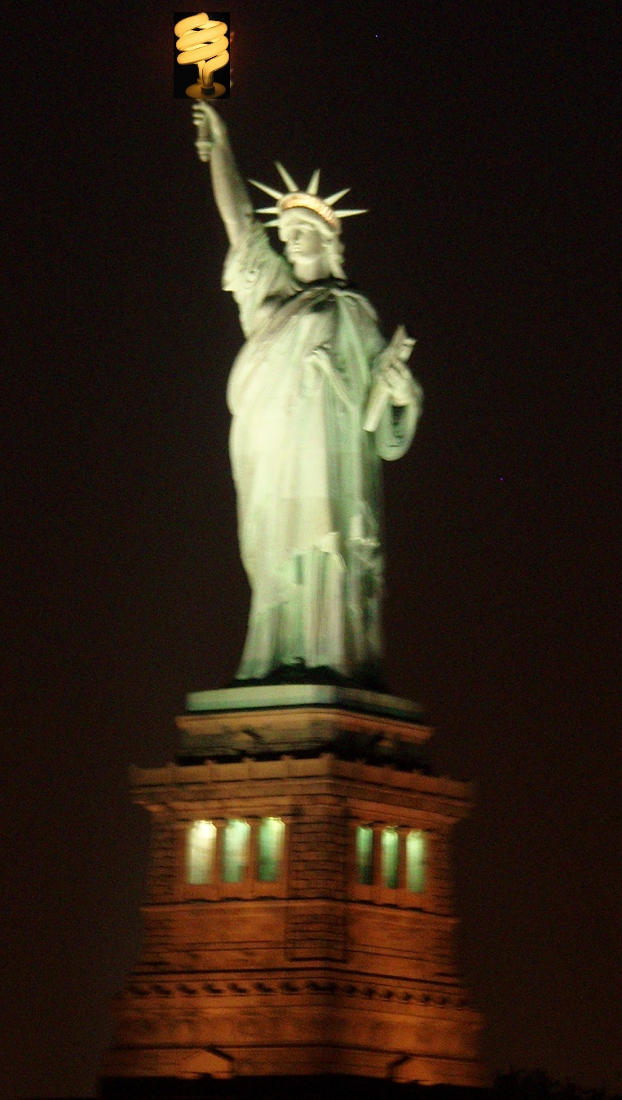
Many things you can do:
Going
Green!

Slide 39

The Challenge:
Sustainable Management of an Ever-Changing Planet

