Slide 1
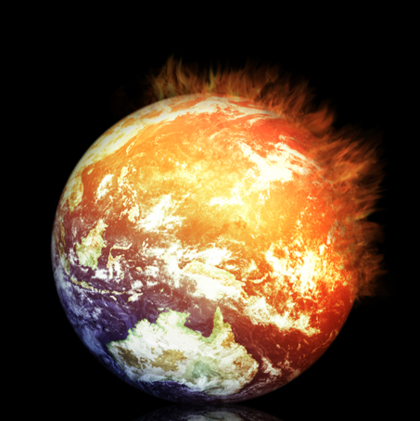
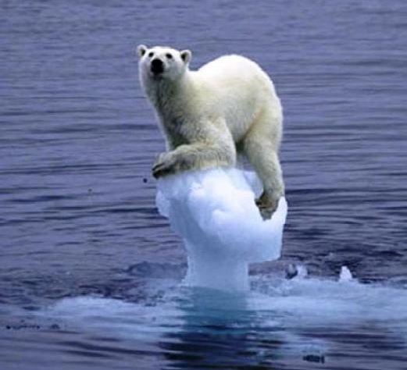
Global warming is alive and well Not that this is a good thing! Kevin E Trenberth NCAR

Slide 2
Climate change is happening: It is due to humans
97% of scientists agree.
The data are of mixed quality and length, but together they tell a compelling story leaving no doubt about the human role in climate change.
What we do about this problem involves value systems and politics!

Slide 3

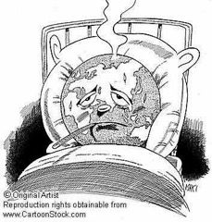
Running a fever: Seeing the doctor
Symptoms: the planet’s temperature and carbon dioxide are increasing
Diagnosis: human activities are causal
Prognosis: the outlook is for more warming at rates that can be disruptive and will cause strife
Treatment: mitigation (reduce emissions) and adaptation (planning for consequences)

Slide 4
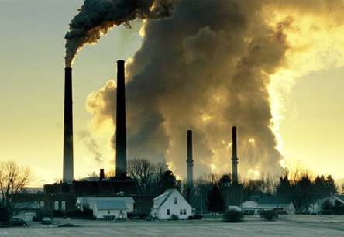

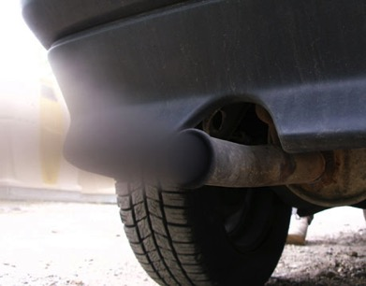
What Is Causing Warming?
Emissions of carbon dioxide pollution

Slide 5
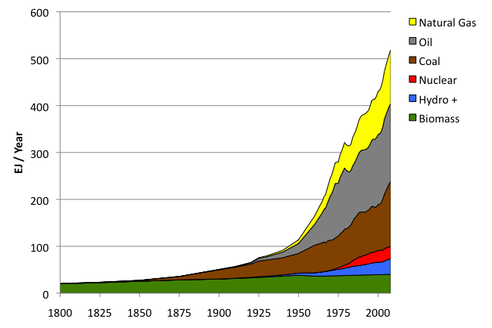
World Primary Energy Supply: 1800 – 2008
Fossil
fuels
Hydro + :means hydropower plus other renewables other than biomass.
Sources: Grubler (2008) - Energy Transitions, BP (2009) – Statistical Review of World Energy, EIA (2009) – International Energy Annual

Slide 6
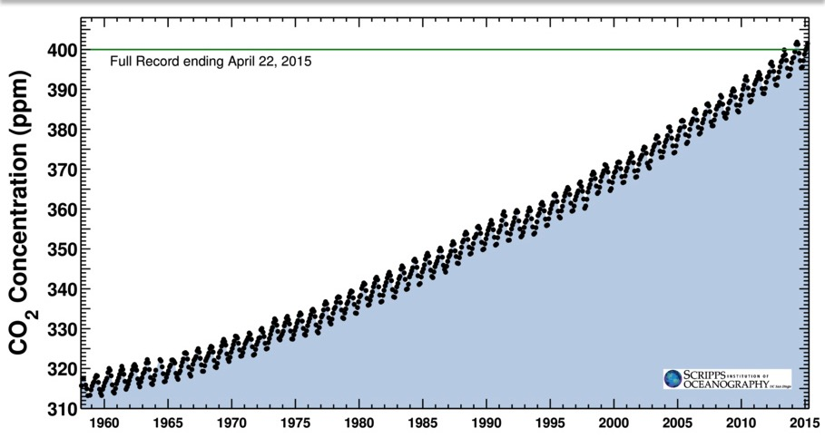
Changing atmospheric composition: CO₂
_{Mauna Loa, Hawaii}
Rate increasing
Data from Climate Monitoring and Diagnostics Lab., NOAA. Data prior to 1974 from C. Keeling, Scripps Inst. Oceanogr.

Slide 7
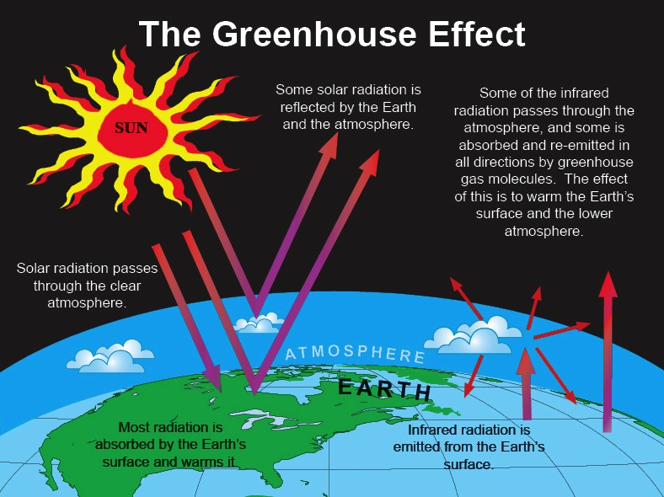

Slide 8
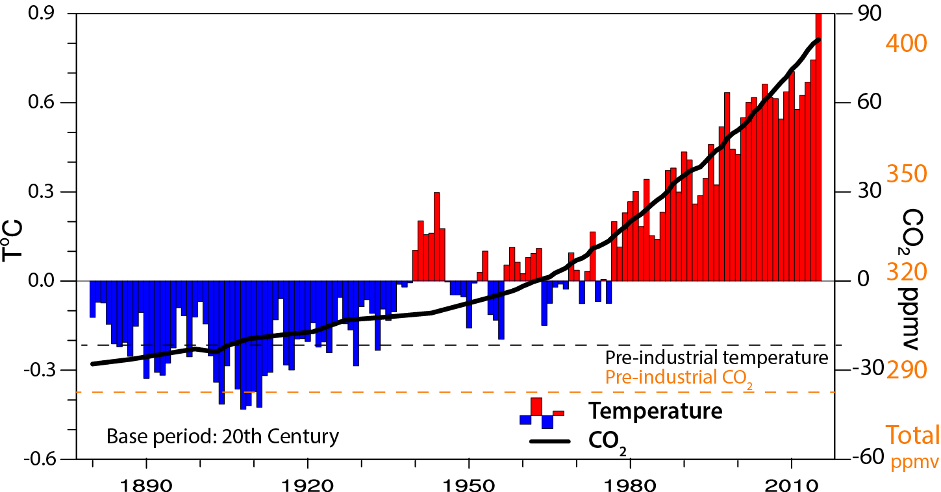
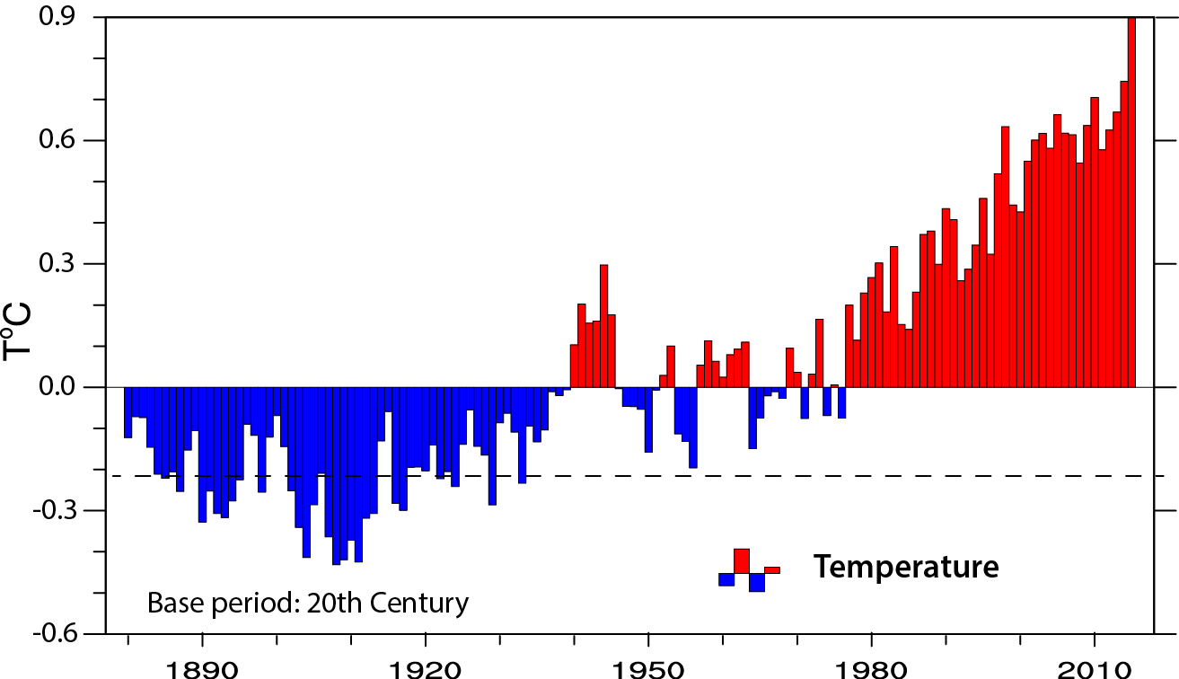
Global temperature and carbon dioxide: anomalies through 2015
1°F-
-1°F-
Base period 1900-99; data from NOAA

Slide 9
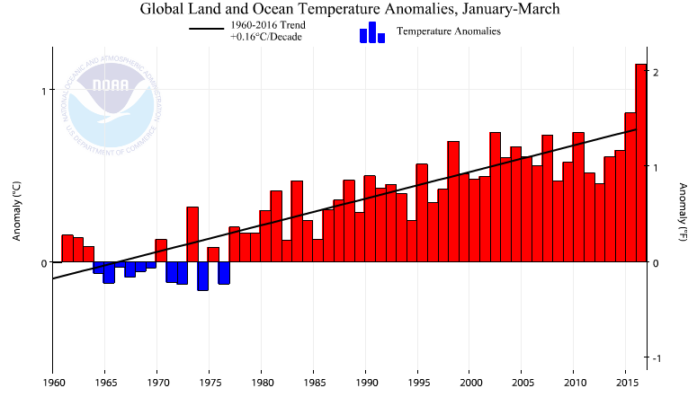
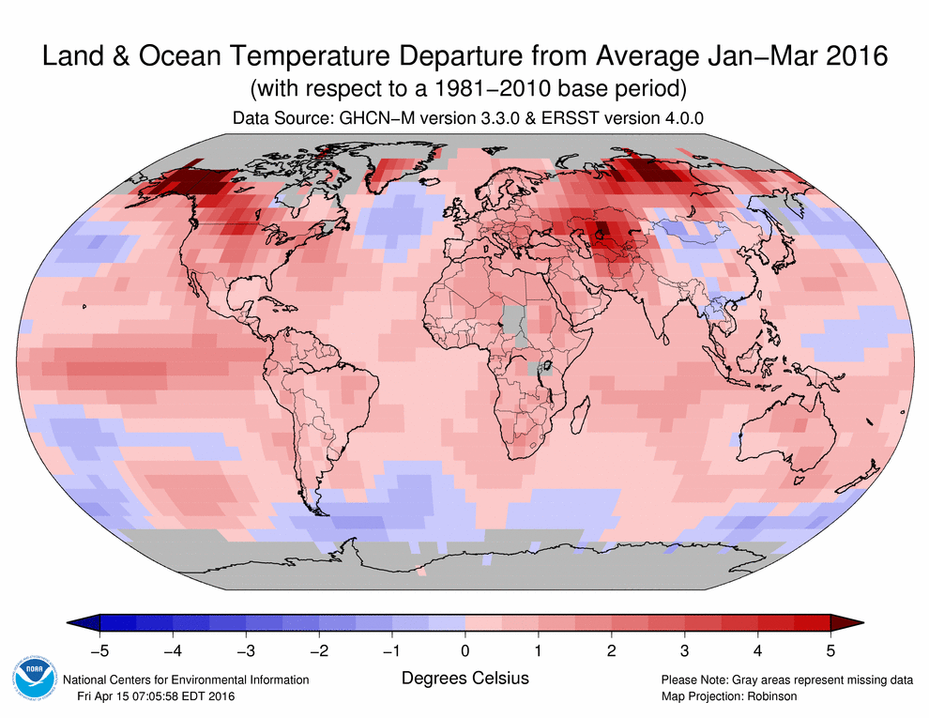
Global temperature Jan-Feb-Mar anomalies through 2016
Base period 1900-99; data from NOAA

Slide 10
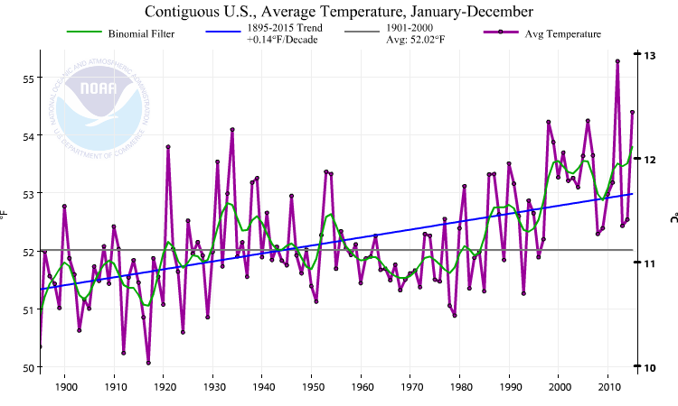
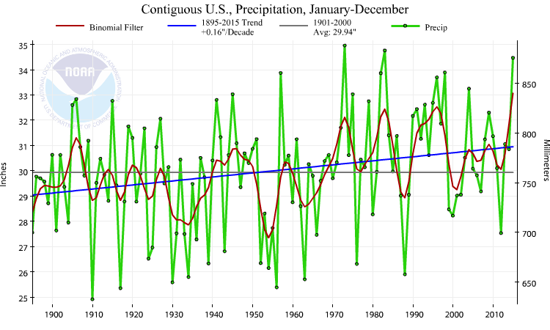
US 48 contiguous States
Temperature: annual
Precipitation:
Annual
Thru 2015
Temp
Precip
Much wetter
2012:
V hot and dry
1930s:
Hot and dry

Slide 11
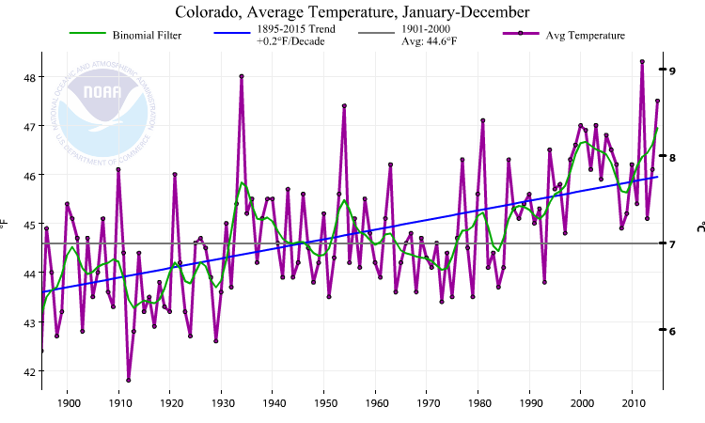
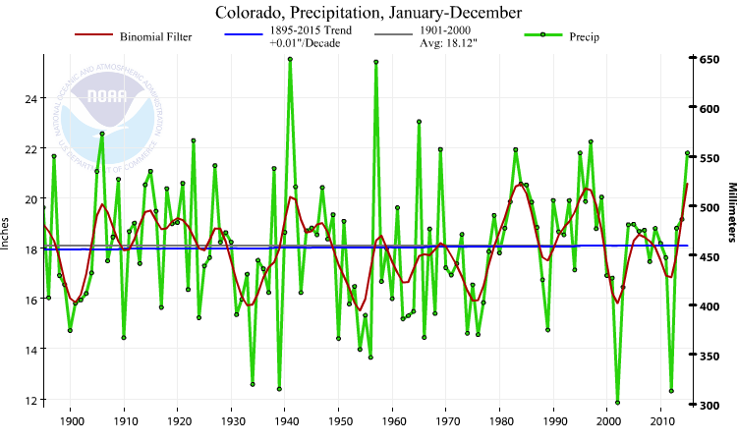
Colorado
Temperature: annual
Precipitation:
Annual
Thru 2015
Temp
Precip
Colorado Compact 1922
1905-28
Cold and wet
1930s:
Hot and dry
2012:
Hot and dry

Slide 12
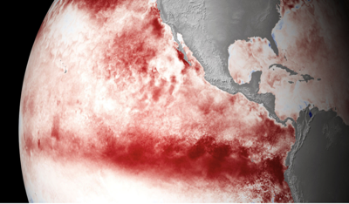
The 2015 El Niño event

Slide 13
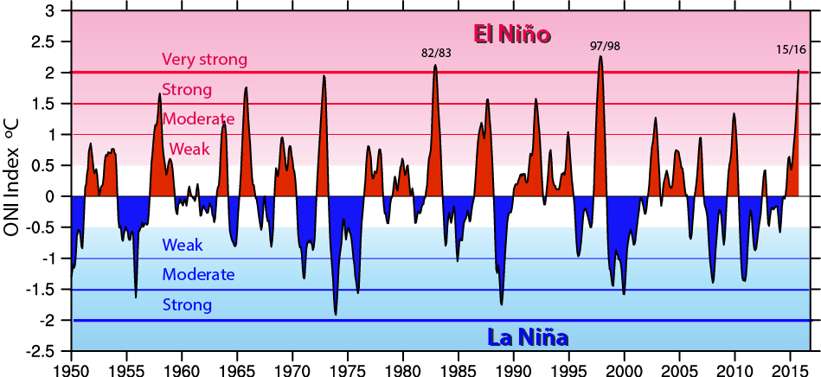
ENSO Events since 1950
El Niños are red
La Niñas are blue
They follow in sequence
Every year or two

Slide 14
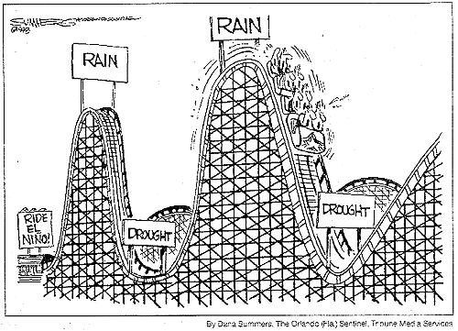
ENSO Cycles

Slide 15
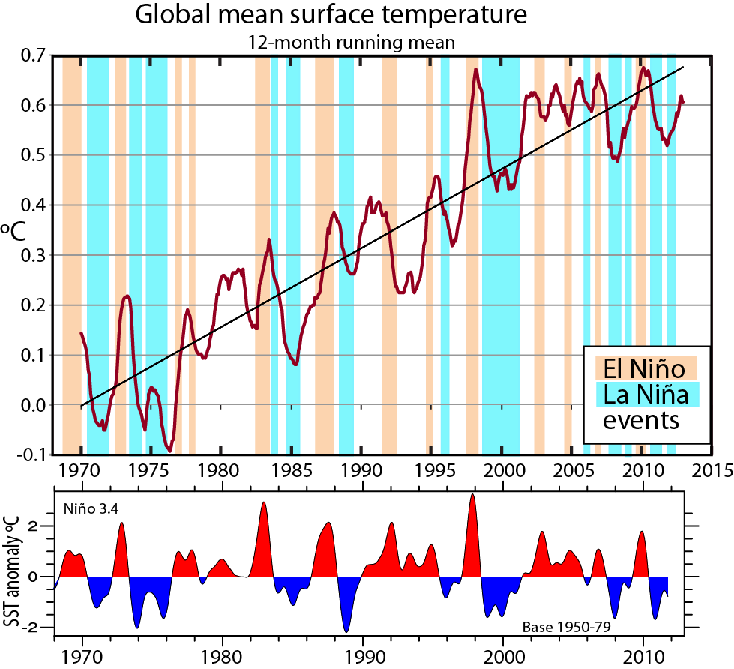
ENSO is the main source of interannual variability
There is a mini-global warming with El Niño, about 0.1°C per 1 °C of SST anomaly in tropical Pacific, delayed by 3-4 months.
Trenberth and Fasullo 2013

Slide 16
Global warming means more heat: Where does the heat go?
>90%
Warms land and atmosphere
Heat storage in the ocean (raises sea level)
Melts land ice (raises sea level)
Melts sea ice and warms melted water
Evaporates moisture ⇒ rain storms, cloud ⇒ possibly reflection of sun’s rays to space

Slide 17
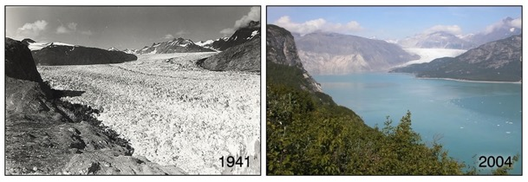
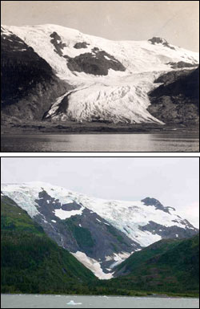
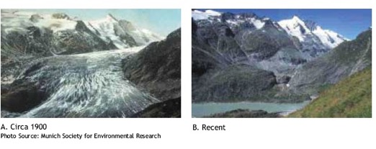
Evidence for reality of climate change
Glaciers melting
Muir Glacier, Alaska
1909
Toboggan
Glacier
Alaska
2000
1900 2003
Alpine glacier, Austria
Increased Glacier retreat since the early 1990s

Slide 18
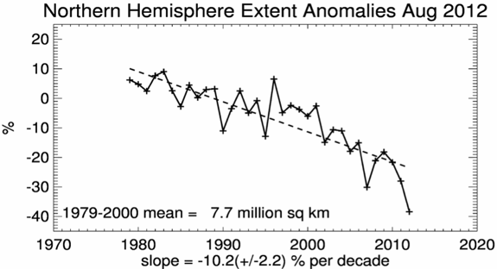
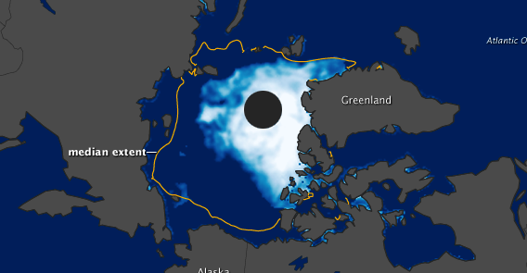
Snow cover and Arctic sea ice are decreasing
5
Arctic sea ice
area decreased by 40% in summer
2012 lowest on record
Late August 2012

Slide 19
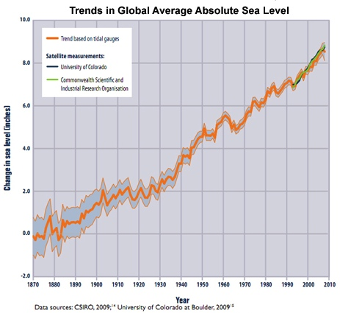
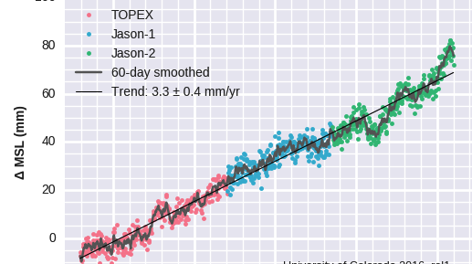
Sea Level Rise
3 inches

Slide 20
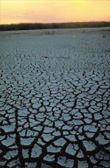
Controlling Heat
Human body: sweats
Homes: Evaporative coolers (swamp coolers)
Planet Earth: Evaporation (if moisture available)
e.g., When sun comes out after showers,
the first thing that happens is that the puddles dry up: before temperature increases.

Slide 21

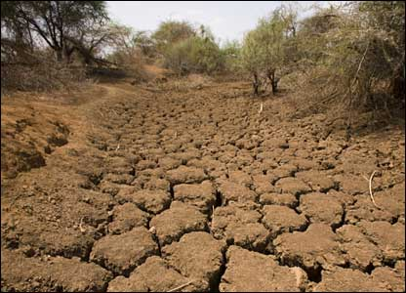
Warmer air holds more moisture
4% per °F
Global warming=
More heat
⇓
More drying
⇓
More evaporation
⇓
More moisture
More rain
More drought

Slide 22
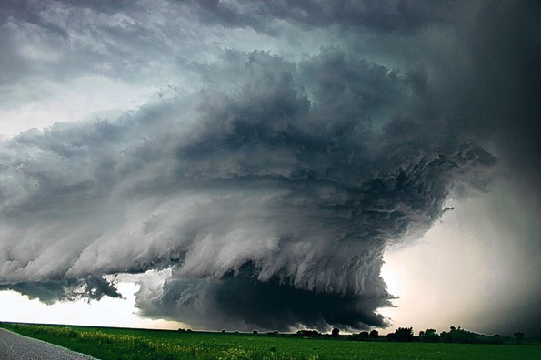
Most precipitation comes from moisture convergence by weather systems
Low level winds bring in moisture from afar
More moisture means heavier rains

Slide 23
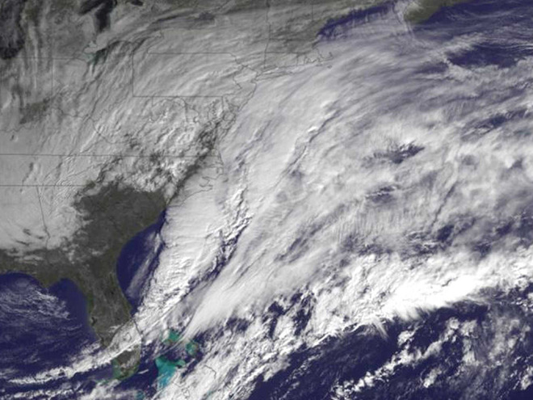
Winter storms and climate change
Snow falls if temperature below about 35°F
Greatest amounts 28-32°F
“Too cold to snow”: freeze dried air
So more snow is a result of a warming climate unless it is so warm it turns to rain.
More snow in mid-winter
Shorter snow season (each end more rain)
Snow melt sooner, runoff earlier
Less snowpack by late spring
Goldilocks effect
27 Jan 2015 NOAA

Slide 24
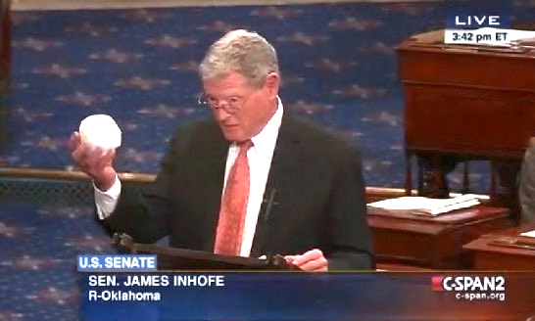
Senator James Inhofe stunt on snow and climate change in Senate
What about all the snow?
26 Feb 2015

Slide 25
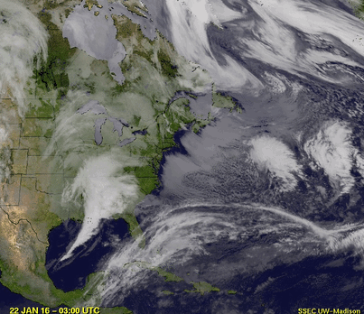
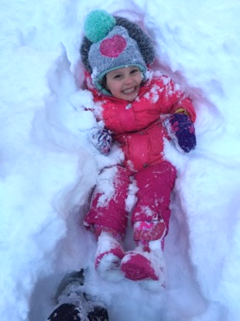
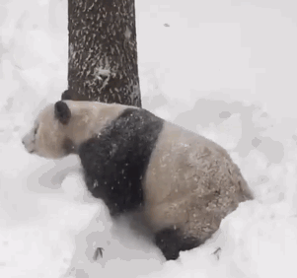
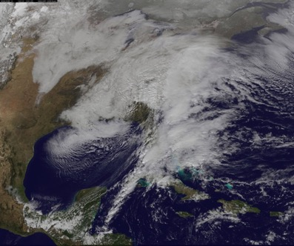
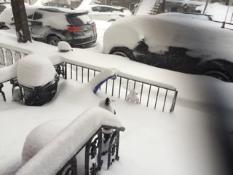
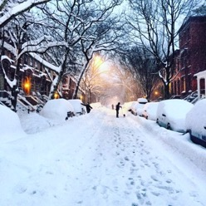
Jonas: East coast snow storm Jan 22-23 2016

Slide 26
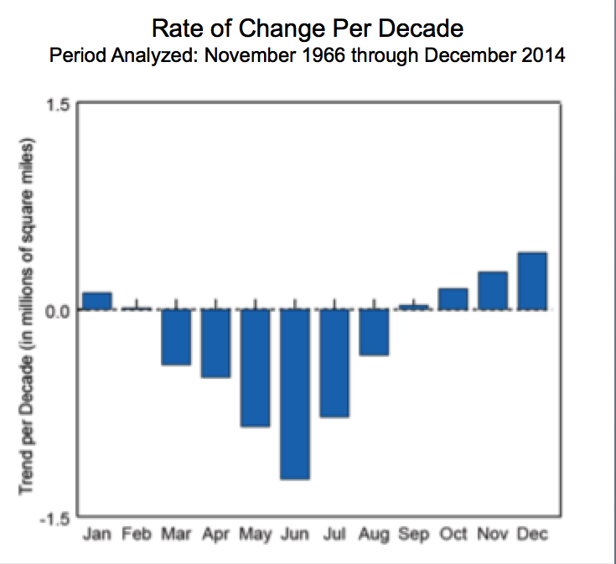
Northern Hemisphere snow cover extent
27 Jan 2015 NOAA

Slide 27
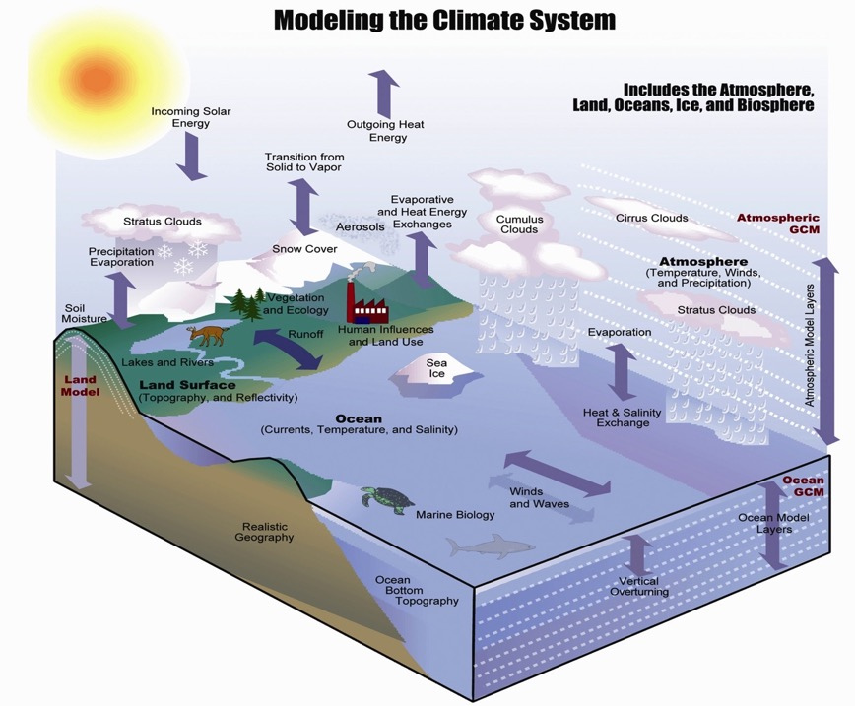
Karl and Trenberth 2003

Slide 28
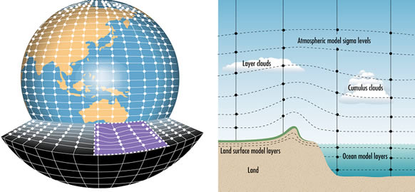
Model discretization

Slide 29
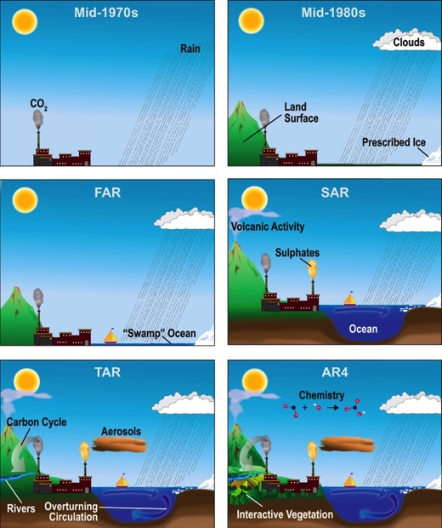
Progress in climate modeling
IPCC
1990
IPCC
2001
IPCC
1995
IPCC
2007
IPCC AR4

Slide 30
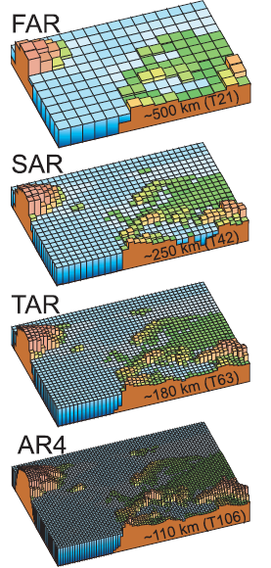
Geographic resolution
Characteristic resolution of the generations of climate models used in the IPCC Assessment Reports:
FAR (IPCC, 1990),
SAR (IPCC, 1996),
TAR (IPCC, 2001a), and
AR4 (2007).
For northern Europe.
IPCC 2007

Slide 31
The Community Earth System Model
www.cesm.ucar.edu
Community Climate
System Model (CCSM)
(Hurrell et al. 2013)

Slide 32
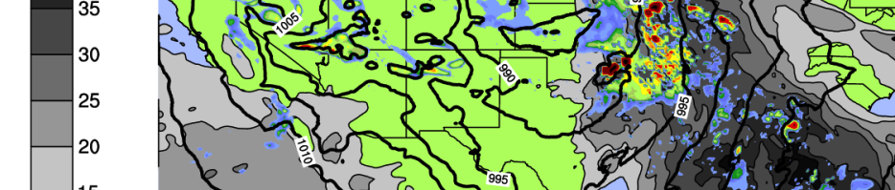
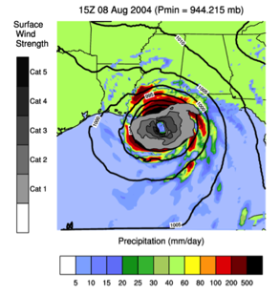
High Resolution Simulations: High Impact Phenomena
12-km Atmospheric Model
With resolving finer spatial scales we are able to simulate high impact events – like hurricanes
As computational power increases, we will be able to assess the impact of climate change on these types of events
Mid-west Spring time propagating systems
Tropical Cyclones
(Hurricanes)
Slide courtesy of Rich Neale

Slide 33
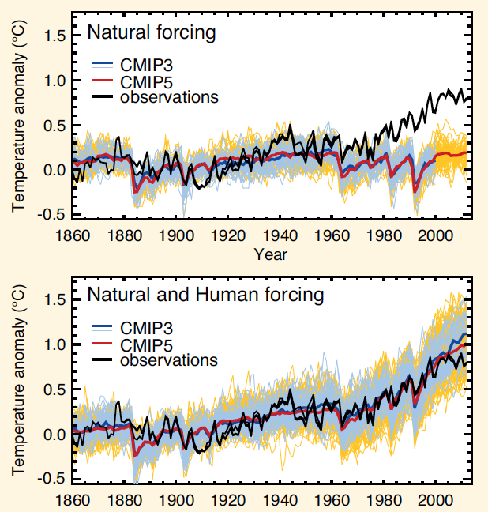
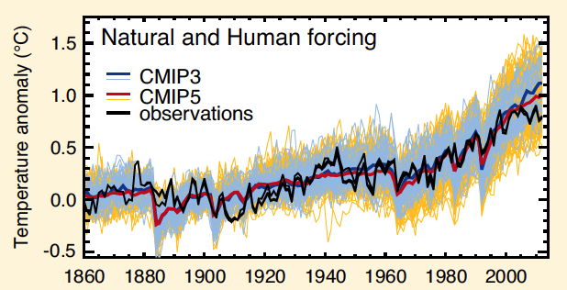
Attribution of climate change
With climate models, scientists can play “God”.
We can run models with and without human influences and see what the difference is.
Global surface temperature
IPCC 2013

Slide 34
Projections vs Predictions
Predictions start from an observed state, and may go for a decade or so. Projections are tied to scenarios of plausible trajectories of the future: not initialized.
Scenarios of different rates and magnitudes of climate change provide a basis for assessing the risk of crossing identifiable thresholds in both physical change and impacts on biological and human systems.
GHG emissions
Climate
GHG
Concentrations

Slide 35
Climate projections:
Earlier, in projecting climate, a number of possible future worlds were envisaged that varied population, standards of living, economic activity, energy usage, carbon intensity etc. These were then used to estimate carbon dioxide and other emissions and thus carbon dioxide concentrations, and from there the climate.
But there are huge uncertainties that accumulate along the way.

Slide 36
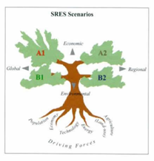
SRES Scenarios
A1 storyline and scenario family: a future world of very
rapid economic growth, global population that peaks
in mid-century and declines thereafter, and rapid
introduction of new and more efficient technologies.
A2 storyline and scenario family: a very heterogeneous world with continuously increasing global population and regionally oriented economic growth that is more fragmented and slower than in other storylines.
B1 storyline and scenario family: a convergent world with the same global population as in the A1 storyline but with rapid changes in economic structures toward a service and information economy, with reductions in material intensity, and the introduction of clean and resource-efficient technologies.
B2 storyline and scenario family: a world in which the emphasis is on local solutions to economic, social, and environmental sustainability, with continuously increasing population (lower than A2) and intermediate economic development.

Slide 37
Projections vs Predictions
More recently, the IPCC has decided to start in the middle with the CO₂ concentrations as specified: called
“RCPs : Representative Concentration Pathways”
GHG emissions
Climate
GHG
Concentrations

Slide 38
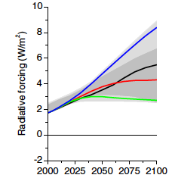

Planet
heating
RCPs

Slide 39
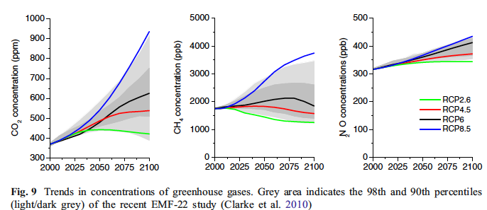
Concentrations

Slide 40



Slide 41

IPCC AR5

Slide 42


Slide 43

Community Integrations - Large Ensemble
40 Members
2000-2060, A1B
CCSM3, T42
Initial state varied by a round-off level change
Role of natural variability exposed
Regionally, esp. for USA, effects are huge.
Global effects are more robust.
From Deser et al., 2012, Nature Climate Change

Slide 44


Extremes matter
Extremes may or may not be rare
They often break records: values outside of previous experience
Things break (thresholds crossed)
High impact events, high costs, loss of life and limb.
The straw that breaks the camel’s back

Slide 45




Colorado on Fire: June 2012
Flagstaff fire: above NCAR, circled.
High Park fire 259 houses, 1 death
Waldo Canyon fire
346 homes…

Slide 46

Boulder Flooding September 2013

Slide 47





Slide 48

Precipitation Records
Boulder
Daily record (24 hour) 9.08”,
previous record 4.80” July 31, 1919
Monthly record for September of 17.18”
previous record 5.50” Sept 1940
previous record for any month 9.60” May 1995
Annual record of 30.14” through September and counting
previous record 29.47” 1995
Homes destroyed: 345
Homes damaged: 557
Commercial properties damaged: 33
Commercial properties destroyed: 3
NOAA NWS Denver Boulder Online Summary

Slide 49



Frasier Meadows, east Boulder
Farther east

Slide 50


Former location of Mesa Trail over Bluebird creek. Green Mountain Rd (Flagstaff)
http://www.flickr.com/photos/bouldercolorado/sets/72157636661981633/

Slide 51
2015-16 events
What have we seen from the combination of El Niño and climate change?

Slide 52




2015: Flooding
Cyclone Pam
Vanuatu March 2015

Slide 53








Flooding in Texas and Oklahoma May 2015
17-24 May

Slide 54






Widespread disruption: summer 2015 Heat records all over
Deadly heat in many places:
Europe (Berlin 102F; Warsaw 98F; Madrid 104F)
Egypt; Turkey, Middle East
Iran 115F (in July)
Japan: Tokyo longest over 95F
India 122F (2300 dead; May-June)
Canada; Alaska
Notes:
http://www.washingtonpost.com/blogs/capital-weather-gang/wp/2015/08/10/central-and-eastern-europe-simmering-in-historic-heat-wave/
http://thinkprogress.org/climate/2015/08/10/3689813/heat-wave-middle-east/
The Rocky Fire burning about 200 miles northeast of San Francisco grew on Tuesday to 69,600 acres, and was 20% contained as of Wednesday morning.

Slide 55







Wildfires galore: summer 2015 Western US
Alaska, Canada, Washington, Oregon, California
Tonasket, Washington, Aug
2015: costliest on record to fight wildfires: nearly $2 billion
9.8 billion acres burned (2nd highest).
Wild fire season now 78 days longer than normal.
July 2, 2015
Aug 23, 2015
Along Trans-Alaska pipeline, June
Oregon, July
Watching motorcade for dead
firefighters, WA
California, April
Notes:
http://www.washingtonpost.com/blogs/capital-weather-gang/wp/2015/08/10/central-and-eastern-europe-simmering-in-historic-heat-wave/
http://thinkprogress.org/climate/2015/08/10/3689813/heat-wave-middle-east/
The Rocky Fire burning about 200 miles northeast of San Francisco grew on Tuesday to 69,600 acres, and was 20% contained as of Wednesday morning.

Slide 56





Summer 2015: Hurricanes galore: El Niño + global warming
Philippines, China, Taiwan, Japan, …
Goni, Atsani 25 Aug
Kilo: 2 Sept
Widespread flooding in Japan
(Sept 10): TS Etau, Joso, Japan
Notes:
http://mashable.com/2015/10/22/hurricanes-typhoons-2015-photos/#73Tz3EqPFmqM

Slide 57






Major flooding Carolinas October 3-5, 2015
South Carolina

Slide 58







Major flooding Southern India (Chennai = Madras) November-Dec, 2015 Hundreds dead (275+). 47” in Nov (wettest ever) plus 11 inches first week Dec.
Notes:
http://www.slate.com/blogs/the_slatest/2015/12/04/chennai_floods_devastate_india_s_fourth_largest_city.html

Slide 59

Drought in Indonesia
Wildfires on the island of Borneo
on October 14, 2015. NASA/GSFC/LaRC/JPL-Caltech, MISR Team

Slide 60







Drought in South Africa
South Africa's worst drought in memory adds to economic gloom
Source: Reuters - Thu, 14 Jan 2016
Notes:
http://www.reuters.com/article/safrica-economy-idUSL8N14Y2DG20160114

Slide 61





Widespread Flooding late December 2015
Missouri
Mississippi River
26 Dec 2015

Slide 62





Flooding in the Americas:
Late December 2015.
Ascunción, Paraguay (29 Dec. below)
and surrounding areas:
Sat pics 26 and 28 Dec.
Rainfalls up to 400 mm (15.75”)

Slide 63







2016: Hurricane: strongest ever in SH
Cyclone Winston
Fiji 21-22 February 2016
Fiji

Slide 64





Houston flooding: mid April 2016
April 18 2016 was the second wettest day on record in Houston, with 9.92” of rain; vs 10.34” on June 26, 1989.

Slide 65


Dec 12, 2016
Will everyone follow through?

Slide 66







20 September 2014: New York City. Some 400,000 marched for climate justice.
Photos: Gary Braasch

