Slide 1
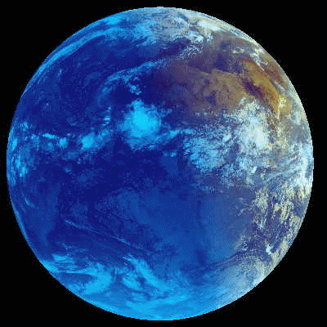
Climate Change
and
Water:
From the Globe to Utah
Kevin E. Trenberth
NCAR

Slide 2
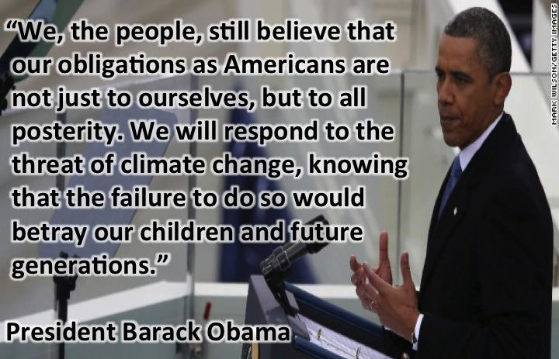
Climate change
Inaugural speech
2nd term

Slide 3
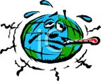
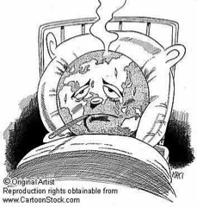
Running a fever:
Seeing the doctor
Symptoms: the planet’s temperature and carbon dioxide are increasing
Diagnosis: human activities are causal
Prognosis: the outlook is for more warming at rates that can be disruptive and will cause strife
Treatment: mitigation (reduce emissions) and adaptation (planning for consequences)

Slide 4
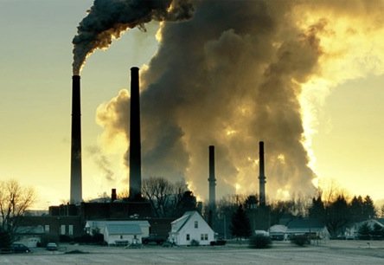
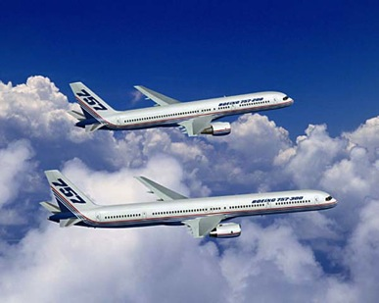
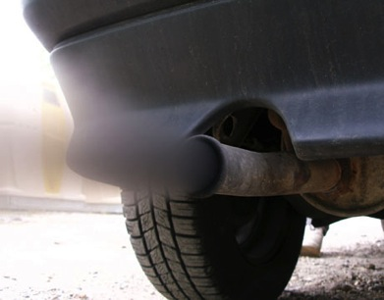
What Is Causing the Warming?
Emissions of carbon dioxide pollution

Slide 5
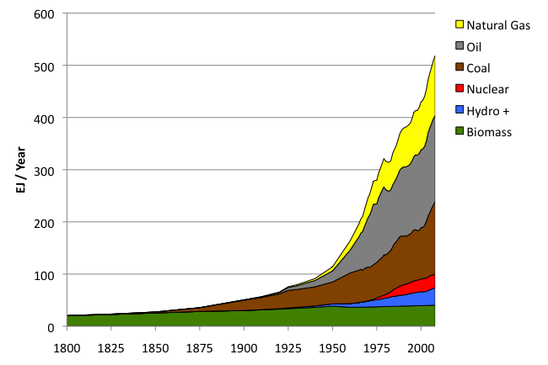
World Primary Energy Supply: 1800 – 2008
Fossil
fuels
Hydro + :means hydropower plus other renewables other than biomass.
Sources: Grubler (2008) - Energy Transitions, BP (2009) – Statistical Review of World Energy, EIA (2009) – International Energy Annual

Slide 6
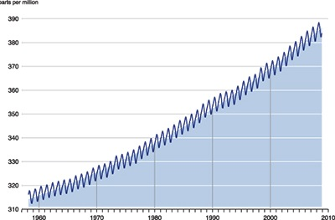
Changing atmospheric composition: CO₂
_{Mauna Loa, Hawaii}
ppm
390
380
370
360
350
340
330
320
310
Rate increasing
1960 1970 1980 1990 . 2000 2010
Data from Climate Monitoring and Diagnostics Lab., NOAA. Data prior to 1974 from C. Keeling, Scripps Inst. Oceanogr.

Slide 7
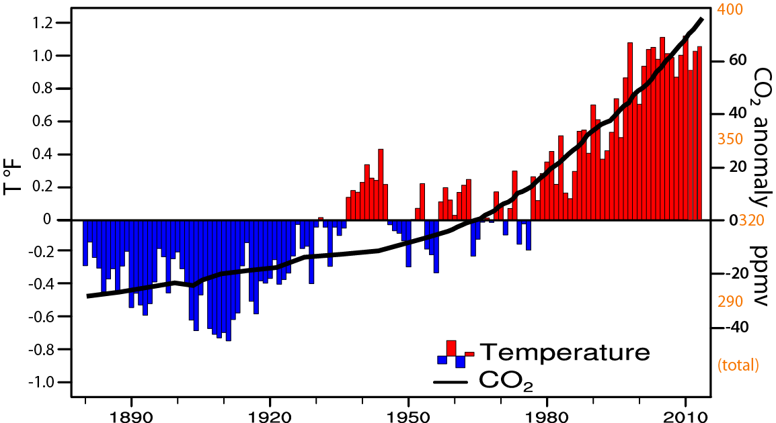
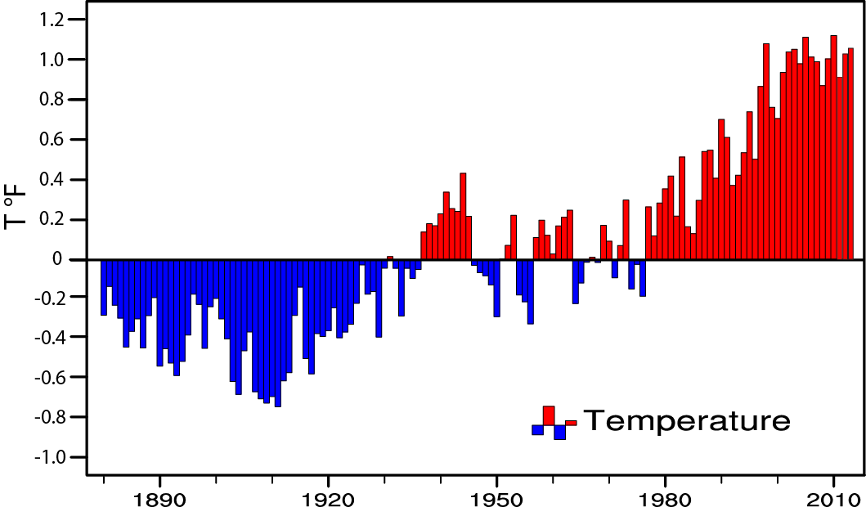
Global temperature and carbon dioxide: anomalies through 2013
Base period 1900-99; data from NOAA

Slide 8

Water is “Trending Now”!
Water is irreplaceable and non-substitutable.
It is more than just another natural resource.
“Water is life”.

Slide 9
How does the hydrological cycle
(and all its components) change over time?
Increasing demand for water from burgeoning populations
Issues of water security, governance, management, transboundary water
Changes in water availability with climate change
Other human influences: dams, irrigation etc.
2nd World Water Forum in 2000:
“to provide water security in the 21st century... means ensuring that freshwater, coastal and related ecosystems are protected and improved; that sustainable development and political stability are promoted; that every person has access to enough safe water at an affordable cost to lead a healthy and productive life; and
that the vulnerable are protected from the risks of water-related hazards.”

Slide 10

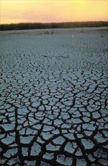
Controlling Heat
Human body: sweats
Homes: Evaporative coolers (swamp coolers)
Planet Earth: Evaporation (if moisture available)
e.g., When sun comes out after showers,
the first thing that happens is that the puddles dry up: before temperature increases.

Slide 11
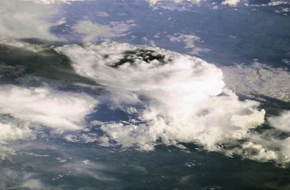
How should precipitation change as climate changes?
Usually only total amount is considered
But most of the time it does not rain
The frequency and duration (how often)
The intensity (the rate when it does rain)
The sequence
The phase: snow or rain
The intensity and phase affect how much runs off versus how much soaks into the soils.
Trenberth et al. 2003; Trenberth 2011

Slide 12
Daily Precipitation at 2 stations
Monthly
Amount 75 mm
Amount 75 mm
A
B
Frequency 6.7%
Intensity 37.5 mm
Frequency 67%
Intensity 3.75 mm
drought wild fires local
wilting plants floods
soil moisture replenished
virtually no runoff

Slide 13

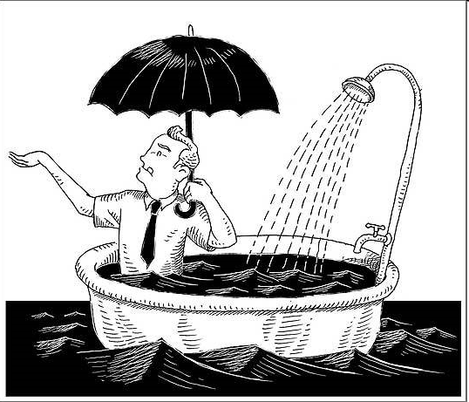
Factors in Changes in Precipitation
It never rains but it pours!

Slide 14
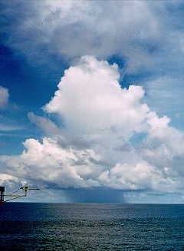
Why does it rain?

Slide 15

Warmer air holds more moisture
4% per °F
- As long as moisture is available

Slide 16
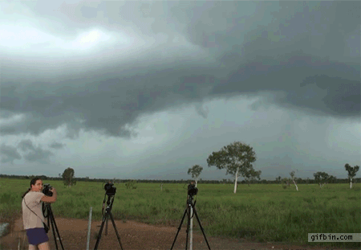
Take a parcel of air:
When it rises
(for whatever reason),
it expands and cools,
and any moisture in it condenses
and forms a cloud,
and then it rains the moisture out.

Slide 17
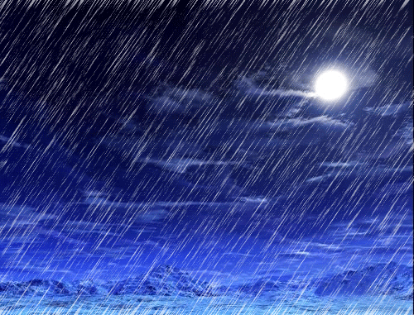

Slide 18
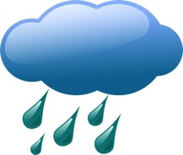
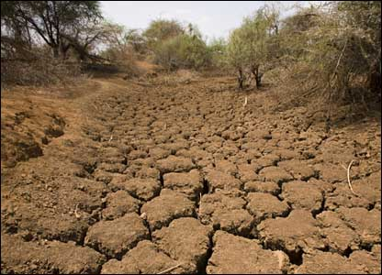
Warmer air holds more moisture
4% per °F
More heat
⇓
More drying
⇓
More evaporation
⇓
More moisture
More rain
More drought

Slide 19
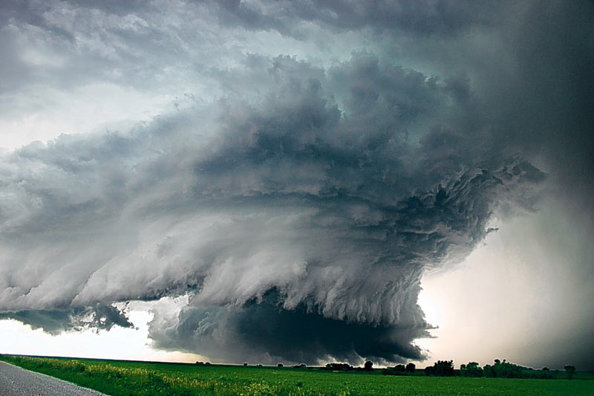
Most precipitation comes from moisture convergence by weather systems
Low level winds bring in moisture from afar
More moisture means heavier rains

Slide 20
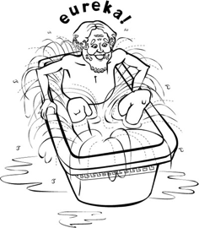
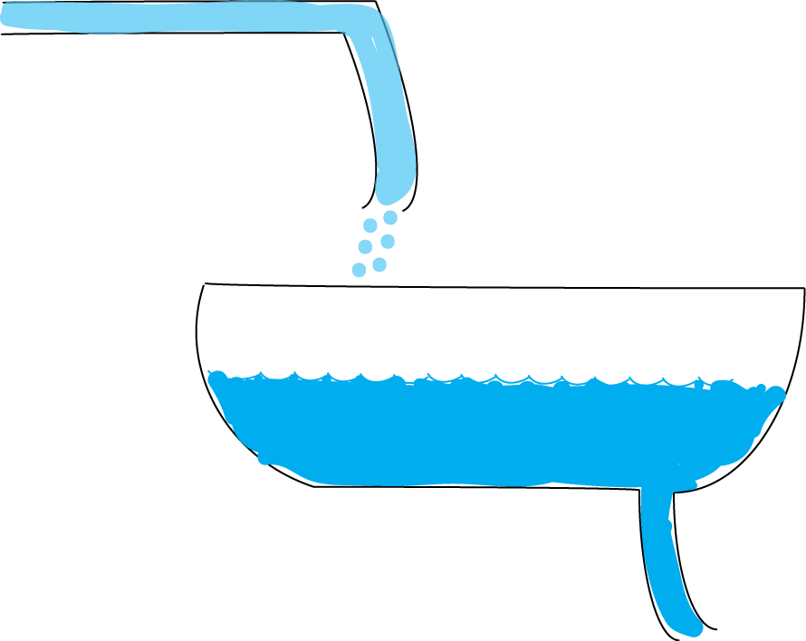

Bathtub analogy
Before warming
After warming
Evaporation
Atmosphere
Moisture
Precipitation
Inflow increases somewhat
Level increases a lot
Intermittent outflow:
Depends on bath plug
Outflow is more episodic: larger
(because tub is fuller) but less frequent

Slide 21
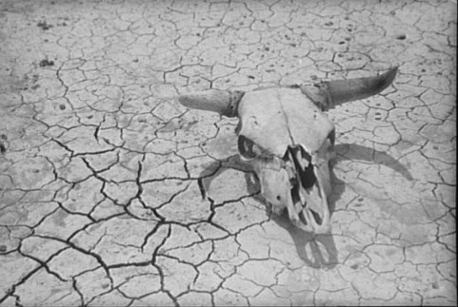
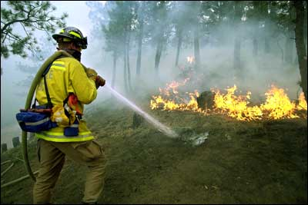
SNOW PACK: In many mountain areas, contributions of global warming include:
more precipitation falls as rain rather than snow, especially in the fall and spring
snow melt occurs faster and sooner in the spring
snow pack is therefore less as summer arrives
soil moisture is less, and recycling is less
global warming means more drying and heat stress
the risk of drought increases substantially in summer
along with heat waves and wildfires

Slide 22
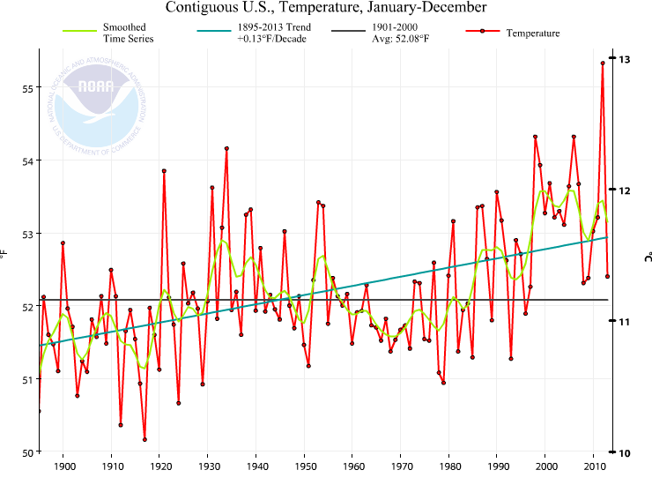
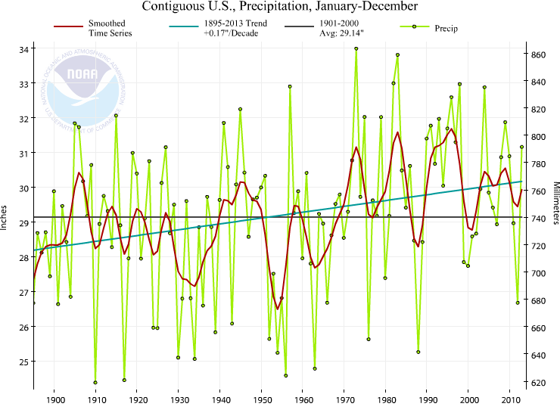
US 48 contiguous States
Temperature: annual
Precipitation:
Annual
Thru 2013
Temp
Precip
Much wetter
2012:
V hot and dry
1930s:
Hot and dry

Slide 23
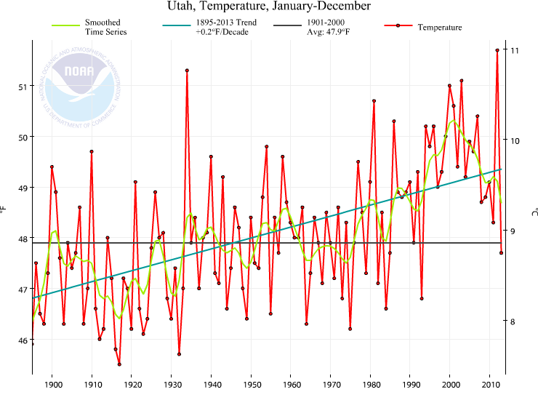
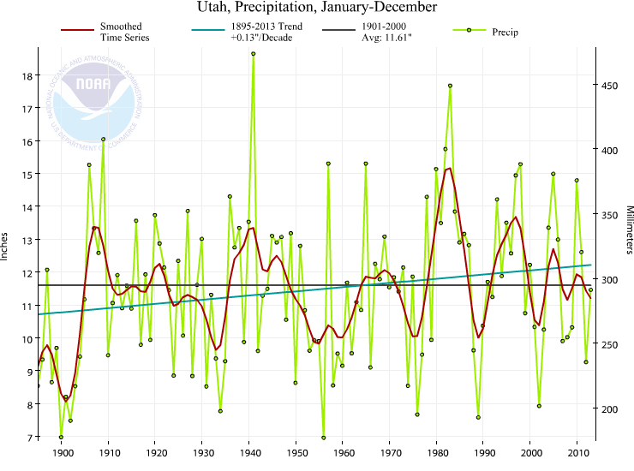
Utah
Temperature: annual
Precipitation:
Annual
Thru 2013
Temp
Precip
1905-28
Cold and wet
Wet;
Colorado compact
of 1922
2012:
Hot and dry

Slide 24
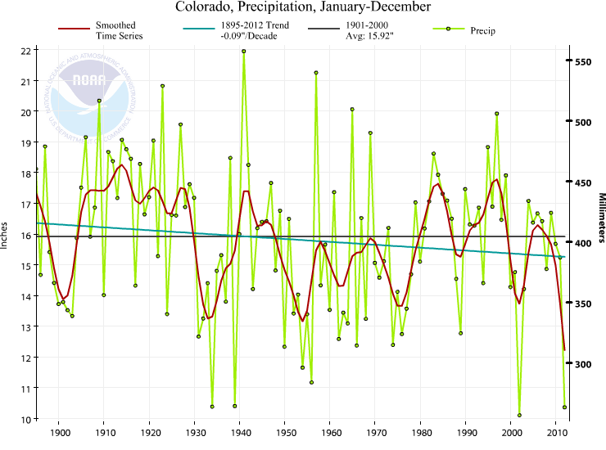
The Colorado River Compact of 1922
Spells out water rights
The cornerstone of the "Law of the River”
Negotiated by the 7 Colorado River Basin states and the federal government in 1922.
It defined the relationship between the upper basin states, where most of the river's water supply originates, and the lower basin states, where most of the water demands were developing.
Linked to plans for Hoover Dam
Wet;
Colorado compact
of 1922

Slide 25
The environment in which all storms form has changed owing to human activities.

Slide 26
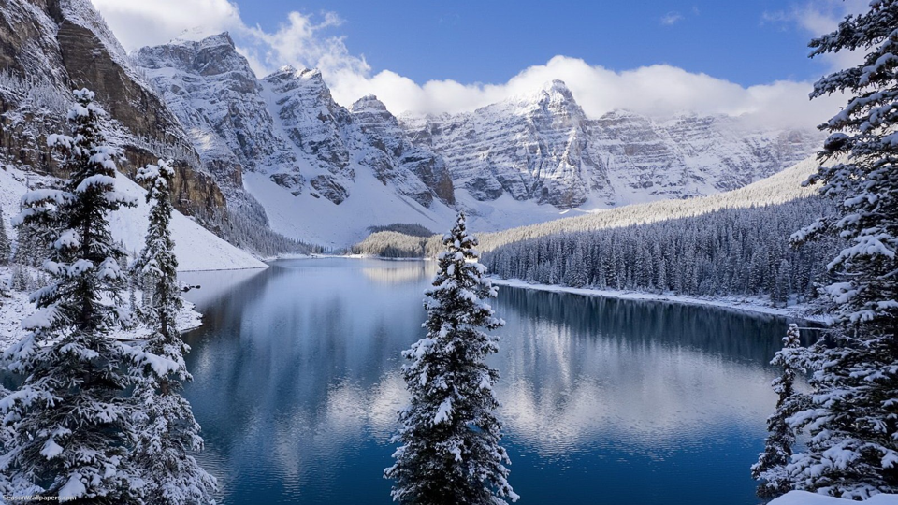
Mountains and climate change
Continental climate: strong seasons continue
With warming, snow season gets shorter (each end)
Glaciers retreat: amplifies changes (snow feedback)
More snow in mid-winter
Snow melt sooner, runoff earlier
Less snowpack
Prospects for less water in summer
Greater risk of drought, heat waves, wild fires
Expansion of pests (Like bark beetle)
Imgpot.com

Slide 27
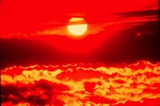
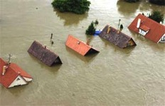
Changes in extremes
Matter most for society and human health
With a warming climate:
  More high temperatures, heat waves
  Wild fires and other consequences
  Fewer cold extremes.
More extremes in hydrological cycle:
  More intense precipitation
  Longer dry spells
  Increased risk of flooding and drought
  More intense storms, hurricanes, tornadoes
Major challenges for a water manager

Slide 28
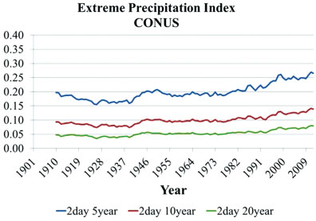
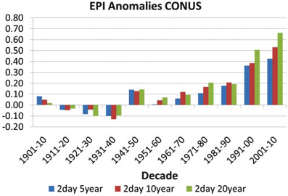
Extremes of precipitation
(say 2 day 10 year events)
have gone from 0.08 to over 0.13 for CONUS:
an over 50% increase
Ten year running averages
Janssen et al. 2014 Earth’s Future

Slide 29
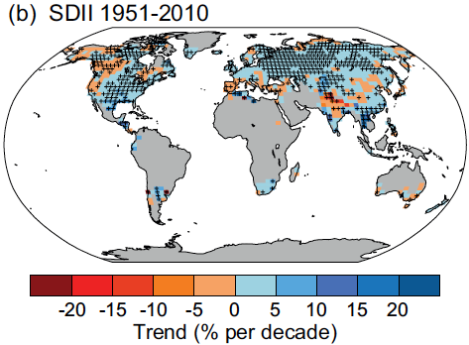
IPCC AR5:
In general extremes of precipitation have increased most places
(where data are available).
IPCC AR5
Daily Precipitation intensity

Slide 30
Recent climate events North America

Slide 31
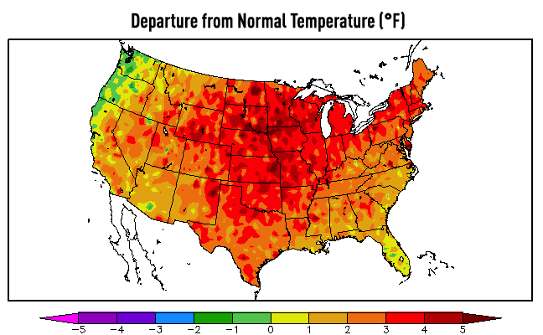
U.S. Temperatures: 2012 Hottest year on record
362 all time record Highs; 3,527 monthly weather records
0 record lows Credit: Forecast the Facts

Slide 32
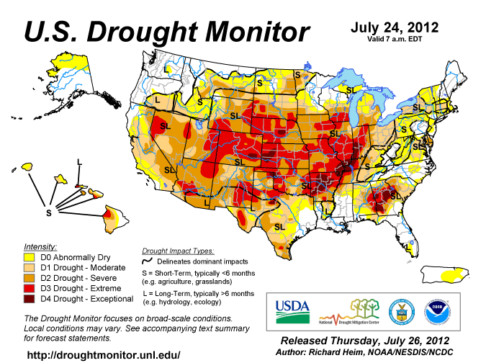
US Drought 2012: 64% in D1 to D4
CNBC, others: Total cost : >$75 billion
Notes:
Initial estimates range from $60 billion to $100 billion, for drought (10 Dec 2012)
http://www.cnbc.com/id/100294265
Wikipedia:
The drought has inflicted, and is expected to continue to inflict, catastrophic economic ramifications for the affected states, so far costing more than $35 billion in the Midwest. As for the whole US, the drought is predicted to reduce the gross domestic product by 0.5-1%, equating to a loss of $75 to $150 billion.^{[4][5]} I

Slide 33
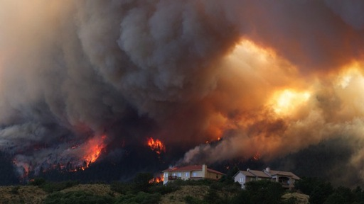
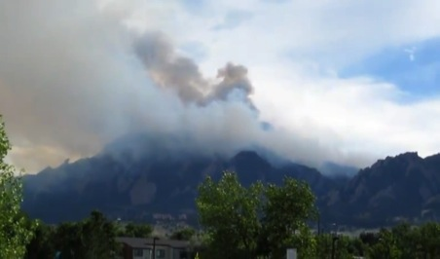
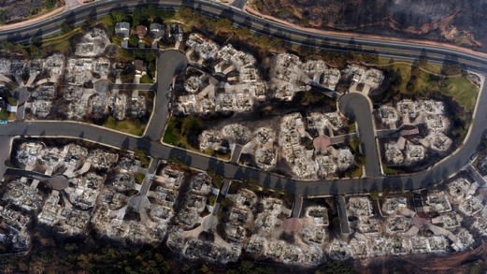
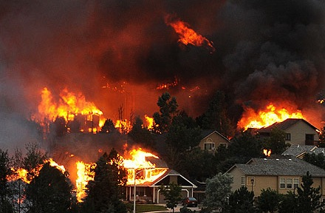
Colorado on Fire: June 2012
AP Photo/Gaylon Wampler
Flagstaff fire: above NCAR, circled.
High Park fire 259 houses, 1 death
AP Photo/Denver Post, RJ Sangosti
Waldo Canyon fire
346 homes…
Helen H. Richardson / The Denver Post / Polaris
Notes:
http://www.csmonitor.com/USA/Latest-News-Wires/2012/0627/Waldo-Canyon-fire-reaches-epic-proportions-video
http://abcnews.go.com/meta/search/imageDetail?format=plain&source=http://abcnews.go.com/images/US/ap_colorado_wildfires_update2_lpl_120629
http://www.people.com/people/article/0,,20608032,00.html

Slide 34
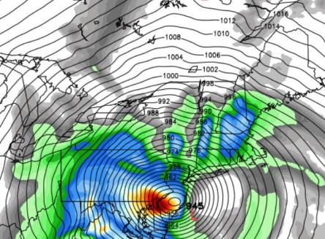
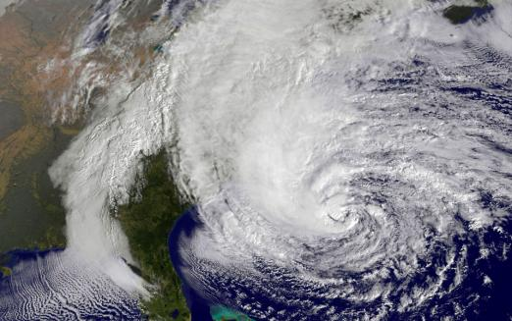
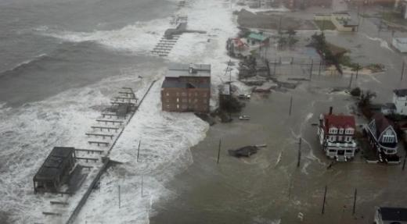
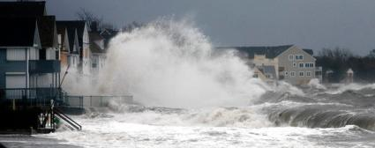
Super Storm Sandy: Oct 29-31, 2012.
More intense because of climate change.
Sea level higher => storm surge greater.
Hybrid storm:
Over $65B damages
>110 lives lost
6abc Action News

Slide 35
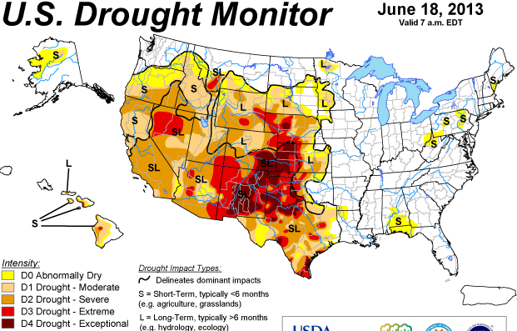
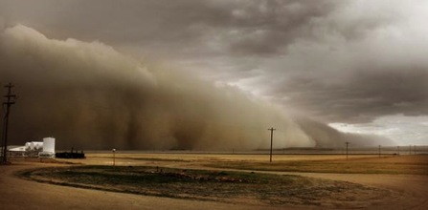
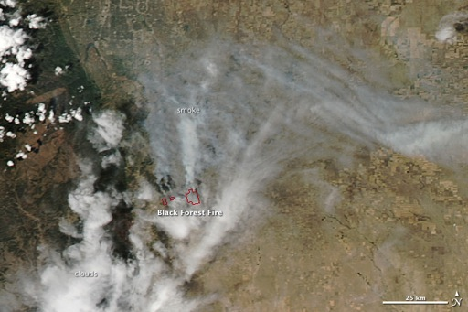
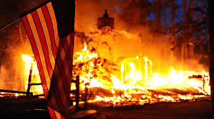
Drought and wildfires June 2013
Dust storm Lamar, CO
(June 15, Denver Post)
Black Forest wildfire: CO
>511 homes burned

Slide 36
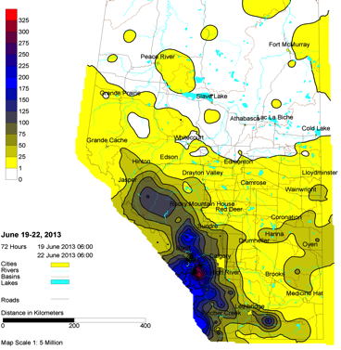



Alberta
Calgary, Alberta
Canada
Flooding
21-22 June 2013

Slide 37



California Rim Fire late August 2013
One of biggest on record

Slide 38

Boulder Flooding September 2013

Slide 39





Slide 40


Before and after: South Platte
Landsat 8
NASA

Slide 41


Former location of Mesa Trail over Bluebird creek. Green Mountain Rd (Flagstaff)
http://www.flickr.com/photos/bouldercolorado/sets/72157636661981633/

Slide 42


Winter 2013-14
Record cold in places
Very persistent pattern
Record heat in west and
Alaska

Slide 43
What about Utah?
We expect:
Increased heavy rain events and even snows.
  Risk of floods
More snow in mid-winter, but a shorter snow season
Earlier runoff peak (drier in late spring and early summer)
Increased risk of drought, heat waves and wild fires
Major challenges for water managers:
  Saving water when there is too much for when there is not enough.
  Reservoirs, dams etc (in spite of environmental objections).
  Strategies for paying those with water rights (esp in farming) to use their water.
  Better management of forests and wild fire risk, litter
  Building codes (non flammable roofs) etc.
  Establishing safe areas around buildings, etc:
  We Need:
Proper assessment of flood plains and risk.
Can vegetation migrate to higher elevations/latitudes?
  Or do we have to do it for the trees, etc?

Slide 44


