Slide 1
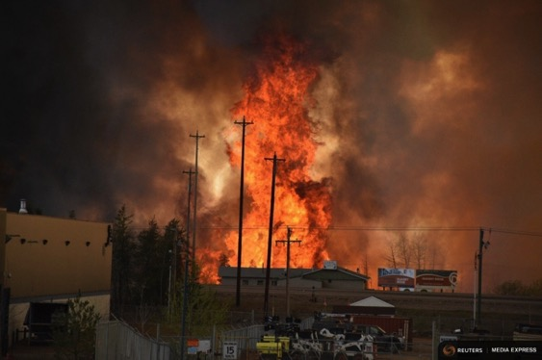
Attribution of extreme climate events
Kevin Trenberth
NCAR
Wildfires Fort McMurray, Alberta May 2016
Is it global warming?
Is it natural variability?
These are not the right questions: do not have answers.
Instead it is always a combination of both.

Slide 2
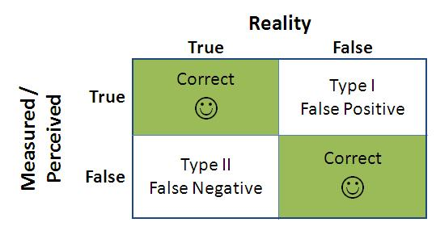
Null hypothesis:
“There is no human influence on climate”
Burden of proof is high. Scientists typically require 95% confidence level (5% significance level)
Type I errors: False positive. Wrongly concluding there is a human influence when there isn’t.
Type II errors: False negative. Wrongly concluding there is no human influence, when there is.
This kind of error is very common!

Slide 3
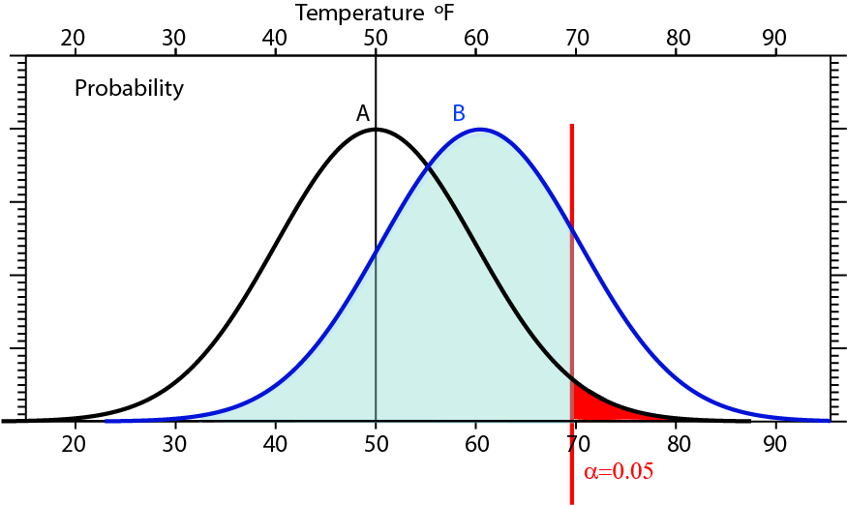
For a 1 standard deviation (10°F) shift in the distribution (due to climate change) from A to B, only values of B to the right of the two tailed 5% significance level (α=0.05 in red) would be considered significant under a null hypothesis of no change. All the values in the blue area of the B distribution would not.

Slide 4
What are expectations for climate events?
Changes in atmospheric circulation with climate change are small and require a very large ensemble to identify.
In any event the individual character of the weather phenomenon always outweighs any climate signal.
Studies aiming to attribute events always conclude that “natural variability” dominates.
(they should!)

Slide 5
What are expectations for climate events?
Essential to distinguish between small noisy chaotic unpredictable dynamics vs thermodynamic effects.
It is more useful to regard the extreme circulation regime or weather event as being largely unaffected by climate change, and instead ask the question of whether the impact of the particular event was affected by known changes in the environment:
the climate system's thermodynamic state
in which there is more confidence.

Slide 6
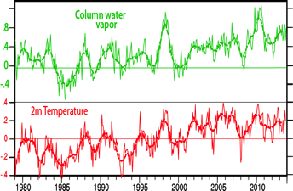
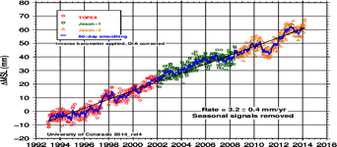
Dynamics vs thermodynamics
Phenomena:
Movement
Development
Chaotic (unpredictable)
Unique
Environment:
Temperature
Water vapor
Sea level
Robust (predictable)
The environment for all storms has changed:
Warmer by 0.6°C,
Moister by 5%
Ocean Heat Content is much higher
Sea level is higher by 19 cm
Supported by the huge memory and thermal inertia of the oceans: Ocean Heat Content

Slide 7
Problems with current practice
There have been many misleading and erroneous statements made by several groups concerning the role of humans in extreme climate events.
Russian heat wave
Boulder floods
California drought
And many misleading null statements:
  Super storm Sandy
  Typhoons, hurricanes,
  Snow storms; etc
The result has been disastrous for public understanding.

Slide 8
More fruitful scientific questions
Essential to distinguish between small noisy unpredictable dynamics vs thermodynamic effects.
Given the weather pattern, how were the temperatures, precipitation, and associated impacts influenced by climate change?
Given a drought, how was the drying (evapotranspiration) enhanced by climate change and how did that influence the moisture deficits and dryness of soils, and wild fire risk? Did it lead to a more intense and perhaps longer lasting drought, as is likely?
Given a flood, where did the moisture come from? Was it enhanced by high ocean temperatures that may have had a climate change component?
Given a heat wave, how was that influenced by drought, changes in precipitation (absence of evaporative cooling from dry land), and extra heat from global warming?
Given extreme snow, where did the moisture come from? Was it related to higher than normal SSTs off the coast or farther afield?
Given an extreme storm, how was it influenced by anomalous SSTs and ocean heat content, anomalous moisture transports into the storm, and associated rainfall and latent heating? Was the storm surge worse because of high sea levels?

Slide 9
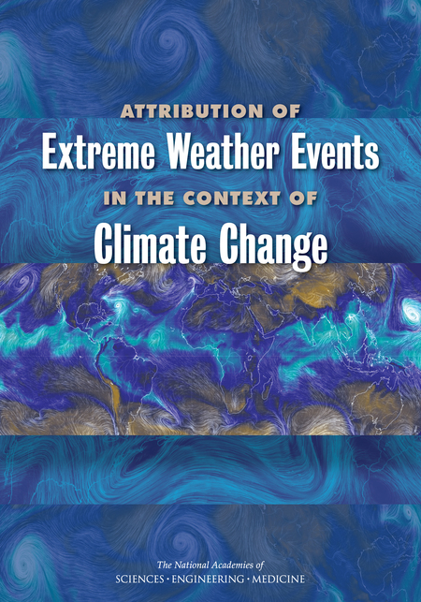
National Academy of Sciences weighs in
“Attribution of Extreme Weather Events in the Context of Climate Change”
in March 2016.

Slide 10
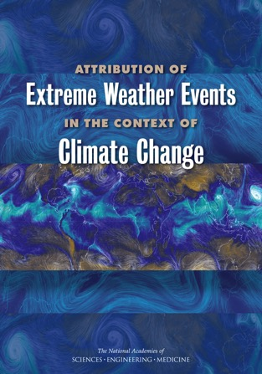
National Academy of Sciences
“Attribution of Extreme Weather Events in the Context of Climate Change”
in March 2016.
The committee did not draw out the perceived tension between
the traditional approach and my strongly conditioned approach,
it just presented both as two aspects of the same spectrum,
virtually without comment: (from the web site)
“scientists cautioned in the past that individual weather events couldn't be attributed to climate change. Now, with advances in understanding the climate science behind extreme events and the science of extreme event attribution, such blanket statements may not be accurate.”
The message is that the strongly conditioned approach is very acceptable, while the traditional approach is limited by adequacy of the modeling tools available.
In particular, as the consideration turns from extremes such as heat waves to extreme precipitation and storms, the examples cited are more in line with the strongly conditioned approach.
The new approach does seem to be catching on!

Slide 11
Ted Shepherd: Curr. Clim. Change Rep. 2016.
“A Common Framework for Approaches to Extreme Event Attribution”
From a scientific perspective, the question can be framed in various ways, and the answer depends very much on the framing.
One such framing is a risk-based approach: answers the question probabilistically, as a change in likelihood of a class of event similar to the one in question, and natural variability is treated as noise.
  Two worlds: “factual” vs “counter-factual” (i.e. no cc)
  Traditional approach - tends to fail if dynamics important
A different framing is a storyline approach: examines the role of various factors contributing to the event, including anomalous natural variability, and answers the question deterministically.
  Trenberth et al. 2015
… the most useful level of conditioning will depend on the
question being asked and the uncertainties involved.

Slide 12

Oh Sandy

Slide 13
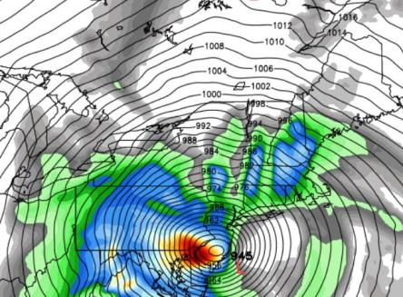
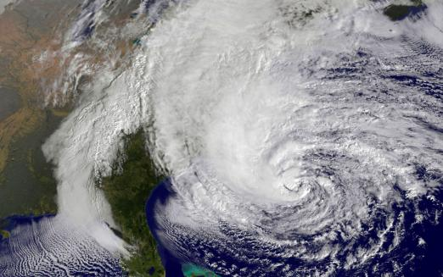
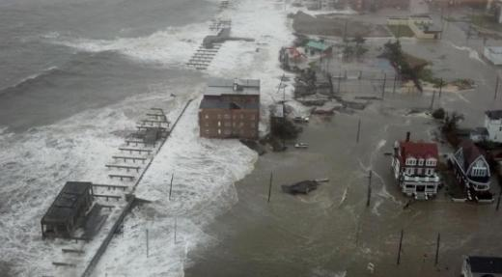
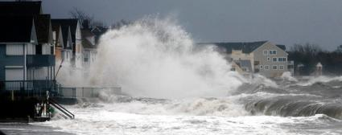
Super Storm Sandy
Oct 29-31, 2012.
Hybrid storm:
Over $70B damages
>110 lives lost

Slide 14
Super storm Sandy
Landfall: 30 Oct 2013
Super storm Sandy caused tremendous damage when it made landfall on the New Jersey coast and New York area on 30 October 2012.
It began as a hurricane, with peak strengths making it a category 3 storm, and it caused substantial impacts in the Caribbean.
As it moved north it became a hybrid storm before making landfall, which greatly increased its overall size.
The worst problems on the Jersey Shore were caused by the strong winds and the associated storm surge, leading to extensive flooding.
Farther inland, heavy precipitation was also a major problem.
Widespread damage from flooding streets, tunnels and subway lines and cutting power in and around New York City led to damages exceeding $70 billion.

Slide 15
Super storm Sandy
Well forecast by ECMWF 6 days in advance
ECMWF performed experiments on the performance and behavior of the storm using an ensemble of forecasts five days in advance of landfall.
They swapped the observed SSTs for climatological values that average 1 to 1.5°C cooler in a broad strip along the coast.
Only small changes occurred to the track of the storm
The observed SSTs led to a bigger more intense storm, stronger winds and greater precipitation.
Magnusson et al 2014. Mon. Wea. Rev

Slide 16
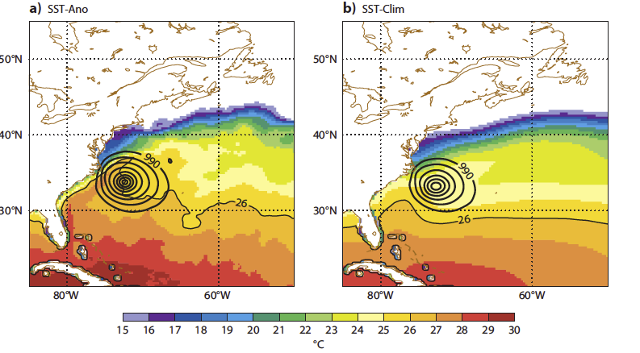
Sandy
SST for 2012-10-24 00z +120h for different experiments together with the MSLP below 990 hPa to show the position of Sandy. The isotherm for 26°C is highlighted.
Magnusson et al 2013 ECMWF

Slide 17
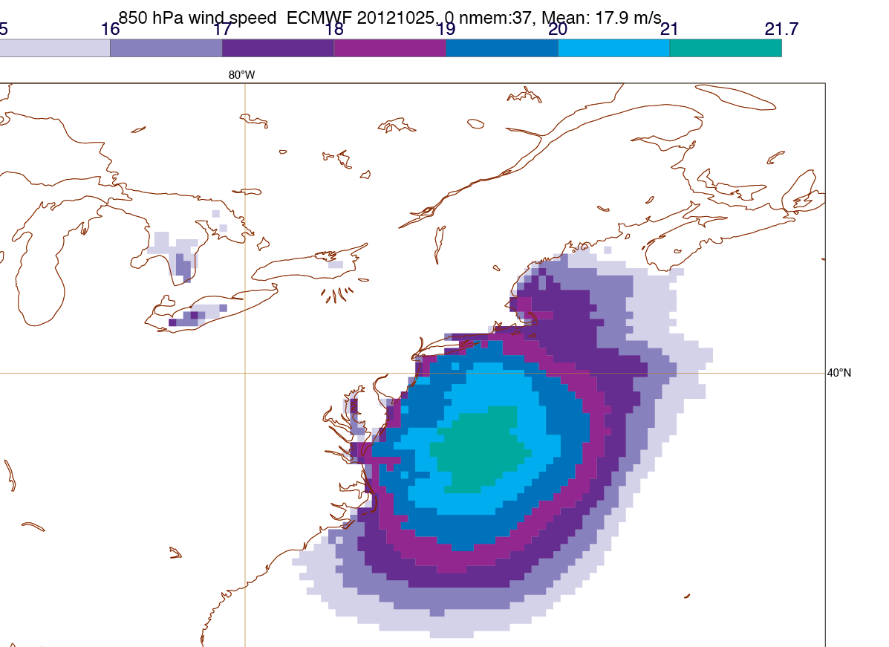
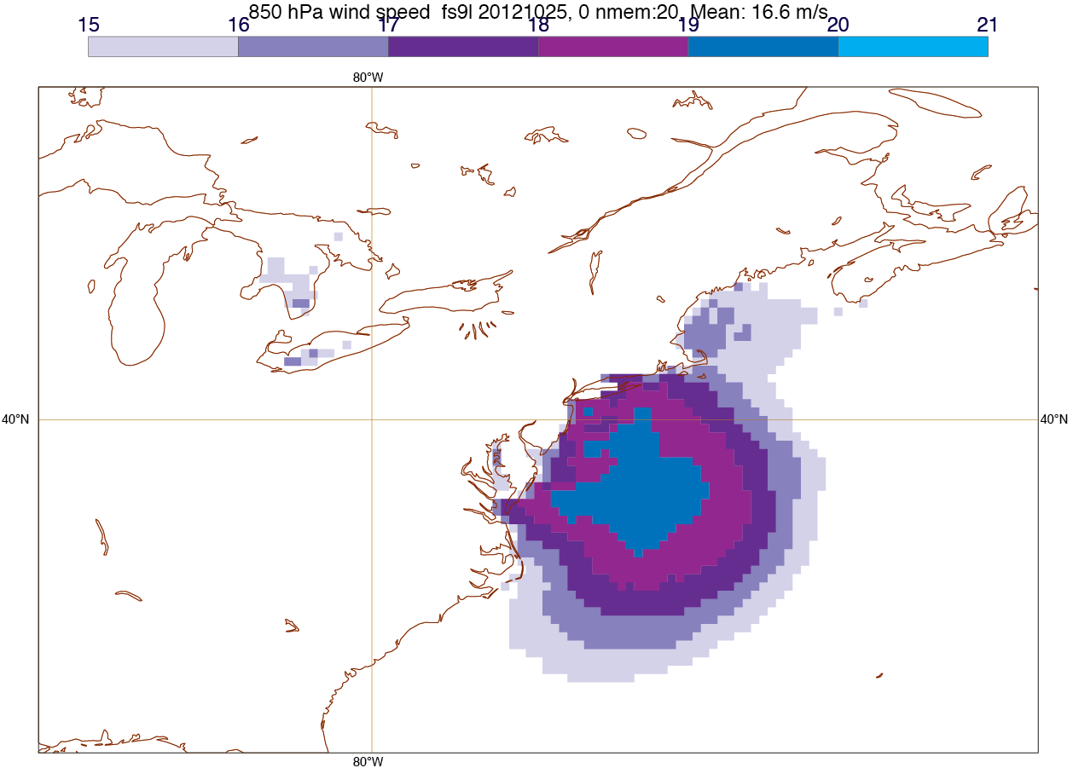
Sandy
Wind speeds, m s⁻¹
Obs SSTs Clim SSTs
3.6 m s⁻¹ increase overall.
21 vs 19 m s⁻¹ means a 35% increase in damage:
goes as v³
Magnusson et al 2013 MWR

Slide 18
Super storm Sandy
Well forecast by ECMWF 6 days in advance
ECMWF performed experiments on the performance and behavior of the storm using an ensemble of forecasts five days in advance of landfall.
They swapped the observed SSTs for climatological values that average 1 to 1.5°C cooler in a broad strip along the coast.
Only small changes occurred to the track of the storm
The observed SSTs led to a bigger more intense storm, stronger winds and greater precipitation.
  Average depth of the storm was increased by 7.6 hPa,
  Wind speeds increased by 3.6 m s⁻¹
  Precipitation increased by 35%.
  Sea levels were higher by about 19 cm due to global warming.
Climate change is significant part of the SST change (maybe 1/3).
It is very likely that the subways and tunnels between Manhattan and Brooklyn and New Jersey would NOT have flooded without climate change!
Hence most of the damage, probably >$40B, was caused by climate change.
Magnusson et al 2014. Mon. Wea. Rev

Slide 19
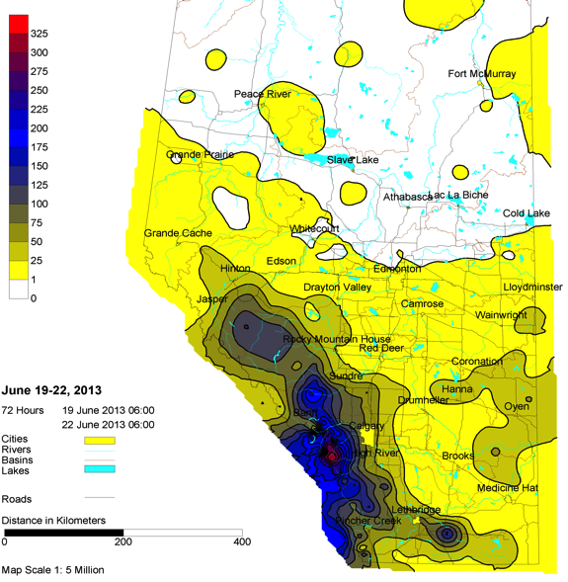
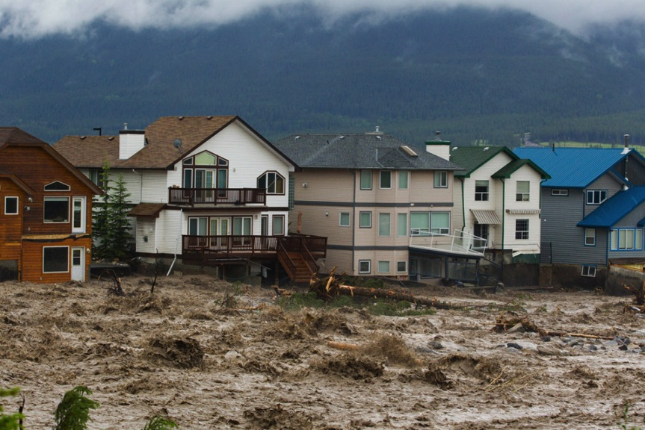
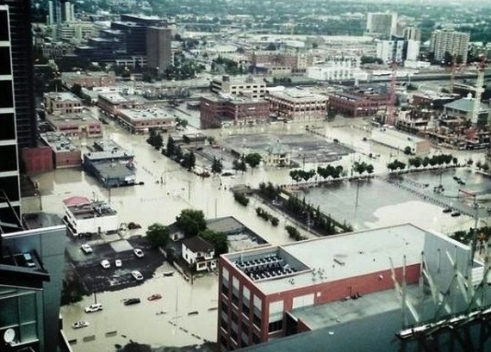
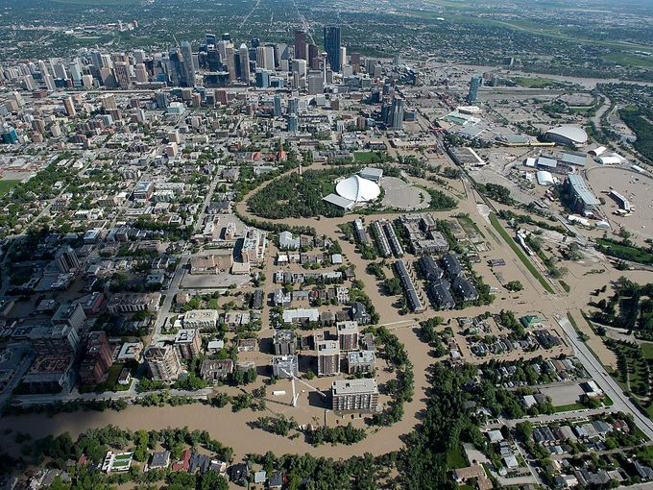
Calgary, Alberta
Canada
Flooding
19-22 June 2013
Where did all the moisture come from?
Gulf of Mexico and Atlantic?

Slide 20
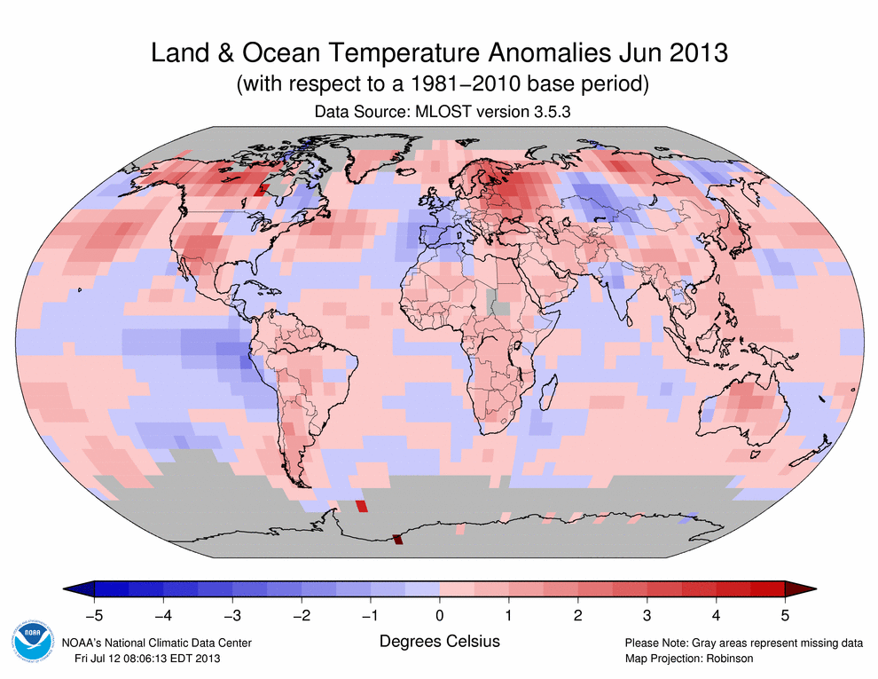

Slide 21
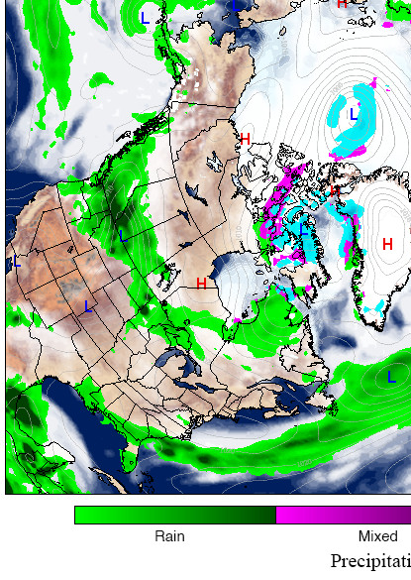
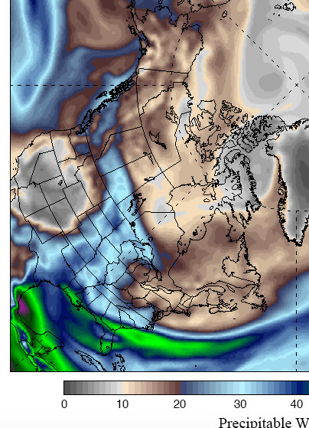
Precip, SLP Precipitable water
H
L
H
Thurs, June 20, 2013
Climatereanalyzer.org

Slide 22
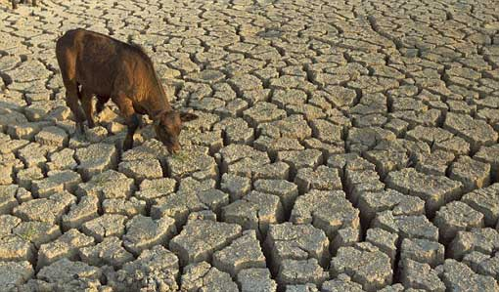
Drought
Whether and when a dry spell or drought occurs is largely natural variability, dominated by ENSO.
But given a drought, global warming makes it more intense and longer lasting.
Extra heat builds up: has nowhere to go.
Increased drying
Increased heating and heat waves
Increased wildfire risk

Slide 23
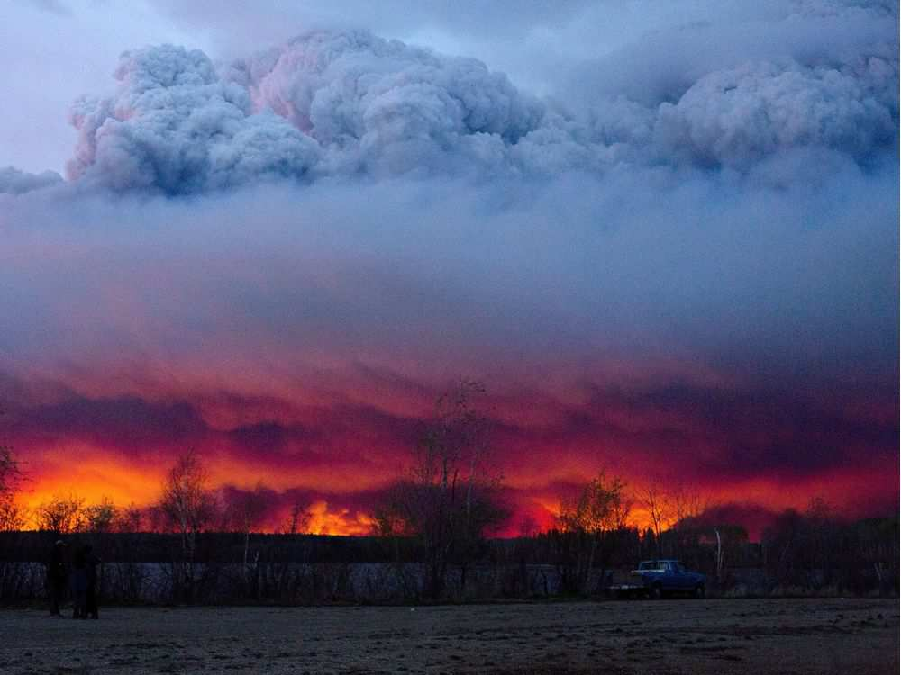
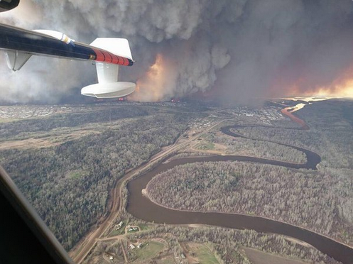
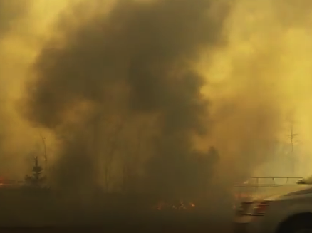
Wildfires
Fort McMurray, Alberta
4 May 2016
Along Trans-Alaska pipeline, June
Oregon, July
Notes:
http://www.washingtonpost.com/blogs/capital-weather-gang/wp/2015/08/10/central-and-eastern-europe-simmering-in-historic-heat-wave/
http://thinkprogress.org/climate/2015/08/10/3689813/heat-wave-middle-east/
The Rocky Fire burning about 200 miles northeast of San Francisco grew on Tuesday to 69,600 acres, and was 20% contained as of Wednesday morning.

Slide 24
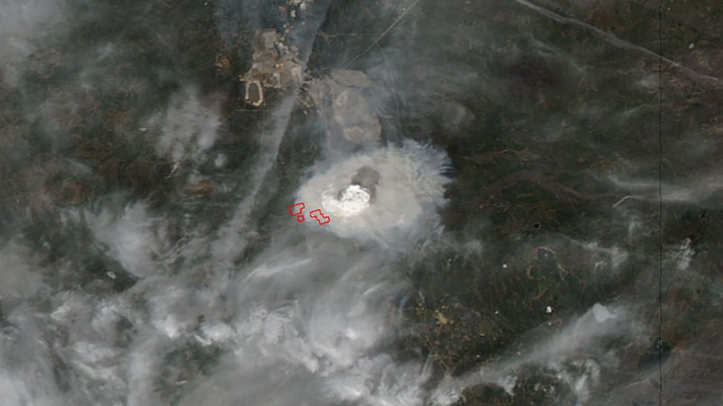
Wildfires Fort McMurray, Alberta
May 2016
Making it’s own weather:
Pyrocumulous
May 3 2016
Modis, NASA
88,000 evacuated
Along Trans-Alaska pipeline, June
Oregon, July
Notes:
http://www.washingtonpost.com/blogs/capital-weather-gang/wp/2015/08/10/central-and-eastern-europe-simmering-in-historic-heat-wave/
http://thinkprogress.org/climate/2015/08/10/3689813/heat-wave-middle-east/
The Rocky Fire burning about 200 miles northeast of San Francisco grew on Tuesday to 69,600 acres, and was 20% contained as of Wednesday morning.
https://theconversation.com/wildfires-in-west-have-gotten-bigger-more-frequent-and-longer-since-the-1980s-42993?utm_medium=email&utm_campaign=Latest%20from%20The%20Conversation%20for%20May%2023%202016%20-%204908&utm_content=Latest%20from%20The%20Conversation%20for%20May%2023%202016%20-%204908+CID_c399e597e967a555ae26fd28ecb2816d&utm_source=campaign_monitor_us&utm_term=Wildfires%20in%20West%20have%20gotten%20bigger%20more%20frequent%20and%20longer%20since%20the%201980s

Slide 25
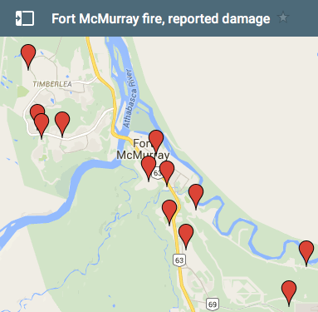
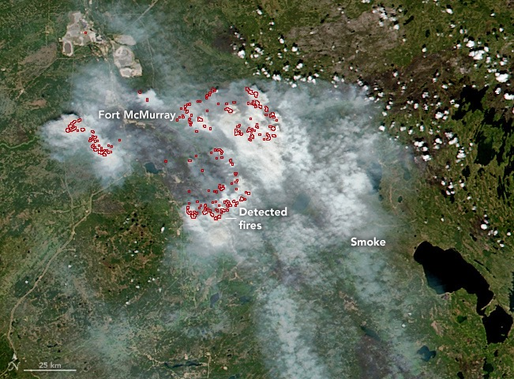
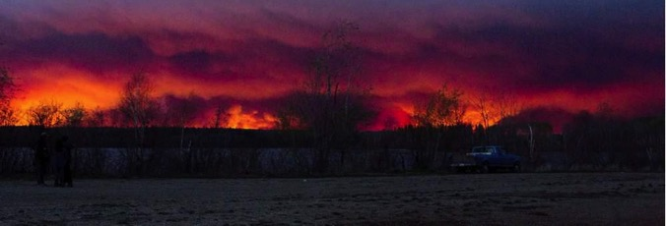
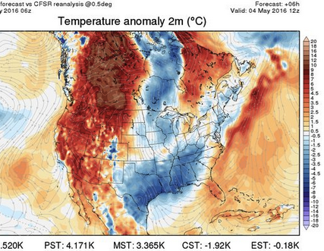
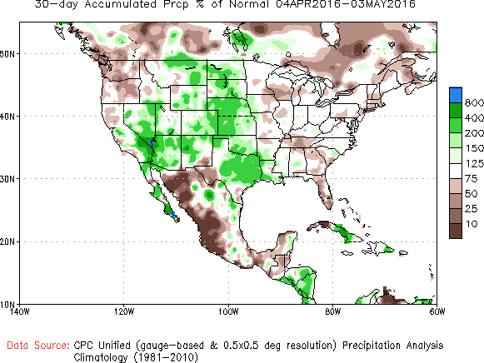
Peat keeps burning…
15 May 2016 VIIRS, NASA

Slide 26
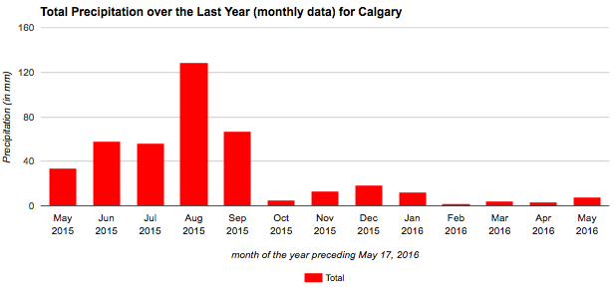
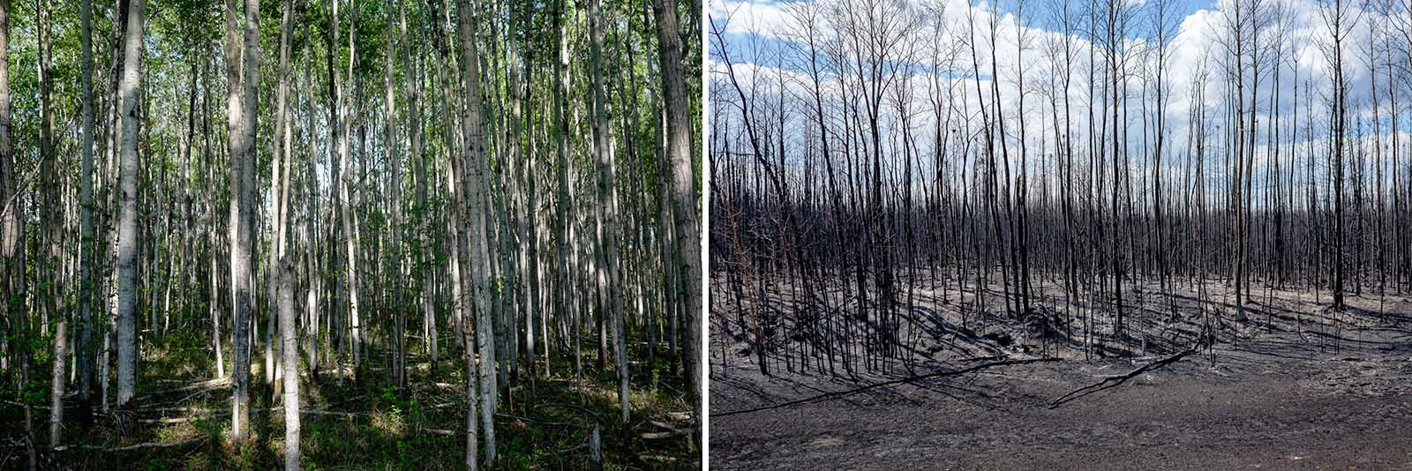
Wildfires Fort McMurray, Alberta; May 2016
Longer wildfire seasons:
El Niño dry weather pattern
Global warming extra heat=> drying, 30°C
Makes for tinder dry conditions
20% of normal
Before After
Notes:
http://www.washingtonpost.com/blogs/capital-weather-gang/wp/2015/08/10/central-and-eastern-europe-simmering-in-historic-heat-wave/
http://thinkprogress.org/climate/2015/08/10/3689813/heat-wave-middle-east/
The Rocky Fire burning about 200 miles northeast of San Francisco grew on Tuesday to 69,600 acres, and was 20% contained as of Wednesday morning.

Slide 27

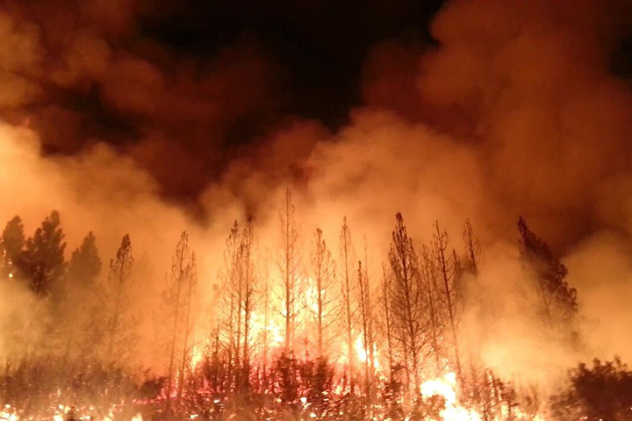
Currently the energy imbalance is order 1 W m⁻². In drought, water plays no role, and so over 1 month the extra accumulated energy is equivalent to running a microwave oven at full power (720W) over every square foot for 6 minutes.
No wonder things catch on fire!

Slide 28
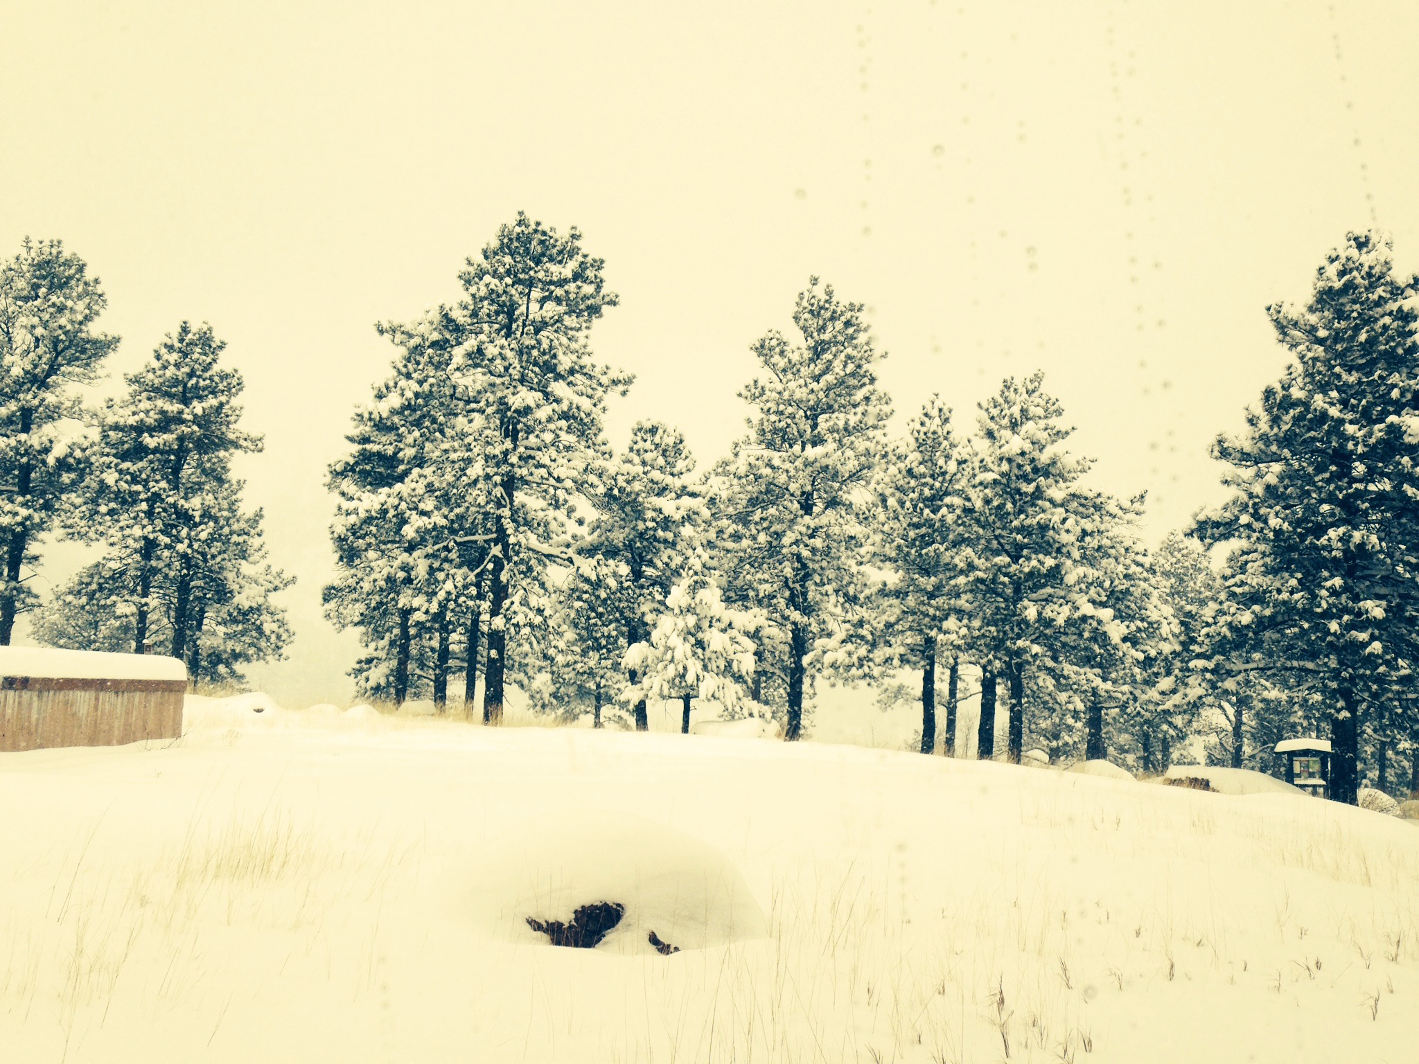
SNOW
Feb 2, 2016 NCAR

Slide 29
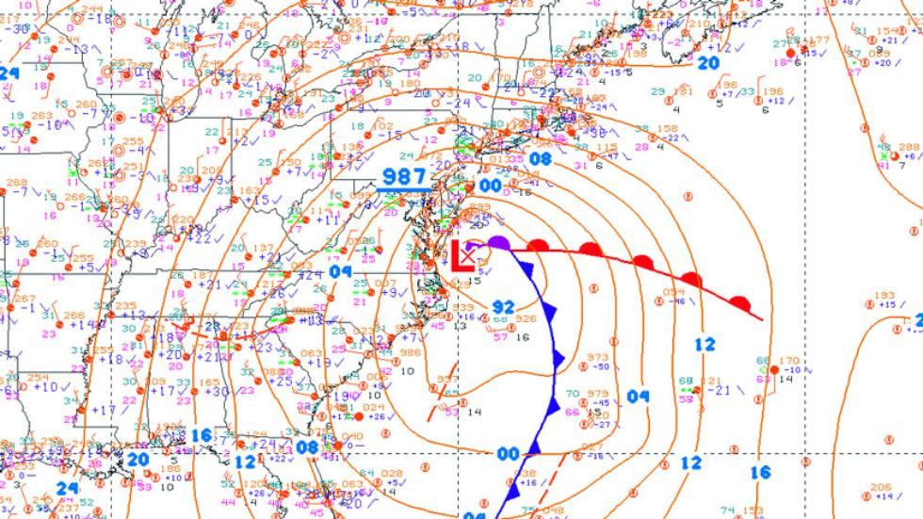
Jonas: East coast snow storm
Jan 22-23 2016
Record breaking snow amounts in many areas

Slide 30
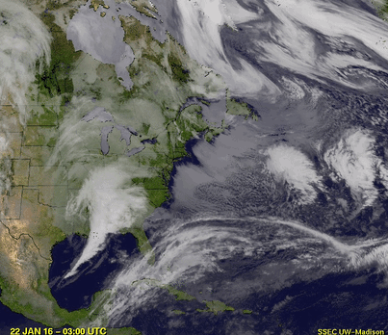
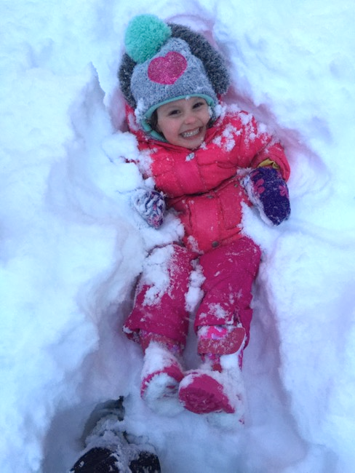

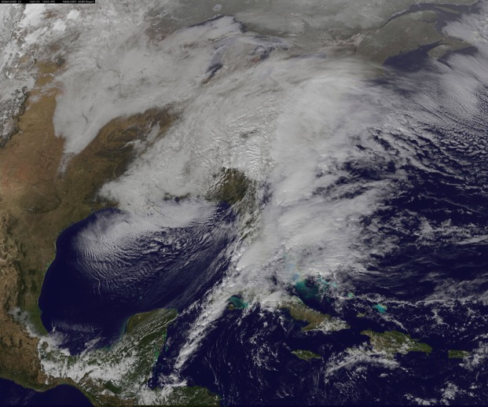
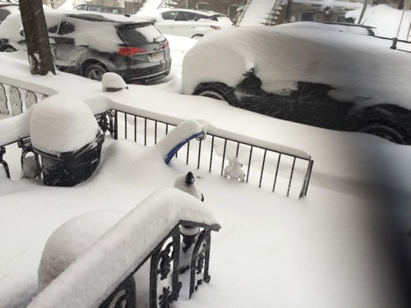
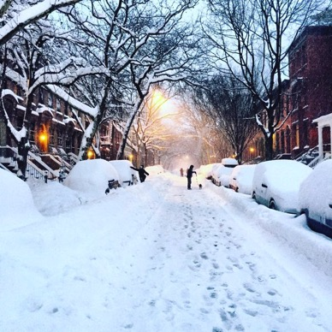
Jonas: East coast snow storm
Jan 22-23 2016

Slide 31
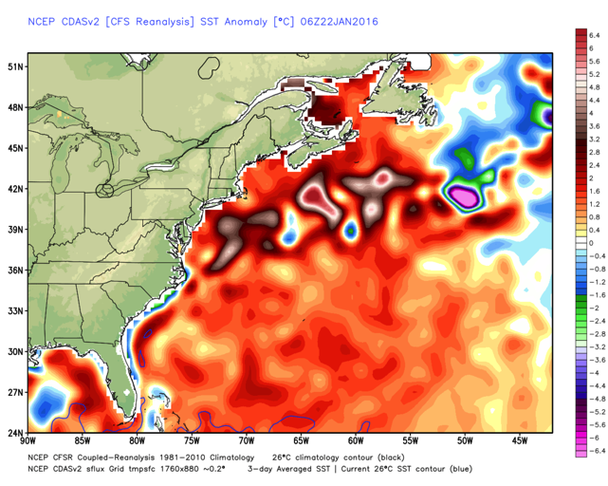
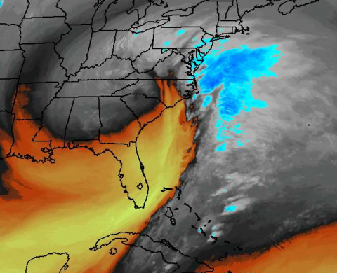
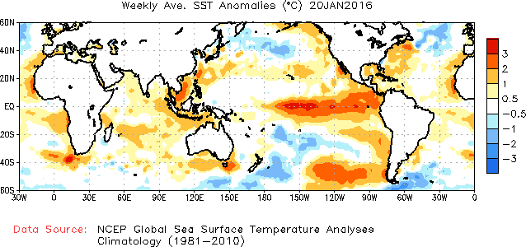
Jonas: East coast snow storm
Jan 22-23 2016
SST anomalies >1.5 C
Water vapor imagery 22 Jan 2016

Slide 32
Jonas: East coast snow storm
Jan 22-23 2016
How does snow change with climate change?
Goldilocks effect:
          Too cold, air freeze dried
          Too hot: rain
          Highest snow when -3 to 0°C
2. Clausius Clapeyron:
          1°C increase in T => 7% increase in wv
          SSTs are higher by 0.6°C from climate change
          Generally 5% more wv than pre-1970s.
          Up to 10% more precipitation
Most precipitation comes from moisture convergence
          Region 4x rain dimension
          Typically >1000 km

Slide 33
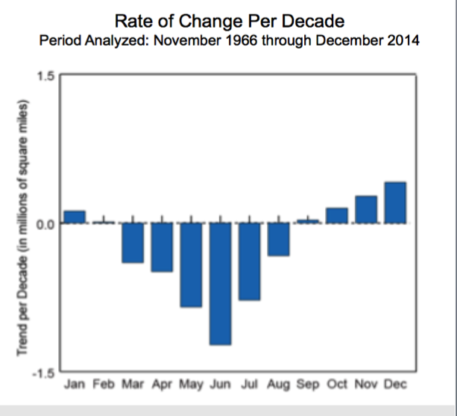
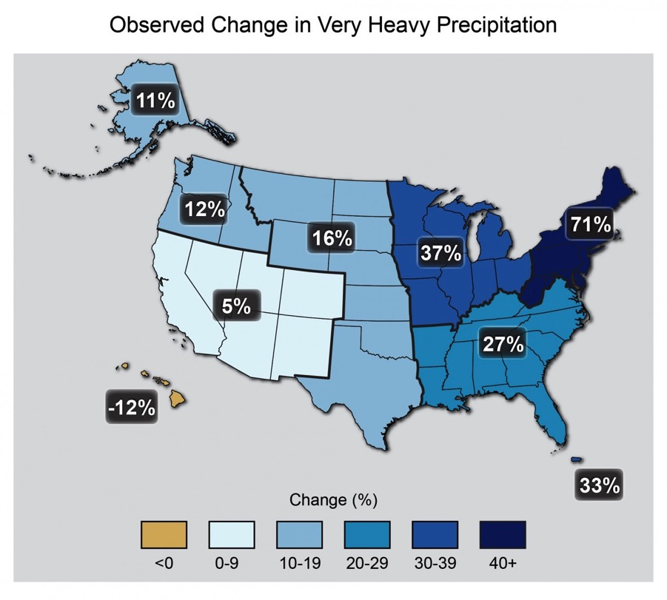
Changes in snow cover: NH
NASA/NOAA
National Climate assessment

Slide 34
Attribution Needs
There is a tremendous need for near real-time statements.
It is always helpful to have a model run with the best forcings available, including observed SSTs.
But then a fairly standard practice should be to make a run with climatological SSTs.
Recognize that an 1981-2010 climo has considerable warming built in.
Recognize that human-induced climate change is operating on 20 year time scales and longer.
The main memory is in the ocean: OHC, and one should not be fooled or distracted by short-term perturbations.
Formulate answerable questions
Recognize the chaotic character of the atmosphere so that questions on dynamics are poorly posed.

Slide 35
Attribution of extremes
While it we can not say that these events were due to global warming (poorly posed question),
it is highly likely that they would not have had such extreme impacts without global warming!

Slide 36
